Slide 1
VIDEO ONE · CAPABILITY FORMATION
How I Changed Jobs Without Starting My Career Over
Temidayo Afonja · temidayoafonja.com
Notes:
0:00-0:35 Opening promise - memorize exactly.
Start on your face, not this slide. Move to the title only after
'the three things that helped me do it.'
Camera: full frame for the first sentence, then drop to the small
presenter box in the upper-left safe area.

Slide 2



MY PATH WAS NOT STRAIGHT
The titles changed. The capability kept accumulating.
ACCOUNTING
CONSULTING
LIFE SCIENCES
TECHNOLOGY
PEOPLE STRATEGY
CAPABILITY FORMATION
Notes:
0:35-1:25 Personal context - speak from ideas.
Landing line: 'The continuity was not always visible in the job titles.
I had to look underneath the titles and ask what the work was teaching me to do.'
Gem: 'The titles changed. The capability kept accumulating.'
Camera: keep the presenter box small or hide it while the timeline is up.

Slide 3
THE THREE MOVES
Three practices that carried the value forward.
01
02
03
Separate the title from the capability
Translate the work into outcomes
Keep evidence before you need it
Notes:
1:25 Set up the three moves, then teach them one at a time.
Reveal one card at a time. Camera stays in the upper-left safe area.

Slide 4
MOVE ONE
Separate the title from the capability.
A title tells people where the work sat. It does not tell them what the work trained you to see, decide or solve.
01
What problems can I now solve?
02
What decisions can I make with better judgment?
03
What can I do today that I could not do two years ago?
04
What would remain mine if this role disappeared?
Notes:
1:25-3:10 Move 1 - speak from ideas, reveal one question at a time.
Gem: 'Being new to the setting did not erase what I already knew how to do.'
Viewer action: write your title, then three problems people trust you to solve.

Slide 5
THE CAPABILITY FORMATION FIELD KIT · PAGE 06 · OPTIONALITY
“If my role disappeared tomorrow, the capability I built would still be mine to carry.”
Statement 9 · score 1-5
Notes:
Artifact for Move 1. Field Kit page 6, statement 9, rebuilt as
readable slide type - do not put the whole PDF page on screen.
Camera: hide the presenter box briefly here.

Slide 6
MOVE TWO
Translate the work into outcomes.
The translation question: what changed because I was there?
Internal description
Portable outcome
Led an onboarding redesign.
Helped redesign the new-hire integration experience; the integrating score moved from 47 to 75.
→
Outcome language: time saved · errors reduced · adoption improved · risk lowered · retention strengthened · capability built
Notes:
3:10-5:05 Move 2 - one concrete before-and-after, not a list.
Say clearly that this was done with a team.
Gem: 'The project name tells people what I worked on.
The result tells them what the work changed.'

Slide 7
MOVE TWO · THE EVIDENCE
Onboarding redesign.
New-hire integrating score, led with the team.
47
75
→
Before
After
A score without an evidence line is a guess with decimal points.
Notes:
Reveal 47 first, then 75. Return to camera when you explain
why the outcome travels outside the company.

Slide 8
THE CAPABILITY FORMATION FIELD KIT · PAGE 06 · OPTIONALITY
“I can describe what I do in terms of outcomes, not just my company’s internal language.”
Statement 8 · score 1-5
Notes:
Artifact for Move 2. Field Kit page 6, statement 8, rebuilt as
readable slide type. Move to the 47-to-75 proof slide after this.

Slide 9

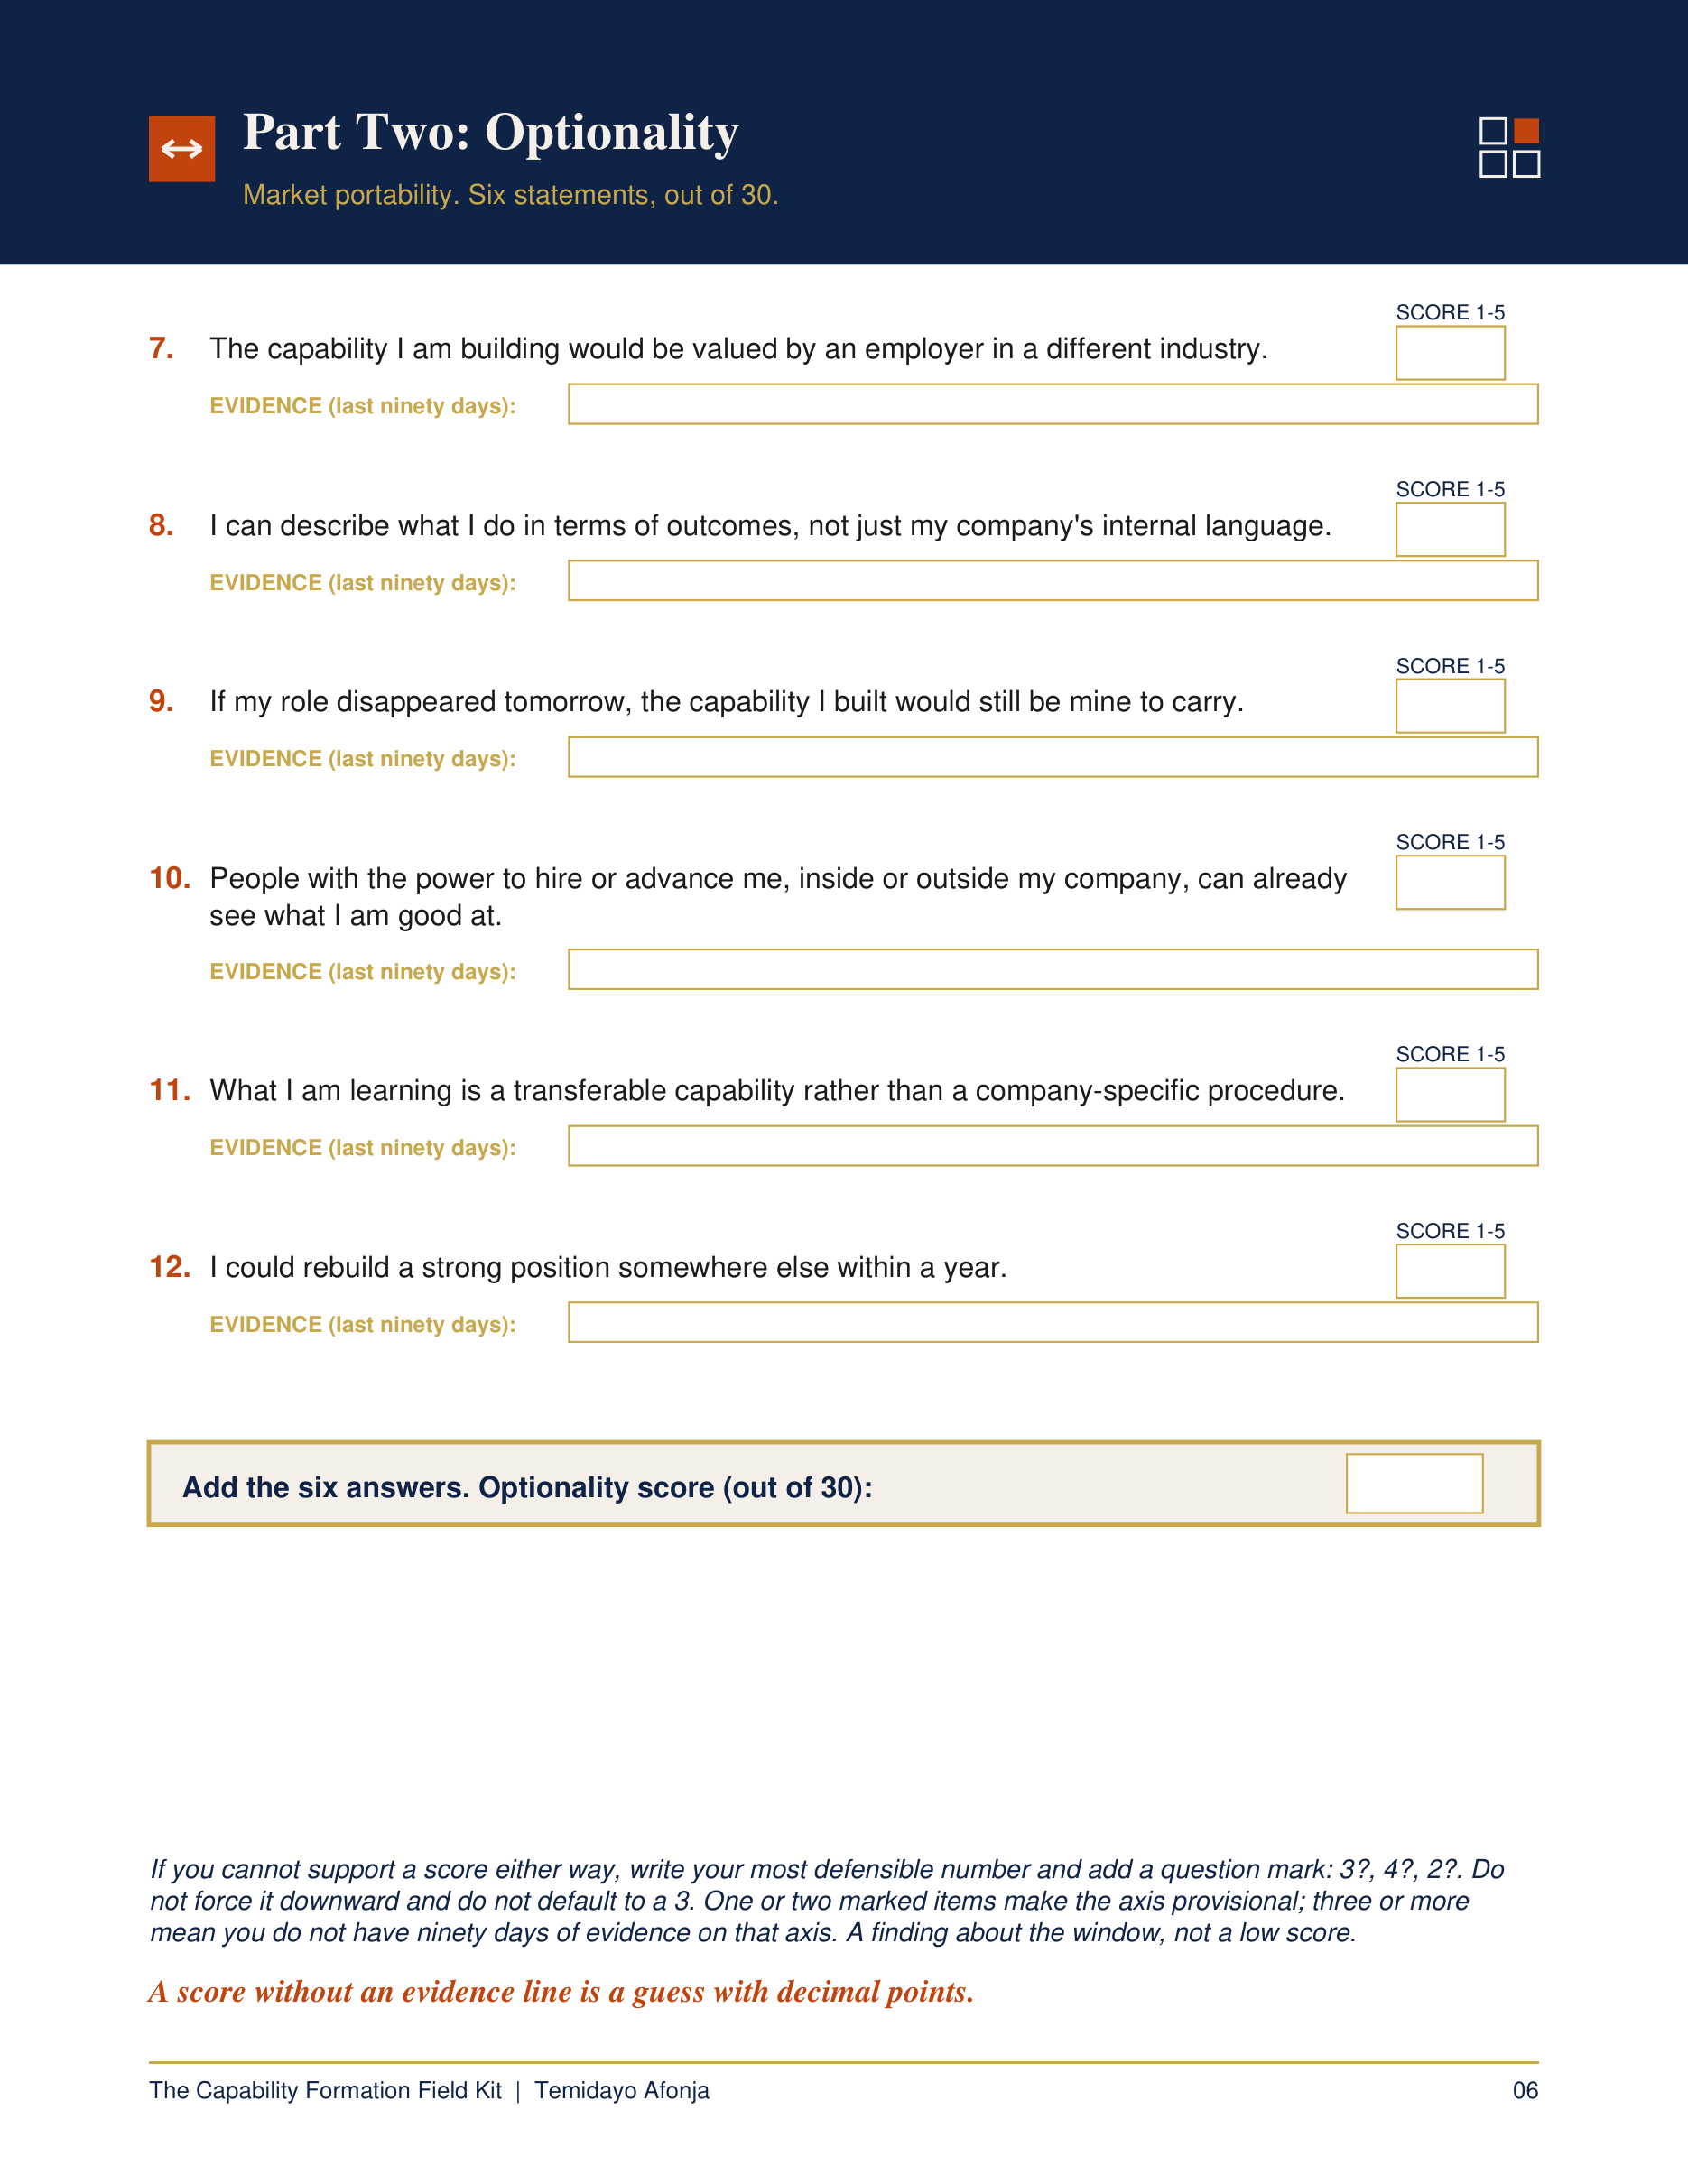
THE CAPABILITY FORMATION FIELD KIT
Know what your work is building.
Complete the full assessment privately, using evidence from the last ninety days.
temidayoafonja.com/book
Notes:
5:05-5:35 Field Kit invitation - memorize exactly.
The only purchase invitation in the video. Keep it calm, specific, brief.
Camera: visible but smaller than the product. Do not show Maven in this video.

Slide 10
MOVE THREE
Keep evidence before you need it.
A 90-day record. No confidential information required.
Problem
New hires needed a stronger integration experience.
Action
Led the onboarding redesign with the team.
Outcome
The integrating score moved from 47 to 75.
Capability
Diagnosing an employee-experience problem and leading a measurable organizational response.
Notes:
5:35-7:25 Move 3 - teach the card slowly, one row at a time.
Gem: 'A score without an evidence line is a guess with decimal points.'

Slide 11
BEFORE YOUR NEXT MOVE
Three questions.
What can I solve?
What problem can I solve today that I could not solve two years ago?
What changed?
What outcome have I produced that another employer would understand?
What can I carry?
If my current role disappeared tomorrow, what capability would still be mine?
Notes:
7:25-8:25 Viewer exercise - slow down.
Ask one question, pause, then reveal the next.
Leave five to seven seconds of quiet after the last question.

Slide 12
WATCH NEXT
Is your job making you less marketable?
temidayoafonja.com/book
Notes:
8:25-9:00 Next-video bridge - memorize exactly. Do not summarize.
The right side of this frame is deliberately empty for YouTube's
linked-video end-screen element. Hold for at least 12 seconds.

