Slide 1
Hotel Reservation Analysis Using SQL
Prepared by: Temiloluwa Priscilla Jokotola

Slide 2
Introduction
The hotel industry relies on data to make informed decisions and provide a better guest experience.This analysis uses Structured Query Language (SQL) on the BigQuery platform to analyze the hotel reservation datasets provided to gain insights into guest preferences, booking trends, and other key factors that impact the hotel's operations. You Fifteen business case questions were provided and answered using SQL. Analysis of this dataset aided in providing appropriate recommendations that can improve the hotel’s operations.

Slide 3
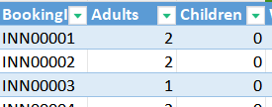
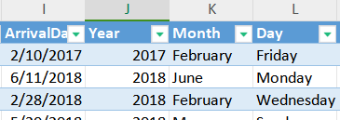
Data Cleaning & Transformation using MS Excel Spreadsheets
Table Structuring
10%
20%
Check for Blanks
Data Type Consistency
30%
Text Analysis
40%

Slide 4

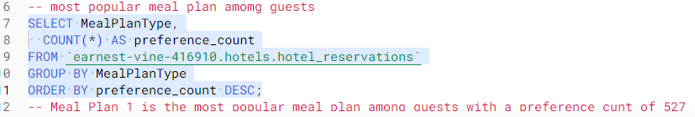
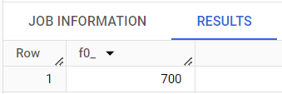
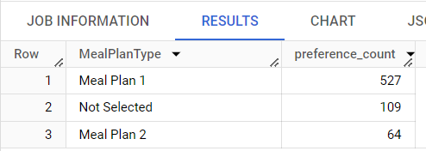
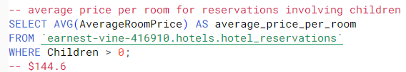
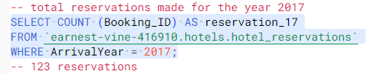
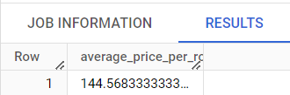
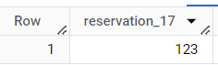
Methodology: SQL Analysis
Total Number of Reservations
Most Popular Meal Plan
AVG Room Price for Reservations Involving Children
2017 Reservations

Slide 5

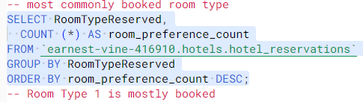

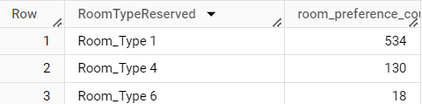
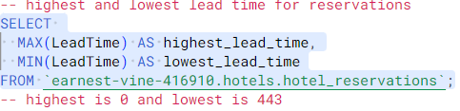
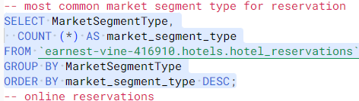

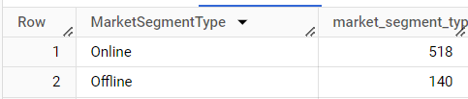
Methodology: SQL Analysis
Number of Weekend Reservations
Most Commonly Booked Room
Highest & Lowest Lead Time
Most Common Market Segment Type

Slide 6
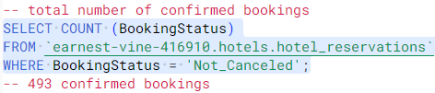
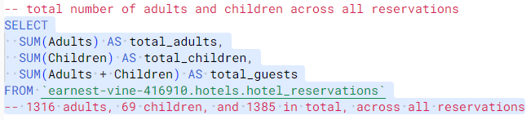


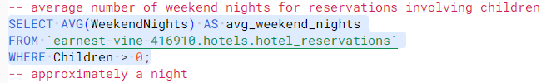
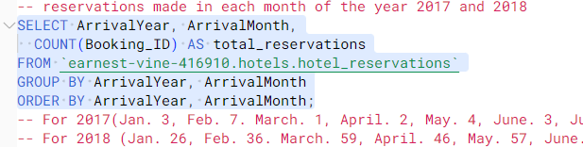


Methodology: SQL Analysis
Total Confirmed Bookings
Total Adults and Children
AVG Weekend Nights with Children
Monthly Reservations

Slide 7
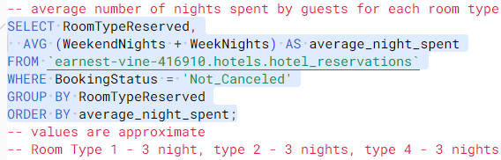
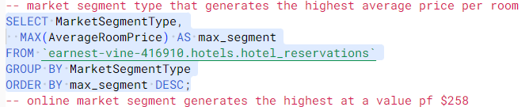

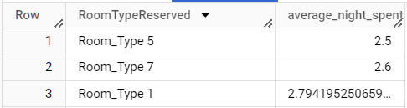
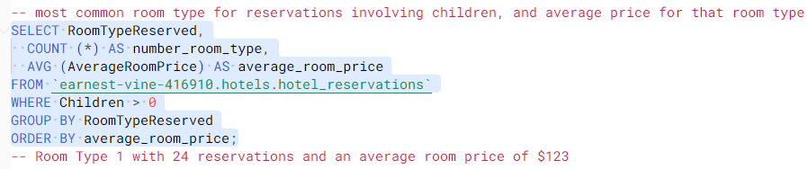
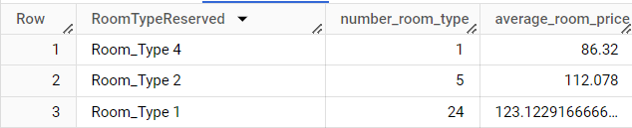
Methodology: SQL Analysis
AVG Nights Spent in Each Room Type
The Most-Expensive Market Segment Type
Most Popular Room Type Involving Children and its Average Price

Slide 8
Observations and Key Insights
Online Reservations
Weekly Reservations
Most reservations were made online
High number of reservations on weeknights than weekend nights
Room Type
Meal Plan
A large percentage of guests prefer Room Type 1
A large percentage of guests prefer Meal Plan 1
Seasons
Total Reservations
Reservations are high during summer and spring months. This can be due to the fact that most people travel for summer holidays
700 Reservations were made

Slide 9
Recommendations
75%
50%
30%
80%
Survey
Discount Bookings
Targeted Ads
Newsletter
Investment in targeted ads online and offline
Weekend nights bookings should be discounted to increase reservation rate
Encourage guests to sign up for monthly newsletters to keep them up to date on the company’s operations
Carry out a survey during checkout to know why customers prefer Room Type 1 and to detect and lag in the service provided.

