Slide 1
Student Performance
K-Means Clustering
Data Mining Project
Random Forest
Kaggle Dataset · Python ·
Linear Regression
EDA & Visualization
Data Mining · Final Project Baitur Temiraliev

Slide 2
Dataset Overview
Students Performance Dataset — Kaggle
5,000+
22
5
Student Records
Features / Columns
Grade Categories (A–F)
Key Features
• Attendance %
• Study Hours/Week
• Midterm Score
• Sleep Hours/Night
• Final Score
• Stress Level (1–10)
• Assignments Avg
• Family Income Level
• Quizzes Avg
• Parent Education
• Participation Score
• Extracurriculars

Slide 3
Methodology
Data Reduction
Preprocessing
01
02
Dropped non-predictive columns (ID, Names, Email) Reduced from 22 → 18 features
Label encoding for categorical variables Train/test split: 80% / 20%
EDA
Clustering
03
04
Grade distribution, correlation heatmap Study hours vs. total score scatter plot
K-Means (k=3): High, Medium, Low achievers Based on study hours & total score
Classification
05
Random Forest Classifier to predict Grade (A–F) Feature importance analysis

Slide 4
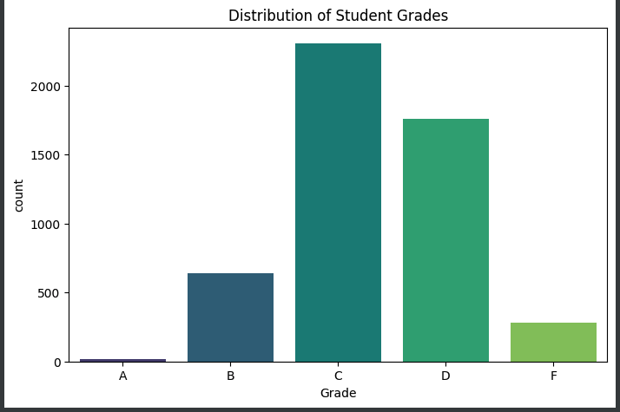
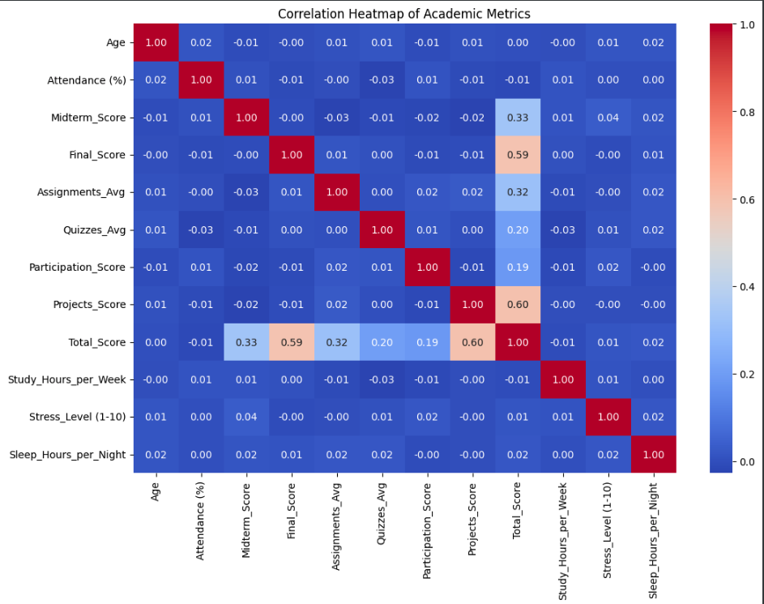
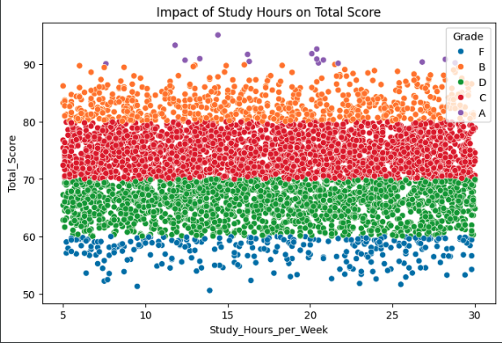
Exploratory Data Analysis
Uncovering patterns before modeling
[ Grade Distribution Chart ]
[ Correlation Heatmap ]
Grade Distribution
Feature Correlation Matrix
[ Study Hours vs. Total Score Scatter Plot ]

Slide 5
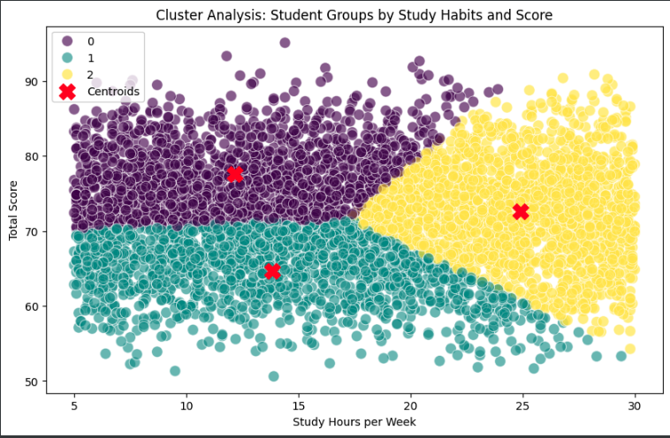
K-Means Clustering
Unsupervised segmentation of student behavior
Cluster 0 — High Achievers
High study hours, top scores
Cluster 1 — Medium Performers
[ K-Means Cluster Plot ]
Average effort, mid-range scores
Cluster 2 — Low Performers
Low study hours, lower scores
k = 3 · Features: Study Hours & Total Score · StandardScaler applied

Slide 6
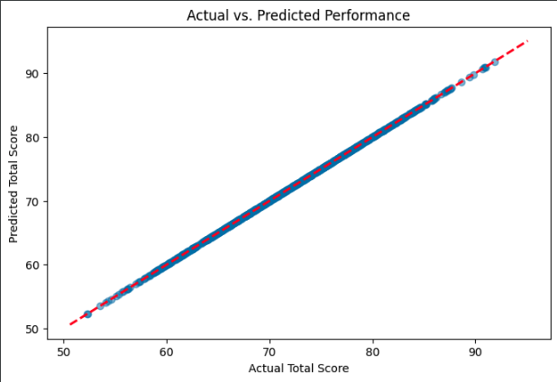
Classification & Regression
Predicting student outcomes with ML models
R² Score
Linear Regression on Total Score
High
[ Actual vs. Predicted Total Score ]
Actual vs. Predicted

Slide 7
Key Insights
Attendance & Study Hours
3 Distinct Student Groups
Strongest predictors of final grade across all models
K-Means revealed clear High / Medium / Low performer clusters
Reliable Prediction
Lifestyle Factors Matter
Linear Regression achieved a high R² on the test set
Stress level & sleep hours show measurable impact on scores
Dimensionality Reduction
Department Variation
Dropping 4 ID columns improved model clarity and efficiency
Performance gaps exist across Engineering, CS, and Business

Slide 8
Conclusion
Tools & Technologies
This project demonstrated how data mining techniques can reveal actionable insights from student academic data.
Python
Pandas / NumPy
✓ K-Means → 3 clear student behavior clusters
Scikit-Learn
✓ Linear Regression → accurate score prediction
Seaborn / Matplotlib
✓ Top factors: Attendance, Study Hours, Stress
Kaggle Dataset
Data Mining · Final Project

