Slide 1
Sentiment Analysis
Concept, Application, and Implementation
in R Language

Slide 2
The Definition of Sentiment Analysis
Also known as opinion mining: to understand the attitude of a speaker or a writer with respect to some topic
– The attitude may be their judgment or evaluation, their affective state or the intended emotional communication
– Most popular classification of sentiment: positive or negative

Slide 3


Positive or negative movie review?
unbelievably disappointing
Full of zany characters and richly applied satire, and some great plot twists
this is the greatest screwball comedy ever filmed
It was pathetic. The worst part about it was the boxing scenes.

Slide 4
The Structure of Sentiment Analysis
Sentiment = Holder + Polarity + Target
– Holder: who expresses the sentiment
– Target: what/whom the sentiment is expressed to
– Polarity: the nature of the sentiment (e.g., positive or negative)

Slide 5
The Example of Structural Analysis of Sentiment Analysis
Sentiment = Holder + Polarity + Target
In his recent State of the Union address, US President Bush quite unexpectedly labeled
Iran, Iraq, and the DPRK as an “axis of evil”.
Negative

Slide 6
Why sentiment analysis?
Movie: is this review positive or negative?
Products: what do people think about the new iPhone?
Public sentiment: how is consumer confidence? Is despair increasing?
Politics: what do people think about this candidate or issue?
Prediction: predict election outcomes or market trends from sentiment

Slide 7
References
Sentiment Analysis Tutorials (Bing Lu): https://www.cs.uic.edu/~liub/FBS/sentiment-analysis.html
Sentiment Analysis (Dan Jurafsky): https://web.stanford.edu/class/cs124/lec/sentiment.pdf
Sentiment Analysis and Opinion Mining (Furu Wei):

Slide 8
網路爬蟲步驟範例
Ncapture + Nvivo 10 為例
Ncapture + Nvivo 10 為例

Slide 9

將檔案載為Posts as Dataset

Slide 10
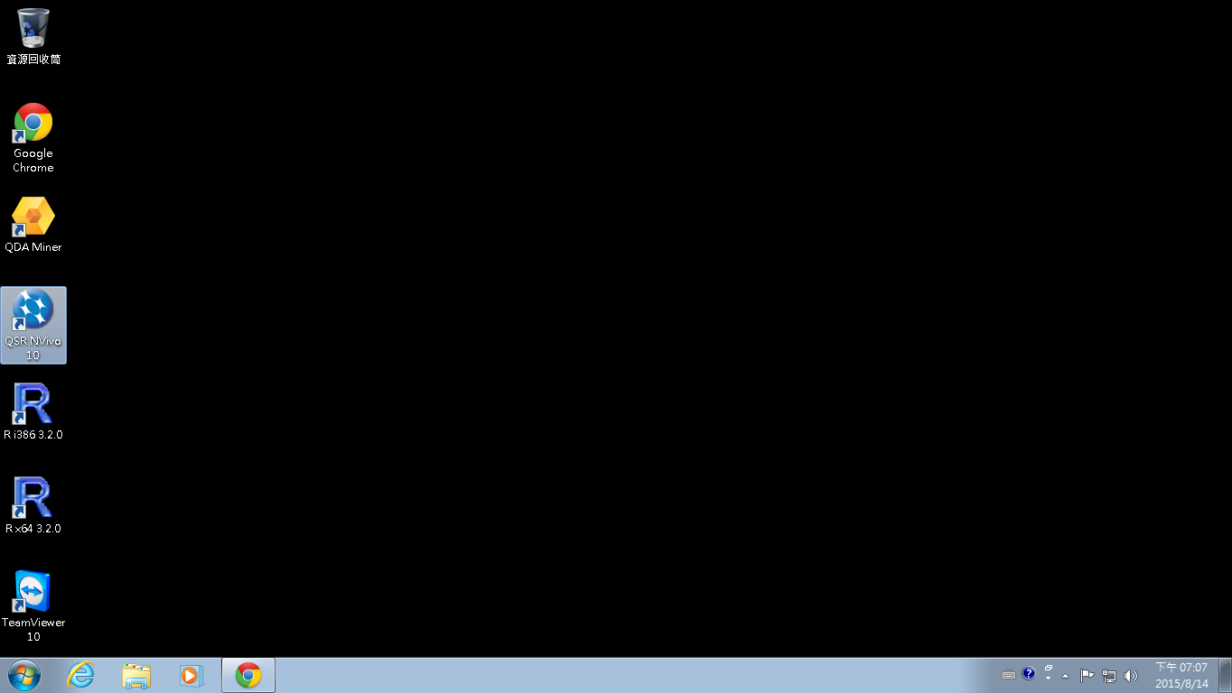
Nvivo分析區隔IP與句子
打開Nvivo分析軟體

Slide 11
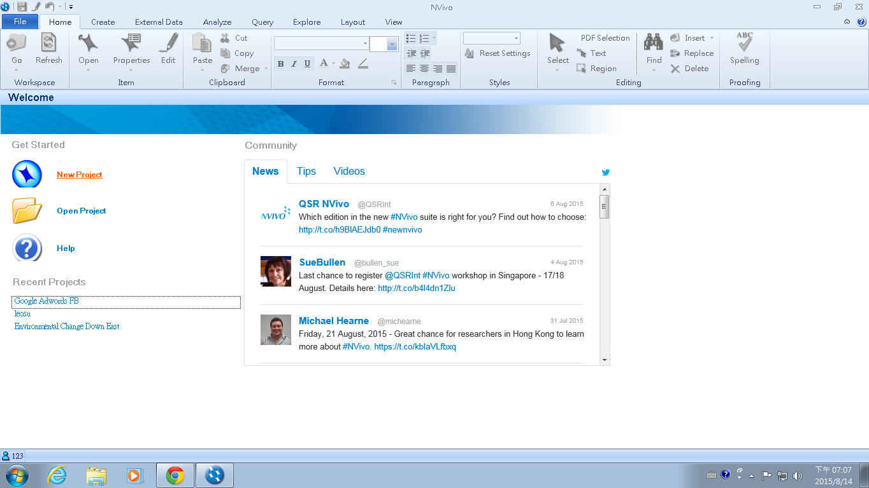
使用Nvivo區隔程式碼內ID與文字
步驟一：開啟一個新計畫

Slide 12
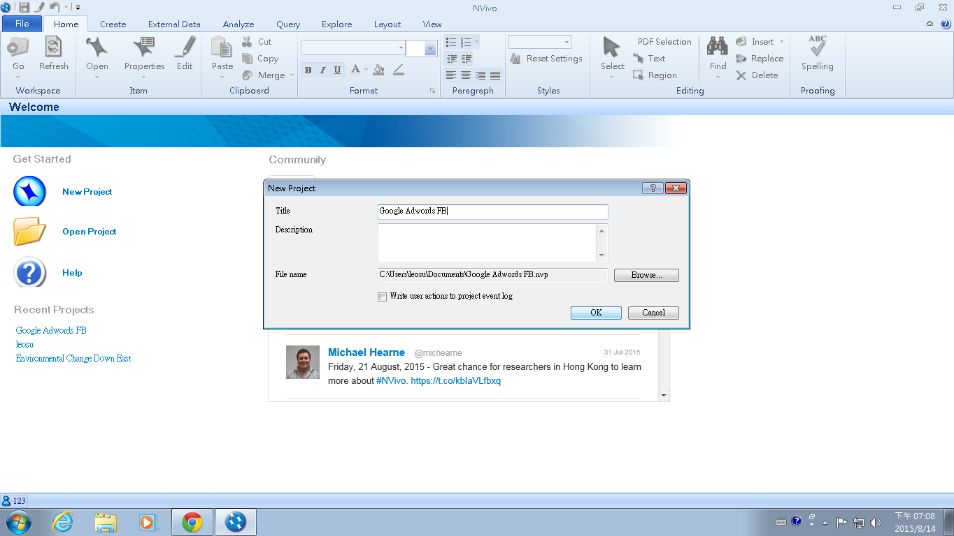
使用Nvivo區隔程式碼內ID與文字
步驟二：輸入新計畫名稱

Slide 13
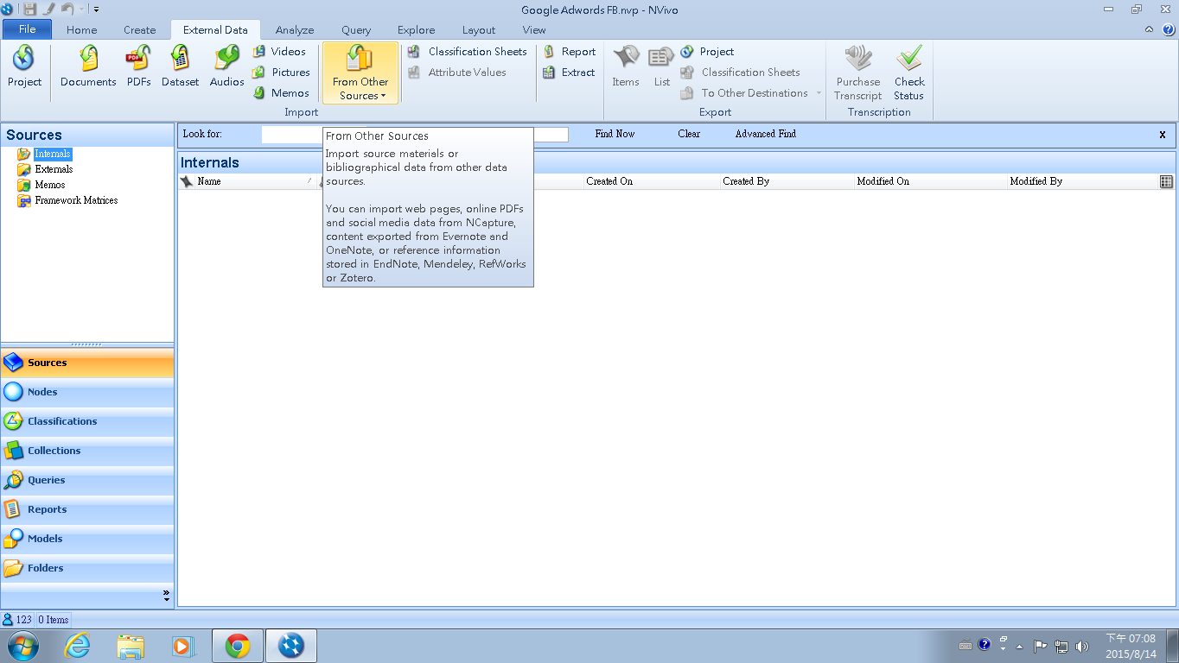
使用Nvivo區隔程式碼內ID與文字
步驟三：從From Other Sources尋找Ncapture載下的網頁

Slide 14
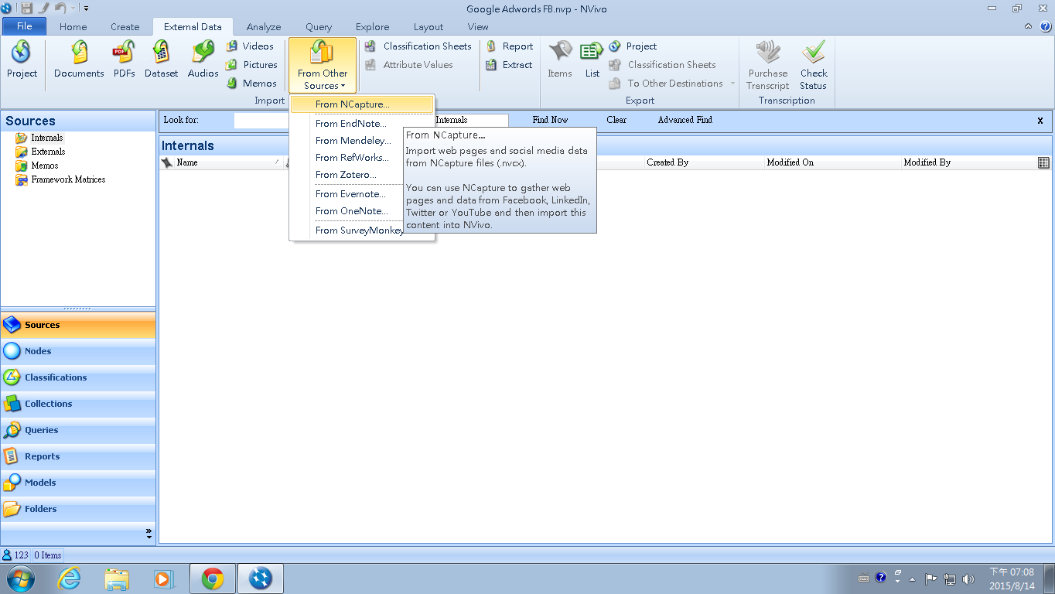
使用Nvivo區隔程式碼內ID與文字
步驟四：選擇From NCapture

Slide 15
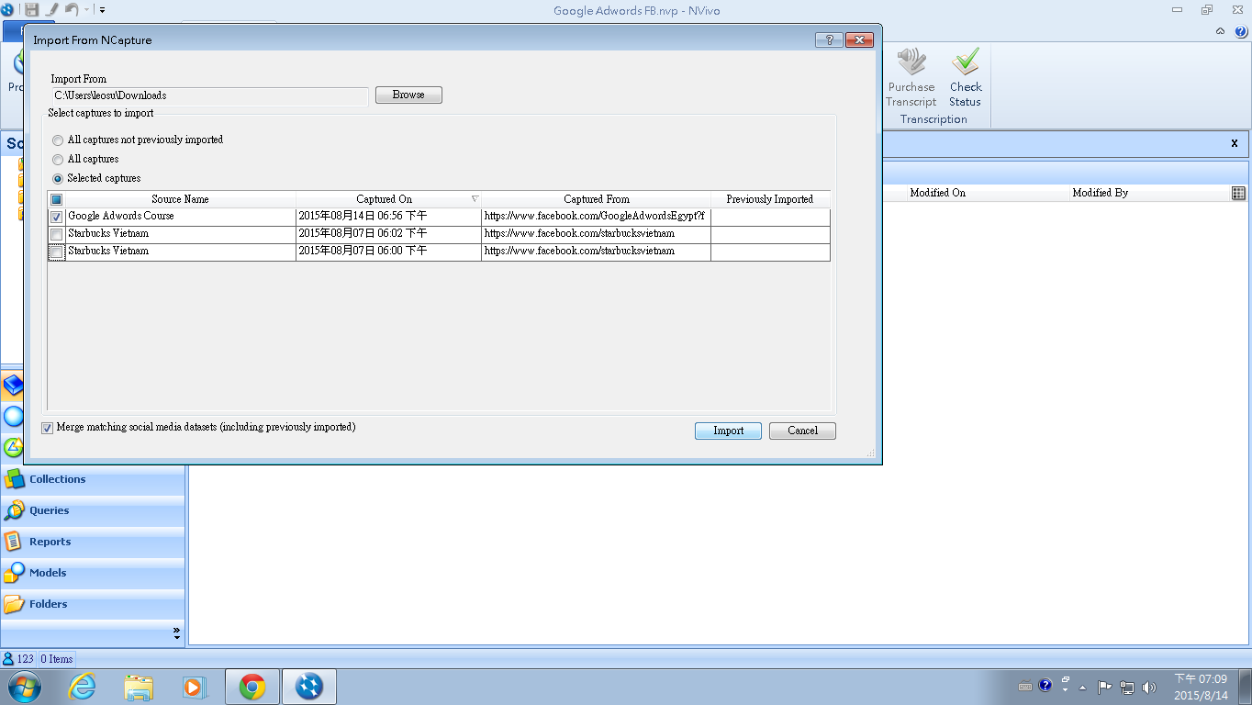
使用Nvivo區隔程式碼內ID與文字
步驟五：選擇我們要得網頁資訊

Slide 16
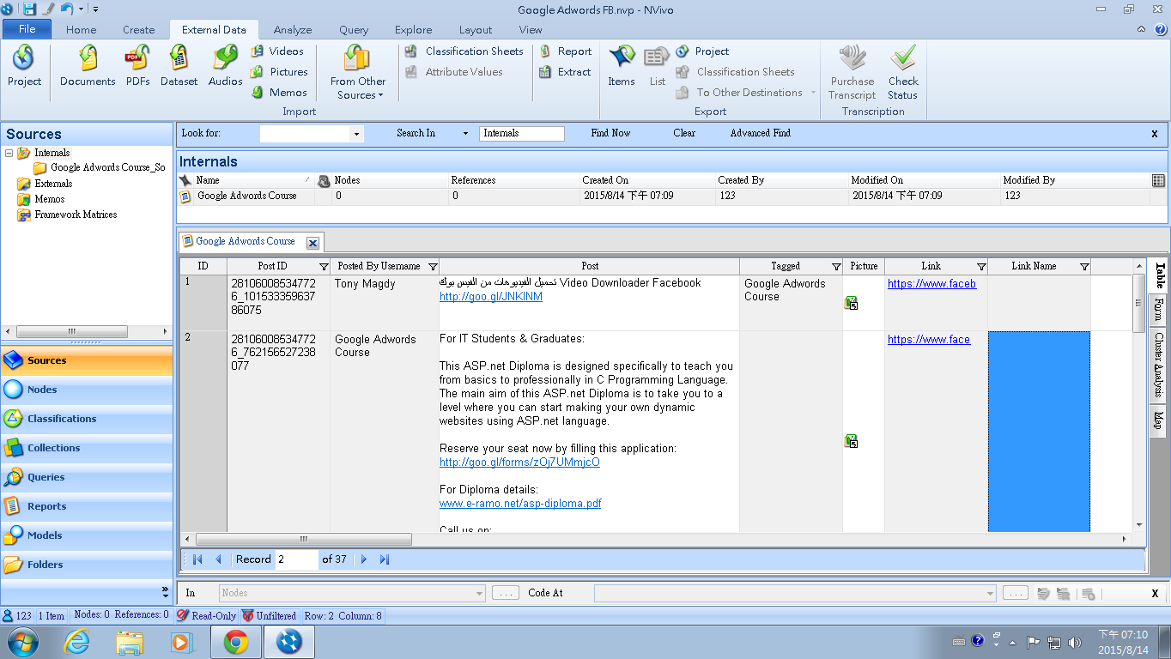
使用Nvivo區隔程式碼內ID與文字
步驟六：取得區隔ID、名稱、文字等等

Slide 17
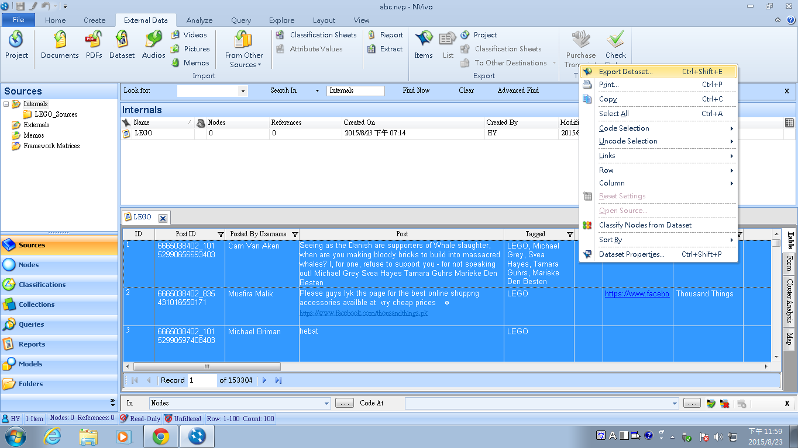
使用Nvivo區隔程式碼內ID與文字
步驟八：右鍵選擇Export Dataset

Slide 18
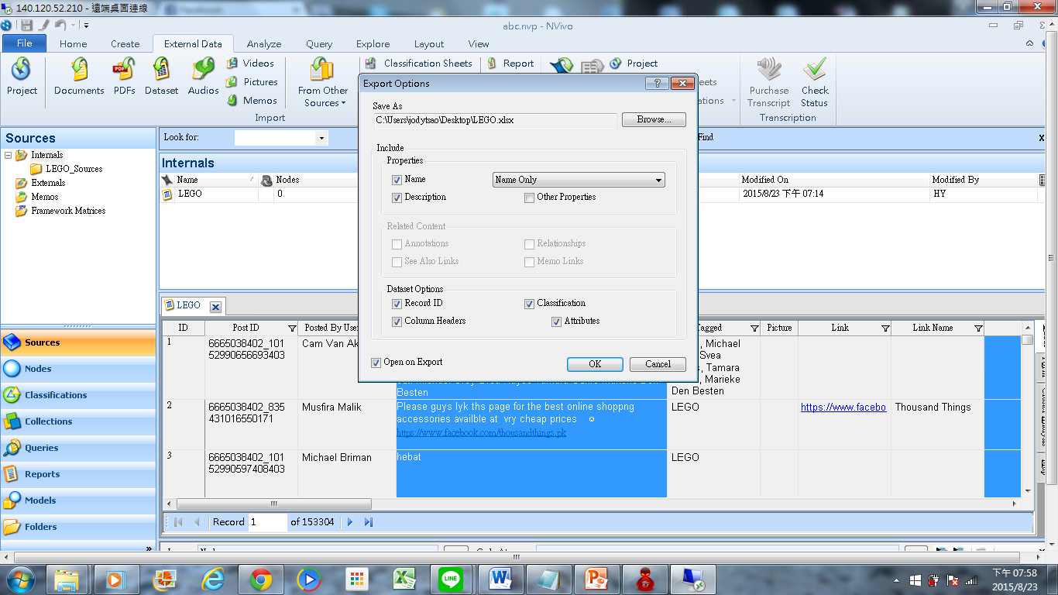
使用Nvivo區隔程式碼內ID與文字
步驟九：圈選Export Options內容以供後續Data分析用

Slide 19
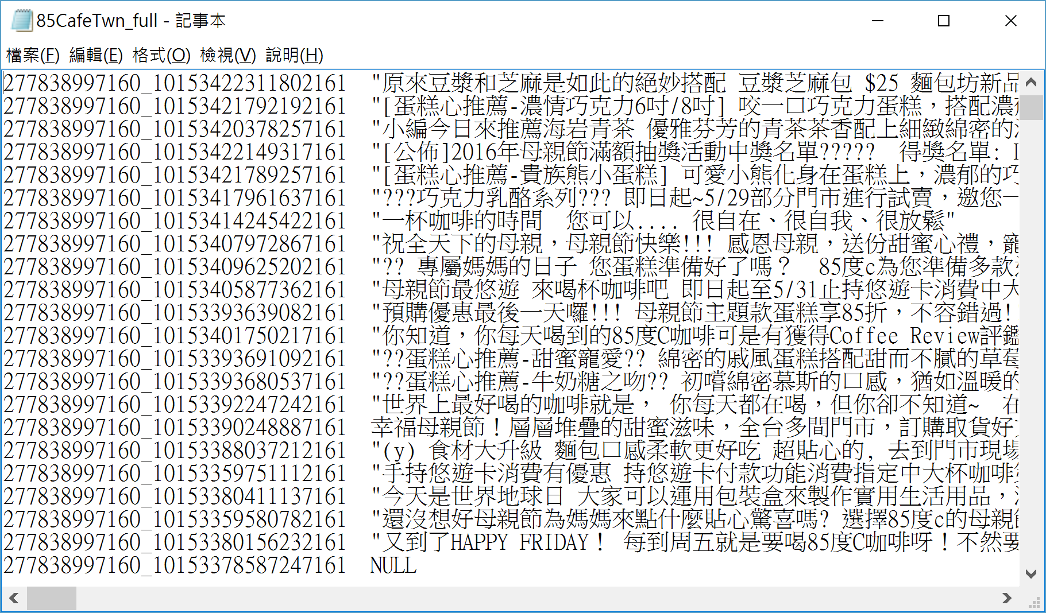

Slide 20
Sentiment Analysis
Implementation in R

Slide 21
R Language 相關資源(執行環境與函數)
Step 1:
R Language Download
Step 2:
R Studio Download
Step3:
中文段字Jeiba
Step4:
中文情緒分析
R and Data Mining
R Turtorial
Introduction R online course
Introduction to R - Princeton University
R Statistics
R 中文教學

Slide 22
中文情緒分析網站範例
​http://mcdm.ntcu.edu.tw/jieba/ (中文情緒分析軟體介紹)
http://dailyview.tw/ (網路溫度計)
http://www.i-buzz.com.tw/ (口碑研究中心)

Slide 23
中文斷句Jeiba範例
ChineseJeibaR_Tsao.R

Slide 24
中文情緒分析範例 (Without Machine Learning)
sentiment_analysis_Chinese.R

Slide 25
中文情緒分析範例(Machine Learning)
sentiment_analysis_chinese_ML.R

