Slide 1

Time Server Node.js
By Temitayo Alli
20011

Slide 2
CONTENT
FEATURES
EXPECTATIONS AND DELIVERABLES
TEXT EDITOR WITH PROJECT CODES
STARTING THE SERVER
RESULTS

Slide 3
An ubuntu vm host engine
Text editor
Ubuntu Terminal
Browser
FEATURES

Slide 4
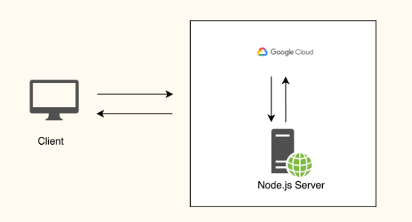
EXPECTATIONS

Slide 5
Installation of VM
Installation of nodejs
Installation of npm
Create code in Texteditor
Starting the server
Results
DELIVERABLES

Slide 6
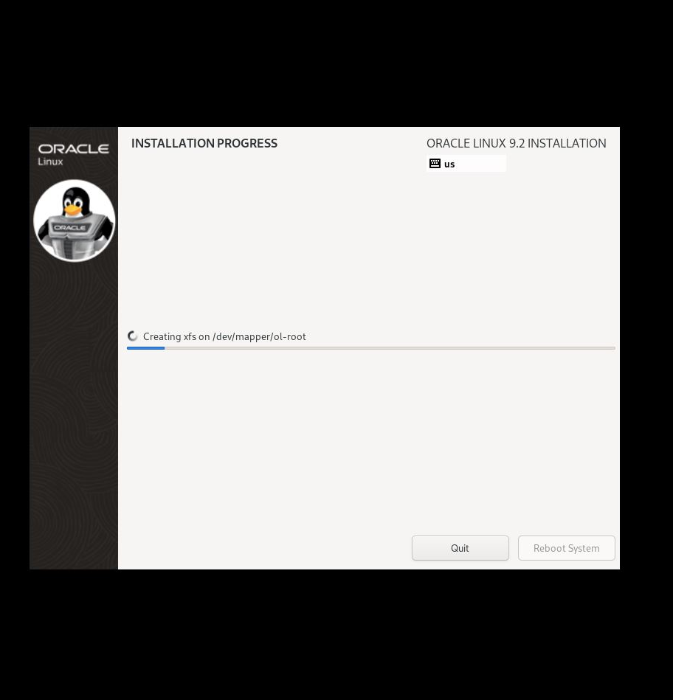
Installation of VM

Slide 7
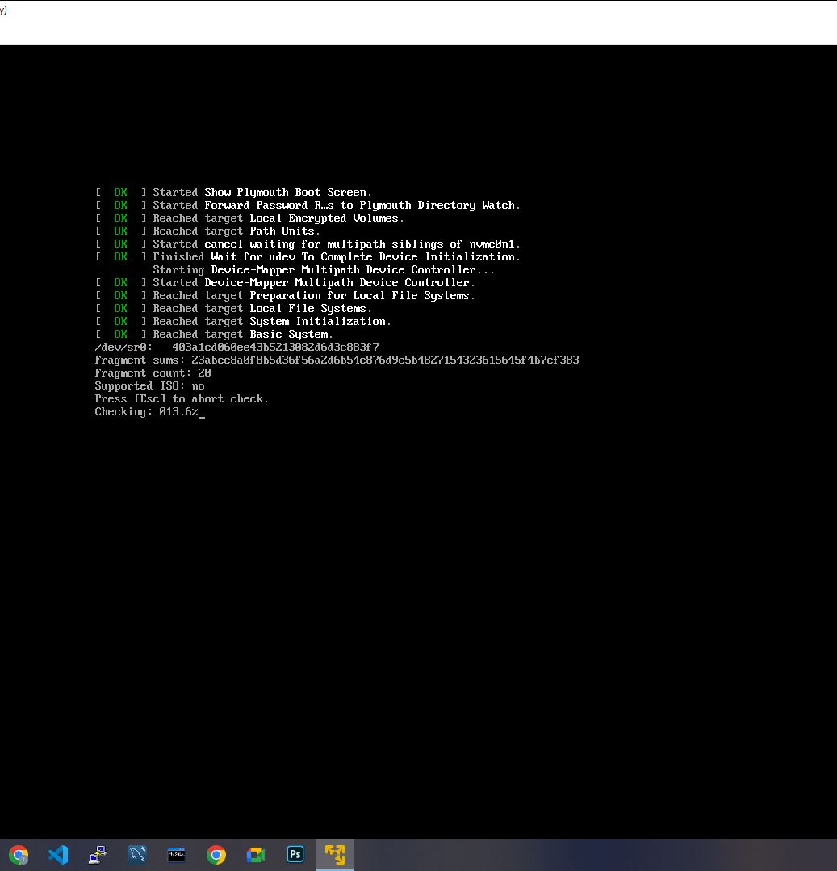
Installation of VM

Slide 8
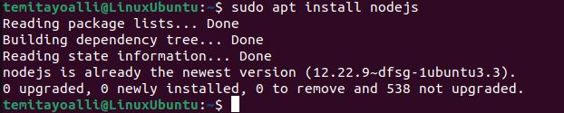
Installation of nodejs

Slide 9
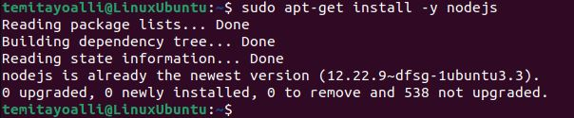
Installation of npm

Slide 10
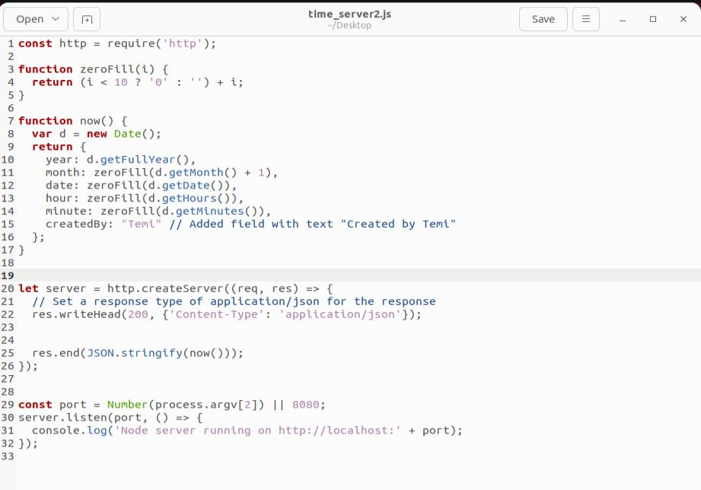
TEXT EDITOR WITH PROJECT CODES

Slide 11
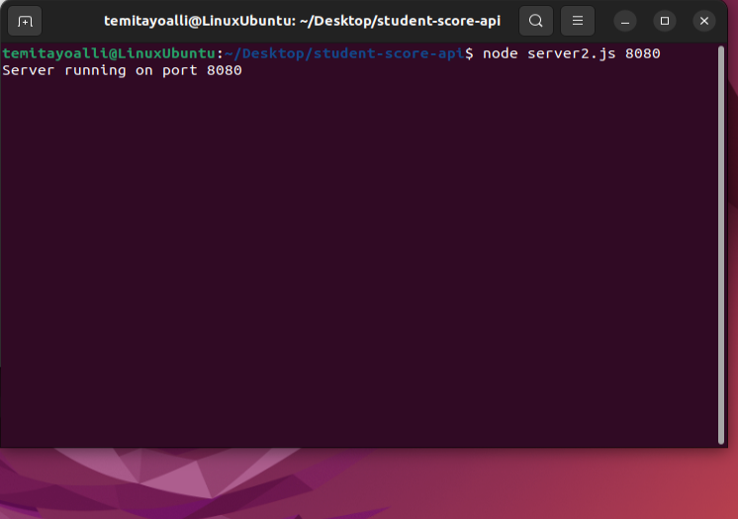
STARTING THE SERVER
You have to open the terminal from where you created your directory and follow through with other instructions.
Run “node time_server2.js 8080”
Copy link and access in a browser

Slide 12
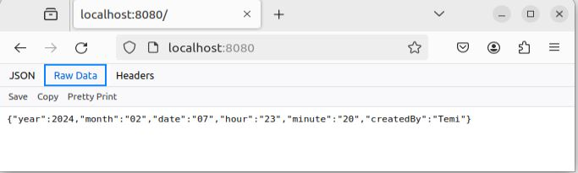
Results

Slide 13
REFRENCE
Exercises for Learnyounode. (2021). Sfbu.edu. https://hc.labnet.sfbu.edu/~henry/npu/classes/javascript/node_js/course/nodeschool/learnyounode/exercise_learnyounode.html
Node.js on Ubuntu. (2024). Sfbu.edu. https://hc.labnet.sfbu.edu/~henry/npu/classes/javascript/node_js/slide/ubuntu.html
Time Server. (2021). Sfbu.edu. https://hc.labnet.sfbu.edu/~henry/npu/classes/javascript/node_js/course/nodeschool/learnyounode/time_server.html
Exercises for Ubuntu. (2020). Sfbu.edu. https://hc.labnet.sfbu.edu/~henry/npu/classes/linux/ubuntu/slide/exercise_ubuntu.html#setup
‌

Slide 14
Conclusion
In conclusion, the deployment of a Node.js time server on a local VM on a windows environment was a success.

