Slide 1
Reasons Employee are prone to leave Company X

Slide 2
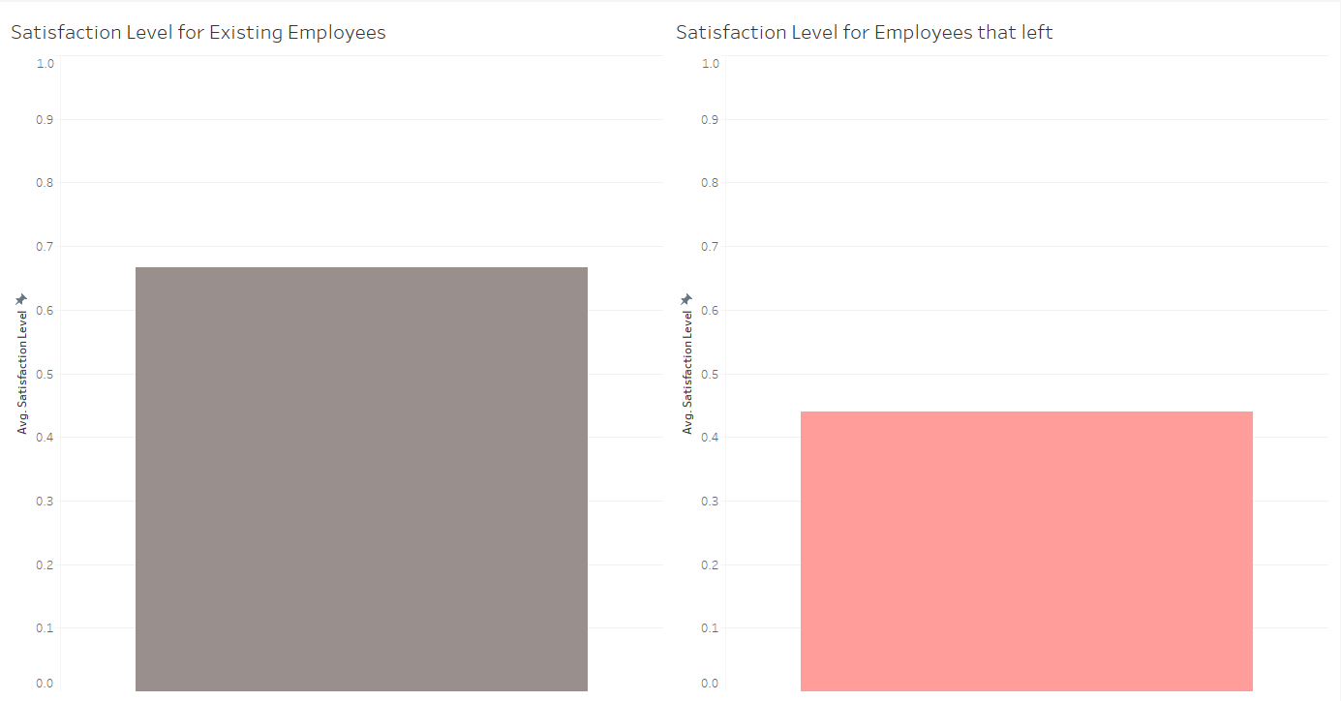
Satisfaction level of Employee
Satisfaction level of an employee has a very huge effect on if they stay at the company or they leave the company.
We can see that the average satisfaction level of Existing employees is much more than employees who left the company. This goes a long way in knowing employees who are prone to leave

Slide 3
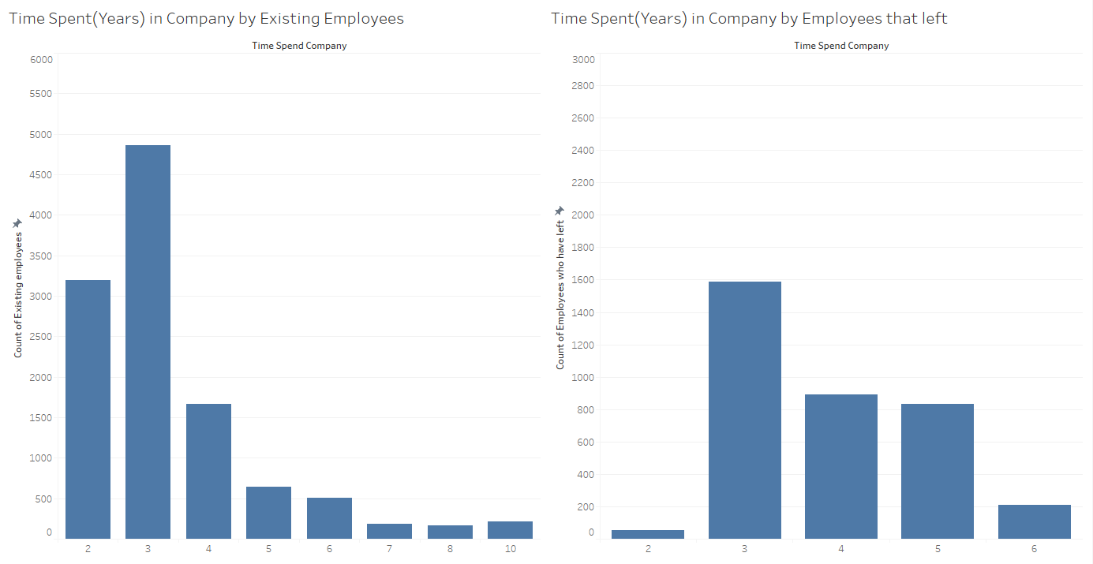
Time spent at the Company
Employees which have spent less that 6 years at the company are more prone to leave. This can be seen in the graph below
No Employee who have worked for the company for over 7 years left

Slide 4
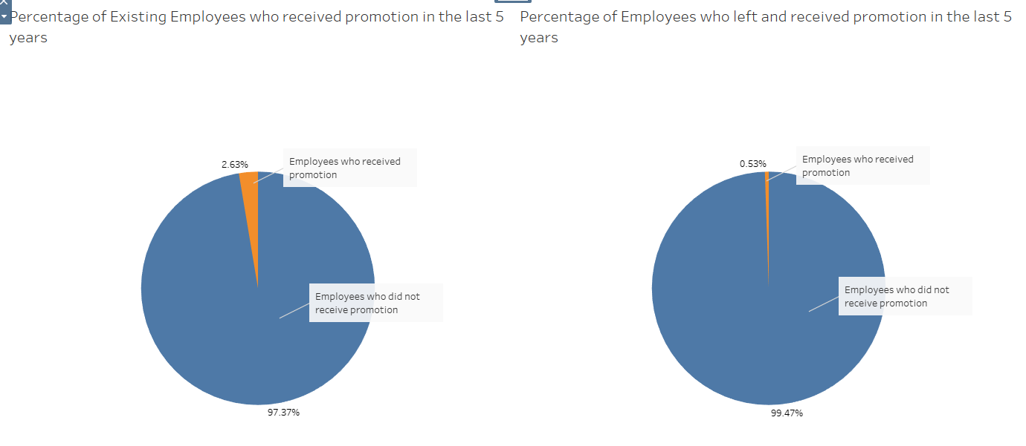
Promotion in the last 5 years
Employees who left has a very low percentage that was promoted in the last 5 years compared to Existing employees

Slide 5
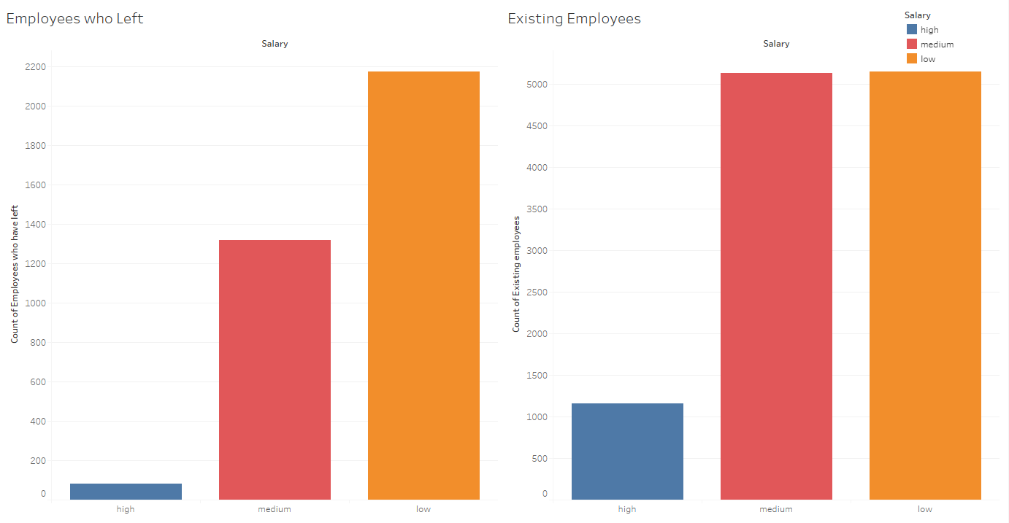
Salary of Employees
Existing employees has a balance between employees with low salary and medium salary meaning there was less bias and employees with high salary were much more than their counterparts who left
Most employees who left had a lot of people with low salary, and the difference between employees with low salary was much more than employees with medium salary causing a large bias between the employees and employees with high salary are very low

Slide 6
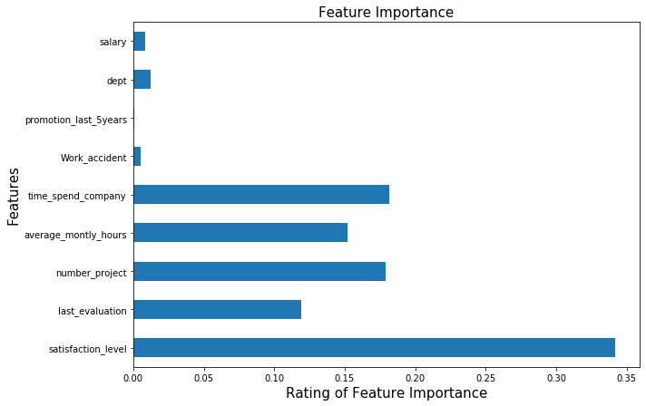
Bases on a model created to predict Employees who will leave, this model achieved an accuracy of 98%. Below is a graph of the various features and their importance's in helping the model to achieve such high accuracy

Slide 7
Types of Employees prone to leave in the future
Employees with low salary
Employees who hasn’t received promotion in the last 5 years
Employees who has not spent 7 years and above at the company
Employees who are not satisfied at the company, this can be measured with the satisfaction level of the employee is below average

