Slide 1

Systems Engineering (SE) Tools
National Aeronautics and Space Administration
Example Applications of SE Tools
www.nasa.gov

Slide 2
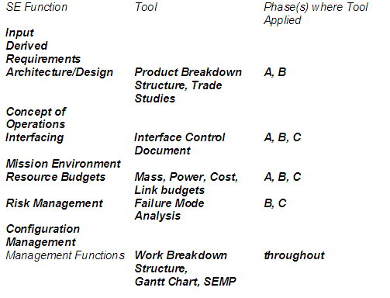
SE Tools
This chapter is meant to provide examples of systems engineering tools which may be needed during the SE design process.

Slide 3
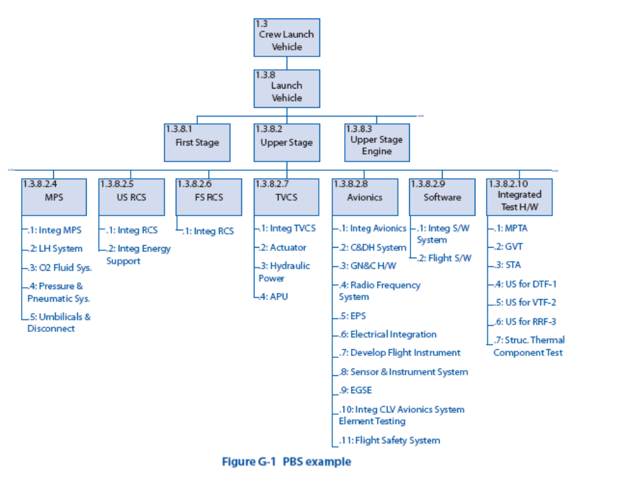
Product Breakdown Structure (PBS): A hierarchical breakdown of the hardware and software products of the project

Slide 4
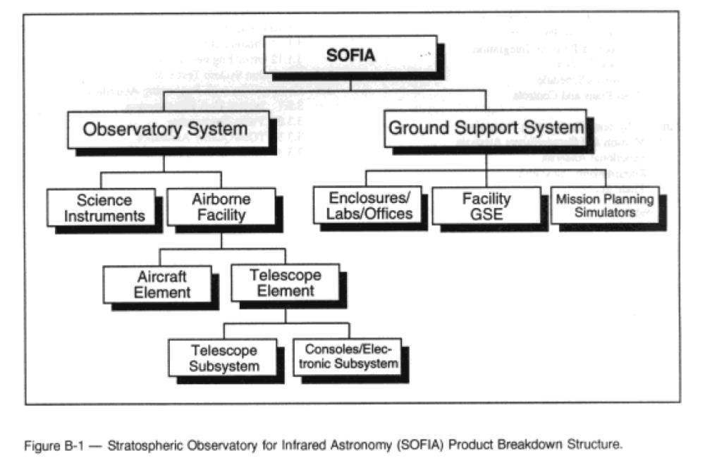
PBS for the SOFIA infrared telescope

Slide 5
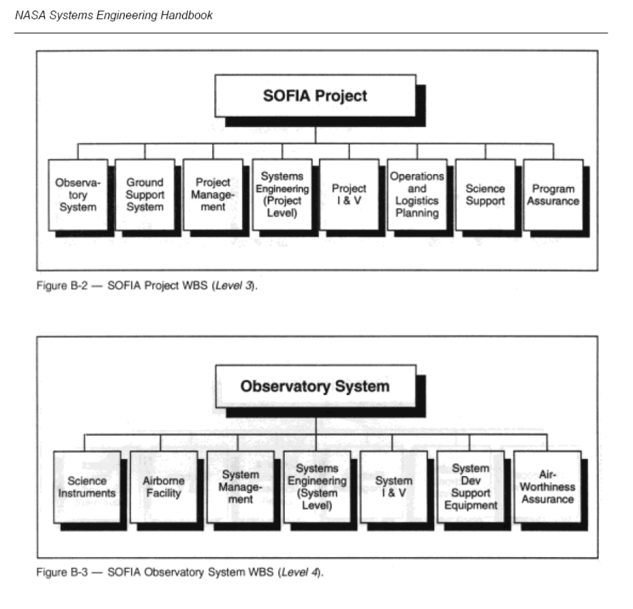
Work Breakdown Structure (WBS) - A hierarchical division of hardware, software, services and data, which includes the PBS.

Slide 6
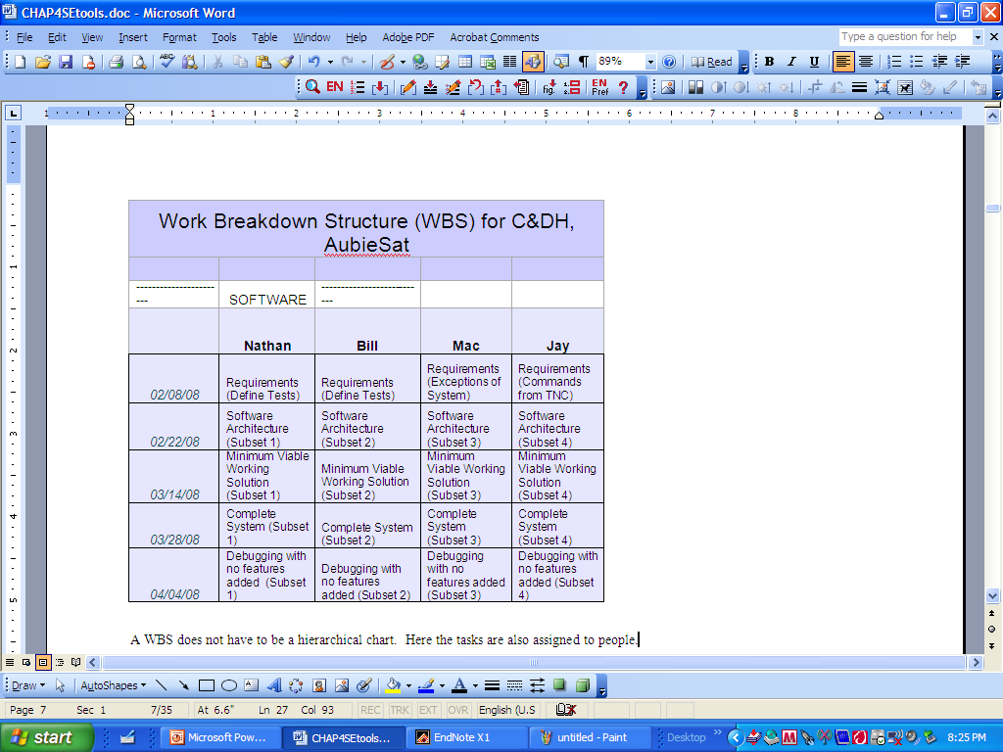
Simplified WBS for a subsystem, with assignments and due dates

Slide 7
Trade Studies
A trade study is a tool used to help choose the best solution among alternatives. Numerical values are given based on weight factors and a normalization scale for the evaluation criteria. Evaluation criteria are important factors that we want to include in the trade study. Weight factors are used to dictate how important the evaluation criteria are relative to each other. Normalization scale creates a constant interval scale that allows us to set a numerical for each of the evaluation criteria (e.g. cost, mass, volume, power consumption legacy, ease of use). The choice of weight factors and normalization scale are extremely important to this process.
Steps to a trade study
1. Define the problem.
2. Define constraints on the on the solutions.
3. Find 3-5 solutions
4. Define evaluation criteria.
5. Define weight factors
6. Define normalization scale
7. Fill out trade study (in EXCEL)
8. Rank the solutions
SEE NEW CAR EXAMPLE IN CHAPTER 4

Slide 8
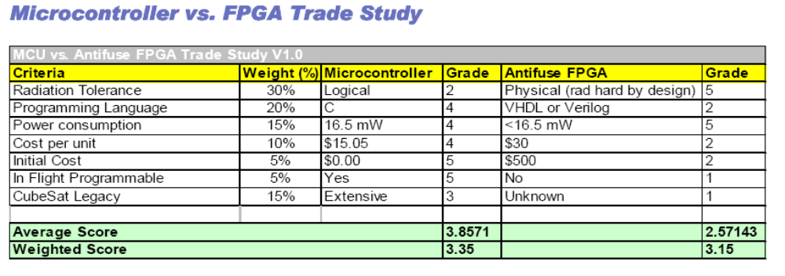
Trade Study Example – Comparison of Controllers for CubeSat

Slide 9
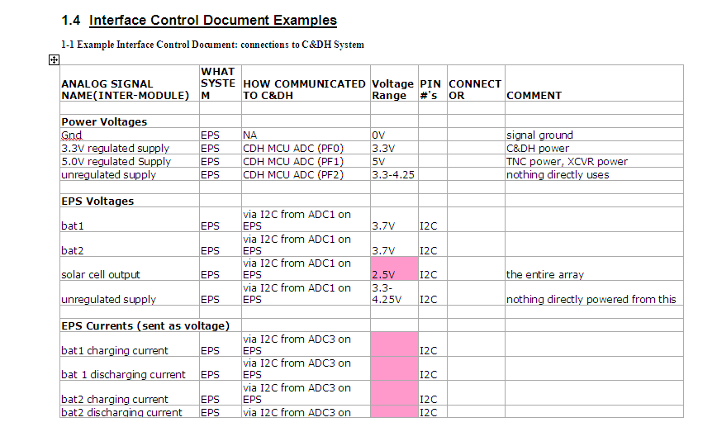
Interface Control Document (ICD)

Slide 10
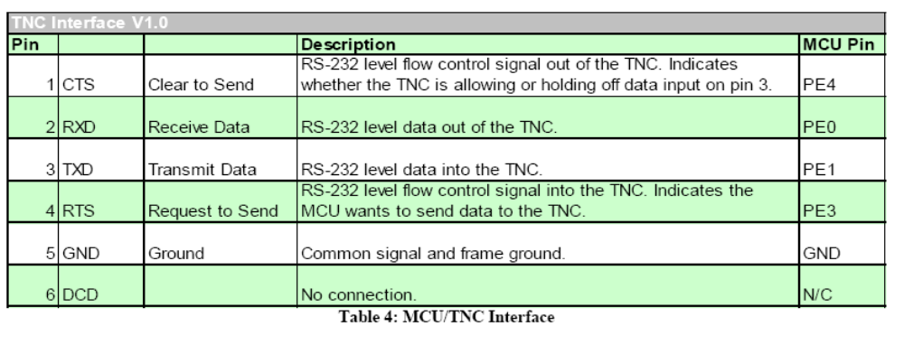
Interface Control Document (ICD)

Slide 11
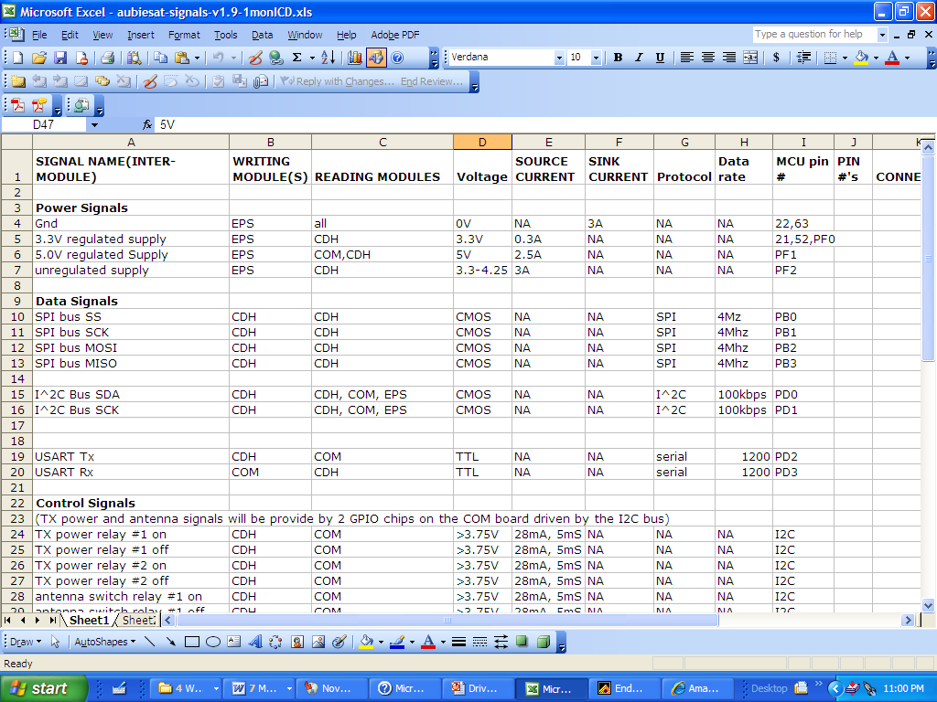
Interface Control Document (ICD)

Slide 12
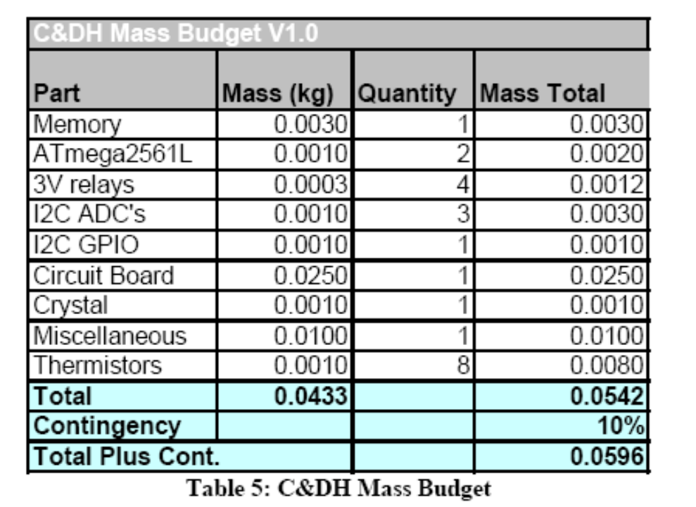
Mass Budget

Slide 13
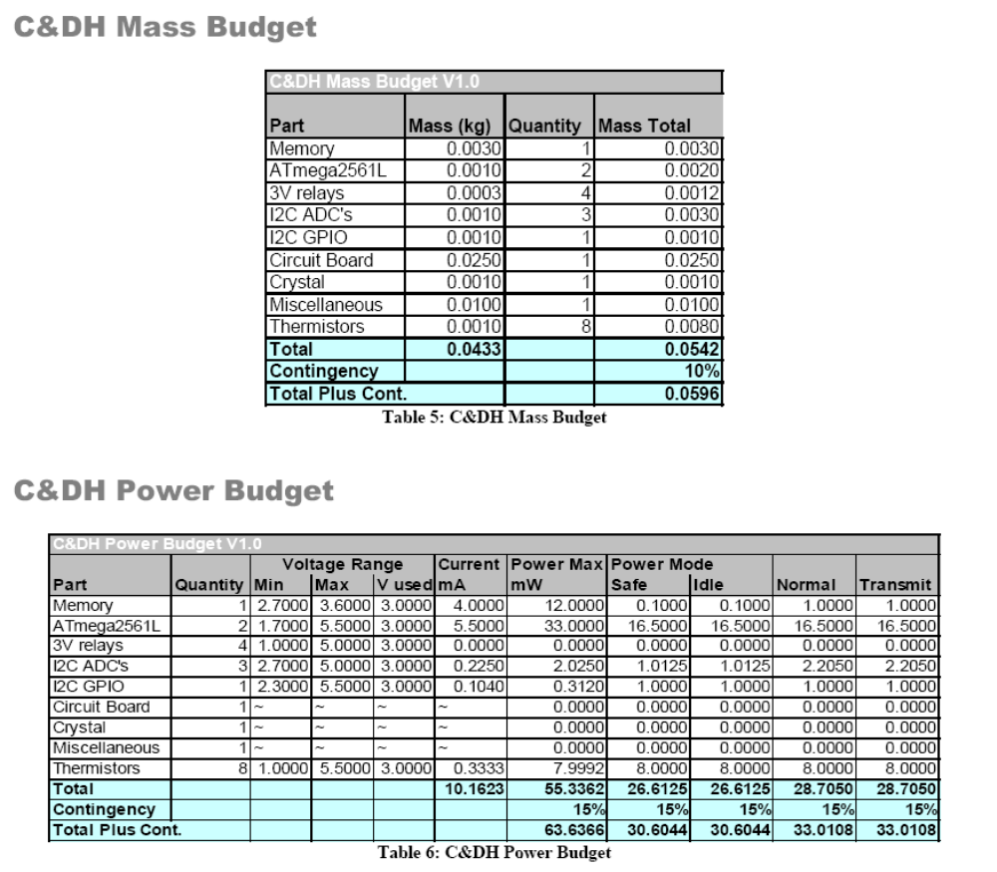
Power Budget

Slide 14
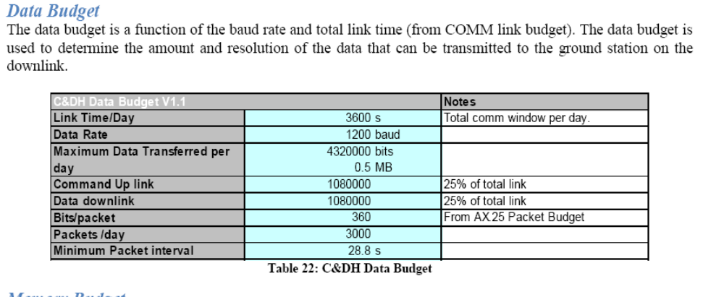
Data Budget

Slide 15
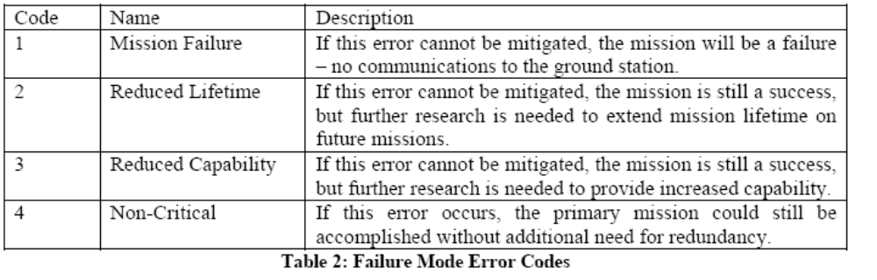
Failure Mode Analysis

Slide 16
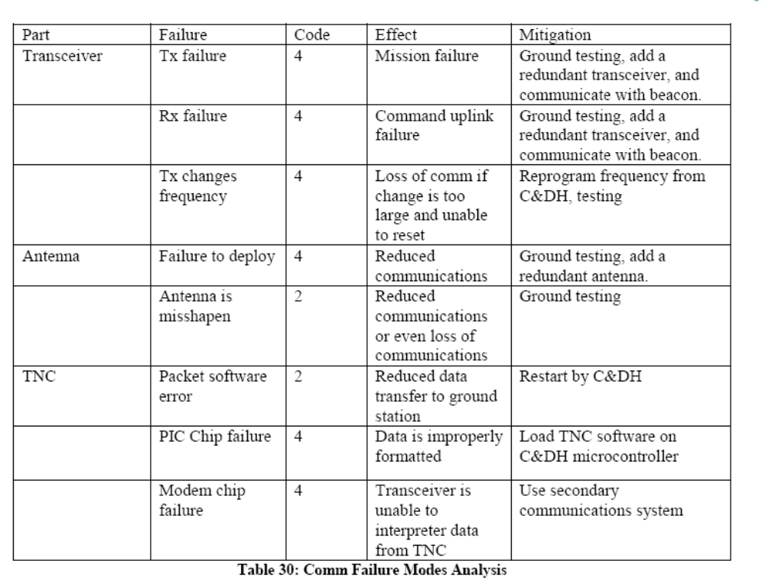
Failure Mode Analysis – COMM System

Slide 17
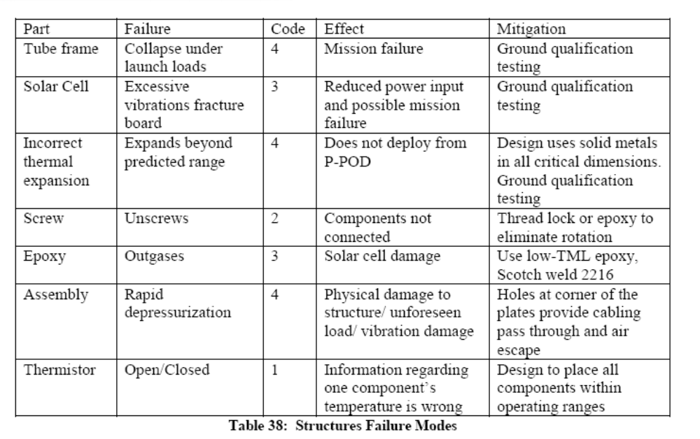
Failure Mode Analysis - Structures

Slide 18
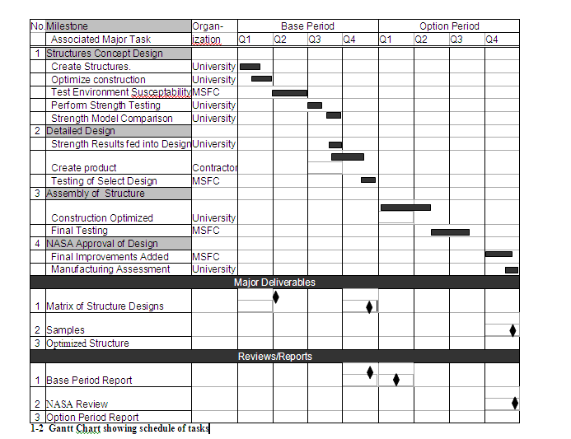
Gantt Chart – A bar chart that can be used to allot time to tasks, schedule reviews, and date milestones

Slide 19
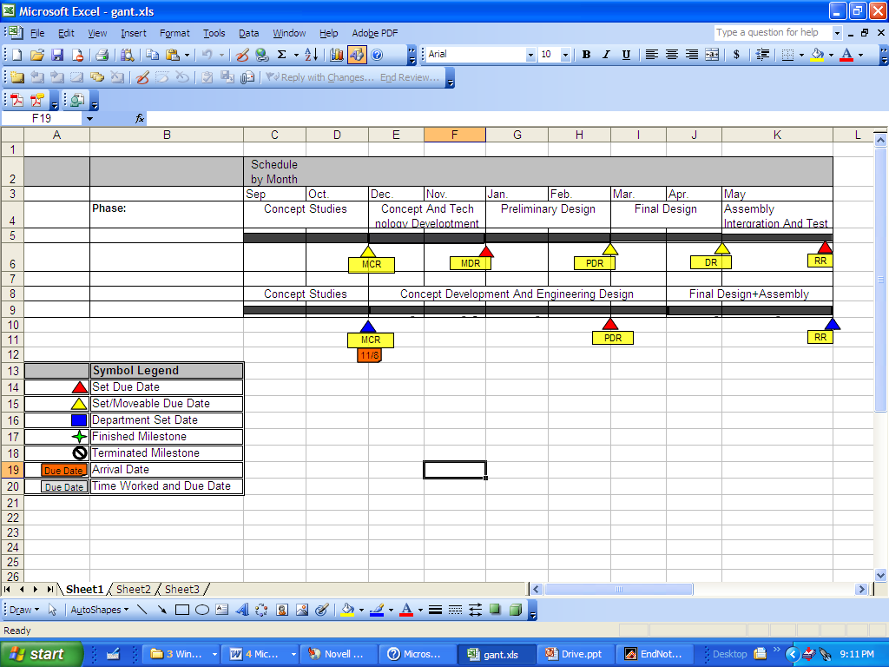
EXCEL Gantt Chart

Slide 20
Systems Engineering Management Plan (SEMP) – assigns SE function responsibility
1. Introduction, including Mission Overview, Project schedule with life cycle and reviews.
2. System Engineering Life Cycle, Gates, and Reviews
3. Communication
4. Systems Engineering Functions
4.1 Mission Objectives
4.2 Operations Concept Development
4.3 Mission Architecture and Design Development
4.4 Requirements Identification and Analysis
4.5 Validation and Verification
4.6 Interfaces and ICDs
4.7 Mission Environments
4.8 Resource Budgets and Error Allocation
4.9 Risk Management
4.10 System Engineering Reviews
5. Configuration Management
6. System Engineering Management

Slide 21
Notes:
NASA Presentation Sign-Off Page

