Slide 1

Chapter 5: The Lunar Environment
National Aeronautics and Space Administration
www.nasa.gov

Slide 2
Environmental Challenges
Environmental challenges for astronauts and equipment include:
  No free water (except for the possibility of water-ice at the lunar poles)
  No atmosphere and pressures of a hard vacuum (<10⁻⁶ torr)
  Severe temperature fluctuations from day to night
  Lethal radiation that degrades materials and limits human activities outside protected shelters
  Fine, invasive and abrasive lunar dust
  Micrometeoroid activity
  There is some seismic activity due to moonquakes (the largest ever recorded was an earth equivalent magnitude of 4)

Slide 3
In-situ Resources
Significant “In-situ resources” exist to build and sustain a lunar base
  Sunlight is a source for thermal power and conversion to electrical power
  Regolith (lunar dirt) can be processed to extract
    Oxygen for breathing, water production and fuel
    Hydrogen for fuel and water production
    Metals for construction
    Building material for roads, berms, habitats, garages, landing pads, etc.

Slide 4
References
General references with detailed information
  The Lunar Sourcebook (Heiken, Vaniman, & French, 1991) is the best source for a detailed presentation of the lunar environment.
  Lunar and Planetary Institute (LPI, 2008), which has Apollo Mission summaries, information on lunar samples and Apollo documents describing the Apollo mission equipment, including Lunar Roving Vehicles (LRVs) and landing modules. There are many photographs, maps, reports and information about lunar samples.
  The Moon (Schrunk, 2008) and The Lunar Base Handbook (Eckart, 1999)

Slide 5
Gravity and the Lunar Vacuum
Gravitation acceleration on the moon’s surface is 1.622 m/sec², or about 1/6 that of earth.
Atmospheric pressure of a hard vacuum (1x 10⁻¹² torr, remember 760 torr = 1 atm= 1.01E5 Pa).
  Without an atmosphere the sun’s radiation is more intense than on earth, and particularly harmful types or radiation reach the surface.
  Convective heat transfer is not possible
  Micrometeoroids reach the surface and with high speed

Slide 6
The Lunar Day and Lunar Night
Except near the poles the lunar day is 29.5 earth days long (night and daylight about 14 earth days each).
At the poles:
  Lunar daylight increases to ½ earth year for half the year, with ½ earth year of night
  The sun’s elevation varies between + 1°32 (barely above the horizon during 6 months of daylight) and - 1°32 (barely below during 6 months of night)
  The moon’s rotation is said to be “gravitational-locked” to the earth. The opposite side of the moon (aka the “darkside”) is not always dark and does see sunlight, but is never visible from the earth

Slide 7
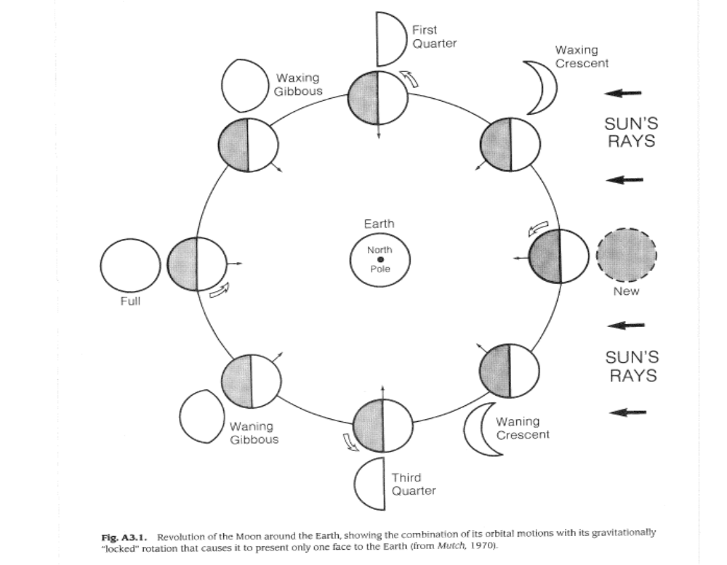
Moon Rotation about the Earth

Slide 8
Radiation Types
Electromagnetic wave radiation is classified and characterized by a wave and its frequency, and includes - in order of increasing frequency - radio, microwave, terahertz, infrared, visible light, ultra-violet (UV), x-ray and gamma rays.
Energized particulate radiation includes electrons, protons, neutrons, helium nuclei and heavy ions.
Most radiation comes from the sun and reaches the moon’s surface because of a lack of atmosphere.
Strong radiation (UV, X-rays, gamma rays, some energized particles) can ionize material in its path, degrading material properties; this is called ionizing radiation.
Special environmental effects chambers are available at NASA that can be used to expose materials to expected lunar dosages for testing.

Slide 9
Three Types of Lunar Ionizing Radiation
Solar Wind is a steady stream of nuclear particles continuously emitted by the sun.
  Mostly of low to mid-range energy protons (10 keV/nucleon), plus electrons
  Solar wind travels at 300-700 km/s.
  Not particularly damaging because of its low energy.
  Implanted valuable and easily recoverable volatile elements into the regolith.
Solar Cosmic Rays from Solar Particle Events (SPE)
  SPE are from solar flares, They consist of a burst of electrons and protons with high energies (>10MeV) that can arrive in as little as 20 minutes after a solar flare.
  Warning system would be installed. SPE radiation can be lethal to humans and damaging to electronic equipment
Galactic Cosmic Rays (GCR)
  High energy ions (GeV/nucleon).
  GCR come from outside the solar system. Their flux is low, and is constant.

Slide 10
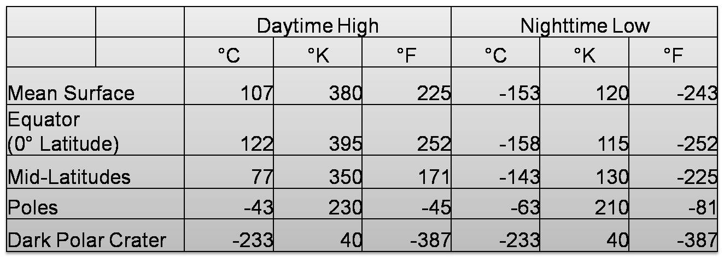
Lunar Surface Temperatures
Temperature on the surface of the regolith in table below
Temperature of an object above the surface depends on radiation.
Temperature will depend upon whether an object is shaded or not. To determine its temperature requires a thermal analysis calculation (see Chapter 7)

Slide 11
Radiation Effects and Mitigation
SPE events are the primary concern.
Most Effected: Astronauts (even in protective suits), solar cells (photovoltaic semiconductors), organic materials, polymers, integrated circuits and electronics.
Mitigation Methods:
  Shielding (the thickness needed depends on the radiation event and the shielding materials)
  Software routine can reroute electrical flowpaths around the damaged circuit elements.
  Coverslides have been used for solar cells to absorb and protect against radiation.
  Humans and equipment are effectively shielded by at least 2m of regolith
Design of shielding for equipment should involve a trade study and risk analysis, comparing all the alternative shielding methods, their cost and the risks involved.
The radiation dose is the amount of radiation deposited, measured in Rad. The damage threshold depends on the material. Indium arsenide solar cells are more resistant than gallium arsenide solar cells, which are more resistant that silicon solar cells.
Given the expected environmental dosage of radiation, there are software routines that can calculate dose versus depth of shielding for each type of radiation (Conley, 1998), (Tribble, 2003).
If radiation causes a memory device to flip a bit, it is called a single event upset (SEU). Electronics can be “radiation-hardened”

Slide 12
Temperature Concerns in Design
Be aware of component and material operating temperature range, and design to operate in that range.
Equipment designers should be concerned with an extreme temperature gradient that occurs when one part of a device is exposed to the sun and the other in shade.
Consider mating parts made with materials with low or similar coefficients of thermal expansion.
Thermal swings can damage electronics.
Outgassing of materials and lubricant is also increased with temperature, so design so lubricants do not evaporate and polymer seals are thermally protected.
Low temperatures can cause certain materials to become brittle and loose ductility.

Slide 13
Micrometeoroids
Micrometeoroids are less than 1mm diameter, less than .01 g, 13-18 km/sec
Could hit larger facilities and equipment. The damage may not be just small pitting. Penetration thickness and crater depth of an impact can estimated using empirical formula for certain materials presented in (Elfer, 1996)
Can also be tested with hypervelocity impact guns at test facilities.
A few millimeters of a tough composite material is estimated to provide sufficient protection from micrometeoroid impact in the 1 milligram range (Heiken et al., 1991).

Slide 14
Regolith -What Astronauts Said
Neil Armstrong, as he stepped onto the moon, stated
“the surface is fine and powdery. I can pick it up loosely with my toes. It does adhere in fine layers like powdered charcoal to the sole and sides of my boots. I only go in a small fraction of an inch. Maybe an eighth of an inch, but I can see the footprints on my boots and the treads in the sandy particles”
Astronaut Alan Bean stated
“After lunar liftoff . . . a great quantity of dust floated free within the cabin. This dust made breathing without the helmet difficult, and enough particles were present in the cabin atmosphere to affect our vision. The use of a whisk broom prior to ingress would probably not be satisfactory in solving the dust problem, because the dust tends to rub deeper into the garment rather than to brush off”

Slide 15
Lunar Regolith, Soil and Dust
Lunar regolith refers to all the fragmented rock material that covers the moon.
Lunar soil is technically regolith excluding rocks larger than 1 cm in size.
Lunar dust is technically defined as having particle sizes less the 20 μm with a bulk density of 1.5 g/cm3.

Slide 16
Regolith Characteristics
Thickness: It is estimated to be 4-5 meters thick in mare regions (lunar planes) and 10-15 m in older highland regions (plains of higher elevation than the mare).
The first few centimeters to tens of centimeters is well-mixed or “gardened” zone, from the churning of repeated micrometeoroid strikes.
Made up of a significant amount of very sharp and angular particles. Lunar soils are far more abrasive than earth soils. Four types of particles:
  mineral fragments (minerals possess a characteristic chemical composition, a highly ordered atomic structure and specific physical properties),
  glasses (without distinct grains and without a highly ordered atomic structure, that are often sharp and are the major cause the abrasiveness),
  lithic fragments (pieces of broken lunar rock which also contains minerals) and
  agglutinates (which are small (<1 mm) lunar regolith particles bonded together with glass).

Slide 17
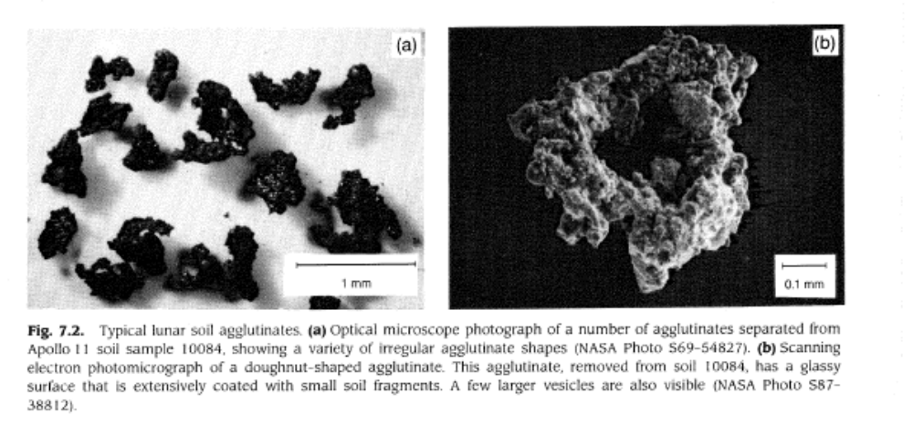
Agglutinates

Slide 18
Regolith Properties
Electrostatically Charged - sticks to anything that is not grounded (space-suits, tools, equipment, polished reflectors, solar cells and telescope lenses) Easily disturbed by landing and launch vehicles. Erodes bearings, gears, and other mechanical mechanisms not properly sealed, reduces radiator efficiency, damages sensitive equipment.
Free Radicals?? There is some discussion that the regolith may contain free radicals, which are atoms or molecules with unpaired electrons which make them highly reactive.
Conductivity - Low electrical and thermal conductivity, and low dielectric loss. The low thermal conductivity makes lunar soil an excellent thermal insulator.

Slide 19
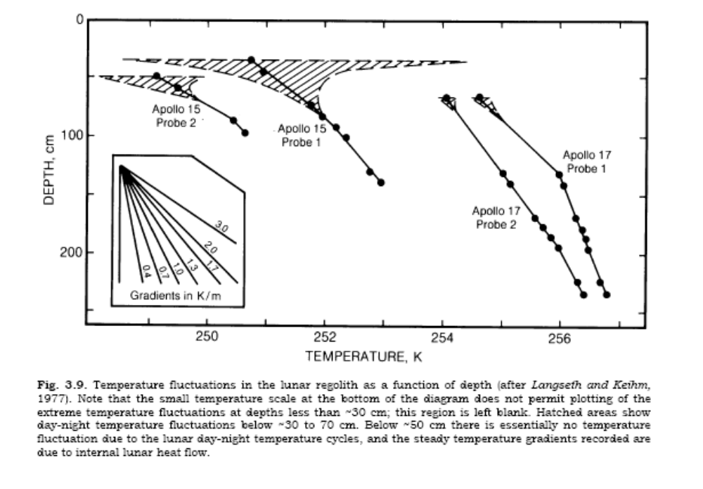
Temperature Range versus Depth

Slide 20
Chemistry
Chemical Composition: 45% oxygen, 21% silicon, 13% aluminum, 10% calcium, 5.5% magnesium, 6% iron with less than 1% titanium, sodium and sulfur.
Other volatile elements called solar-wind-implanted element - hydrogen,, helium, with some carbon and nitrogen. The concentrations are believed to be quite low (less than 100 micrograms/gram)
. It is estimated that excavating 10cm deep, .7 km² area would produce 1 ton of H (based on 50 μg/g regolith) (Eckart, 1999).
Solar-wind-implanted elements are volatiles that can be removed by moderate heating (up to 700 degrees C).
The dark craters at the poles do have significantly higher concentration of hydrogen, possibly as water-ice.

Slide 21
Geotechnical and Engineering Properties
The bulk density (weight of soil per unit volume) at the surface is approximately 1.3 g/cm³ (water is 1 g/cm³), increases rapidly to 1.52 g/cm³ at a depth of 10 cm, then more gradually to 1.83 g/cm³ at a depth of 100 cm.
Relative density ρ_{R} is a measure soil particle packing. Void ratio e is the volume of void space between particles divided by the total volume.
Relative density is a percentage scaling of the range from minimum to maximum void ratio.
Relative density of a given soil can be increased by low-amplitude vertical shaking, causing the soil particles to settle due to gravity to a more tightly packed arrangement.
The relative density affects properties such as thermal conductivity, seismic velocity, shear strength, compressibility and dielectric constant.

Slide 22

Soil Strength
Strength of lunar soils is explained by Mohr-Coulomb equation:
τ is the shear strength (kPa), c is cohesion, φ is the friction angle and σ is the normal stress. Parameter values for c and φ have been determined by standard soil mechanics tests.
This information can be used to predict digging forces

Slide 23
Engineering Properties Dependent on Soil Strength
Bearing Capacity - the ability of a soil to support a load, such as a structure or an astronaut, and depends on the load and the area of the footing. Very high for lunar soils.
Slope Stability - an excavated slope can be vertical to a depth of 3 m, and in fact boreholes in the lunar surface remained with stable walls after the bit was removed. However, when constructing a berm or embankment, either by dumping, or dumping then compacting, the soil will not be as strong, so the maximum slope will be less than an excavated slope.
Trafficability - the capacity of a soil to provide sufficient traction. The Apollo 15 LRV encountered soft soil and spun its wheels, so soft soil could be a problem in a heavily loaded vehicle or hauling a heavy load. Bekker equations (Bekker, 1969) have been used to determine the sinkage, rolling resistance and forward thrust.

Slide 24
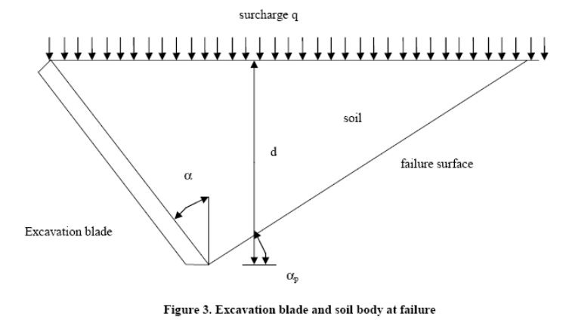
Models of Excavation Force
Blouin 2001, Willman and Boles 1995, Zheng 2007 presented force expressions to predict failure of lunar simulant with a flat blade.
See the Appendix (Draft) for an example calculation.

Slide 25
Regolith Simulants
Only about 300 kilograms of lunar soil was brought to the earth, so it is not available for testing.
Simulants are needed to test excavators, rovers, airlocks, earthmoving equipment, structures, dust removal techniques, space suits, etc.; these simulants should approach or match regolith properties, such as the abrasive nature and particle size distribution of regolith.
The first simulant for general use was JSC-1. New simulants are JSC-1AF (with particles </= 50μm diameter), JSC-1AVF (with particles </= 20 μm diameter) and JSC-1AC (with particles 1mm to 5 mm diameter)
The simulant can be purchased from ORBITEC while the supply lasts.

Slide 26
Notes:
NASA Presentation Sign-Off Page

