Slide 1

Chapter 6 – Component Design and Selection
National Aeronautics and Space Administration
www.nasa.gov

Slide 2
Chapter Objective
Here the focus is on components that would be a concern of a mechanical designer.
This includes mechanical components (bearings, fasteners, lubricants), motors, materials and an overview of power systems.
This topic is too broad to consider in great detail here, so references are often cited instead.
Often the selection of a component is not clear, and many choices are possible. In these situations a trade study may be appropriate.

Slide 3
Legacy
Component design and selection for use on the moon is driven by the application and the environment
Legacy “refers to the original manufacturer’s level of quality and reliability that is built into the parts which have been proven by (1) time and service, (2) number of units in service, (3) mean time between failure performance, and (4) number of use cycles.”
If a candidate component has a successful legacy, then a designer should strongly consider using it.

Slide 4
Design Issues for Lunar Machinery
Abrasion and wear on parts that contact regolith
Vacuum welding of metals, which may require special coating and treatments.
Electrostatic properties of regolith will cause it to adhere to and penetrate bearings, structural connections, viewing surfaces, solar panels, radiators and antennas.
Strategies will be needed to create effective vacuum seals (e.g. for door locks) and effective bearings (including lubricants, filters, and seals for bearings).

Slide 5
Student Project Strategy
If the objective is a Phase B prototype, it is not necessary to purchase special components or to manufacture using materials that would be expected to be in a lunar mission-ready lunar excavator.
Nevertheless the team should be able to justify that their prototype, if tested successfully, could be a basis for further development beyond Phase B (remember that Phase C ends with component fabrication for the space mission). This requires an awareness of components’ design and selection choices for a lunar mission.

Slide 6
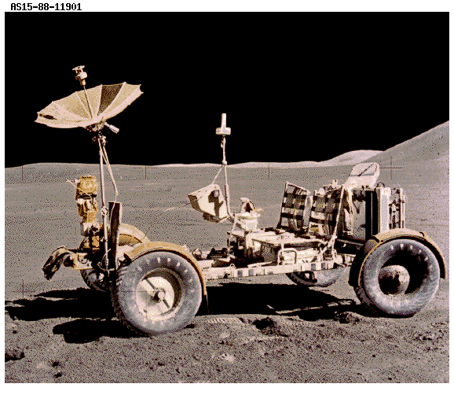
The Successful Legacy of the Lunar Rover

Slide 7
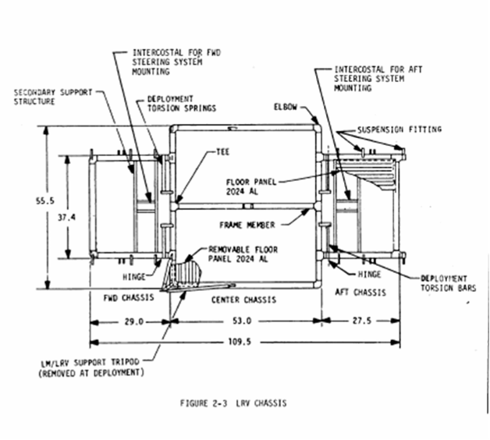
Foldable frame constructed from Aluminum 2219 welded tube

Slide 8
Traction Drive
Four ¼ horsepower electric motors located at each wheel
Speeds up to 17 km/h.
The motors were speed reduced 80:1 with a harmonic drive gearing (http://www.gearproductnews.com/issues/0406/gpn.pdf), which are known for large gear ratios, light weight, compact size and no gear backlash when compared to a planetary gear system.
The motors and harmonic drive were hermetically sealed and pressurized to 7.5 psia to protect from lunar dust and for improved brush lubrication.
Braking was both electodynamic by the motors and from brake shoes forced against a drum through a linkage and cable.

Slide 9
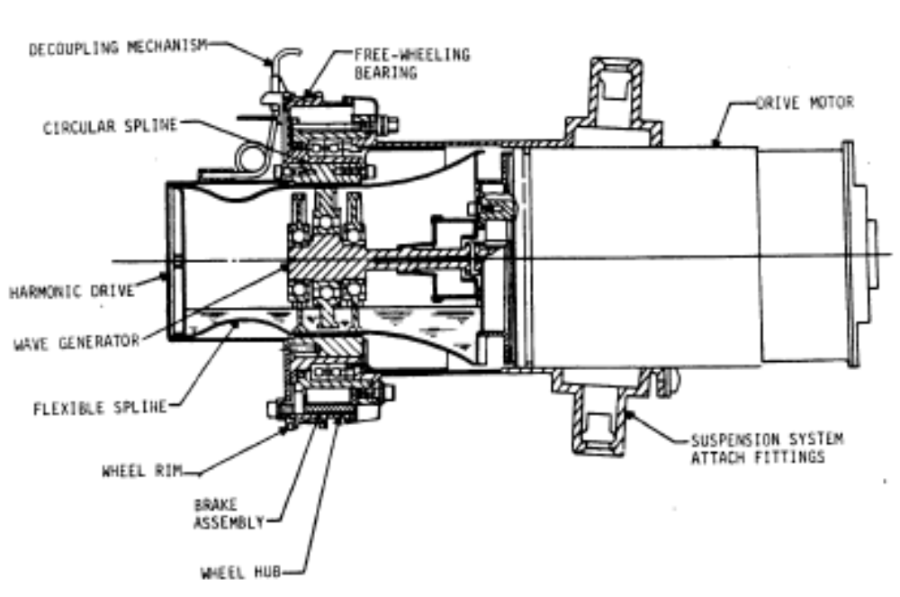
Traction Drive

Slide 10
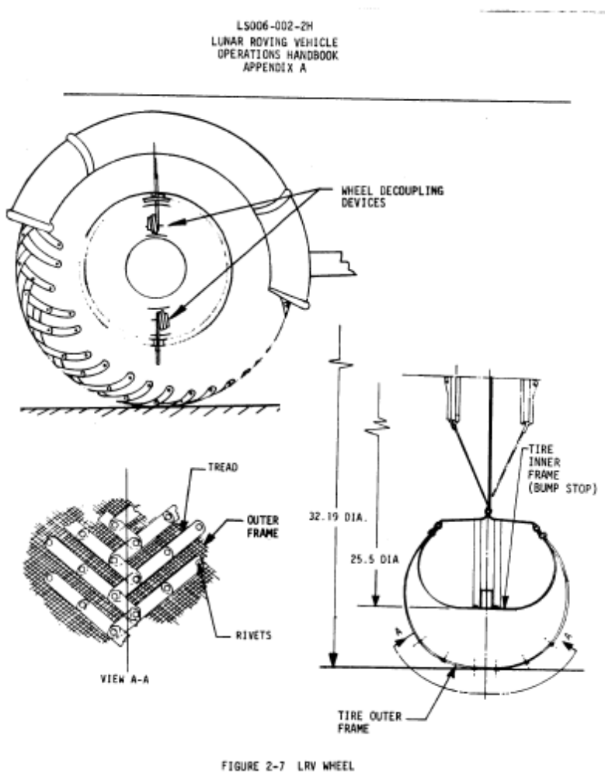
Wheels

Slide 11
Other Rover Details
The suspension was a double wishbone, each wishbone attached to a torsion bar and a damper between the chassis and upper wishbone.
The wheels consisted of an aluminum hub, tire made of zinc coated woven piano wires and titanium chevron treads, attached to the rim and discs of formed aluminum. Dust guards were mounted about each wheel
Front and rear wheel steer was accomplished by an Ackermann-geometry steering linkage system, driven by an electric motor servo-system that amplifies the left and right joystick motion from the astronaut.
In order to protect the LRV against the thermal environment of the moon several different thermal control systems were incorporated into the LRV design. These systems consisted of MLI blankets (Multi-layer insulation) covered by Beta Cloth, space radiators, mass heat sinks, special surface coatings and finishes, and thermal straps.
One of the main problems that the LRV encountered was an issue concerning the lunar dust. Degradation of thermal and electronic components was a problem as well as the wear and tear of components and other surfaces from the abrasive lunar dust.

Slide 12
Standards and References
AIAA S-114-2005, “Moving Mechanical Assemblies for Space and Launch Vehicles”
The Proceedings of the Aerospace Mechanism Symposium are published annually and papers are concerned with actuators, lubricants, latches, connectors, and other mechanisms.
NASA/TP-1999-2069888 NASA Space Mechanisms Handbook. The Handbook (including CD/DVD) is available only to US citizens who need the material. It is restricted under ITAR (International Traffic in Arms Regulations).
MIL-HDBK-5 Metallic Materials and Elements for Aerospace Structures, contains standardized mechanical property design values and other related design information for metallic materials, fasteners and joints.
Other Standards:
DOD-HDBK-343 Design, Construction, and Testing Reqmts for One of a Kind Space Equipment
MIL-STD-100 Engineering Drawing Practices
MIL-STD-1539 Direct Current Electrical Power Space Vehicle Design Requirements
DOD-E-8983 General Specification for Extended Space Environment Aerospace Electronic Equipment
MIL-S-83576 General Specification for Design and Testing of Space Vehicle Solar Cell Arrays
DOD-STD-1578 Nickel-Cadmium Battery Usage Practice for Space Vehicles

Slide 13
Flight Qualified
Any hardware or materials used for lunar missions will need to be of a special variety know as "Flight Qualified".
Flight qualified materials and parts are always flight proven hardware with program heritage.
The process to get any new material or part flight qualified is an arduous and long task.

Slide 14
Fasteners
Space Fasteners design choices, with attention given to aerospace applications, materials and temperature ranges, are presented in the Fastener Design Manual (Barrett, 1990), http://gltrs.grc.nasa.gov/reports/1990/RP-1228.pdf.
MIL-HDBK-5 also contains allowable strengths for many fasteners. Fasteners for MS (military standard) and NAS (national aerospace standard) can be found at http://www.standardaeroparts.com/.

Slide 15
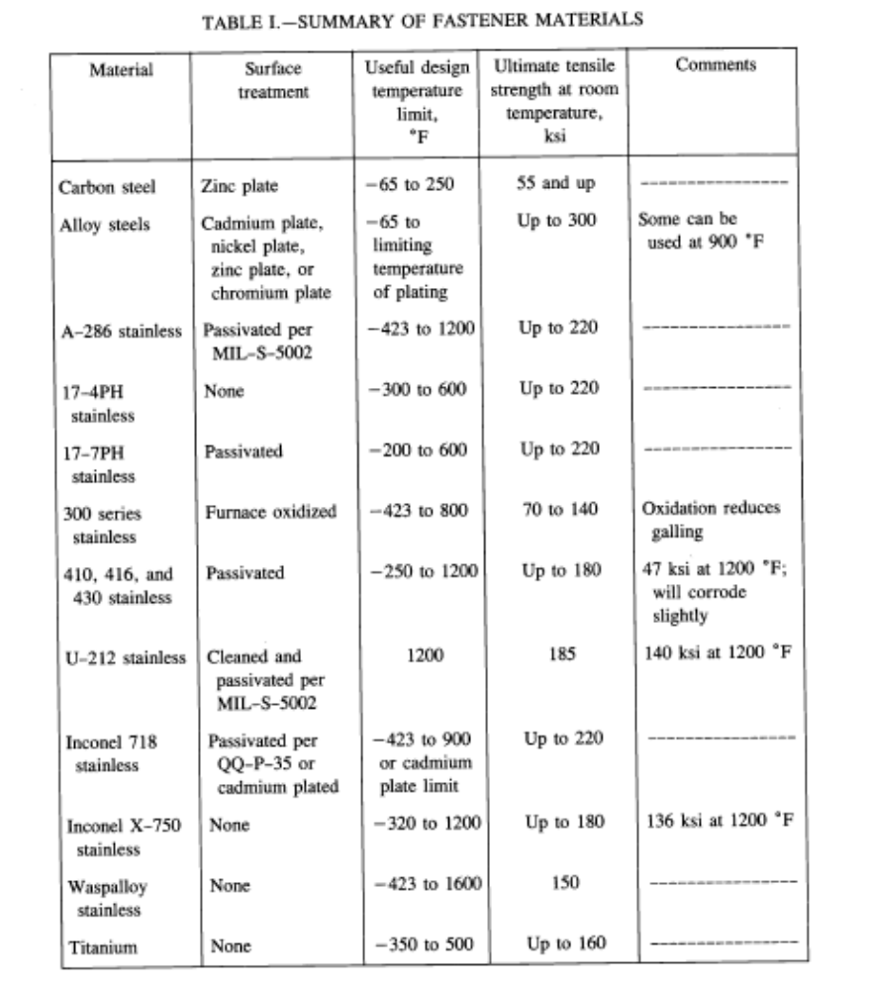

Slide 16
Bearings
Rolling-element bearings for lunar applications must capably withstand the challenges of the lunar environment (temperature extremes, penetrating regolith and the vacuum environment) and be highly reliable to minimize repairs.
For space flights the AISI 440C (a high hardness, corrosion resistant steel) and AISI 52100 (not as hard or corrosion-resistant, but better wear resistance) are the most common bearing materials.
Shields and seals cover the rolling element so they are not exposed and protected to a certain degree from outside contaminates like regolith. Shields and seals are attached on a bearing’s outer race, and move with the outer race. A shield will not touch the inner race because of a small clearance gap. Seals do rub against the inner race but will be less likely to allow regolith particles inside.
Thermal control is a concern in a lunar environment where convection is not an available heat transfer mechanism. Thermal conductivity through a bearing is increased by the presence of a lubricant.

Slide 17
Lubricants
The three types of lubricants are liquids (lubricating oils, lubricant greases) and solid films.
Lubricant inadequacies have been implicated as a cause of a number of space mechanism failures.
An ideal lubricant would retain the desired viscosity over a wide temperature range and be nonvolatile.
The ability of a lubricant to resist becoming a gas is related to its molecular weight. Low molecular weight lubricants are more volatile in vacuum and heat than higher molecular weight lubricants.
Solid films, such as soft metal films, polymers and low-shear strength materials, find use in bearings, bushings, contacts and gears. See (Conley, 1998) and (Fusaro, 1994) for details.

Slide 18
Motors
The types that have been used in satellites include DC brush, DC brushless and stepper motors.
A trade study should be performed to select the best motor for the application and environmental conditions

Slide 19
Power System Components – Solar Arrays
The most widely used and cost efficient form of energy conversion is the photovoltaic solar array.
Types –
  Single-Crystal Silicon Cells
  Gallium Arsenide Cells
  Semi-Crystalline & Poly-Crystalline Cells
  Thin Film Cells
  Amorphous Cells – Not enough data to be selected as a serious candidate for space applications (new technology).
  Multi-Junction Cells – High efficiency and good manufacturability.
Solar arrays can provide power requirements from tens of watts to several kilowatts with a life span of a few months to fifteen years.
The life of a solar array degrades due to the space environmental effects on the photovoltaic cells.

Slide 20
Power System Components - Batteries
Rechargeable Energy Storage Systems
  Silver Zinc Batteries
  Nickel Cadmium (NiCd)
  Nickel Hydrogen (NiH2) – Currently used in place of Nickel Cadmium for space applications
  Nickel Metal Hydride (NiMH)
  Lithium-Ion (Li-Ion)
Perform a trade study to choose the best for the application and conditions

Slide 21
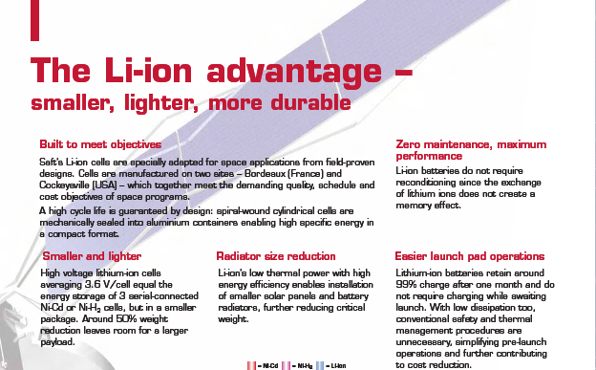

Slide 22
Notes:
NASA Presentation Sign-Off Page

