Slide 1
Modelling bumblebee foraging distance
J Melanson
Bayes Meeting – September 16, 2025

Slide 2

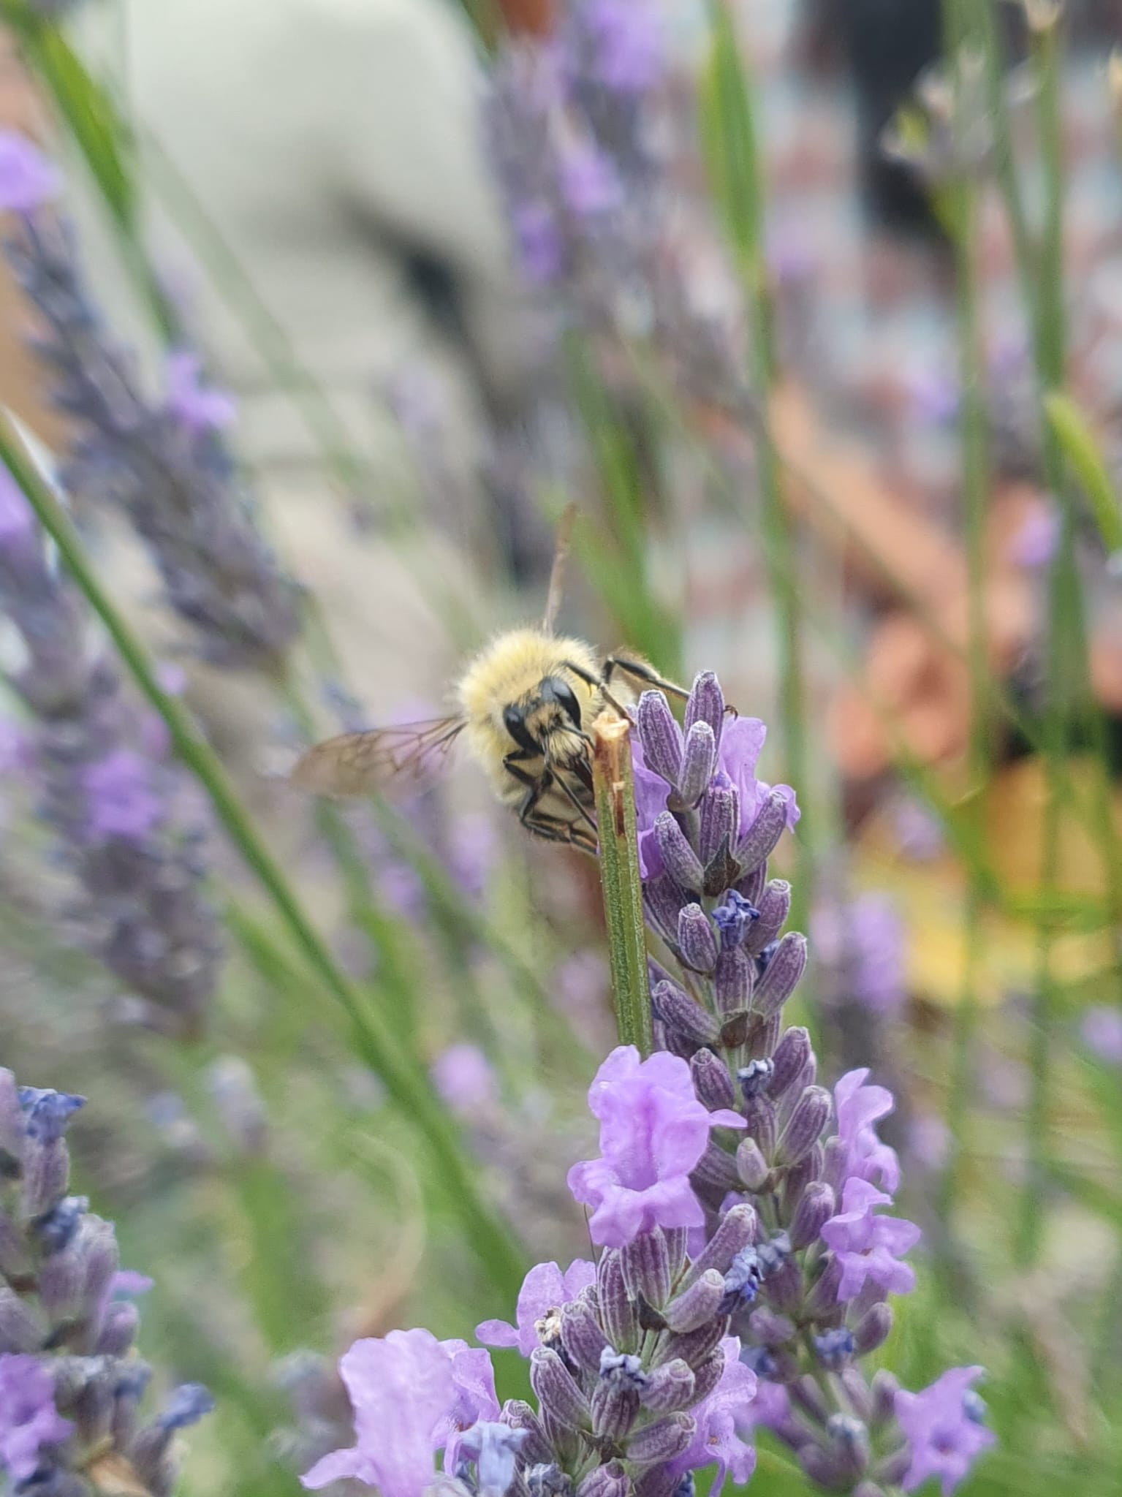
Important bumblebee biology
Central place foragers – workers originate from a colony and traverse the landscape in search of pollen and nectar, with they return to the colony
Range of foraging can help us learn the relevant scale for conservation interventions, pollen dispersal, etc. Can also play a role in species coexistence, invasion, etc.
But bees are very tiny and very hard to track in real time!
V. Van der Meersch

Slide 3
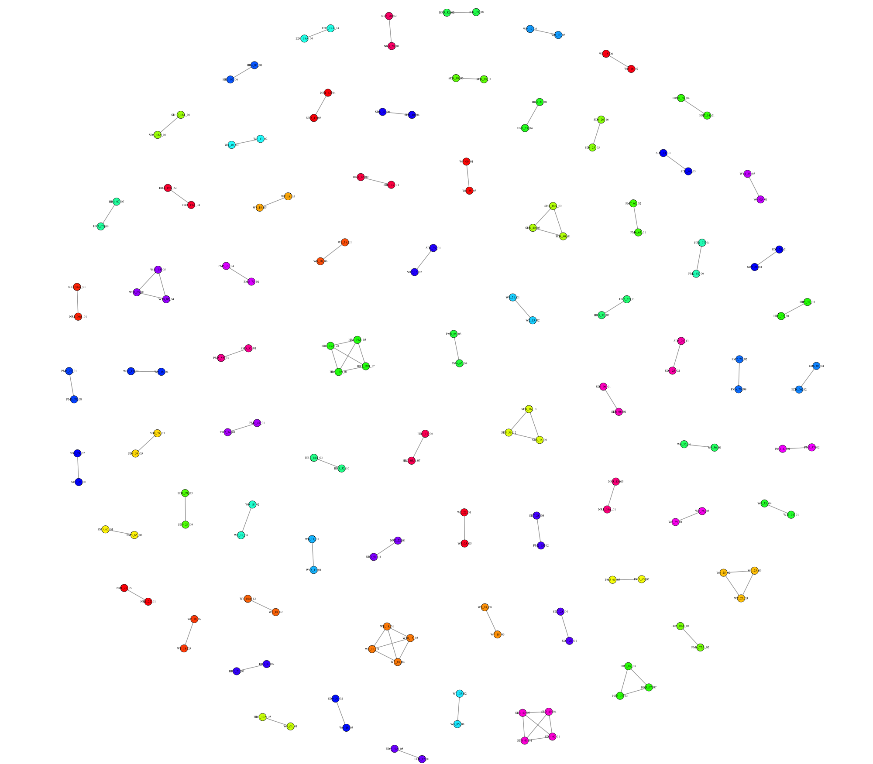
Important bumblebee biology
Workers from a given colony are (presumed to be) sisters – bumblebees are haplodiploid, meaning that full sisters share ~75% of their genetic material

Slide 4
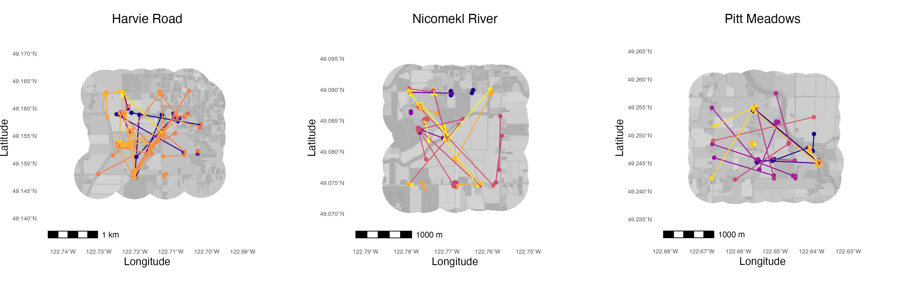
Important bumblebee biology

Slide 5
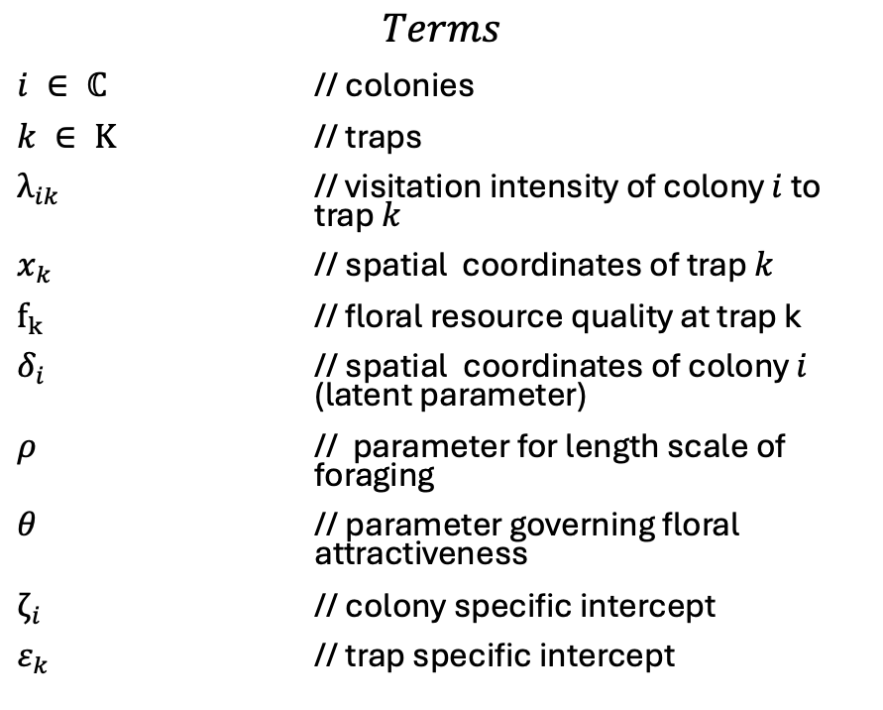
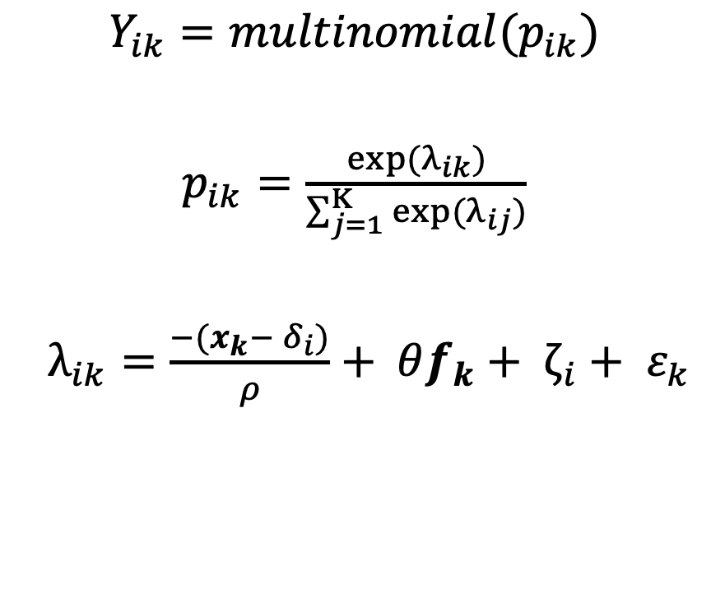
A basic model for foraging distance
$$Y_{ik}=multinomial(p_{ik})$$
$p_{ik}=\frac{exp⁡(λ_{ik})}{\sum_{j=1}^{Κ}{exp⁡(λ_{ij})}}$
$λ_{ik}=\frac{−(x_{k}− δ_{i})}{ρ}+ θf_{k}+ ζ_{i}+ ε_{k}$
$$Terms$$
$i ∈ ℂ$ // colonies
$k ∈ Κ$ // traps
$λ_{ik}$ // visitation intensity of colony $i$ to trap $k$
$x_{k}$ // spatial coordinates of trap $k$
$f_{k}$ // floral resource quality at trap k
$δ_{i}$ // spatial coordinates of colony $i$ (latent parameter)
$ρ$ // parameter for length scale of foraging
$θ$ // parameter governing floral attractiveness
$ζ_{i}$ // colony specific intercept
$ε_{k}$ // trap specific intercept

Slide 6
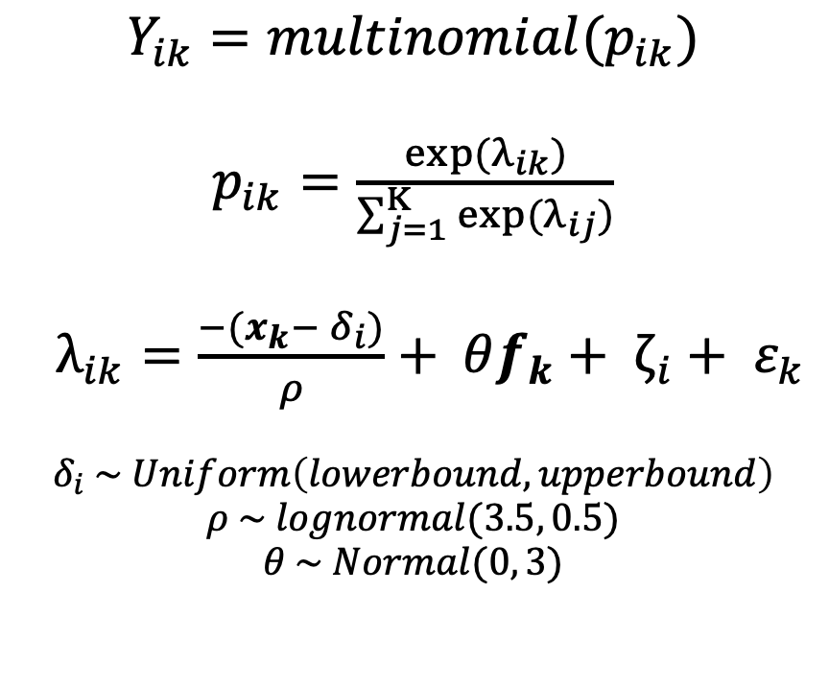
A basic model for foraging distance
$$Y_{ik}=multinomial(p_{ik})$$
$p_{ik}=\frac{exp⁡(λ_{ik})}{\sum_{j=1}^{Κ}{exp⁡(λ_{ij})}}$
$λ_{ik}=\frac{−(x_{k}− δ_{i})}{ρ}+ θf_{k}+ ζ_{i}+ ε_{k}$
$$δ_{i} \sim Uniform\left(lowerbound, upperbound\right)$$
$$ρ \sim lognormal(3.5, 0.5)$$
$$θ \sim Normal(0, 3)$$
$$Terms$$
$i ∈ ℂ$ // colonies
$k ∈ Κ$ // traps
$λ_{ik}$ // visitation intensity of colony $i$ to trap $k$
$x_{k}$ // spatial coordinates of trap $k$
$f_{k}$ // floral resource quality at trap k
$δ_{i}$ // spatial coordinates of colony $i$ (latent parameter)
$ρ$ // parameter for length scale of foraging
$θ$ // parameter governing floral attractiveness
$ζ_{i}$ // colony specific intercept
$ε_{k}$ // trap specific intercept

Slide 7
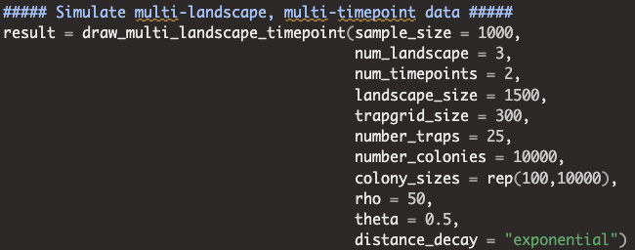
Simulating some data
hiding my ugly code inside of this function so that you can’t see it…

Slide 8
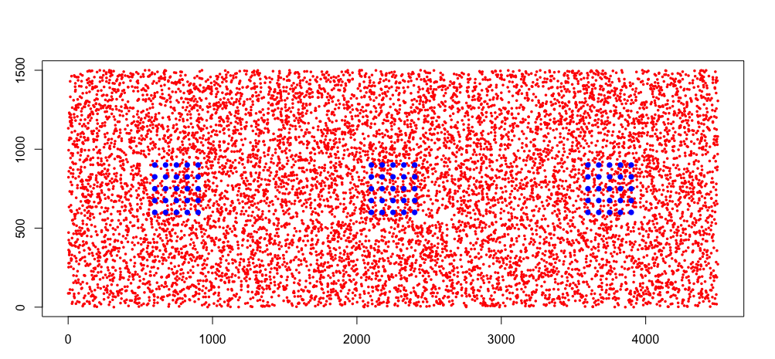
Simulating some data
hiding my ugly code inside of this function so that you can’t see it…

Slide 9
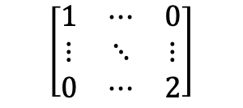
Simulating some data
hiding my ugly code inside of this function so that you can’t see it…
traps (k)
$$\left[\begin{matrix}1 & ⋯ & 0 \\ ⋮ & ⋱ & ⋮ \\ 0 & ⋯ & 2\end{matrix}\right]$$
colonies (C)

Slide 10
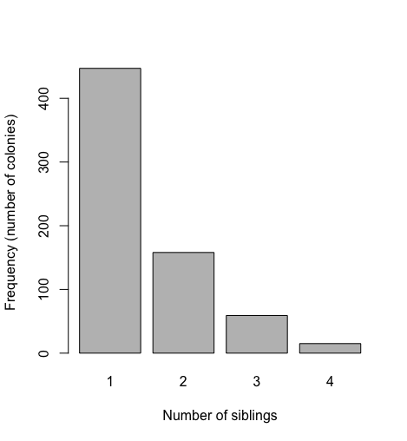
Simulating some data
hiding my ugly code inside of this function so that you can’t see it…
traps (k)
$$\left[\begin{matrix}1 & ⋯ & 0 \\ ⋮ & ⋱ & ⋮ \\ 0 & ⋯ & 2\end{matrix}\right]$$
colonies (C)

Slide 11
[[go to Stan code]]

Slide 12
But wait…there’s more…
My dataset consists of:
6 trapping grids
with some missing data, i.e., did not survey every “trap” during every visit
2 years
10 sampling rounds year 1 (May-August)
17 sampling rounds year 2 (March-August)
2 species
Thinking of fitting the models separately for each, so this doesn’t matter…

Slide 13
How to reformat the data for Stan?
4 dimensional array?
colonies x traps x timepoints x landscapes
Reformat data to vectors
each element represents a sampling event?
trap x timepoint
but then each sampling event must be associated with a vector of colonies which are observed at that landscape, not just the ones observed at that timepoint
Multinomial probability becomes tricky
More computationally efficient, avoid so many NA’s?

Slide 14
