Slide 1
Grapevine Phenology Modeling
Ken Michiko Samson
8 December 2025

Slide 2
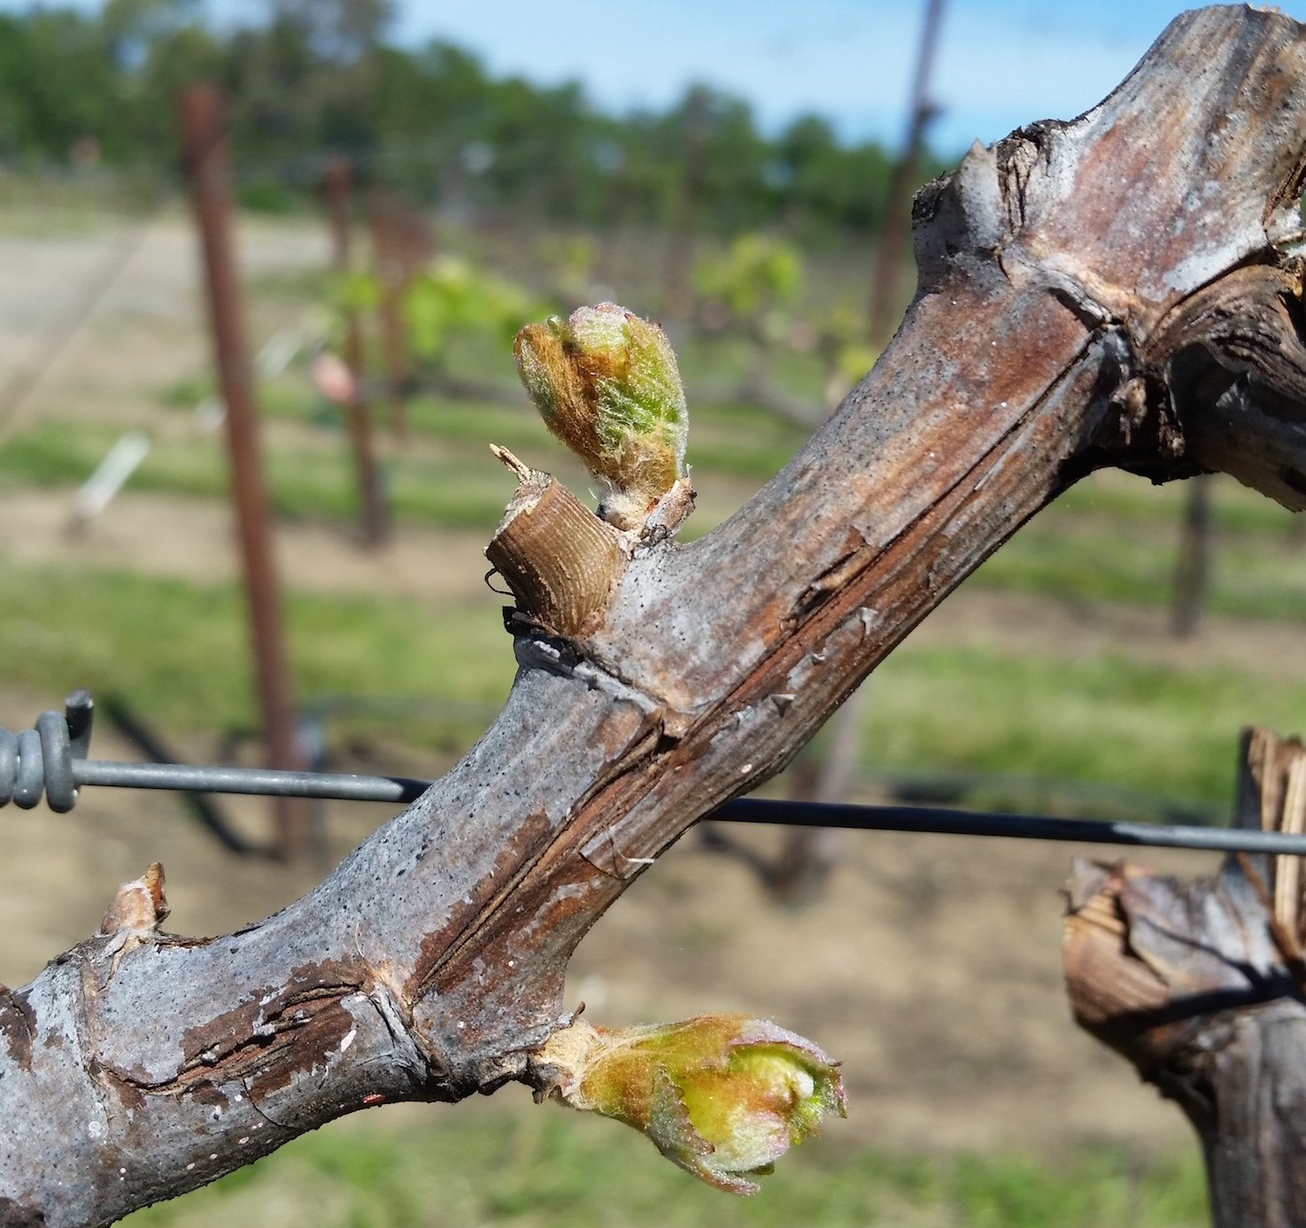


Common grapevine growing stages
Dormancy
Budburst
Flowering (50%)
Maturity (determined usually by sugar content, very variable by variety and preference)
Veraison (50%)
Notes:
Common grapevine phenological stages include budburst, flowering, veraison, and maturity/harvest. Maturity is very variable though as it depends a lot on the wine end product, variety, and preference. The other stages may also refer broadly over a growing period spanning multiple BBCH stages.

Slide 3
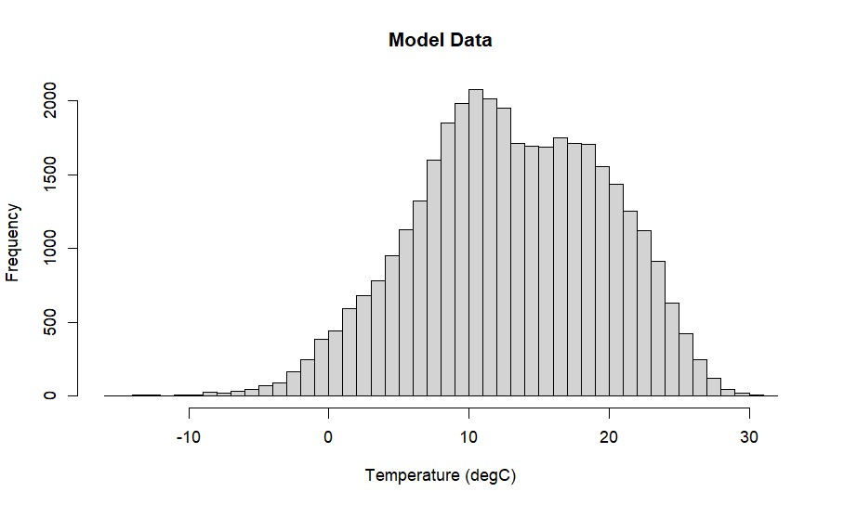
Growth from flowering to veraison usually experience the highest temperatures (usually from May to September) (France data below)
Global warming may affect this stage most by driving temperatures above an assumed maximum temperature for growth
Flowering (50%)
Veraison (50%)

Slide 4
Grapevine Flowering Veraison (GFV model)
Based on daily thermal sums or ‘forcing’ (e.g. Growing Degree Days) with given base temperature (Tb) and mean temperatures (T)
GDD = max(T – Tb, 0)
Start date is set at DOY (Day of Year) 60 instead of DOY of flowering
Variety-specific accumulated forcing thresholds are optimized with the Tb and start date
Flowering (50%)
Veraison (50%)
Notes:
Parker et al., 2011; Parker et al., 2013

Slide 5
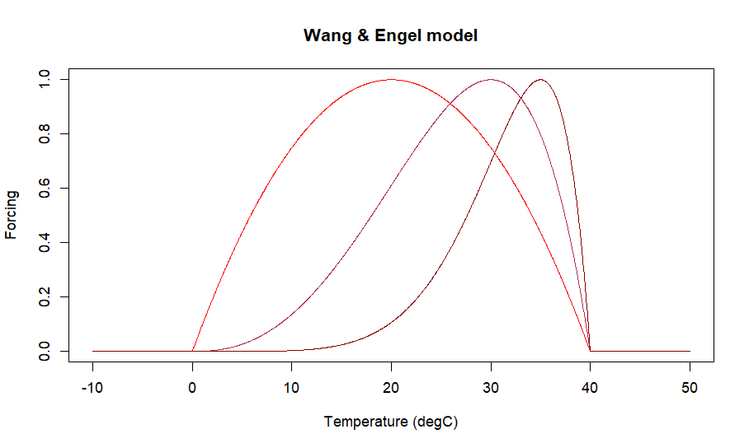
Wang & Engel (WE)-based model
Based on forcing as calculated by the WE model with three parameters
  Tmin – temperature below which forcing is 0
  Tmax – temperature above which forcing is 0
  Topt – temperature where forcing is 1
Flowering (50%)
Veraison (50%)
Notes:
Moralles-Castilla et al., 2020, Wang & Engel, 1998
Tmin = 0, Tmax = 40, Topt = 20, 30, 35

Slide 6
Wang & Engel (WE)-based model
More physiologically-realistic; growth decreases with higher temperature e.g. no growth at 800 degC
Accumulated forcing from flowering to veraison
Thresholds are still variety-specific
Flowering (50%)
Veraison (50%)
Notes:
Moralles-Castilla et al., 2020, Wang & Engel, 1998
Tmin = 0, Tmax = 40, Topt = 20, 30, 35

Slide 7
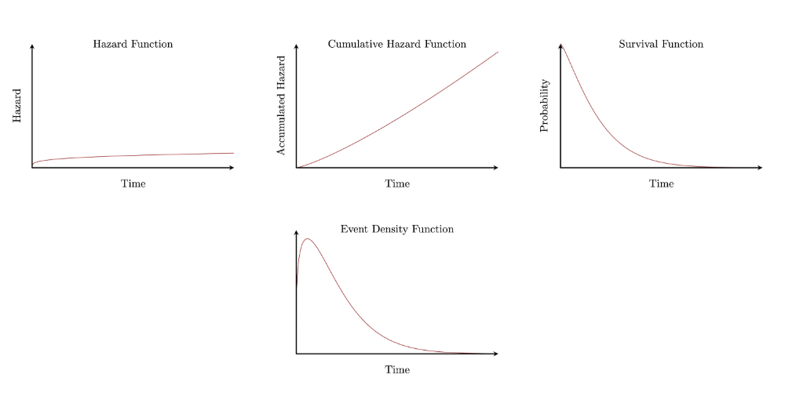
Modeling changes in phenological stages
Presented GFV and WE-based models are developed by optimizing parameters using Efficiency (EF) and Root Mean Square Error (RMSE)
Survival models provide a probabilistic approach to changes in stages
  Events (e.g. phenological stage transition) occur only once
  Driven by accumulation of something (e.g. growth, damage) over time
  ‘Survival’ comes from application to undesirable events (e.g. death)
Notes:
Betancourt, 2022
S(t = 0) = 1, S(t -> inf) = 0

Slide 8
Survival function (S(t))
The function giving the probability of survival should never increase
Notes:
Betancourt, 2022
S(t = 0) = 1, S(t -> inf) = 0

Slide 9
Hazard function (lambda(t))
‘Hazard’ is something that accumulates over time, driving the occurrence of an event
Notes:
Betancourt, 2022

Slide 10


Survival model
Combining the survival and hazard functions, we get the relationship between the survival function and the cumulated hazard function.
(I’m not sure if this is a unique relationship given this formulation but it’s certainly convenient for our purposes)
Event density is given as below
For phenology, we use lambda = forcing (psi) and Lambda = accumulated forcing (Psi)
Notes:
Betancourt, 2022

Slide 11
Event density function (pi(t))
Looking into pi(t) shows why we don’t just use a defined distribution for the accumulated forcing (Psi(t))
  Some probability at negative Psi which should not be possible by definition
  Events are possible on days when there is no growth
With the survival model, these issues are resolved
  Though we added a small base daily forcing as the log density goes to negative infinity if the sampler stumbles on Tmin and Tmax values where some veraison dates have no growth
Notes:
Betancourt, 2022

Slide 12
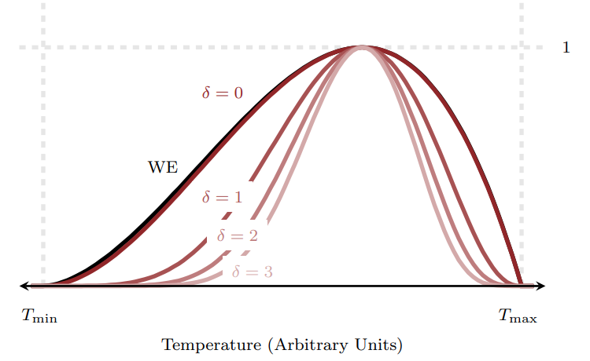
Smoothed Wang & Engel (SWE) function
Betancourt derived a modified Wang & Engel with smoothed edges controlled by a parameter (delta)
At delta = 0, SWE is very similar to WE
Higher delta, more differentiable at Tmin and Tmax
At fixed parameters, increasing delta decreases forcing over forcing-temperature range
At fixed delta, increasing the range (Tmax – Tmin) increases forcing
Notes:
Betancourt, 2022

Slide 13
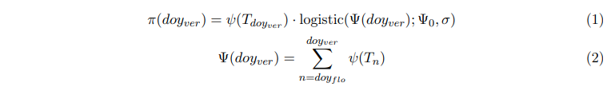
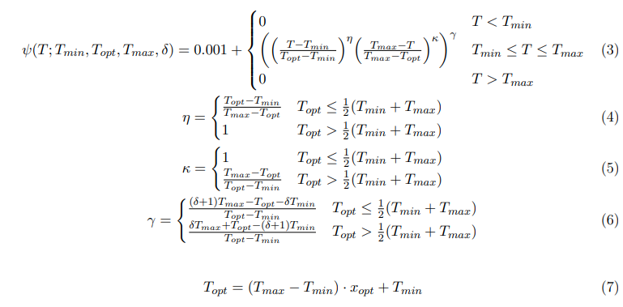
Model specification
Survival model
SWE (forcing/hazard function)

Slide 14
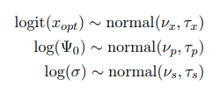
Pooling approaches
Complete pooling
  6 parameters (Tmin, Tmax, delta, Topt, Psi0, sigma)
No pooling
  3 species-level parameters (Tmin, Tmax, delta)
  3 parameters each by variety (Topt, Psi0, sigma)
Partial pooling
  3 species-level parameters (Tmin, Tmax, delta)
  3 parameters each by variety (Topt, Psi0, sigma)
  6 species-level parameters on (Topt, Psi0, sigma)

Slide 15
Prior sets
5 different priors on Tmin and Tmax (with Topt adjusting to always have 98% probability within 22-32)
2 different priors on Psi0 (wide and small)

Slide 16
Checking model behaviour on simulated data
Fixed parameter values according to partial pooling approach
Simulated data
  Daily temperatures from uniform distribution from 0 to 40 degC
  Flowering from variety-specific distributions (shouldn’t matter though)
  Veraison from SWE-based threshold
Simulated veraison
  Actual temperature and flowering data
  Veraison simulated from SWE-based threshold

Slide 17
Simulated Data Results

Slide 18
Simulated Data Results
Tmin and Tmax quite well-estimated, Tmin less so
delta prior pulls posterior to lower values -> increased Psi0
Topt within or slightly higher, may be due to prior
sigma expected to be slightly higher to like Psi0 but surprisingly no

Slide 19
Simulated Veraison Results

Slide 20
Simulated Veraison Results
Tmin and Tmax are strongly informed by priors
Data informs variety-specific parameters better (more clustered samples) at expense of species-level parameters
delta prior still pulls to lower values -> increased Psi0
Potential non-identifiability with only temperature on one side of Topt
Multimodality issues as seen for fit with complete pooling approach and prior set 7

Slide 21
Model fits on actual data

Slide 22
Actual Data Results
Tmin and Tmax are still strongly informed by priors
delta prior pulls posterior to higher values -> lower forcing
Increased (Tmax – Tmin) -> higher forcing
Topt estimates are within 1 degC (2 degC across NP and PP), pooled by hierarchy
Need some temperature data closer to extremes, not necessarily constant as shown by simulated data results

