Slide 1
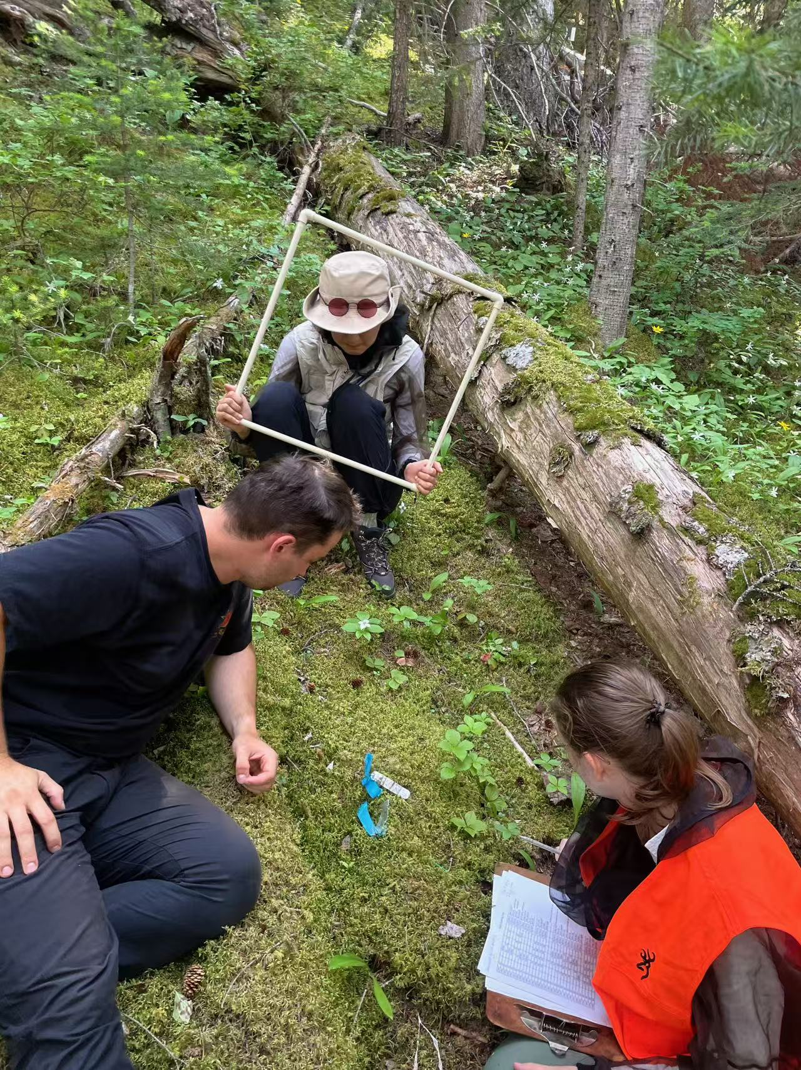
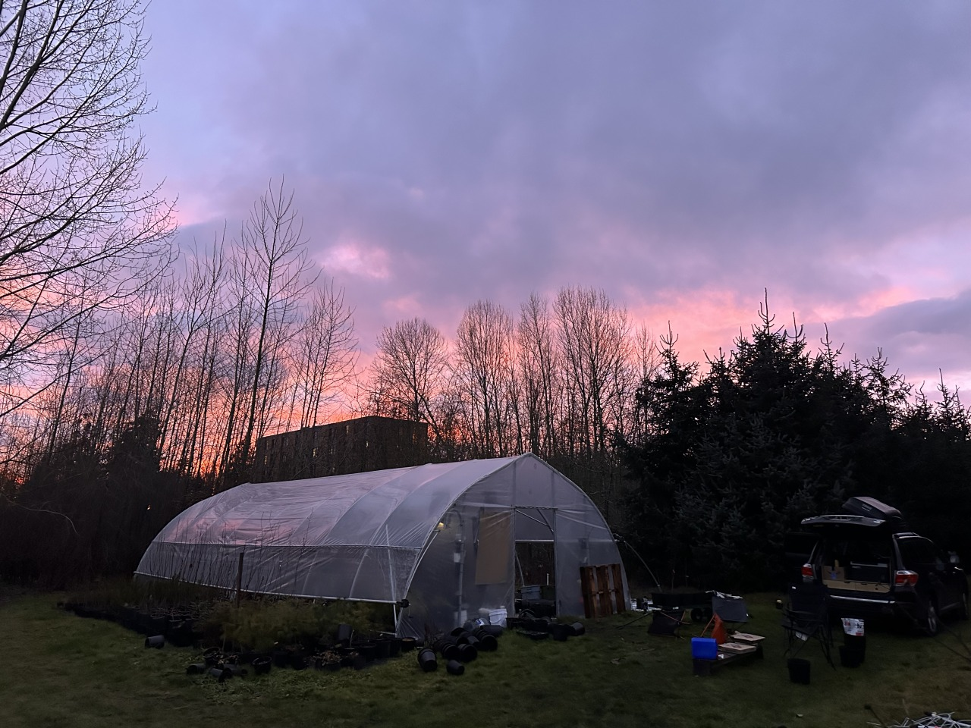
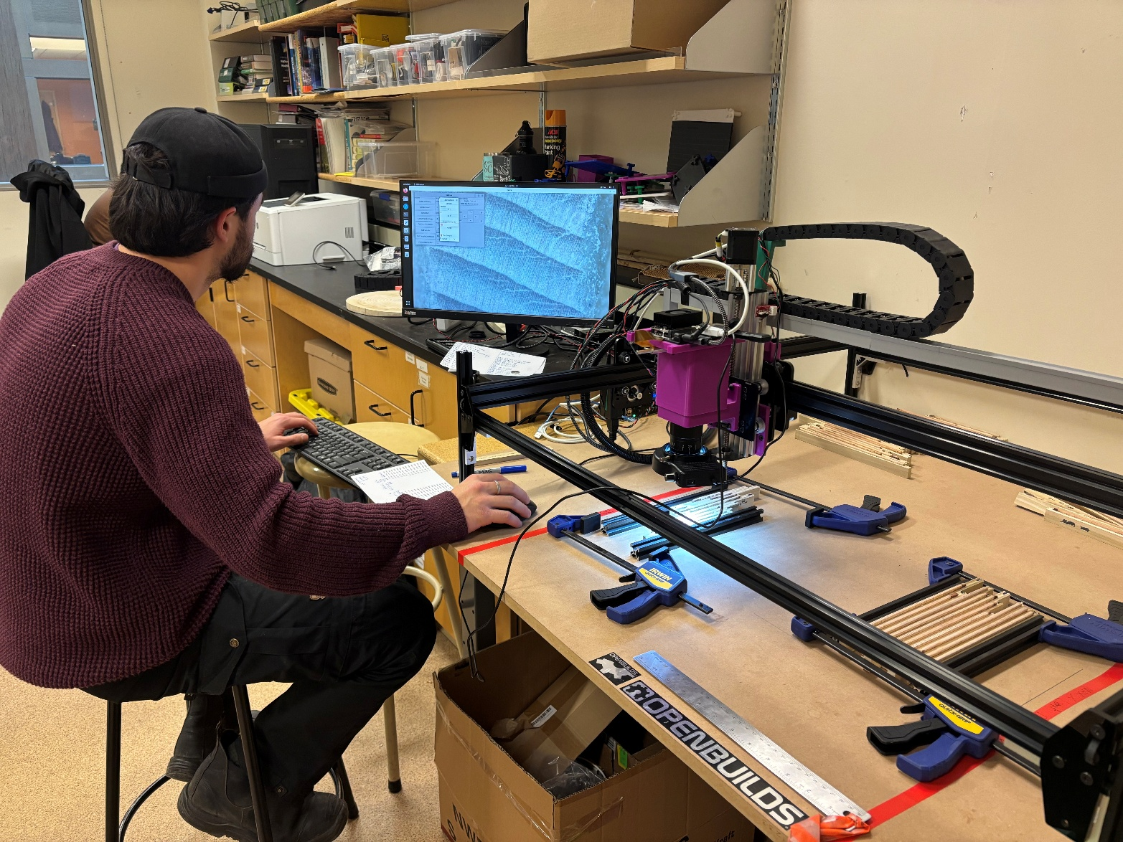
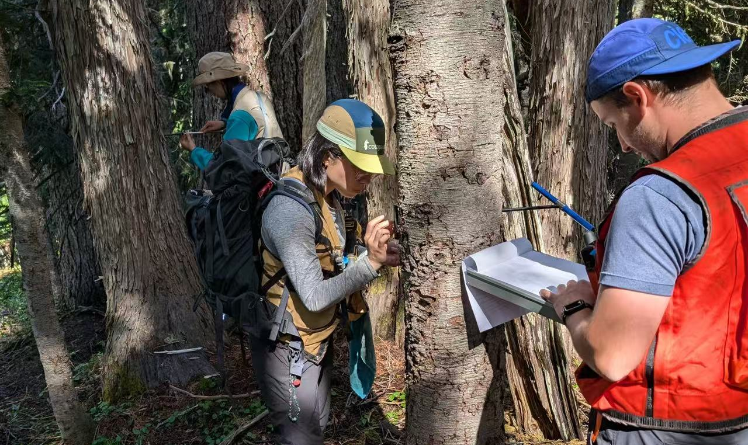
This summer
Join the Temporal Ecology Lab
Study how climate change is reshaping
Forests in Pacific Northwest
Various optional tasks in the lab, including coding, engineering, experiments, and fieldwork.
Email Lizzie Wolkovich (e.wolkovich@ubc.ca) your transcript, interests and background by March 26.

