Slide 1
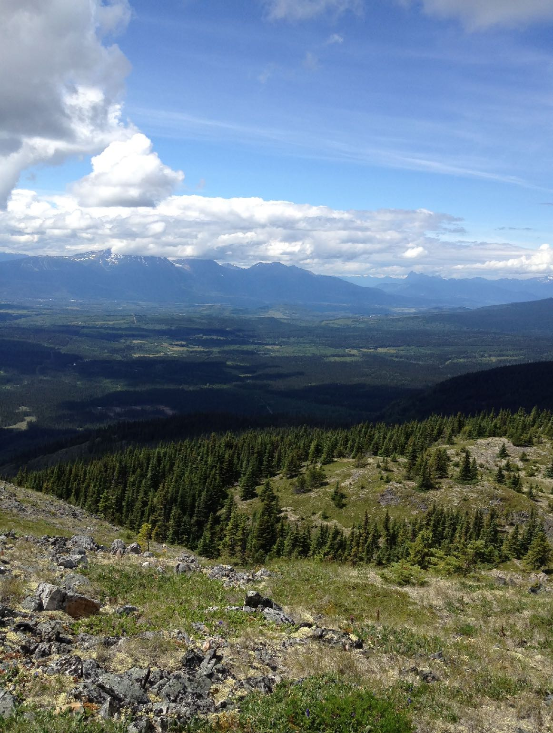
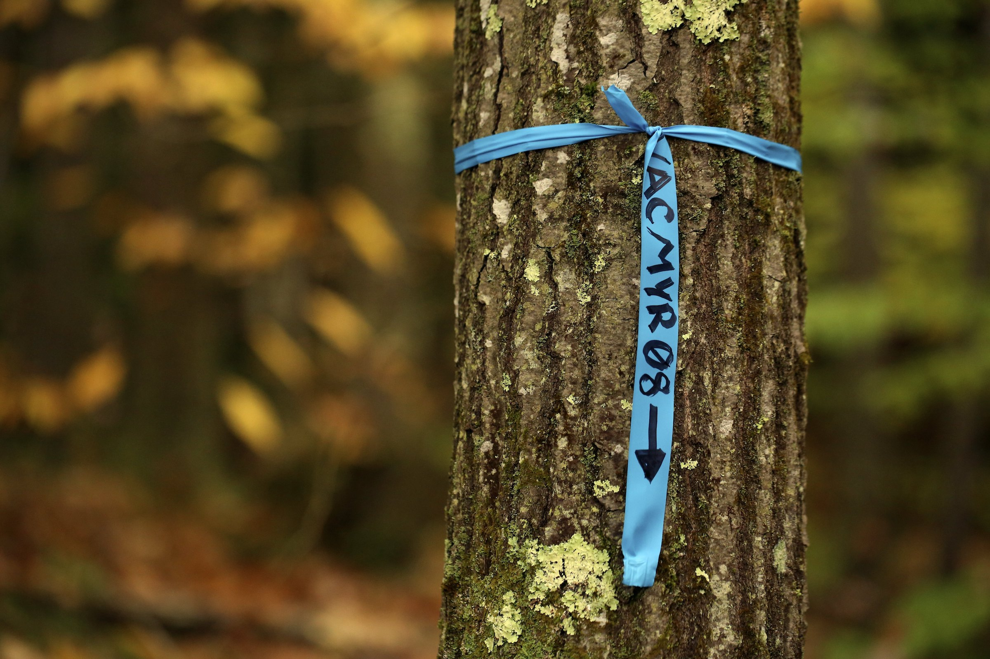
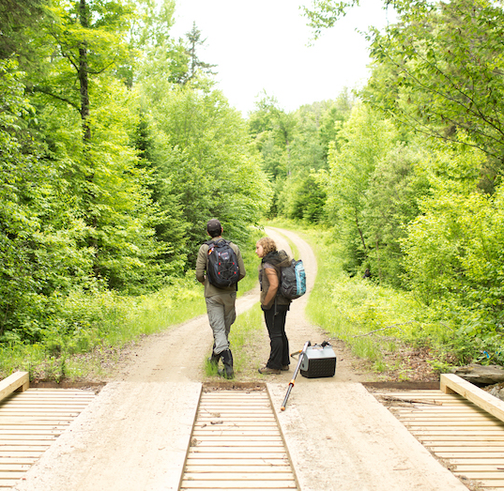
This summer
Join the Temporal Ecology Lab
Study how climate change is reshaping
British Columbia’s vineyards and forests
Field work in the Okanagan valley and
Provincial Parks (Manning and/or Smithers)
Email Lizzie Wolkovich (e.wolkovich@ubc.ca) your transcript, interests and background by March 3.

