Slide 1
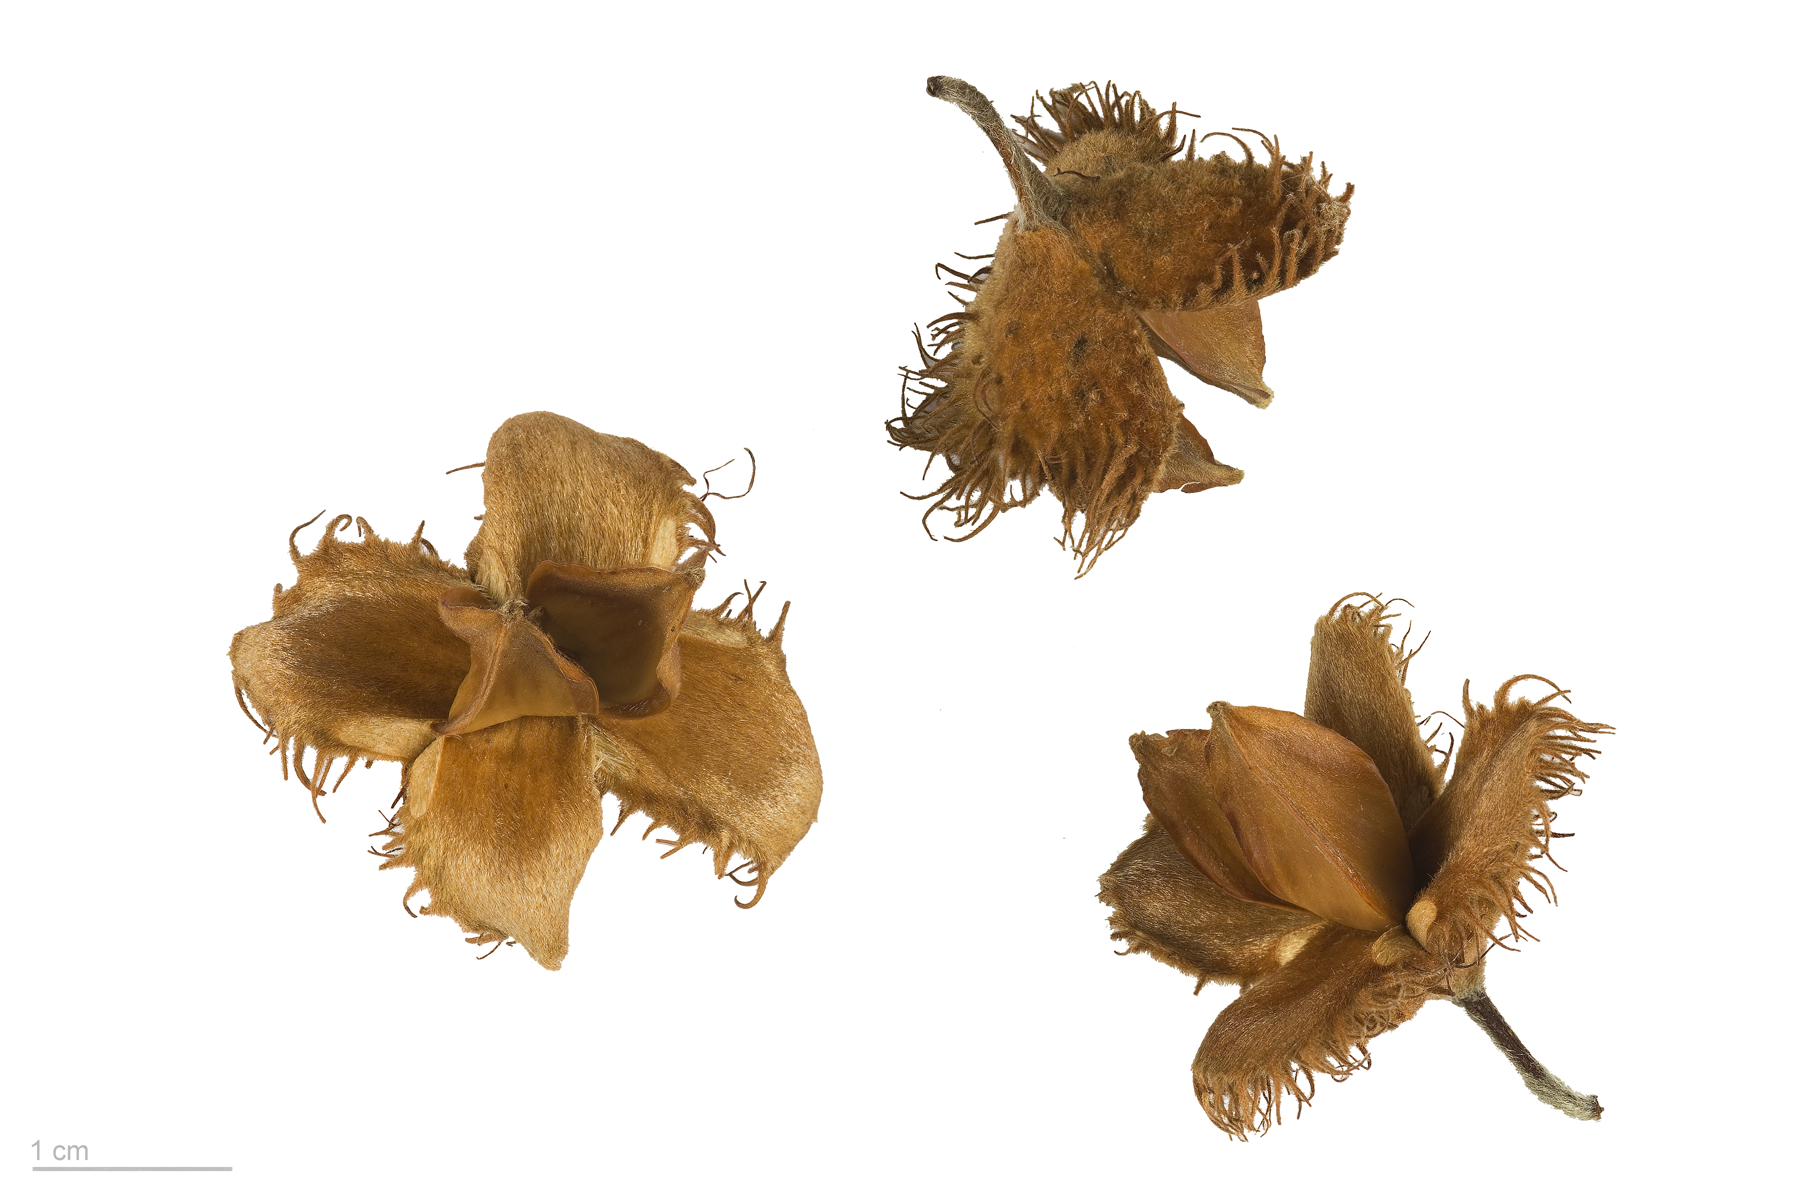
How climatic drivers and intrinsic biological processes shape beech
masting dynamics

Slide 2
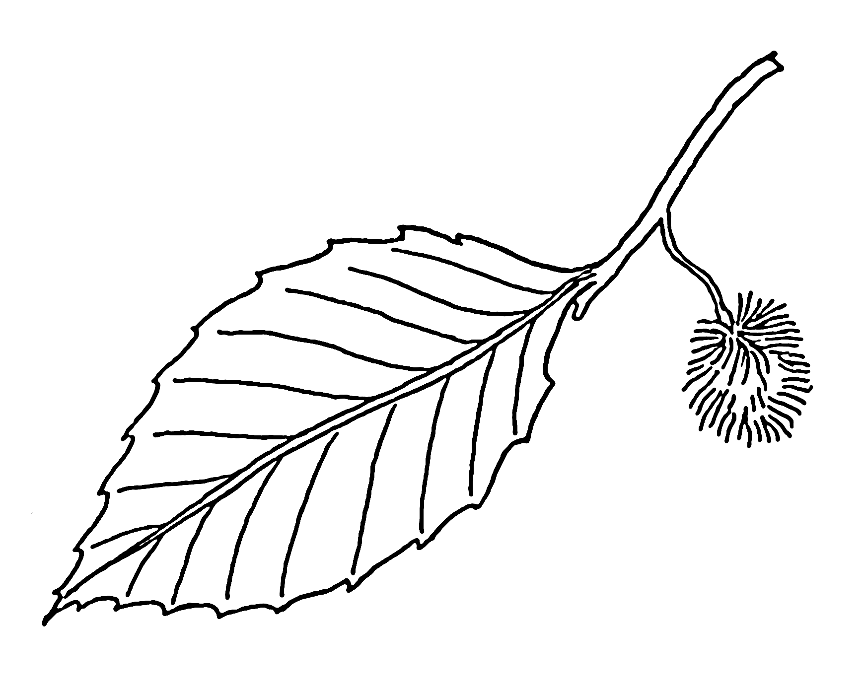
Current state of the field

Slide 3

Current state of the field
clear explicit theories on the evolutionary drivers
Notes:
- field have clear explicit theories and hypotheses on the evolutionary drivers that could explain masting behavior
- economy-of-scale: maximize pollination efficiency (lots of lower in a forest, more efficient!), if year with no seed in a forest/ predator satiation, which controls predator populations, and if a lot of seed: dilution effect

Slide 4
Current state of the field
clear explicit theories on the evolutionary drivers
- maximize pollination
Notes:
- field have clear explicit theories and hypotheses on the evolutionary drivers that could explain masting behavior
- economy-of-scale: maximize pollination efficiency (lots of lower in a forest, more efficient!), if year with no seed in a forest/ predator satiation, which controls predator populations, and if a lot of seed: dilution effect

Slide 5
Current state of the field
clear explicit theories on the evolutionary drivers
- maximize pollination
- avoid predation
Notes:
- field have clear explicit theories and hypotheses on the evolutionary drivers that could explain masting behavior
- economy-of-scale: maximize pollination efficiency (lots of lower in a forest, more efficient!), if year with no seed in a forest/ predator satiation, which controls predator populations, and if a lot of seed: dilution effect

Slide 6
Current state of the field
clear explicit theories on the evolutionary drivers
- maximize pollination
- avoid predation
(- improve dispersion)
Notes:
- field have clear explicit theories and hypotheses on the evolutionary drivers that could explain masting behavior
- economy-of-scale: maximize pollination efficiency (lots of lower in a forest, more efficient!), if year with no seed in a forest/ predator satiation, which controls predator populations, and if a lot of seed: dilution effect

Slide 7
Current state of the field
clear explicit theories on the evolutionary drivers
- maximize pollination
- avoid predation
(- improve dispersion)
Fitness benefit that would favor
phenotypes that are synchronized
Notes:
- the idea is that these interactions between individual from the same species and within the ecosystem with predators etc. would have favored, on evolutionary timescale, individual that are synchronized

Slide 8
Current state of the field
clear explicit theories on the evolutionary drivers
ultimate causes
- maximize pollination
- avoid predation
(- improve dispersion)
Fitness benefit that would favor
phenotypes that are synchronized
Notes:
- these potential evolutionary drivers, which were already explicited in the 70s by Janzen and other people (nothing new?) can be seen as the ultimate causes of masting

Slide 9

Current state of the field
clear explicit theories on the evolutionary drivers
ultimate causes
some ideas of the environmental drivers
Notes:
- more recently, because we have more data at larger scale, there were improvements on the investigation regarding the potential environmental drivers

Slide 10
Current state of the field
clear explicit theories on the evolutionary drivers
ultimate causes
some ideas of the environmental drivers
- effect of previous summer temperatures
Notes:
- summer temperature from the previous year is the driver that is always the most significant (at least for beech), and some other people thikn that what matter is the deltaT, difference betwwen year n-2 and n-1 (summer memory, I won’t go into details…)

Slide 11
Current state of the field
clear explicit theories on the evolutionary drivers
ultimate causes
some ideas of the environmental drivers
- effect of previous summer temperatures
- spring weather and pollination
Notes:
- the conditiosn during the pollinatino could also be an improtant driver, for example could control the pollinator activities or the success of wind pollination

Slide 12
Current state of the field
clear explicit theories on the evolutionary drivers
ultimate causes
some ideas of the environmental drivers
- effect of previous summer temperatures
- spring weather and pollination
- “vetos”: frost, drought
Notes:
- a weather mechanism that is often invoked are the vetos, which can prevent a tree to reproduce even in a good year: for example late sprign frost that would kill the flowers, or a summer drought that would abort the fruits

Slide 13
Current state of the field
clear explicit theories on the evolutionary drivers
ultimate causes
some ideas of the environmental drivers
- effect of previous summer temperatures
- spring weather and pollination
- “vetos”: frost, drought
- good growth conditions
Notes:
- another psosibility, finally, is that the reproduction depends more on the growth conditions, so if it’s a good year for photosynthesis (or the year before), the tree has more chance to reproduce

Slide 14
Current state of the field
clear explicit theories on the evolutionary drivers
ultimate causes
some ideas of the environmental drivers
proximal causes
- effect of previous summer temperatures
- spring weather and pollination
- “vetos”: frost, drought
- good growth conditions
Notes:
- this is what we could called the proximate causes, the local or regional conditions that necessarily have, to some extent an impact on the reproduction dynamics

Slide 15

Current state of the field
clear explicit theories on the evolutionary drivers
ultimate causes
some ideas of the environmental drivers
proximal causes
overlooked biological mechanisms
Notes:
- finally, in my opinion, the field tends to forget that there is an actual living tree behind the seed dynamics we observe, and that this tree has some biological constraints: we will see later that the biology of reproduction is often only used a posteriori to explain the results

Slide 16

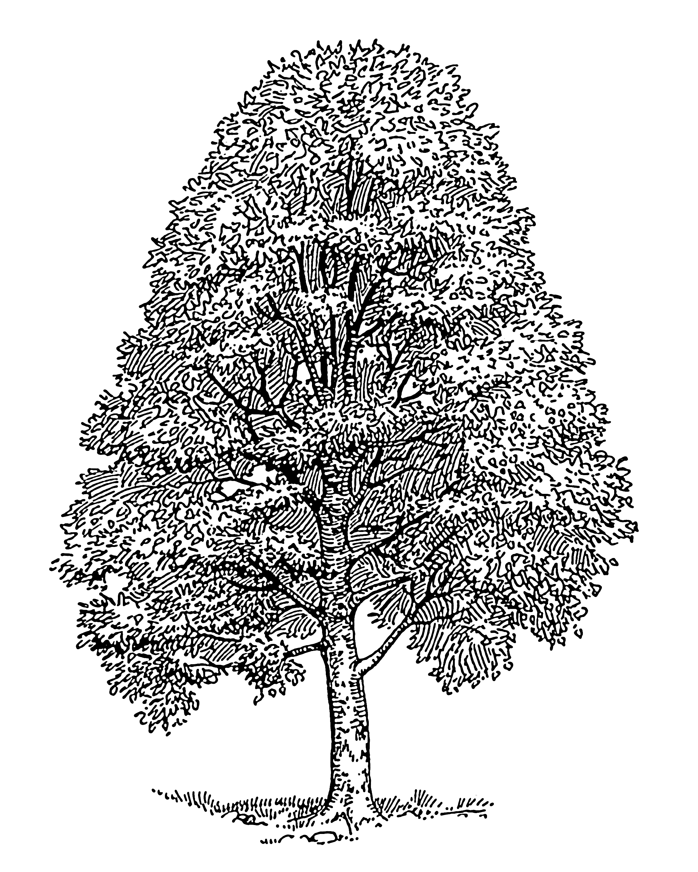
The biology behind tree reproduction

Slide 17

The biology behind tree reproduction
Induction of flowers in buds the previous summer

Slide 18
The biology behind tree reproduction
Induction of flowers in buds the previous summer
Vegetative bud
Mixed bud

Slide 19
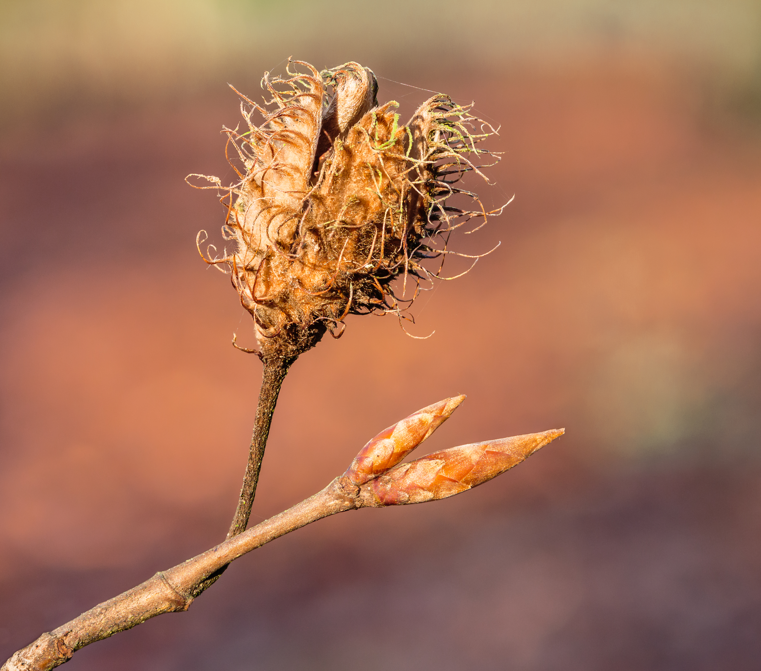
The biology behind tree reproduction
Induction of flowers in buds the previous summer
Vegetative bud
Mixed bud

Slide 20

The biology behind tree reproduction
Induction of flowers in buds the previous summer
Resource
trade-off with fruit maturation
Vegetative bud
Mixed bud

Slide 21
Current state of the field
clear explicit theories on the evolutionary drivers
ultimate causes
some ideas of the environmental drivers
proximal causes
overlooked biological mechanisms
- flower initiation in previous year
- trade-off between fruit maturation and flower induction
Notes:
- finally, in my opinion, the field tends to forget that there is an actual living tree behind the seed dynamics we observe, and that this tree has some biological constraints: we will see later that the biology of reproduction is often only used a posteriori to explain the results

Slide 22
Current state of the field
clear explicit theories on the evolutionary drivers
ultimate causes
some ideas of the environmental drivers
proximal causes
overlooked biological mechanisms
biol. constraints
- flower initiation in previous year
- trade-off between fruit maturation and flower budset
Notes:
- finally, in my opinion, the field tends to forget that there is an actual living tree behind the seed dynamics we observe, and that this tree has some biological constraints: we will see later that the biology of reproduction is often only used a posteriori to explain the results

Slide 23

Lack of connection between theories & models
ultimate causes
proximal causes
biol. constraints
Notes:
so how these three layers, from the individual biology to the population or species-level evolutionary benefit, are taken into account today? In the models

Slide 24
Lack of connection between theories & models
ultimate causes
Some model
proximal causes
phys. constraints
Notes:
- from what I see, people tend to build a model, like a linear regression or whatever, and include some climate predictors; they also include sometimes the previous year reproduction as a predictor, but as a totally separated effect from the climate

Slide 25
Lack of connection between theories & models
Already presupposes the thesis
ultimate causes
Some model
proximal causes
phys. constraints
Notes:
- so, most of the time, the statistics that are used do no test directly for the hypothesis behind masting, the models are are shaped by our pre-existing beliefs
With the current model it’s hard to tell to what extent the individuals are synchronized? Like are they perfectly synchronized? To what spatial scale? All these features are not explictly incorporated in the model, and so not directly tested. We do not model the state of masting. So the current predictions are not falsifiable, and it’s hard to say whether the theories are really supported by the data

Slide 26
Lack of connection between theories & models
Already presupposes the thesis
Doesn’t explicitly test it
ultimate causes
Some model
proximal causes
phys. constraints
Notes:
- so, most of the time, the statistics that are used do no test directly for the hypothesis behind masting, the models are are shaped by our pre-existing beliefs
With the current model it’s hard to tell to what extent the individuals are synchronized? Like are they perfectly synchronized? To what spatial scale? All these features are not explictly incorporated in the model, and so not directly tested. We do not model the state of masting. So the current predictions are not falsifiable, and it’s hard to say whether the theories are really supported by the data

Slide 27
Lack of connection between theories & models
Already presupposes the thesis
Doesn’t explicitly test it
ultimate causes
Some model
proximal causes
Biology is invoked
a posteriori
phys. constraints
Notes:
similarly, biological constraitns that I mentioned, such as flower iniation in the previous summer, are most of the time invoked a posterior to explain the results of the linear regression, without explictly incorporating the tree behavior.
The model never try to include the explicit state of masting or non-masting for each individual, related to these constraints

Slide 28
Lack of connection between theories & models
Already presupposes the thesis
Doesn’t explicitly test it
ultimate causes
Some model
proximal causes
Biology is invoked
a posteriori
Not explicitly included
phys. constraints
Notes:
similarly, biological constraitns that I mentioned, such as flower iniation in the previous summer, are most of the time invoked a posterior to explain the results of the linear regression, without explictly incorporating the tree behavior.
The model never try to include the explicit state of masting or non-masting for each individual, related to these constraints

Slide 29
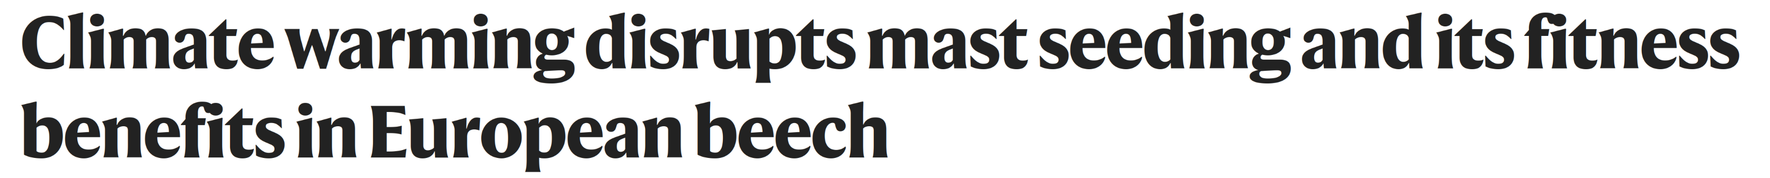
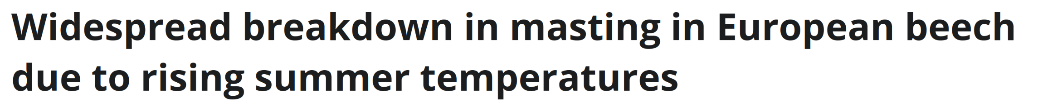
More regeneration failures in future climates?
increase seed production
less years without reproduction
less synchrony
Climate warming
Bogdziewicz et al. 2020, Foest et al. 2024
Notes:
these limitations reduce the usefulness of inference and weaken the robustness of the forecasts that can be derived from the model
One hypothesis regarding the masting behavior of beech in Europe is that recent warming has increased seed production while reducing both synchrony and interannual variability.
Some people suggest that, because warmer summers favor reproduction in all trees, years with no reproduction have become less frequent, thereby decreasing the adaptive value of masting
And that this should become even worse in future climates
But how can we really assess these changes if we do not explicitly simulate the masting process and the ways in which climate influences masting states?

Slide 30

More regeneration failures in future climates?
increase seed production
less years without reproduction
less synchrony
Climate warming
Disruption of long-term reproductive patterns?
Bogdziewicz et al. 2020, Foest et al. 2024
Notes:
these limitations reduce the usefulness of inference and weaken the robustness of the forecasts that can be derived from the model
One hypothesis regarding the masting behavior of beech in Europe is that recent warming has increased seed production while reducing both synchrony and interannual variability.
Some people suggest that, because warmer summers favor reproduction in all trees, years with no reproduction have become less frequent, thereby decreasing the adaptive value of masting
And that this should become even worse in future climates
But how can we really assess these changes if we do not explicitly simulate the masting process and the ways in which climate influences masting states?

Slide 31
Biological constraints (may) matter!
ultimate causes
proximal causes
biol. constraints
Notes:
So what’s our approach?
Our idea is to build a model of masting that explictly incorporate our knowledge of the masting, and to build up from there to incorporate climate effects and quantify the synchronicity of seed production and forecast what can happen with climate change

Slide 32

Biological constraints (may) matter!
ultimate causes
proximal causes
biol. constraints
Building from physiological knowledge
Notes:
So what’s our approach?
Our idea is to build a model of masting that explictly incorporate our knowledge of the masting, and to build up from there to incorporate climate effects and quantify the synchronicity of seed production and forecast what can happen with climate change

Slide 33

Biological constraints (may) matter!
To forecast regeneration potential!
ultimate causes
proximal causes
biol. constraints
Building from physiological knowledge
Notes:
So what’s our approach?
Our idea is to build a model of masting that explictly incorporate our knowledge of the masting, and to build up from there to incorporate climate effects and quantify the synchronicity of seed production and forecast what can happen with climate change

Slide 34

Our approach!
Many flowers
Notes:
We built a model at the individual level
With a clear sequence of states: the tree is either masting or not, and there is a dependency between those consecutive states
We can model explicitly the transition from non-masting to masting with a transition matrix
Thsi is what we call an Hidden Markov Model, or HMM
Our model captures the biology behind the masting, or at least better than simple regression:
the idea behind these transition is that there is a variable resource allocation to fruit maturation or flower initiation, and these transitions explicitly capture these boom-bust states

Slide 35

Our approach!
Fruits
> Buds
Many flowers
Notes:
We built a model at the individual level
With a clear sequence of states: the tree is either masting or not, and there is a dependency between those consecutive states
We can model explicitly the transition from non-masting to masting with a transition matrix
Thsi is what we call an Hidden Markov Model, or HMM
Our model captures the biology behind the masting, or at least better than simple regression:
the idea behind these transition is that there is a variable resource allocation to fruit maturation or flower initiation, and these transitions explicitly capture these boom-bust states

Slide 36
Our approach!
Fruits
> Buds
Masting
Many flowers
Notes:
We built a model at the individual level
With a clear sequence of states: the tree is either masting or not, and there is a dependency between those consecutive states
We can model explicitly the transition from non-masting to masting with a transition matrix
Thsi is what we call an Hidden Markov Model, or HMM
Our model captures the biology behind the masting, or at least better than simple regression:
the idea behind these transition is that there is a variable resource allocation to fruit maturation or flower initiation, and these transitions explicitly capture these boom-bust states

Slide 37

Our approach!
Few flowers
Fruits
> Buds
Masting
Many flowers
Notes:
We built a model at the individual level
With a clear sequence of states: the tree is either masting or not, and there is a dependency between those consecutive states
We can model explicitly the transition from non-masting to masting with a transition matrix
Thsi is what we call an Hidden Markov Model, or HMM
Our model captures the biology behind the masting, or at least better than simple regression:
the idea behind these transition is that there is a variable resource allocation to fruit maturation or flower initiation, and these transitions explicitly capture these boom-bust states

Slide 38

Our approach!
Few flowers
Fruits
> Buds
Buds
> Fruits
Masting
Many flowers
Notes:
We built a model at the individual level
With a clear sequence of states: the tree is either masting or not, and there is a dependency between those consecutive states
We can model explicitly the transition from non-masting to masting with a transition matrix
Thsi is what we call an Hidden Markov Model, or HMM
Our model captures the biology behind the masting, or at least better than simple regression:
the idea behind these transition is that there is a variable resource allocation to fruit maturation or flower initiation, and these transitions explicitly capture these boom-bust states

Slide 39
Our approach!
Few flowers
Fruits
> Buds
Non-masting
Buds
> Fruits
Masting
Many flowers
Notes:
We built a model at the individual level
With a clear sequence of states: the tree is either masting or not, and there is a dependency between those consecutive states
We can model explicitly the transition from non-masting to masting with a transition matrix
Thsi is what we call an Hidden Markov Model, or HMM
Our model captures the biology behind the masting, or at least better than simple regression:
the idea behind these transition is that there is a variable resource allocation to fruit maturation or flower initiation, and these transitions explicitly capture these boom-bust states

Slide 40
Our approach!
Non-masting
Masting
Transition
matrix
M
NM
NM
M
Notes:
We built a model at the individual level
With a clear sequence of states: the tree is either masting or not, and there is a dependency between those consecutive states
We can model explicitly the transition from non-masting to masting with a transition matrix
Thsi is what we call an Hidden Markov Model, or HMM
Our model captures the biology behind the masting, or at least better than simple regression:
the idea behind these transition is that there is a variable resource allocation to fruit maturation or flower initiation, and these transitions explicitly capture these boom-bust states

Slide 41

Our approach!
Non-
masting
Transition
matrix
Masting
M
NM
NM
M
Notes:
We built a model at the individual level
With a clear sequence of states: the tree is either masting or not, and there is a dependency between those consecutive states
We can model explicitly the transition from non-masting to masting with a transition matrix
Thsi is what we call an Hidden Markov Model, or HMM
Our model captures the biology behind the masting, or at least better than simple regression:
the idea behind these transition is that there is a variable resource allocation to fruit maturation or flower initiation, and these transitions explicitly capture these boom-bust states

Slide 42
Our approach!
Cold summer
Non-
masting
Stay in a
non-masting
state
Transition
matrix
Non-
masting
Masting
M
NM
NM
M
NM
NM
Notes:
We built a model at the individual level
With a clear sequence of states: the tree is either masting or not, and there is a dependency between those consecutive states
We can model explicitly the transition from non-masting to masting with a transition matrix
Thsi is what we call an Hidden Markov Model, or HMM
Our model captures the biology behind the masting, or at least better than simple regression:
the idea behind these transition is that there is a variable resource allocation to fruit maturation or flower initiation, and these transitions explicitly capture these boom-bust states

Slide 43

Our approach!
Summer
warming
Stay in a
masting
state
Masting
Masting
Transition
matrix
M
M
M
NM
NM
M
NM
NM
Notes:
We built a model at the individual level
With a clear sequence of states: the tree is either masting or not, and there is a dependency between those consecutive states
We can model explicitly the transition from non-masting to masting with a transition matrix
Thsi is what we call an Hidden Markov Model, or HMM
Our model captures the biology behind the masting, or at least better than simple regression:
the idea behind these transition is that there is a variable resource allocation to fruit maturation or flower initiation, and these transitions explicitly capture these boom-bust states

Slide 44

Our approach!
Transition matrix
M
M
M
NM
NM
M
NM
NM
Seed production
Notes:
We built a model at the individual level
With a clear sequence of states: the tree is either masting or not, and there is a dependency between those consecutive states
We can model explicitly the transition from non-masting to masting with a transition matrix
Thsi is what we call an Hidden Markov Model, or HMM
Our model captures the biology behind the masting, or at least better than simple regression:
the idea behind these transition is that there is a variable resource allocation to fruit maturation or flower initiation, and these transitions explicitly capture these boom-bust states

Slide 45
Our approach!
Few flowers
Fruits
> Buds
Non-masting
Buds
> Fruits
Masting
Many flowers
Notes:
We built a model at the individual level
With a clear sequence of states: the tree is either masting or not, and there is a dependency between those consecutive states
We can model explicitly the transition from non-masting to masting with a transition matrix
Thsi is what we call an Hidden Markov Model, or HMM
Our model captures the biology behind the masting, or at least better than simple regression:
the idea behind these transition is that there is a variable resource allocation to fruit maturation or flower initiation, and these transitions explicitly capture these boom-bust states

Slide 46
Our approach!
Individual-level model
Clear sequence of states
Few flowers
Fruits
> Buds
Non-masting
Buds
> Fruits
Masting
Many flowers
Notes:
We built a model at the individual level
With a clear sequence of states: the tree is either masting or not, and there is a dependency between those consecutive states
We can model explicitly the transition from non-masting to masting with a transition matrix
Thsi is what we call an Hidden Markov Model, or HMM
Our model captures the biology behind the masting, or at least better than simple regression:
the idea behind these transition is that there is a variable resource allocation to fruit maturation or flower initiation, and these transitions explicitly capture these boom-bust states

Slide 47


Our approach!
Individual-level model
Clear sequence of states
No fruit
Previous summer
Notes:
We built a model at the individual level
With a clear sequence of states: the tree is either masting or not, and there is a dependency between those consecutive states
We can model explicitly the transition from non-masting to masting with a transition matrix
Thsi is what we call an Hidden Markov Model, or HMM
Our model captures the biology behind the masting, or at least better than simple regression:
the idea behind these transition is that there is a variable resource allocation to fruit maturation or flower initiation, and these transitions explicitly capture these boom-bust states

Slide 48

Our approach!
Individual-level model
Clear sequence of states
No fruit
Budset
Previous summer
Notes:
We built a model at the individual level
With a clear sequence of states: the tree is either masting or not, and there is a dependency between those consecutive states
We can model explicitly the transition from non-masting to masting with a transition matrix
Thsi is what we call an Hidden Markov Model, or HMM
Our model captures the biology behind the masting, or at least better than simple regression:
the idea behind these transition is that there is a variable resource allocation to fruit maturation or flower initiation, and these transitions explicitly capture these boom-bust states

Slide 49


Our approach!
Individual-level model
Clear sequence of states
No fruit
Flowering
Mast fruiting
Budset
Previous summer
Current year
Notes:
We built a model at the individual level
With a clear sequence of states: the tree is either masting or not, and there is a dependency between those consecutive states
We can model explicitly the transition from non-masting to masting with a transition matrix
Thsi is what we call an Hidden Markov Model, or HMM
Our model captures the biology behind the masting, or at least better than simple regression:
the idea behind these transition is that there is a variable resource allocation to fruit maturation or flower initiation, and these transitions explicitly capture these boom-bust states

Slide 50
Our approach!
Individual-level model
Clear sequence of states
No fruit
Flowering
Mast fruiting
Budset
Limited budset
Previous summer
Current year
Notes:
We built a model at the individual level
With a clear sequence of states: the tree is either masting or not, and there is a dependency between those consecutive states
We can model explicitly the transition from non-masting to masting with a transition matrix
Thsi is what we call an Hidden Markov Model, or HMM
Our model captures the biology behind the masting, or at least better than simple regression:
the idea behind these transition is that there is a variable resource allocation to fruit maturation or flower initiation, and these transitions explicitly capture these boom-bust states

Slide 51
Our approach!
Individual-level model
Clear sequence of states
No fruit
Flowering
Mast fruiting
No fruit
Budset
Limited budset
Previous summer
Current year
Next year
Notes:
We built a model at the individual level
With a clear sequence of states: the tree is either masting or not, and there is a dependency between those consecutive states
We can model explicitly the transition from non-masting to masting with a transition matrix
Thsi is what we call an Hidden Markov Model, or HMM
Our model captures the biology behind the masting, or at least better than simple regression:
the idea behind these transition is that there is a variable resource allocation to fruit maturation or flower initiation, and these transitions explicitly capture these boom-bust states

Slide 52
Our approach!
Individual-level model
Clear sequence of states
No fruit
Flowering
Mast fruiting
No fruit
Budset
Limited budset
Non-masting
Masting
Masting
Non-masting
Previous summer
Current year
Next year
Notes:
We built a model at the individual level
With a clear sequence of states: the tree is either masting or not, and there is a dependency between those consecutive states
We can model explicitly the transition from non-masting to masting with a transition matrix
Thsi is what we call an Hidden Markov Model, or HMM
Our model captures the biology behind the masting, or at least better than simple regression:
the idea behind these transition is that there is a variable resource allocation to fruit maturation or flower initiation, and these transitions explicitly capture these boom-bust states

Slide 53
Our approach!
Individual-level model
Clear sequence of states
No fruit
Flowering
Mast fruiting
No fruit
Budset
Limited budset
Non-masting
Masting
Masting
Non-masting
OR
OR
Non-masting
Non-masting
Masting
Masting
Notes:
We built a model at the individual level
With a clear sequence of states: the tree is either masting or not, and there is a dependency between those consecutive states
We can model explicitly the transition from non-masting to masting with a transition matrix
Thsi is what we call an Hidden Markov Model, or HMM
Our model captures the biology behind the masting, or at least better than simple regression:
the idea behind these transition is that there is a variable resource allocation to fruit maturation or flower initiation, and these transitions explicitly capture these boom-bust states

Slide 54
Our approach!
Disentangle impacts of climate:
masting transition, masting intensity
No fruit
Flowering
Mast fruiting
No fruit
Budset
Limited budset
Summer
temperature
Previous summer
Current year
Next year
Notes:
- we include several climate predictors, and because of our model structure we were able to differentiate where they impact the observed seed counts

Slide 55
Our approach!
Disentangle impacts of climate:
masting transition, masting intensity
No fruit
Flowering
Mast fruiting
No fruit
Budset
Limited budset
Spring
conditions
Summer
temperature
Previous summer
Current year
Next year
Notes:
- we include several climate predictors, and because of our model structure we were able to differentiate where they impact the observed seed counts

Slide 56
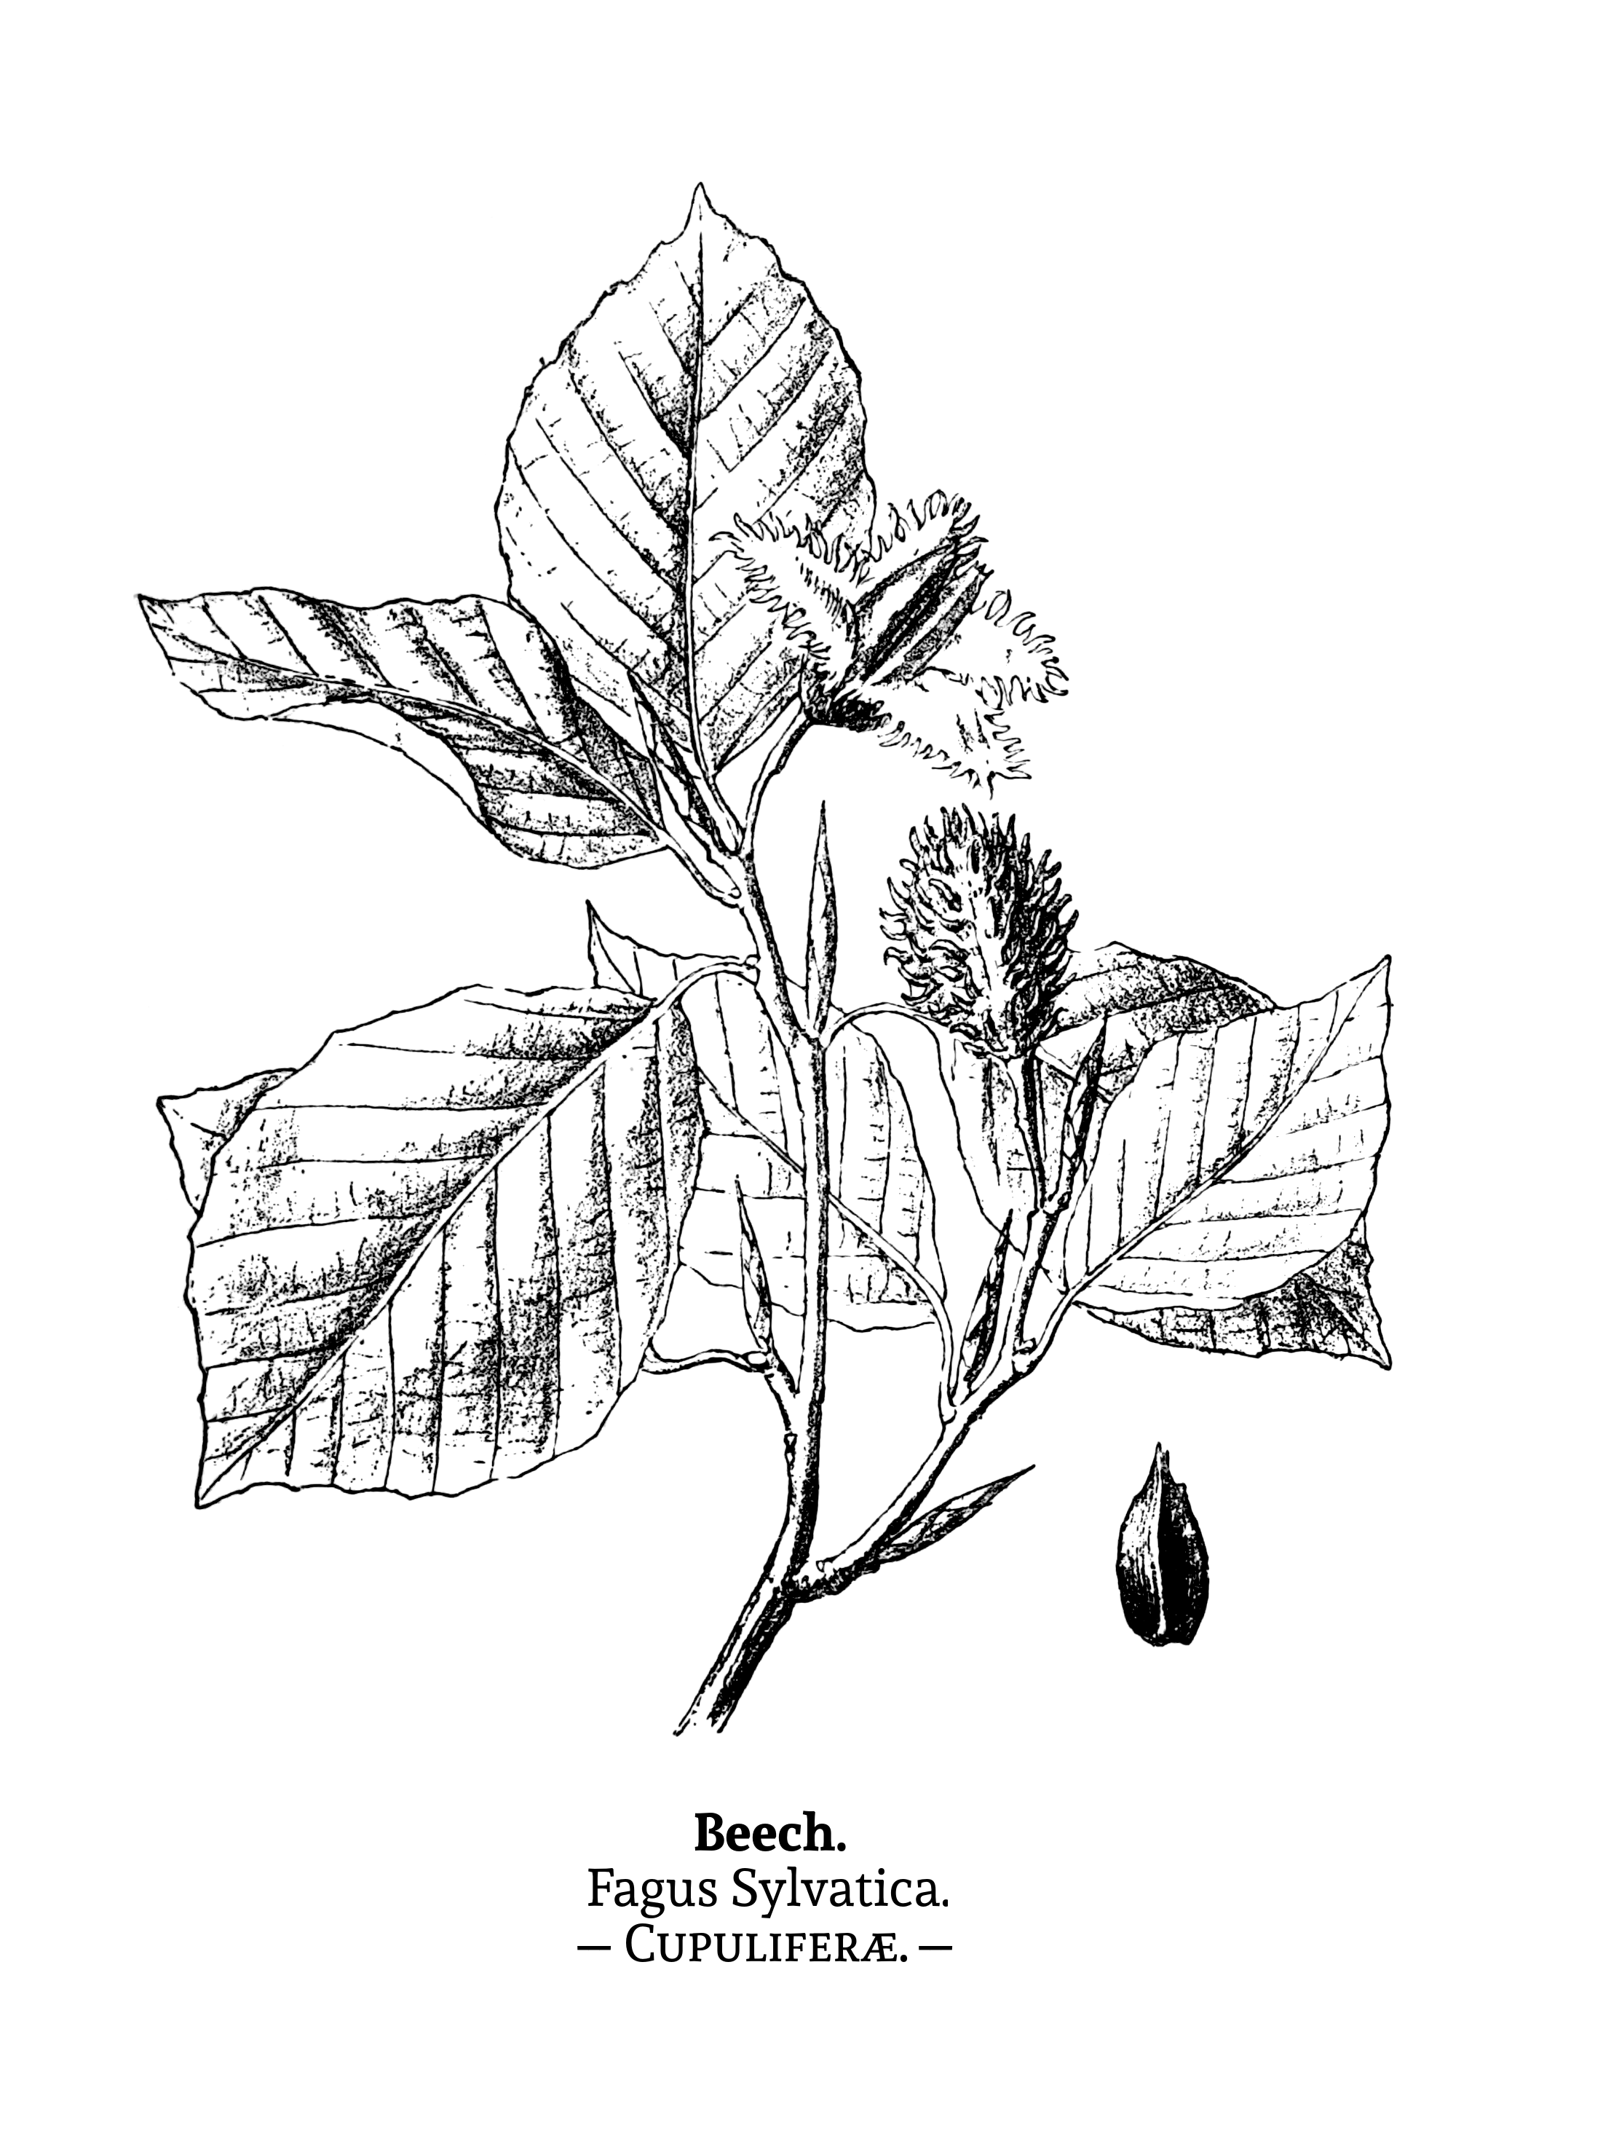
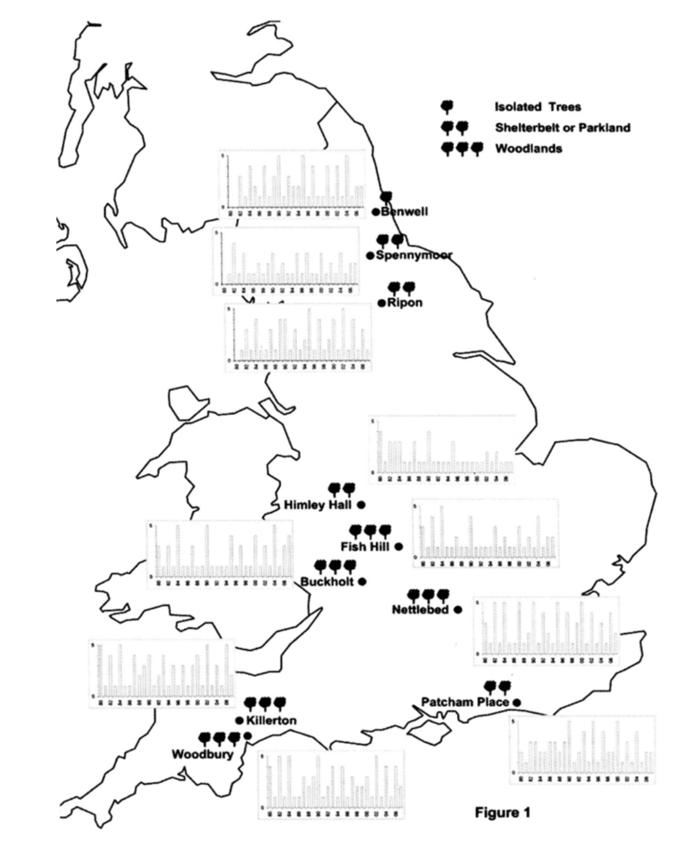
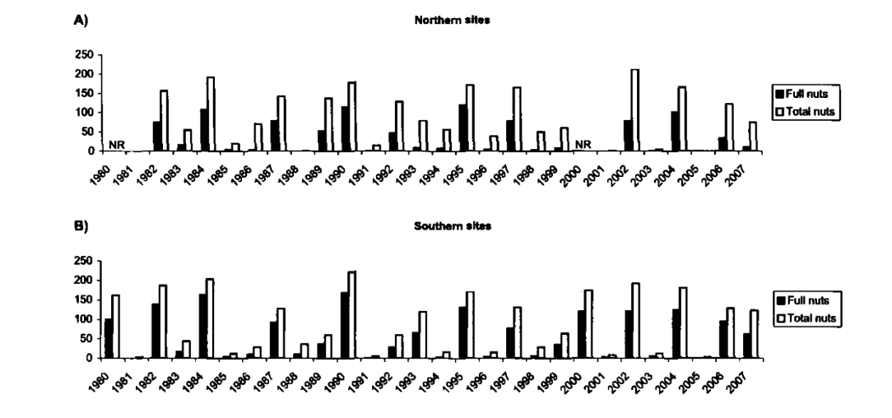
Beech trees in England
Slide not finished :-)
Notes:
to test our model, we use beech data from England
Beech is a model masting species, with seed production characterized by large interannual variation and synchrony
We have over 50 trees in 7 sites, recorded since the 80s
Tree production: more or less at the individual level, the below ground is searched for some amount of time
This dataset have been used in several studies, including in the one that found a massive breakdown

Slide 57
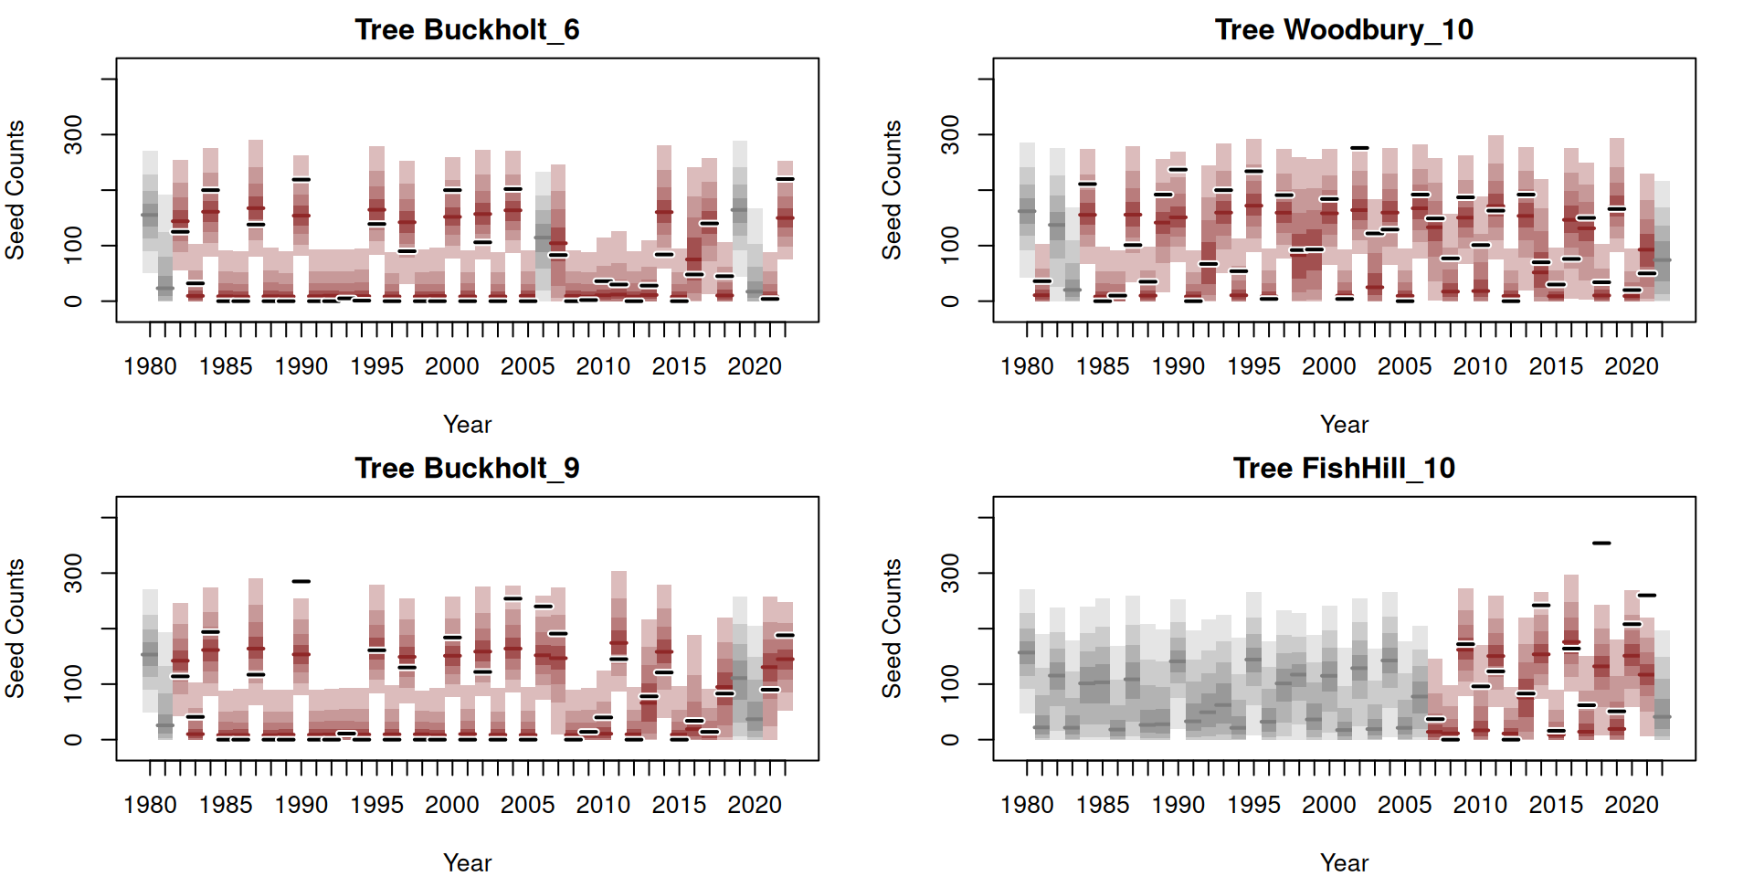
Boom-bust individual dynamics
Slide not finished :-)
Notes:
we obtain a good fit to the individual tree reproduction
we are able to predict both the non-masting and the masting seed production, which is not the case for all models, as it seems easier to predict non-masting years
and since we model the transition year-to-year, the model is able to make inference even if one year is missing (which would be totally ignored if we were doing a classic linear regression like we tend to see in the literature)

Slide 58
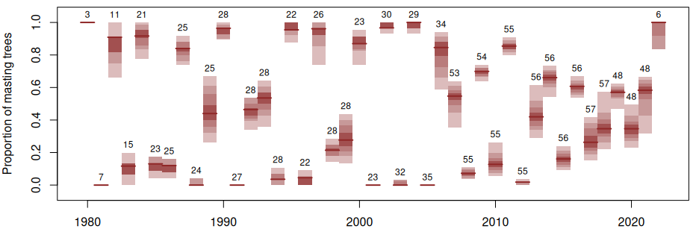
Synchrony across populations
Slide not finished :-)
Notes:
- and then we are able to look at the masting synchronicity across all trees that we have here
since we explicitly model for the masting state of each tree
the small number are the total number of trees that were observed this year
we observe year with an apparent high synchrony, but also year where trees seem to be less synchronized

Slide 59
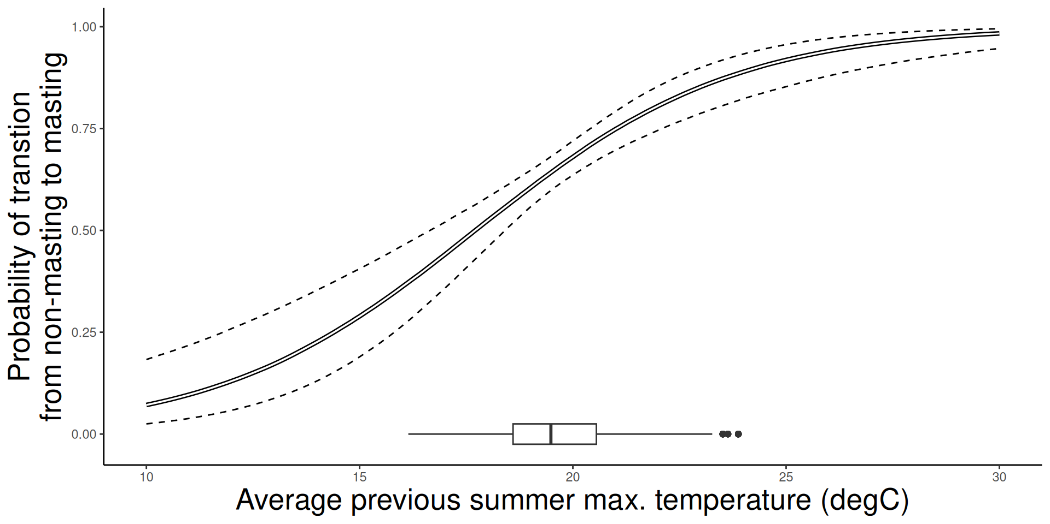
Influence of climate
Previous summer
Current year
Slide not finished :-)
Notes:
- what are the effects of climate on this?
Remember that we had 3 predictors, I will focus on summer temp and frost effect
Coherent with literature, we observed that a warm summer the year before increase the probability to go from non-masting state to a masting state
So if the tree is not bearing any fruits, a warm summer will likely increase the flower bud set
Then, once the tree is in a masting taste, we found that the risk of frost during the spring decrease the potential seed number that it will produce
So these two cliamte drivers impacts the masting behavior at two different time in the reproductive cycle, which make sense right-? And it was not the case in previous model where you direclty model climate impacts on seed production regardless of the masting state. Here, the spring frost does not determine the masting state, as the bud flower initiation happens the year before

Slide 60
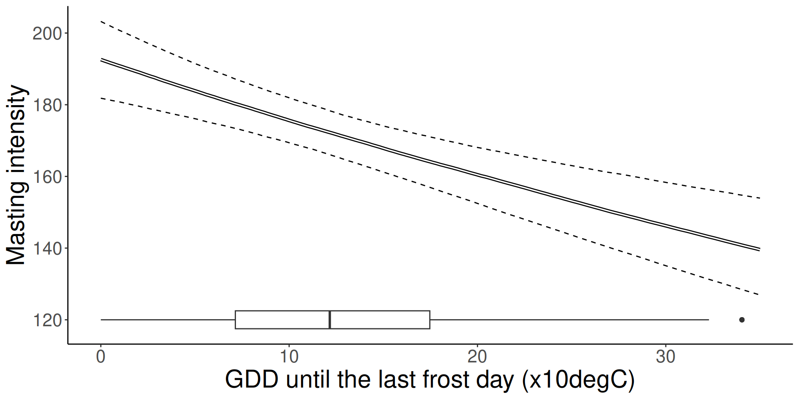
Influence of climate
Previous summer
Current year
Slide not finished :-)
Notes:
- what are the effects of climate on this?
Remember that we had 3 predictors, I will focus on summer temp and frost effect
Coherent with literature, we observed that a warm summer the year before increase the probability to go from non-masting state to a masting state
So if the tree is not bearing any fruits, a warm summer will likely increase the flower bud set
Then, once the tree is in a masting taste, we found that the risk of frost during the spring decrease the potential seed number that it will produce
So these two cliamte drivers impacts the masting behavior at two different time in the reproductive cycle, which make sense right-? And it was not the case in previous model where you direclty model climate impacts on seed production regardless of the masting state. Here, the spring frost does not determine the masting state, as the bud flower initiation happens the year before

Slide 61
Implications in a warming world
Warm summers increase the probability of transition from non-masting to masting
Slide not finished :-)
Notes:
- and so, what implicatiosn in a warming world?
We found that summer temperature do increase the probability of masting
but remember, it’s the probability of transition from non-masting to masting
The breakdown hypothesis that I mention is saying that the interannual variability is decreased, and that trees tend to stay into a masting state, because of warming summer
So behind the breakdown hypothesis, it means that summer warming has a strong effect on the probabiltiy to stay into masting
we can add a summer temperature parameter on this transition, right? And if we simualte data with a strong effect, we observe this breakdown
But when we estimate the effect of transtition from masting to masting, the prob of staying into masting, we don’t find any effect! With a warming summer, we don’t observe a massive breakdown and every tree is not going
Biological constraints, due to trade-off between budset and fruit maturation, prevent this vicious cycle

Slide 62
Implications in a warming world
Warm summers increase the probability of transition from non-masting to masting
But no impact of the probability of staying in a masting state
Slide not finished :-)
Notes:
- and so, what implicatiosn in a warming world?
We found that summer temperature do increase the probability of masting
but remember, it’s the probability of transition from non-masting to masting
The breakdown hypothesis that I mention is saying that the interannual variability is decreased, and that trees tend to stay into a masting state, because of warming summer
So behind the breakdown hypothesis, it means that summer warming has a strong effect on the probabiltiy to stay into masting
we can add a summer temperature parameter on this transition, right? And if we simualte data with a strong effect, we observe this breakdown
But when we estimate the effect of transtition from masting to masting, the prob of staying into masting, we don’t find any effect! With a warming summer, we don’t observe a massive breakdown and every tree is not going
Biological constraints, due to trade-off between budset and fruit maturation, prevent this vicious cycle

Slide 63
Implications in a warming world
Warm summers increase the probability of transition from non-masting to masting
But no impact of the probability of staying in a masting state
Breakdown hypothesis?
Trees masting
Summer warming
Slide not finished :-)
Notes:
- and so, what implicatiosn in a warming world?
We found that summer temperature do increase the probability of masting
but remember, it’s the probability of transition from non-masting to masting
The breakdown hypothesis that I mention is saying that the interannual variability is decreased, and that trees tend to stay into a masting state, because of warming summer
So behind the breakdown hypothesis, it means that summer warming has a strong effect on the probabiltiy to stay into masting
we can add a summer temperature parameter on this transition, right? And if we simualte data with a strong effect, we observe this breakdown
But when we estimate the effect of transtition from masting to masting, the prob of staying into masting, we don’t find any effect! With a warming summer, we don’t observe a massive breakdown and every tree is not going
Biological constraints, due to trade-off between budset and fruit maturation, prevent this vicious cycle

Slide 64
Implications in a warming world
Warm summers increase the probability of transition from non-masting to masting
But no impact of the probability of staying in a masting state
Breakdown hypothesis?
What this model says
Trees masting
Summer warming
Slide not finished :-)
Notes:
- and so, what implicatiosn in a warming world?
We found that summer temperature do increase the probability of masting
but remember, it’s the probability of transition from non-masting to masting
The breakdown hypothesis that I mention is saying that the interannual variability is decreased, and that trees tend to stay into a masting state, because of warming summer
So behind the breakdown hypothesis, it means that summer warming has a strong effect on the probabiltiy to stay into masting
we can add a summer temperature parameter on this transition, right? And if we simualte data with a strong effect, we observe this breakdown
But when we estimate the effect of transtition from masting to masting, the prob of staying into masting, we don’t find any effect! With a warming summer, we don’t observe a massive breakdown and every tree is not going
Biological constraints, due to trade-off between budset and fruit maturation, prevent this vicious cycle

Slide 65
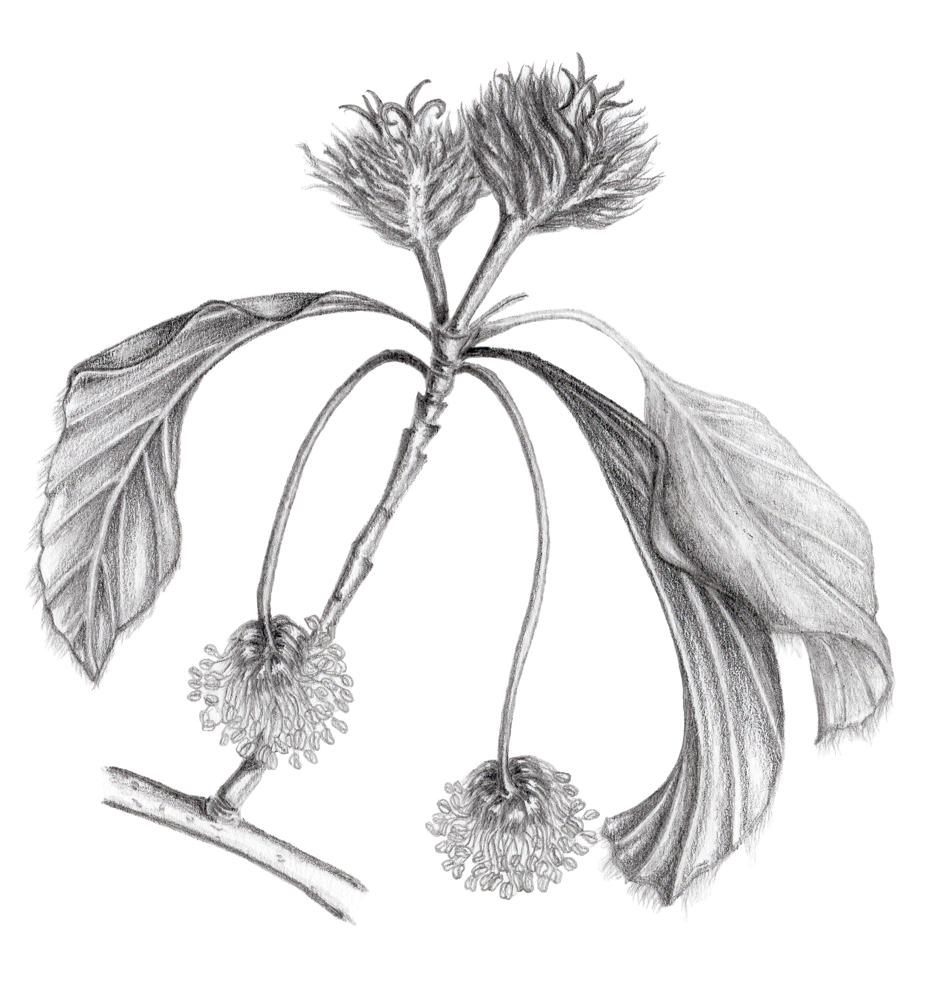
What’s next?
Trade-off with growth
Drivers of population synchrony
Adaptive value!
Notes:
- So, what’s next?
Starting from this HMM that better incorporate the biology of masting, we would be now able to iteratively increase its complexity if we want to expand the analysis
- e.g., test for the trade-off with growth: if we don’t have a breakdown, do we still have a resource depletion? This is one the hypothesis, that more reproduction because of warming reduce tree growth
- test for the main driver of high/low synchronicity: a very bad year can be a precise cue, and then the biological constraints maintain some sort of synchronicity, to some level...
- quantify the adaptive value of masting: how the observed and simulated behavior are optimal at the population scale

