Slide 1


DATA COLLECTION, DATA CLEANING, AND EXPLORATORY DATA ANALYSIS
CHRISTIAN SY

Slide 2

Specific Learning Outcomes
Knowledge and Understanding
Explain the role of data collection, data cleaning, and exploratory data analysis in the Machine Learning and NLP development lifecycle.
Differentiate between primary and secondary data and identify appropriate sources of datasets for AI research.
Describe common data quality problems, including missing values, duplicate records, inconsistent values, noise, and outliers.
Explain the purpose of Exploratory Data Analysis in understanding dataset characteristics and identifying potential problems before model development.

Slide 3
Specific Learning Outcomes
Application and Analysis
Identify the data requirements of their proposed thesis project.
Select an appropriate data collection method based on the research problem and proposed AI application.
Inspect and clean a dataset using appropriate preprocessing techniques.
Perform basic exploratory data analysis using descriptive statistics and visualizations.
Identify potential features, target variables, classes, or textual attributes relevant to their proposed ML or NLP task.
Analyze potential data quality, privacy, bias, and ethical issues associated with their dataset.

Slide 4
Thesis-Oriented Outcome
Develop a preliminary thesis dataset and data readiness report that can serve as the foundation for subsequent model development activities.

Slide 5
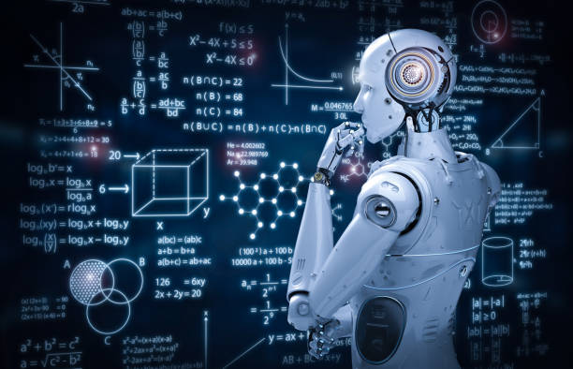
Introduction
Machine Learning (ML) and Natural Language Processing (NLP) projects are fundamentally data-driven. Regardless of how advanced an algorithm is, the quality and appropriateness of its output depend heavily on the quality, relevance, and preparation of the data used for training, testing, analysis, or knowledge retrieval.

Slide 6
Introduction
A common misconception among beginning AI researchers is that the most important part of an AI project is selecting a sophisticated algorithm. In practice, a substantial portion of AI development involves understanding, collecting, organizing, cleaning, and analyzing data.

Slide 7
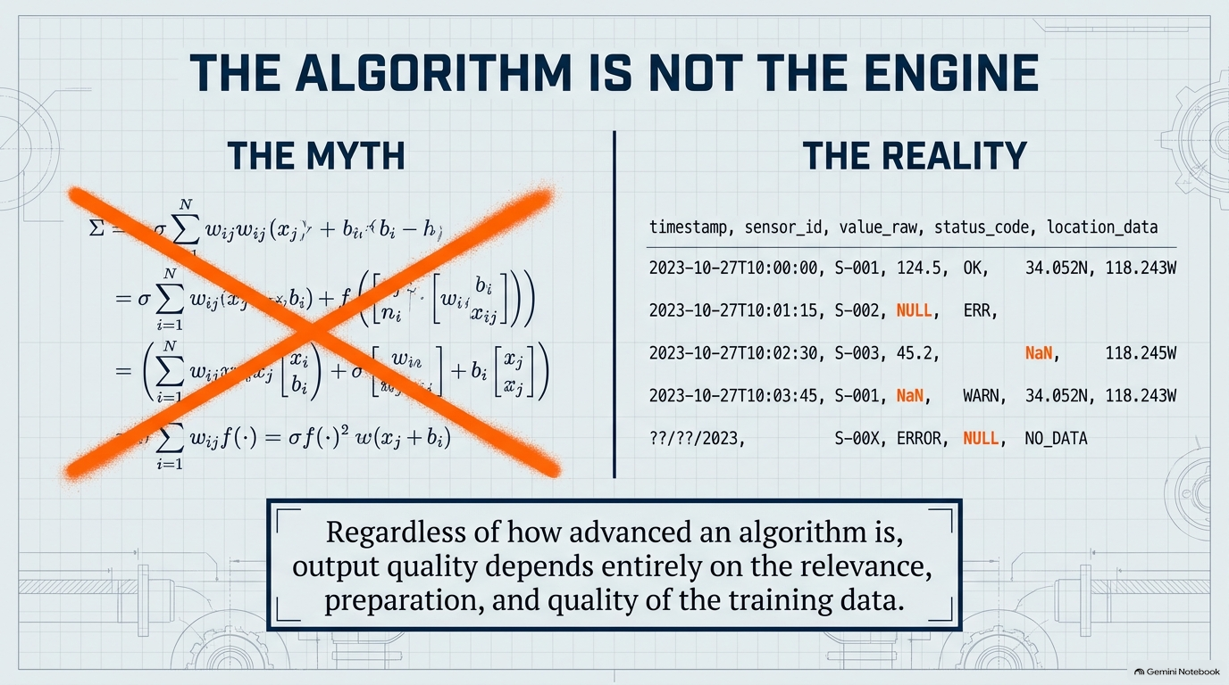

Slide 8
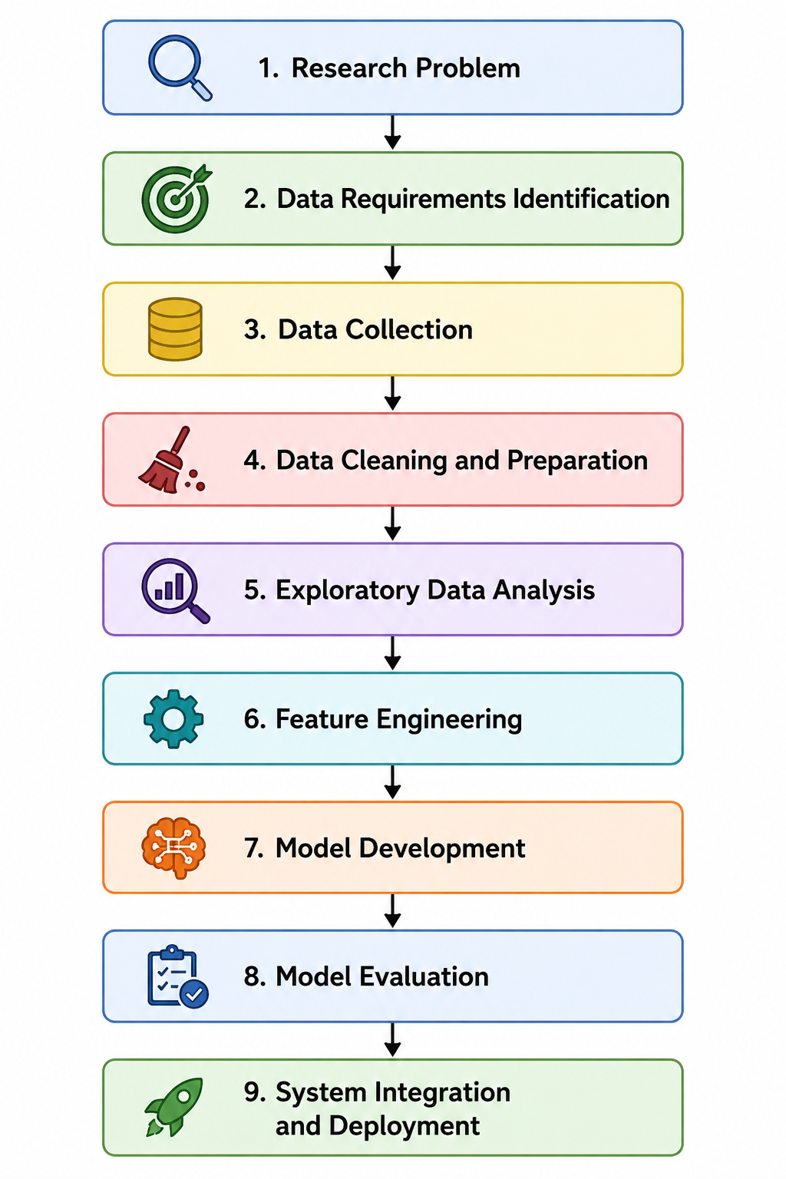

Overview of the
AI Data Lifecycle

Slide 9
PART I: DATA COLLECTION
Understanding Data Collection
Data collection is the systematic process of gathering information required to answer a research question, develop a computational model, or support a decision-making process. In Machine Learning, data serves as the basis from which a model learns patterns.
Before collecting data, students must first understand: What information does my proposed system need in order to perform its intended task?

Slide 10
PART I: DATA COLLECTION
Identifying Data Requirements
Students should not immediately collect any available dataset. They must first define their data requirements.
  What is the problem?
  What should the system do?
  What information might help make a prediction, classification, analysis, or decision?
  What should the model predict, classify, generate, or retrieve?
The predicted variable is commonly called the target variable, dependent variable, label, or output variable.

Slide 11
Features and Target Variables
Features are input variables used by a Machine Learning model to identify patterns. The target variable is the value or category the model attempts to predict.
Students should be able to complete the statement: My proposed AI system will use __________ as input in order to predict/classify/generate/retrieve __________.

Slide 12
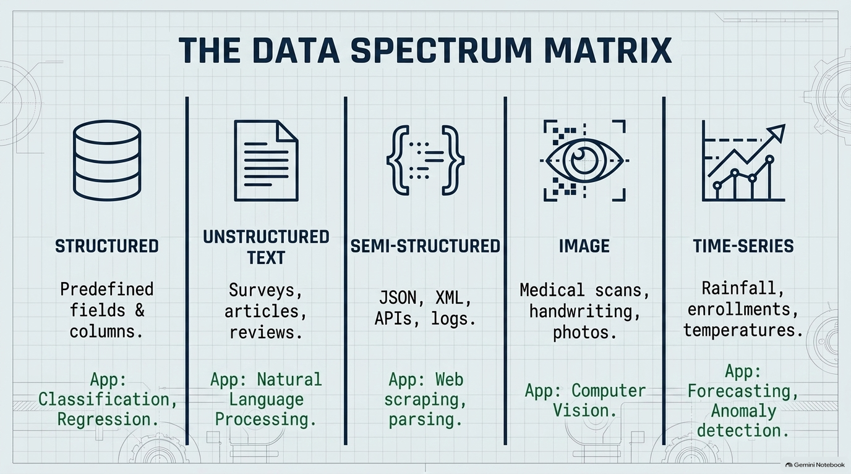
Notes:
1. Structured Data
Structured data is organized into predefined fields or columns. Examples include databases, spreadsheets, and CSV files. It is commonly used for classification, regression, prediction, and clustering.
2. Unstructured Text Data
Examples include survey responses, social media posts, student feedback, documents, news articles, and customer reviews. This type of data is commonly used in NLP.
3. Semi-Structured Data
Semi-structured data contains some organizational structure but does not follow a traditional relational database format. Examples include JSON, XML, API responses, and log files.
4. Image Data
Examples include plant leaf images, medical images, handwritten characters, and other visual data used in Computer Vision.
5. Time-Series Data
Time-series data is collected over time. Examples include daily rainfall, monthly enrollment, and temperature records. Common applications include forecasting, trend analysis, and anomaly detection.

Slide 13
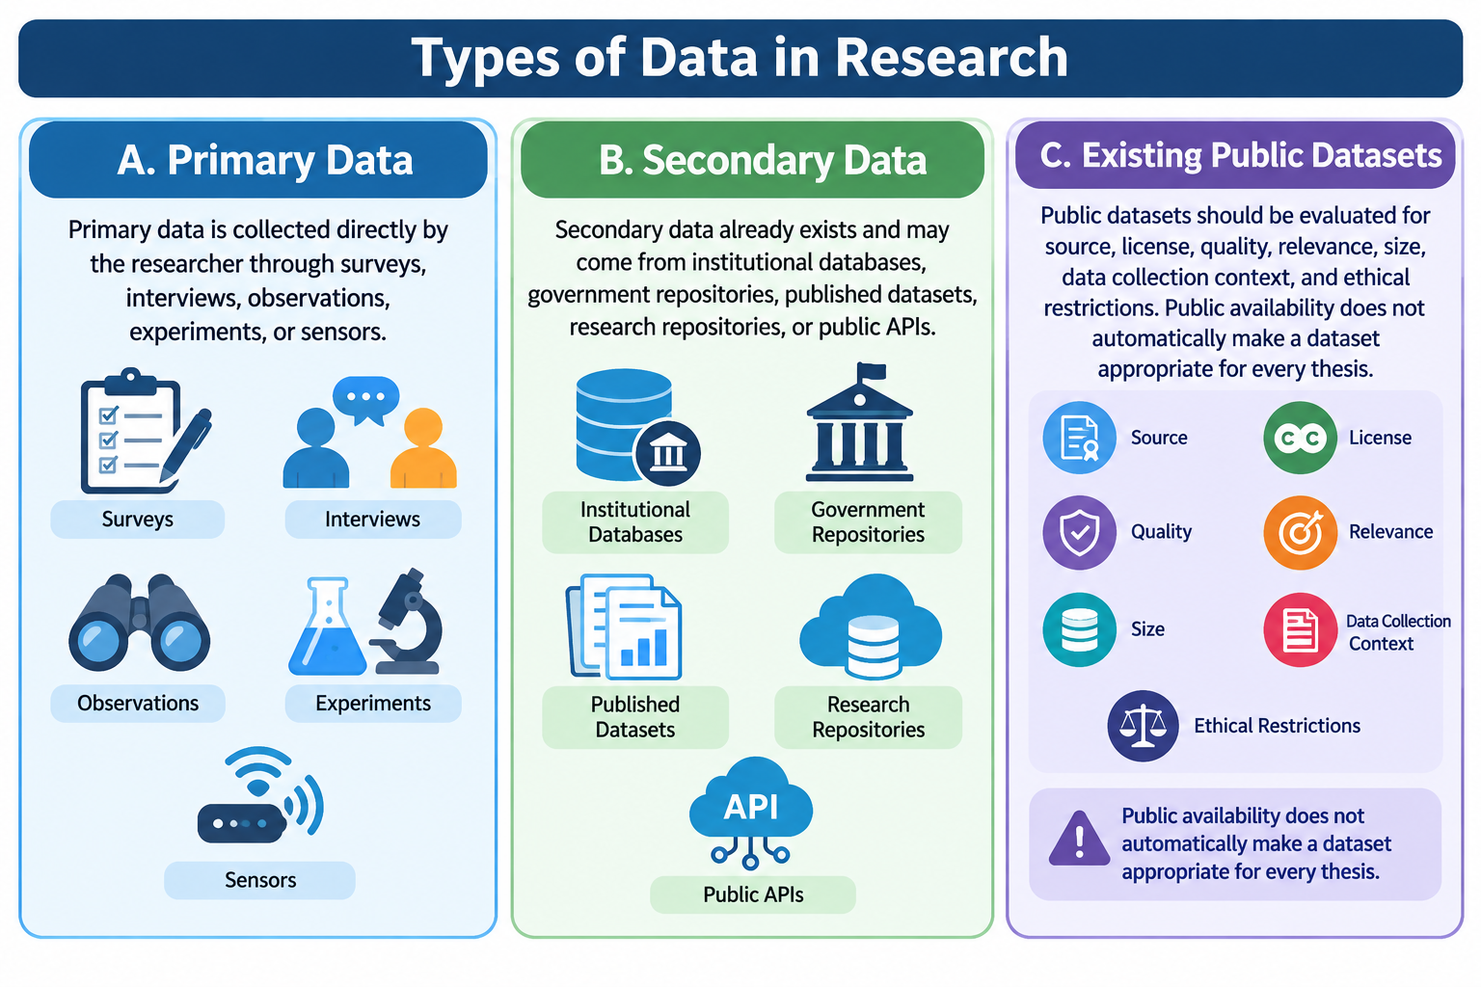
Notes:
A. Primary Data
Primary data is collected directly by the researcher through surveys, interviews, observations, experiments, or sensors.
B. Secondary Data
Secondary data already exists and may come from institutional databases, government repositories, published datasets, research repositories, or public APIs.
C. Existing Public Datasets
Public datasets should be evaluated for source, license, quality, relevance, size, data collection context, and ethical restrictions. Public availability does not automatically make a dataset appropriate for every thesis.

Slide 14
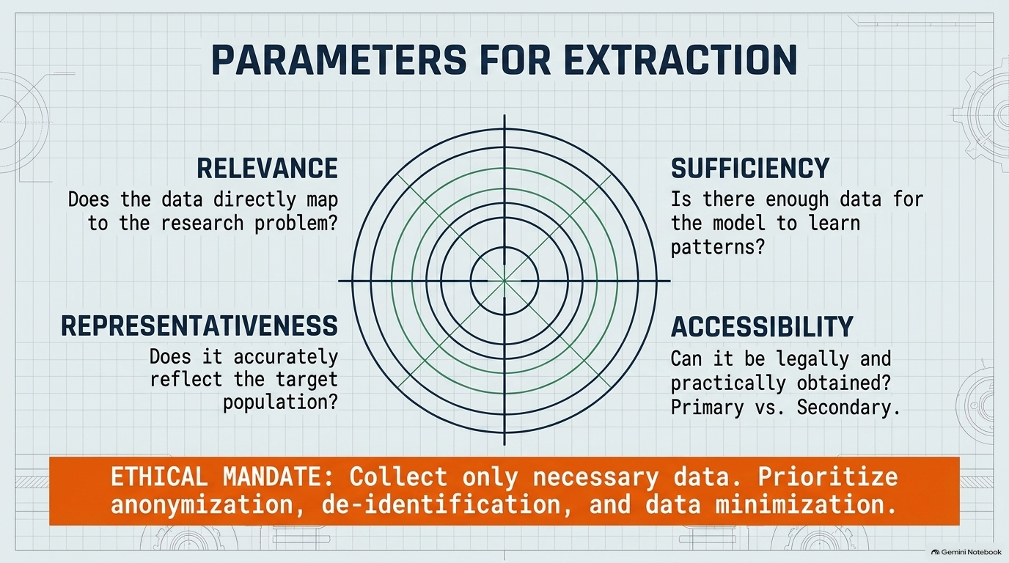
Notes:
1. Relevance
The data must directly relate to the research problem.
2. Sufficiency
There is no universal minimum dataset size. Students should consider whether they have sufficient and representative data for the proposed task.
3. Representativeness
The dataset should reasonably represent the population or situation being studied.
4. Accessibility
Students must determine whether the data can legally and practically be obtained, considering permissions, restrictions, and privacy requirements.

Slide 15
Data Privacy and Ethical Considerations
AI researchers must consider privacy, consent, security, and potential bias. Personally identifiable information should not be collected unless it is necessary and properly authorized.
Researchers should consider anonymization, de-identification, data minimization, and secure storage.
A key principle is: Collect only the data necessary to achieve the purpose of the study.

Slide 16
PART 2: DATA CLEANING
What is Data Cleaning?
Data cleaning is the process of identifying and correcting problems within a dataset. Real-world data commonly contains missing values, duplicate records, typographical errors, inconsistent formatting, incorrect data types, noise, outliers, and invalid values.
Poor-quality data can produce poor-quality models.

Slide 17
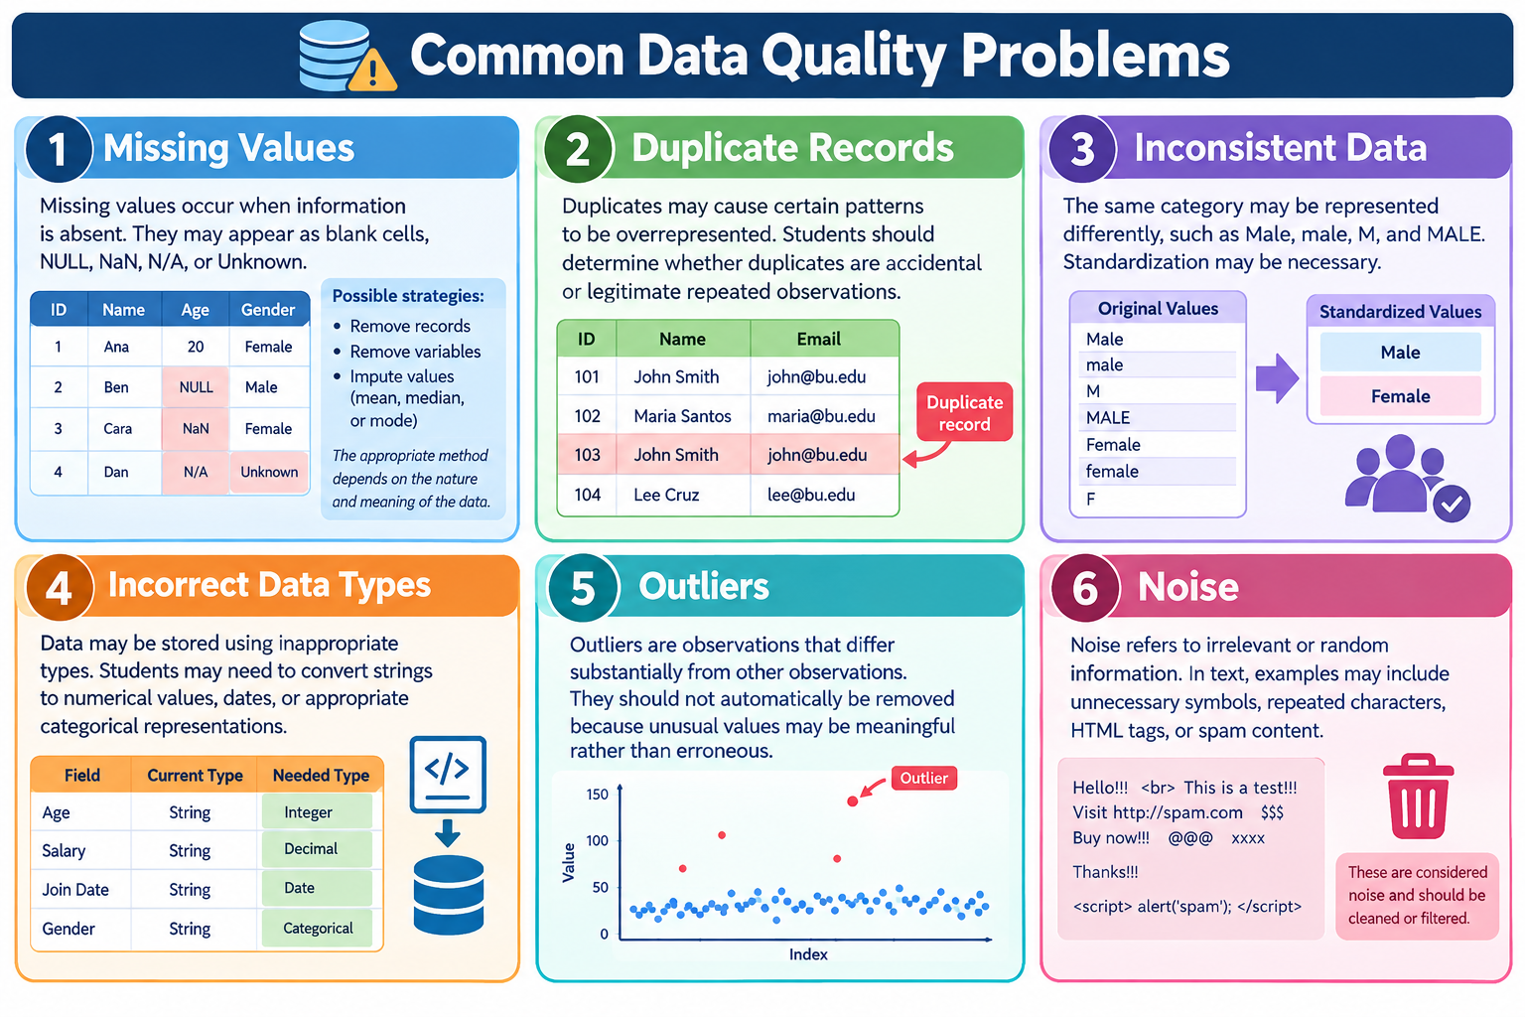
PART 2: DATA CLEANING
Notes:
Common Data Quality Problems
1. Missing Values
Missing values occur when information is absent. They may appear as blank cells, NULL, NaN, N/A, or Unknown.
Possible strategies include removing records, removing variables, or imputing values using approaches such as mean, median, or mode. The appropriate method depends on the nature and meaning of the data.
2. Duplicate Records
Duplicates may cause certain patterns to be overrepresented. Students should determine whether duplicates are accidental or legitimate repeated observations.
3. Inconsistent Data
The same category may be represented differently, such as Male, male, M, and MALE. Standardization may be necessary.
4. Incorrect Data Types
Data may be stored using inappropriate types. Students may need to convert strings to numerical values, dates, or appropriate categorical representations.
5. Outliers
Outliers are observations that differ substantially from other observations. They should not automatically be removed because unusual values may be meaningful rather than erroneous.
6. Noise
Noise refers to irrelevant or random information. In text, examples may include unnecessary symbols, repeated characters, HTML tags, or spam content.

Slide 18
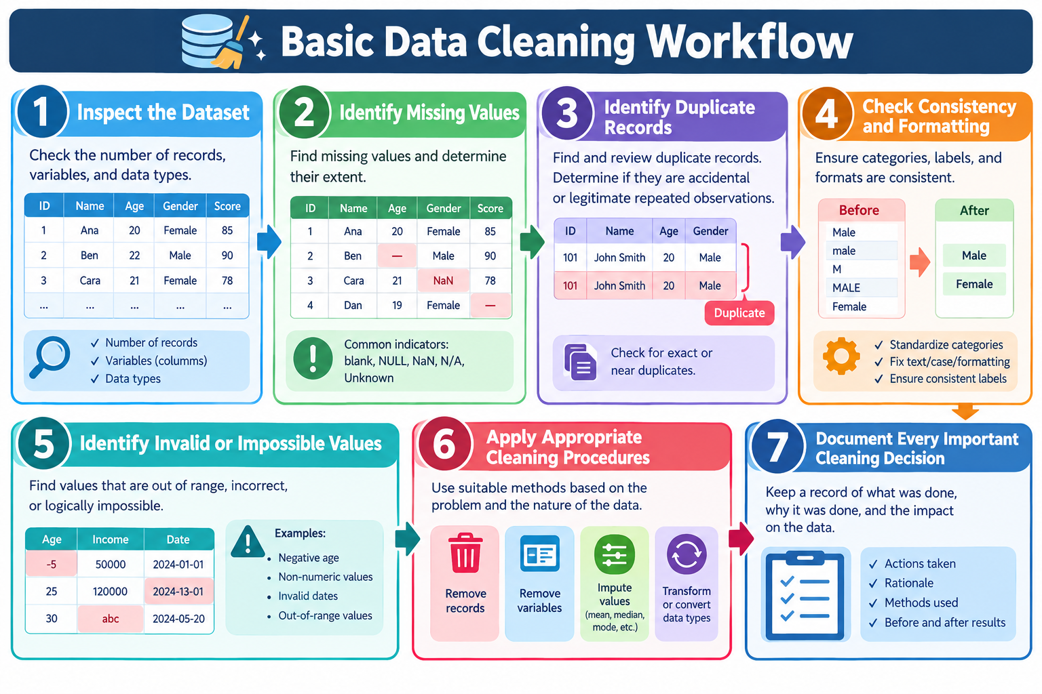
PART 2: DATA CLEANING
Notes:
Basic Data Cleaning Workflow
Inspect the dataset: number of records, variables, and data types.
Identify missing values and determine their extent.
Identify duplicate records.
Check data consistency and formatting.
Identify invalid or impossible values.
Apply appropriate cleaning procedures.
Document every important cleaning decision.

Slide 19
PART 3: EXPLORATORY DATA ANALYSIS
Exploratory Data Analysis (EDA) is the process of examining, summarizing, and visualizing a dataset to better understand its characteristics before major model development.
EDA helps answer questions such as:
How is the data distributed?
Are there missing values?
Are classes balanced?
Are some variables related?
Are there unusual values?

Slide 20
PART 3: EXPLORATORY DATA ANALYSIS
Why EDA is Important
EDA can reveal problems such as class imbalance.
For example, a dataset with 95% of observations in one class may produce misleadingly high accuracy if a model simply predicts the majority class. EDA helps researchers identify such problems before interpreting model performance.

Slide 21
PART 3: EXPLORATORY DATA ANALYSIS
Descriptive Statistics
Mean
The mean is the average value.
Median
The median is the middle value after arranging observations.
Mode
The mode is the most frequently occurring value.
Minimum and Maximum
These values help identify the range of observations and may reveal unexpected values.

Slide 22
PART 3: EXPLORATORY DATA ANALYSIS
Data Visualization
1. Bar Chart
Useful for categorical data and class distributions.
2. Histogram
Useful for understanding the distribution of numerical variables.
3. Box Plot
Useful for identifying potential outliers and understanding data spread.
4. Scatter Plot
Useful for examining relationships between two numerical variables.
5. Correlation Matrix
Used to examine relationships among numerical variables. Correlation does not automatically imply causation.

Slide 23
PART 4: EXPLORATORY DATA ANALYSIS
Class Distribution
For classification problems, students must examine how observations are distributed among classes. Class imbalance can affect model performance and make accuracy alone misleading.

Slide 24
PART 4: EDA FOR NLP DATA
Exploratory Analysis of Textual Data
For NLP datasets, students should examine the number of documents, text length, empty responses, duplicate texts, frequently occurring words, language use, and class distribution.
Possible exploratory measures include character counts, word counts, sentence counts, and frequency analysis.
Text preprocessing may include lowercasing, removing unnecessary spaces, handling URLs, and removing duplicate texts. More advanced preprocessing such as tokenization, stop-word removal, stemming, and lemmatization should depend on the research objective and model.

Slide 25
PART 4: EDA FOR NLP DATA
The Iterative Relationship Between Collection, Cleaning, and EDA
These processes are interconnected. A researcher may collect data, discover quality problems during cleaning, perform EDA, identify class imbalance, and then return to the data collection stage to obtain additional representative observations.

Slide 26
Common Mistakes Students Should Avoid
  Collecting data without a clear purpose.
  Selecting an algorithm before understanding the problem and data.
  Automatically deleting all missing data.
  Treating all outliers as errors.
  Ignoring class imbalance.
  Cleaning data without documentation.

Slide 27
Class Discussion Questions
  What data does your proposed system actually need to perform its intended function?
  Where will you obtain this data?
  Do you have permission to access and use the data?
  What will your model use as input?
  What should your model predict, classify, generate, or retrieve?
  What happens if a substantial portion of your dataset contains missing values?
  How would you know whether your dataset is biased or unbalanced?

Slide 28
Week 3 Lecture Post-Requirement
Thesis Dataset Readiness Assessment
Each group will prepare a preliminary assessment of the data required for their proposed thesis.
A. Thesis Title
B. Proposed AI/Computational Problem
C. Required Dataset
D. Data Source
E. Initial Features or Input Variables
F. Target Variable or Expected Output
G. Potential Data Issues
H. Data Ethics and Privacy Statement

Slide 29
Key Takeaways
Start with the research problem rather than immediately selecting an algorithm.
Define the data requirements needed to address the problem.
Data quality matters because incorrect, biased, missing, or poorly labeled data can affect model performance.
Explore the data before modeling to understand its characteristics and limitations.
Document the complete process for research reproducibility and thesis writing.

Slide 30
"A Machine Learning model does not begin with an algorithm. It begins with a problem and the data needed to understand that problem. Before asking which model performs best, a researcher must first understand what the data represents, where it came from, and whether it is suitable for the task."

Slide 31
Thank You

