Slide 1


INTRODUCTION TO MACHINE LEARNING AND BASELINE MODEL DEVELOPMENT
CHRISTIAN SY

Slide 2

Specific Learning Outcomes
Knowledge and Understanding
Explain the fundamental concepts and basic workflow of Machine Learning.
Differentiate supervised, unsupervised, and reinforcement learning at a conceptual level.
Distinguish between classification and regression problems.
Define the purpose and characteristics of a baseline model.
Explain the roles of features, labels, training data, validation data, and test data.
Describe overfitting, underfitting, and data leakage in introductory terms.

Slide 3
Specific Learning Outcomes
Application and Analysis
Translate their thesis problem into an appropriate Machine Learning task.
Identify the input features and target variable needed for a baseline model.
Prepare a dataset for basic model training using appropriate preprocessing procedures.
Split data into training and testing subsets.
Develop and train at least one appropriate baseline Machine Learning model.
Generate predictions and evaluate the model using appropriate metrics.
Interpret baseline results and identify possible areas for improvement.

Slide 4
Thesis-Oriented Outcome
Develop Baseline Model v1.0 using the student’s thesis dataset or a justified preliminary dataset, accompanied by a short experiment report documenting the problem, data, model, procedure, results, and initial interpretation.

Slide 5

What is Machine Learning?
Machine Learning is a field of Artificial Intelligence in which computational systems learn patterns from data in order to make predictions, classifications, estimates, recommendations, or other data-driven outputs.
Instead of programming a separate rule for every possible situation, the developer provides examples from which an algorithm identifies useful patterns.

Slide 6
Introduction
For example, a researcher may provide historical student records and known academic outcomes so that a model can learn relationships between student-related inputs and academic risk.
Conceptually: DATA + LEARNING ALGORITHM → MODEL → PREDICTION / DECISION.

Slide 7
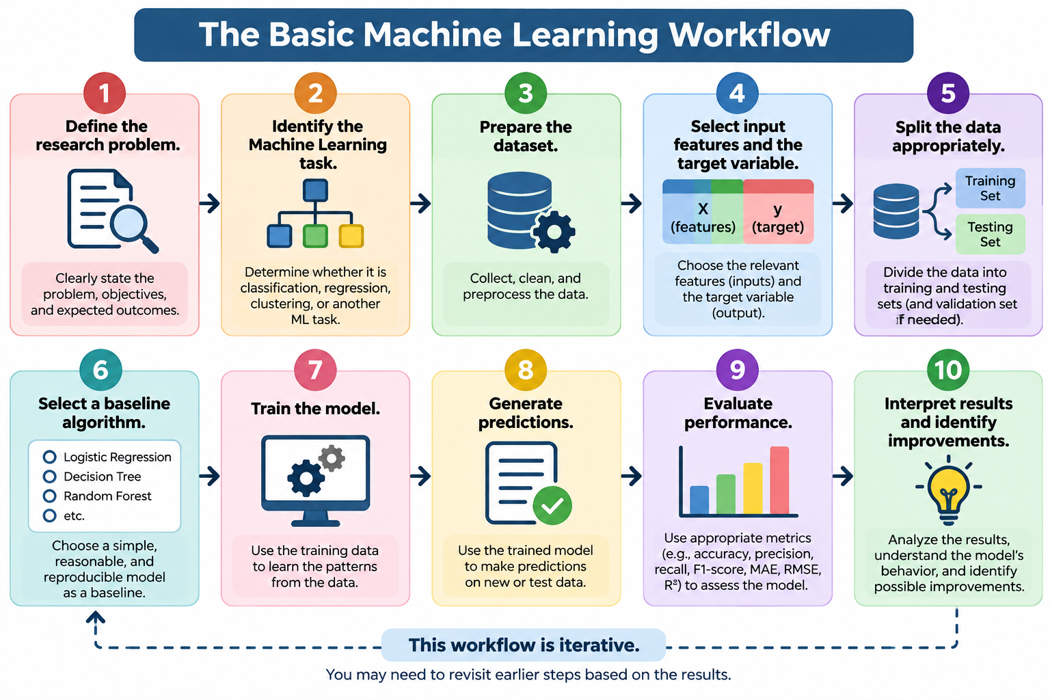

Slide 8
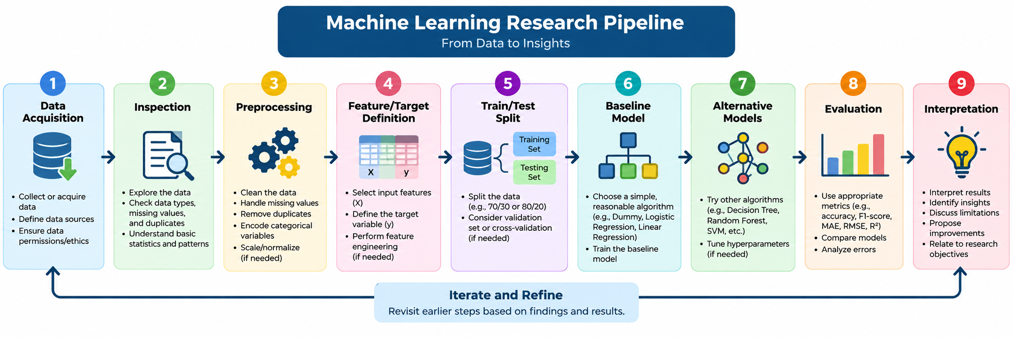

Slide 9
Major Types of Machine Learning
1. Supervised learning is appropriate when historical examples include known outputs; examples include academic-risk classification, phishing detection, plant-disease classification, final-grade estimation, rainfall estimation, and enrollment forecasting.
    Example: Given student attendance, GPA, study hours, and failed subjects together with known Risk Status labels, a model can learn to classify new students as At Risk or Not At Risk.

Slide 10
1. Supervised Learning
Supervised learning uses labeled examples. Each observation contains input information and a known output or target. The model learns a relationship between inputs and outputs.
Input | Known Output
Student attendance, GPA, failed subjects | At Risk / Not at Risk
Email text | Spam / Not Spam
House characteristics | House price
The two most common supervised tasks are classification and regression.

Slide 11
Major Types of Machine Learning
2. Unsupervised learning is appropriate when no predefined target is available and the objective is to discover structure; examples include student-profile clustering, customer segmentation, document clustering, and topic discovery.
    Example: Student records containing attendance, GPA, study hours, and failed subjects can be standardized and grouped using K-Means without supplying Risk Status. Researchers then inspect cluster profiles and a silhouette score to determine whether meaningful structures are present. Cluster numbers have no inherent real-world meaning and must be interpreted from the observed characteristics.

Slide 12
2. Unsupervised Learning
Unsupervised learning works with data that does not contain a predefined target label. The objective is often to discover hidden groups, structures, or relationships. Common examples include clustering and dimensionality reduction.
Input | Discovered Output / Pattern
Student attendance, GPA, study hours, failed subjects | Student groups or clusters with similar academic profiles
Customer purchase frequency, spending, and transaction history | Customer segments with similar purchasing behavior
News articles or documents | Groups of documents with similar topics
Social media posts | Topics, themes, or clusters of similar posts
Patient measurements and health indicators | Groups of patients with similar characteristics
Network traffic characteristics | Normal traffic clusters and potentially unusual patterns
Product purchase records | Groups of products or customers with similar purchasing patterns
Images represented by extracted features | Groups of visually similar images
Unlike supervised learning, the student dataset does not contain labels such as At Risk or Not at Risk. An algorithm such as K-Means examines the features and discovers groups based on similarities in the data.

Slide 13
Major Types of Machine Learning
3. Reinforcement learning is appropriate for sequential decision-making in which an agent learns through interaction, such as grid-world navigation, adaptive traffic control, game playing, and simulated resource allocation.
    Example: In a small grid world, a virtual robot observes its current position, chooses Up/Down/Left/Right, and receives a positive reward for reaching a goal and a small penalty for unnecessary moves. Q-learning can be used to learn a policy. For this lesson, reinforcement learning serves as an introductory demonstration unless a thesis specifically requires sequential decision-making.

Slide 14
3. Reinforcement Learning
Reinforcement learning involves an agent learning through interaction with an environment using rewards or penalties.
State / Input | Possible Actions | Reward / Goal
Robot's current position in a grid | Move Up, Down, Left, Right | Reach the goal using fewer steps
Current traffic conditions at an intersection | Change or maintain traffic-light phase | Reduce vehicle waiting time and congestion
Current state of a computer game | Move, jump, attack, defend | Maximize game score or win
Current location and obstacles of a mobile robot | Move forward, turn left/right, stop | Reach destination while avoiding obstacles
Current allocation of computing resources | Allocate, release, or reassign resources | Improve resource utilization and reduce delays
Current network conditions | Select routing path | Reduce latency or congestion
Current inventory level and demand | Order, wait, or adjust quantity | Minimize shortages and inventory costs
Current energy demand and system condition | Adjust energy allocation | Meet demand efficiently
Example: In the Grid-World activity, the agent starts at a particular location. It does not receive a known correct output such as At Risk. Instead, it tries actions and receives rewards or penalties.

Slide 15
Classification and Regression
Classification and regression are both supervised-learning tasks, but their targets differ.
Classification predicts discrete categories, whereas regression estimates continuous numerical values.
Classification may be binary (At Risk/Not At Risk), multiclass (Low/Moderate/High risk), or multilabel (a document assigned several tags).
Regression examples include final-grade estimation, rainfall amount, energy demand, enrollment count, and travel time.
Decision guide: If the intended output is a named class or category, formulate the problem as classification. If the intended output is a numerical quantity on a continuous scale, formulate it as regression. The research objective and target definition should determine the task, not the algorithm the researcher prefers to use.

Slide 16
Classification
Classification predicts a category or class.
Example Problem | Possible Output
Spam detection | Spam / Not Spam
Sentiment analysis | Positive / Negative / Neutral
Student risk prediction | At Risk / Not at Risk
Disease classification | Disease category

Slide 17
Regression
Regression predicts a continuous numerical value.
Example Problem | Predicted Output
House price prediction | Price
Rainfall forecasting | Rainfall amount
Enrollment forecasting | Number of students
If the expected output is a category, consider classification;
if it is a numerical quantity, consider regression.

Slide 18
Translating a Thesis Problem into a Machine Learning Problem
Academic Risk Prediction:
Given academic and learning-related indicators, the model should classify students according to academic risk in order to support early intervention.
One row represents one student; X may include attendance, GPA, study hours, failed subjects, internet access, and other justified predictors; y is Risk Status.
An identifier such as Student_ID should normally be excluded because it identifies the record rather than describing a meaningful predictive characteristic.

Slide 19
Translating a Thesis Problem into a Machine Learning Problem
Academic Risk Prediction:
Final Grade Estimation: Given attendance, study hours, previous grade, and assignment completion, the model should estimate Final Grade.
Because the target is numerical, this is a regression problem.
The experiment can compare a mean Dummy Regressor, Linear Regression, Decision Tree Regressor, and Random Forest Regressor using MAE, RMSE, and R-squared.

Slide 20
Translating a Thesis Problem into a Machine Learning Problem
A thesis title or general research problem does not automatically define a Machine Learning task. Students must transform the research problem into a computational formulation.
Useful template: Given [INPUT DATA], the proposed model should [PREDICT / CLASSIFY / ESTIMATE] [TARGET] in order to [PURPOSE].
Example: Given student academic and attendance records, the proposed model should classify students according to academic risk in order to support early intervention.
Unit of analysis: What does one row or observation represent?
Features: What information will be used as input?
Target: What should the model predict?
Task type: Classification or regression?
Success criteria: How will performance be evaluated?

Slide 21
Understanding Features and Labels
Example: In academic-risk classification, Attendance, GPA, Study_Hours, and Failed_Subjects are candidate features (X), while Risk_Status is the target (y). In sentiment analysis, the original text is the input; after TF-IDF feature extraction it becomes a numerical feature matrix, while Sentiment is the target label. Features should be available at the intended prediction time and should not directly reveal the target.
Features are input variables used by a model to identify patterns and are commonly represented as X. The target or label is the value the model attempts to predict and is commonly represented as y.
Attendance | GPA | Failed Subjects | Risk Status
95 | 1.75 | 0 | Not at Risk
60 | 3.00 | 3 | At Risk
Students should avoid including variables that reveal the target directly or information that would not realistically be available at prediction time.

Slide 22
What is a Baseline Model?
Example progression for classification: begin with a most-frequent Dummy Classifier to establish a naive reference, then train Logistic Regression as a simple learned baseline. Only after establishing these references should students compare Decision Tree, KNN, Random Forest, or other justified algorithms.
For regression, a mean Dummy Regressor can be followed by Linear Regression before more flexible models are tested.
For NLP text classification, a transparent baseline is TF-IDF plus Logistic Regression or Multinomial Naive Bayes. This allows students to understand feature extraction and model behavior before moving to embeddings or transformer-based methods.
A baseline model is an initial model used as a reference point for later comparison. It is usually simple, computationally manageable, reproducible, and sufficiently interpretable for an initial experiment. The baseline answers: What level of performance can be achieved using a reasonable initial approach?

Slide 23
Example
Suppose there are 100 students, with 70 Not at Risk and 30 At Risk.
A Dummy Classifier that always predicts Not at Risk would obtain:
Accuracy = 70%
This becomes a very simple reference point.
Then the students train Logistic Regression and obtain, for example:
Accuracy = 82%, Precision = 78%, Recall = 75%, F1 = 76%
They can then test Decision Tree, KNN, and Random Forest and determine whether these models provide meaningful improvement.
The important point is:
Baseline → Compare → Improve → Evaluate → Justify
A model should not be considered an improvement merely because it is more sophisticated. Students should demonstrate that it improves relevant performance measures, generalizes to unseen data, and remains appropriate for the research problem.

Slide 24
Characteristics of a Good Baseline
Appropriate for the identified problem type.
Simple enough to implement and explain.
Reproducible.
Evaluated using appropriate metrics.
Used as a reference for later improvement and comparison.

Slide 25
Baseline Versus Advanced Models
A baseline is not necessarily the final model. Its purpose is to establish a measurable starting point. Later models can be evaluated to determine whether they provide meaningful improvement. A complex model is not automatically better simply because it is sophisticated.
Recommended progression: Understand the problem → Understand the data → Establish a baseline → Compare and improve.

Slide 26
Examples of Baseline Algorithms
For Classification
Dummy Classifier or majority-class baseline
Logistic Regression
Decision Tree
k-Nearest Neighbors (KNN)
For Regression
Dummy Regressor or mean-prediction baseline
Linear Regression
Decision Tree Regressor
For introductory thesis work, students may begin with an interpretable algorithm such as Logistic Regression for classification or Linear Regression for regression, unless the data characteristics justify another choice.

Slide 27
What is a Baseline Model?
ML Task / Application | Example Baseline Model | What the Baseline Does | Possible Models for Later Comparison
Student Academic Risk Classification | Dummy Classifier | Predicts the majority class, e.g., Not at Risk | Logistic Regression, Decision Tree, KNN, Random Forest
Student Academic Risk Classification | Logistic Regression | Establishes a simple learned classification baseline | Decision Tree, Random Forest, SVM, boosting
Spam Email Detection | Logistic Regression | Classifies TF-IDF email features as Spam/Not Spam | Naive Bayes, Linear SVM, Random Forest
Sentiment Analysis | TF-IDF + Logistic Regression | Classifies text as Positive/Negative/Neutral | Naive Bayes, Linear SVM, transformers
Disease Classification | Logistic Regression | Establishes an interpretable initial classifier from structured features | Decision Tree, Random Forest, SVM, neural network
Final Grade Prediction | Dummy Regressor | Predicts the mean training-set grade for every case | Linear Regression, Decision Tree Regressor, Random Forest
Final Grade Prediction | Linear Regression | Establishes a simple learned numerical prediction baseline | Random Forest Regressor, Gradient Boosting
House Price Prediction | Linear Regression | Estimates price using a linear relationship with house characteristics | Decision Tree, Random Forest, boosting
Rainfall Prediction | Mean Dummy Regressor / Linear Regression | Provides a simple numerical reference | Random Forest Regressor, Gradient Boosting
Student Profile Clustering | K-Means | Provides an initial clustering solution | Hierarchical Clustering, DBSCAN
Document Clustering | TF-IDF + K-Means | Groups documents using text-feature similarity | Embedding-based clustering, BERTopic

Slide 28
Preparing Data for Model Training
Tabular classification:
inspect missing values and duplicates;
remove identifiers;
define numerical and categorical columns;
fit scaling to numerical variables and one-hot encoding to categorical variables through a preprocessing Pipeline.
This helps ensure that transformations learned from training data are applied consistently to unseen data.

Slide 29
Preparing Data for Model Training
Clustering:
because K-Means uses distances, variables such as Attendance, GPA, Study_Hours, and Failed_Subjects should be standardized before clustering so that a variable with a larger numerical scale does not dominate the distance calculation.
NLP sentiment analysis:
inspect text and labels, remove duplicates where appropriate, normalize text only when justified, split text and labels into training/testing sets, and fit TF-IDF on the training text through a Pipeline. Do not fit the vectorizer on the full dataset before the split.

Slide 30
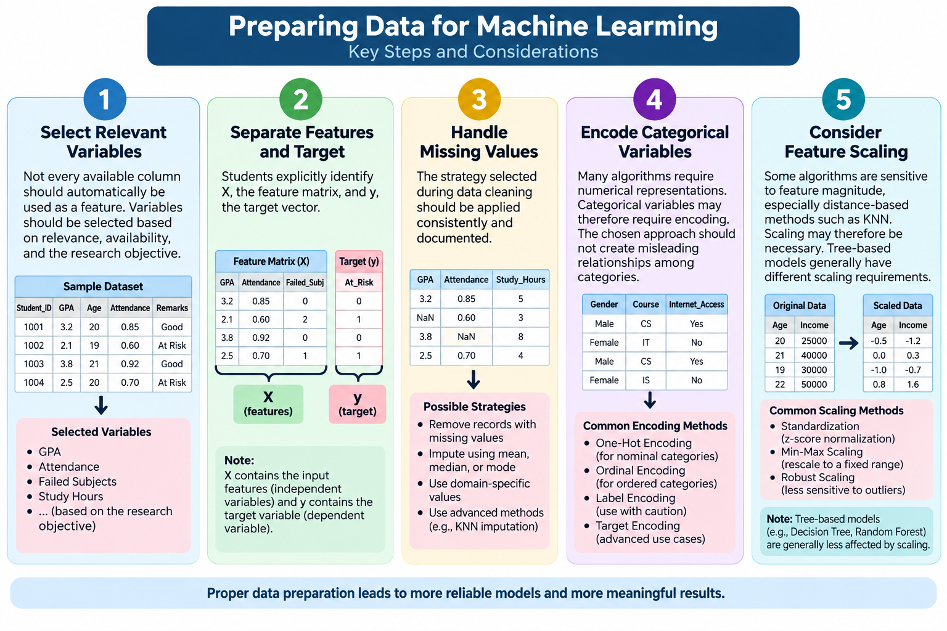

Slide 31
Training, Validation, and Testing Data
Example:
With 300 labeled observations, an introductory experiment might reserve 20% as a held-out test set and use the remaining 80% for training and model development.
For classification, stratification can help preserve class proportions.
Cross-validation can then be applied within the training/model-development process to compare configurations more reliably.
The held-out test set should not become a repeated tuning target.

Slide 32
Training, Validation, and Testing Data
The training set is used by the algorithm to learn patterns from known examples.
The testing set is held out and used to estimate how the trained model performs on unseen observations.
A validation set may be used during model selection and tuning.
In introductory activities, students may initially use a train-test split and later learn cross-validation. An 80:20 split is a common example, but the appropriate proportion depends on dataset size and research design.

Slide 33
Data Leakage
leakage examples:
encoding Risk_Status as an input feature;
fitting StandardScaler or TF-IDF using the complete dataset before evaluation;
using a future-semester outcome to predict an earlier event; and
allowing duplicate or near-duplicate cases to appear in both training and testing sets.
Extremely high performance should therefore trigger a leakage check rather than immediate acceptance of the result.

Slide 34
Data Leakage
Data leakage occurs when information that should not be available during training improperly influences the model or evaluation process. Leakage can produce unrealistically high performance.
Including the target variable or a direct proxy for it among the features.
Using information from the test set improperly during preprocessing or model selection.
Using future information to predict an earlier event.
Allowing duplicate or near-duplicate observations to appear in both training and test sets when they should be treated as related.
Preventing leakage is essential for trustworthy and defensible thesis results.

Slide 35
Training the Baseline Model
Classification example: after preprocessing, train Logistic Regression on X_train and y_train, then generate predictions only for X_test.
Regression example: train Linear Regression using the training subset and estimate continuous values for the held-out subset.
Unsupervised example: K-Means is fitted to a prepared feature matrix without y because clustering has no predefined target.
Reinforcement-learning example follows a different training structure: define the environment, states, actions, and rewards; initialize action values; allow exploration and exploitation; update Q-values after interactions; then evaluate the learned policy by observing whether it reaches the goal efficiently.

Slide 36
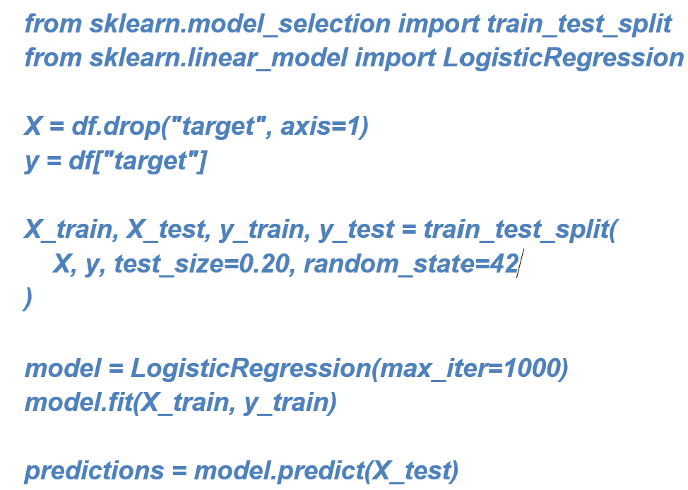
Training the Baseline Model
Model training is the process in which an algorithm identifies relationships between input features and known target values in the training data.
Students should modify the code according to their own dataset and problem. The code is not the research method by itself; students must understand and document each step.

Slide 37
Initial Model Evaluation
Classification example: suppose 20 students are actually At Risk and the model detects 18. Recall for the At Risk class is high, but precision may still be lower if many Not At Risk students are incorrectly flagged. Accuracy alone therefore cannot describe the consequences of the model's errors.
Regression example: MAE expresses the average absolute error in the target's unit; MSE penalizes larger errors more strongly; RMSE returns the error to approximately the original unit; and R-squared describes performance relative to a mean-prediction reference. These metrics should be interpreted together rather than in isolation.

Slide 38
Initial Model Evaluation
Evaluation metrics should match the Machine Learning task and the consequences of possible errors.
Classification Metrics
Accuracy: proportion of predictions that are correct.
Precision: among predicted positive cases, how many were actually positive?
Recall: among actual positive cases, how many were correctly identified?
F1-score: a harmonic balance between precision and recall.
Accuracy alone can be misleading, particularly when classes are imbalanced.
Regression Metrics
Mean Absolute Error (MAE)
Mean Squared Error (MSE)
Root Mean Squared Error (RMSE)
Coefficient of Determination (R²)

Slide 39
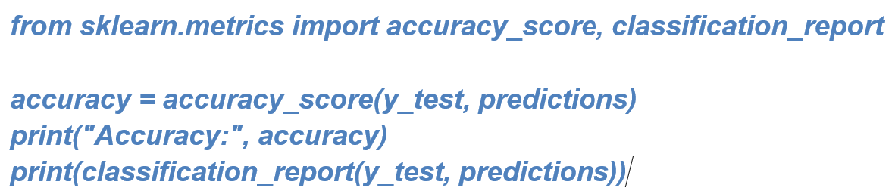
Initial Model Evaluation

Slide 40
The Confusion Matrix
Example interpretation: A false negative in academic-risk prediction means an actually At Risk student is predicted as Not At Risk. A false positive means a Not At Risk student is flagged as At Risk. Which error is more serious depends on the research application, available interventions, and consequences of incorrect decisions.
For classification, a confusion matrix summarizes correct and incorrect predictions by class.
True Positive (TP)
True Negative (TN)
False Positive (FP)
False Negative (FN)
Students should consider the consequences of different errors. In some applications, failing to identify a true positive case may be more serious than incorrectly flagging a negative case.

Slide 41
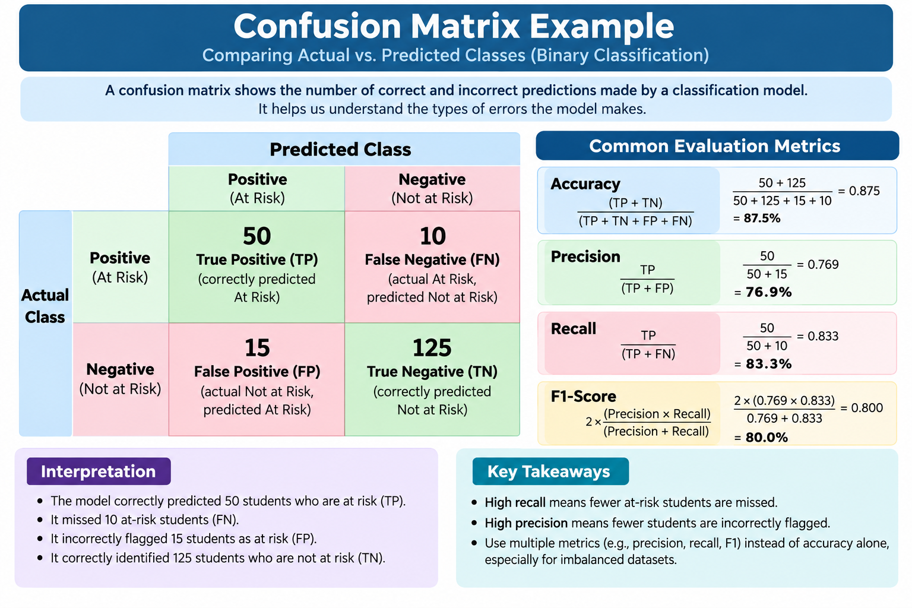

Slide 42
Overfitting and Underfitting
a Decision Tree with very shallow depth may perform poorly on both training and testing data, suggesting underfitting. A fully grown tree may achieve nearly perfect training accuracy but noticeably weaker test accuracy, suggesting overfitting. Students should compare training and unseen-data behavior rather than reporting training performance alone.
Underfitting occurs when a model is too simple or insufficiently trained to capture important patterns. Performance may be poor even on training data.
Overfitting occurs when a model learns patterns that are overly specific to the training data, including noise, and performs poorly on unseen data. The goal is not simply to maximize training performance but to generalize reasonably well.

Slide 43
Reproducibility in Thesis Experiments
For every experiment, record the dataset source/version, observations used, features and target, preprocessing procedures, split or validation method, algorithm, important hyperparameters, random seed, evaluation metrics, results, and interpretation.
For text experiments, also document normalization, tokenization or vectorization settings; for clustering, document scaling and number of clusters; for reinforcement learning, document states, actions, reward design, learning rate, discount factor, exploration strategy, and number of episodes.

Slide 44
Reproducibility in Thesis Experiments
Students should document experiments so that the work can be repeated and verified.
Dataset source and version
Number of observations used
Features and target variable
Preprocessing procedures
Train-test split or validation procedure
Algorithm used
Important model parameters
Random seed, where applicable
Evaluation metrics
Results and interpretation
This documentation will later support the methodology and results sections of the thesis.

Slide 45
Interpreting Baseline Results
Model comparison should be evidence-based.
For classification, compare the naive baseline and learned models using metrics relevant to the problem and inspect confusion-matrix errors.
For regression, compare MAE/RMSE/R-squared and inspect large residuals.
For clustering, inspect silhouette score together with cluster profiles.
For reinforcement learning, inspect the learned policy, path efficiency, and accumulated reward.
A more complex model should be retained only when its improvement is meaningful for the research objective.

Slide 46
Key Takeaways
A baseline result should not simply be described as good or bad. Students should ask:
Does the model perform better than a trivial or naive approach?
Which classes are predicted well or poorly?
Is the dataset imbalanced?
Are some features missing or unreliable?
Could preprocessing be improved?
Should another algorithm be tested?
Are the results sufficient to justify continuing the proposed approach?
The baseline is the beginning of systematic experimentation, not the final answer.

Slide 47
Baseline Model for NLP Thesis Projects
Sentiment-analysis example:
create or acquire labeled feedback with Positive, Negative, and Neutral classes;
inspect duplicates and class distribution;
split the original text and labels;
normalize text conservatively;
extract TF-IDF features through a Pipeline;
compare a Dummy Classifier with Logistic Regression, Multinomial Naive Bayes, or Linear SVM;
evaluate accuracy and macro/weighted F1;
display a confusion matrix;
and read misclassified statements to identify ambiguity, negation, slang, code-switching, or insufficient context.

Slide 48
Baseline Model for NLP Thesis Projects
Example statements:
'The application is easy to use' -> Positive;
'The system keeps crashing during submission' -> Negative;
'The update was installed yesterday' -> Neutral.
These are instructional examples. Actual thesis labels should follow a documented annotation procedure appropriate to the research design.
For NLP theses, the same baseline principle applies, but the input consists of textual data. A practical introductory text-classification pipeline is:
Text → Cleaning/Normalization → TF-IDF Vectorization → Logistic Regression or Naive Bayes → Prediction → Evaluation

Slide 49
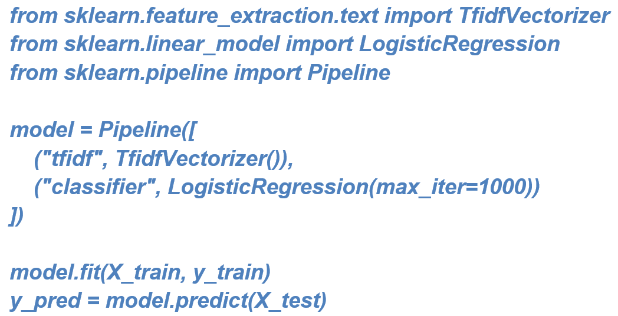
Baseline Model for NLP Thesis Projects
TF-IDF converts text into numerical features based on term importance. Logistic Regression or Multinomial Naive Bayes can then use those features for classification.
This provides a transparent educational baseline that can later be compared with word embeddings, pretrained language models, or transformer-based approaches.

Slide 50
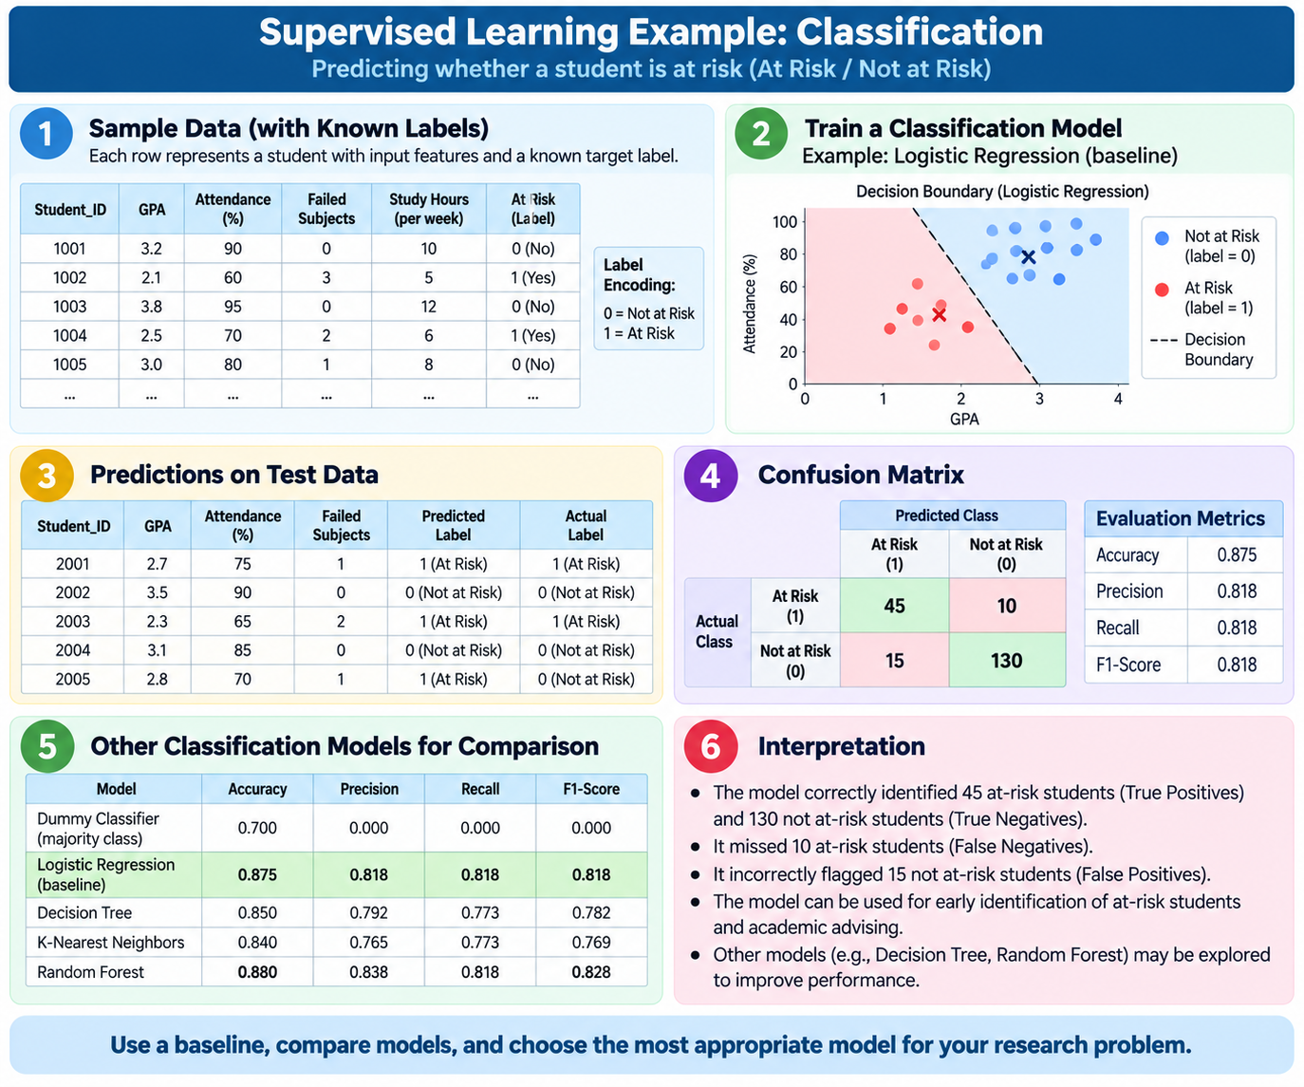

Slide 51
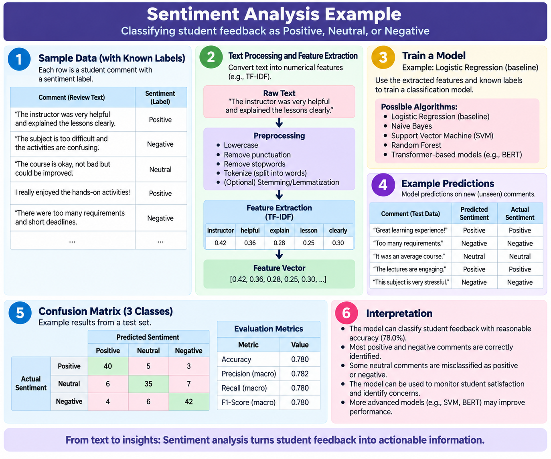

Slide 52
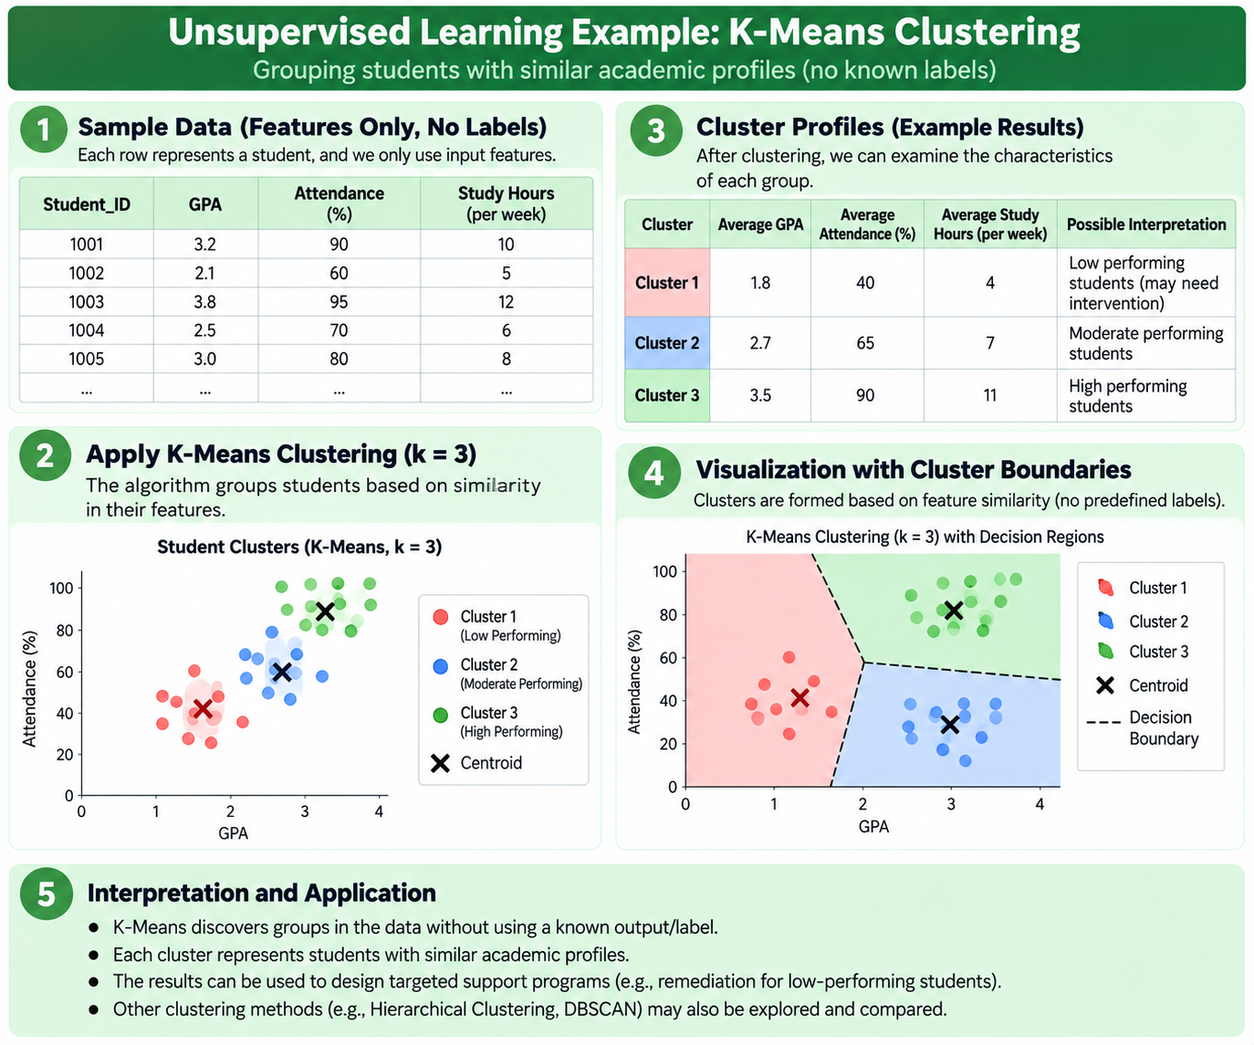

Slide 53
Class Discussion Questions
Integrated application summary:
Academic Risk Prediction demonstrates supervised classification;
Final Grade Estimation demonstrates supervised regression;
Student Profile Discovery demonstrates unsupervised clustering;
Grid-World Navigation demonstrates reinforcement learning;
and Student Feedback Sentiment demonstrates supervised NLP classification.
Across examples, students should move systematically from problem formulation and data preparation to modeling, evaluation, error analysis, interpretation, and documentation.

Slide 54
Class Discussion Questions
What exactly should your thesis model predict or classify?
What does one observation in your dataset represent?
Which variables should be used as input features?
Which variable is the target?
Why is a simple baseline useful before testing a complex model?
How can a model obtain high accuracy but still be ineffective?
What type of error would be most harmful in your thesis application?
How can you ensure that your experiment is reproducible?
For an NLP thesis, why might TF-IDF plus Logistic Regression be a useful baseline?

Slide 55
Week 5-8 Lecture Post-Requirement
Baseline Model Planning Sheet. Students will prepare a concise plan before implementing their first baseline model.
Component | Required Student Response
Thesis Title | State the current thesis title.
Research Problem | Briefly state the problem to be addressed.
ML Problem Formulation | Use the Given–Model–Purpose statement.
Task Type | Classification, regression, or another justified task.
Unit of Analysis | Explain what one row or observation represents.
Features | List the initial input variables.
Target | Identify the expected output or label.
Baseline Algorithm | Identify and justify the initial algorithm.
Data Split Plan | State the proposed train-test procedure.
Evaluation Metrics | Identify appropriate metrics and justify them.
Expected Challenges | Identify likely data or modeling problems.

Slide 56
Key Takeaways
A Machine Learning model begins with a clearly defined computational problem.
The selection of features and target variable determines what the model can learn.
A baseline model provides an essential reference for later experiments.
Training and testing must be separated to estimate performance on unseen data.
Evaluation metrics must match the research problem and the consequences of errors.
Baseline results should guide improvement, comparison, and further experimentation.
NLP projects can establish transparent traditional baselines before moving to advanced language models.
Every experiment should be documented for reproducibility and thesis writing.

Slide 57
“The purpose of a baseline model is not to prove that the first algorithm is the best. Its purpose is to establish a clear and measurable starting point. Once the researcher knows where the model begins, meaningful improvement and comparison can follow.”

Slide 58
Thank You

