Slide 1

Hotspot Garbage Collection

Slide 2
What I'm going to cover
Part I - Diving into the Dark (~30 min)
GC Theory
Hotspot memory organisation and collectors
Break! (2 min)
Our brains hurt
Part II - Shining a light into the Darkness (8 min)
Reading GC Logs
Tooling and Basic Data
Part III - Real World Scenarios (8 min)
Likely Memory Leaks
Premature Promotion
Healthy App
High Pausing

Slide 3
What I'm not covering
G1 Collector
It's supported in production now
Not a lot of good independent empirical research on this
JRockit, Azul Zing, IBM J9 etc
Sorry, these warrant their own talks
Go see Azul on level 3 though, what they do is... cool.
PhD level technical explanations
I want you to have a working understanding
Reality: I'm not that smart
Going for that PhD? See me after

Slide 4
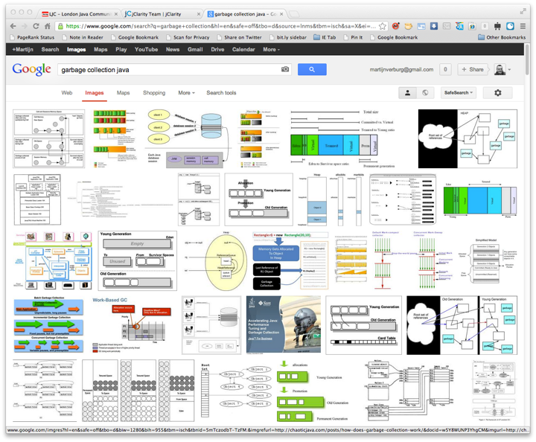
Search for Garbage Collection..

Slide 5
Part I - Diving into the Dark
What is Garbage Collection (GC)?
Hotspot Memory Organisation
Collector Types
Young Collectors
Old Collectors
Full GC

Slide 6
What is Garbage Collection (GC)?
The freeing of memory that is no longer "live"
Otherwise known as "collecting dead objects"
Which is a misnomer
GC is typically executed by a managed runtime
Javascript, Python, Ruby, .NET CLR all have GC

Slide 7

And so does Java!
One of the main 'selling' points in its early life

Slide 8
Why should I care?
Hotspot just sorts this out doesn't it?
Just set -Xms and -Xmx to be == right?
Stab myself in the eye with a fork
A poorly tuned GC can lead to:
High pause times / high % of time spent pausing
– OutOfMemoryError
It's usually worth tuning the GC!
"Cheap" performance gain
Especially in the short to medium term

Slide 9
Hotspot Java Virtual Machine
Hotspot is a C/C++/Assembly app
Native code for different platforms
Roughly made up of Stack and Heap spaces
The Java Heap
A Contiguous block of memory
Entire space is reserved
Only some space is allocated
Broken up into different memory pools
Object Creation / Removal
Objects are created by application (mutator) threads
Objects are removed by Garbage Collection

Slide 10
Memory Pools
Young Generation Pools
Eden
Survivor 0
Survivor 1
Old Generation Pool (aka Tenured)
Typically much larger than young gen pools combined
PermGen Pool
Held separately to the rest of the Heap
Was intended to hold objects that last a JVM lifetime
Reloading and recycling of classes occurs here.
Going away in Java 8

Slide 11
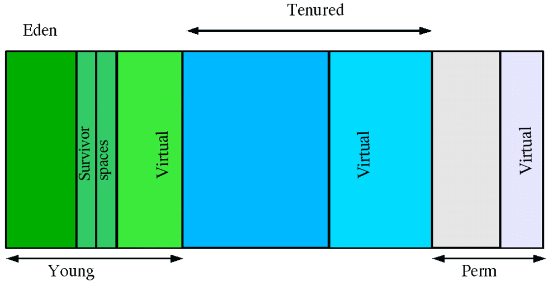
Java Heap Layout
Copyright - Oracle Corporation

Slide 12
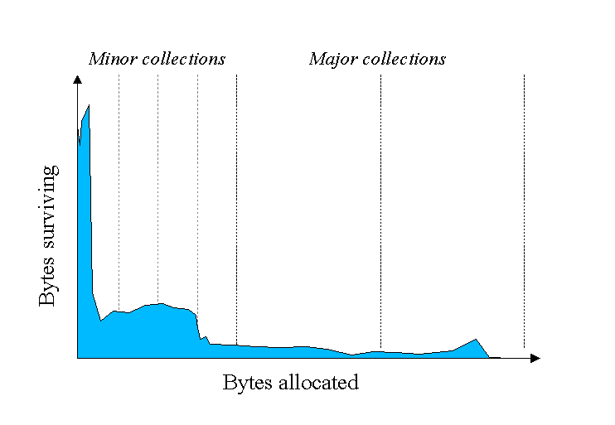
Weak Generational Hypothesis
Copyright - Oracle Corporation

Slide 13
Copy
aka "stop-and-copy"
Some literature talks about "Cheney's algorithm"
Used in many managed runtimes
Including Hotspot
GC thread(s) trace from root(s) to find live objects
Typically involves copying live objects
From one space to another space in memory
The result typically looks like a move as opposed to a copy

Slide 14
Mark and Sweep
Used by many modern collectors
– Including Hotspot, usually for old generational collection
Typically 2 mandatory and 1 optional step(s)
Find live objects (mark) 2.'Delete' dead objects (sweep) 3.Tidy up - optional (compact)

Slide 15
Mark and Sweep collectors in Hotspot
Several Hotspot collectors use Mark and Sweep
Concurrent Mark and Sweep (CMS)
Incremental Concurrent Mark and Sweep (iCMS)
MarkSweepCompact (aka Serial)
PS MarkSweep (aka ParallelOld)
So it's worth learning the theory

Slide 16
Java objects
Java objects have Ordinary Object Pointers (OOPs)
That point to an object...
Which points to the header
The header contains a mark bit for GC
Plus other metadata (hashcodes, locking state etc)
When you call a constructor
Space for the object is allocated

Slide 17
Step 1 - Clear the Mark
The header contains the boolean mark field
If true --> the object is live
Step 1 - set all the mark fields to false
We need to start afresh

Slide 18
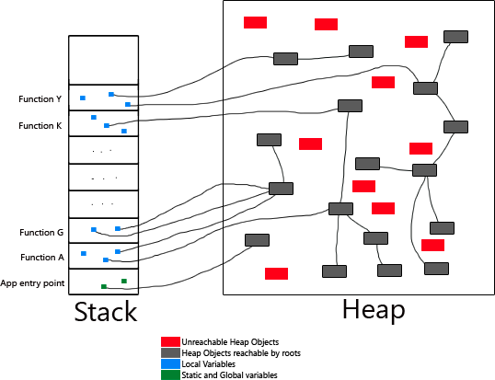
Step 2 - Mark live objects
GC Roots
– A pointer to data in the heap that you need to keep
Copyright - Michael Triana

Slide 19
Step 2 - Mark live objects
GC Roots are made up of:
Live threads
Objects used for synchronisation
JNI handles
The system class loaders
Possibly other things depending on your JVM
Plus one more special case...

Slide 20
Step 2 - Mark live objects
Special case - Old Gen refs into Young Gen
Treated as roots during a young collection
Special card table to track these
Each card references an area of 512 bytes in old gen
If it references young gen it will have been marked as dirty
Dirty areas are scanned as part of the young collection
Conclusion - there's a lot to trace!

Slide 21
Step 3 - Sweep
Sweep
Mark space that dead objects occupy as deleted
Compact
Not part of the normal operation of some collectors
Always attempted before OOME's can be thrown
'Defrags' the remaining space
Not quite a full defrag
I'll cover some Java specific collectors shortly

Slide 22
Young Generation Pools
Eden
Where new objects should get created
Objects are added at the end of currently allocated block
Uses Thread Local Allocation Buffers (TLABs)
Points at end of allocated block of objects
Survivor 0 and Survivor 1
Known as Hemispheric GC
Only one is active at a time
The other one is empty, we call it the target space

Slide 23
Young Generation Collectors
When Eden gets "full"
"Full" is technically passing a threshold
A collector will run
Live objects get copied to the target Survivor space
From Eden and active Survivor space
Some Live objects are promoted to Old Gen
If they've survived > tenuringThreshold collections
Or if they can't fit in the target space
When the collector is finished
A simple pointer swizzle activates the target Survivor space
Dead objects effectively disappear (no longer referenced)

Slide 24
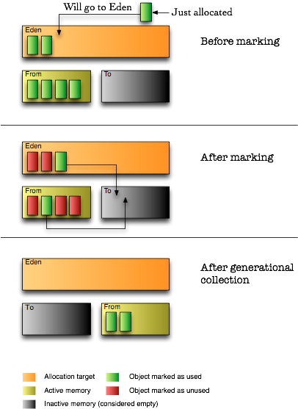
Copyright chaoticjava.com

Slide 25
Young Generation Collectors
Most use parallel threads
i.e. A multi-core machine can make your GC faster
I'll cover the PS Scavenge and ParNew collectors
They're almost identical
PS Scavenge works with PS MarkSweep old gen
ParNew works with ConcurrentMarkSweep (CMS) old gen
Other young collectors:
Copy (aka Serial)
G1

Slide 26
PS Scavenge / ParNew
aka "Throughput collectors"
Number of threads is set as a ratio to # of cores
They're Stop-The-World (STW) collectors
They're monolithic (as opposed to incremental)
Each thread gets a set of GC roots
They do work stealing
It performs an copy (aka evacuate)
Surviving objects move to the newly active survivor pool

Slide 27
Age and Premature Promotion
Objects have an age
Every time they survive a collection..
– age++
At age > tenuringThreshold
Objects get moved (promoted) to old/tenured space
Default tenuringThreshold is 4
Premature Promotion occurs when
High memory pressure (high life over death ratio)
Eden is too small to deal with rate of new objects
Objects are too big to fit in Eden
Objects are too big to be promoted to Survivor spaces

Slide 28
Old Generation Collectors
Most are variations on Mark and Sweep
Most use parallel threads
e.g. A multi-core machine can make your GC faster
I'll cover PS MarkSweep & CMS
CMS is often paired with the ParNew young collector
Other old collectors:
MarkSweepCompact (aka Serial)
Incremental CMS (iCMS)
G1

Slide 29
PS MarkSweep
aka "ParallelOld"
Often paired with PS Scavenge for young gen
Parallel GC threads get sections to look after
Usual Mark and Sweep occur
Special Compact phase takes place
low occupancy sections get merged
e.g. A compact / defrag operation

Slide 30
CMS Old Gen Collector
Only runs when Tenured is about to get full
Tunable as to what 'about to get full' means
Attempts to share CPU with application
About a 50/50 ratio as a default
Application can keep working whilst GC is taking place
It's a partial Stop-The-World (STW) collector
It has 6 phases
2 STW
4 Concurrent
It does not compact unless it fails..

Slide 31
CMS Phases
Phase 1 - Initial Mark (STW)
Marks objects adjacent to GC roots
Phase 2 - Mark (Concurrent)
Completes depth first marking
Phase 3 - Pre Clean (Concurrent)
Retraces the updated objects, finds dirty cards
Phase 4 - Re Mark / Re Scan (STW)
Hopefully a smaller graph traversal over dirty paths
Phase 5/6 - Concurrent Sweep and Reset
Sweep out dead objects and reset any data structures

Slide 32
Concurrent Mode Failure (CMF)
Occurs when CMS can't complete 'in time'
'In time' meaning that tenured has filled up
GC subsystem reverts to a Full GC at this point
Basically ouch

Slide 33
Promotion Failure
Occurs when objects can't be promoted into Tenured
Often due to the Swiss Cheese nature of Old Gen
Because CMS does not compact
This will almost always happen.... eventually
Triggers a Full GC
Which compacts old space
No more Swiss Cheese! For a short while...

Slide 34
Full GC
Can be triggered by a number of causes
A CMF from the CMS Collector
Promotion Failure
When tenured gets above a threshold
– System.gc()
– Remote System.gc() via RMI
Runs a full STW collection
Over Young and Old generational spaces
Compacts as well

Slide 35

Special Case: OOME

Slide 36
Special Case: OOME
98%+ time is spent in GC
< 2% of Heap is freed in a collection
Allocating an object larger than heap
Sometimes when the JVM can't spawn a new Thread

Slide 37
Part II - Shining a light into the dark
Collector Flags ahoy
Reading CMS Log records
Tooling and basic data

Slide 38
'Mandatory' Flags
-verbose:gc
Get me some GC output
-Xloggc:<pathtofile>
Path to the log output, make sure you've got disk space
-XX:+PrintGCDetails
Minimum information for tools to help
Replace -verbose:gc with this
-XX:+PrintTenuringDistribution
Premature promotion information
-XX:+PrintGCApplicationStoppedTime

Slide 39
Basic Heap Sizing Flags
-Xms<size>
Set the minimum size reserved for the heap
-Xmx<size>
Set the maximum size reserved for the heap
-XX:MaxPermSize=<size>
Set the maximum size of your perm gen
Good for Spring apps and App servers

Slide 40
Other Flags
-XX:NewRatio=N
-XX:NewSize=N
-XX:MaxNewSize=N
-XX:MaxHeapFreeRatio
-XX:MinHeapFreeRatio
-XX:SurvivorRatio=N
-XX:MaxTenuringThreshold=N
.....

Slide 41
Why Log Files?
Log file can be post processed
Log files contain more information
Than runtime MXBeans
Runtime MXBeans impact the running application
Causing it's own GC problems!

Slide 42
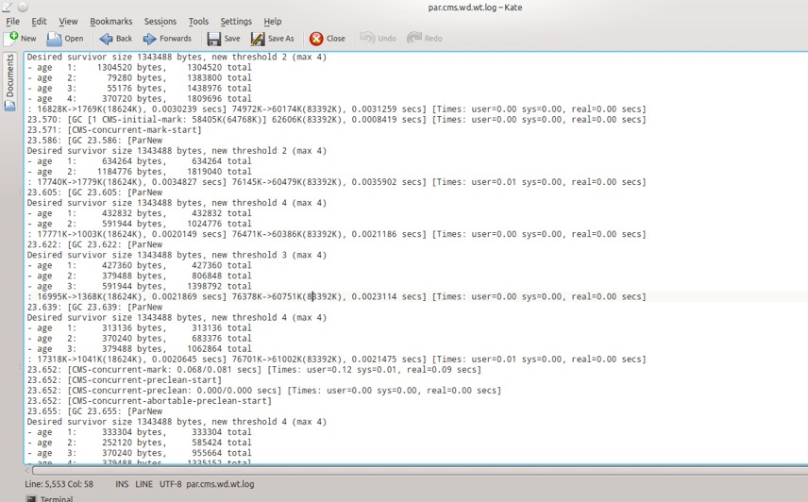
Raw GC Log File

Slide 43
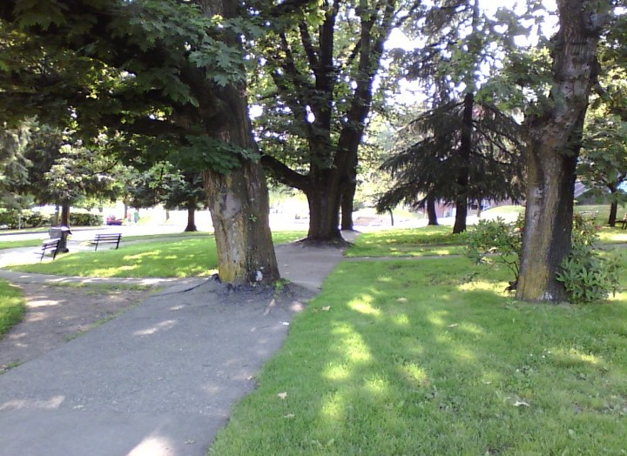
WAT

Slide 44
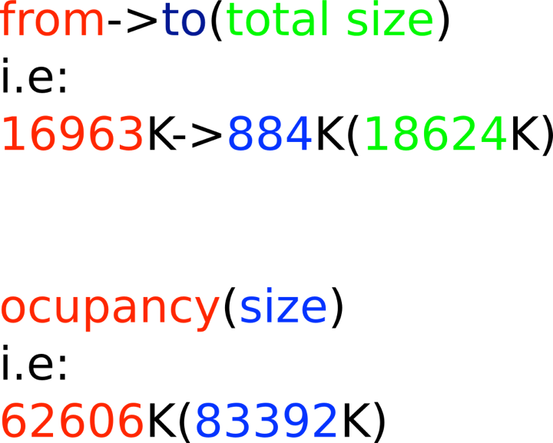
General Format

Slide 45
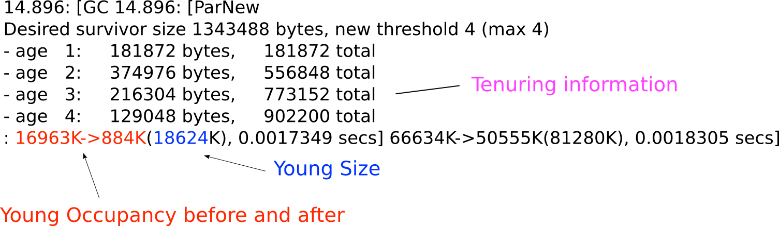
Young Gen Collection Part I

Slide 46
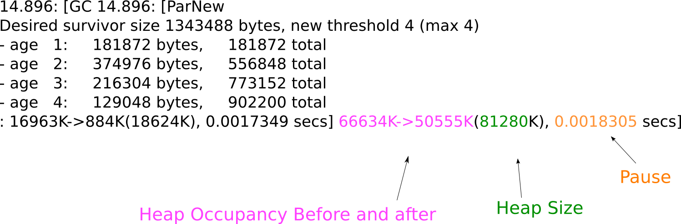
Young Gen Collection Part II

Slide 47
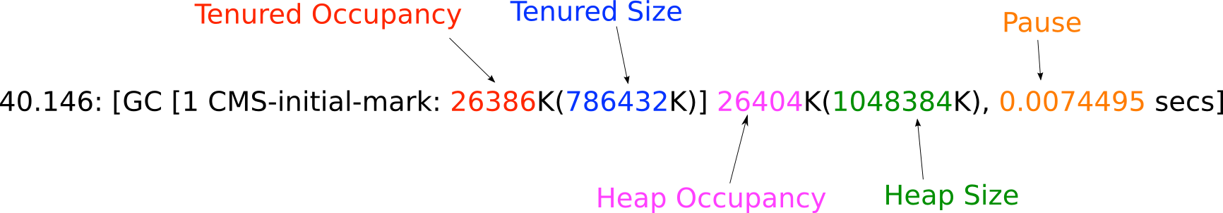
CMS Initial Mark

Slide 48
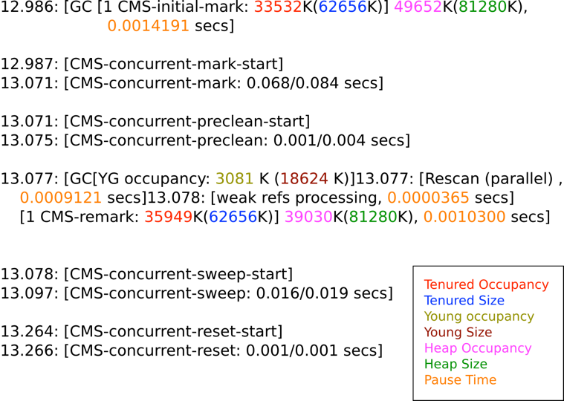
All CMS

Slide 49
Tooling
HPJMeter (Google it)
Solid, but no longer supported / enhanced
GCViewer (http://www.tagtraum.com/gcviewer.html)
Has rudimentary G1 support
GarbageCat (http://code.google.com/a/eclipselabs.org/p/garbagecat/)
Best name
IBM GCMV (http://www.ibm.com/developerworks/java/jdk/tools/gcmv/)
J9 support
jClarity Censum (http://www.jclarity.com/products/censum)
The prettiest and most useful, but we're biased!

Slide 50
Part III - Scenarios
Possible Memory Leak(s)
Premature Promotion
Healthy Application
High percentage of time spent pausing

