Slide 1




Benchmark, measure, improve

Slide 2


About Me
Pariwesh Gupta
I am a solution architect and have spent 17 years in IT industry.
I have worked a lot with Java and currently work a lot with Scala, Angular JS and of course Java
pariweshg@gmail.com

Slide 3

Introduction to JVM

Slide 4
Java Performance– Making the JVM perform
Java is one of the most popular development platform and has been one for many years
Java platform is much more than just the Java language itself
The real backbone of the platform is its Virtual Machine that does the major heavy lifting required for managing memory, threads etc
Java platform has evolved to support new age programming languages like Scala, Groovy etc.
In all this, the one thing that stays is the JVM

Slide 5

Java – Making the JVM perform
JVM is something that is very familiar to every Java developer, but to use it with efficiency, its important to know the
JVM hides the complexity under the hoods. But open the hoods to drive it better.

Slide 6

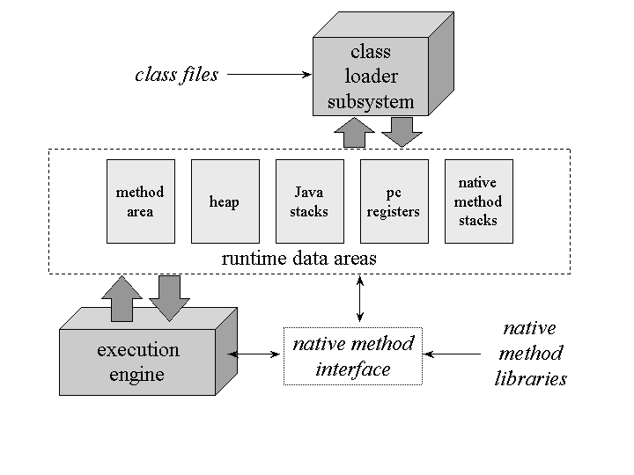
The JVM Architecture
Before going deeper into the JVM, lets first understand what constitutes the JVM

Slide 7
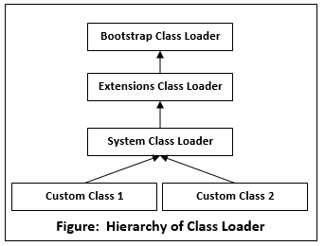
The Class Loader System

Slide 8
The Runtime Data Area
There are two parts to the runtime data area in JVM
Data Area for individual thread
Data Area shared across threads

Slide 9
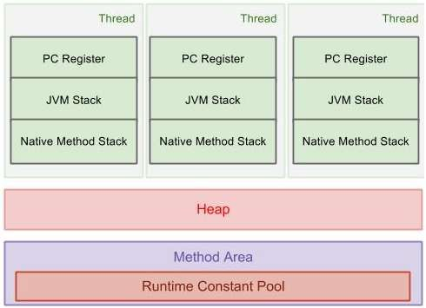
The Runtime Data Area

Slide 10

Data Area For Individual Threads
This area is created when a thread is created and includes
Program Counter Register – Used to
Control execution of each thread
JVM Stack – Contains Frames. A frame
contains local variable array, Operand Stack, Reference to Constant Pool.
Native Method Stack - used to support native methods, i.e., non-Java language methods.

Slide 11
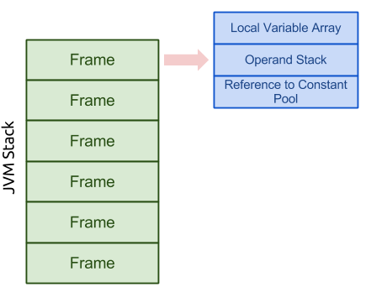
Data Area For Individual Threads

Slide 12

Data Area Shared by All Threads
All threads share Heap and Method area
Heap: it is the area that we most frequently deal with. It stores arrays and objects, created
when JVM starts up. Garbage Collection works in this area.
Method Area: it stores run-time
constant pool, field and method data, methods and constructors code
Runtime Constant Pool: It is a per class, per interface representation of constant Pool. It contains several types of constants ranging from numerals known at compile time to references that must be resolved at run-time

Slide 13
The JVM Execution Engine
The execution engine is the one that provides the execution environment for the applications
It provides the necessary services to The application

Slide 14
Measuring to Tune

Slide 15

Does my application need tuning?
Before embarking on improving the performance of your application it is important to first find out whether there is a need for tuning
The answer to this will come from what kind of performance is expected from your application and what is the actual performance that your application is providing.
There are multiple tools available that can be used to run performance test on your application to set the current benchmark and compare it against the expectations

Slide 16

What is affecting the performance?
If the performance noted is not up to the mark then it is important to find out what is causing the performance issue
There could be multiple reasons for the performance being not up to the mark
Inefficient Application Algorithm
Database that is not responsive
Inefficient usage of the available resources
Inefficiently configured JVM
The first two points would require the developer to dig deep into their code or architecture and find a way to improve things

Slide 17
Is my app using the available resources?
All programs need CPU time to execute, and CPU is the most valuable resource out there
It is important to find out if the application is utilising the CPU(s) available to it
CPU utilization can be derived from tools supplied along with JDK or OS. One such tool for linux is vmstat
Running vmstat on a machine will provide insight into the usage of CPU by an application.

Slide 18

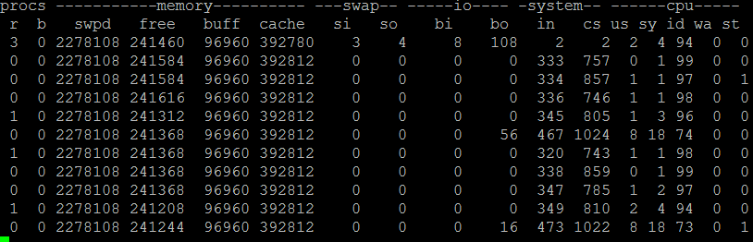
Reading the CPU utiliza
tion report?
The reading is provided every seco
nd and is a measure
of how long the CPU was busy in the last 1 second
The CPU could be used by the app
lication or the
system (OS) itself, for IO or networ

Slide 19
Reading the CPU utiliza
tion report?
us: Time Spent by application
id: Time for which CPU was idle
sy: Time Spent by system
wa: Time for which CPU was waiting on IO
st: Time stolen by hyperv from vm

Slide 20

So is everything ok?
The application should aim for maximum utilization of the CPU.
The aim is to use the CPU to its maximum for as short a time as possible.
The first reading below shows the app used CPU for 2% of time while system did it for 4 %. The CPU was idle 94 % of the time.

Slide 21

Why is my CPU so idle?
The CPU could be idle for multiple reasons.
The application might be blocked on synchronization primitive and unable to execute until lock is released
The application is waiting for some reason, like call to a database
The application has nothing to do
The first two points might be improved through optimizing code for resource access like faster db execution or better thread usage.
The last point is where the complexity lies. Is the CPU choosing to be idle, when it could be doing something?

Slide 22

Factors affecting Performance

Slide 23
How does JVM play a role?
The JVM is a highly sophisticated system that not just runs the program but contributes to its performance in multiple ways.
The two biggest way in which the performance is impacted by JVM are
Just in time compilation
Garbage collection

Slide 24

Just In Time Compilation (JIT Compiler)

Slide 25

Java code execution
Java is a cross platform language and achieves this through its generation of intermediate byte code
The byte codes are loaded on the JVM and executed by the Java interpreter
Traditional programming languages like C and C++ compile their program to the OS specific binaries. Compiled binaries execute
Interpreted code run slower than compiled code as the execution environment executes one line at a time and thus can not make any optimizations that might be possible

Slide 26
Just In Time Compilation
To make the java application perform better, the JVM chooses to compile the code Just In Time
This means the code that runs more often and needs to be executed faster will be compiled with optimizations applied

Slide 27

HotSpot Compilation
HotSpot compilation refers to compilation of piece of code that is executed most often
When a piece of code is executed by JVM it is not compiled immediately
JVM does not wish to waste cycles on compiling code that might be executed only once in the application life cycle. Interpreting and running such code will work faster

Slide 28
Flavours of Compiler
The JIT compiler comes in two flavours
Client
Server
The choice of which compiler to use depends on the hardware platform and configuration.
The fundamental difference between the two types of compilers is its aggressiveness in compilation

Slide 29

Client Compiler
The client compiler begins compiling code faster than the server compiler does
During beginning of code execution, the client compiler will be faster than the server one.

Slide 30
Server Compiler
The server compiler begins compiling code later than the what client compiler would do
Server compiler waits to gain more information about the application usage before it compiles the identified code
Knowing more about the code enables compiler to apply optimizations

Slide 31

Tiered Compilation
The tiered compilation was introduced in Java 7
Tiered compilation brings client start up speed to the server VM
The client compiler is used to generate compiled versions of methods that collect profiling information about themselves
The tiered scheme can also achieve better peak performance than a regular server VM because the faster profiling phase allows a longer period of profiling, which may yield better optimization.

Slide 32

Compiler Flags
Unlike most java flags, the flags to select compiler are different. They do not use –XX
The standard compiler flags are simple words
-client
-server
-d64 (gets the JVM into the 64-bit mode)
java –server –XX:+TieredCompilation other_args

Slide 33

Optimizations during JIT
Analysis of the code execution enables JVM to apply multiple types of optimizations.
Simple optimization like eagerly substituting a specific object type in a polymorphic case
Example-
Consider statement b = obj1.equals(obj2);
Over time, the JVM may notice that the obj1 is always an instance of java.lang.String and may compile the code to call String.equals() directly. Such a code will execute faster than the original code.

Slide 34
Inlining of Code
Good object oriented code often have Javabeans with several properties accessible as setters and getters.
Example- class A{
int b;
void setB(int i){b=i;}
int getB()={return b;}
}
This means accessing the value b would result in method calls which have its over heads. Fortunately, the JVM inlines such code that boosts performance immensely.

Slide 35

Inlining of code
So code like
A a = new A(); a.setB(a.getB() * 2) will be inlined to
A a = new A();
a.b = a.b*2;
Inlining is enabled by default.

Slide 36

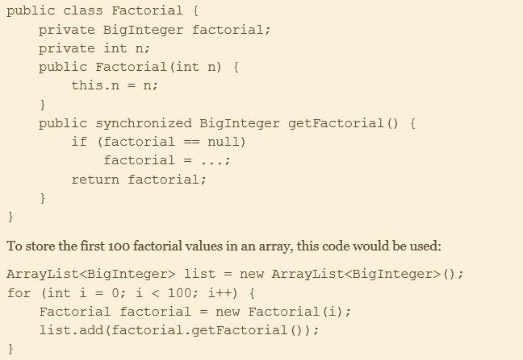
Escape Analysis
Server compiler performs very aggressive optimizations if the escape analysis is on –XX:DoEscapeAnalysis. This is on by default
If the JVM finds out getFactorial() is called only within the loop it will bypass the need to get synchronization lock.
It can also choose to keep “n” in register.

Slide 37

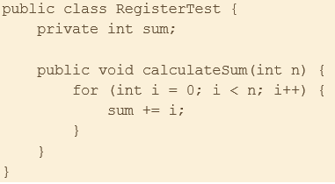
Registers and Main Memory
One of the main optimization that compiler can make is to decide on when to use values from main memory and when to store values in register
Consider the code
The JVM can optimize the performance of this code by loading the sum into the
register instead of reading it from main memory

Slide 38
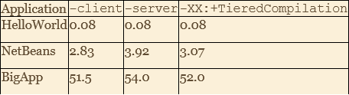
Optimizing Startup
The client compiler is most often used when fast startup is
the primary goal
As can be seen, an application like NetBeans that loads 10K classes and performs various initializations at startup gains immensely from client compiler.
TieredCompilation, proves to be faster than the server compiler

Slide 39
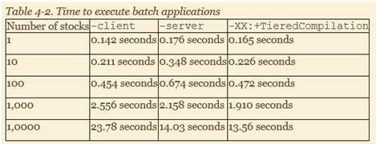
Optimizing Batch Operations
Batch operations run a fixed amount of operations and the choice of compiler depends on which compiler gives best optimization in a given amount of time
For 1-100, faster startup of client compiler completes the job
faster
Beyond that the advantage tilts towards server, and particularly the one with TieredCompilation on.

Slide 40

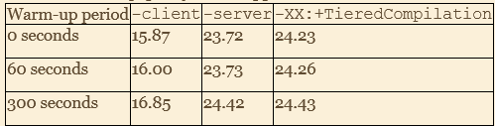
Optimizing Long Running Operations
Performance of long running applications is typically measured after the “Warm-up” period.
The server compiler provide better throughput even in a very low warm up scenario, since it can apply enough optimizations to derive faster performance.

Slide 41
32 bit JVM vs 64 bit JVM
If you have a 32 bit OS, then you have to use 32 bit JVM
If you have a 64 bit OS, then you can either choose 32 bit JVM or a 64 bit one
If the size of your heap is less than 3 GB, then a 32 bit JVM will perform better than a 64 bit one.
This is because memory references within JVM will be 32 bits and manipulating them is easier than manipulating 64 bit references
The 32 bit references also consume less memory
The downside to 32 bit JVM is that the total process size must be less than 4 GB

Slide 42
Code Cache
When JVM compiles code, it loads the assembly instructions into a code cache
The code cache has a fixed size and once it is full, the JVM will not be able to compile any further code
The possibility of code cache filling up is much higher in case of client or tiered compilation
The server compiler will usually pick very few classes to compile and so is unlikely to run out of code cache
When using the tiered compilation, its often important to monitor the code cache threshold and adjust it to tune the application

Slide 43
Code Cache
The maximum size of code cache is set by – XX:ReservedCodeCacheSize=N Flag
The initial size is set by –XX:InitialCodeCacheSize=N flag
Reserved Code Cache size setting is enough as resizing of code cache happens in the background and does not impact performance

Slide 44
When does the code get compiled?
The major factor that trigger the code compilation is the
number of time a method or a loop has been executed
Once the code is executed a certain number of time, the compilation threshold is reached
Compilation is based on two counters in JVM
Number of times a method has been called
Number of times a loop has completed execution, either because it reached the end or encountered a continue
When the JVM executes a method it checks if the compilation threshold has been reached. If it has then it adds it to the compilation queue.

Slide 45

On-Stack Replacement
In case there is a loop that lasts long or does not end but controls the entire execution of the program, then the loop is compiled based on the threshold defined for the how many times a loop has executed
Once the threshold is reached, the loop (not the entire method) is compiled
The JVM will load the compiled code and the next execution of the loop will happen with the compiled code and will be much faster. This kind of compilation is called On-Stack-Replacement compilation.

Slide 46
Inspecting compilation process
Standard compilation is triggered by
-XX:CompileThreshold=N flag.
To inspect compilation process use the tool jstat. Enable printing of compilation with the flag
-XX:+PrintCompilation
Tiered compilation levels are as follows
0. Interpreted Code
1. Simple C1 compiled code
2. Limited C1 compiled code
3. Full C1 compiled code
4. C2 compiled code

Slide 47

Compilation Threads
When a method becomes eligible for compilation, it is queued for compilation
The queue is processed by one or more background threads ensuring that the compilation is achieved asynchronously.

Slide 48
De-optimzations
When running the example, we can see couple of places where the compiler
The common types of de-optimizations are
Making code “Not Entrant”
Making code “zombie”

Slide 49
Not Entrant Code
There are two reasons for a code to get not-entrant
One is the way classes and interfaces work
One is due to the behaviour of tiered compilation
Consider you program with 1 interface and 2 implementations.
If JVM determines use of only one implementation, then it will compile method for that implementation
If in some scenario, the other implementation is used, then the original compiled method is made not entrant
In second case for a tiered compilation, when server compiler is ready, JVM marks some of code compiled by client as not entrant.

Slide 50
Zombie Code
Zombie code occurs when objects associated with a not entrant code are no longer referenced and are up for GC
Once all the objects are replaced the compiler notices that the compiled methods are now no longer required and is marked as zombie
For performance this is a good thing as code cache is limited and need to be freed up to perform more compilations

Slide 51

Garbage Collection

Slide 52
What is garbage collection?
Java platform free up the developers from the headaches of memory management
Memory management is one of the main functions of JVM and it accomplishes this using the garbage collectors
Garbage collectors are responsible to keep track of all the objects that are unused and remove them so as to free up the memory
Without Garbage Collection, your program would of course not work too long

Slide 53

What are GC challenges?
Freeing up memory and not leaving behind any unused object is a challenge in its own and requires some complex algorithms
Two of the common ways to find out if a particular object is a garbage or not is through
Reference Counting
Object graph tracing
Java does not use Reference Counting as it is prone to issues, especially in the case of circular reference

Slide 54

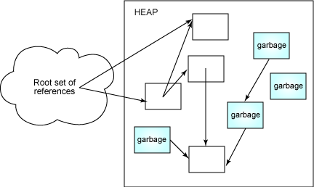
Tracing Collectors
Collectors take a snapshot of root objects. Objects that referenced from stack (Local Variables) or Perm Gen Space (Static Variables)
Starts tracing objects reachable from root objects and
marks them as reachable.
Rest is Garbage
Tracing collectors are generally Stop the world collectors

Slide 55
Types of Tracing Collectors
There are multiple types of tracing collectors
Mark-Sweep
Copying Collector

Slide 56
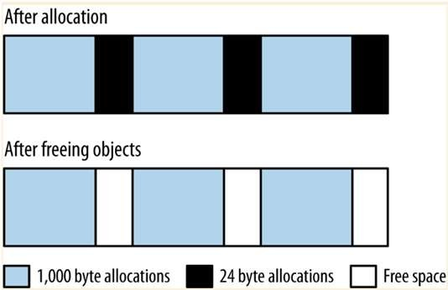
Mark and Sweep Collectors
This is the basic tracing collector
Marking
Every object has a mark bit in its header. This collector clears all the marks and then marks those that are reachable
Sweep
The collector goes through all the allocated objects and collects those that are not marked
Challenges in this approach are
Collector has to go through all allocated objects in the sweep phase
Leaves the memory fragmented

Slide 57
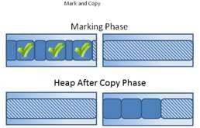
Copying Collectors
Overcomes issue with Mark Sweep
Creates two spaces - active and inactive
Moves surviving objects from active to inactive space.
Roles of spaces is flipped.
Advantages
Does not have to visit garbage objects to know its marker.
Solves the reference locality issue.
Disadvantages
Overhead of copying objects
Adjusting references to point to new location

Slide 58
Mark and Compact
Overcomes challenges of Copy (Twice size is not needed) &
Mark-Sweep (no fragmentation)
Marking - Same as Mark-Sweep i.e. Visits each live objects and marks as reachable.
Compaction - Marked objects are copied such that all live
objects are copied to the bottom of the heap.
Clear demarcation between active portion of heap and free area.
Long lived objects tend to accumulate at the bottom of the heap so that they are not copied again as they are in copying collector.

Slide 59
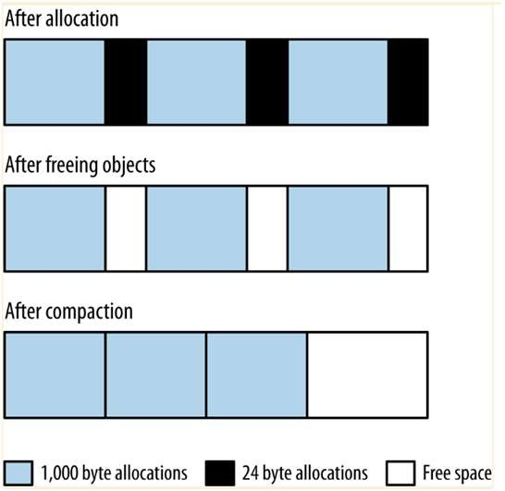
Mark and Compact

Slide 60

Performance impact of Garbage Collection

Slide 61

How GC impacts Performance?
GC is one of the biggest creator of performance issues in JVM
The various operations that the GC performs in the background impact performance
Stop the world collection of garbage
Mark and sweeping in a background thread, taking away CPU cycles from application threads
Compaction of memory
Copying of survivors and update of reference

Slide 62

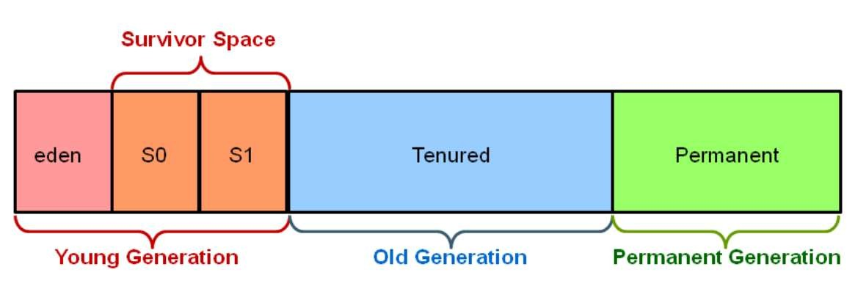
Heap Organization
All garbage collectors take a generational approach to the organization of heap
The generations defined by the GC are
Old or Tenured Generation
Young Generation. This generation is further divided into
Eden Space
Survivor Spaces

Slide 63
How do generations help?
A typical (well written) object oriented code will create a lot of objects that stay for a very small duration and then are discarded
sum = BigDecimal(10); for(Price p:prices.value()){
BigDecimal diff = p.closingPrice().subtract(averagePrice);
diff=diff.multiply(diff ); sum=sum.add(diff );
}
As can be seen in the code above, the BigDecimal diff, which is immutable is assigned multiple times in a loop. Every time it creates a new reference and the earlier reference is discarded

Slide 64

How do generations help?
Garbage collection is designed to take advantage of such behaviour and by allocating the newly created objects in the young generation space which occupies a smaller percentage of the overall memory
Once the space fills up, the garbage collector stops the
application to perform garbage collection
The fact that it has to cover a smaller memory footprint means the applications are paused for a smaller amount of time
Also, since all objects are allocated in Eden, the GC moves all referenced objects to survivor space while leaving Eden Empty. This achieves automatic compaction.

Slide 65
How does garbage collection happen in spaces
All GC algorithms have stop the world pauses for the young
generation collection.
As objects are moved to the old generation, that space will also eventually fill up and will need garbage collection
This where GC algorithms have the biggest difference. The simpler algorithms stop all the application threads, find unused objects, free up the space and eventually compact. This process is called full GC and generally causes the long pause.
On the other hand, it is possible though computationally complex to find unused objects while application threads are still running. CMS and G1 both take this approach.

Slide 66

What GC should I use?
Choice of garbage collector will depend on the application
In a JEE application, each individual request will be impacted in the following way.
Individual requests will be impacted by long pause times. If the goal is to ensure minimal impact of pause time then choose concurrent collector
If the average response time is all that matters and a few slow responses is not an issue, then you can go for throughput collectors
The benefits of avoiding long pauses with concurrent collector comes at the expense of CPU usage

Slide 67
What GC should I use?
in batch operation, the choice of GC is guided by following
If enough CPU is available then the use of concurrent collector with small pauses will enable job to be done faster
If CPU is limited then the extra CPU consumption by the GC will make the jobs slower

Slide 68
GC Algorithms

Slide 69

There are choices
JVM comes with multiple implementations of garbage collectors. You can choose the one that suits you
The various algorithms available are
The Serial Collector
The throughput Collector
The CMS collector
The G1 Collector

Slide 70
Serial Collector
The serial collector is the simplest collector and is used by default in a client machine
The serial collector uses a single thread to process the heap and stops all application for processing the heap
During a full GC it will fully compact the old generation.
The serial collector is enabled using - XX:+UseSerialGC flag

Slide 71
Throughput Collector
This is the default collector for a server class machine
The throughput collector uses multiple threads to process the young generation, which makes minor GCs much faster than the serial collector
The collector can use multiple threads when collecting old generation. This can be enabled by - XX:+UseParallelOldGC flag.
This collector stops all application threads when performing the minor and full GCs.
This collector is enabled using -XX:+UseParallelGC - XX:+UseParallelOldGc

Slide 72
CMS Collector – Working with young generation
This collector is designed to eliminate long pauses
CMS stops all application threads during a minor GC, which it performs with multiple threads
It uses a different algorithm than the throughput
collector. (-XX:+UseParNewGC)
CMS: Concurrent Mark Sweep

Slide 73
CMS Collector – Working with old generation
Instead of stopping the application for full GC, the CMS collector frequently analyses the old generation using one or more background threads and discards the unused objects
This ensures there is no pause in application threads but comes at the expense of CPU availability to the application.

Slide 74

CMS Collector - Issues
The fact that there is no compaction done by the background thread means that the memory can become fragmented over time
The background thread may also not get a chance to analyze the memory if there is not enough CPU
If the collector notices that the memory has become too fragmented or CPU too full, then it can revert to a Serial collector behaviour and does a clean and compact operation, before reverting to the concurrent background processing again.
CMS is enabled by specifying flags -
XX:+UseConcMarkSweepGC -XX:+UseParNewGC

Slide 75

G1 Collector – Young Generation
The G1 (Garbage First) collector is designed to process large heaps (size greater than 4 GB) with minimum pauses.
This collector divides heap into multiple regions. The young generation is also one of the regions.
The young generation collection requires a full pause and is done in multiple threads.

Slide 76

G1 Collector – Old Generation
The old generation collection is where things differ
Since the old generation is divided into multiple regions, the collector performs garbage cleaning by moving survivors from one region to another
This approach ensures that each region is compacted automatically and there is less chance of memory fragmentation.
G1 is enabled by the flag -XX:+UseG1GC

Slide 77
Choosing a GC algorithm

Slide 78

How to make the choice?
The choice of a GC algorithm depends on the application and what are its performance goals.
The serial collector is useful for an application that takes up low memory, generally less than 100 MB
These scenarios are better of handled without multiple threads of the concurrent collectors.
Most program though, would need to choose between the throughput collector and concurrent collectors

Slide 79

GC Algorithm for batch jobs
For batch jobs, the pauses introduced by the collectors,
particularly the full GC is a big concern.
If extra CPU is available then the concurrent collector will give the application a performance boost.
The table shows that the background threads introduced by the CMS takes up extra CPU time when there are 4 CPUs, but the job finishes 3 seconds faster
While in case of a single CPU, the background thread tends to interfere with the application thread and this increased contention for CPU makes the processing slower

Slide 80
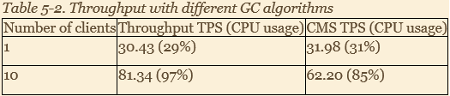
GC Algorithm for greater throughput
The basic tradeoffs here are same as in the case of batch
jobs but the effect of pause is quite different.
As can be seen when there is only one client, which leaves more CPU free, then the CMS collector performs better.
But when there are more clients and consequently lesser CPU available, then the fact that background threads contend for the CPU time means the throughput is lesser

Slide 81

Between CMS and G1
As a general rule of thumb, the CMS performs better when the memory footprint is smaller. Less than 4GB
G1 performs better in case of heap size greater than 4GB.

Slide 82

Basic GC Tuning

Slide 83

Sizing the heap
The first basic tuning is the size of the heap
The right heap size is a matter or balance.
If the size is too small, then the program will spend too much time performing GC and not enough time performing application logic
On the other hand, if the size of the heap is too large then the pauses will be less frequent, but each pause will take that much more time.

Slide 84
Why not make it very large?
Apart from the fact that GC will take a really long time,
there is issue of virtualization
In case of large size memory, the OS may choose to allocate some of that in the virtual memory
This is ok for memories of multiple application since they are not used at the same time, but for JVM this is a problem as there can be multiple threads accessing the objects in memory.
The single most important rule in heap sizing is not to specify it more than the available physical memory.
If there are multiple JVMs on the machine then this applies to the sum of all their heap sizes.

Slide 85

Controlling Heap Size
The size of the heap is controlled by two parameters
Minimum specified by (-XmsN)
Maximum specified by (-XmxN)
The default depends on the operating system, the amount of system RAM and the JVM in use.

Slide 86
Why the two parameters?
Having an initial and maximum size allows JVM to tune its behaviour depending on the workload
If the JVM sees that it is doing too much GC, then it will increase the heap until JVM does the "correct" amount of GC or until maximum size is hit.
If the configured heap size is not providing adequate performance then the size can be adjusted using the parameters.

Slide 87
How much should we set the value to?
A good rule of thumb is to size the heap to be 30% more than the memory utilization after a full GC
This can be achieved by setting up the application to reach its steady state
Then connecting using a profiler tool and performing a full GC.
Observe how much memory is consumed after the full GC. Determine your values based on that

Slide 88

Sizing the generations
Once the heap size has been determined, it will have to be determined how much of it has to be provided for the young generation and how much for the old.
If young generation is too big then it will fill up slowly and the GC will run less frequently
On the other hand, because the older generation is smaller, it will fill up faster and the full GC will run that often
Striking a balance is key.

Slide 89
How to configure?
Different GC algorithms try to strike this balance in different
ways. All of them use the same set of flags to achieve this
-XX:NewRatio=N. Default is 2
Sets the ration of new generation to old generation
-XX:NewSize=N
Sets the initial size of the young generation
-XX:MaxNewSize=N
Sets the maximum size of the young generation
-XmnN
Shorthand for setting both newsize and maxsize to the same amount

Slide 90

How are parameters used?
The young generation is first sized using the NewRatio.
The formula used is
Initial Young Gen Size = Initial Heap Size / (1+NewRatio)
If NewSize is set then it takes precedence over the one calculated using this formula
As the heap expands, the young generation size will expand as well, until it reaches the max new size.
Tuning using minimum and maximum young generation size is difficult. If an application needs dynamically sized heap then focus on setting the NewRatio.

Slide 91

Sizing Perm Gen Space / Metaspace
When JVM loads classes, it must keep track of certain metadata about the classes
This data is held in a separate heap space called the permgen (or permanent generation) in Java 7 and Meta Space in Java 8.
In Java 7 perm gen contains some miscellaneous objects that are unrelated to the class data. These are moved into the regular heap in Java 8
Either of these spaces don't hold the actial instance of the class object, neither the reflection Method object. These are stored in regular Heap.

Slide 92
How to configure?
There isn't a good way to calculate how much perm gen
space a particular program will need
It will be proportional to the number of classes it uses.
Larger the application, larger should be the size of the perm gen space.
The sizes are specified via the flags
-XX:PermSize=N
-XX:MaxPermSize=N
-XX:MetaSpaceSize=N
-XX:MaxMetaSpaceSize=N
The spaces are sized dynamically based on the initial size and increase as needed to a maximum size.

Slide 93

Controlling Parallelism
All GC algorithms except the Serial collector uses multiple
threads.
The number of these threads is controlled by -
XX:ParallelGCThreads=N flag.
The value of this flag effects the number of threads created for
the following operations
Collection of young generation when using -XX:+UseParallelGC
Collection old generation when using -XX:+UseParallelOldGC
Collection of young generation when using -XX:+UseParNewGC
Collection of the young generation when using -XX:+UseG1GC

Slide 94
How many threads should I run?
Because the GC operations stop the application threads from executing the JVM attempts to use as many CPU resources as it can in order to minimize the pause time
By default the JVM will run one thread for each CPU on the machine, up to eight.
Once it has reached 8 threads and there are more than 8 CPUs, then it allocates one new thread for every 5/8 of a CPU.
Parallel GC Threads = 8 + ((N-8)*5/8)

Slide 95
What if there are multiple JVMs on a machine
If there are multiple JVMs running on a machine, then it is a good idea to limit the number of GC threads among all the JVMs
For example :
On a 16 CPU machine running 4 JVMs, each JVM will by default have 18 GC threads. This will result in the machine having 52 CPU hungry threads running in contention.
It might be better to provide each JVM with 4 GC threads.

Slide 96
Performance Enhancements in Java 8

Slide 97
Does Java 8 give better performance
Java 8 has focused a lot on improving the Java language and adding modern features to it
Its focus has not necessarily been on improving performance
Still some new Java 8 features provide better performance

Slide 98
Concurrency utiities
The Collections Framework has undergone a major revision in Java 8 to add aggregate operations based on the newly added streams facility and lambda expressions.
As a result, the ConcurrentHashMap class introduces over 30 new methods in this release.
These include various forEach methods
(forEach, forEachKey,forEachValue, and forEachEntry), search methods (search, searchKeys, searchValues,
and searchEntries) and a large number of reduction methods (reduce, reduceToDouble, reduceToLong etc.)
These utilities enable developer to write much more
efficient algorithms to work with collections.
Efficient algorithms enable compilers to optimize better

Slide 99
Tiered Compilation
Tiered compilation introduced in Java 7
It has been perfected and made default in Java 8

Slide 100
Meta Space
Permament generation, where the VM stored internal native data structures, such as class information, has been replaced with metaspace.
Metaspace eliminates java.lang.OutOfMemoryError: PermGen space errors.
The java command introduces the option - XX:MetaspaceSize, which sets the maximum amount of native memory that can be allocated for class metadata
In addition, the experimental option -Xshare has been introduced, which reduces footprint and startup time by sharing loaded JDK classes between all Java processes on the same host

Slide 101

Lambda Expressions
Lambda expressions introduced in Java 8 perform better than the inner classes
An Example
public class Calculator {
interface IntegerMath {
int operation(int a, int b);
}
public int operateBinary(int a, int b, IntegerMath op) { return op.operation(a, b);
}
public static void main(String... args) { Calculator myApp = new Calculator();
IntegerMath addition = (a, b) -> a + b; IntegerMath subtraction = (a, b) -> a - b; System.out.println("40 + 2 = " +
myApp.operateBinary(40, 2, addition)); System.out.println("20 - 10 = " +
myApp.operateBinary(20, 10, subtraction));
}
}

