Slide 1


JVM: Memory Management Details

Slide 2
Agenda
What is a JVM?
JVM Components
JVM Concepts/Terminology
Garbage Collection Basics
Concurrent Garbage Collection
Tools for analyzing memory issues

Slide 3
What is a Java Virtual Machine?
Abstraction is the driving principal in the Java Language specification
Bytecodes => processor instruction set
Java memory model => hardware memory model
Java threading model => OS threading model
Abstract the ‘underlying’ platform details and provide a standard development environment

Slide 4
What is a Java Virtual Machine?
Java Virtual Machine along with a set of tools implements the Java Language Specification
Bytecodes
Generated by the Javac compiler
Translated to the processor instruction set by the JVM
Java threads
Mapped to OS threads by the JVM
Java memory model
JVM inserts the right ‘memory barriers’ when
needed

Slide 5
What is a Java Virtual Machine (JVM)?
Java Application
Layer between platform and the application
Abstracts away operating system details
Abstracts away hardware architecture details
Key to Java’s ‘write once run anywhere’ capability.
C++
Application
Operating System
Hardware
JVM
Operating System
Hardware

Slide 6



Portability
Compile once, run everywhere
Same code!
Java Application
Java Application
JVM
JVM
Operating System
Operating System
Hardware Architecture #1
Hardware Architecture #2

Slide 7
The JVM Components
An Interpreter
Straightforward translation from byte-codes to hardware
instructions
One byte-code at a time
No optimizations, simple translation engine
JIT Compilers
Compiles byte-codes to hardware instructions
A lot more optimizations
Two different flavors targeting different optimizations
Client compiler for short running applications
Server compiler for long running applications
Server compiler generates more optimized code

Slide 8
The JVM Components
A Runtime environment
Implements a threading model
Creates and manages Java threads
Each thread maps to an OS thread
Implements synchronization primitives, i.e., locks
Implements dynamic class loading & unloading
Implements features such as Reflection
Implements support for tools

Slide 9
The JVM Components
Memory management module
Manages all of the program memory
Handles allocation requests
Recycles unused memory
Free Memory
Allocation
Memory In Use
Garbage Collection
Unused Memory
Program Activity

Slide 10
JVM Concepts/Terminology
Java Threads
Threads spawned by the application
Threads come and go during the life of a program
JVM allocates and cleanups resources on thread creation and death
Each thread has a stack and several thread-local data
structures, i.e., execution context
Also referred to as ‘mutators’ since it mutates heap objects

Slide 11
JVM Concepts/Terminology
Java objects
Java is an object oriented language ☺
Each allocation creates an object in memory
The JVM adds meta-data to each object: “object-header”
Object-header information useful for GC, synchronization, etc.
Object Reference
Pointer to a Java object
Present in thread-stacks, registers, other heap objects
Top bits in a reference can be used for meta-data

Slide 12
JVM Concepts/Terminology
Safepoints
The JVM has the ability to stop all Java threads
Used as a barrier mechanism between the JVM and the Java
threads
‘Safe’ place in code
Function calls
Backward branches
— JVM has precise knowledge about mutator stacks/registers etc. at a safepoint.
– Useful for GC purposes, e.g., STW GC happens at a safepoint.
Safepoints reflect as application ‘pauses’

Slide 13
Garbage Collection Taxonomy
Several ways to skin this cat:
Stop-The-World vs. Concurrent
Generational vs. Full Heap
Mark vs. Reference counting
Sweep vs. Compacting
Real Time vs. Non Real Time
Parallel vs. Single-threaded GC
Dozens of mechanisms
Read-barriers
Write-barriers
Virtual memory tricks, etc..

Slide 14
Garbage Collection Taxonomy
Stop-The-World GC
Recycles memory at safepoints only.
Concurrent GC
Recycles memory without stopping mutators
Generational GC
Divide the heap into smaller age-based regions
Empirically known that most garbage is found in ‘younger’ regions
Focus garbage collection work on ‘younger’ regions

Slide 15
Garbage Collection Basics
What is ‘live’ memory
Liveness == Accessibility
Objects that can be directly or transitively accessed by mutators
Objects with pointers in mutator execution contexts, i.e., ‘root- set’
Objects that can be reached via the root-set
Implemented using ‘mark’ or by ‘reference counting’
What is ‘dead’ memory
Everything that is not ‘live’

Slide 16
Garbage Collection
How does the garbage collector identify ‘live’ memory
Starts from the root set of mutator threads
Does a depth-first or breadth-first walk of the object graph
‘Marks’ each object that is found, i.e., sets a bit in a liveness bitmap
Referred to as the ‘mark-phase’
Could use reference counting
Problems with cyclic garbage
Problems with fragmentation
A
D
B
C
E

Slide 17
Garbage Collection Basics
How does GC recycle ‘dead’ memory Sweep:
Sweep ‘dead’ memory blocks into free-lists sorted by size
Hand out the right sized blocks to allocation requests
Pros:
Easy to do without stopping mutator threads
Cons
Slows down allocation path, reduces throughput
Can causes fragmentation

Slide 18
Garbage Collection Basics
How does GC recycle ‘dead’ memory Compaction:
Copy ‘live’ memory blocks into contiguous memory locations
Update pointers to old-locations
Recycle the original memory locations of live objects
Pros:
Supports higher allocation rates, i.e., higher throughputs
Gets rid of memory fragmentation
Cons: Concurrent versions are hard to get right

Slide 19
Garbage Collection
Desired Characteristics
Concurrent
Compacting
Low application overhead
Scalable to large heaps
These map best to current application characteristics
These map best to current multi-core hardware

Slide 20
Concurrent Garbage Collection
GC works in two phases
Mark Phase
Recycle Phase (Sweep/Compacting)
Either one or both phases can be concurrent with mutator threads
Different set of problems to implement the two phases concurrently
GC needs to synchronize with application threads

Slide 21
Concurrent Garbage Collection
Synchronization mechanisms between GC and mutators Read Barrier
Synchronization mechanism between GC and mutators
Implemented only in code executed by the mutator
Instruction or a set of instructions that follow a load of an object reference
JIT compiler spits out the ‘read-barrier’
Precedes ‘use’ of the loaded reference.
Used to check GC invariants on the loaded reference
Expensive because of the frequency of reads
Functionality depends on the ‘algorithm’

Slide 22
Concurrent Garbage Collection
Synchronization mechanisms between GC and mutators Write Barrier
Similar to read-barrier
Implemented only in code executed by the mutator
Instruction or a set of instructions that follow/precede a write
JIT compiler spits out the ‘write-barrier’
Generally used to track pointer writes
Cheaper, since writes are less common
Functionality depends on the ‘algorithm’

Slide 23
Concurrent Garbage Collection
Concurrent Mark
Scanning the heap graph while mutators are actively
changing it
Multiple-readers, single-writer coherence problem
Mutators are the multiple writers
GC only needs to read the graph structure

Slide 24
Concurrent Garbage Collection
Concurrent Mark: What can go wrong?
Mutator writes a pointer to a yet ‘unseen’ object into an
object already ‘marked-through’ by GC
Can be caught by write barriers
Can be caught by read barriers as well
A
Mutator write
GC considers object C ‘dead’.
Will recycle object C, causing a crash
Avoid by:
Marking object C ‘live’ OR
Re-traverse object A
C
B
Unmarked
Marked
Marked-Through

Slide 25
Concurrent Garbage Collection
Concurrent Compaction: What can go wrong
— Concurrent writes to old locations of objects can be lost
A | A’
4 | 0
5 | 0
6 | 0
A | A’
4 | 4
5 | 0
6 | 0
A | A’
8 | 4
5 | 5
6 | 0
A | A’
8 | 4
5 | 5
6 | 6
Start Copy Mutator Write End Copy
Object A is being copied to new location A’
A is the ‘From-Object’ ; A’ is the To-Object
Mutator writes to ‘From-Object’ field after it has been copied
Happens because mutator still holds a pointer to ‘From-Object’
Timeline
Need to make sure that writes to object A, during and after the copy are reflected in the new location A’

Slide 26
Concurrent Garbage Collection
Concurrent Compaction: What can go wrong
Propagating pointers to the old-location
B
B
A
A’
Relocate A
A
C
C
D
D
E
During or after the object copy is done, the mutator writes a pointer to the old-location of the object in an object that is not known to the collector

Slide 27
Concurrent Garbage Collection
Propagating pointers to the old-location
Collector thinks object A has been copied to A’
Recycles old-location A
Mutator attempts to access A via object E and crashes
Can be prevented by using
Read barriers, e.g., Azul’s C4 Collector
Compacting in ‘stop-the-world’ mode, e.g., CMS Collector

Slide 28
Biggest Java Scalability Limitation
For MOST JVMs, compaction pauses are the biggest current challenge and key limiting factor to Java scalability
The larger heap and live data / references to follow, the bigger challenge for compaction
Today: most JVMs limited to 3-4GB
To keep “FullGC” pause times within SLAs
Design limitations to make applications survive in 4GB chunks
Horizontal scale out / clustering solutions
In spite of machine memory increasing over the years…
This is why I find Zing so interesting, as it has implemented concurrent compaction…
— But that is not the topic of this presentation… ☺

Slide 29
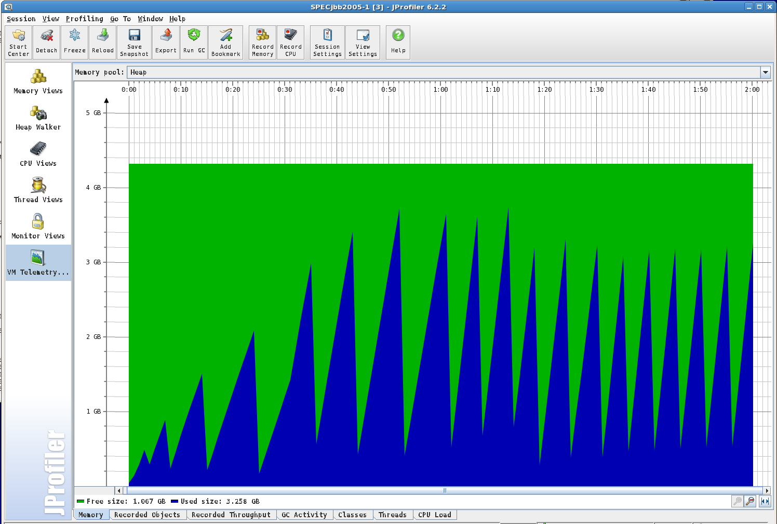
Tools: Memory Usage

Slide 30
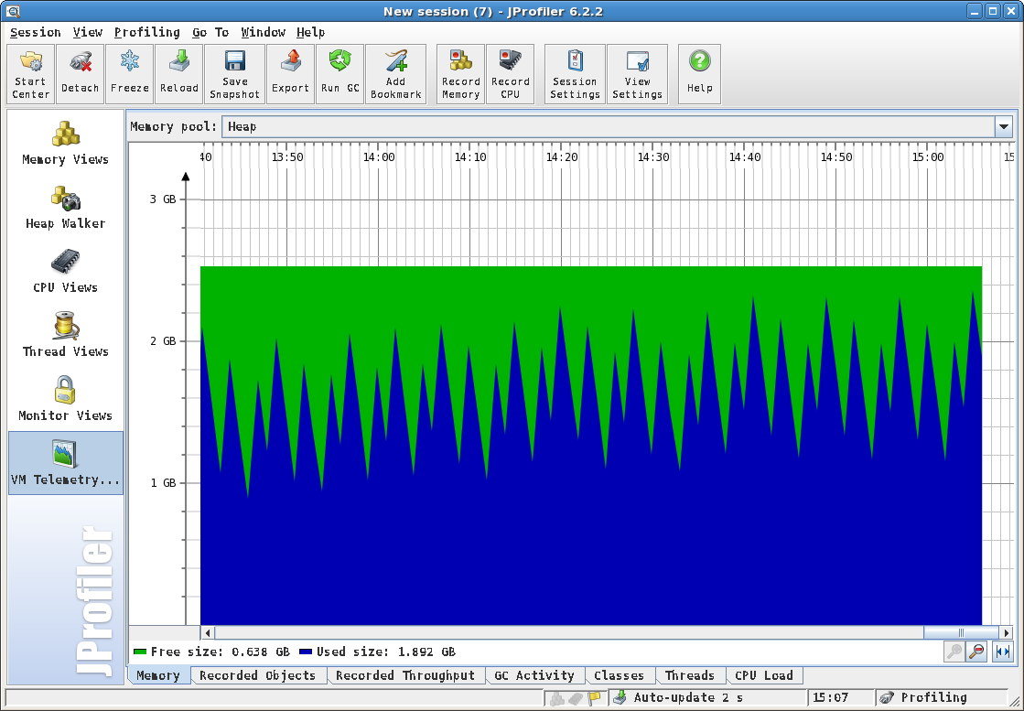
Tools: Memory Usage Increasing

Slide 31
Tools: jmap
Usage:
jmap [option] <pid>
(to connect to running process)
jmap [option] <executable <core> (to connect to a core file)
jmap [option] [server_id@]<remote server IP or hostname>
(to connect to remote debug server)
where <option> is one of:
<none>
-heap
-histo[:live]
to print same info as Solaris pmap to print java heap summary
to print histogram of java object heap; if the "live" suboption is specified, only count live objects
to print permanent generation statistics
to print information on objects awaiting finalization
-permstat
-finalizerinfo
-dump:<dump-options> to dump java heap in hprof binary format dump-options:
live
dump only live objects; if not specified, all objects in the heap are dumped.
format=b binary format
file=<file> dump heap to <file>
Example: jmap -dump:live,format=b,file=heap.bin <pid> force. Use with -dump:<dump-options> <pid> or -histo
to force a heap dump or histogram when <pid> does not respond. The "live" suboption is not supported
in this mode.
to print this help message
to pass <flag> directly to the runtime system
-F
-h | -help
-J<flag>

Slide 32
Tools: jmap Command to Collect
/jdk6_23/bin/jmap -dump:live,file=SPECjbb2005_2_warehouses 15395
File sizes
-rw-------. 1 me users 86659277 2011-06-15 15:23 SPECjbb2005_2_warehouses.hprof
-rw-------. 1 me users 480108823 2011-06-15 15:25 SPECjbb2005_12_warehouses.hprof

Slide 33
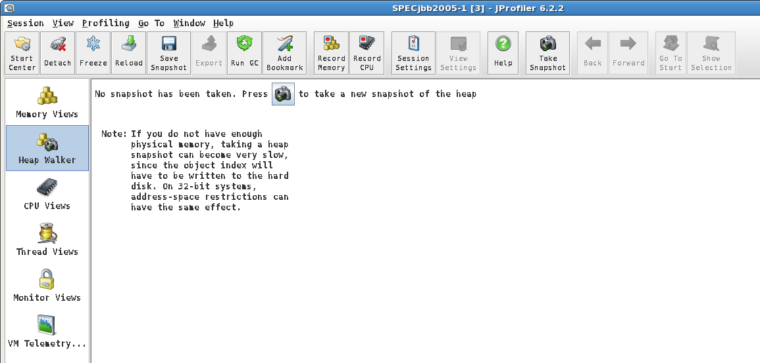
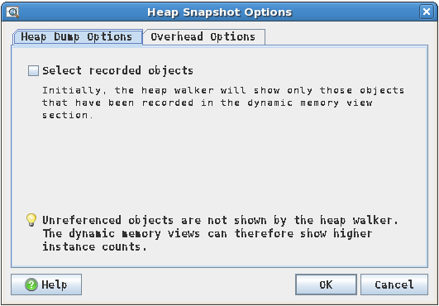
Tools: JProfiler Memory Snapshot

Slide 34
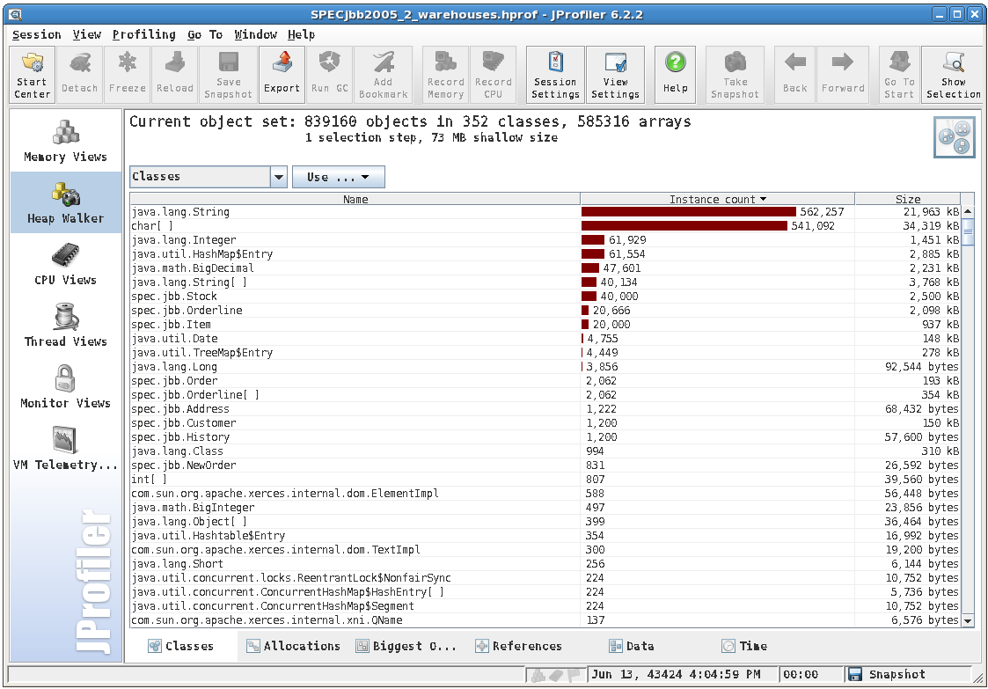
Tools: JProfiler Objects (2 warehouses)

Slide 35
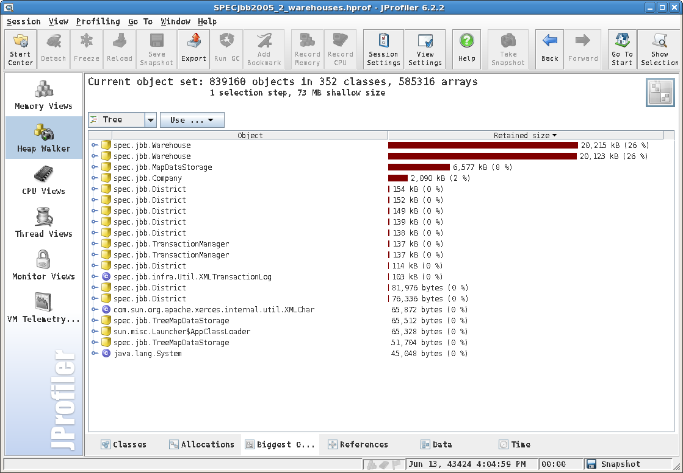
Tools: JProfiler Biggest Retained Sets

Slide 36
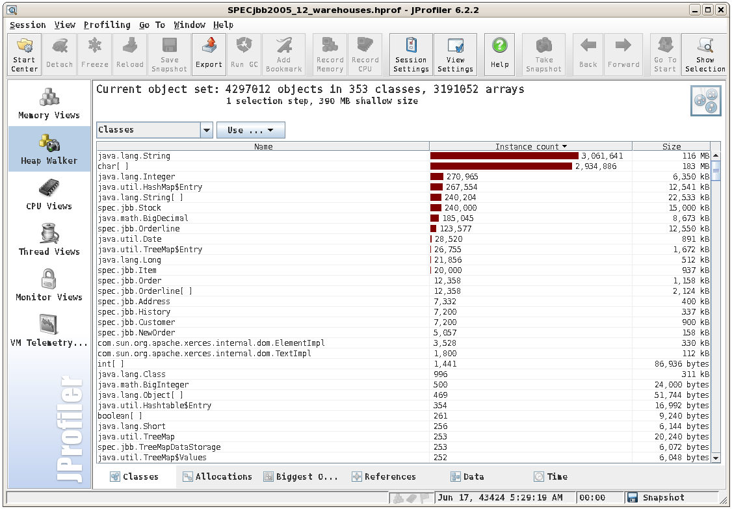
Tools: JProfiler Objects (12 warehouses)

Slide 37
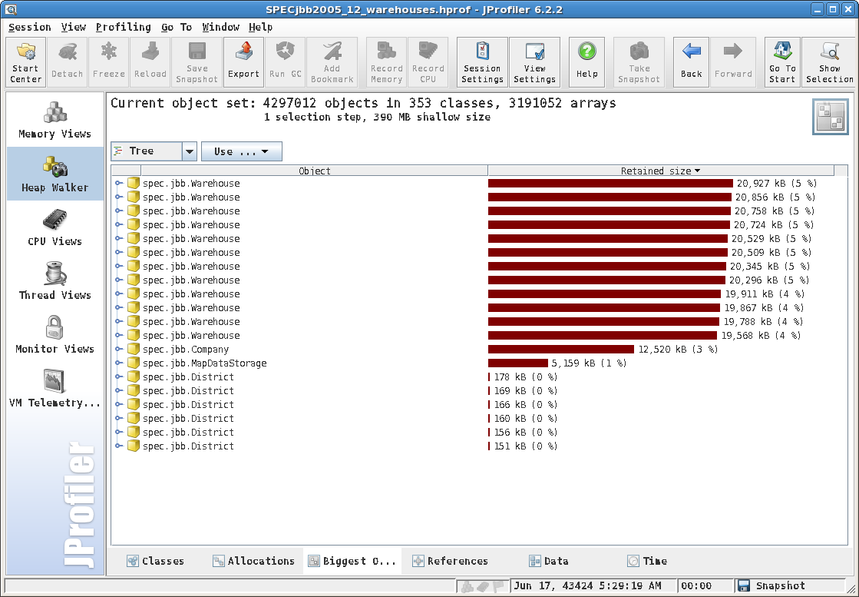
Tools: JProfiler Biggest Retained Sets

Slide 38
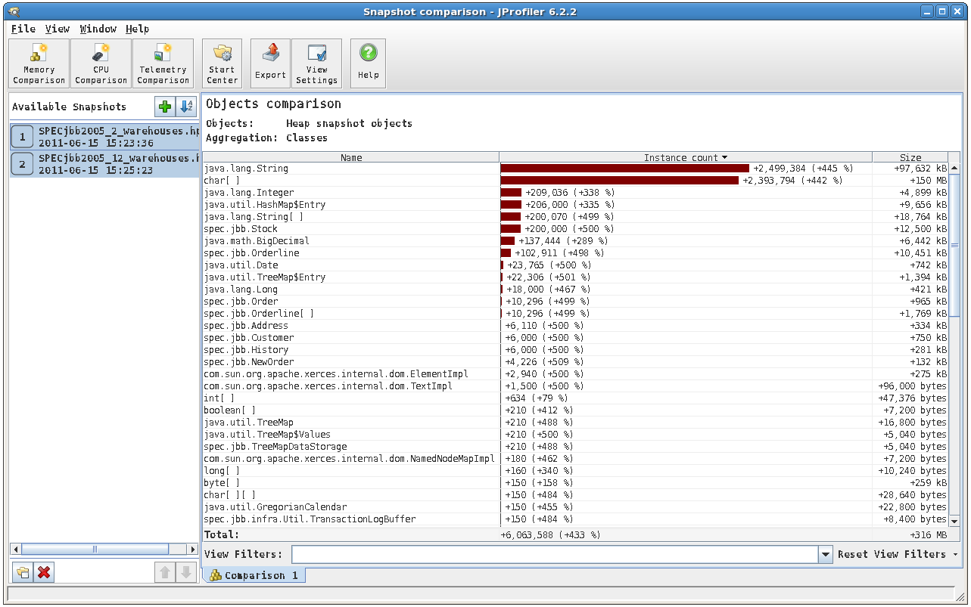
Tools: JProfiler Difference Between 2/12

Slide 39
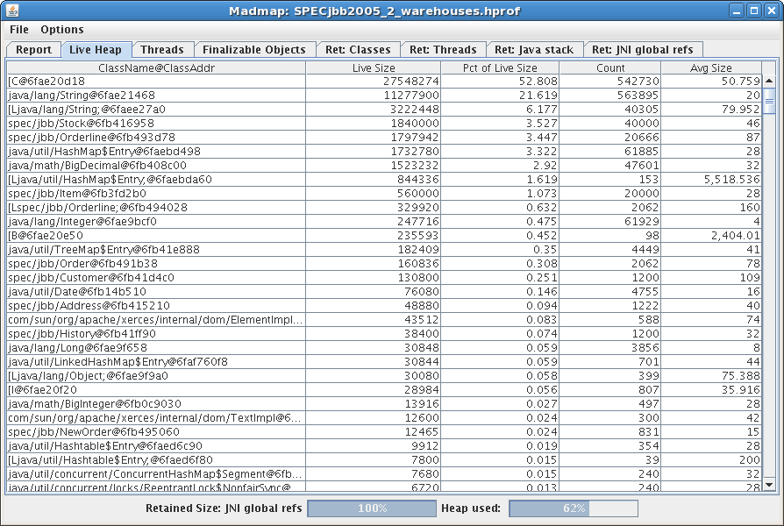
Tools: madmap

Slide 40
GC and Tool Support
The Heap dump tools uses the GC interface
Walks the object graph using the same mechanism as GC
Writes out per-object data to a file that can later be analyzed.
GC also outputs detailed logs
These are very useful in identifying memory related bottle necks
Quite a few tools available to analyze GC logs

Slide 41
2c for the Road
What to (not) Think About
Why not use multiple threads, when you can?
Number of cores per server continues to grow…
Don’t be afraid of garbage, it is good!
Always be careful around locking
If it passes testing, hot locks can still block during production load
Benchmarks are often focused on throughput, but miss out on real GC impact – test your real application!
“Full GC” never occurs during the run, not running long enough to
see impact of fragmentation
Response time std dev and outliers (99.9…%) are of importance for a real world app, not throughput alone!!

Slide 42
Summary
JVM – a great abstraction, provides convenient services so the Java programmer doesn’t have to deal with environment specific things
Compiler – “intelligent and context-aware translator” who helps speed up your application
Garbage Collector – simplifies memory management, different flavors for different needs
Compaction – an inevitable task, which impact grows with live size and data complexity for most JVMs, and the current largest limiter of Java Scalability

Slide 43
Additional Resources
For more information on…
…JDK internals: http://openjdk.java.net/ (JVM source code)
…Memory management: http://java.sun.com/j2se/reference/whitepapers/memorymanagement_w hitepaper.pdf (a bit old, but very comprehensive)
…Tuning:
http://download.oracle.com/docs/cd/E13150_01/jrockit_jvm/jrockit/genin fo/diagnos/tune_stable_perf.html (watch out for increased rigidity and re-tuning pain)
…Generational Pauseless Garbage Collection: http://www.azulsystems.com/webinar/pauseless-gc (webinar by Gil Tene, 2011)
…Compiler internals and optimizations:
http://www.azulsystems.com/blogs/cliff (Dr Cliff Click’s blog)

