Slide 1
8月BSR开款（二） 以下款式有BSR标签 买手绑定后 可享搜推提权——额外流量 男装单马甲 男士休闲运动风衣、夹克（免审版寄样） 男士风衣

Slide 2

对接买手：游无垠

Slide 3
上款路径指引
服装、鞋靴和珠宝饰品 > 男士时尚 > 男装 > 男士外套 > 男装单马甲
服装、鞋靴和珠宝饰品 > 男士时尚 > 男装 > 男士休闲运动服 > 男士休闲运动风衣、夹克
服装、鞋靴和珠宝饰品 > 男士时尚 > 男装 > 男士外套 > 男士风衣雨衣 > 男士风衣

Slide 4
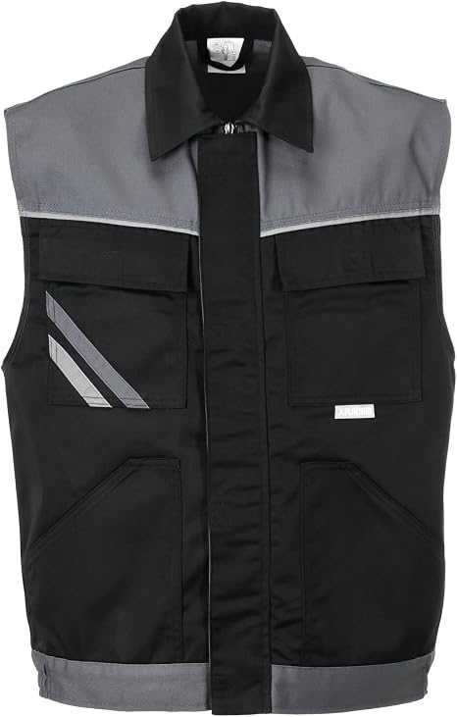
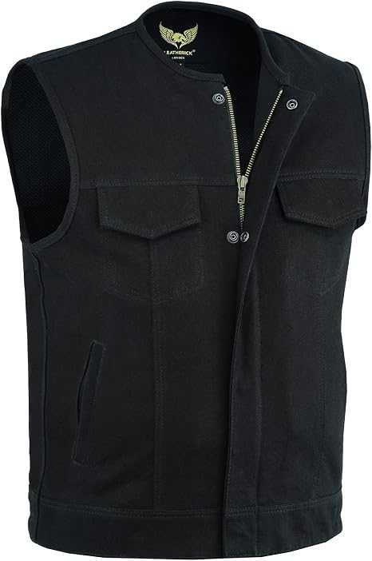
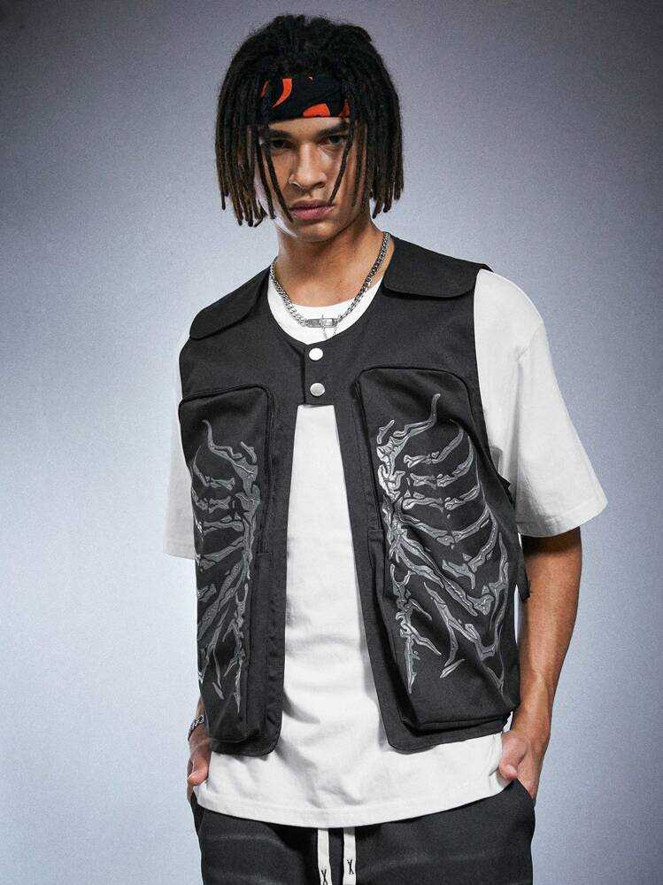
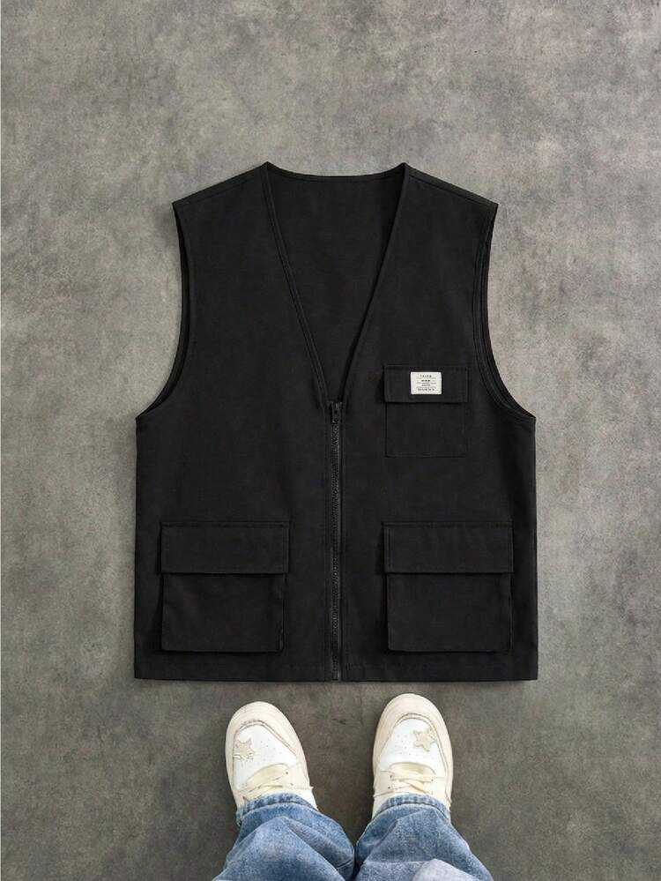
男士单马甲 日常轻便
https://es.shein.com/Artur-Kramer-Manfinity-Streetrush-Men-s-Skeleton-Print-Pocket-Casual-Vest-Vacation-Halloween-Summer-Autumn-Outing-Streetwear-Vest-Gift-Weighted-Vest-For-Friends-Husband-Boyfriend-Streetwear-For-Men-Men-Vest-Jacket-Men-s-Casual-Skull-Print-Pattern-Colorful-Vest-Vest-Jacket-Loose-Vest-INS-Best-Seller-Men-s-Street-Fashion-Loose-Vest-Casual-Vest-Men-s-Vest-Jacket-Men-s-Clothing-Suit-Men-s-Fashion-Clothing-Suitable-For-Gifts-For-Boyfriends-Street-Vest-Streetwear-For-Going-Out-p-441102785.html
https://www.shein.co.uk/Manfinity-Unisex-Locker-sitzende-Herren-Weste-mit-Buchstaben-Patch-und-Klapptasche-(ohne-T-Shirt),-Herbst,-Winter,-Paar-Accessoires-p-21417059-cat-6277.html
https://www.amazon.de/dp/B07LG95Y5V
https://www.amazon.de/dp/B07V1PMKVC

Slide 5
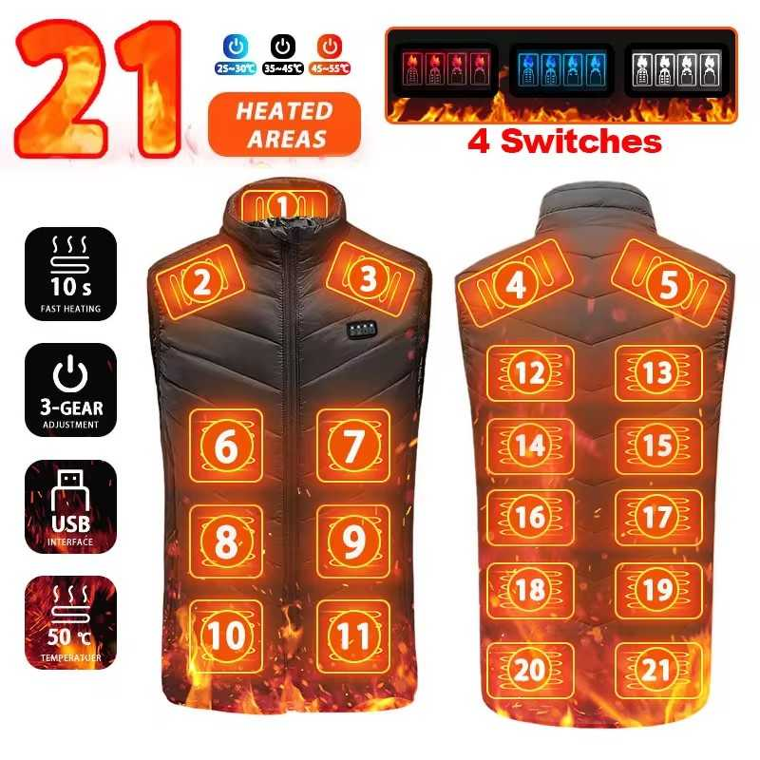
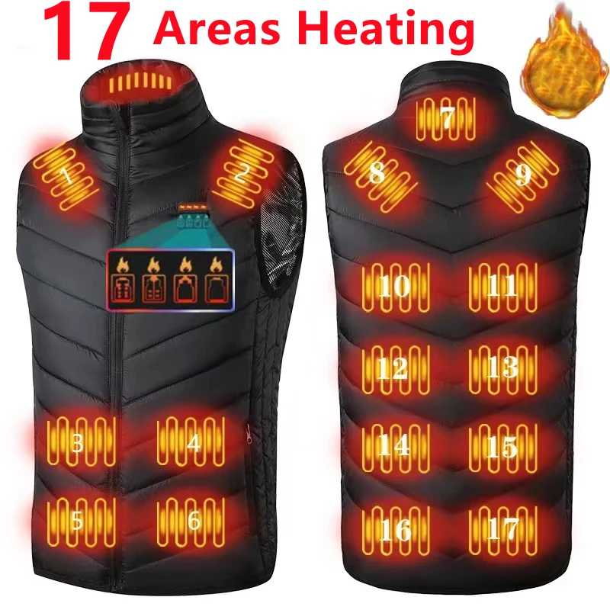
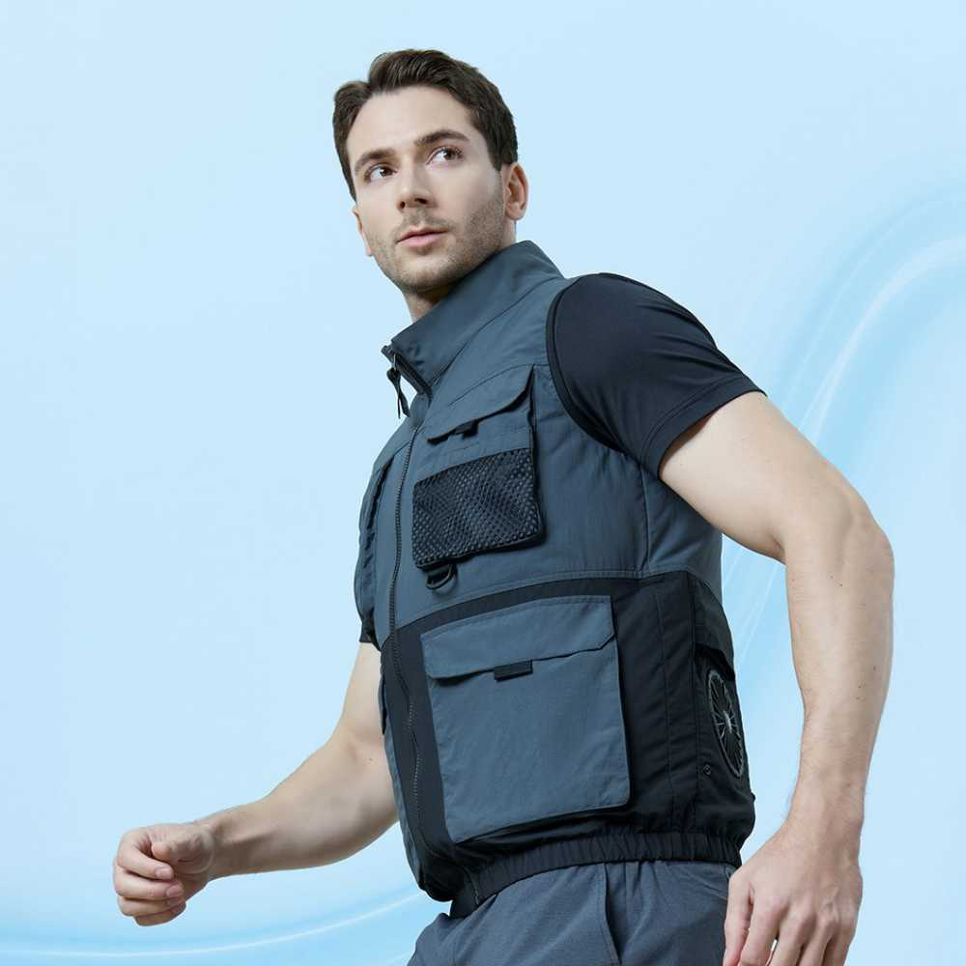
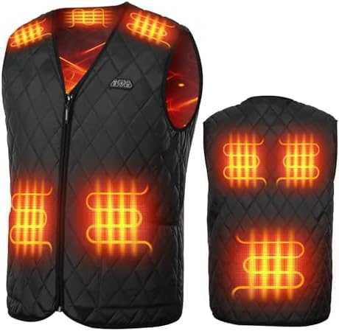
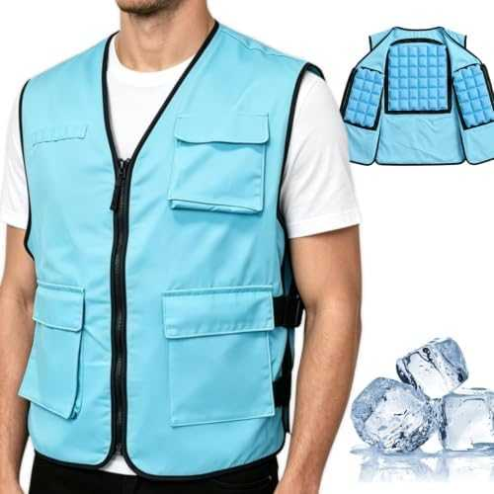
男士单马甲 功能性(热/冷）
https://www.aliexpress.com/item/1005008077733003.html
https://www.aliexpress.com/item/1005006269056940.html
https://www.amazon.de/dp/B0H3V81PTK
https://www.amazon.com/dp/B0GT7YDFCY?th=1
https://www.coupang.com/vp/products/9507854615?itemId=28331147768&vendorItemId=95407461565&sourceType=CATEGORY&categoryId=564927

Slide 6
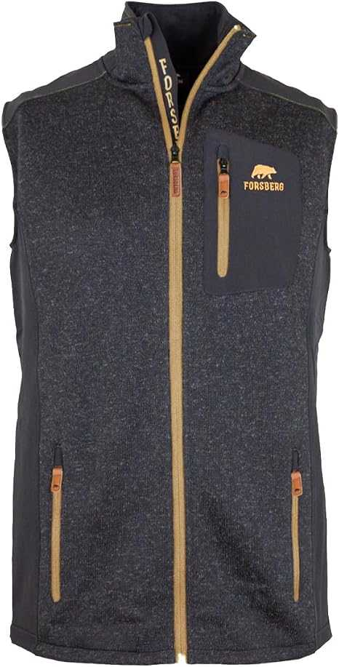
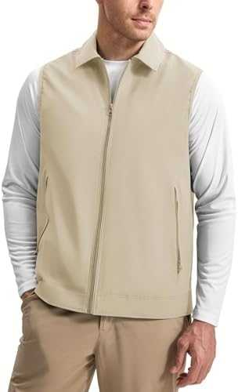
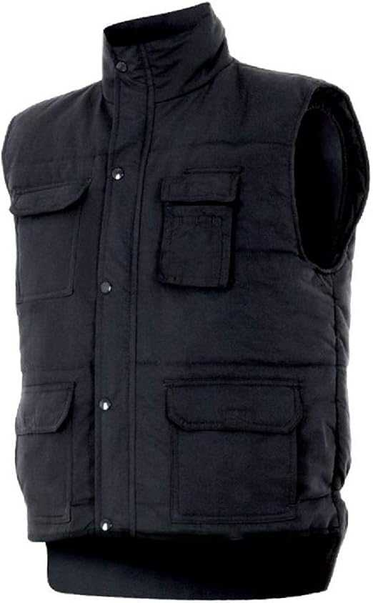
男士单马甲 御寒
https://www.amazon.de/dp/B07D5R37M2
https://www.amazon.de/dp/B0GCZPH1YS
https://www.amazon.de/dp/B019OEHWJY

Slide 7
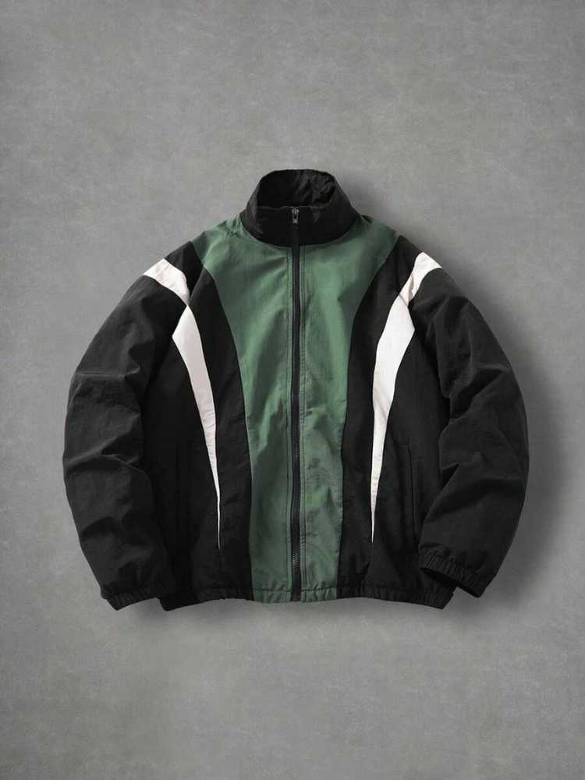
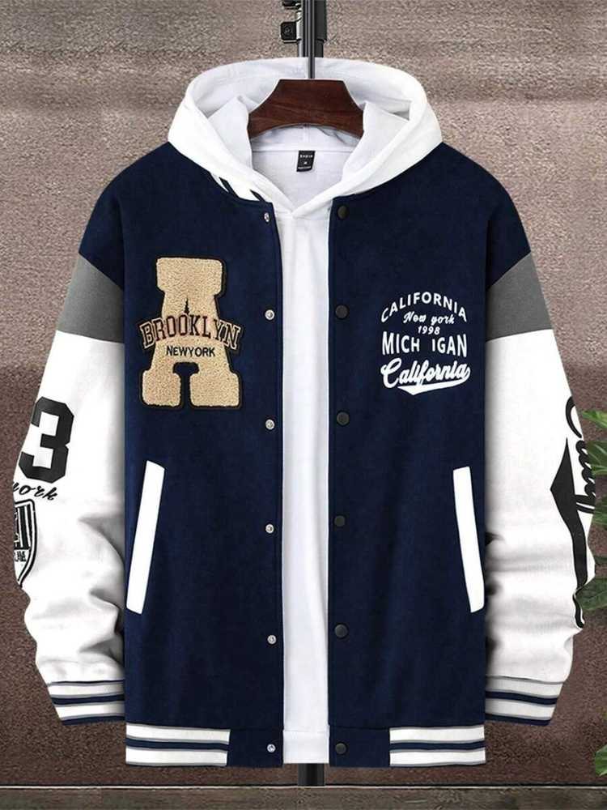
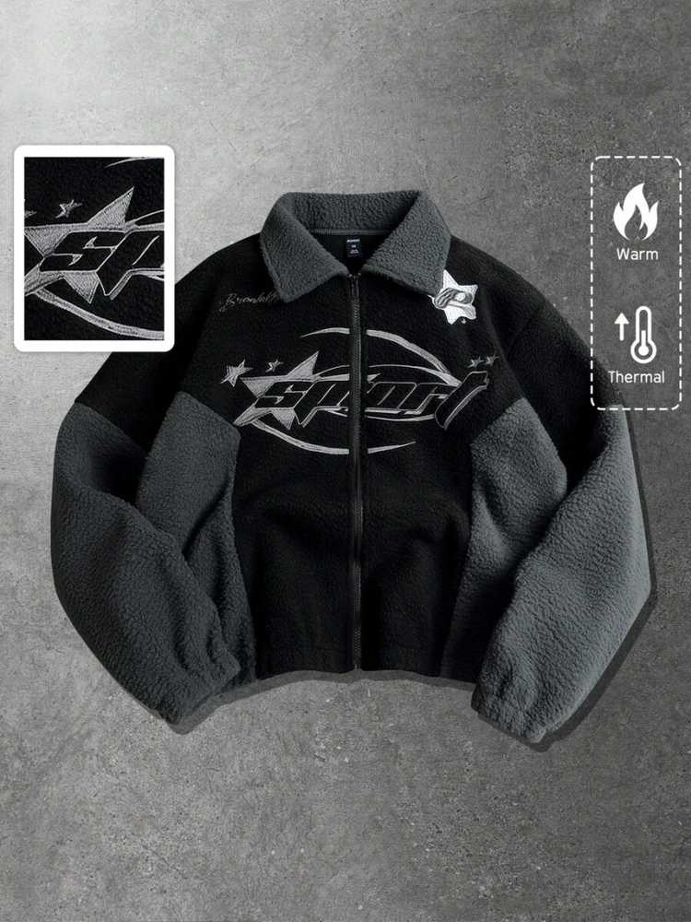
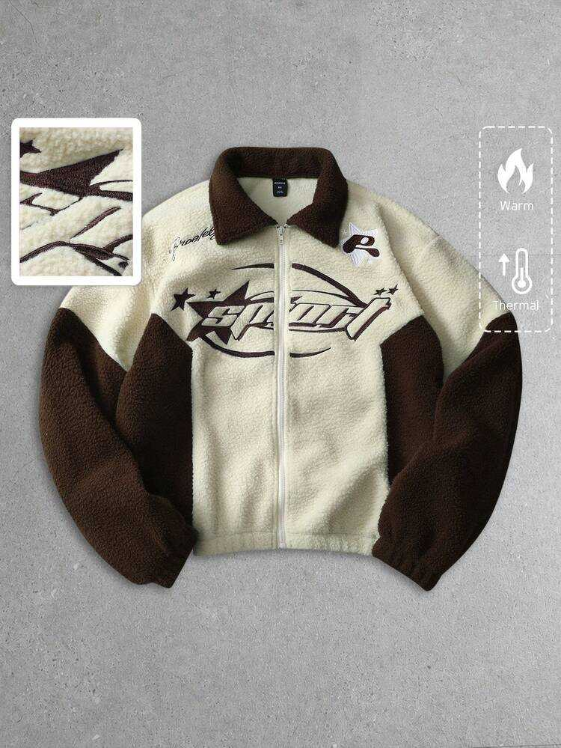
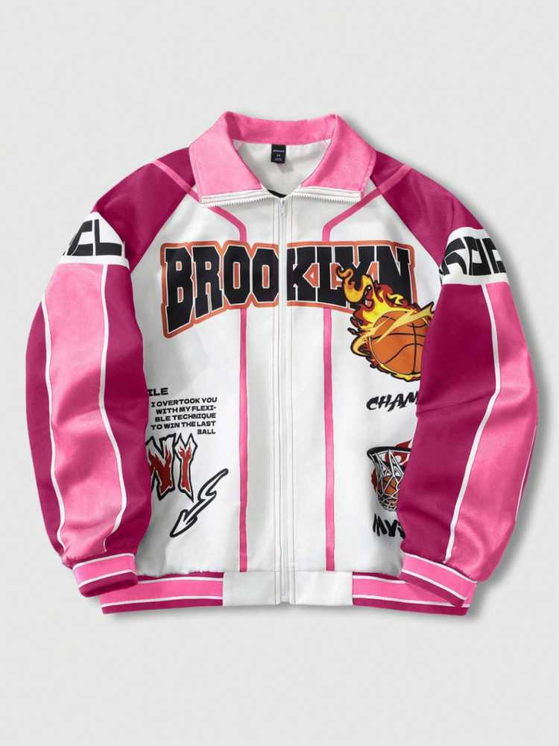
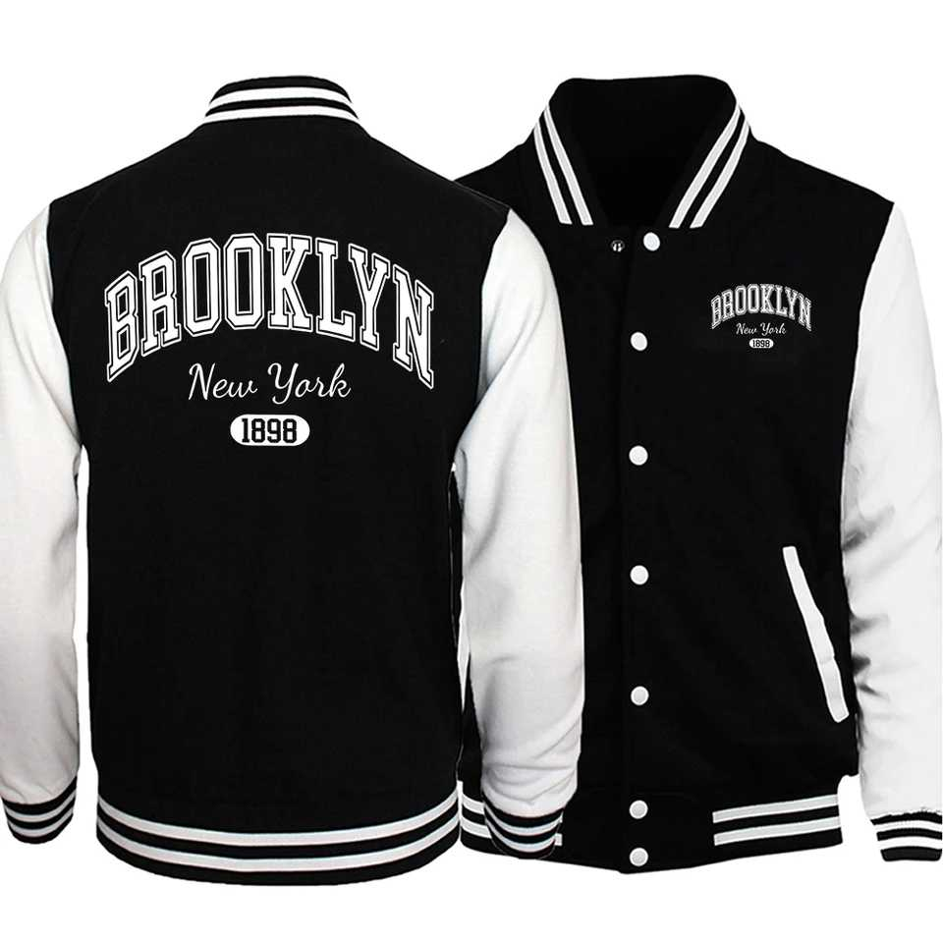
男士休闲运动风衣、夹克 颜色拼接
https://us.shein.com/ROMWE-MEN-Prep-Men's-Contrast-Color-Graffiti-Pattern-Zip-Up-Long-Sleeve-Jacket-p-227158496.html
https://us.shein.com/Manfinity-EMRG-Men's-Contrast-Color-Zipper-High-Collar-Casual-Long-Sleeve-Jacket-p-196975515.html
https://us.shein.com/Manfinity-Sporsity-Loose-Fit-Men's-Letter-Printed-Patched-Jacket-(Hoodie-Not-Included)-p-25940145-cat-1983.html
https://us.shein.com/ROMWE-MEN-Street-Life-Unisex-Patchwork-Street-Style-American-Jacket,-Autumn/Winter-p-314547498.html
https://us.shein.com/ROMWE-MEN-Street-Life-Men's-Jacket-And-Coat-Autumn/Winter-Design-Patchwork-Street-Style-American-Jacket-Coat-Unisex-p-499238692-cat-1983.html
https://ko.aliexpress.com/item/1005007646838856.html

Slide 8
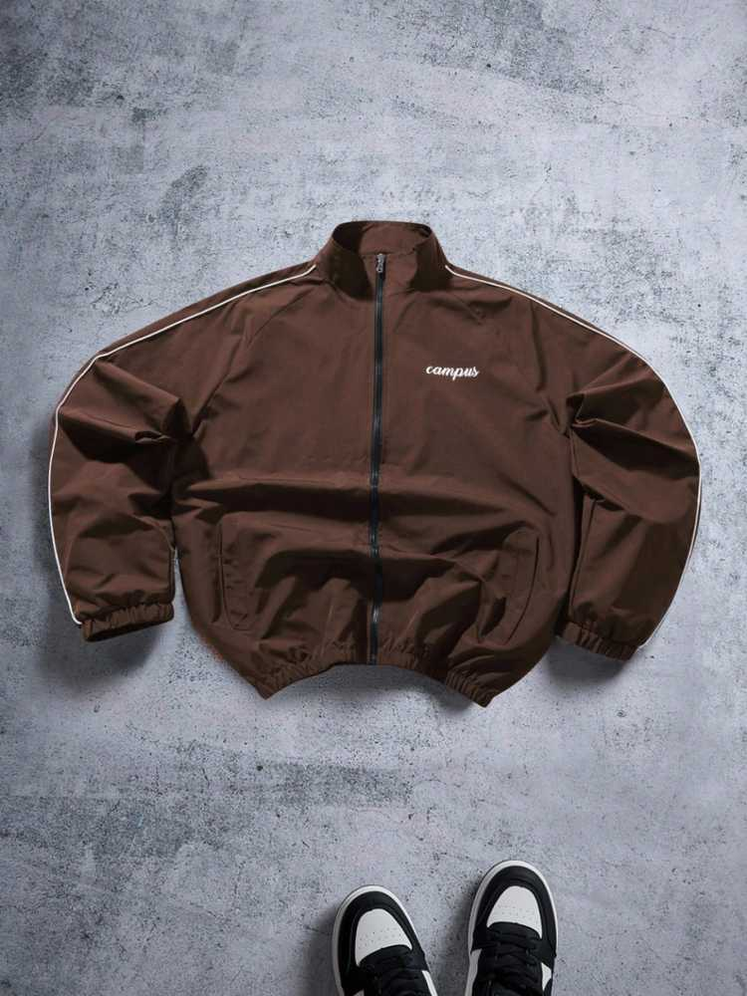
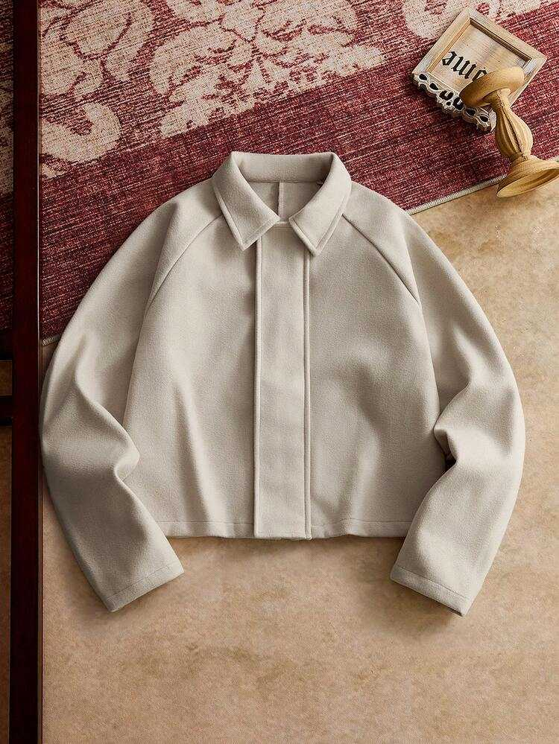
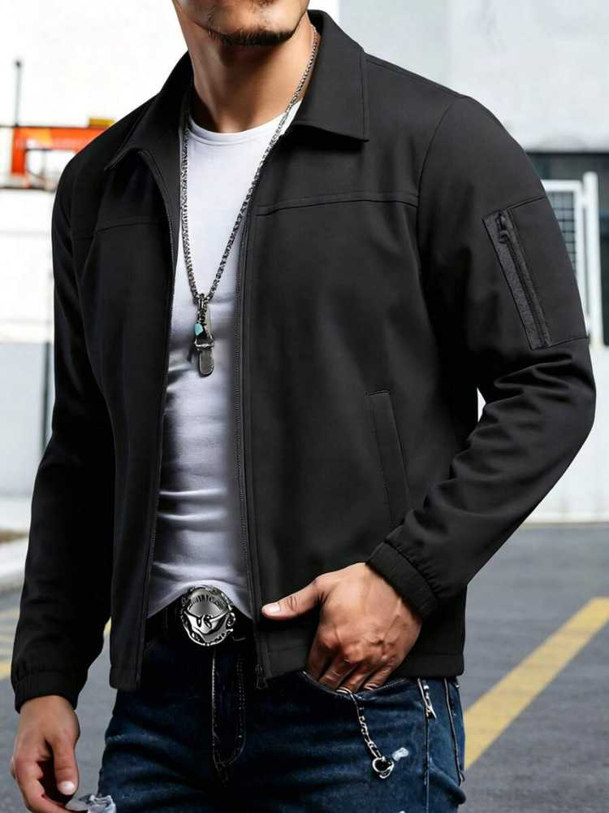
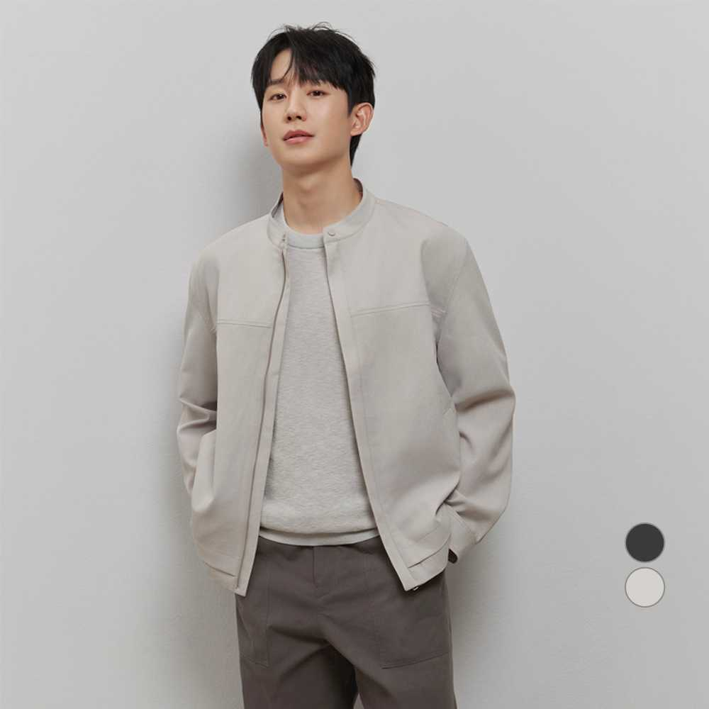
男士休闲运动风衣、夹克 素色
https://us.shein.com/Manfinity-INSISELF-Men's-Boxy-Casual-Turndown-Collar-Long-Sleeve-Jacket,-Suitable-For-Autumn/Winter-p-182675673.html
https://us.shein.com/Men's-Casual-Lapel-Jacket,-Sports-Comfortable-Multi-Pocket-Lightweight-Versatile-Outerwear,-Suitable-As-Gift-For-Husband,-Friend,-Boyfriend,-Father-p-424425306-cat-2448.html
https://www.coupang.com/vp/products/8679910074?itemId=25197451153&vendorItemId=92194106703&sourceType=CATEGORY&categoryId=564927
https://us.shein.com/Manfinity-ZONE917-Men's-Casual-Fashion-Street-College-Sports-Letter-Print-Contrast-Piping-Stand-Collar-Zip-Up-Jacket,-Autumn-p-188771772.html

Slide 9
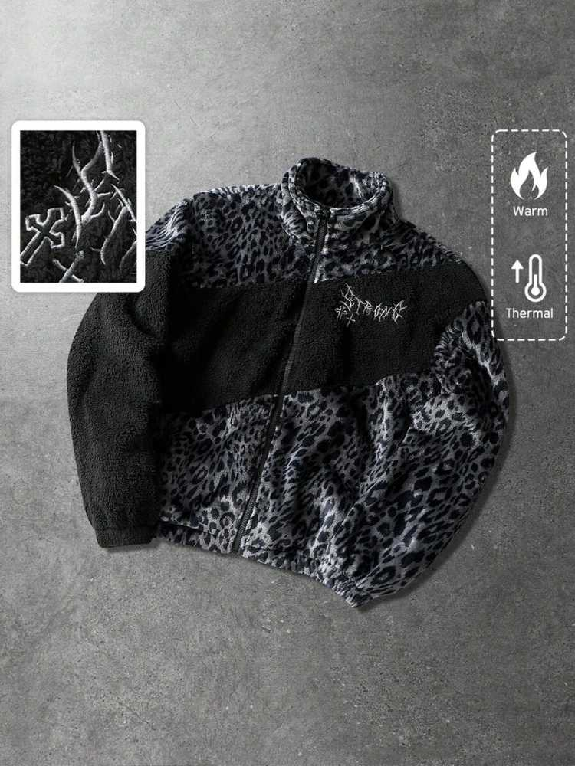
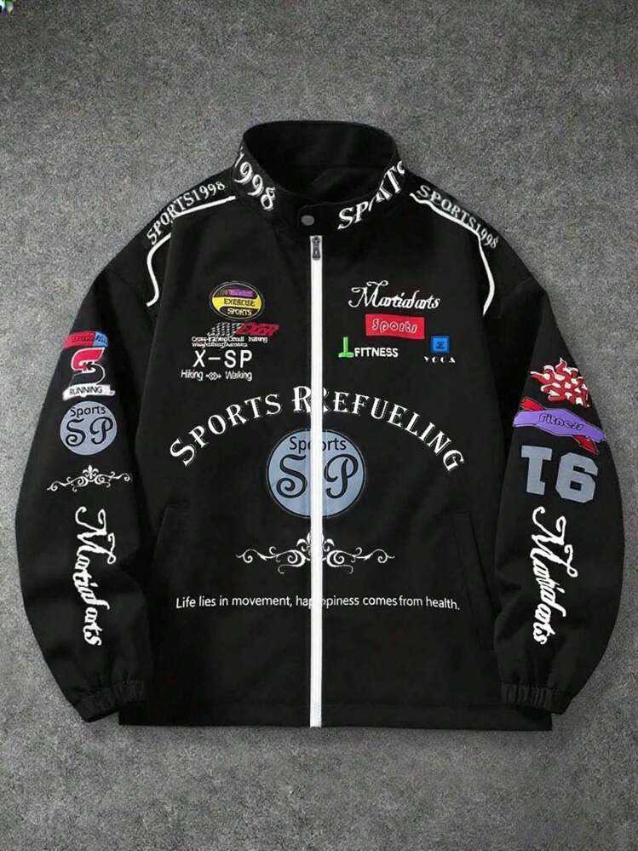
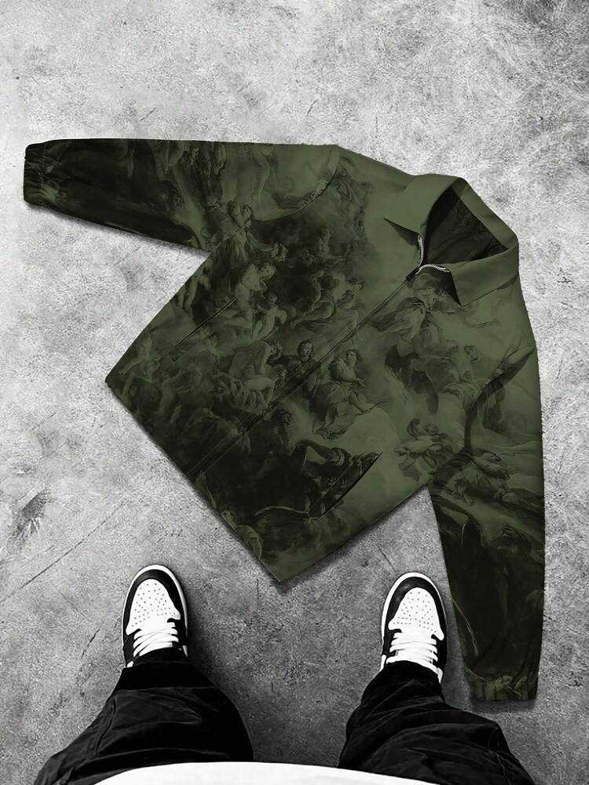
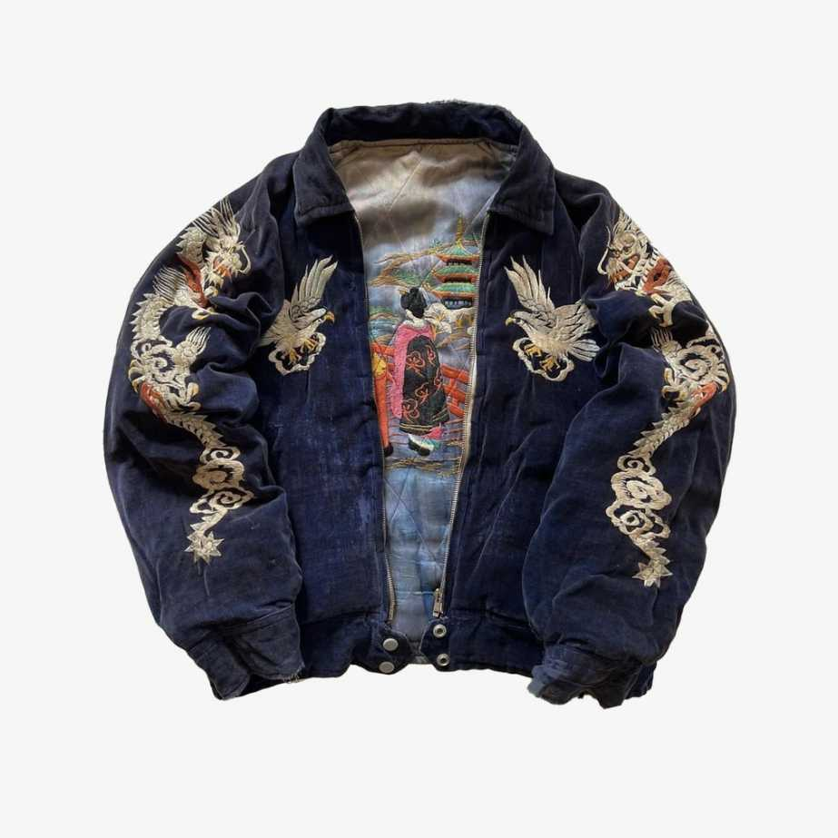
男士休闲运动风衣、夹克 街头风格
https://us.shein.com/ROMWE-MEN-Street-Life-Unisex-Leopard-Print---English-Text-Graphic-Patchwork-Fleece-Lined-Jacket,-Autumn/Winter-p-200798388.html
https://us.shein.com/PAVTROS-Manfinity-Streetrush-Men's-Fashionable-Printed-Long-Sleeve-Jacket-Outerwear-Sports-Jacket-Zip-Up-Jacket-Graphic-Jacket-Racing-Jacket-Sportswear-Jacket,-2000s-Style,Fall-p-149403824-cat-1983.html
https://us.shein.com/Manfinity-EMRG-Men's-Figure-Graphic-Long-Sleeve-Zipper-Collar-Casual-Jacket-p-65815610-cat-1983.html
https://es.aliexpress.com/item/1005010645689710.html

Slide 10
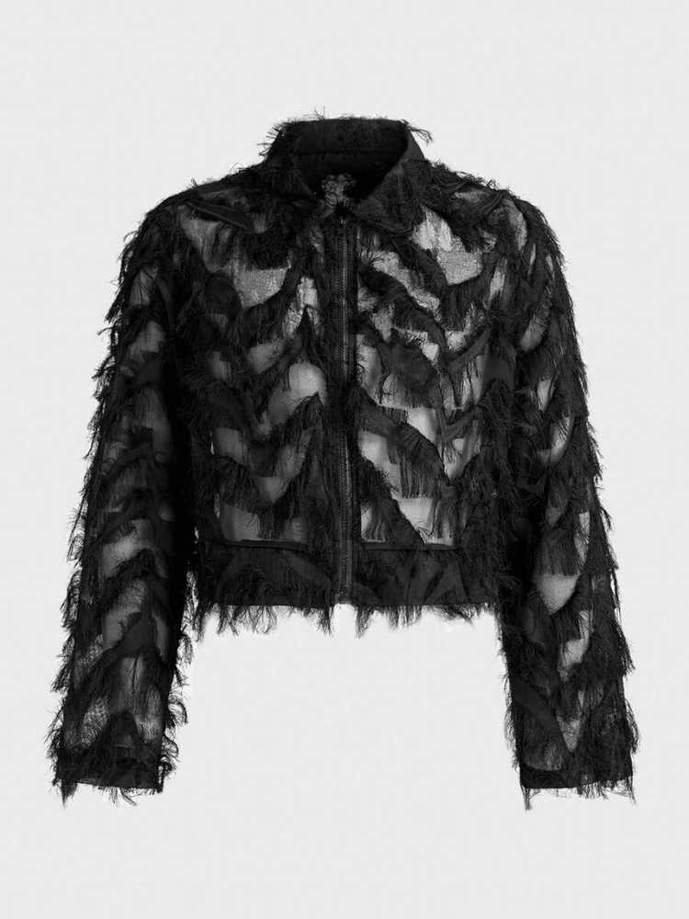
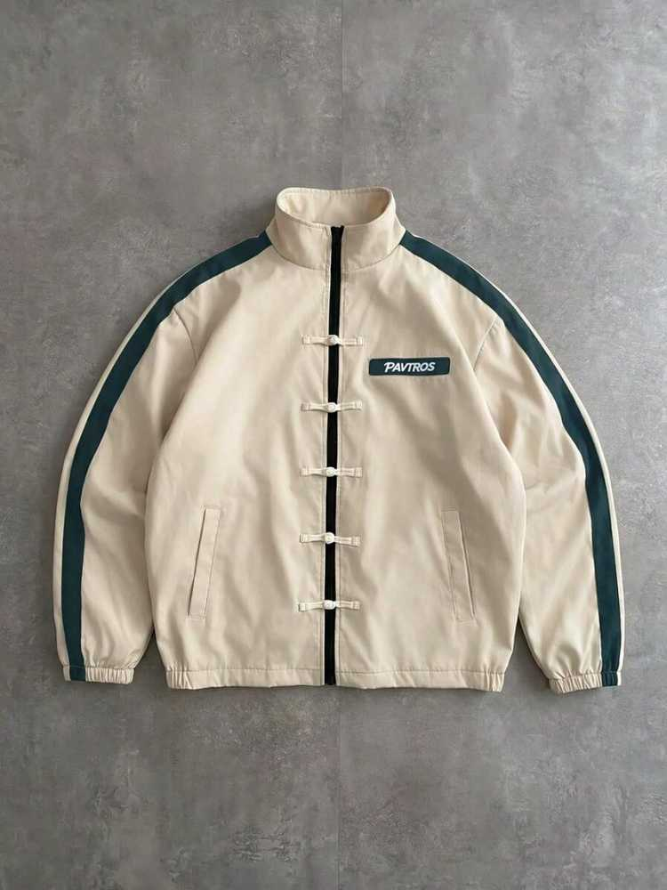
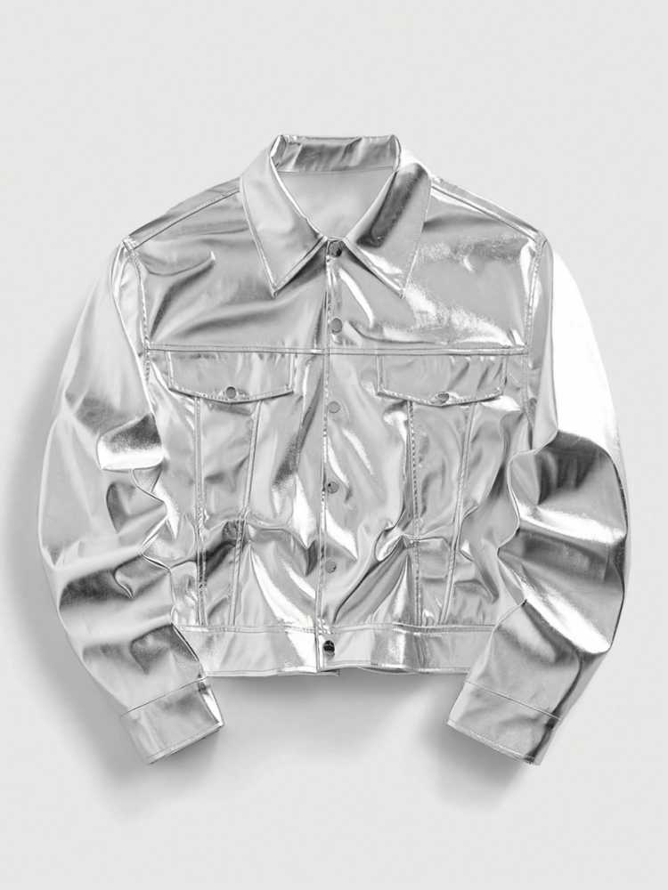
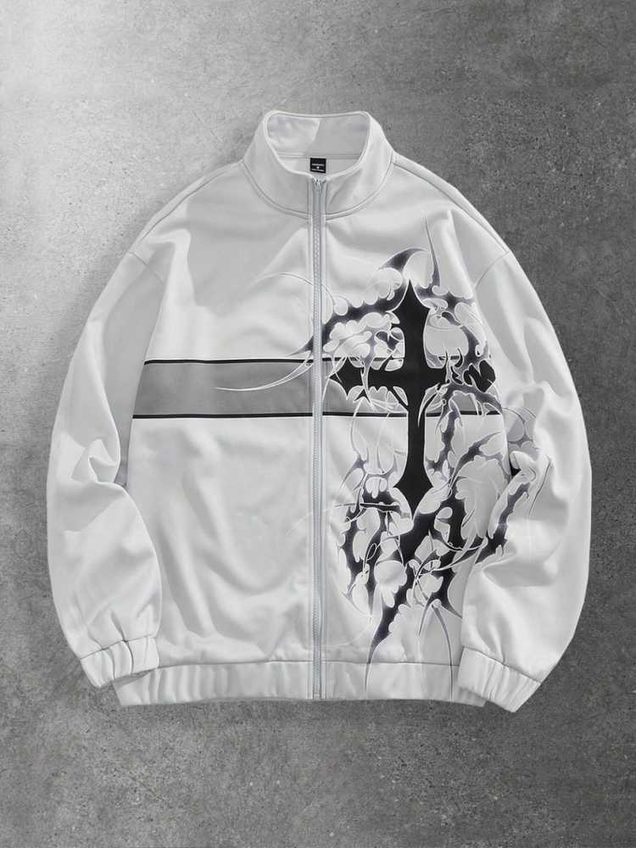
男士风衣 潮流款
https://us.shein.com/PAVTROS-Men's-Letter-Print-Contrast-Color-Long-Sleeve-Frog-Button-Jacket-p-503300905-cat-1983.html
https://us.shein.com/ROMWE-MEN-Street-Life-Men's-Turndown-Collar-Single-Breasted-Fashionable-Versatile-Commuter-Long-Sleeve-Jacket-p-309314711.html
https://us.shein.com/ROMWE-MEN-Street-Life-Men's-Autumn-Casual-Fashion-Street-Cross-Print-Contrast-Color-Zipper-Stand-Collar-Jacket-p-217520760.html
https://www.shein.com/FeverCity-Men's-Fashion-Punk-Zipper-Jacket,-Fall,-Winter,-Grunge-p-168597190-cat-1983.html

Slide 11
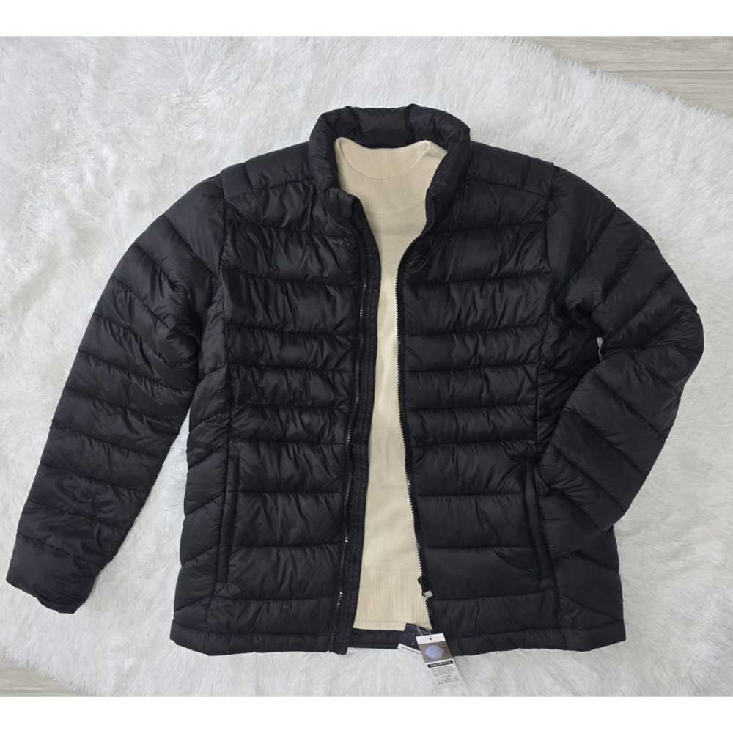
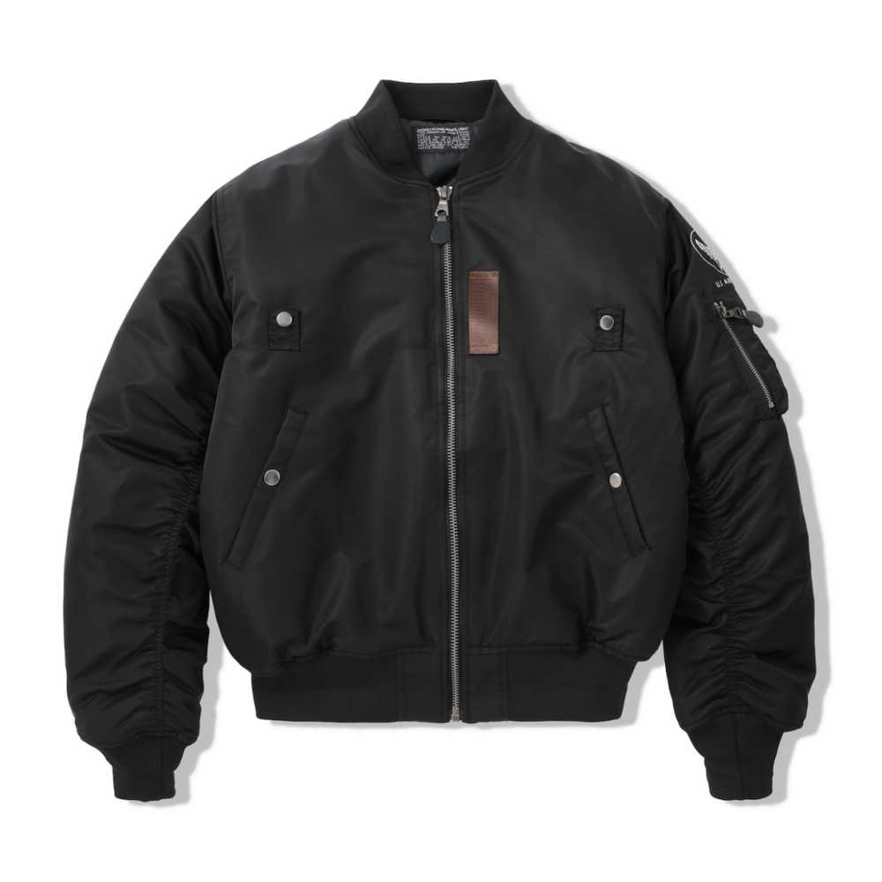
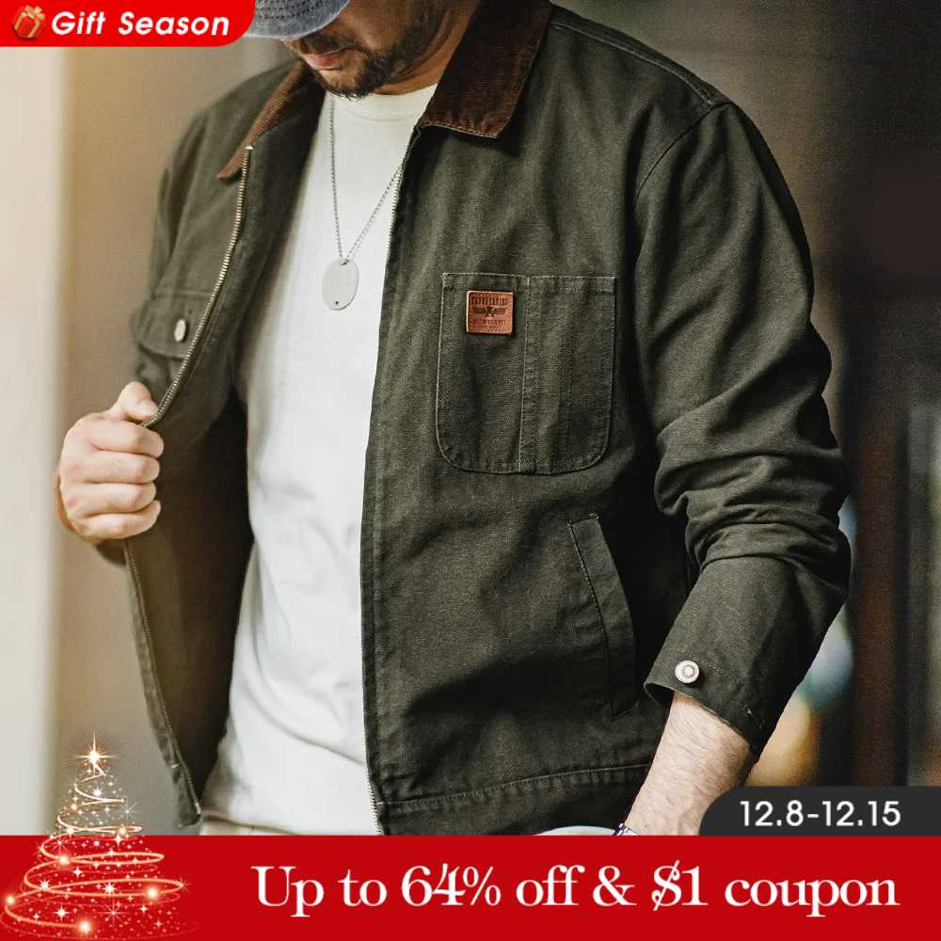
男士休闲运动风衣、夹克 保暖/休闲
https://www.coupang.com/vp/products/9065661162?itemId=26621475265&vendorItemId=94481750027&sourceType=CATEGORY&categoryId=431683
https://www.aliexpress.com/item/1005007729603286.html
https://www.aliexpress.com/item/1005010304567889.html

Slide 12
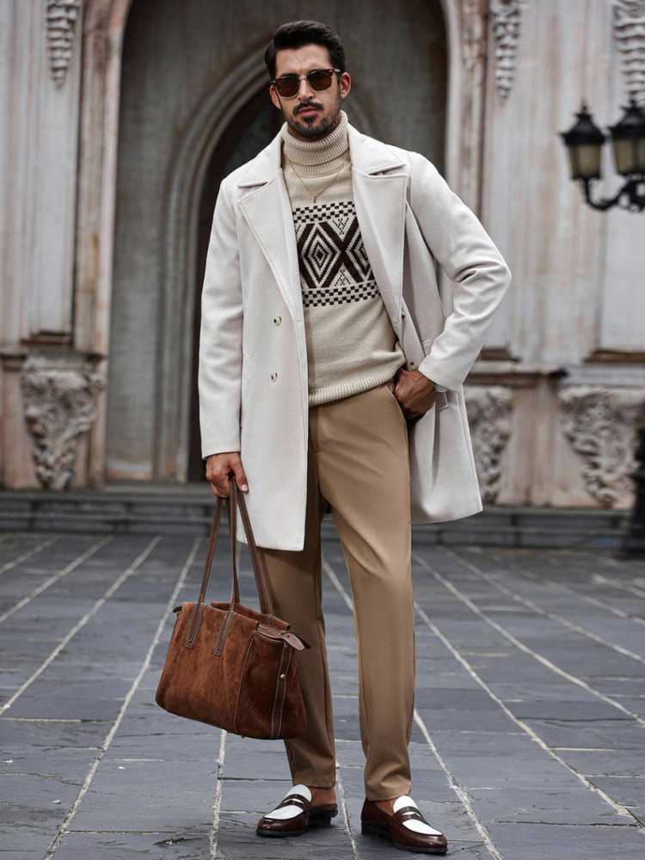
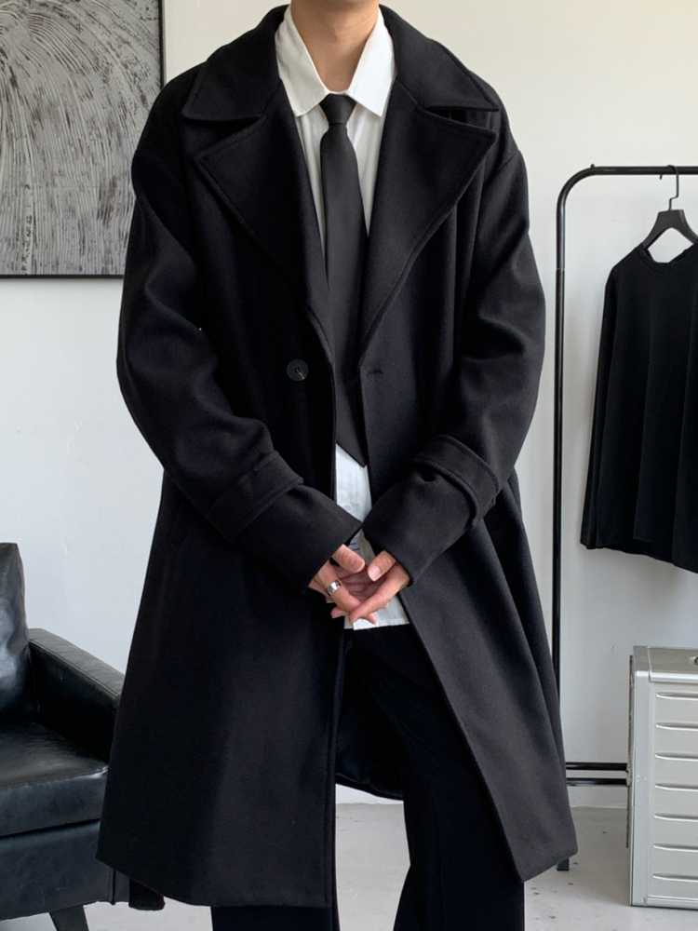
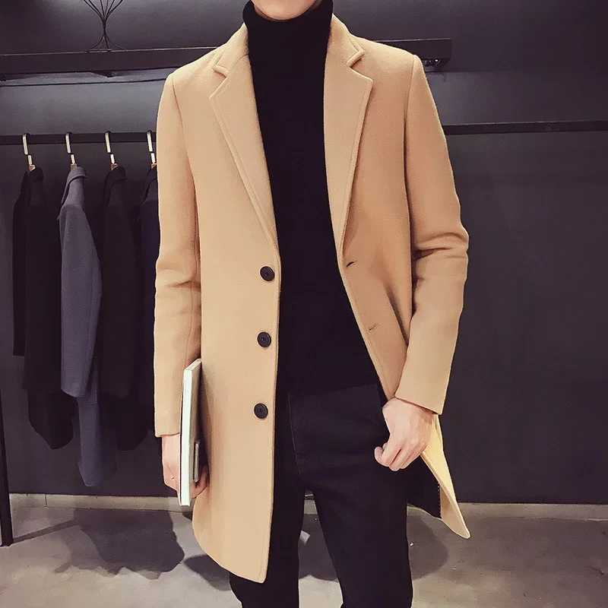
男士风衣 长款
https://us.shein.com/Manfinity-Bizformal-Men's-Double-Breasted-Casual-Jackets,-Fall-And-Winter,-Mix-And-Match-Autumn-Menswear,-Winter-Men's-Coats,-Warm-Coats-Elegantcasual-Cream-Outfit-Men-Beige-Men-Outfit-Manfinity-Streetrush-Young-Street-Style-For-Men-p-179345550.html
https://us.shein.com/Manfinity-Hypemode-Loose-Fit-Men's-Lapel-Collar-Dropping-Shoulder-Belted-Overcoat-p-11470441-cat-3137.html
https://www.aliexpress.com/item/1005004455834645.html

