Slide 1
8月BSR开款（一） 以下款式有BSR标签 买手绑定后 可享搜推提权——额外流量 男装单马甲 男士休闲运动风衣、夹克（免审版寄样） 男士风衣

Slide 2

对接买手：游无垠

Slide 3
上款路径指引
服装、鞋靴和珠宝饰品 > 男士时尚 > 男装 > 男士外套 > 男装单马甲
服装、鞋靴和珠宝饰品 > 男士时尚 > 男装 > 男士休闲运动服 > 男士休闲运动风衣、夹克
服装、鞋靴和珠宝饰品 > 男士时尚 > 男装 > 男士外套 > 男士风衣雨衣 > 男士风衣

Slide 4
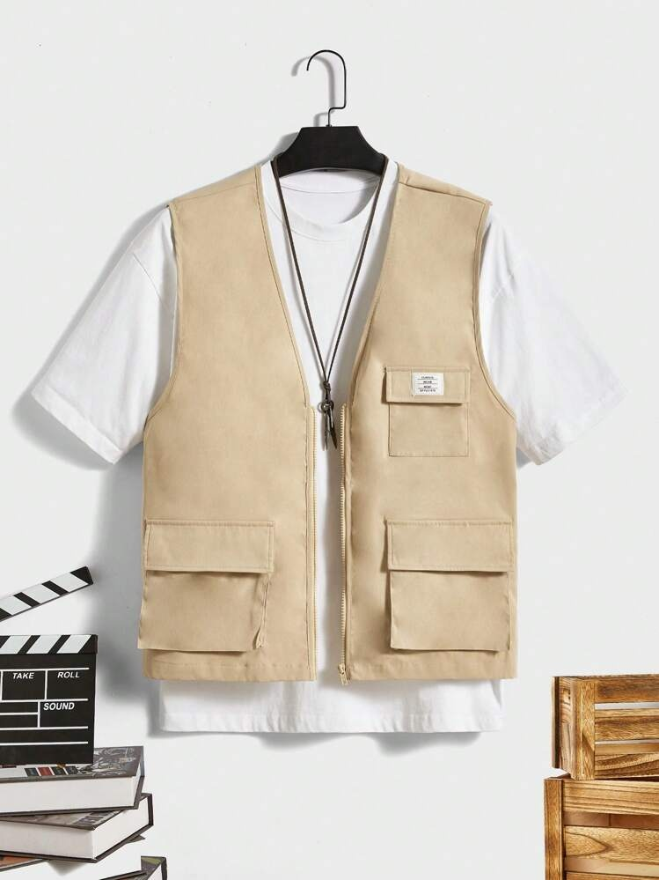
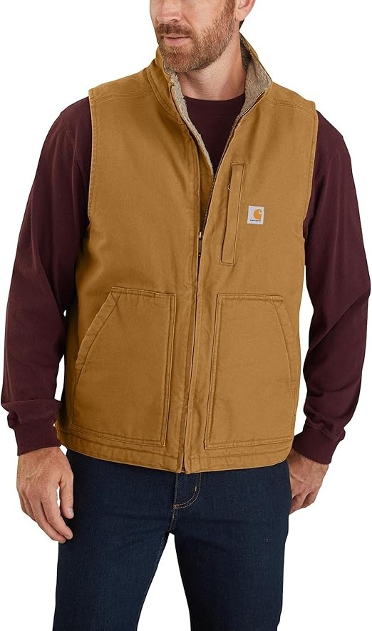
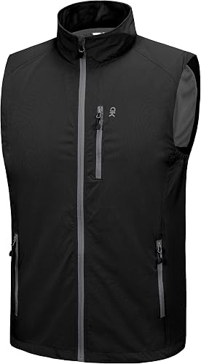
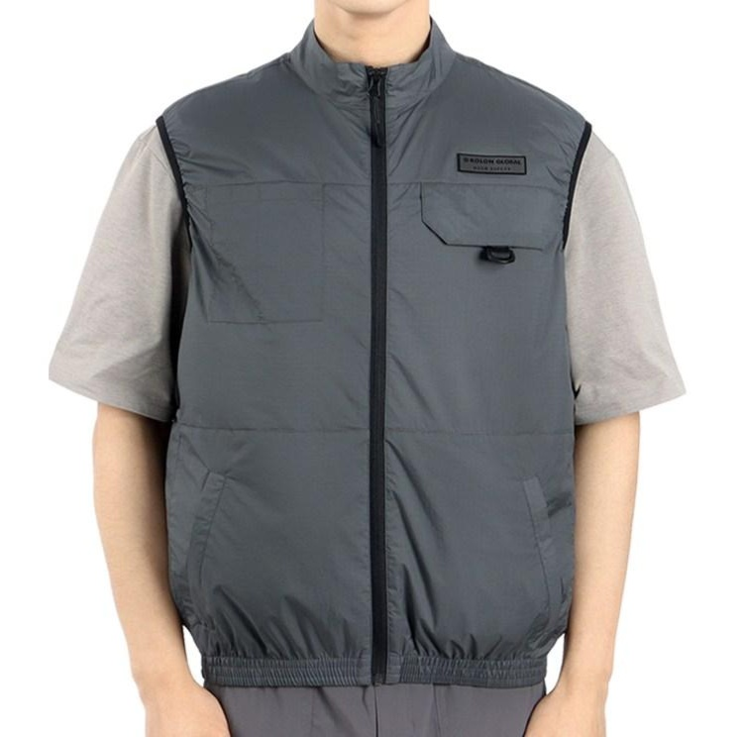
男士单马甲 日常搭配
https://www.amazon.com/dp/B0BKJVXWTM
https://www.coupang.com/vp/products/9588829593?itemId=28601190716&vendorItemId=95555475605&sourceType=CATEGORY&categoryId=564927
https://us.shein.com/Manfinity-UrbanChill-Men-Flap-Pocket-Vest-Without-Tee,-Going-Out-Casual-Jogger-Vest-p-16498689-cat-6277.html
https://www.amazon.se/dp/B083Z162Y6

Slide 5
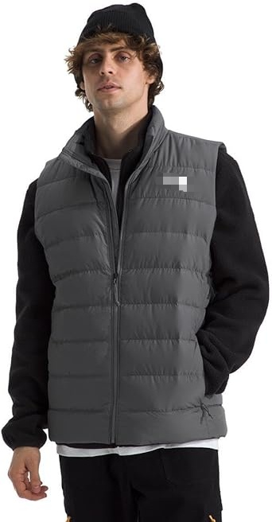
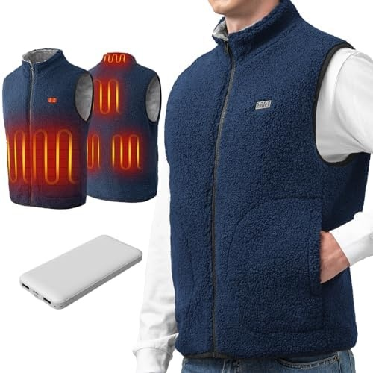
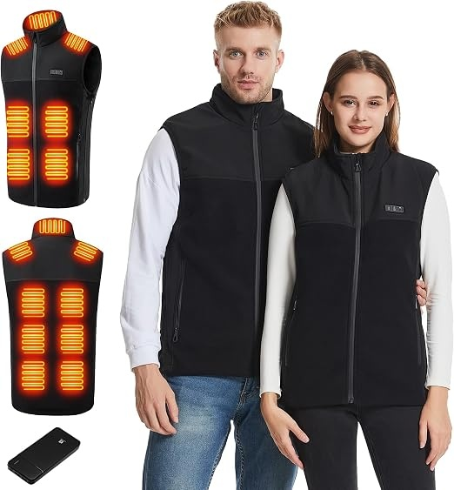
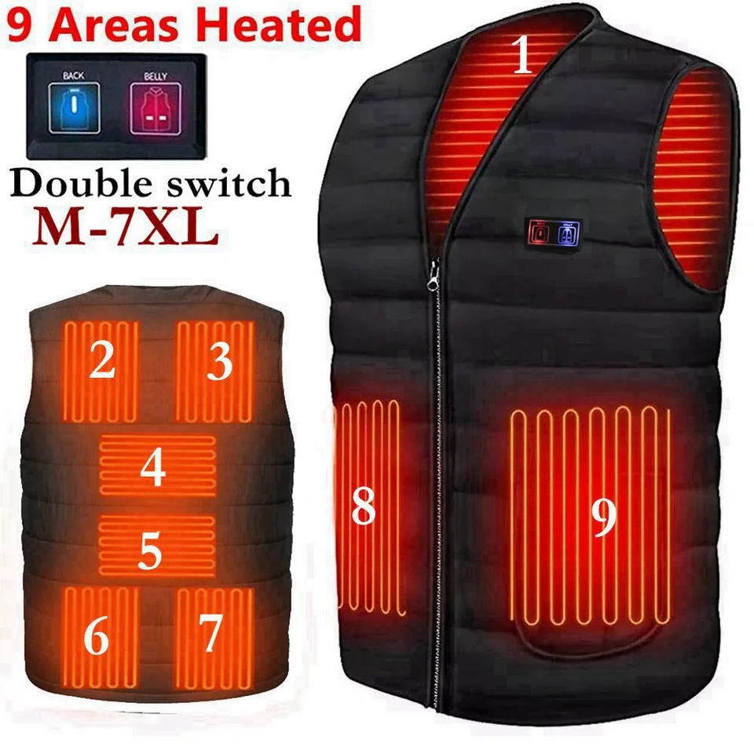
男士单马甲 加热保暖
https://pt.aliexpress.com/item/1005007410714609.html
https://www.amazon.fr/dp/B0CG6LG9KT
https://www.amazon.de/dp/B0FR2TDYBS?th=1&psc=1
https://www.amazon.ae/dp/B0CNBTTYLC?th=1&psc=1

Slide 6
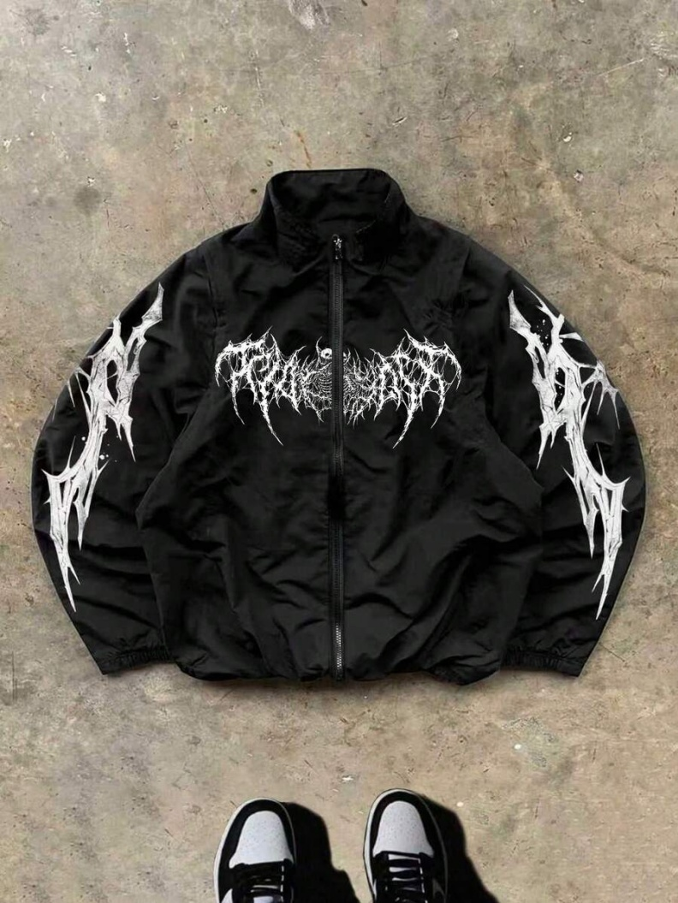
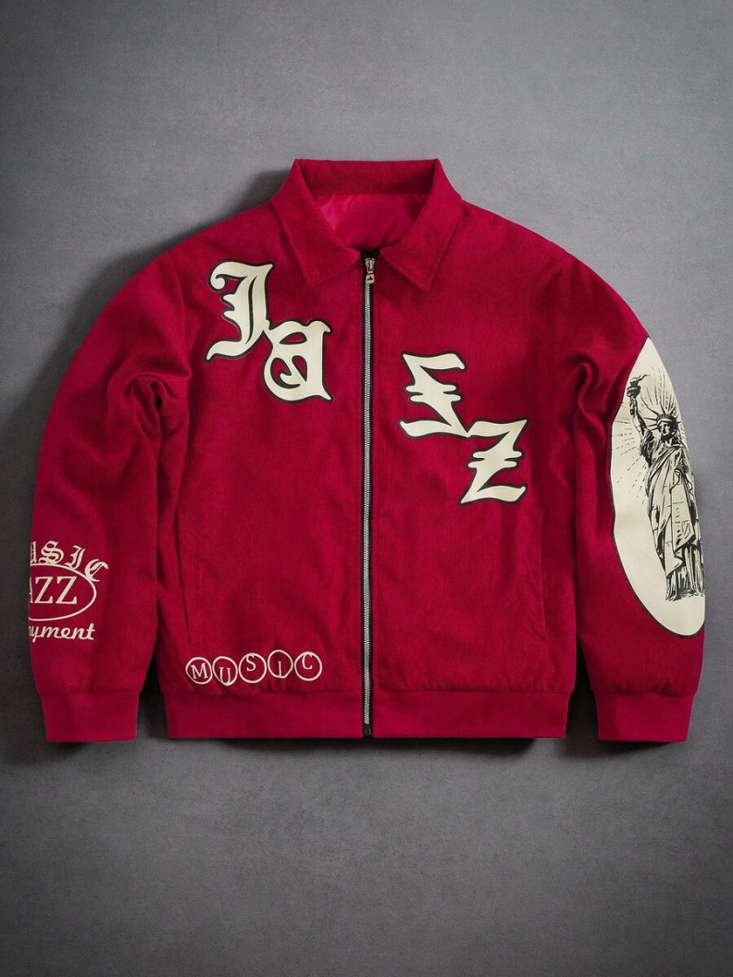
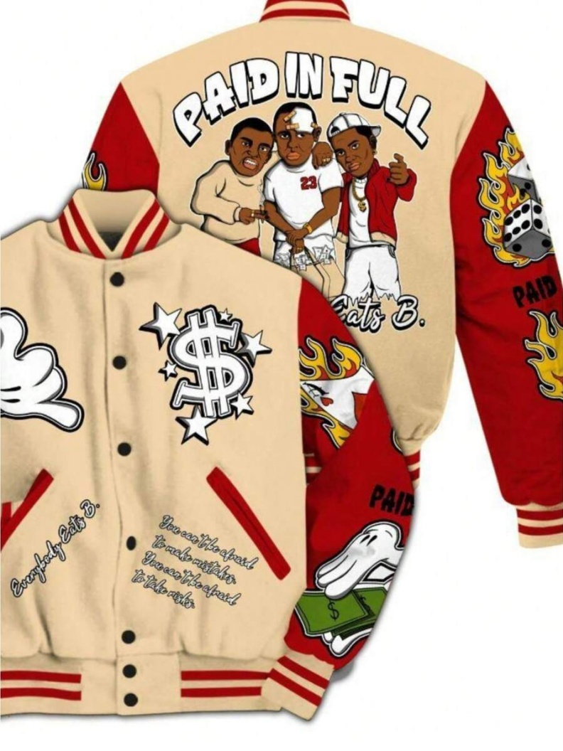
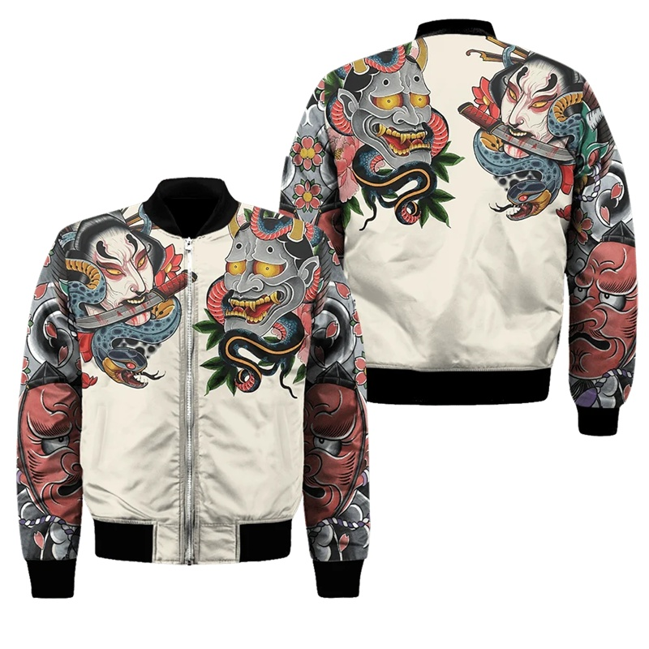
男士休闲运动风衣、夹克 街头风格
https://us.shein.com/Men-s-Jacket-Court-Style-3D-Printed-Baseball-Jacket-Single-Breasted-Jacket-p-438939790.html
https://us.shein.com/PAVTROS-Manfinity-Streetrush-Men's-Street-Fashion-Red-Zip-Up-Jacket,-Statue-Of-Liberty-Jacket-Jazz-Graphic-Jacket-Red-Corduroy-Jacket-Music-Graphic-Zip-Up-Red-Graphic-Jacket-Y2k-Jacket-Varsity-Jacket,-Fall-Winter-p-161766266-cat-1983.html
https://es.aliexpress.com/item/1005006745637828.html
https://us.shein.com/Sport-MetroGents-Men's-Minimalist-Printed-Zip-Up-Long-Sleeve-Sports-Jacket-p-380324682.html

Slide 7
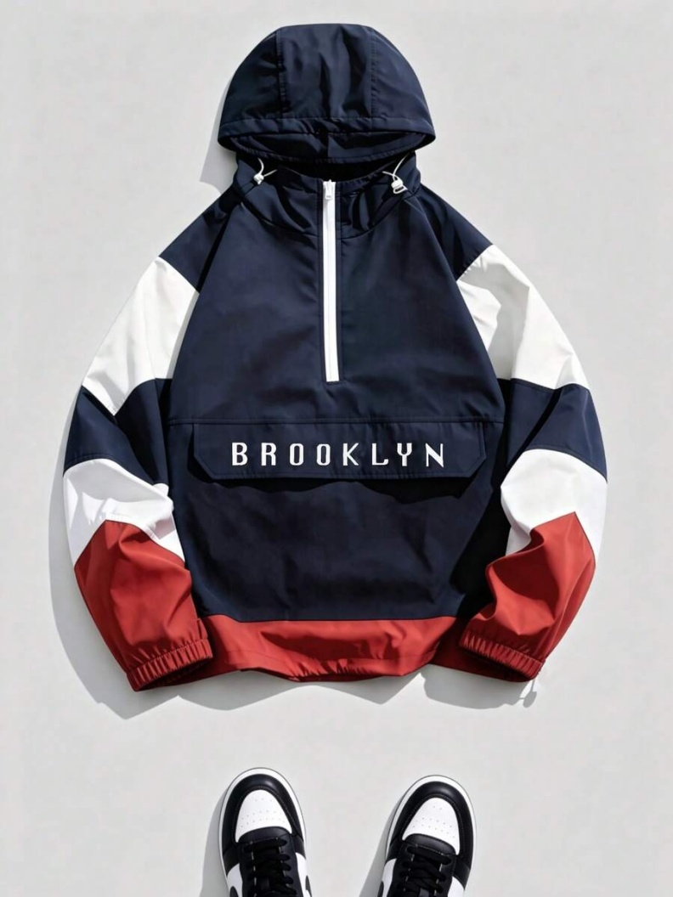
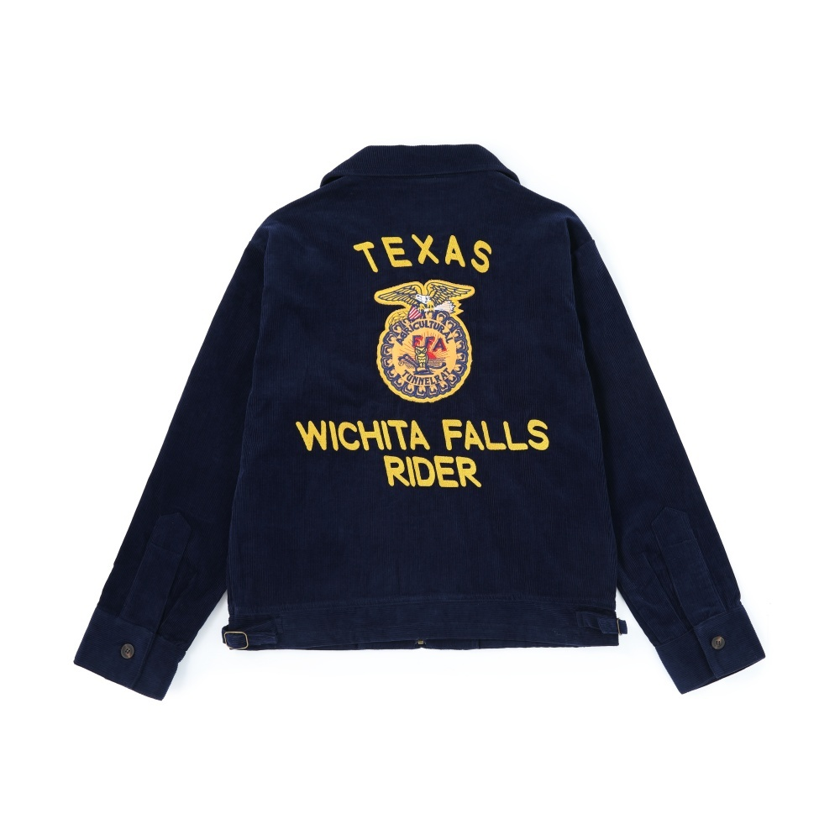
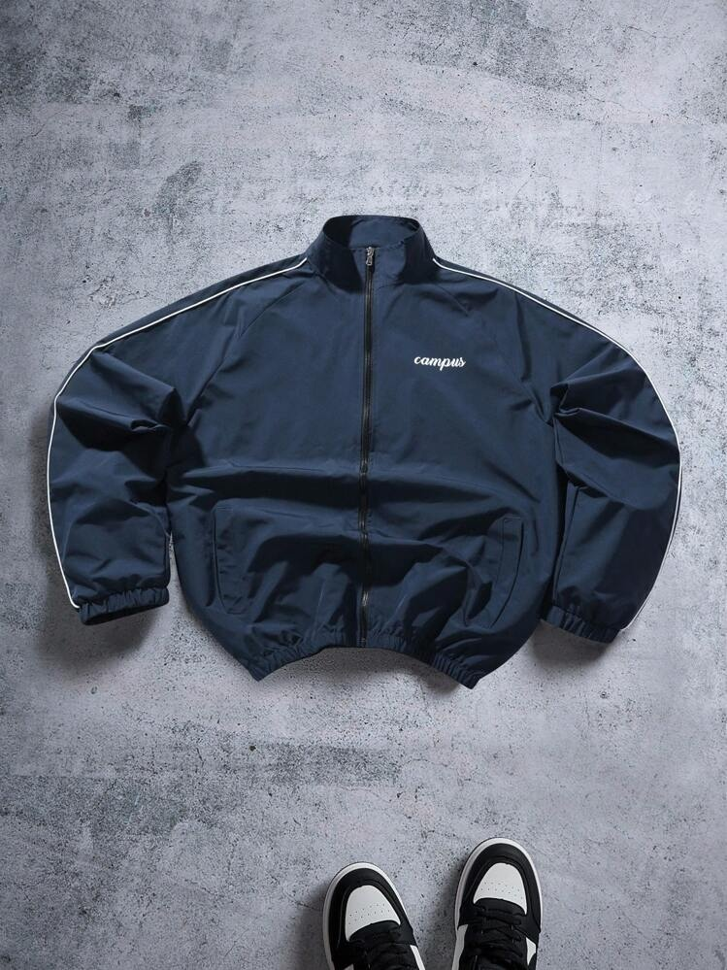
男士休闲运动风衣、夹克 地名
学校
https://www.aliexpress.com/item/1005009011963657.html
https://us.shein.com/Manfinity-ZONE917-Men's-Letter-Print-Long-Sleeve-Zip-Front-Casual-Jacket-Track-Jacket-Cropped-Jacket-Men-Mens-Zip-Up-Jacket-p-134785727-cat-1983.html
https://www.shein.co.uk/Herren-Kapuzenjacke-mit-Farbbl%C3%B6cken,-Rei%C3%9Fverschluss-und-Stickerei,-l%C3%A4ssige-Streetwear-Sportjacke-p-317127452-cat-1983.html

Slide 8
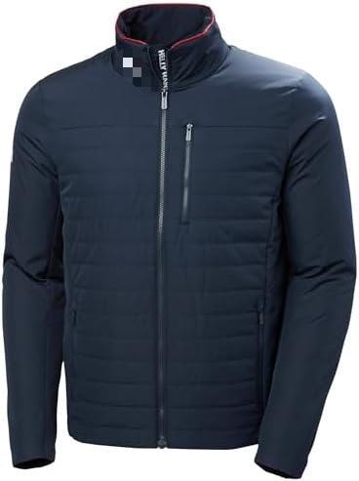
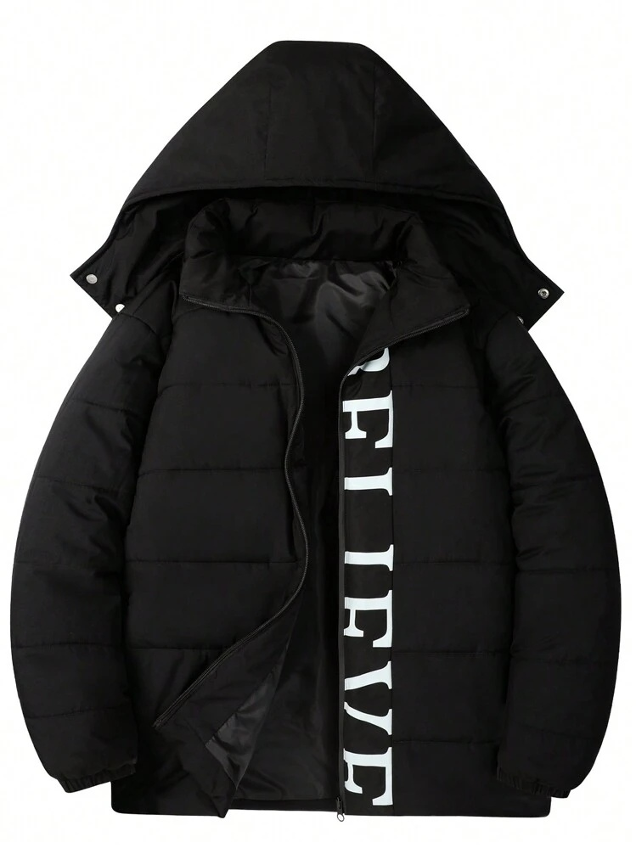
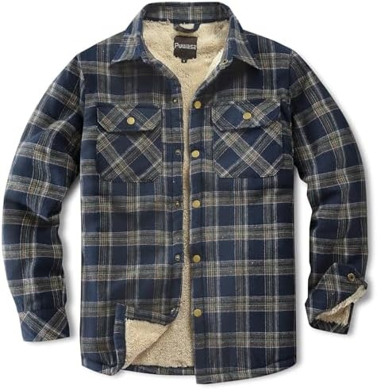
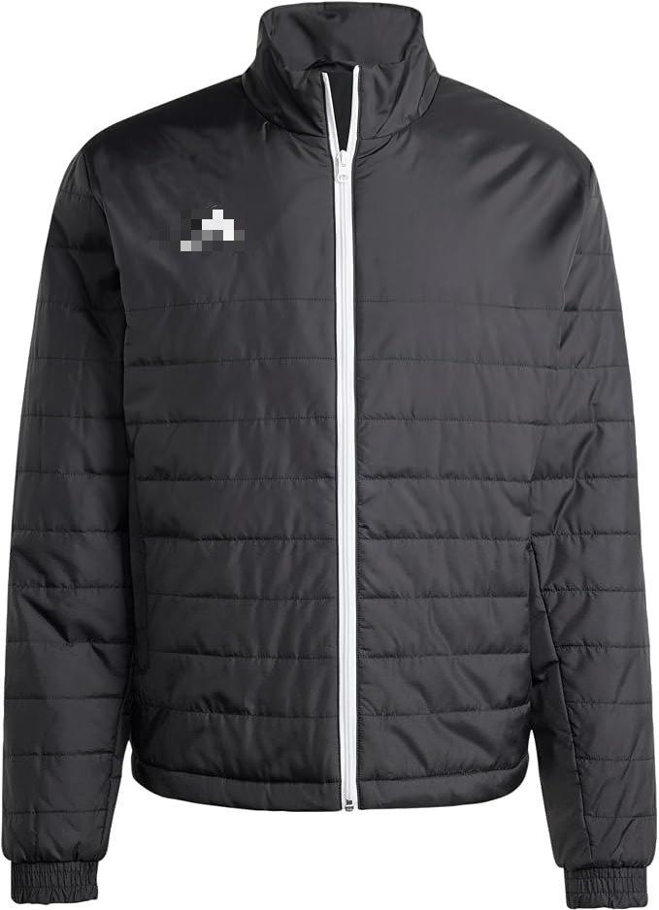
男士休闲运动风衣、夹克 保暖款
https://www.amazon.es/dp/B09T3F5NPP
https://www.amazon.com/dp/B0CKLPHZGV?th=1&psc=1
https://peterglenn.com/helly-hansen-crew-softshell-jacket-men-s/
https://www.shein.co.uk/Manfinity-Hypemode-Men's-Loose-Fit-Hooded-Quilted-Jacket-With-Letter-Print,-Going-Out-Casual-Bubble-Coat-Letter-Winter-Coat-p-26245613-cat-3138.html

Slide 9
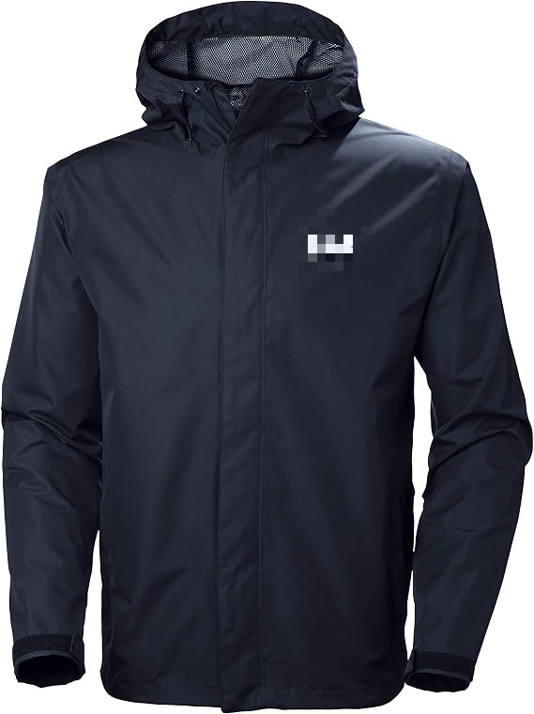
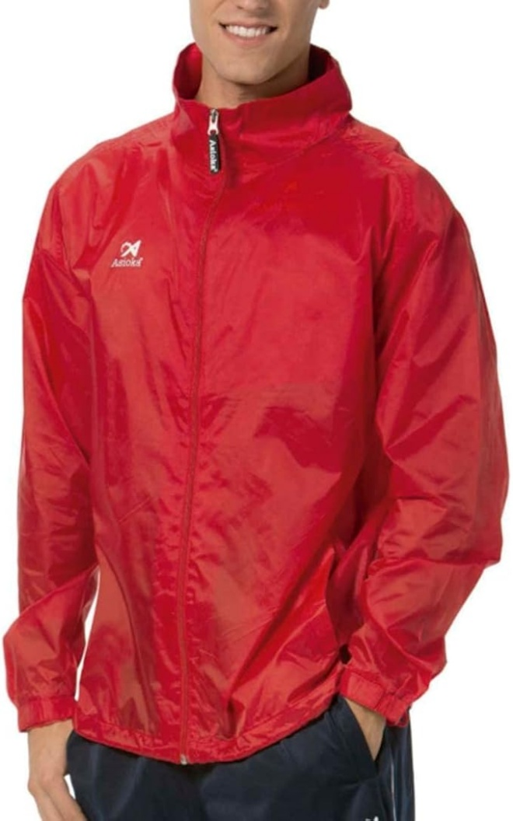
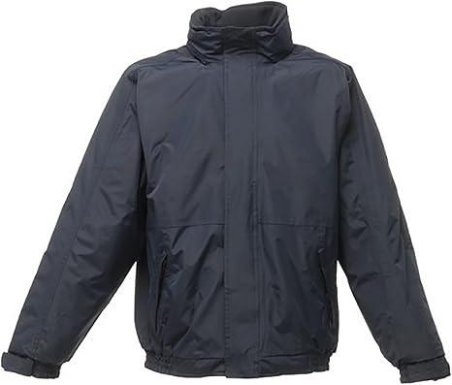
男士休闲运动风衣、夹克 单色
https://www.amazon.es/dp/B07HF1Z1VK
https://www.amazon.es/dp/B094NZ6C19
https://www.amazon.es/dp/B079RKKN2L

Slide 10
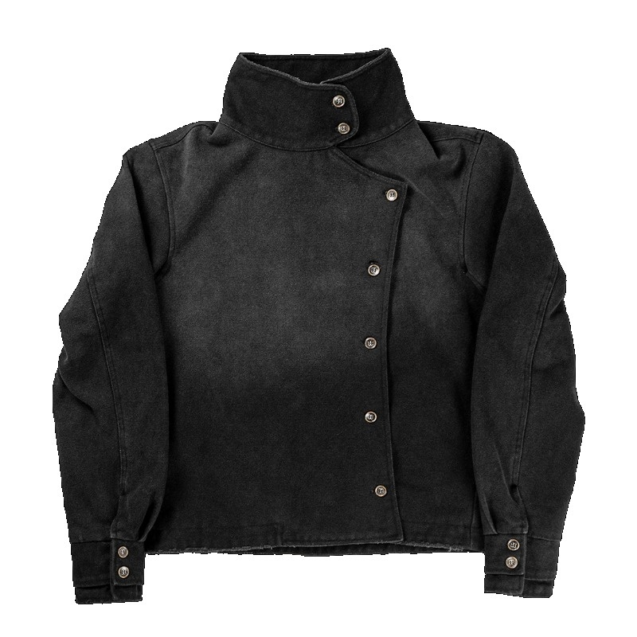
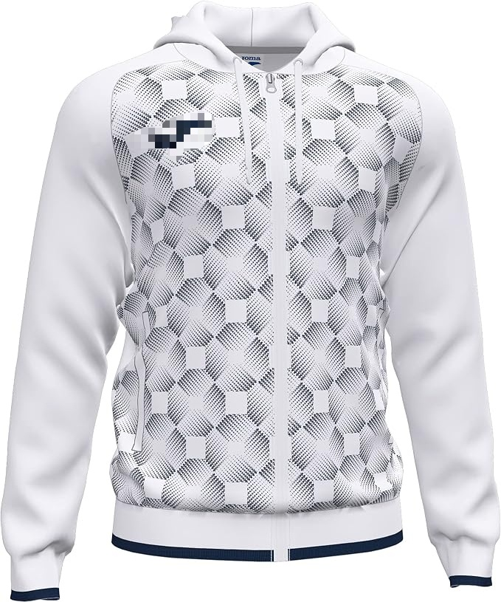
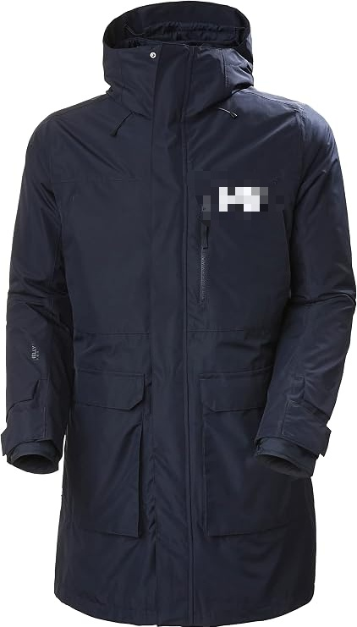
男士休闲运动风衣、夹克
连帽抽绳
连帽长款
复古风
https://www.amazon.es/dp/B08Z84VB91
https://www.amazon.ie/Helly-Hansen-Mens-Rigging-Coat/dp/B083MT6ZCP?th=1&psc=1
https://www.aliexpress.com/item/1005010456943986.html

Slide 11
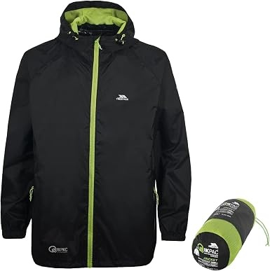
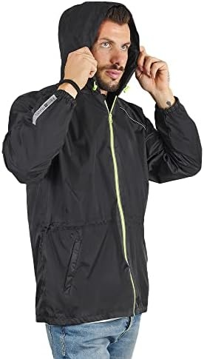
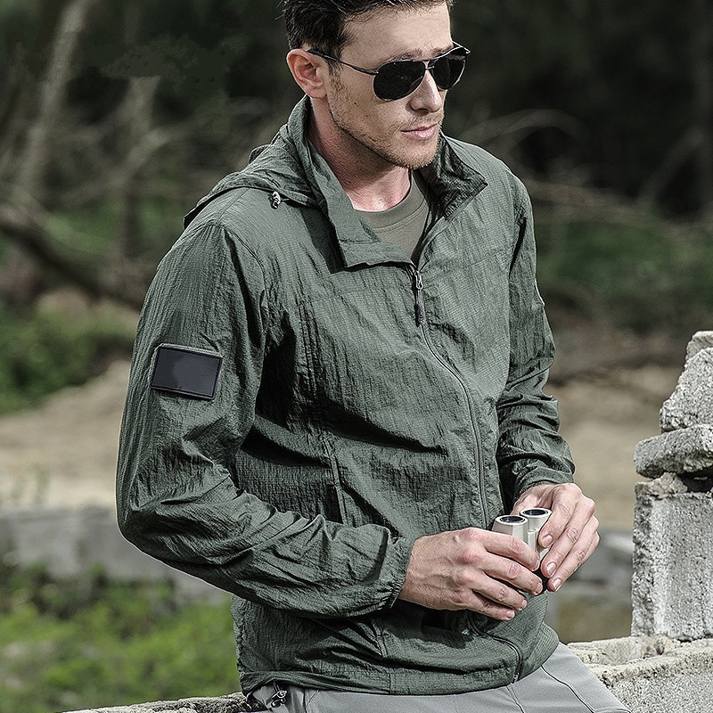
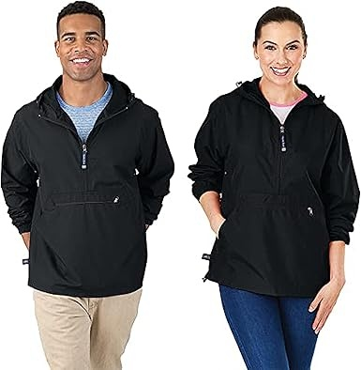
男士风衣
连帽风衣
https://es.aliexpress.com/item/1005008720752734.html
https://www.amazon.es/dp/B0B43296NV?th=1&psc=1
https://www.amazon.de/dp/B00BRT2NFI?th=1&psc=1
https://www.amazon.com/dp/B000BB7W4U?th=1&psc=1

Slide 12
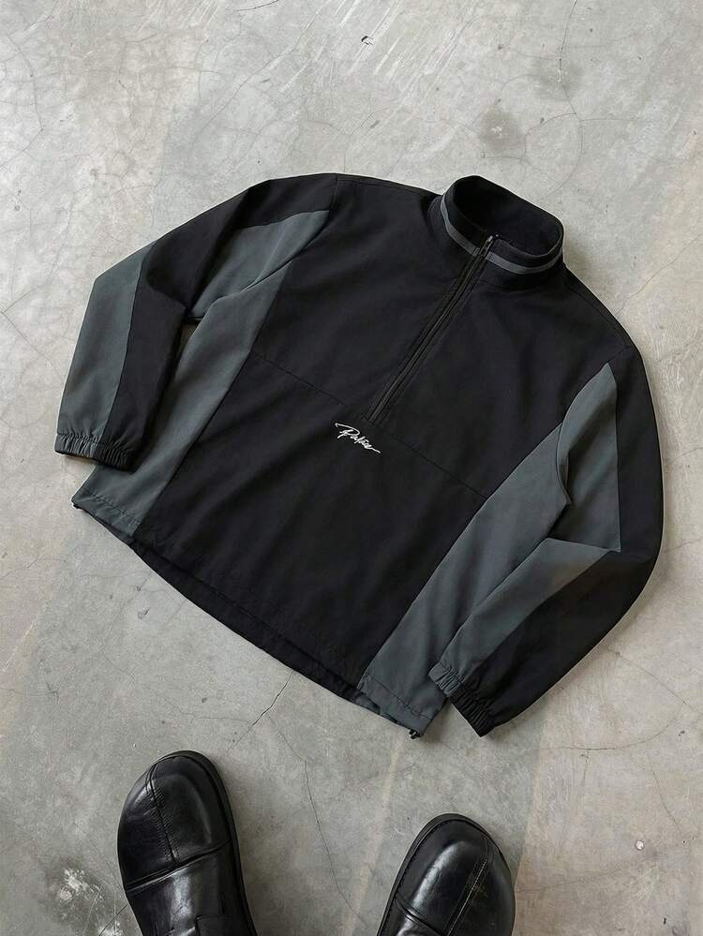
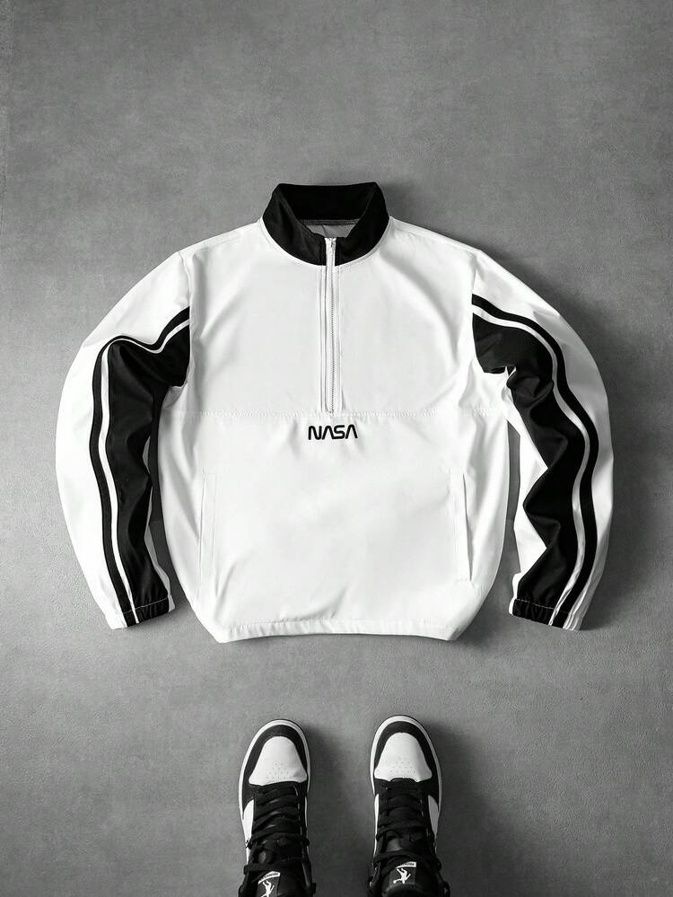
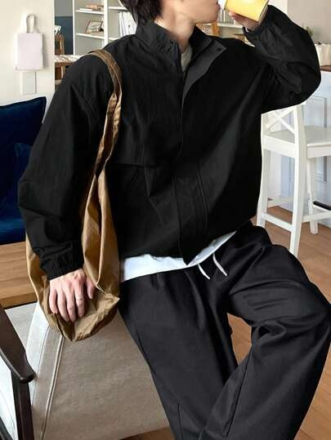
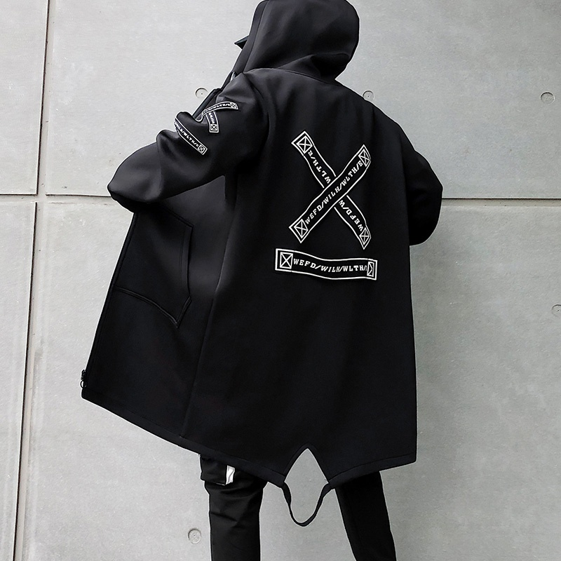
男士风衣
潮流款
https://us.shein.com/PAVTROS-Men's-Casual-Fashionable-Street-Wear-Contrast-Color-Letter-Print-Half-Zip-Stand-Collar-Jacket,-Suitable-For-Spring-And-Autumn-p-415041317-cat-1983.html
https://us.shein.com/PAVTROS-Men's-Contrast-Color-Half-Zip-Stand-Collar-Casual-Fashion-Patchwork-Pullover-Jacket-Football-p-453743472-cat-1983.html
https://jp.shein.com/DAZY-Men's-Casual-Solid-Color-Zip-Up-Stand-Collar-Jacket,-Fashion-Street-Style,-Autumn-p-163543679-cat-1983.html
https://pt.aliexpress.com/item/1005005062652749.html

Slide 13
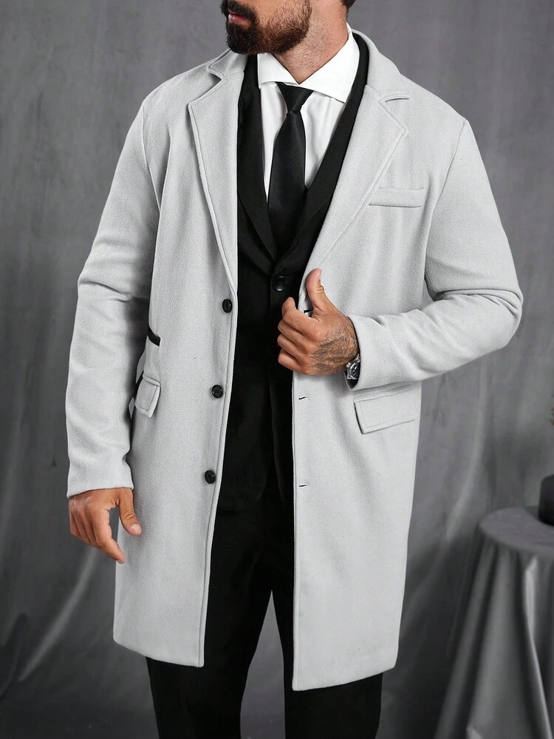
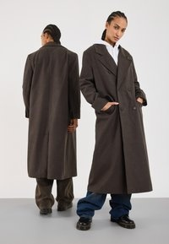
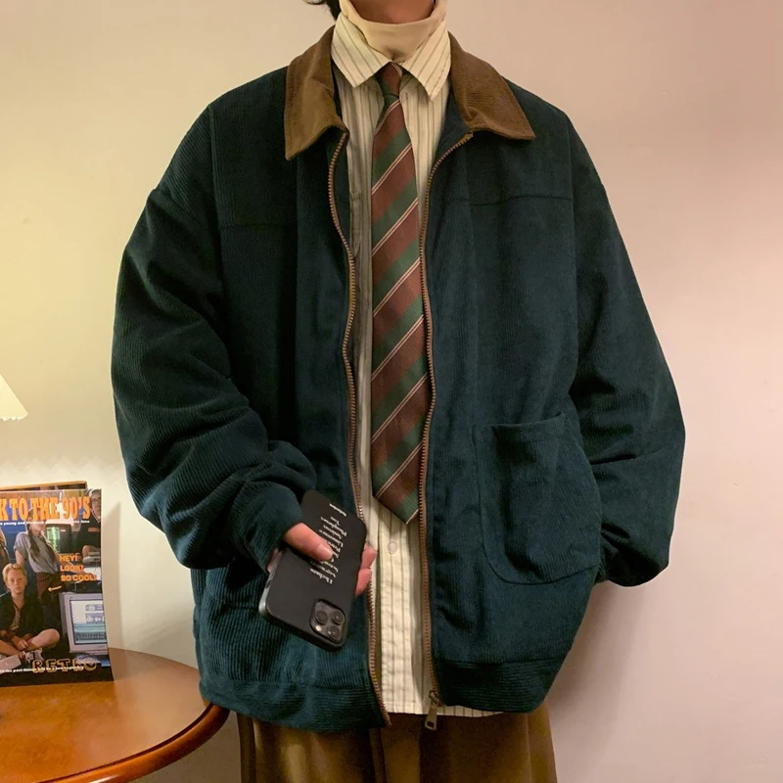
男士风衣 休闲款
https://es.aliexpress.com/item/1005007203754997.html
https://www.shein.co.uk/Manfinity-CasualCool-Men's-Solid-Color-Pocket---Button-Front-Long-Sleeve-Overcoat,-Autumn-Fall-Going-Out-Overcoat,-For-Friends,-Husband,-Boyfriend-Gifts-p-194431951-cat-3137.html
https://www.zalando.nl/yourturn-unisex-mantel-brown-yo12101gd-o11.html

