Slide 1

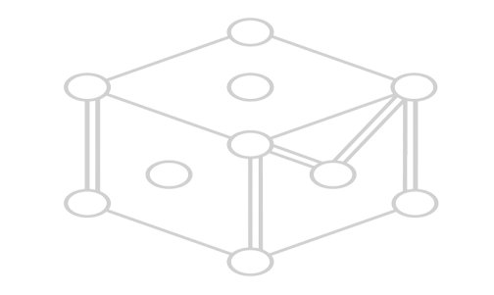

Warsaw university of technology
FACULTY OF MATERIAL SCIENCE AND ENGINEERING
BIOMATERIALS
Bioengineering
Title: Bioceramics in Bone regeneration
Presentation by Temesgen Ufaysa Dola
January,2025

Slide 2
contents
Introduction
Key properties
Classification
Applications
Advantages
Challenges
Possible solutions for challenges
Conclusion
References

Slide 3
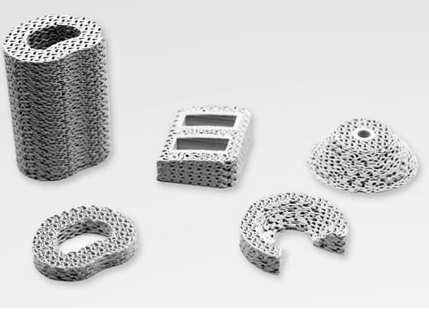
Introduction
What are Bioceramics? Specialized ceramics designed for medical applications.
Why Bioceramics for Bone Regeneration? Mimic natural bone, promote healing, and integrate seamlessly with biological tissues.

Slide 4
Key Properties of Bioceramics
Biocompatibility: Non-toxic and compatible with human tissues.
Bioactivity: Ability to bond with bone and stimulate growth.
Mechanical Strength: Suitable for structural support.
Degradability: Gradual resorption to allow natural bone replacement.

Slide 5
Classification of Bioceramics
Bioinert Ceramics Examples: Alumina, Zirconia Properties: Durable but lack bioactivity.
Bioactive Ceramics Examples: Hydroxyapatite, Bioglass Properties: Bond with bone and stimulate growth.
Bioresorbable Ceramics Examples: Tricalcium Phosphate, Calcium Sulfate Properties: Gradually degrade and integrate.

Slide 6
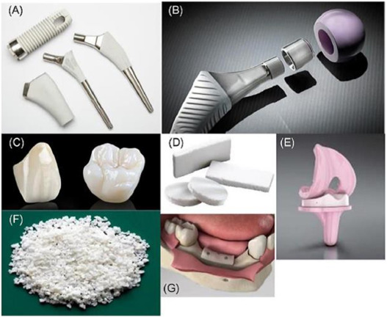
Applications in Bone Regeneration
Bone Grafts
Used as fillers or scaffolds to repair bone defects.
Examples: Common in craniofacial and spinal surgeries.
Scaffolds in Tissue Engineering
Porous 3D structures that promote cell attachment, growth, and differentiation.
Orthopedic Implants
Bioceramic coatings, such as HA, enhance osseointegration and reduce rejection.
Dental Applications
Used in root canal treatments, jawbone repair, and dental fillings

Slide 7
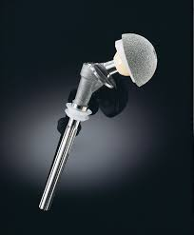
Advantages of Bioceramics
Promote natural bone growth and integration.
Reduce complications such as implant rejection.
Provide mechanical stability, especially in load-bearing applications.
Available in resorbable and non-resorbable forms for diverse clinical needs.

Slide 8
Challenges of Bioceramics
Brittleness: Limits application in high-stress environments.
Degradation Rates: Need precise control to match natural bone regeneration.
Cost: High production and material costs.
Processing Complexity: Difficulties in achieving the desired porosity and mechanical properties simultaneously.

Slide 9
possible solutions to overcome the challenges of bioceramics
Combine bioceramics with polymers or elastomeric materials to improve toughness and flexibility.
Add metals like Ti, Mg or graphene, for enhanced mechanical strength.
Tailored Composition, Protective Coatings, Scaffold Design to control biodegradability.
Coat bioceramics with bioactive molecules, or growth factors to stimulate osteogenesis.
Use techniques like plasma spraying, chemical etching, or laser treatment to create rough, porous, or patterned surfaces for better cell attachment and integration.

Slide 10
Conclusion
Bioceramics are transforming the field of bone regeneration by providing effective solutions for repairing and replacing damaged bone.
Combining advanced materials with emerging technologies ensures continual improvement in outcomes.
Future innovations promise even more tailored and effective treatments, contributing significantly to patient care.

Slide 11
references
Ravaglioli, A. and Krajewski, A., 1991. Bioceramics: materials· properties· applications. Springer Science & Business Media.
Brochu, B.M., Sturm, S.R., Kawase De Queiroz Goncalves, J.A., Mirsky, N.A., Sandino, A.I., Panthaki, K.Z., Panthaki, K.Z., Nayak, V.V., Daunert, S., Witek, L. and Coelho, P.G., 2024. Advances in Bioceramics for Bone Regeneration: A Narrative Review. Biomimetics, 9(11), p.690.
Salinas, A.J., Esbrit, P. and Vallet-Regí, M., 2013. A tissue engineering approach based on the use of bioceramics for bone repair. Biomaterials Science, 1(1), pp.40-51.
Baino, F., Novajra, G. and Vitale-Brovarone, C., 2015. Bioceramics and scaffolds: a winning combination for tissue engineering. Frontiers in bioengineering and biotechnology, 3, p.202.

Slide 12
Thank you for your attention
THE END
THE END

