Slide 1

TEM-ULAŞ

Slide 2
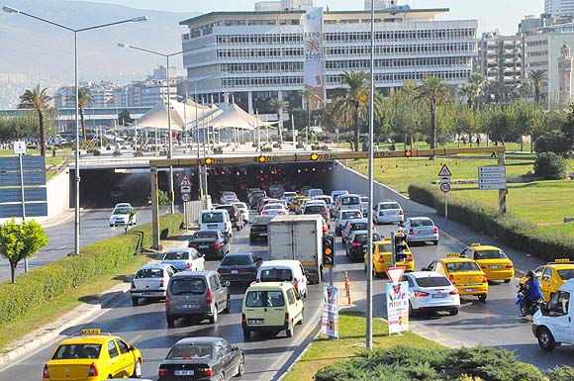

What is the problem?

Slide 3
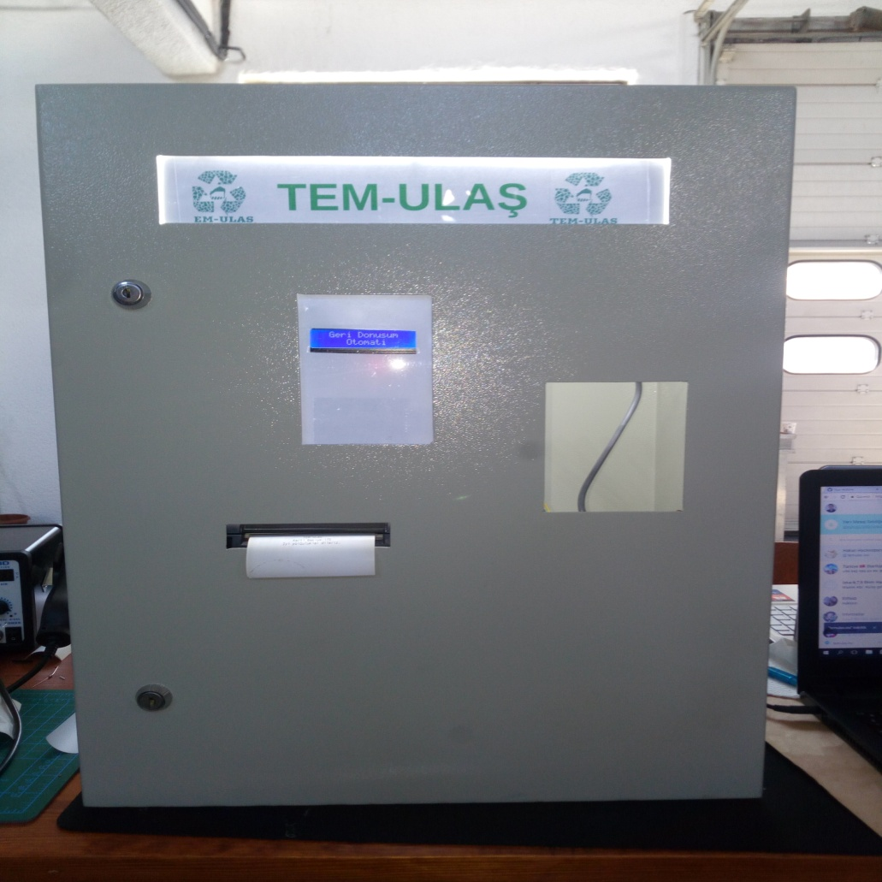

Our Solution

Slide 4



Why we use TEM-ULAS?

Slide 5

How can we use?

Slide 6

Business Plan

Slide 7
Thank You

