Slide 1

Vehicle Detection & External Communication
Subsystems

Slide 2

Vehicle Detection Subsystem
Problem
Detecting the opponent to be caught within 5cm range
Detecting the opponent if it reaches from back within 5cm
Giving meaningful data to Pi to trigger handshake protocol
DUAYENLER

Slide 3

Vehicle Detection Subsystem
Main Solution
Two time-of-flight distance sensors at the front and back
DUAYENLER

Slide 4
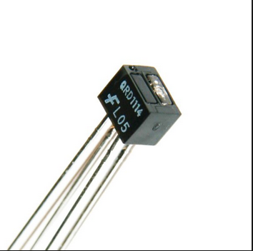
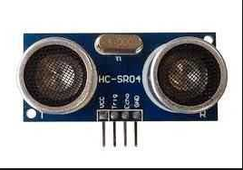
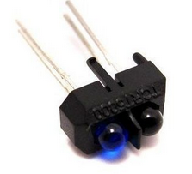
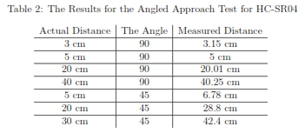
Vehicle Detection Subsystem (Tests)
DUAYENLER

Slide 5
External Communication System
Problem
Communicating with the opponent via Wi-Fi protocol
Executing handshake protocol
DUAYENLER

Slide 6

External Communication System
Main Solution
An algorithm utilizing network programming
DUAYENLER

Slide 7
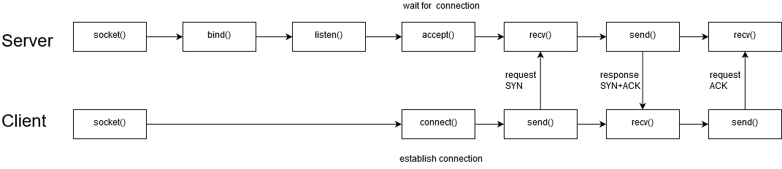
External Communication System
Main Solution
An algorithm utilizing network programming
DUAYENLER

Slide 8
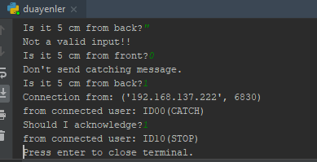
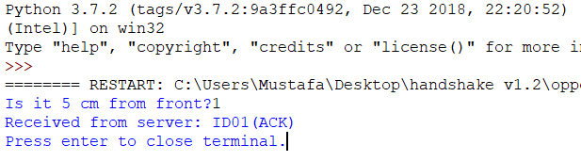
External Communication System(Results)
Duayenler as server:
Opponent as client:
DUAYENLER

Slide 9
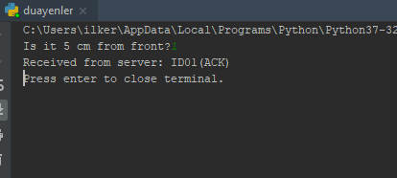
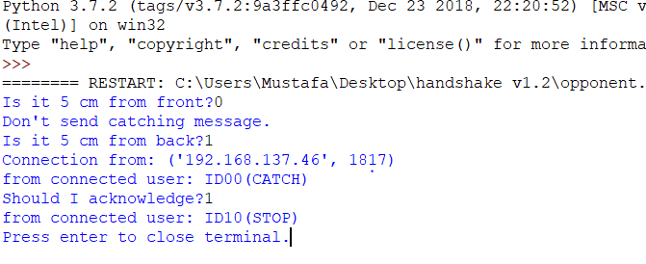
External Communication System(Results)
Duayenler as client:
Opponent as server:
DUAYENLER

Slide 10
External Communication System
Improvements to be done:
Distance sensor data should be added to the system
Client should not be connected to the hotspot manually
Client mode function should be able to run before server
DUAYENLER

