Slide 1

Vehicles chasing each other around
a closed course with varying properties

Slide 2

Outline
DUAYENLER

Slide 3
DUAYENLER

Slide 4
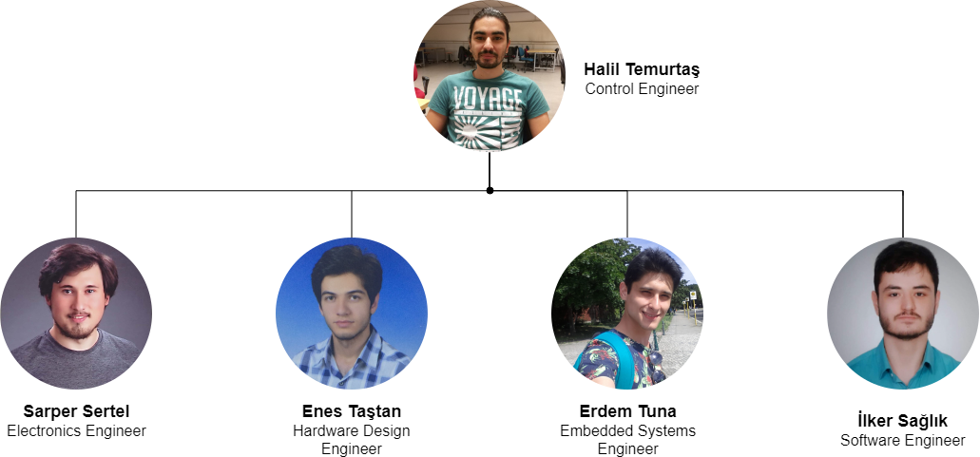
Team
DUAYENLER

Slide 5
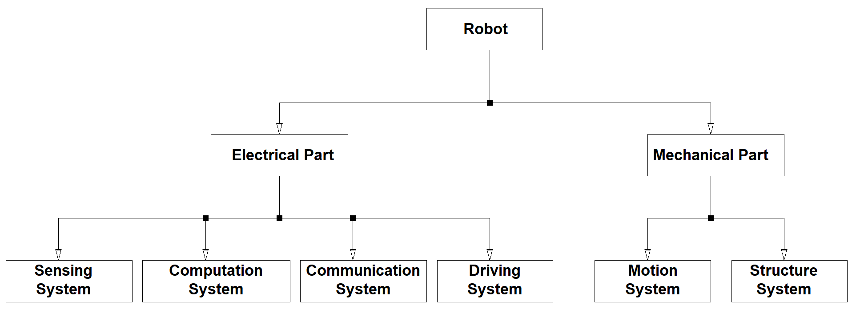
System Diagram
DUAYENLER

Slide 6
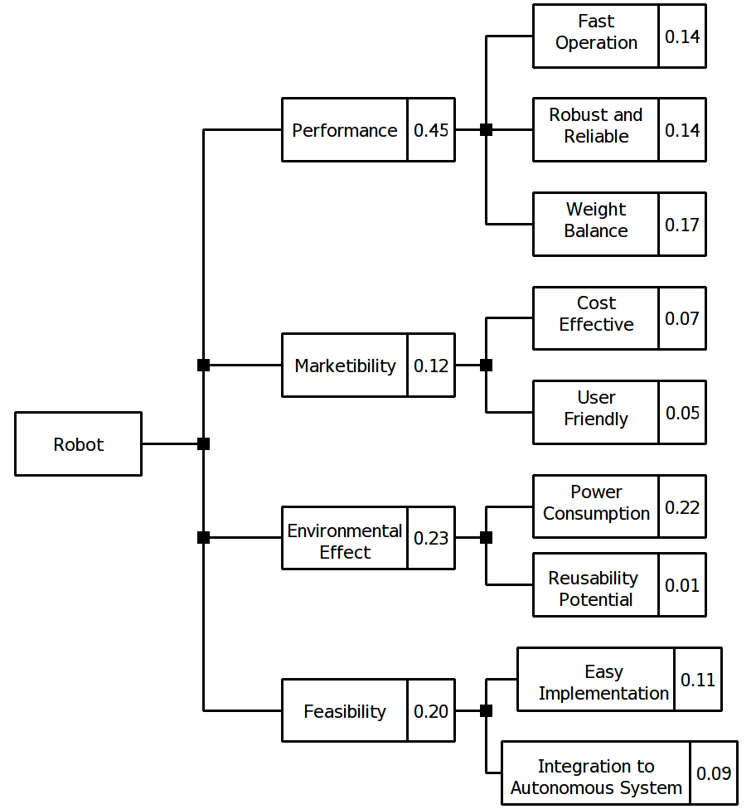
Objective Tree
DUAYENLER

Slide 7
Project Requirements
The vehicle should
detect the lane,
follow the lane,
detect the opponent and
communicate with the opponent.
DUAYENLER

Slide 8
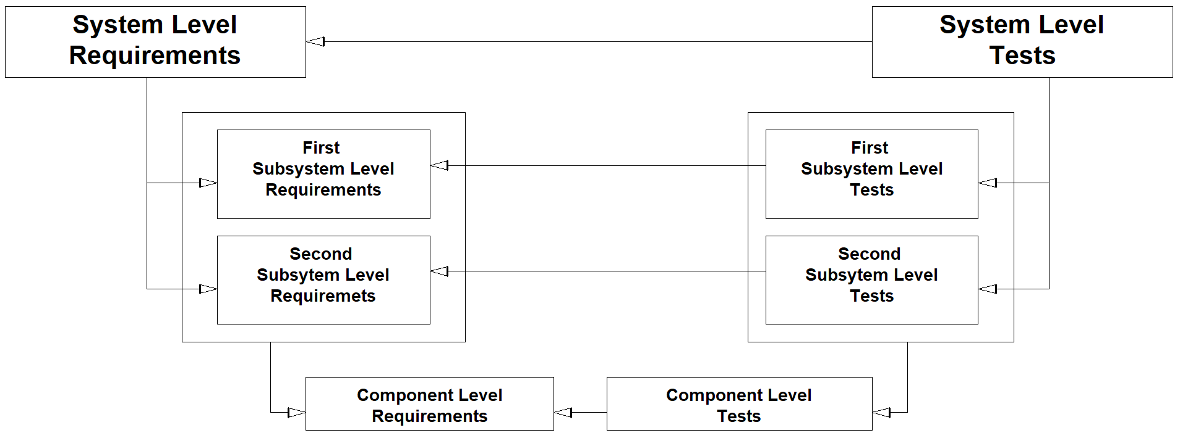
V-Model
DUAYENLER

Slide 9
Lane Detection Subsystem
Problem
Detecting lane lines out of a captured image in real time
DUAYENLER

Slide 10
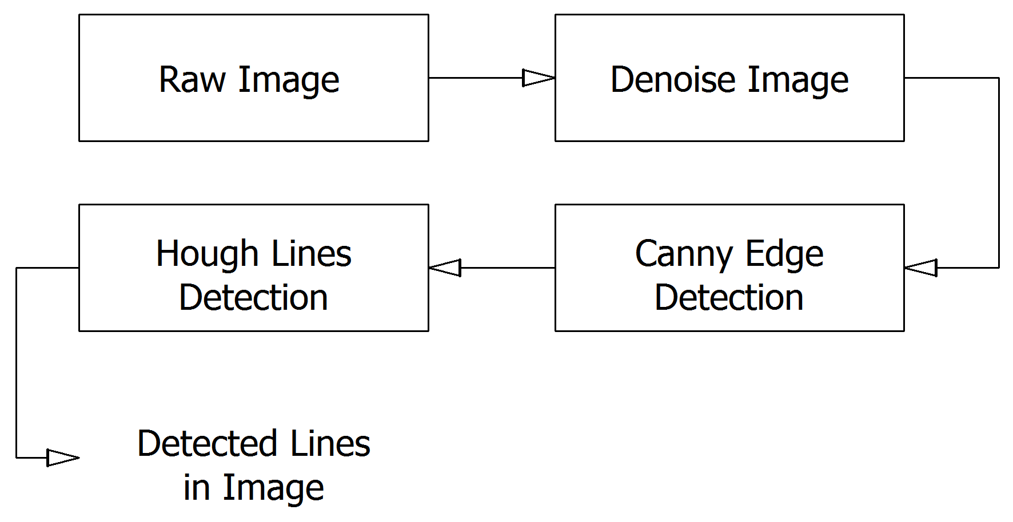
Lane Detection Subsystem
Solution
DUAYENLER

Slide 11
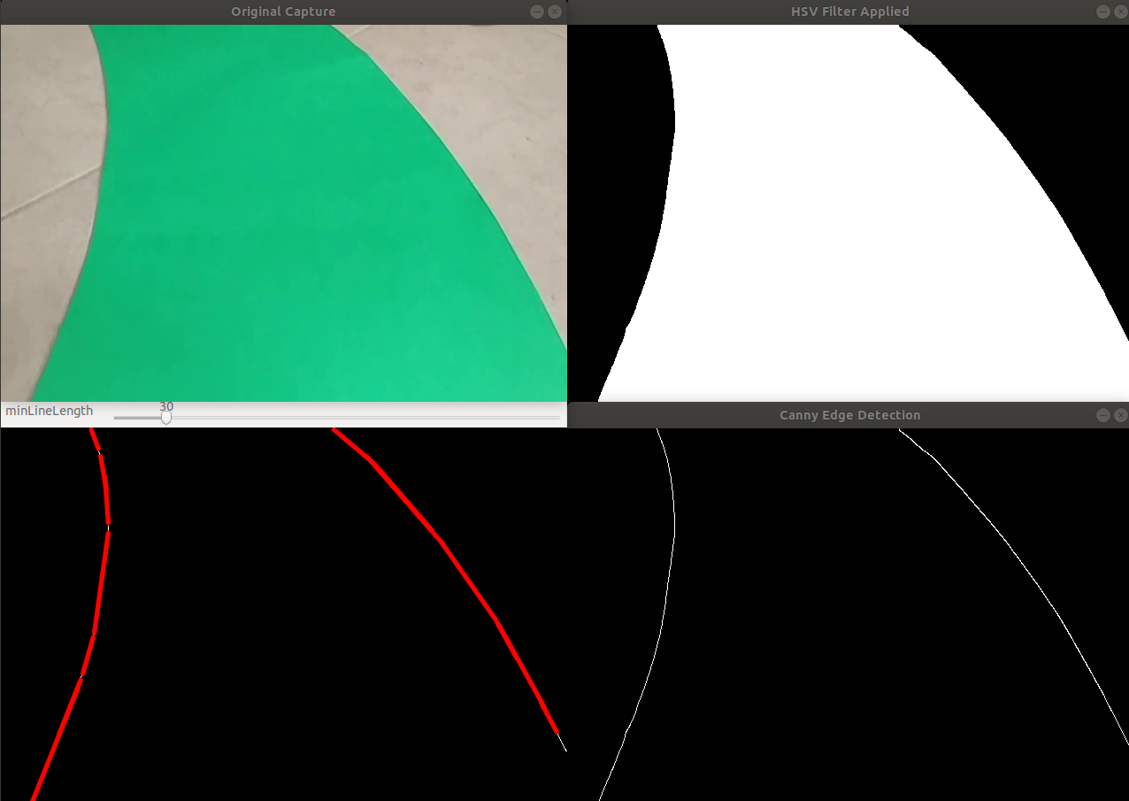
Lane Detection Subsystem
Sample Outputs of Color Filtering, Canny Edge Detection and Hough lines
DUAYENLER

Slide 12
Data Processing Subsystem
Problem
Determining the turn angle and direction out of the found lines in the image
DUAYENLER
Notes:
12

Slide 13
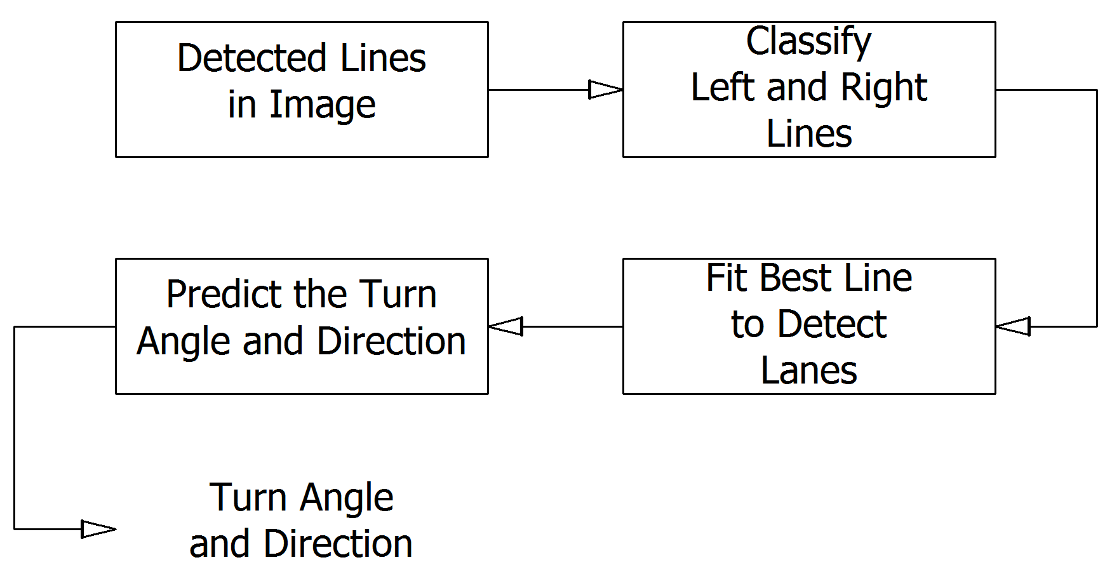
Data Processing Subsystem
Solution
DUAYENLER

Slide 14
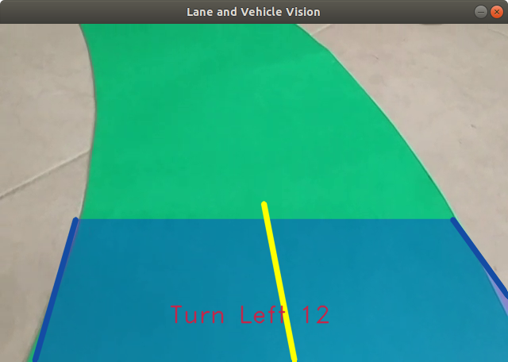
Data Processing Subsystem
Sample Output of Data Processing Subsystem
DUAYENLER

Slide 15
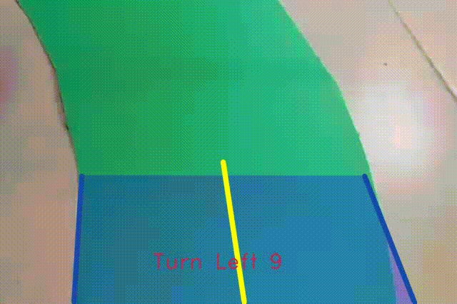
Lane Vision of the Vehicle
Sample Realtime Video Containing the Turn Angle and Direction
DUAYENLER

Slide 16
Controller Subsystem
Problem
Receiving data data from processing unit
Serial communication of Rpi and Arduino
Following the path with acquired input
Differential drive
DUAYENLER

Slide 17
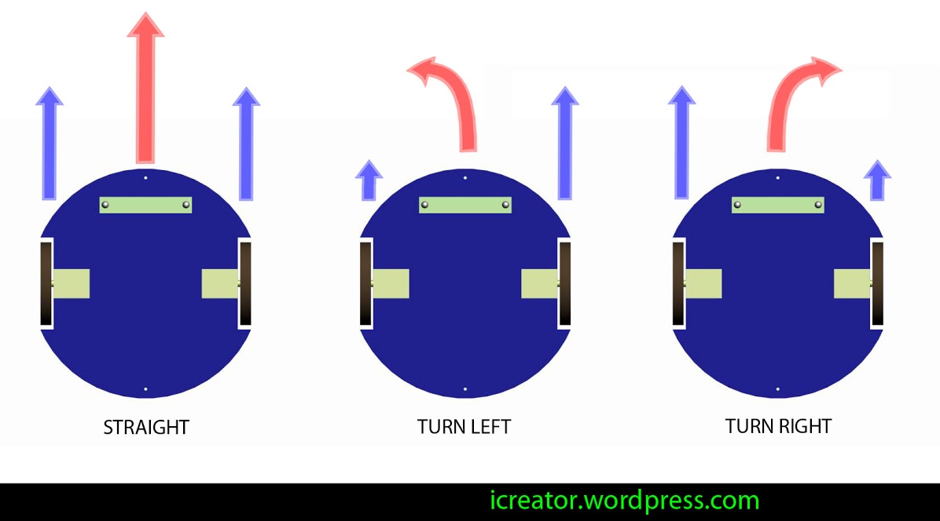
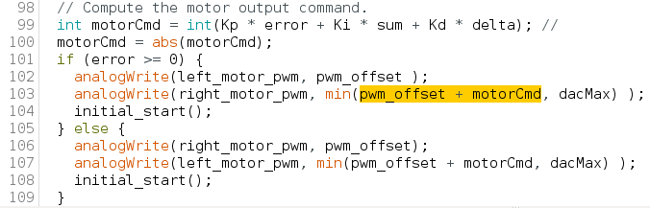
Differential drive
DUAYENLER

Slide 18
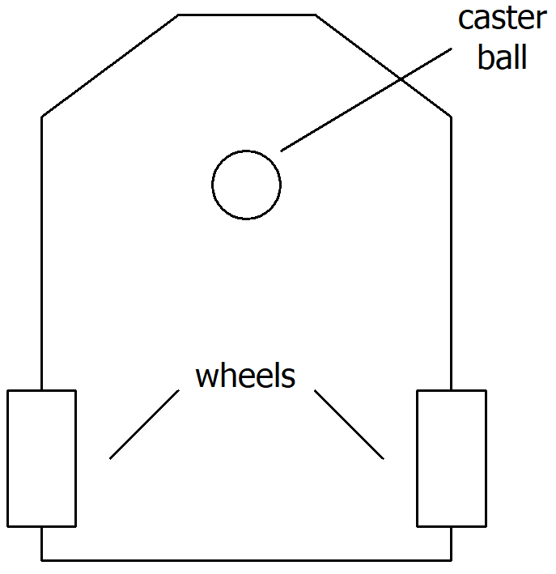
Structure Subsystem
Chassis structure
DUAYENLER

Slide 19
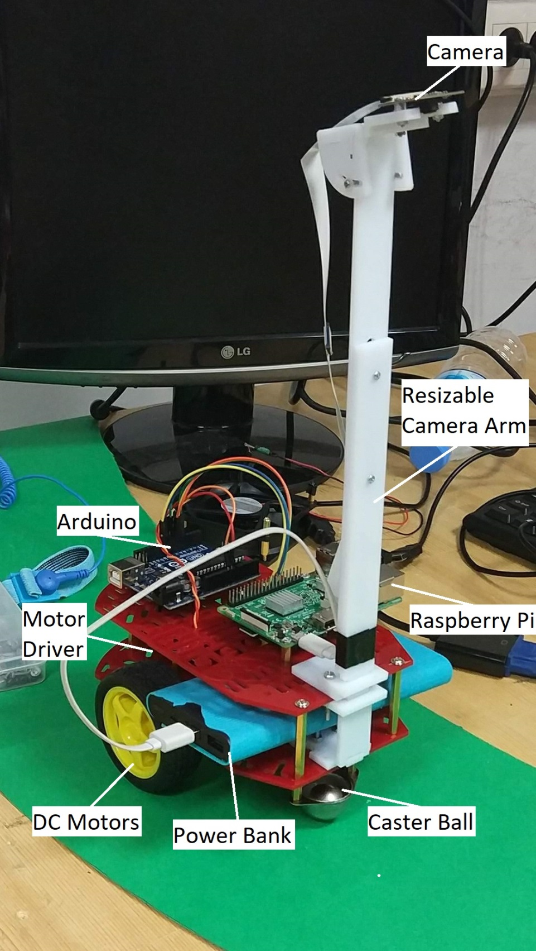
DUAYENLER

Slide 20
Vehicle Detection Subsystem
Problem
Detecting the opponent to be caught within 5cm range
Detecting the opponent if it reaches from back within 5cm
Giving meaningful data to Pi to trigger handshake protocol
DUAYENLER

Slide 21

Vehicle Detection Subsystem
Main Solution
Two time-of-flight distance sensors at the front and back
DUAYENLER

Slide 22
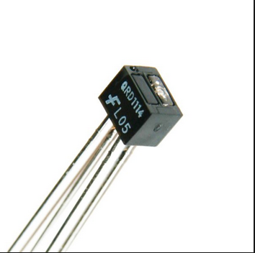
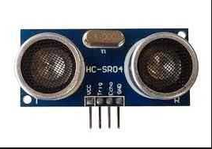
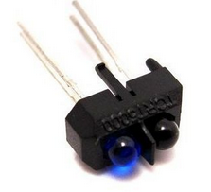
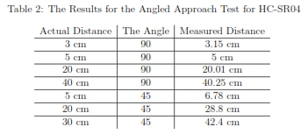
Vehicle Detection Subsystem (Tests)
DUAYENLER

Slide 23
External Communication Subsystem
Problem
Communicating with the opponent via Wi-Fi protocol
Executing handshake protocol
DUAYENLER

Slide 24

External Communication Subsystem
Main Solution
An algorithm utilizing network programming
DUAYENLER

Slide 25
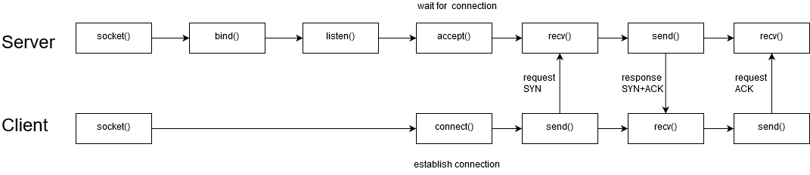
External Communication Subsystem
DUAYENLER

Slide 26
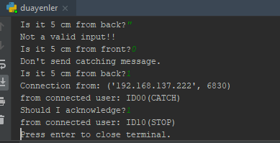
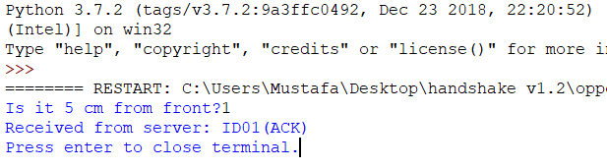
External Communication Subsystem(Results)
Duayenler as server:
Opponent as client:
DUAYENLER

Slide 27
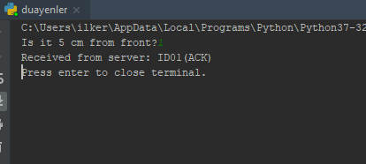
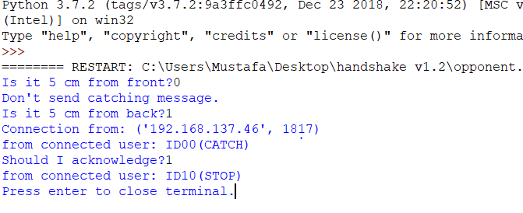
External Communication Subsystem(Results)
Duayenler as client:
Opponent as server:
DUAYENLER

Slide 28
External Communication Subsystem
Improvements to be done:
Distance sensor data should be added to the system
Client should not be connected to the hotspot manually
Client mode function should be able to run before server
DUAYENLER

Slide 29
Power consumption
 | Current (Avg) A | Watt(Avg) W | Current (Max) A | Watt(Max) W
Raspberry Pi | 0,85 | 4,25 | 2,5 | 12,5
Arduino | 80m | 0,4 | 0,2 | 1
Driver and DC Motors | 1,5 | 18 | 3 | 36
ToF sensors | 19m | 62.7m | 40m | 132m
Total power consumption | 2,45 | 22,71 | 5,74 | 49,6
DUAYENLER

Slide 30
Cost Analysis
Component | Price ($)
Raspberry Pi | 48
Arduino | 5
Driver and DC Motors | 24,5
ToF sensors | 18
Wheels | 8
Powerbank | 12
Li-Po Battery | 15
Additional components | 10
Additional payment | 15
Camera | 23
Chassis | 20
Total Project | 198,5
DUAYENLER

Slide 31
Deliverables
Technical manuals
Eliptical path
Rechargeable battery and the charger
Two (2) years of warranty
DUAYENLER

Slide 32
CONCLUSION
DUAYENLER

Slide 33
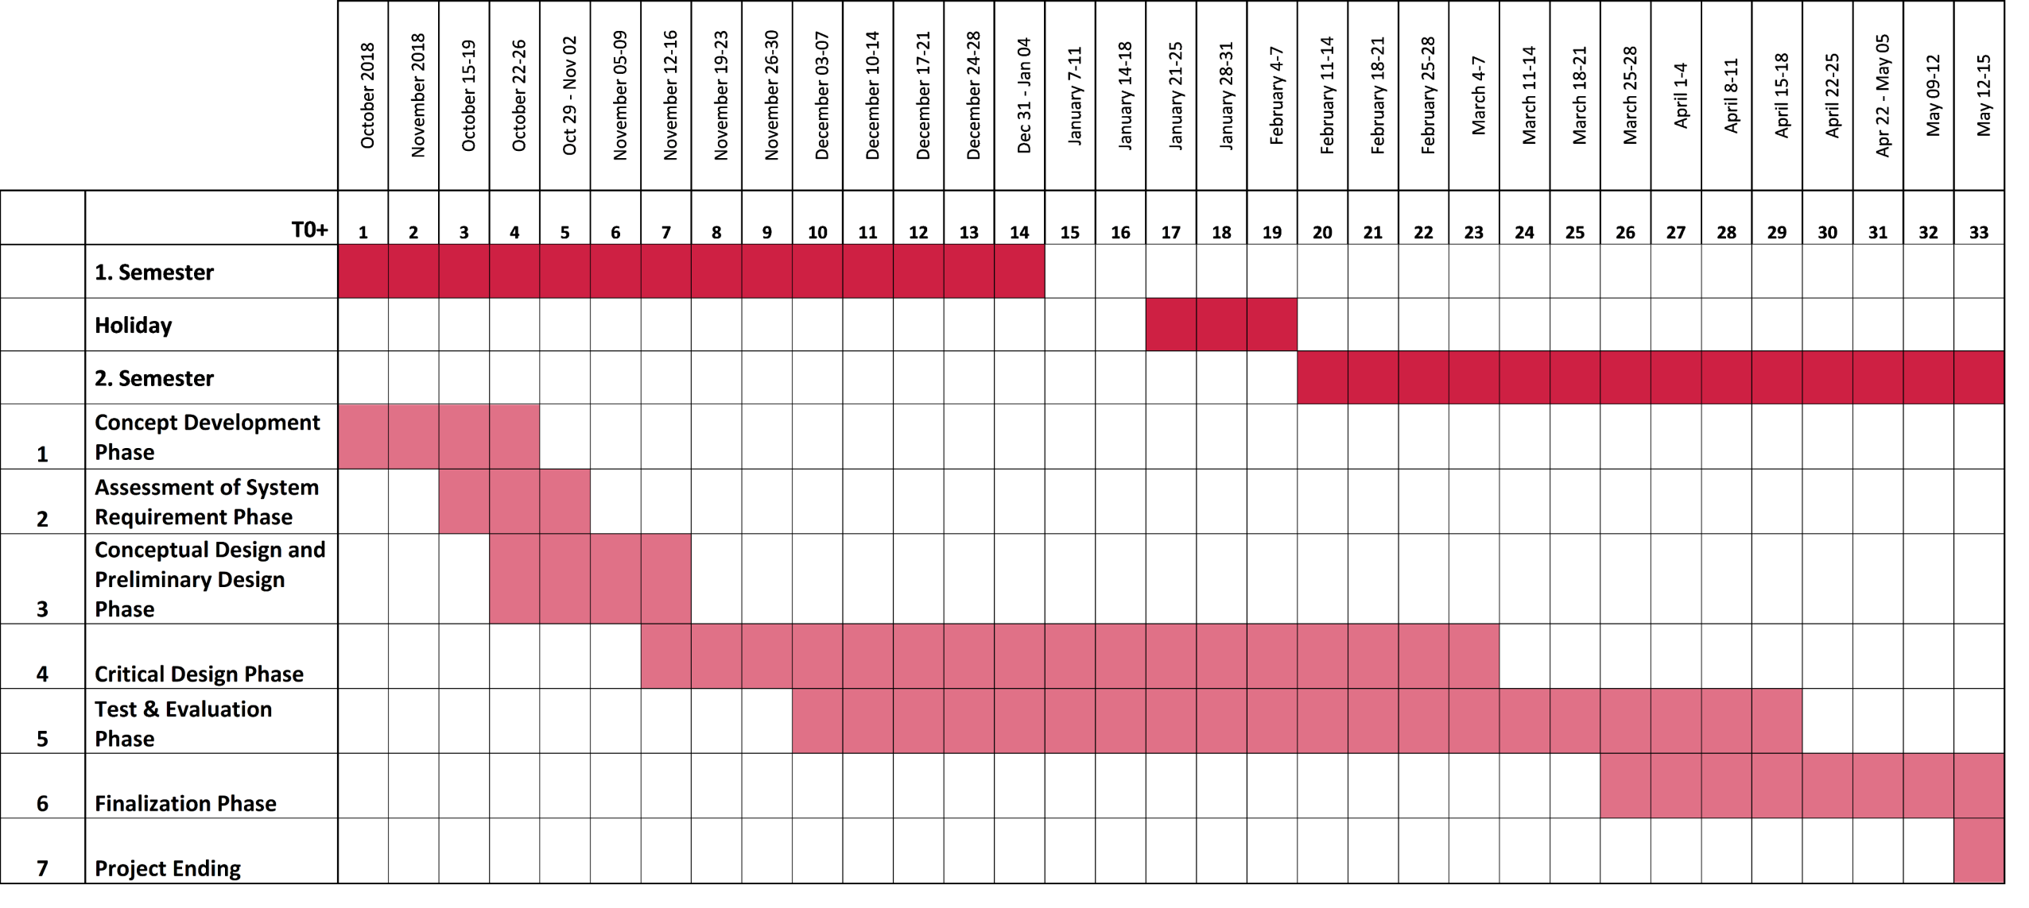
Gantt Chart
DUAYENLER
Notes:
33

