Slide 1
01 Web Program
PhD. AMARSANAA Ganbold
Department of information and Computer Science
NUM, School of Engineering and Applied Sciences
amarsanaag@num.edu.mn
ICSI301 Web Programming
2017 Fall

Slide 2
Objectives
Learn dynamic web content
Client-server architecture, Multi-tier web application
Frond-end and Back-end technologies
All together: HTML, CSS, JavaScript, JSON, XML, PHP, MySQL
Learn about a web server’s functionality.
Apache HTTP Server

Slide 3
Recap of WWW
The World Wide Web allows computer users to execute web-based applications and to locate and view multimedia-based documents on almost any subject over the Internet.
In 1989, a technology for sharing information via hyperlinked text documents was developed
HyperText Markup Language (HTML) — a markup language for hypertext content
Hypertext Transfer Protocol (HTTP) — a communications protocol used to send information over the web
First web browser and Web server
Uniform Resource Locator (URL) specifies the address (i.e., location) of the web page displayed in the browser window, begin with http://

Slide 4
URL
URIs (Uniform Resource Identifiers) identify resources on the Internet
URIs that start with http:// are called URLs (Uniform Resource Locators)
refer to files, directories
or server-side code that performs tasks such as database lookups
http://num.edu.mn:80/programs/courses.hml
/programs/courses.html
actual directory on the web server’s file system
or the location is typically a virtual directory
Same as: www.num.edu.mn
Default port: 80
File: index.html
Protocol: HTTP
protocol
domain
port
path

Slide 5
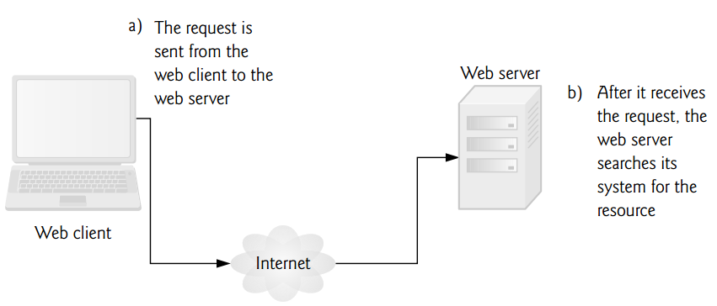
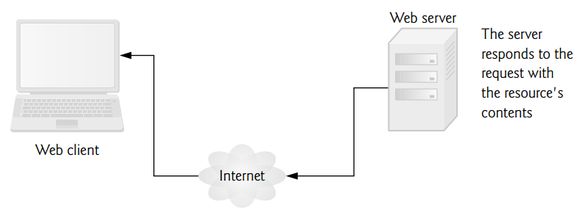
HTTP Transaction
web server and the client communicate using the platform-independent Hypertext Transfer Protocol (HTTP),
a protocol for transferring requests and files over the Internet or a local intranet
a simple request-response protocol layered on TCP/IP protocol
Establish a TCP/IP connection to www.num.edu.mn:80
Send a HTTP GET request along connection
Read from the connection the response from the web server
HTTP Request
GET /programs/courses.html HTTP/1.1
…
HTTP Response
HTTP/1.1 200 OK
…

Slide 6
Web Server
Web Server
the specialized software that responds to client requests (typically from a web browser) by providing resources such as HTML5 documents
web server maps the URL to a resource on the server (or to a file on the server’s network) and returns the requested resource to the client
Examples of web server software
Apache HTTP Server (will be used in this course) - https://httpd.apache.org/
Microsoft’s Internet Information Services
Tomcat
Web application framework
Ruby on Rails
Server framework
NodeJS – a JavaScript Runtime built on Chrome’s V8 Engine

Slide 7
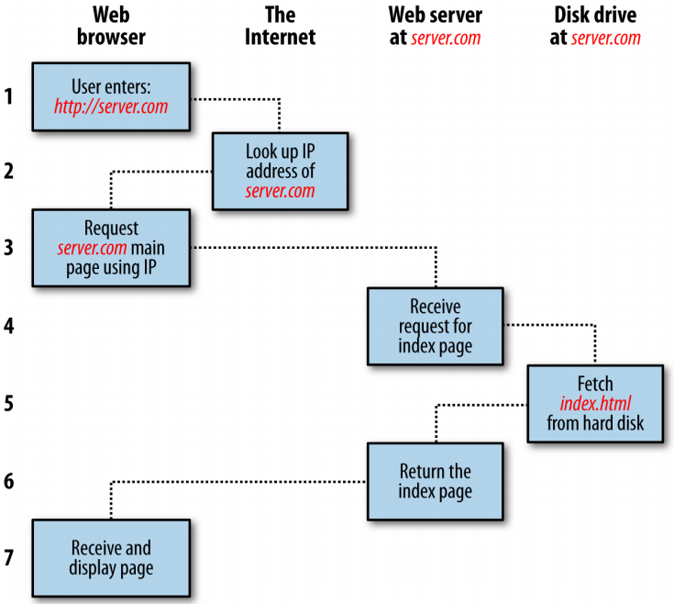
Basic client/server request/response sequence
this process takes place once for each object within the page: a graphic, an embedded video or Flash file, and even a CSS template.

Slide 8
HTTP Request
Method
URL
Protocol version
GET /index.html HTTP/1.1
Host: www.google.com
Connection: keep-alive
Cache-Control: max-age=0
User-Agent: Mozilla/5.0 (Windows NT 10.0; Win64; x64) AppleWebKit/537.36 (KHTML, like Gecko) Chrome/54.0.2840.99 Safari/537.36
Accept: text/html,application/xml;q=0.9,image/webp,*/*;
Accept-Encoding: gzip, deflate, sdch, br
Accept-Language: en-US,en;q=0.8,bg;q=0.6, mn;q=0.2
Header
Body (optional)

Slide 9
HTTP Response
version
Status Code
Status Message
HTTP/1.1 200 OK
Date: Mon, 05 Dec 2016 05:40:59 GMT
Expires: -1
Cache-Control: private, max-age=0
Content-Type: text/html; charset=UTF-8
Server: gws
X-XSS-Protection: 1; mode=block
X-Frame-Options: SAMEORIGIN
Set-Cookie: NID=91=kbl8JCS-OBWriFoib0lpuPS6GrswHkv-eRLGWk0pYhW2Q8jINpWaz7xU677Ejfd45szUAqIcc9C3HWXs-_5kYWVvSDegkTqD3b9ОIKRpCq21pTMPGCZ-msEsJkQYv6SF; expires=Tue, 06-Jun-2017 05:40:59 GMT; path=/; domain=.google.com; HttpOnly
Alt-Svc: quic=":443"; ma=2592000; v="36,35,34"
Content-Length: 48625
Header
<!doctype html><html itemscope="" itemtype="http://schema.org/WebPage" lang="en"><head><meta content="IE=edge" http-equiv="
Body

Slide 10
HTTP Methods
GET – Fetch a URL
HEAD – Fetch information about a URL
PUT – Store to a URL
POST – Send form data to a URL and get a response back
DELETE – Delete a URL
GET and POST (forms) are commonly used.
REST APIs used GET, PUT, POST and DELETE

Slide 11
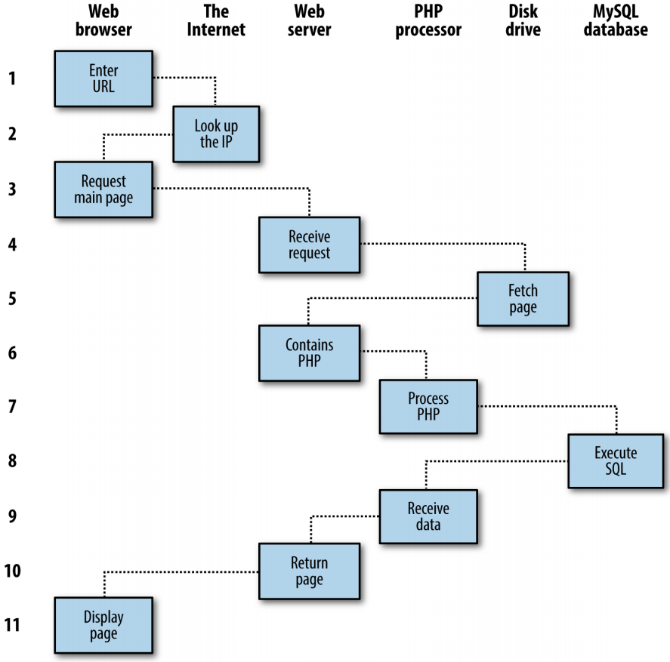
Dynamic client/server request/response sequence
For dynamic web pages, the procedure is a little more involved, because it may bring both PHP and MySQL into the mix

Slide 12
HTTP Headers
Web server is sending an HTML5 text document, so one HTTP header
Content-type: text/html
Multipurpose Internet Mail Extensions (MIME) type
specifies data formats
text/plain - sent information is text that can be displayed directly
image/jpeg - the content is a JPEG image
GET and POST
get request typically gets (or retrieves) information from a server
post requests are to send form data or documents to a server
An HTTP request often posts data to a server-side form handler that processes the data
get request appends data to the URL, www.google.com/search?q=МУИС&lang=mn
Query string: ?q=МУИС&lang=mn
key – q, value – МУИС
key – lang, value – mn

Slide 13
Client-side cache
Browsers often cache (save on disk) recently viewed web pages for quick reloading
If there are no changes between the version stored in the cache and the current version on the web
An HTTP response can indicate the length of time for which the content remains “fresh.”
If this amount of time has not been reached, the browser can avoid another request to the server and the browser loads the document from the cache.
“not modified” HTTP response, indicating that the file content has not changed since it was last requested
304 Not Modified - client redirection response code indicates that there is no need to retransmit the requested resources

Slide 14
Accessing Web Servers
To request documents from web servers, users must know the hostnames on which the web server software resides.
Users can request documents from local web servers (i.e., ones residing on users’ machines)
localhost—a hostname that references the local machine and normally translates to the IP address 127.0.0.1 (known as the loopback address)
or remote web servers (i.e., ones residing on different machines).
referenced by a fully qualified hostname or an IP address can also serve documents

Slide 15
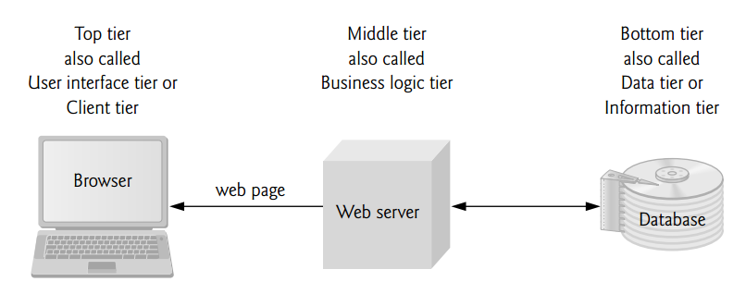
Multitier Application Architecture
bottom tier maintains the application’s data
typically stores data in a relational database management system (RDBMS)
middle tier implements business logic, controller logic and presentation logic to control interactions between the application’s clients and its data
intermediary between data in the information tier and the application’s clients
controller logic processes client requests (such as requests to view a product catalog) and retrieves data from the database
presentation logic then processes data from the information tier and presents the content to the client
business logic enforces business rules and ensures that data is reliable before the application updates a database or presents data to users
top tier is the application’s user interface, which gathers input and displays output

Slide 16
Client-Side vs Server-Side Scripting
Client-side scripting (with JavaScript)
can be used to validate user input, to interact with the browser, to enhance web pages, and to add client/server communication between a browser and a web server
have limitations, such as browser dependency; the browser or scripting host must support the scripting language and capabilities
client-side scripts can be viewed by the client using the browser’s source-viewing capability
Server-side scripting
often generate custom responses for clients
queries the database, dynamically generates an HTML document
a wider range of programmatic capabilities than their client-side equivalents
access to server-side software that extends server functionality
Apache HTTP Servers

Slide 17
Php, MySQL, JavaScript, CSS, HTML: All-in-one
HTML – web content
CSS – content design
JavaScript – manipulate content & design and make interactive on client
PHP – Backend processing data & application logic
MySQL – Data storage
HTTP Request
GET, POST … with parameters
Server-side processing
Interpret PHP Code
Data manipulation
MySQL queries
Client-side processing
Parse HTML, CSS, Render content,
Interpret JavaScript code
Return HTML, CSS, JavaScript etc.

Slide 18
Using PHP
to embed dynamic activity in web pages
pages the .php extension, they have instant access to the scripting language
<?php
echo " Today is " . date("l") . ". ";
?>
Here's the latest news.
PHP script
Output
Today is Wednesday. Here's the latest news.
The opening <?php tells the web server to allow the PHP program to interpret all the following code up to the ?> tag.
the built-in date function displays the current day of the week according to the server’s system time
to place the PHP construct directly next to PHP code
Today is <?php echo date("l"); ?>. Here's the latest news.

Slide 19
Using MySQL
Why database? - multiple simultaneous accesses, perform complex searches etc.
relational databases with structured querying
one or more tables that contain your data
INSERT INTO users VALUES('Dorj', 'Bat', 'dorj@mysite.com');
SELECT surname, firstname FROM users WHERE email='dorj@mysite.com';
Using PHP, you can make all these calls directly to MySQL without having to run the MySQL program yourself or use its command-line interface
the results in arrays for processing and perform multiple lookups, each dependent on the results returned from earlier ones, to drill right down to the item of data you need.

Slide 20
Using JavaScript
to enable scripting access to all the elements of an HTML document
dynamic user interaction such as checking email address validity in input forms
Combined with CSS, JavaScript is the power behind dynamic web pages that change in front of your eyes rather than when a new page is returned by the server.
<script type="text/javascript">
document.write("Today is " + Date() );
</script>
JavaScript
Output
Today is Monday, September 4, 2017 10:45:23
JavaScript is being used for AJAX (Asynchronous JavaScript and XML).
the process of accessing the web server in the background.
web pages have started to resemble standalone programs
don’t have to be reloaded in their entirety

Slide 21
Using CSS
With the emergence of the CSS3 standard
not only can you style any HTML element to change its dimensions, colors, borders, spacing, and so on,
but now you can also add animated transitions and transformations to your web pages, using only a few lines of CSS
<style>
p {
text-align: justify;
font-family: Helvetica;
}
</style>
These rules will change the default text alignment of the <p> tag so that paragraphs contained in it will be fully justified and will use the Helvetica font.

Slide 22
HTML5
Markup
Including new semantic elements such as <nav> and <footer>, and deprecated elements like <font> and <center>.
New APIs
For example, the <canvas> element for writing and drawing on a graphics canvas, <audio> and <video> elements, offline web apps, microdata, and local storage.
Applications
Including two new rendering technologies:
MathML (Math Markup Language) for displaying mathematical formulae) and
SVG (Scalable Vector Graphics) for creating graphical elements outside of the new <canvas> element.

Slide 23
The Apache Web Server
Apache doesn’t serve up just HTML files
it handles a wide range of files from images and Flash files to MP3 audio files, RSS (Really Simple Syndication) feeds, and so on.
each element a web client encounters in an HTML page is also requested from the server, which then serves it up
static files such as GIF images can be generated by PHP scripts
modules either precompiled into Apache or PHP or called up at runtime
GD (Graphics Draw) library, which PHP uses to create and handle graphics
Apache also supports a huge range of modules of its own
Rewrite module,
which enables the web server to handle a varying range of URL types and rewrite them to its own internal requirements
Proxy module,
which you can use to serve up often-requested pages from a cache to ease the load on the server
Open source
developed in the community by teams of programmers writing the features they themselves want and need
not purchase additional licenses

Slide 24
Bringing It All Together
PHP handles all the main work on the web server
MySQL manages all the data
the combination of CSS and JavaScript looks after web page presentation
JavaScript can also talk with your PHP code on the web server whenever it needs to update something (either on the server or on the web page)
powerful new features in HTML5, such as the canvas, audio and video, and geolocation, you can make your web pages highly dynamic, interactive, and multimedia packed

Slide 25
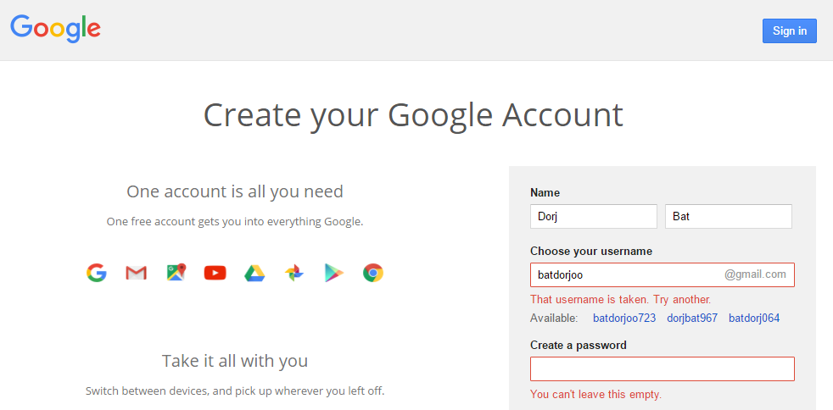
Web app: Google account
Ajax feature that many websites use: checking whether a desired username already exists on the site when a user is signing up for a new account

Slide 26
Web app: Steps involved in Ajax process [2]
The server outputs the HTML to create the web form,
which asks for the necessary details, such as username, first name, last name, and email address.
At the same time, the server attaches some JavaScript to the HTML to monitor the username input box and check for two things:
(a) whether some text has been typed into it, and
(b) whether the input has been deselected because the user has clicked on another input box.
Once the text has been entered and the field deselected, in the background the JavaScript code passes the username that was entered back to a PHP script on the web server and awaits a response.
The web server looks up the username and replies back to the JavaScript regarding whether that name has already been taken.
The JavaScript then places an indication next to the username input box to show whether the name is one available to the user—perhaps a green checkmark or a red cross graphic, along with some text.
If the username is not available and the user still submits the form, the JavaScript interrupts the submission and reemphasizes (perhaps with a larger graphic and/or an alert box) that the user needs to choose another username.
Optionally, an improved version of this process could even look at the username requested by the user and suggest an alternative that is currently available.

Slide 27
References
Paul J. Deitel, Harvey M. Deitel and A. Deitel, Internet & World Wide Web How to Program, 5th edition, 2012,
Robin Nixon, Learning PHP, MySQL, JavaScript, CSS & HTML5, 3rd Edition, 2014, 729 pages
Mendel Rosenblum, Course slides of CS142: Web Applications (Spring 2017), Stanford University

Slide 28
Any questions?

