Slide 1
03 PHP & MySQL
PhD. AMARSANAA Ganbold
Department of information and Computer Science
NUM, School of Engineering and Applied Sciences
amarsanaag@num.edu.mn
ICSI301 Web Programming
2017 Spring

Slide 2
Objectives
MySQL
SQL recap
Database connection pool
PHP Access to a database
Insert, retrieve data
SQL Injection

Slide 3
Recap SQL
SQL is a ANSI (American National Standards Institute) standard computer language for accessing and manipulating databases.
access a database
execute queries, and retrieve data
insert, delete and update records
SQL works with database programs like MySQL, MS SQL Server, Oracle, PostgreSQL, etc.
DDL – Data Definition Language (CREATE TABEL, DROP VIEW…)
DML – Data Manipulation Language (SELECT,INSERT,UPDATE,DELETE)
Relational database
contains one or more tables, each table contain records
RDBMS (Relational Database Management System)
Standalone. e.g., MySQLi, MS Access etc.
Server: e.g., MySQL, Oracle etc.
requires credentials: domain, username, password, database

Slide 4
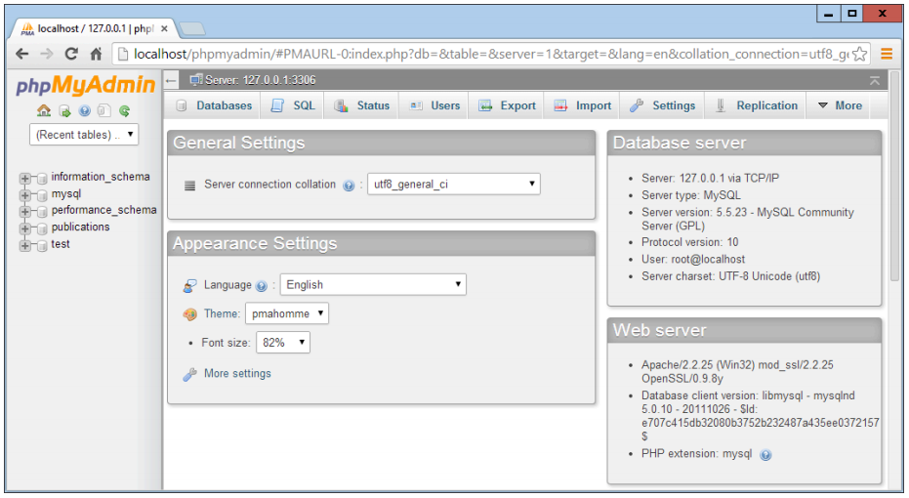
Accessing MySQL
three main ways:
using a command line
via an interface such as web based phpMyAdmin and GUI MySQL Workbench etc.
through a programming language like PHP

Slide 5
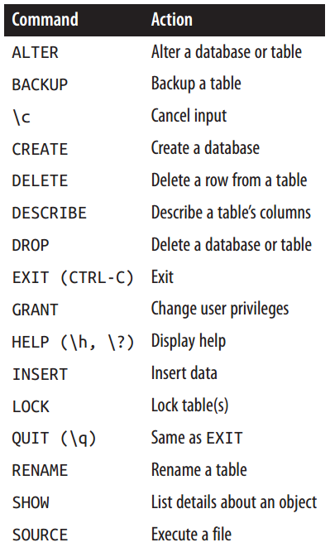
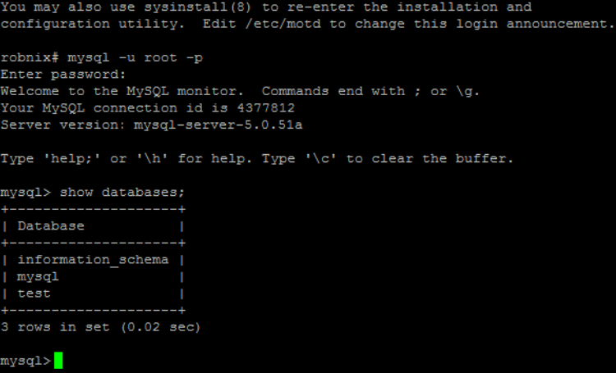
Accessing MySQL [2]
using Linux

Slide 6
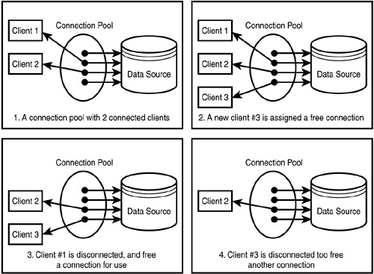
Database connection
a connection pool is a cache of database connections maintained so that the connections can be reused when future requests to the database are required.
Command-Line Format | --max_connections=#
System Variable | Name | max_connections
 | Variable Scope | Global
 | Dynamic Variable | Yes
Permitted Values | Type | integer
 | Default | 151
 | Min Value | 1
 | Max Value | 100000
In MySQL 5.5
mysql> SET GLOBAL max_connections = 5000;
Query OK, 0 rows affected (0.00 sec)

Slide 7
Querying a MySQL Database with PHP
The process of using MySQL with PHP is: 1. Connect to MySQL. 2. Select the database to use. 3. Build a query string. 4. Perform the query. 5. Retrieve the results and output them to a web page. 6. Repeat Steps 3 to 5 until all desired data has been retrieved. 7. Disconnect from MySQL.

Slide 8
PHP Access to a Database
Connect to the database server and login $db = mysqli_connect("host", "username", "password"); returns a database handle — a representation of PHP’s connection to the database.
Choose the database mysqli_select_db("database_name",$db); to select and open the database to be queried
Send queries to the server to add, delete, modify and retrieve data mysqli_query("query" ,$db); specifying the query string and the database to query
Close the connection mysqli_close();
NOTE: mysql_query was deprecated in PHP 5.5.0, and it was removed in PHP 7.0.0.

Slide 9
Insert data
<html>
<head><title>Putting Data in the DB</title></head>
<body>
<?php
/*insert students into DB*/
if(isset($_POST["submit"])) {
$db = mysqli_connect("mysql", "martin");
mysqli_select_db("martin");
$date=date("Y-m-d");/*Get the current date in the right SQL format */
$sql="INSERT INTO students VALUES(NULL,'" . $_POST["f_name"] . "','" . $_POST["l_name"] . "'," . $_POST["student_id"] . ",'" . $_POST["email"] . "','" . $date . "'," . $_POST["gr"] . ")"; /* construct the query */
mysqli_query($sql);
mysqli_close();
echo"<h3>Thank you. The data has been entered.</h3> \n";
echo'<p><a href="data_in.php">Back to registration</a></p>' . "\n";
echo'<p><a href="data_out.php">View the student lists</a></p>' ."\n";
}
else {
?>

Slide 10
Insert data [2]
<h3>Enter your items into the database</h3>
<form action="data_in.php" method="POST">
First Name: <input type="text" name="f_name" /> <br/>
Last Name: <input type="text" name="l_name" /> <br/>
ID: <input type="text" name="student_id" /> <br/>
email: <input type="text" name="email" /> <br/>
Group: <select name="gr">
<option value ="1">1</option>
<option value ="2">2</option>
<option value ="3">3</option>
<option value ="4">4</option>
</select><br/><br/>
<input type="submit" name="submit" /> <input type="reset" />
</form>
<?php
}
?>
</body>
</html>

Slide 11
Retrieve data
Send an SQL query to the server to select data from the database into an array
$result=mysqli_query("query");
Returns FALSE on failure. For successful SELECT, SHOW, DESCRIBE or EXPLAIN queries mysqli_query() will return a mysqli_result object. For other successful queries it will return TRUE.
Either, look into a row and a fieldname
$num=$result->num_rows;
$variable=mysqli_result($result,$i,"fieldname");
Or, fetch rows one by one
$row=$result->fetch_array;
$row[key]

Slide 12
Retrieve data: data_out.php
<html>
<head><title>Getting Data out of the DB</title></head>
<body>
<h1> Student Database </h1>
<p> Order the full list of students by
<a href="data_out.php?order=date">date</a>,
<href="data_out.php?order=student_id">id</a>, or
by <a href="data_out.php?order=l_name">surname</a>.</p>
<p><form action="data_out.php" method="POST">
Or only see the list of students in group
<select name="gr">
<option value ="1">1</option>
<option value ="2">2</option>
<option value ="3">3</option>
<option value ="4">4</option>
</select><br/>
<input type="submit" name="submit" />
</form></p>

Slide 13
Retrieve data: data_out.php
<?php
/*get students from the DB */
$db = mysqli_connect("mysql","martin");
mysqli_select_db("martin", $db);
switch($_GET["order"]){
case 'date': $sql = "SELECT * FROM students ORDER BY date"; break;
case 'student_id': $sql = "SELECT * FROM students ORDER BY student_id"; break;
case 'l_name': $sql = "SELECT * FROM students ORDER BY l_name"; break;
default: $sql = "SELECT * FROM students";
}
if(isset($_POST["submit"])){
$sql = "SELECT * FROM students WHERE gr=" . $_POST["gr"];
}
$result=mysqli_query($sql);
while($row=mysqli_fetch_array($result)){
echo "<h4> Name: " . $row["l_name"] . ', ' . $row["f_name"] . "</h4> \n";
echo "<h5> ID: " . $row["student_id"] . "<br/> Email: " . $row["email"] . "<br/> Group: " . $row["gr"] . "<br/> Posted: " . $row["date"] . "</h5> \n";
}
mysqli_close();
?>
</body>
</html>
view the output page

Slide 14
More queries with PHP
Can create a table
Can delete rows and columns
Can make updates
Can make queries to several tables
Can get connected to several databases
Remember the connection concept

Slide 15
Creating a Login File
multiple program files that will require access to MySQL and will thus need the login and password details
create a single file to store these and then include that file wherever it’s needed
<?php // login.php
$db_hostname = 'localhost';
$db_database = 'publications';
$db_username = 'username';
$db_password = 'password';
?>
<?php // news.php
include_once("login.php");
$db_server = mysql_connect($db_hostname, $db_username, $db_password);
if (!$db_server) die("Unable to connect to MySQL: " . mysql_error());
?>

Slide 16
SQL Injection
is a technique where malicious users can inject SQL commands into an SQL statement, via web page input.
For example, from resetting a password ... to gaining more privileges (any database server)
<?php $uid = $_POST["uid"]; // beware, no input validation! $query = "UPDATE usertable SET pwd='$pwd' WHERE uid='$uid';"; $result = mysqli_query($conn, $query); ?>
<?php // $uid: ' or uid like '%admin% $query = "UPDATE usertable SET pwd='...' WHERE uid='' or uid like '%admin%';"; // $pwd: hehehe', trusted=100, admin='yes $query = "UPDATE usertable SET pwd='hehehe', trusted=100, admin='yes' WHERE ...;"; ?>
Avoidance Techniques
consider verifying data
settype($offset, 'integer');
sprintf("SELECT id, name FROM products ORDER BY name LIMIT 20 OFFSET %d;", $offset);
string escape function
mysql_real_escape_string(), sqlite_escape_string() etc.

Slide 17
Any questions?
No?

Slide 18
Questions
What tag is used to cause PHP to start interpreting program code? And what is the short form of the tag?
What are the two types of comment tags?
Which character must be placed at the end of every PHP statement?
Which symbol is used to preface all PHP variables?
What can a variable store?
What is the difference between $variable = 1 and $variable == 1?
Why do you suppose an underscore is allowed in variable names (e.g., $current_user) whereas hyphens are not (e.g., $current-user)?
Are variable names case-sensitive?

