Slide 1
Cookie, Session, OOP in PHP
Ганболдын АМАРСАНАА
Мэдээлэл, компьютерийн ухааны тэнхим
МУИС, Хэрэглээний шинжлэх ухаан инженерчлэлийн сургууль
amarsanaag@num.edu.mn
ICSI301 Вэб програмчлал
2017 оны Намар

Slide 2
Objectives
Cookies
Sessions and session variables
Objects
Defining objects
Inheritance

Slide 3
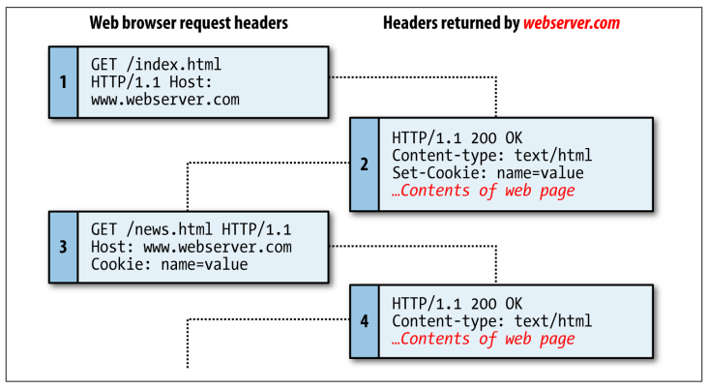
Cookie
A cookie is an item of data that a web server saves to your computer’s hard disk via a web browser.
almost any alphanumeric information (as long as it’s under 4 KB)
and can be retrieved from your computer and returned to the server.
Common uses include session tracking, maintaining data across multiple visits, holding shopping cart contents, storing login details, and more.

Slide 4
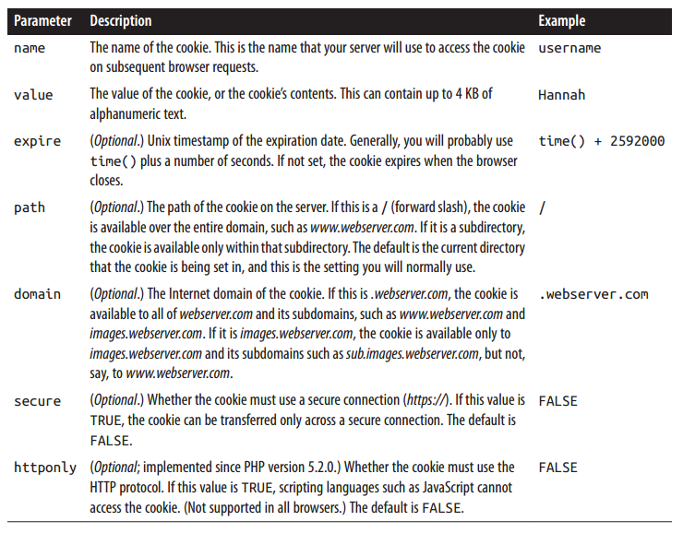
Cookie parameters

Slide 5
Cookie in PHP
setcookie(name,value,expire,path,domain) creates cookies.
<?php
setcookie("uname", $_POST["name"], time()+36000);
?>
<html>
<body>
<p>
Dear <?php echo $_POST["name"] ?>, a cookie was set on this page! The cookie will be active when the client has sent the cookie back to the server.
</p>
</body>
</html>
NOTE:
setcookie() must appear
BEFORE <html> (or any output) as it’s part of the header information sent with the page.
view the output page
<html>
<body>
<?php
if (isset($_COOKIE["uname"]))
echo "Welcome " . $_COOKIE["uname"] . "!<br />";
else
echo "You are not logged in!<br />";
?>
</body>
</html>
$_COOKIE
contains all COOKIE data.
isset() finds out if a cookie is set
use the cookie name as a variable
view the output page

Slide 6
Php Session
By default, HTML and web servers don’t keep track of information entered on a page when the client’s browser opens another page.
Thus, doing anything involving the same information across several pages can sometimes be difficult.
Sessions help solve this problem by maintaining data during a user’s visit,
and can store data that can be accessed from page to page in your site.
You can use session variables for storing information
(this is one way that a “shopping cart” function can work for an online shop, for example).

Slide 7
Php Session [2]
Servers keep track of users’ sessions by using a session identifier,
which is generated by the server when a session starts
and is then used by the browser when it requests a page from the server.
This session ID can be sent through a cookie (the default behavior)
or by passing the session ID in the URL string.
Sessions only store information temporarily,
so if you need to preserve information, say, between visits to the same site,
you should likely consider a method such as using a cookie or a database to store such information.

Slide 8
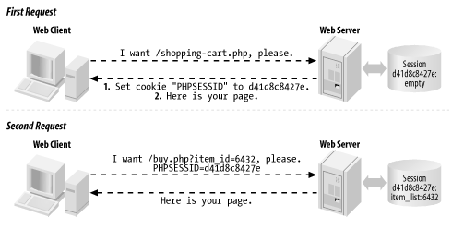
Php Session in action
Sessions use a cookie called PHPSESSID. The value of the PHPSESSID cookie is a random alphanumeric string.
The session ID in the PHPSESSID cookie identifies that web client uniquely to the server.

Slide 9
Starting Session and Storing values
To start a session, use the function session_start() at the beginning of your PHP script before you store or access any data.
For the session to work properly, this function needs to execute before any other header calls or other output is sent to the browser.
<?php
session_start();
?>
<!DOCTYPE html >
<html>
<head><title>Session example</title></head>
<body>
<?php
include_once ('object.php'); // Includes definition of the Person class
$_SESSION['hello'] = 'Hello world';
echo $_SESSION['hello'] . "<br/><br/>\n";
$_SESSION['one'] = 'one';
$_SESSION['two'] = 'two';
$me = new Person("Russ", 36, 2892700);
$_SESSION['name'] = $me->get_name();
echo "Testing " . $_SESSION['one'] .", " . $_SESSION['two'] . ", "
. $me->get_number() . " . . .<br/>\n";
?>
</body></html>
view the output page

Slide 10
Using Session Variable
Once a session variable has been defined, you can access it from other pages.
<?php
session_start();
?>
<!DOCTYPE html>
<html>
<head><title>Session example 2</title></head>
<body>
<?php
echo "Welcome to a new page ". $_SESSION['name'] "!<br/>\n";
echo "Hope you enjoy your stay! <br/>";
?>
<p>Back to regular HTML text...
</p>
</body>
</html>
view the output page

Slide 11
More on Session variables
You need to include a call to the session_start() function for each page on which you want to access the session variables.
A session will end
once you quit the browser (unless you’ve set appropriate cookies that will persist),
or you can call the session_destroy() function.
(Note, however, even after calling the session_destroy() function, session variables are still available to the rest of the currently executing PHP page.)
The function session_unset() removes all session variables.
If you want to remove one variable, use the unset($var) function call.
The default timeout for session files is 24 minutes.
It’s possible to change this timeout.

Slide 12
Deleting All Session variables
<?php
session_start();
?>
<!DOCTYPE html>
<html>
<head><title>Session example 3</title></head>
<body>
<?php
echo "Deleting all session variables using session_unset(); <br/>\n";
session_unset();
echo "Now the session variables are gone. <br/>\n";
if (isset($_SESSION['name']))
{ echo $_SESSION['name'] . "<br/>\n"; }
else
{ echo "Session variable is not here."; }
?>
</body>
</html>
view the output page

Slide 13
Object oriented programming in PHP
PHP, like most modern programming languages (C++, Java, Perl, JavaScript, etc.), supports the creation of objects.
Creating an object requires you to first define an object class (containing variables and/or function definitions) and then using the “new” keyword to create an instance of the object class. (Note that the object must be defined before you instantiate it.)
<?php
// Assume that the “Person” object has been previously defined. . .
$x = new Person; // creates an instance of the Person class (*no* quotes)
// The object type need not be “hardcoded” into the declaration.
$object_type = 'Person';
$y = new $object_type; // equivalent to $y = new Person;
$z = new Vehicle('Jaguar','green'); // creating an object and passing
// arguments to its constructor
?>

Slide 14
Declaring a class
Use the “class” keyword which includes the class name (case-insensitive, but otherwise following the rules for PHP identifiers). Note: The name “stdClass” is reserved for use by the PHP interpreter.
class Person {
var $name;
function set_name($new_name) {
$name = $this -> new_name;
}
function get_name() {
return $this -> name;
}
}
Use the “$this” variable when accessing properties and functions of the current object.
Inside a method this variable contains a reference to the object on which the method was called.

Slide 15
Declaring a Class [2]
Properties and functions can be declared as
“public” (accessible outside the object’s scope),
“private” (accessible only by methods within the same class),
or “protected” (accessible only through the class methods and the class methods of classes inheriting from the class).
Note that unless a property is going to be explicitly declared as public, private, or protected, it need not be declared before being used (like regular PHP variables).
class Person {
protected $name;
protected $age;
function set_name($new_name) {
$name = $this -> new_name;
}
function get_name() {
return $this -> name;
} }

Slide 16
Declaring a Class [3]
Classes can also have
constants defined (using the “const” keyword)
static properties and functions (using the keyword “static” before “var” or “function”)
constructors and destructors (see below).
Static properties and functions are accessed (see below) using a different format than usual for objects, and static functions cannot access the objects properties (i.e. the variable $this is not defined inside of a static function).
<?php
class HTMLtable {
static function start() {
echo "<table> \n";
}
static function end() {
echo "</table> \n";
}
}
HTMLtable::start();
?>

Slide 17
Accessing properties and methods
Once you have an object, you access methods and properties (variables) of the object using the -> notation.
<?php
$me = new Person;
$me -> set_name("Russ");
$me -> print_name();
$name = $me -> get_name();
echo $me -> get_name();
$age = 36;
$me -> set_age($age);
?>

Slide 18
Constructors and destructors
Constructors
to initialize the object’s properties with values as the object is created.
a function with the name __construct().
<?php
class Person {
protected $name;
protected $age;
function __construct($new_name, $new_age) {
$this -> name = $new_name;
$this -> age = $new_age;
}
// . . . other functions here . . .
}
$p = new Person("Bob Jones", 45);
$q = new Person("Hamilton Lincoln", 67);
?>

Slide 19
Constructors and destructors [2]
Destructors
a function name of __destructor()
an object is destroyed, such as
when the last reference to an object is removed
or the end of the script is reached (the usefulness of destructors in PHP is limited, since, for example dynamic memory allocation isn’t possible in the same way that it is in C/C++).

Slide 20
Inheritance
Use the “extends” keyword in the class definition to define a new object that inherits from another.
<?php
class Employee extends Person {
var $salary;
function __construct($new_name, $new_age, $new_salary); {
$this -> salary = $new_salary;
parent::__construct($new_name, $new_age);
}
function update_salary($new_salary) {
$this -> salary = $new_salary;
}
$emp = new Employee("Dave Underwood", 25, 25000);
?>

Slide 21
Inheritance [2]
The constructor of the parent isn’t called unless the child explicitly references it (as in this previous case).
There is no automatic chain of calls to constructors in a sequence of objects defined through inheritance.
You could “hard-code” the call to the parent constructor using the function call
Person::__construct($new_name, $new_age);
but it’s better to define it in the manner given using the parent::method() notation.
The same manner is used to call the method of a parent that has been overridden by its child.
You can use the “self” keyword to ensure that a method is called on the current class (if a method might be subclassed), in this style self::method();
To check if an object is of a particular class, you can use the instanceof operator.
if ($p instanceof Employee) {
// do something here
}

Slide 22
Interface, Abstract Class
interfaces for objects
for which any object that uses that interface must provide implementations of certain methods
abstract classes or methods
that must be overridden by its children
The keyword “final” can be used to denote a method that cannot be overridden by its children.
class Person {
var $name;
final function get_name() {
return $this -> name;
}
}

Slide 23
Classes/Object Functions
There are methods for “introspection” about classes, i.e. the ability of a program to examine an object’s characteristics.
For example, the function class_exists() can be used (surprise!) to determine whether a class exists or not.
The function get_declared_classes() returns an array of declared classes.
$classes = get_declared_classes();
You can also get an array of method names in any of the following (equivalent) manners:
$methods = get_class_methods(Person);
$methods = get_class_methods("Person");
$class = "Person";
$methods = get_class_methods($class);

Slide 24
Classes/Object Functions [2]
There are a wide variety of introspection functions, several more are listed below.
get_class_vars($object); /* gets an associative array that maps
property names to values (including
inherited properties), but it *only*
gets properties that have default
values (those initialized with
simple constants) */
is_object($object); // returns a boolean value
get_class($object); /* returns the class to which an object
belongs */
method_exists($object, $method); // returns a boolean value
get_object_vars($object); /* returns an associative array
mapping properties to values (for
those values that are set (i.e.
not null) */

Slide 25
Object methods
When defining the names of your own object methods, you should generally avoid starting them with a double underscore. Why?
There are some “built-in” or predefined PHP method names that start in this manner, most notably constructors and destructors using the __construct() and __destructor() names.
__sleep() and __wakeup()
which are used for object serialization
and __get() and __set()
which can be defined so that if you try to access an object property that doesn’t exist, these methods give an opportunity to either retrieve a value or set the (default?) value for that property.
For example, if a class is used to represent data obtained from a database, you could write __get() and __set() methods that read and write data whenever requested.

