Slide 1

KBEATBOX
A finite-state machine use case

Slide 2
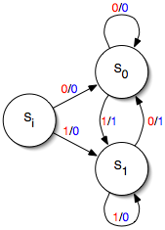
What is Mealy finite-state machine ?
It is an abstract machine that can be in exactly one of a finite number of states at any given time.
The transition from one state to another is in response to a sequence of inputs. It is defined by a list of states, initial state, and conditions or triggers for each transition.
Because of the simplicity of its interfaces and its determinism, Mealy finite-state machines are easy to test thoroughly.

Slide 3
Actions in Transition
send an event
receive an event
start a timer (schedule)
cancel a timer
start another state machine
decision or acknowledgement

Slide 4
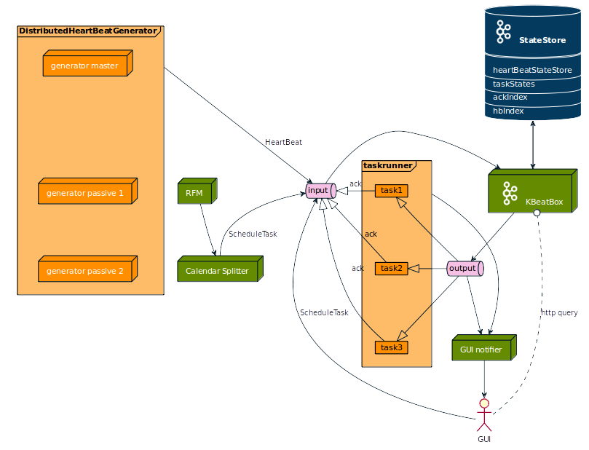
KBeatBox Deployment

Slide 5
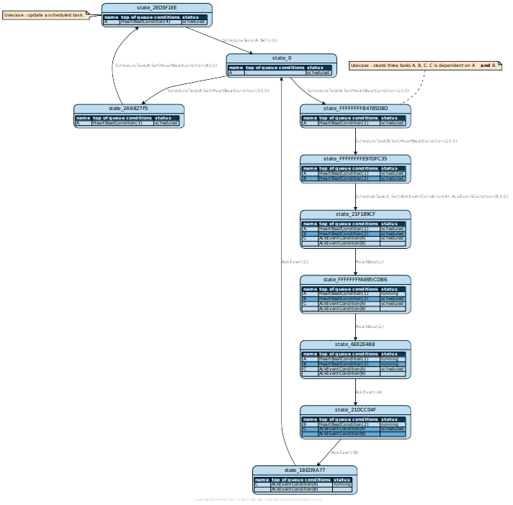

Slide 6
Unique features of KBeatBox
Input events run idempotently – multiple schedules for the same heartBeat has the same effect as a single schedule, ( s * e1 * e1 = s * e1 ).
Deterministic - every state has exactly one transition for each possible input.
Time is purely logical. Having a logical time rather than using a wall clock time directly is a huge advantage for testing. Example vector clock.
Logic is concise and precise as such, presents no edgecases.
Events are chainable, loggable, and replayable.
Event cannot be removed before it is scheduled.
Does not run a scheduled task before it receives a heartbeat (this means we cannot add task from the past).
Able to receive AckEvent, and add events to a chain of AckEvents.
Cannot reschedule or remove a task that is already running.

Slide 7
Idempotence
any write operation should always produce the same result for a given number of input parameters no matter the number of requests. This feature ensures consistency in heartbeat events.

Slide 8
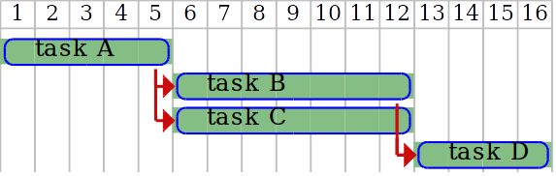
Purely logical time
Time is purely logical :
  There is no access to the CPU clock.
  Time elapsed is provided through heartbeat messages (that contains an integer) and cause-consequence modelling between tasks.
  It also means the KBeatBox code uses a purely deterministic logic (no side effect from CPU clock). KBeatBox acts deterministically solely on the input it receives.
  This allows for easy replayability (everything can be logged).
  This allows for easy testing.
Task A starts at heartbeat 1
Task B depends on task A’s end
Task C depends on task A’s end
Task D depends on task B’s end and on task C’s end.
Conditions can be added together.

Slide 9
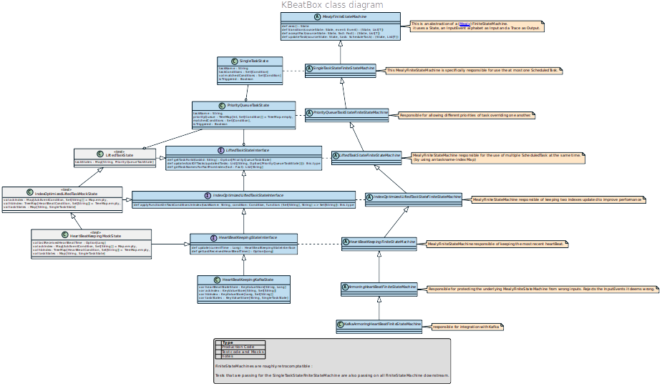
Logic : Layered organisation of logic
946 lines of scala logic, structured in layers.
Each layer is responsible for one purpose and is tested independently

Slide 10
Limitations
Time is logged so there is a limit on the granularity of time (few heartBeats)

Slide 11
KBeatBox vs Open Source Schedulers
Scheduler | Main language | files | blank | comment | code
PagerDuty | Scala | 88 | 1145 | 700 | 6068
Criteo Cuttle | JavaScript, Scala | 55 ; 37 | 697 ; 678 | 177 ; 670 | 8163 ; 3793
Quckoo | Scala | 360 | 5142 | 6489 | 16064
KBeatBox | Scala | 15 | 212 | 344 | 823
To our knowledge, none of these projects include a «task chaining » feature.

Slide 12
Roadmap
Ack Timeout (== NACK??? or different component)
Gui – be able to display states, current events, past events, ackevent, schedule, and reschedule.
Differentiate events and processes (or not events are just empty processes)
Cancelling of task
Synchronous scheduling
Actual deployment on kafkastreams

Slide 13
Annex

Slide 14
Kscheduler deployment
Ack
ScheduleTask
HeartBeat
Input
KScheduler
stateStore
Output
Running Task

Slide 15
Simple finite-state machine
state
1 opened
E : open door
transition
Open
Close
transition condition
2 closed
E : close door
entry action

Slide 16
State Transition Diagram
State I
Transition
ScheduleTask
AckEvent
Transition
HeartBeatEvent
State II
State III
RemoveTask
Transition
HeartBeatEvent
ScheduleTask
State IV
Transition

Slide 17
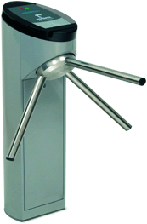
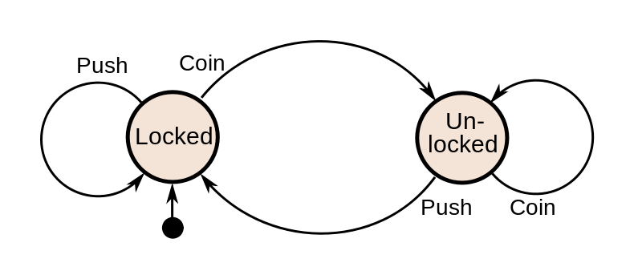
State Diagram of KSchedule
State Diagram
Current State | Input | Next State | Output
Locked | coin | unlocked | Unlocks turnstile so customer can push through.
 | push | locked | none
Unlocked | coin | unlocked | none
 | push | locked | Locks turnstile.

