Slide 1
ESCO Mapping Pilot
Part 1::Scope
Agis Papantoniou, Senior Project Manager, TenForce
Johan De Smedt, CTO, TenForce
Karel Kremer, Software and Knowledge Engineer, TenForce

Slide 2
Scope and Objectives
Creation of mappings between NOCs and ESCO v0 and v0.1
The results → full mapping environment (next year?)
(tools, documents, training)
The pilot applies to 4 PESs (CZ, ES, FR, NL)
Understand how the PES work/function and what are their needs (as related to ESCO)
Understand how can ESCO support them (in a pragmatic way)
Assess quality and measure effort, timings, budget for the final mappings

Slide 3
Approach
Step 1: Selection of PES and Classification Systems
Step 2: Create mappings
Step 3: Assess results
Step 4: Quality improvement and validation
Step 5: Documentation and dissemination

Slide 4
Approach
Step 1: Selection of PES and Classification Systems
Step 2: Create mappings
Step 3: Assess results
Step 4: Quality improvement and validation
Step 5: Documentation and dissemination

Slide 5




Step 1: PES selection
Four EU member states selected
Criteria
Willingness to participate
Number of concepts in the classification
Existing (or non-existing) mappings to ISCO-08 and NACE
Why does this matter?

Slide 6
Approach
Step 1: Selection of PES and Classification Systems
Step 2: Create mappings
Step 3: Assess results
Step 4: Quality improvement and validation
Step 5: Documentation and dissemination

Slide 7
Step 2: Creating mappings
Creation of partial or full mappings (i.e. translation tables with links)
Overall methodology
Transform classifications to SKOS (machine readable format)
Import into thesaurus alignment tool
Assess the quality level of automated mappings (more on this later!)
Finalise mappings, for some sectors – manually
What we will need from you!
NOC in machine readable format (pref. XML and/or RDF)
Participation in the upcoming 4 (technical) workshops

Slide 8
Step 2: Expected outcomes
Identify best practices for the creation of mappings
Assess effort/costs for creating and updating mappings
Understand the time needed for the creation of the mappings
Understand tools, documents and services needed

Slide 9
Approach
Step 1: Selection of PES and Classification Systems
Step 2: Create mappings
Step 3: Assess results
Step 4: Quality improvement and validation
Step 5: Documentation and dissemination

Slide 10
Step 3: Assess results
Once mapping in place → quality assessment
Focus should be given:
On suitability for cross-border job matching
On suitability for skills-based job matching
On technical and interoperability aspects
A phased methodology for the assessment
Let’s have a look

Slide 11


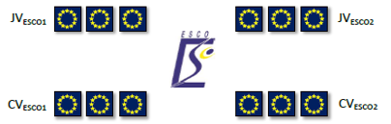



Step 3: Assess results – Criteria
Phase 1
Develop non structured case studies
Information loss
Phase 2
Structure case studies according to NOC
Phase 3
Transcode case studies to ESCO
Phase 4
Match cases and evaluate mappings
Information loss
Criteria
Information loss, comparisons between PESs, matching
Note: the same process will be applied for case studies provided by the PES themselves

Slide 12
Step 3: Expected outcomes
Assess the (semantic) interoperability level
Understand and quantify potential benefits
Identify improvements of ESCO on a conceptual level
Understand the type of support that the PESs will need
A final (same for every PES) methodology? – assess adaptation

Slide 13
Approach
Step 1: Selection of PES and Classification Systems
Step 2: Create mappings
Step 3: Assess results
Step 4: Quality improvement and validation
Step 5: Documentation and dissemination

Slide 14
Step 4: Quality improvement
PES can improve the results of the mappings
(should they want to publish them)
Once the PES validate the final mappings, they can be published (as Linked Open Data)
ESCO Portal, ESCO APIs, PES APIs (possibly)
Expected outcomes
Publicly available mappings, used for further testing
Enrich criteria for Q/A and validation

Slide 15
Approach
Step 1: Selection of PES and Classification Systems
Step 2: Create mappings
Step 3: Assess results
Step 4: Quality improvement and validation
Step 5: Documentation and dissemination

Slide 16
Step 5: Documentation and dissemination
Various reports throughout the project
Final report, summarizing results
Could be shared with all other PESs, that participate in EURES or in EaSI/PROGRESS

Slide 17
What could be the (ideally) final result?

Slide 18
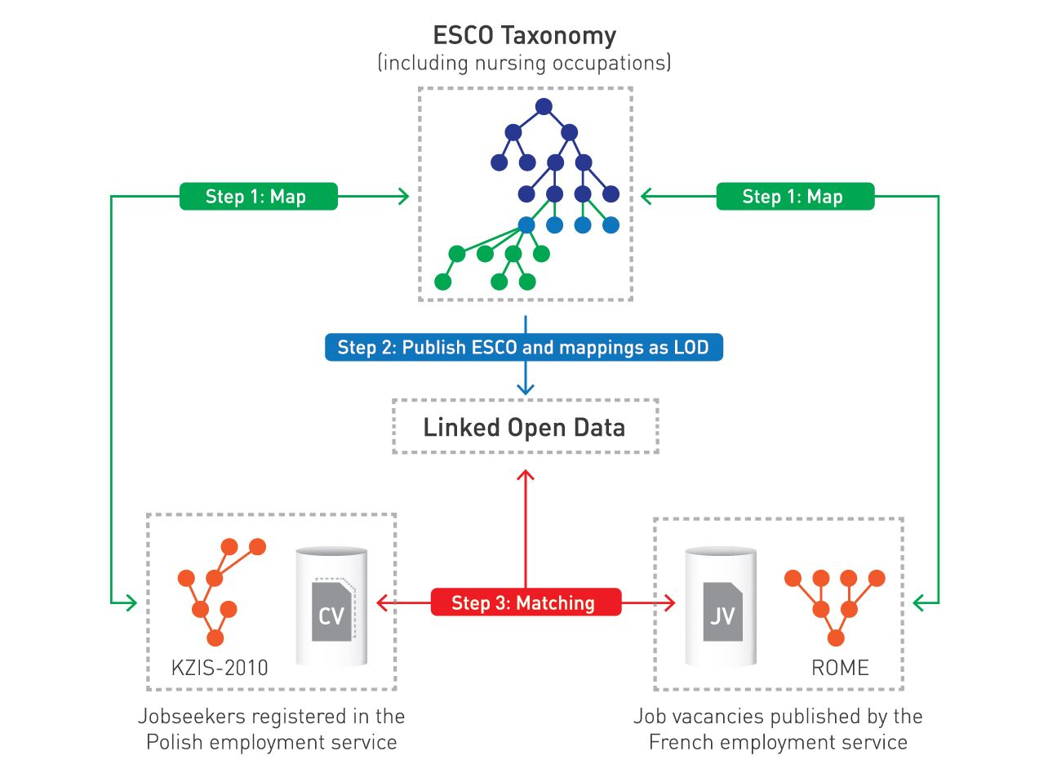
Mappings as Linked (Open?) Data

Slide 19
It’s neither obvious nor easy
From the political perspective
Development, support and maintenance and versioning of the mappings
Linked (Open?) Data
Needs for technical “mentoring”/training in these technologies
From the technology perspective
Taxonomy/ontology alignment is a complex topic
There are quite a lot of tools out there
Some of them are going to be evaluated

Slide 20
Questions?
Thank you for your attention

