Slide 1
ESCO Mapping Pilot
Part II :: Planning
Agis Papantoniou, Senior Project Manager, TenForce
Johan De Smedt, CTO, TenForce
Karel Kremer, Software and Knowledge Engineer, TenForce

Slide 2
Objectives
Identify tasks and actions
Agree on schedule (including workshops)
Present deliverables

Slide 3
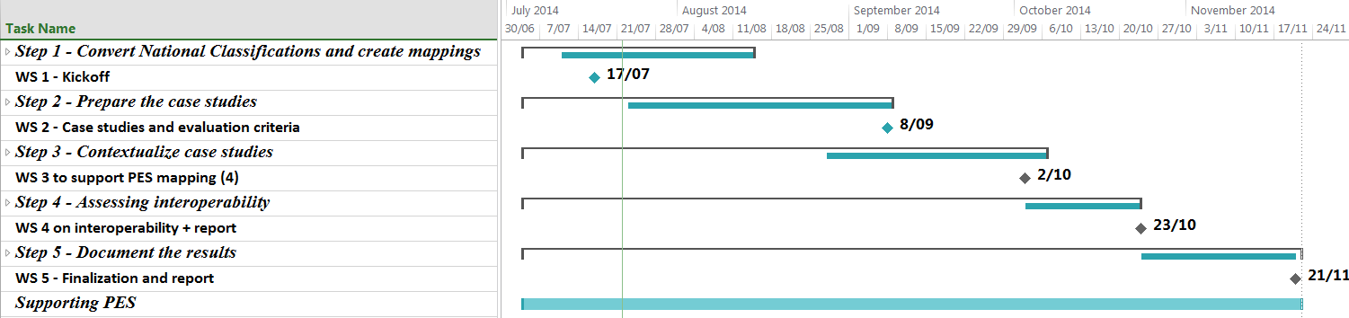
Overview

Slide 4
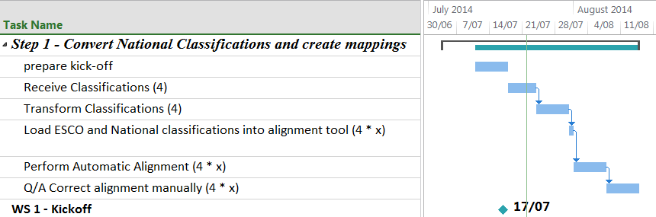
Step 1 - Convert National Classifications

Slide 5
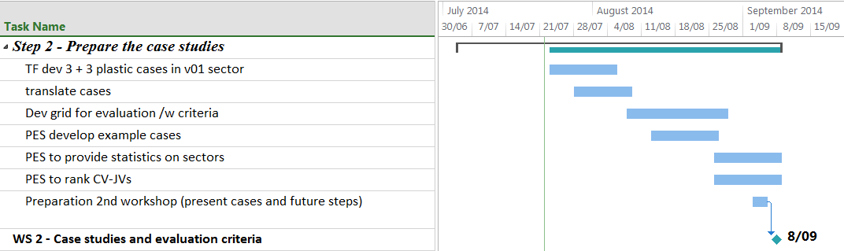
Step 2 - Prepare Case Studies

Slide 6
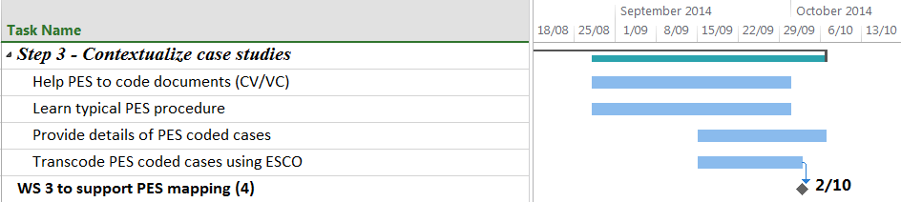
Step 3 - Contextualize Case Studies

Slide 7
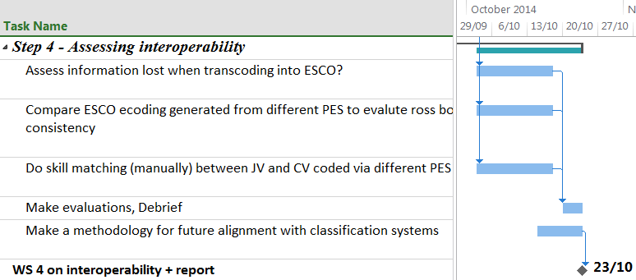
Step 4 - Assessing Interoperability

Slide 8
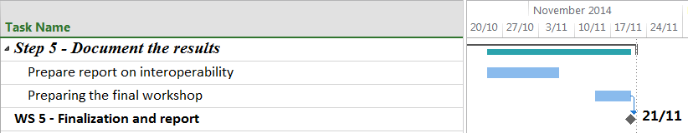
Step 5 - Document the results

Slide 9
Tasks and Actions
(Dates are indicative)
Responsible | Action | Date
PES | Provide national classification | 23/07/2014
TenForce/SEC | Transform classification and load for alignment | 31/07/2014
TenForce/SEC | Automatic alignment and manual correction | 14/08/2014
PES | Provide use cases (JV – CV) with hidden match scores | 26/08/2014
PES | Provide Statistics on chosen sectors | 26/08/2014
TenForce/SEC | Develop 2x3 cases JV – CV matching | 18/08/2014
TenForce/SEC | Define evaluation grid for alignment | 28/08/2014
PES (/w TF support) | Code documents with PES structure and provide feedback | 30/09/2014
TenForce/SEC | Map coded documents to ESCO | 02/10/2014
TenForce/SEC (/w PES support) | Evaluate (information loss, consistency, matching) | 23/10/2014
TenForce/SEC | Final Report | 14/11/2014

Slide 10
Main Deliverables
DLV | Description
DLV01 | Translation tables (partial mappings)
DLV02 | Assessment criteria (grid)
DLV03 | 6 case studies, each in English, French, Dutch, Czech and Spanish
DLV04 | New structured docs
DLV05 | Interoperability assessment report
DLV06 | Final report
DLV07 | Report describing support to PESs
All workshops will be supported by minutes and reports
TenForce and the ESCO SEC will support the PES throughout the whole project

Slide 11
Workshops
(Dates are indicative)
Workshop | Date
WS1 – Kick off workshop | 17/07/2014
WS2 – Transforming JV/CV documents to NOC | 14/08/2014
WS3 – Support transcoding | 02/10/2014
WS4 – Report on interoperability | 23/10/2014
WS5 – Final workshop | 21/11/2014

Slide 12
Questions?
Thank you for your attention

