Slide 1


ECE 484 FA26 MP1 Walkthrough Deep Learning for Lane Detection
HW1/MP1 released September 4th, due September 25th
Junsheng Huang, Hanna Chen, Eric Ji, Taowei Huang, Yuxi Chen, Vishesh Prasad
Professor Huan Zhang
Electrical and Computer Engineering University of Illinois at Urbana-Champaign

Slide 2
Brief Overview
Lane Detection Using Neural Networks: Construct a neural network (Simple ENet) to detect lanes from images.
Training Implementation: Load and preprocess data, initialize the
optimizer, train and validate the model.
Perspective Transformation: Convert detected lanes from the camera
view to a bird’s-eye view for better visualization
Error Metrics: Calculated cross-track and heading error

Slide 3
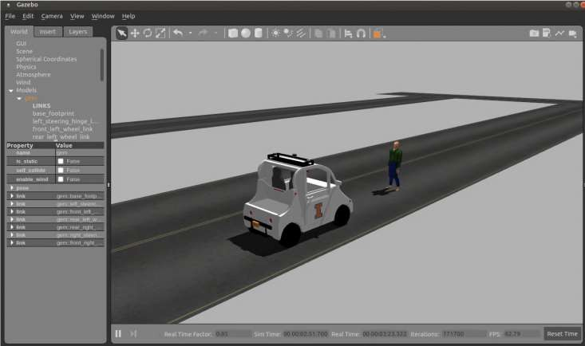
Gazebo – Open-source Robotics Simulator
Simulates physics (like gravity, friction, etc.) and environment in which a robot operates.

Slide 4
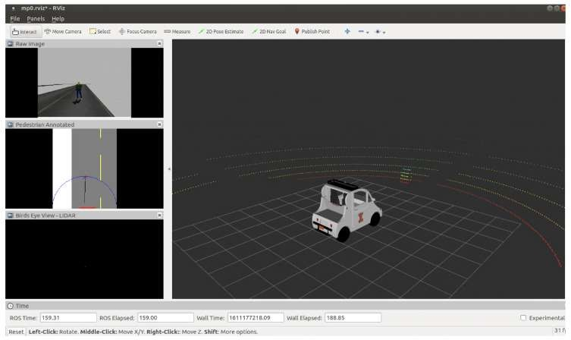
RVIZ – ROS visualizer
Visualizes data, including sensor data, the state of the robot, and planned actions
Subscribe to and visualize data
from ROS topics in real-time
No physics engine
Note: If you SSH into 5072 machines, set your ROS_DOMAIN_ID to your group number to avoid confusion

Slide 5
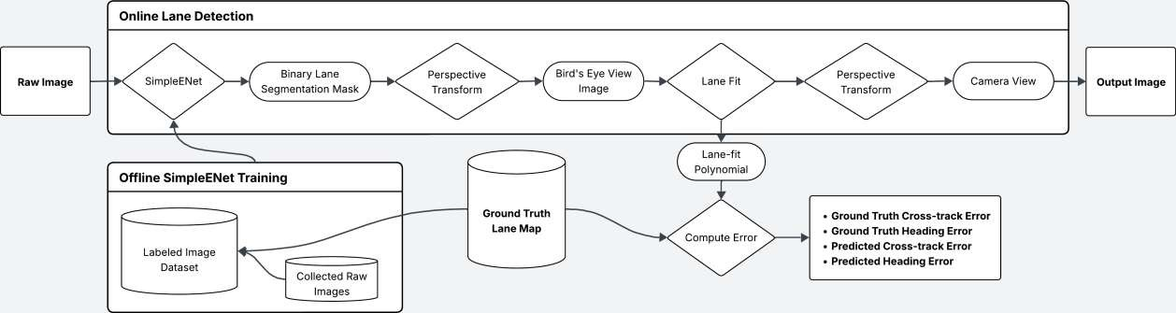
System Overview

Slide 6
Tasks
Preparing the Dataset
Build Simple ENet
Writing the Training Loop
Performing Perspective Transformation
Cross-Track and Heading Error Calculation

Slide 7
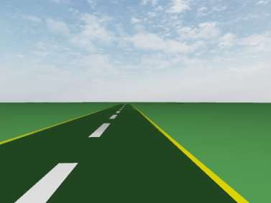

Dataset Preparation
Use drive.py to drive the vehicle with WASD as well as save the training data
Use preprocess.py to generate the label for each image you capture
Raw image
Masked image

Slide 8
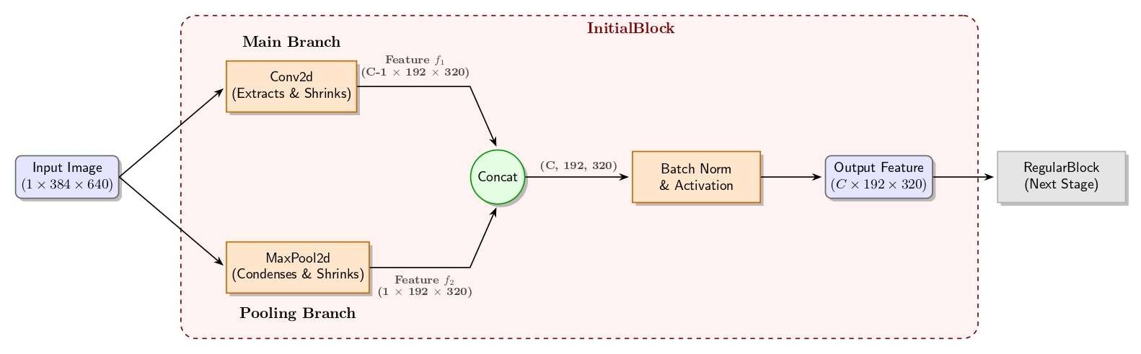
Build InitialBlock in Simple ENet
C - OutputDim

Slide 9

Pytorch Overview - Optimizer
We need a loss function and an optimizer to train a model.
Eg. def train(dataloader, model, loss_fn, optimizer):
…
The optimizer updates the model's weights to minimize the loss.
Eg. optimizer = optim.Adam(model.parameters(), lr=0.001)
Learning Rate (lr)
  Controls the step size of weight updates during training
  Too high – Model diverges ; Too low – Training is slow
  Tip: Start with 1e-3 or 1e-4
Weight Decay
  Adds L2 Regularization
  Penalizes large weights to prevent overfitting

Slide 10
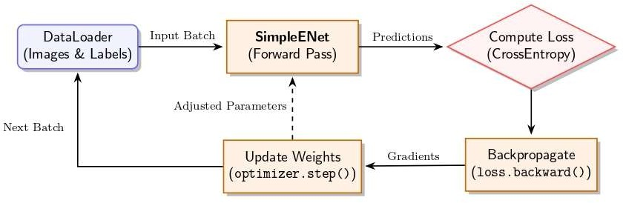
Pytorch Overview – Training pipeline

Slide 11
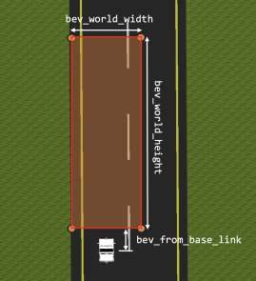
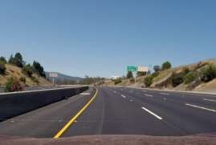
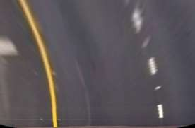
Perspective Transform
Camera view
->
Bird’s Eye View

Slide 12
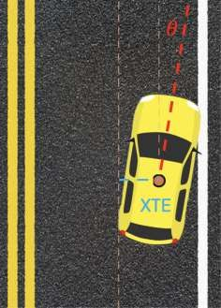
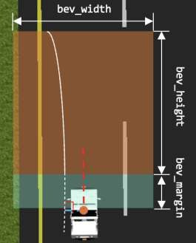
Evaluation
Cross-track error (XTE) measures the deviation of your camera origin from the true center of the lane
Heading error (HE) measures the deviation in your vehicle’s heading angle and the lane’s direction

Slide 13
Grading
HW1 (100 pts) – Individual
Specific point breakdown in documentation
Upload to Gradescope with name and NetID in pdf
MP1 (100pts) – Group
Report 80 pts
Demo (9/25) 20 pts
Upload code to GitHub repo

Slide 14
Logistics and Reminders
Submit your group forms and include GitHub usernames
  Submit even if not sure yet so we can connect usernames to email
Make sure you check your email and accept invitation to join GitHub organization
MP0 code will be submitted through GradeScope
MP0 demo will be in next lab session, September 11th
  Individual questions will be asked
MP1 and HW1 will be due on September 25th
  Start early as you can get stuck
  Lab space may be limited outside of class

Slide 15


