Slide 1
What we have -----
Demo CMS ---------Tami
Future Plans--------

Slide 2
What we have - ACL
Role-Base [Action control]
User-Base [Contract Group]
same role, different workflow/contract involved
same vender, different workflow/contract involved
Configurable Privileges [Action, UI-tabs]
Users: Vendors, Authors, Supervisors, Approvers, TB

Slide 3
What we have - Workflow
Maintain Workflow states, actions, procedure
Tasks on User
Comments recorder

Slide 4
What we have - Report
Management
All current Tasks on users
Data
Total Cost on Vendors

Slide 5
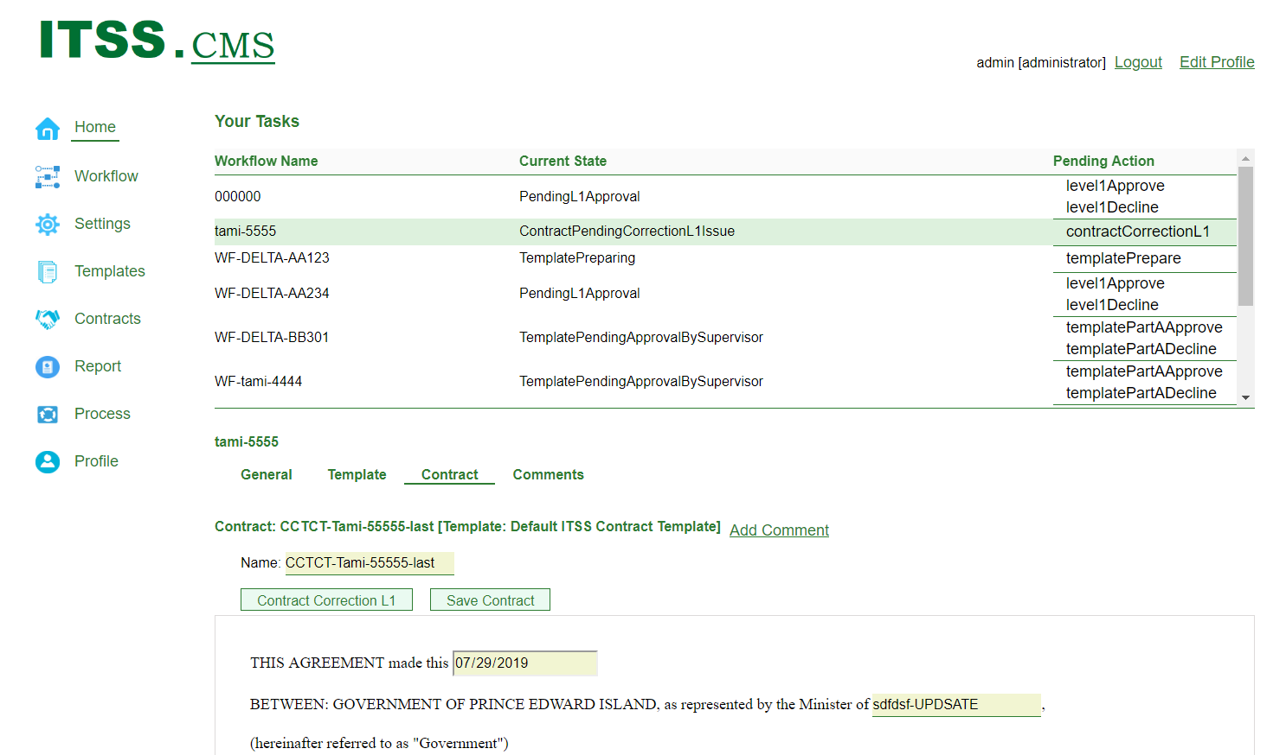
Demo

Slide 6

Future Plans
Done
Partially Done

Slide 7
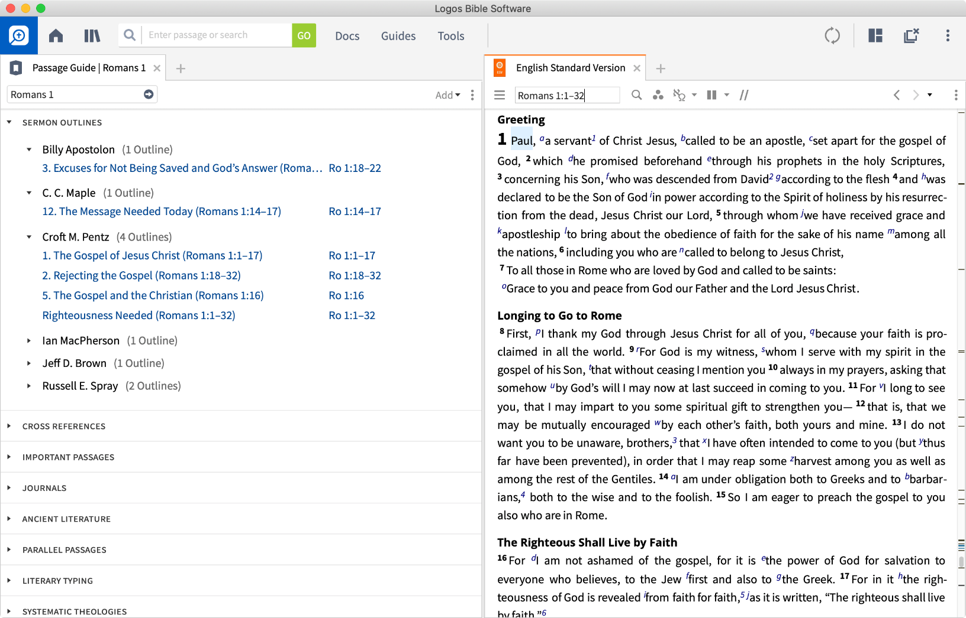
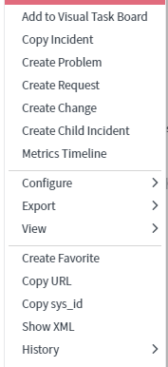

Future Plans – Template Editor
Definitions
Covenants of the Contractor and Government
Payments, Records and Accounts
Conditions of Agreement
Reports
Administration
Termination
Confidentiality and Copyright
Conflict of Interest
Freedom of Information and Protection of Privacy Act
SCHEDULE "A"
SCHEDULE "B"
NONDISCLOSURE AGREEMENT
Administration
Subject to any specified time | schedule or location where the Work is to be performed as may be set forth in Schedule “A” attached hereto, the Work is to be performed at the locations specified in Schedule "B" - Locations of Work to Be Performed and the Contractor shall follow the same time schedule as applicable to employees of Government.
Government shall provide such support, direction, decisions and information to the Contractor as it deems necessary or appropriate under this Agreement and may appoint a person to administer this Agreement and communicate with the Contractor

Slide 8
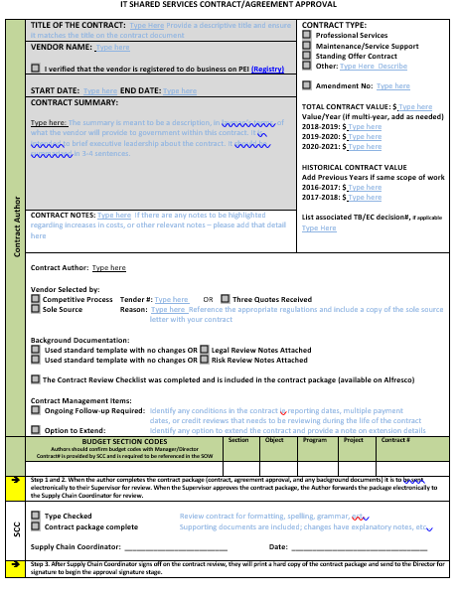
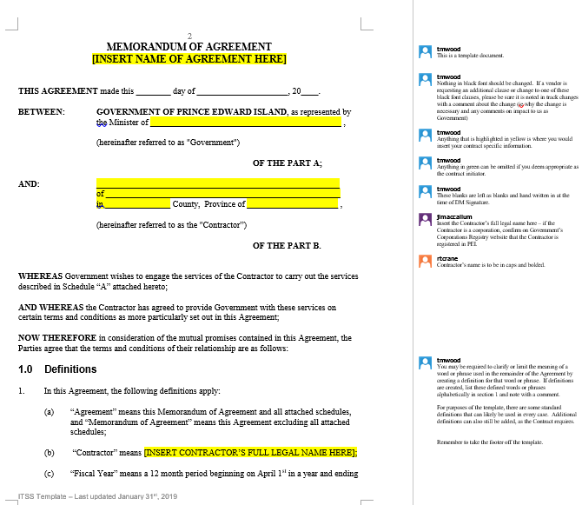
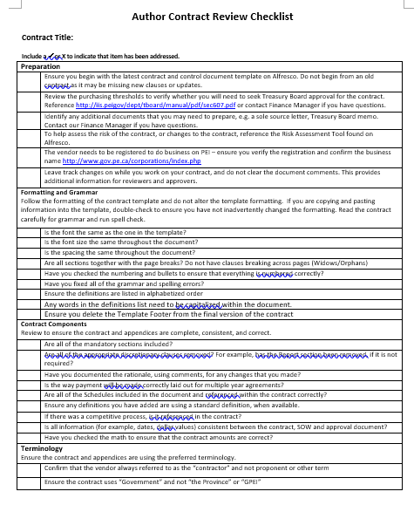
Future Plans – Contract Properties | Docs
Contract Properties
Comments in current Template document
Fulfil Contract content
Schedules docs...
relevent documents
Features
Renewal
Contract Request
Etc.

Slide 9
Future Plans – Enrich Report
Quantity
Various reports
On Requirement
Quality
Data precision
UI representation
Analysis

Slide 10

Future Plans – Better Usability

Slide 11
Future Plans – Response from all Users
Listen to Users

Slide 12
Thank you!

Slide 13
Last 3-week plan
Installation package
Webpack and Docker
Documentations
User Guide
Developer Instruction
Bug fix
More features
OR

