Slide 1
Programming Data Flow with Python
Song Teng

Slide 2
Why data flow?
Data + Flow = (Clean and Useful) Programs

Slide 3
Design Meeting Notes from Microsoft C# Team
Working with data
Today’s programs are connected and trade in rich, structured data: it’s what’s on the wire, it’s what apps and services produce, manipulate and consume.
Traditional object-oriented modeling is good for many things, but in many ways it deals rather poorly with this setup: it bunches functionality strongly with the data (through encapsulation), and often relies heavily on mutation of that state. It is "behavior-centric" instead of "data-centric".
Functional programming languages are often better set up for this: data is immutable (representing information, not state), and is manipulated from the outside, using a freely grow-able and context-dependent set of functions, rather than a fixed set of built-in virtual methods.

Slide 4

Introducing Pyflow
A functional data flow library in Python

Slide 5
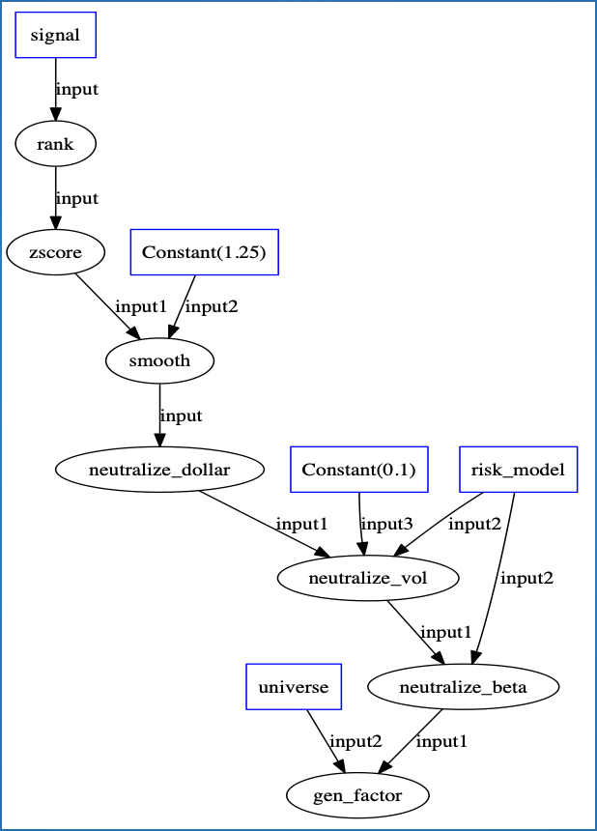
An Example of Transform Sequence for Stock Trading Signals
@lift()
def rank(signal):
return Signal(signal().rank())
@lift()
def zscore(signal):
d = signal()
return Signal((d - d.mean()) / d.std())
@lift()
def smooth(signal, scale):
return Signal(np.tanh(signal() * scale))
@lift()
def neutralize_dollar(signal):
weights = signal()
long = weights[weights >= 0].sum()
short = np.abs(weights[weights < 0].sum())
return Signal((weights / short).where(weights < 0, weights / long))
@lift()
def neutralize_beta(signal, risk_model):
weights = signal()
betas = risk_model.get_beta()
res = ols(y=weights, x=betas, intercept=False)
return Signal(weights - res.beta[0] * betas)
@lift('gen_factor')
def generate_factor(signal, universe):
return Factor(universe, signal())
@lift()
def neutralize_vol(signal, risk_model, target_vol):
weights = signal() / risk_model.get_vol()
portfolio_vol = np.sqrt(weights.dot(risk_model.get_cov()).dot(weights.T))
return Signal(weights / (portfolio_vol / target_vol))
def simple_transform(signal, universe, risk_model, smooth_scale=1.25, target_vol=0.1):
signal = rank(signal)
signal = zscore(signal)
signal = smooth(signal, smooth_scale)
signal = neutralize_dollar(signal)
signal = neutralize_vol(signal, risk_model, target_vol)
signal = neutralize_beta(signal, risk_model)
return generate_factor(signal, universe)

Slide 6
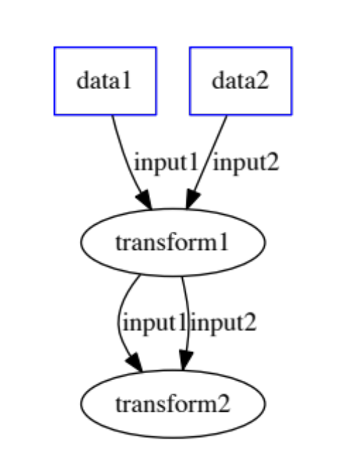
Inside “@lift(...)”
class Transform(Flow):
input1 = Input()
input2 = Input()
output1 = Output()
output2 = Output()
def __init__(self, input1, input2, name):
super().__init__(name)
@when(input1)
def handle(self):
self.output1 = self.input1()
@when(input2)
def handle(self):
self.output2 = self.input2()
tx1 = Transform(data1, data2, 'transform1')
tx2 = Transform(tx1.output1, tx1.output2, 'transform2')

Slide 7
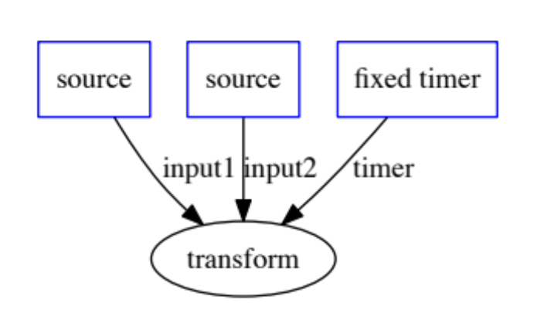
A More Interesting Example
class Transform(Flow):
input1 = Input()
input2 = Input()
timer = Timer()
def __init__(self, input1, input2, default_value):
super().__init__()
self.default_value = default_value
self.done = False
@when(input1)
def handle(self):
self.timer = self.now() + timedelta(minutes=60)
@when(input2)
def handle(self):
if not self.done:
self << self.input1() * self.input2()
@when(timer)
def do_timer(self):
if not self.input2 and not self.done:
self << self.input1() * self.default_value
self.done = True

Slide 8
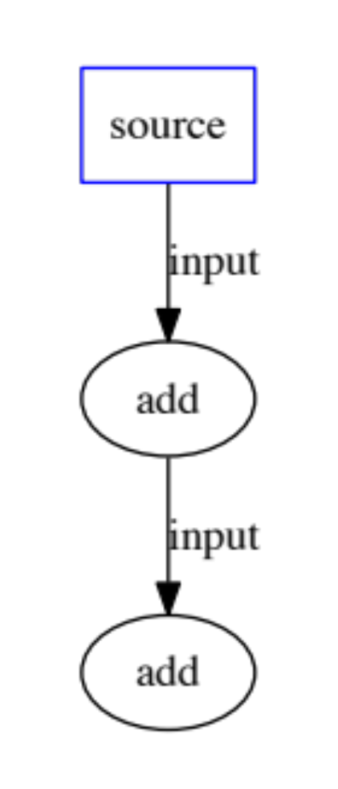
Synchronous Execution Model Enabling Deterministic Concurrency
t1
t2
[(t1, 1), (t2, 2)]
t1 = datetime(2016, 8, 1, 10, 11, 12)
t2 = datetime(2016, 8, 1, 10, 11, 13)
input_series = [(t1, 1), (t2, 2)]
engine = Engine()
data = DataSource(engine, input_series)
@lift()
def add(i):
return i + 1
tx1 = add(input_series)
tx2 = add(tx1)
engine.start(t1, t2)
1
2
3
2
3
4
[(t1, 3), (t2, 4)]

Slide 9
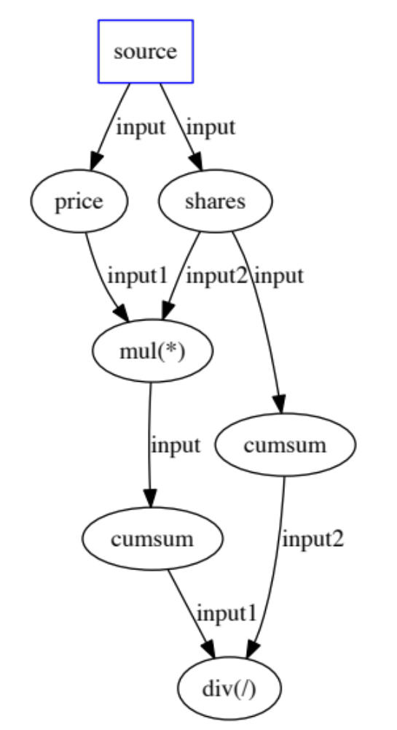
Cut the Boilerplate with Functional Combinators
class Trade:
def __init__(self, price, shares):
self.price = price
self.shares = shares
Before
After
trades = DataSource(trades)
prices = trades.map(lamba t: t.price)
shares = trades.map(lambda t: t.shares)
sp = prices.map2(shares, lambda p: s: p*s)
sp = sp.fold(0, lambda x, a: x + a)
ss = shares.fold(0, lambda x, a: x + a)
vwap = sp.map2(ss, lambda sp, ss: sp / ss)
trades = DataSource(trades)
prices = trades.price
shares = trades.shares
vwap = (shares * prices).sum() / shares.sum()

Slide 10
Additional Features
Feedback to enable cyclic flow
High-order flow (changing graph of flow while executing)
Concurrency
Real-time mode (reacting to real-time events)

Slide 11
Related Work
Apache Spark
Reactive Extensions (Rx.Java ......)
Akka-Stream
Functional Reactive Programming (FRP)
Google Cloud Data Flow

Slide 12
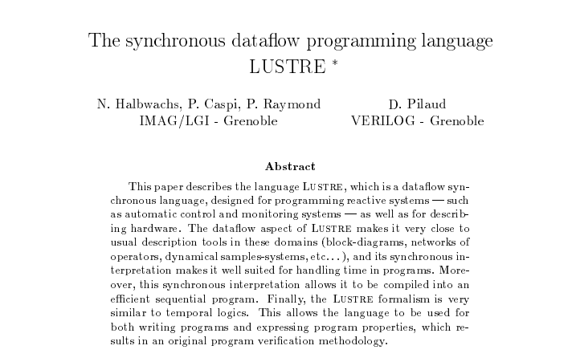
The Genesis ...

