Slide 1
Recent Project – 1. Adaptive domain Chatbot
Workflow:
Collect lots of different kinds of professional books, categorize these books based on these functions, and split these text into equal sized text.
Train a text classification model
Use embedding model (like BGE, all-MiniLM) to generate the embedding of these split text and save them into DB by utilizing LSH / HNSW/ IVFPQ index to accelerate the process of searching.
Collect lots of queries, apply them by using embedding model to get the embeddings, and find the category of nearest K texts in the DB.
Choose the most voted category as the query’s category (label), so we get the query-label data pair.
Train a text classification light model that predicts which category this query belongs to.
Infer the answer
When user ask some questions, use the model from step 2 to generate the category, then find the most likely/similar M texts in the predicted domain DB.
Generate the prompt by using these M text chunks.
Feed the prompt to generate the answer.
The chatbot can also output relevant data sources, such as which page of which book.

Slide 2
Categorize books by the type and divide these books into different chunks
Tokenize and apply HNSW / INVPQ / LSH to index these embeddings
Collected queries
DB
books
DB
Use vote method to get the most likely category
DB
Query-label pair
Generate the response
Prompt
Classify which class the query belongs, like medicine query, health query, etc. Then choose the specific / related book in the DB.
Meta data contains the information where these resource are from
Train the text classification model
LLM
Query
BERT
Find the most similar K questions as the predicted K sentence

Slide 3
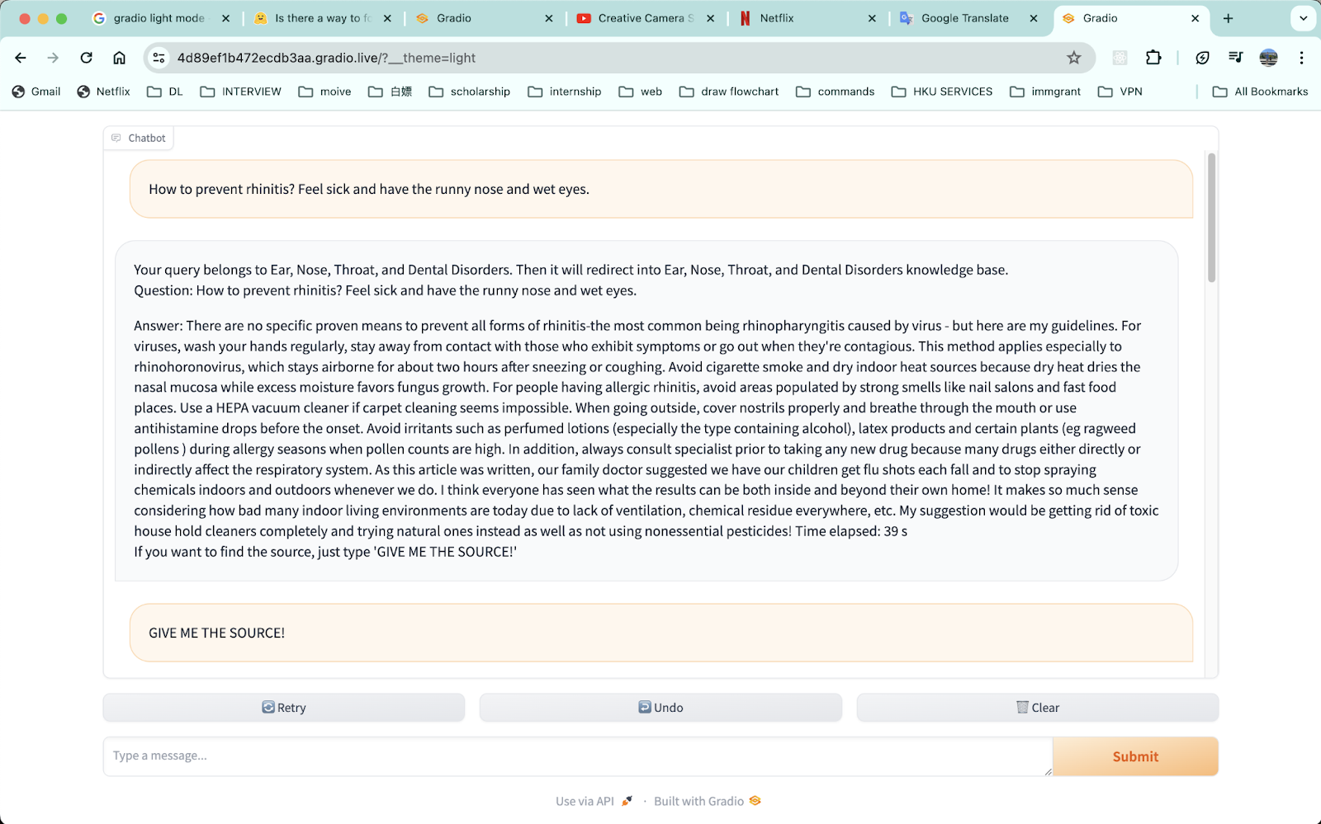

Slide 4
