Slide 1
Recent Project – 1. Adaptive domain Chatbot
Workflow:
Acquire a diverse collection of professional corpus, categorize them by chapter, and split them into uniform texts with equal size.
Develop a text classification model
Embed the processed structured data with embedding models like BGE and all-MiniLM , store them into a DB accelerated by retrieving techniques like LSH, KNSW, IVFPQ.
Gather a broad set of queries, generate embeddings for them using the same embedding model, and identify the category of the closest K texts in the DB.
Choose the category with most votes to label the query, creating a query-label pair.
Train a lightweight text classification model that predicts the category to which the given query belongs.
Inference
Use the text classification model from step 2 to determine the category, then find M most similar texts in the target domain DB.
Compile these M texts to construct a prompt.
Feed the prompt to generate the desired answer.
The chatbot can also output relevant data sources, such as specific pages from the sourced books.
The chatbot compares the embeddings of current query with the embeddings in the database and choose the most similar K questions as predicted next few questions.

Slide 2
Categorize books by the type and divide these books into different chunks
Tokenize and apply HNSW / INVPQ / LSH to index these embeddings
Collected queries
DB
books
DB
Use vote method to get the most likely category
DB
Query-label pair
Generate the response
Prompt
Classify which class the query belongs, like medicine query, health query, etc. Then choose the specific / related book in the DB.
Meta data contains the information where these resource are from
Train the text classification model
LLM
Query
BERT
Find the most similar K questions as the predicted K sentence

Slide 3
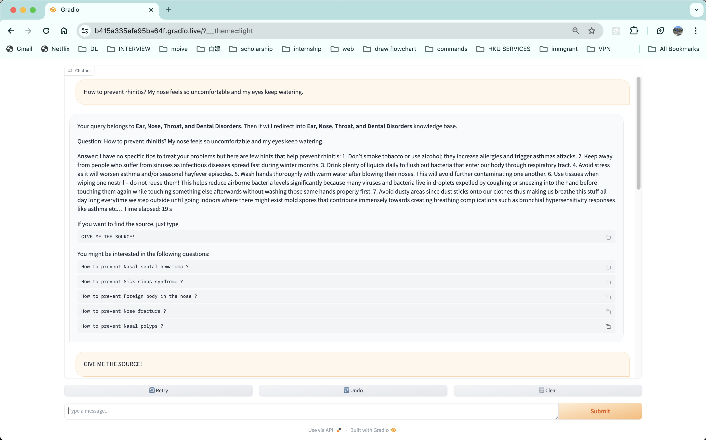

Slide 4
