Slide 1
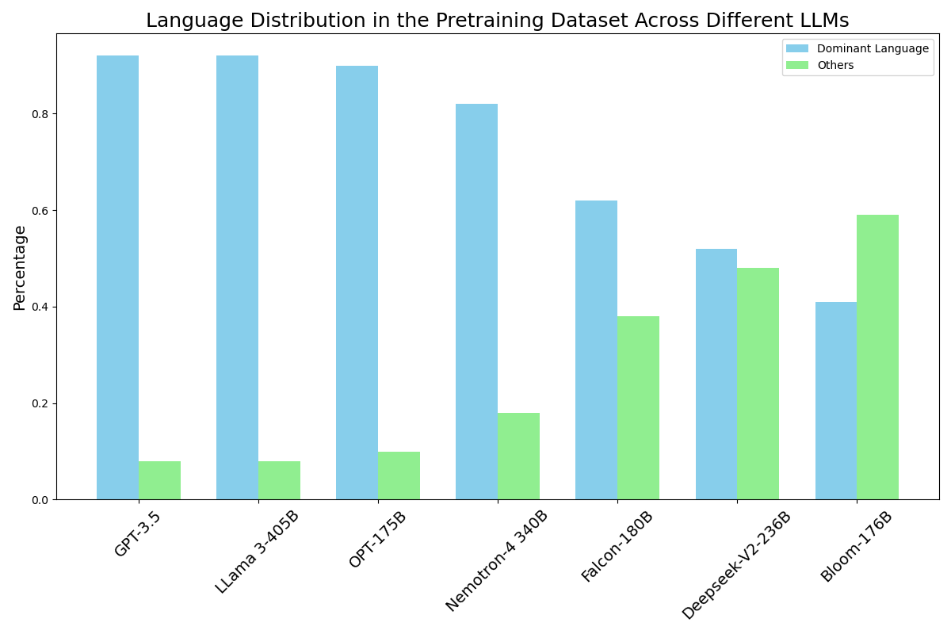
Large Language Models are Good Multi-lingual Learners : When LLMs Meet Cross-lingual Prompts
https://arxiv.org/pdf/2409.11056
Text to Structured Data Task
Background:
LLMs struggle with handling long contexts effectively. LLMs often fail to generate the desired data when dealing with many complex and abstract rules in the prompt. Even if we emphasize or repeat a previously failed rule, the output may still not follow that rule.
Idea:
The distribution of languages in the training dataset varies significantly (e.g., GPT-3: English 92.64%, French 1.81%, etc.).
Translating only the failed rule in the long-context prompt into another language can help the LLM focus more on previously missed rules and produce the correct output.
When requiring the LLM to adhere to a set of complex rules to generate structured data, if the error rate exceeds a certain threshold, translating only the failed rule in the prompt into another language can be an effective strategy.

Slide 2
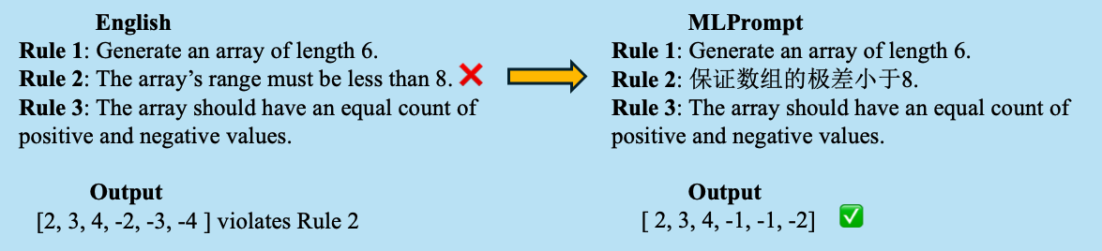
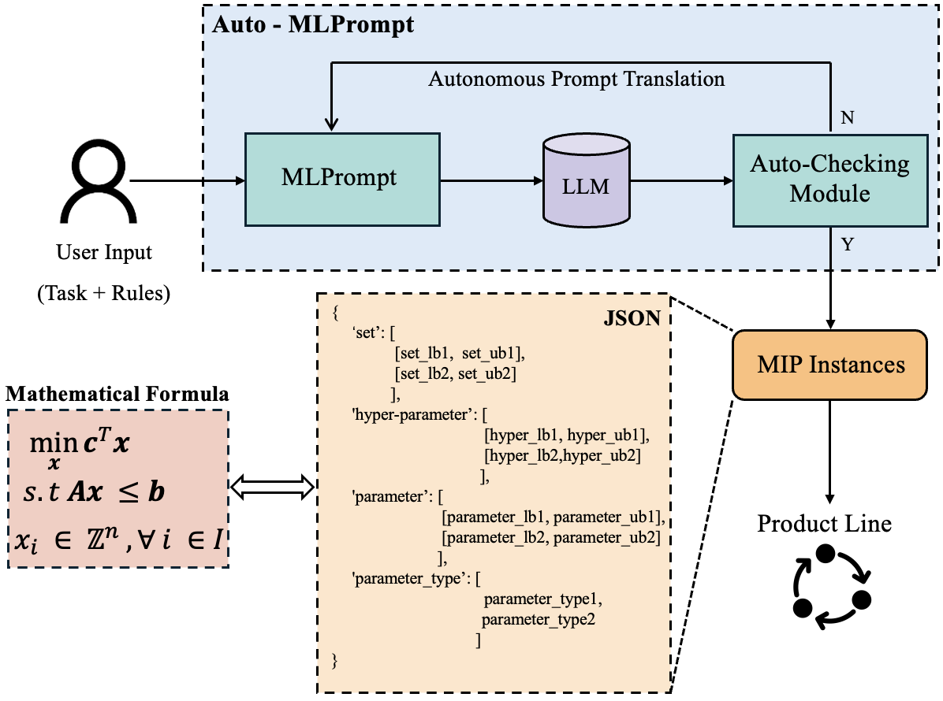
Large Language Models are Good Multi-lingual Learners : When LLMs Meet Cross-lingual Prompts
we propose the MLPrompt to translate the error-prone rule into a non-dominant language of LLM to strengthen the understanding and reasoning of LLM in given complex contexts.

Slide 3
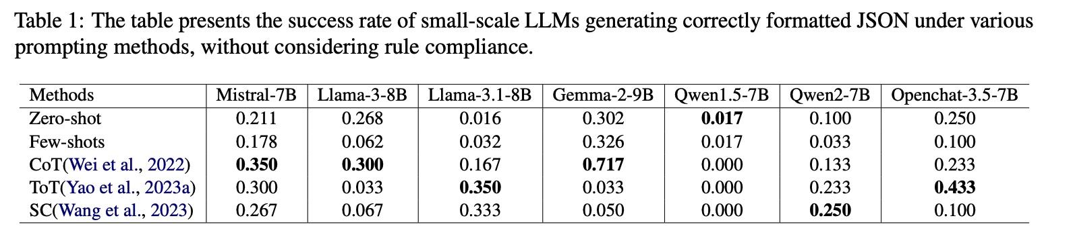
Large Language Models are Good Multi-lingual Learners : When LLMs Meet Cross-lingual Prompts

Slide 4
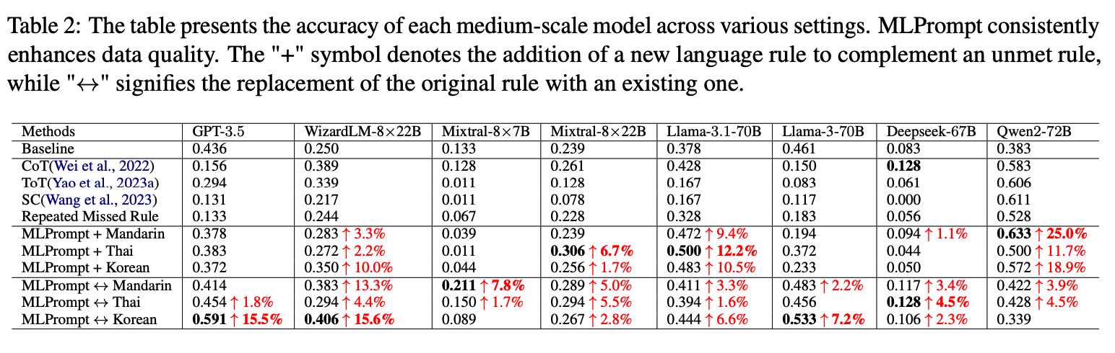
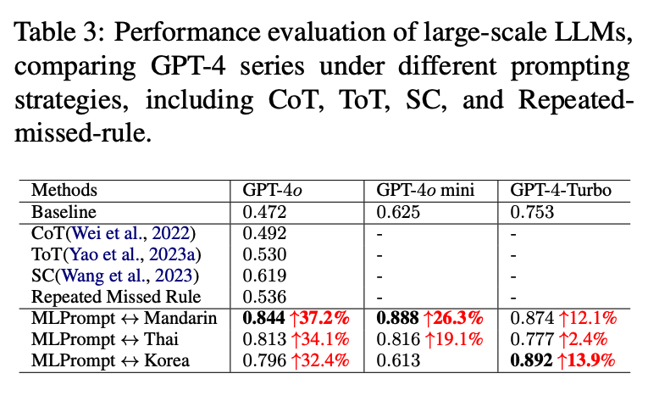
Large Language Models are Good Multi-lingual Learners : When LLMs Meet Cross-lingual Prompts

Slide 5
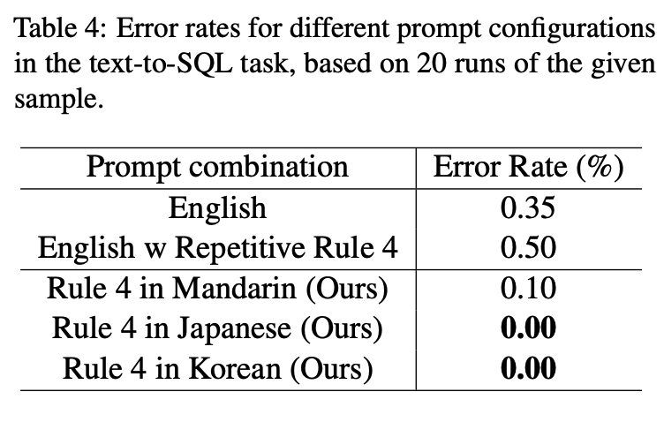
Large Language Models are Good Multi-lingual Learners : When LLMs Meet Cross-lingual Prompts

Slide 6
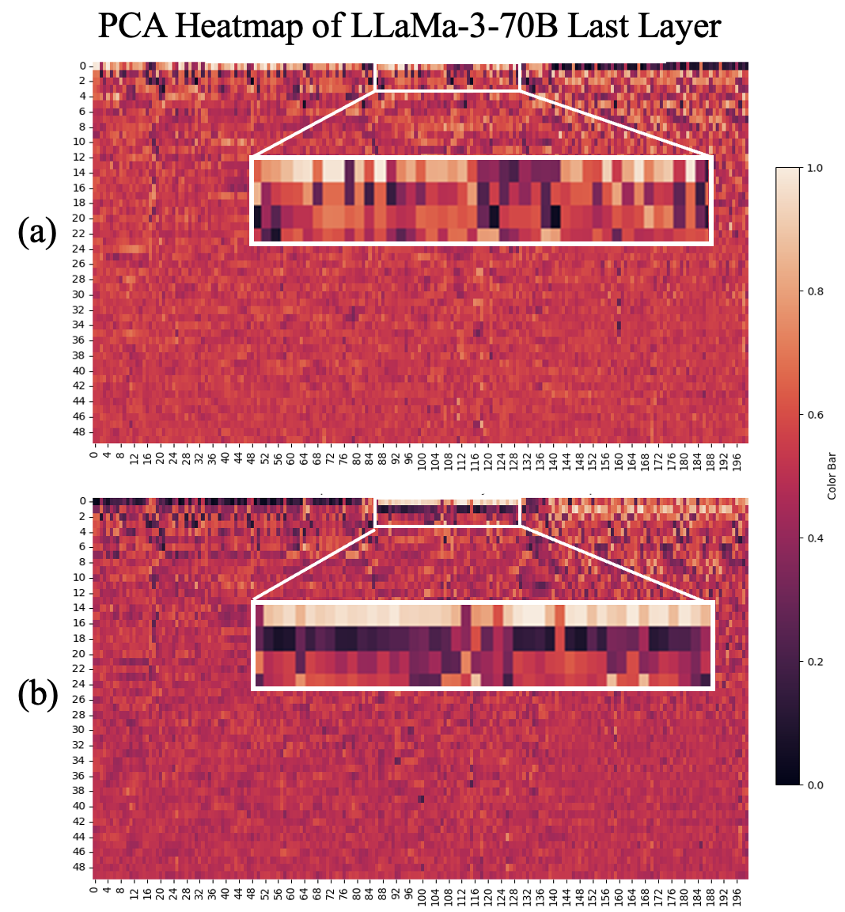
Large Language Models are Good Multi-lingual Learners : When LLMs Meet Cross-lingual Prompts
Heatmap of PCA-transformed final layer of LLaMA-3-70B with different prompts. (a) With original single-lingual Prompt. (b) Multi-lingual Prompts with the rule 8 in maindarin (Ours). The X-axis represents input tokens, and the Y-axis shows the 50 PCA components.

