Slide 1
BCSE497J PROJECT-I · FINAL REVIEW
Context-Aware Personal AI Assistant
Plug in any model, score it on public tasks, route every question by that score, and keep memory and files on your own computer.
Nischay N · Tejas K M · Tenidhar Reddy Chintham
Guide: Prof. Mary Mekala A · School of Computer Science and Engineering, VIT Vellore
November 2026
Notes:
Introduce the team and the idea: any model can be plugged in, every model is scored on public benchmark tasks with a named score, the router uses that score per question, and personal context never leaves the laptop. Then go straight to what Review 2 asked us to fix.

Slide 2
What Review 2 asked us to fix
“The diagrams look AI-generated and the actor graph is off.”
“What is the score name? How is each model graded?”
“Direct questions show 100%. How is it 100%?”
Every diagram is generated by a script from the code, in standard UML and Yourdon notation. Class diagrams are parsed from the source; use cases match real app controls.
The Routing Utility Score (RUS), built from a measured scorecard per model and task type: accuracy with a 95% interval, real cost, real latency.
It was measured on our own prompts. On 200 unseen public prompts the classifier now scores 97%, and every rate shows its n and 95% interval.
Notes:
Open with the three criticisms in the panel's own words and the change for each. The rest of the talk is the evidence for these three cards.

Slide 3
Three goals, one assistant
OPEN
PRIVATE
CHEAP
Any model can be plugged in
Your data stays on your computer
Pay only for what a question needs
Local (Ollama) or cloud (Anthropic, Gemini, any OpenAI-compatible API). One entry in models.yaml, one calibration run.
Memory, documents, history and scorecards live in a local folder. A question that carries any of them is answered by a local model only.
Each question goes to the model with the best measured trade-off of accuracy, cost and speed for its task type.
95% cheaper
than always using Claude Sonnet 5.5, at the same accuracy: 89.5% vs 89% on 200 unseen public tasks.
Notes:
Balanced routing 179/200 vs Sonnet 178/200, McNemar p = 1.0, at $0.127 vs $2.506 per 1,000 questions.

Slide 4
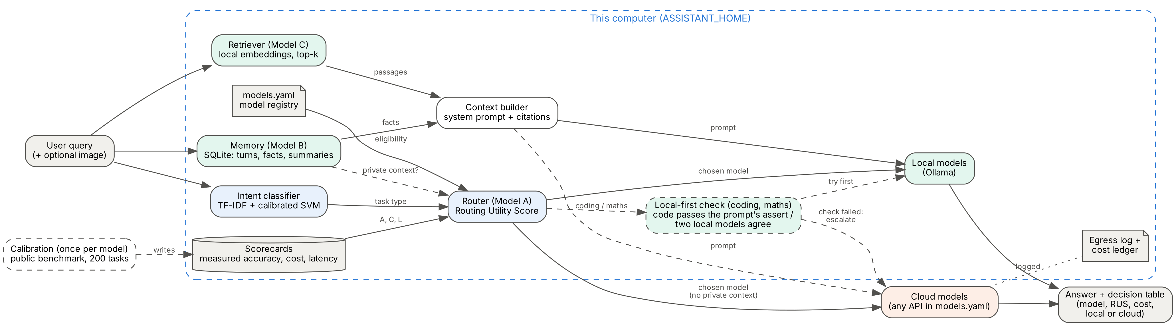
Architecture: one pipeline, three switches
Routing, memory and RAG are switches on one Assistant class, so builds A to D are the same code. Everything inside the dashed box runs on the user's computer; only a prompt with no private context can reach a cloud model.
Notes:
Walk the flow left to right: recall memory and retrieve passages, classify the intent, score every eligible model with RUS, optionally try a local answer first for code and maths, generate, store the turn, log cost. Drawn by scripts/make_diagrams.py.

Slide 5
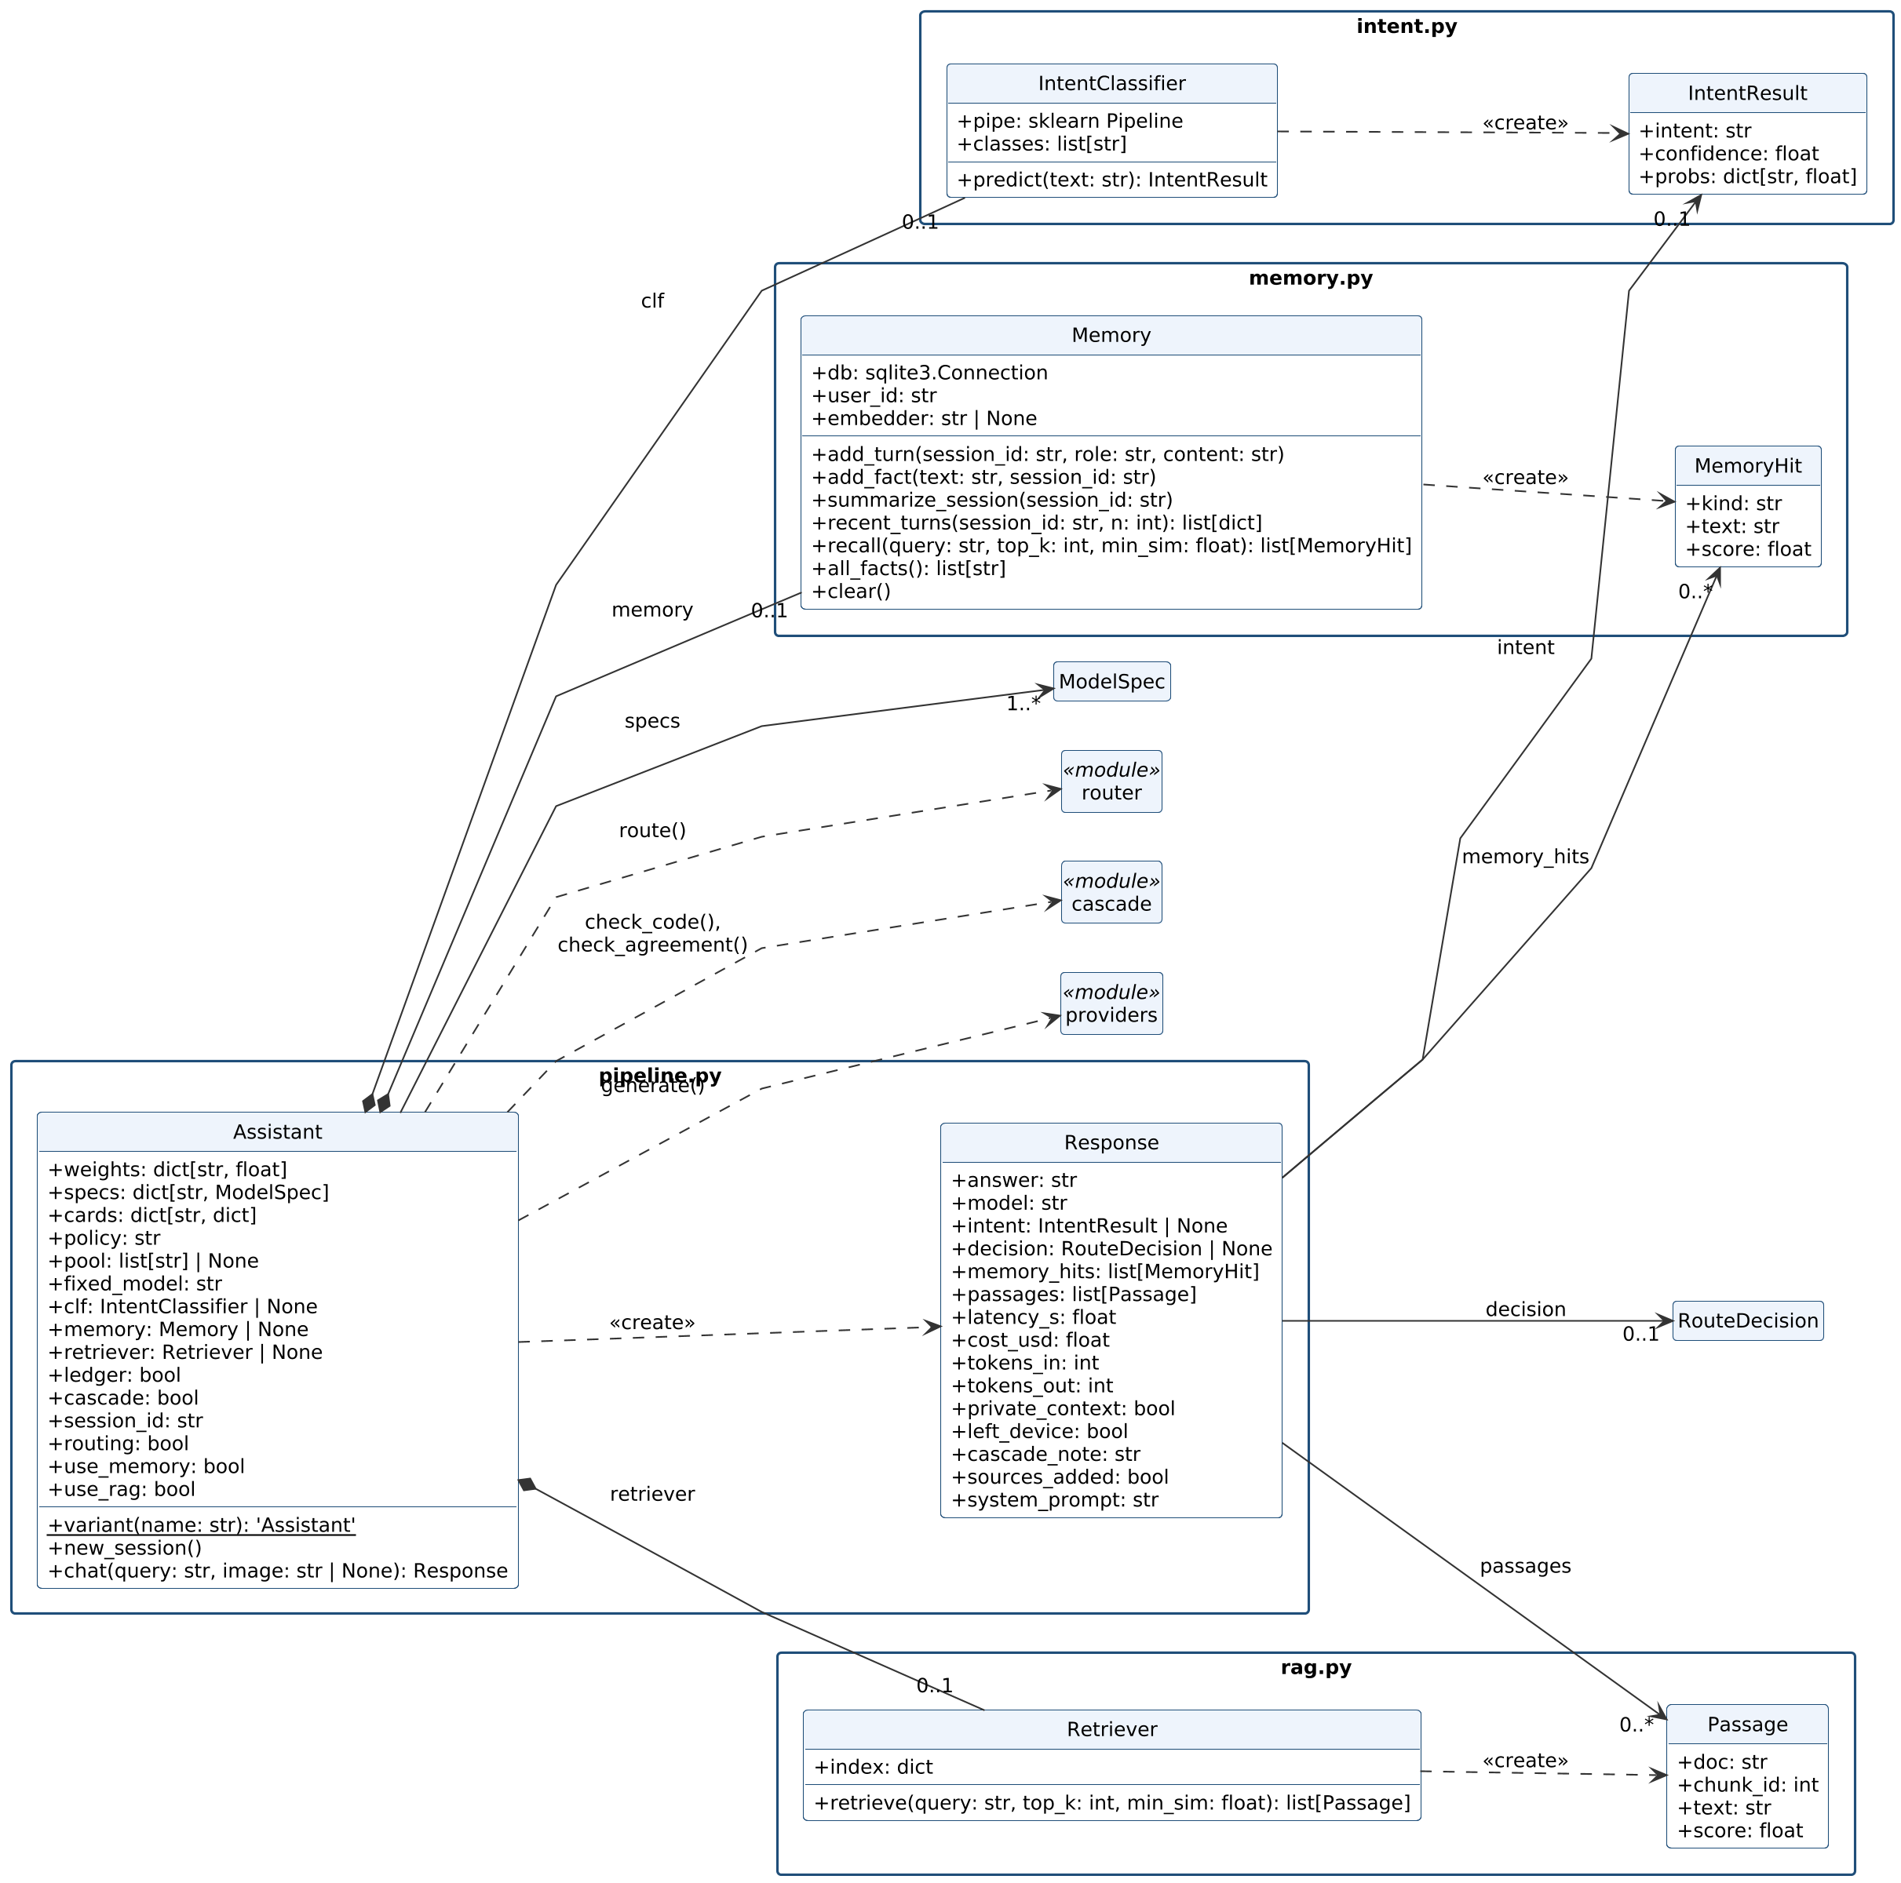
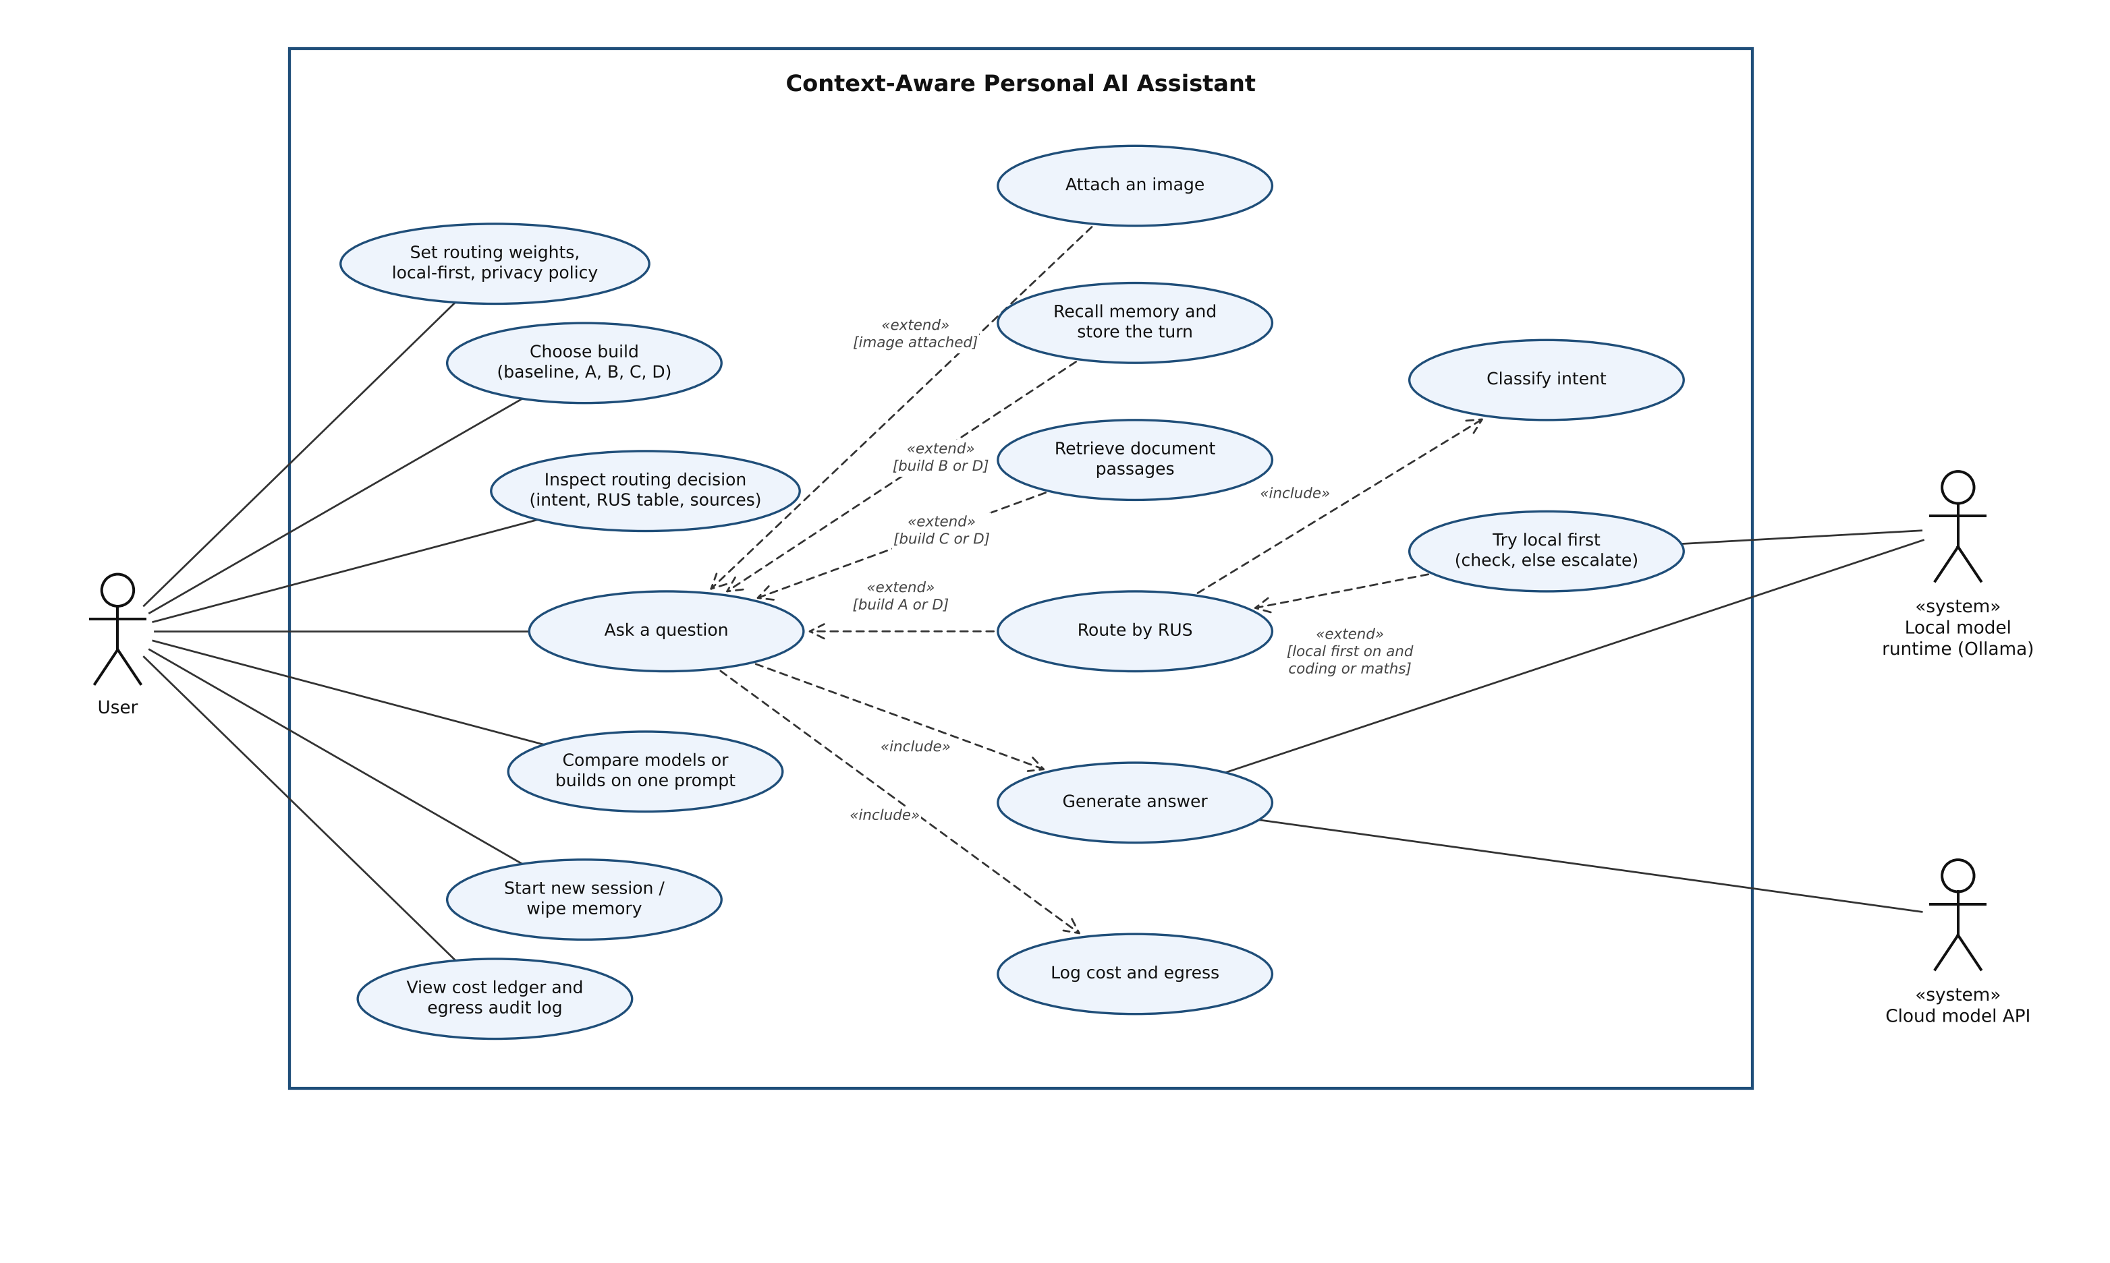
Design in standard notation, generated from the code
Use cases (UML 2.5): every use case is a real app control; «extend» conditions name the build that enables it
Classes parsed from the source with types; composition, associations and dependencies as in the code
Notes:
Answer to the first criticism. The report has the full set: DFD level 0 and 1 (Yourdon notation), two use case diagrams, three class diagrams, a sequence diagram and an activity diagram. Each is produced by a script; the class diagram fails to build if a class it lists no longer matches the code.

Slide 6
Plugging in a model takes two steps
1 · Register it in models.yaml
provider | covers
ollama | any local model
openai | OpenAI, Groq, Together, LM Studio, vLLM
anthropic | Claude models
gemini | Google Gemini
- name: claude-haiku-5.5
provider: anthropic
model: claude-haiku-5-5
api_key_env: ANTHROPIC_API_KEY
local: false
vision: true
price_in: 0.10 # $ per 1M tokens
price_out: 0.50
Calibration runs the 200 public calibration tasks and writes the model's scorecard. The router uses it on the next question. No code changes.
2 · Calibrate it
python -m assistant calibrate --model claude-haiku-5.5
Notes:
Seven models were scored this way: qwen2.5-coder-3b, llama3.2-3b, llama3.2-1b, moondream-1.8b (local) and gemini-3.1-flash-lite, claude-haiku-5.5, claude-sonnet-5.5 (cloud).

Slide 7
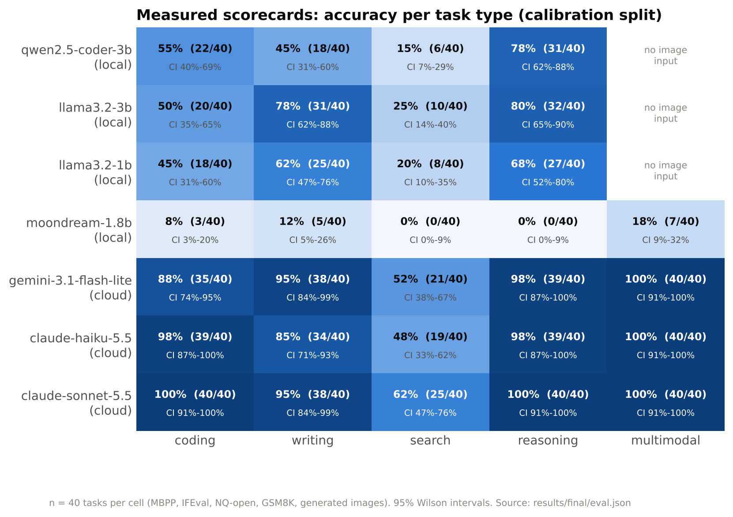
A measured scorecard per model and task type
What a scorecard holds
tasks tried and correct (40 per cell)
accuracy with its 95% Wilson interval
median latency, measured
mean cost per question: real tokens × list price
Cloud models lead on every type. The best local model reaches 80% on maths but 25% on factual questions.
Notes:
This answers 'what is the score per model'. Calibration and test tasks never overlap.

Slide 8
The score: Routing Utility Score (RUS)
RUS = w_{a}·A + w_{c}·(1 − C / C_{max}) + w_{l}·(1 − L / L_{max})
A · accuracy
C · cost
L · latency
Lower end of the 95% Wilson interval. 40/40 gives 0.91; 4/4 only 0.51, so small samples are not over-trusted.
Mean measured cost per question. Budget C_max = $0.002; at or above it the term is 0. Local models cost $0.
Median seconds per answer on our machine. Budget L_max = 30 s.
Balanced weights 0.6 / 0.2 / 0.2, user-adjustable · highest RUS wins, ties go to the cheaper model · private context → local models only
Notes:
This is the answer to 'what is the score name'. Eligibility comes first: a model needs a scorecard for the task type, vision for images, and must be local when the question carries memory or documents.

Slide 9
Worked example: a coding question, balanced weights
Model | Correct / 40 | A (Wilson low) | Cost / question | Latency | 0.6A + 0.2C′ + 0.2L′ | RUS
Claude Haiku 5.5 | 39 | 0.871 | $0.00013 | 2.2 s | 0.523 + 0.187 + 0.185 | 0.895
Gemini 3.1 Flash-Lite | 35 | 0.739 | $0.00012 | 1.3 s | 0.443 + 0.188 + 0.191 | 0.822
Claude Sonnet 5.5 | 40 | 0.912 | $0.00162 | 2.1 s | 0.547 + 0.038 + 0.186 | 0.772
qwen2.5-coder-3b (local) | 22 | 0.398 | $0 | 5.0 s | 0.239 + 0.200 + 0.167 | 0.606
Claude Haiku 5.5 wins. Sonnet is 1 task more accurate, but it spends 81% of the cost budget, so its cost term nearly vanishes. Move the slider to quality-first and Sonnet wins instead.
C′ = 1 − C / $0.002 · L′ = 1 − L / 30 s · coding calibration scorecards
Notes:
Read one row out loud: Haiku got 39 of 40 coding tasks, Wilson lower bound 0.871, times 0.6 is 0.523, and so on. The app's Chat tab shows this table for every question.

Slide 10
400 public tasks, graded by rules, not by AI
Task type | Source | Marked correct when
Coding | MBPP | code passes the dataset's own unit tests
Maths | GSM8K | final number equals the gold number
Factual search | Natural Questions (open) | the answer contains an accepted answer
Writing | IFEval | every stated instruction holds (length, format, keywords)
Images | 80 generated charts and shapes | matches the known answer
200 calibration
40 per type · build the scorecards
200 test
40 per type · never used to build scorecards or train the classifier
Notes:
Split fixed by seed 2026 before anything runs. All results on the next slides are on the test split.

Slide 11
Result: Sonnet's accuracy at a fraction of the cost
89.5%
89%
−95%
routed (balanced), 179/200
95% CI 84.5%–93%
always Claude Sonnet 5.5, 178/200
McNemar p = 1.0: no difference
cost: $0.127 vs $2.506 per 1,000 questions
(₹11.1 vs ₹221)
Routing is significantly better than Gemini alone (86%, p = 0.02) and than the best local model (48%, p < 0.001). It is not more accurate than Sonnet; it is equally accurate for far less money.
Notes:
The 0.5-point lead over Sonnet is noise: they disagree on 11 tasks. If asked about Haiku alone: 88.5% at about the same cost; routing found that automatically.

Slide 12
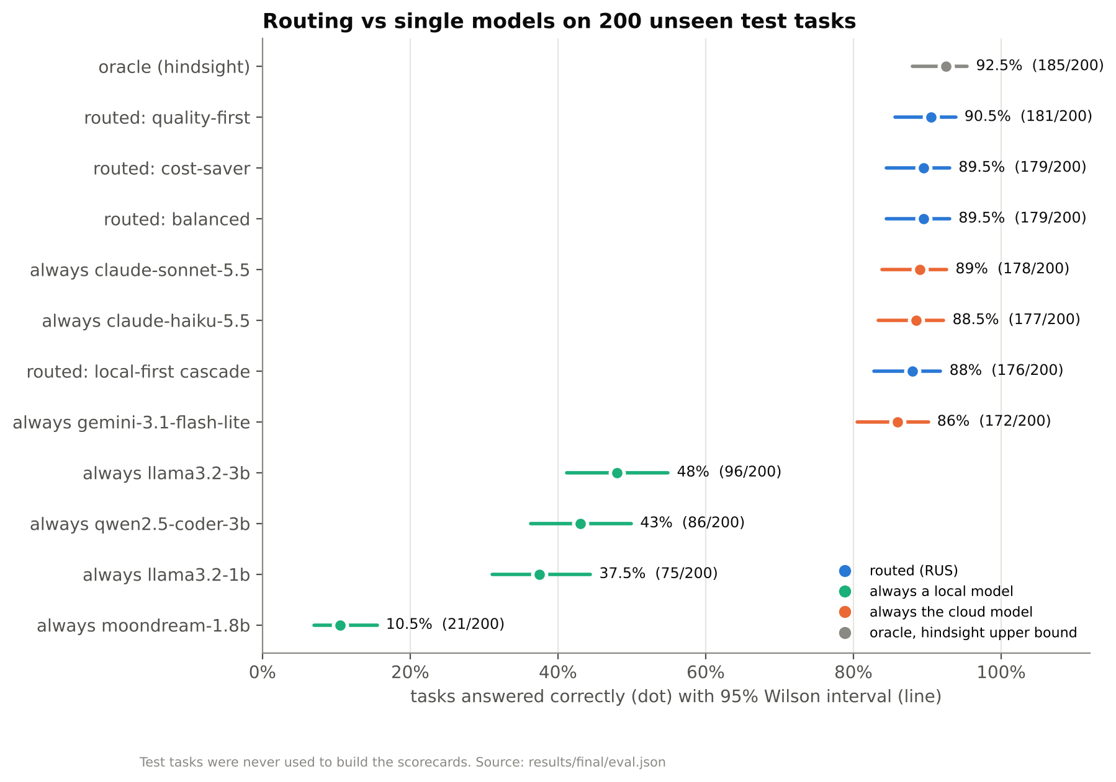
Every policy, with its uncertainty
How to read it
Dot = share of the 200 test tasks answered correctly; line = 95% Wilson interval.
Routed policies and the two Claude models overlap: statistically tied.
The oracle picks, with hindsight, the cheapest model that got each task right: 92.5%. It is the ceiling for any router on these models.
Notes:
Nothing is shown without its interval: this is the answer to the 100% criticism.

Slide 13
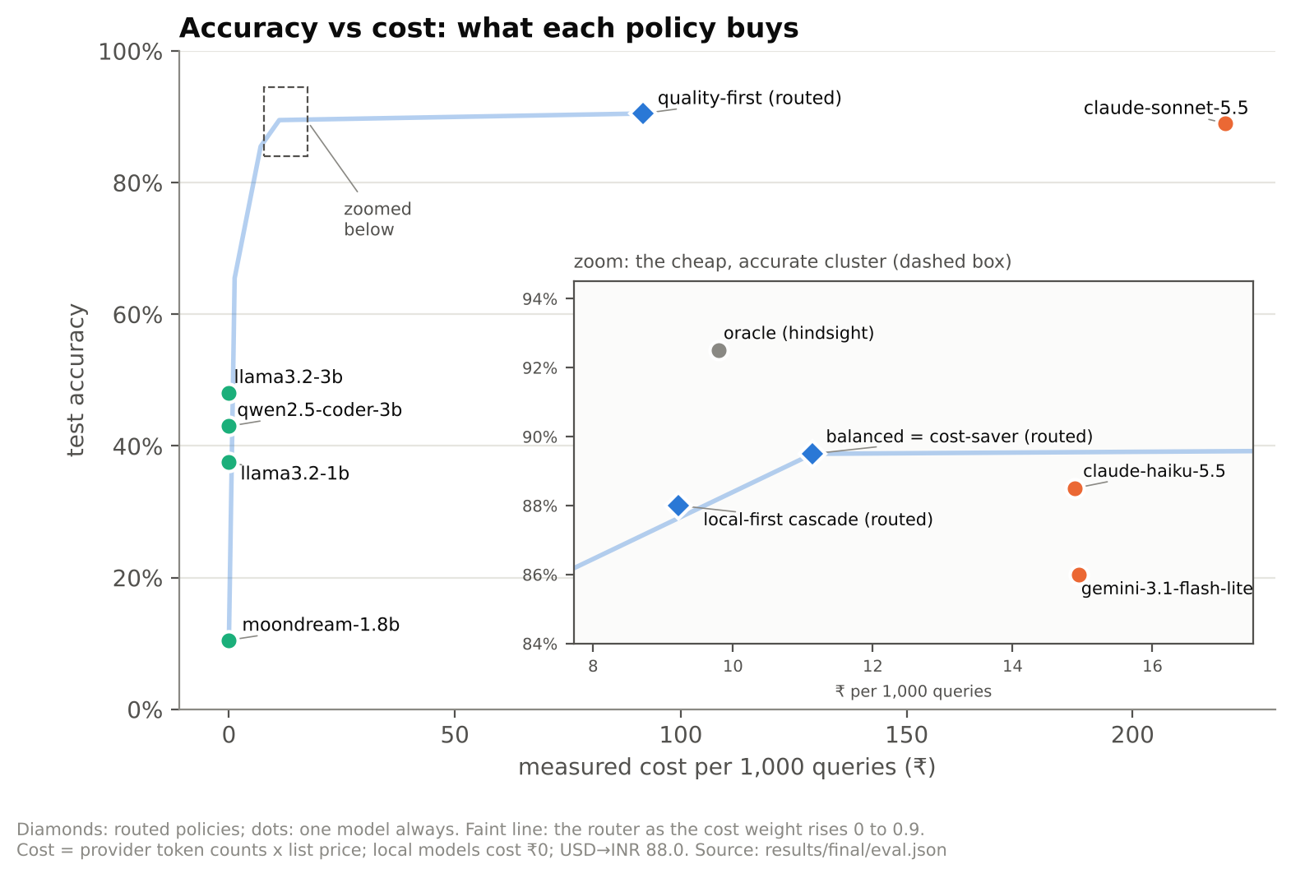
What each policy buys, in rupees
Policy | Accuracy | ₹ / 1k
Routed, balanced | 89.5% | 11.1
Local-first cascade | 88% | 9.2
Always Haiku | 88.5% | 14.9
Always Gemini | 86% | 14.9
Routed, quality-first | 90.5% | 91.6
Always Sonnet | 89% | 220.5
Raising the cost weight to 0.8 sends 63% of questions to local models and accuracy falls to 65.5%.
Notes:
The faint line is the router as the cost weight rises from 0 to 0.9. The user chooses the point; the default sits at the knee.

Slide 14
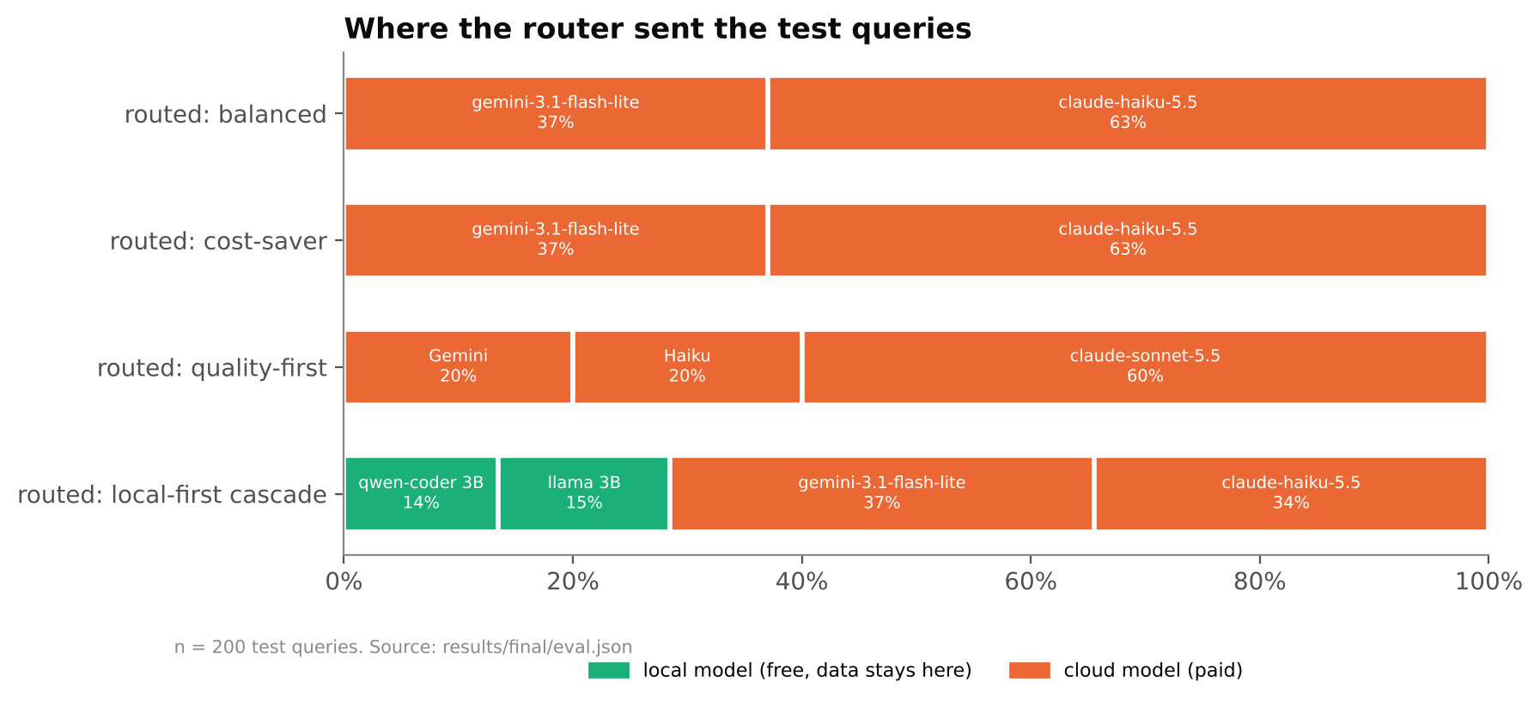
Local first: keep an answer on the laptop if it checks out
Coding
Maths
Otherwise
The local coder's code must pass the example assert in the user's own prompt.
Two different local models must agree on the final number.
Escalate to the model RUS picks. No check uses the right answer.
28.5%
of test questions answered on the laptop, at 88% accuracy (p = 0.79 vs Sonnet) and $0.105 per 1,000.
Kept answers were right 54 times in 57.
Notes:
Plain RUS routing sends nothing to the laptop, because the small local models score far lower. Coding: 27 kept, 25 right. Maths: 30 kept, 29 right. The price is latency: the local attempt runs first.

Slide 15
“How is it 100%?” It was not, on fair prompts
Task type | Before fix | After fix | 95% CI after
Coding | 37/40 | 40/40 | 91.2%–100%
Maths | 38/40 | 40/40 | 91.2%–100%
Factual search | 33/40 | 34/40 | 70.9%–92.9%
Writing | 18/40 | 40/40 | 91.2%–100%
Images | 40/40 | 40/40 | 91.2%–100%
All | 166/200 | 194/200 | 93.6%–98.6%
Where the 100% came from
A random split of our own templated prompts: near-copies sat in both training and test.
The fix
Train on our prompts plus the public calibration prompts; test on the 200 public test prompts it never saw. Misrouted questions: 34 → 6.
Direct phrasings: 50/50, shown as “at least 93%” (95% CI), never as a bare 100%.
Notes:
Answer the criticism head-on: the 100% was real but meaningless. The classifier fix kept routed accuracy the same and lowered cost, because writing prompts now reach the model measured best for writing.

Slide 16
Checking our own grading and stability
Grader audit
Same tasks, run twice
A manual review found correct answers marked wrong (“Rachel Bilson” vs the accepted “Rachel Sarah Bilson”). We added a word-overlap rule with guards and report both graders.
Model | Run 1 | Run 2 | Same mark | p
Claude Haiku 5.5 | 177/200 | 173/200 | 96% | 0.29
Claude Sonnet 5.5 | 178/200 | 178/200 | 99% | 1.00
Gemini 3.1 Flash-Lite | 170/198 | 170/198 | 100% | 1.00
87.5%
87.5%
Wording changes between runs; the pass or fail mark does not. Total paid API spend: about $1.87 under a $5 cap enforced in code.
routed, strict grader
Sonnet, strict grader
Same conclusion under either grader.
Notes:
Two honesty checks: both graders reported, and a full second run of every cloud model. No change between runs is significant.

Slide 17
Ablation: what memory and retrieval each add
Build | Switches | Memory recall | Document Q&A | Made-up answers | Points to a source
Baseline | none | 0/30 | 0/36 | 0/36 | 0/36
Model A | routing | 0/30 | 0/36 | 5/36 | 0/36
Model B | memory | 30/30 | 0/36 | 0/36 | 0/36
Model C | RAG | 0/30 | 31/36 | 1/36 | 34/36
Model D | routing + memory + RAG | 28/30 | 32/36 | 1/36 | 35/36
Each switch does its one job; the full build D keeps both: recall 28/30 (95% CI 78.7%–98.2%), document answers 32/36. Model B's 30/30 is shown with its interval, 88.6%–100%, not as a bare 100%.
Notes:
Same pipeline, different switches. Memory test: facts stated over four sessions, then 30 recall questions in a new session. Document test: 36 questions about a fictional company. Local models only.

Slide 18
Privacy: personal context never left the laptop
The rule
If a question carries a recalled memory, a retrieved passage or earlier turns, only local models are eligible. Cloud models are not even scored.
Kept in one local folder
Memory database · document index · scorecards · cost ledger · egress log (size and hash of each cloud request, never its text)
PRIVACY CHECK · BUILD D · ALL 8 REGISTERED MODELS AVAILABLE
0 of 54
requests carrying personal context went to a cloud model.
Recall stayed at 28/30 with every cloud model available.
Notes:
A measurement, not a claim. Normal questions without personal context can still go to the cloud, and those are logged.

Slide 19
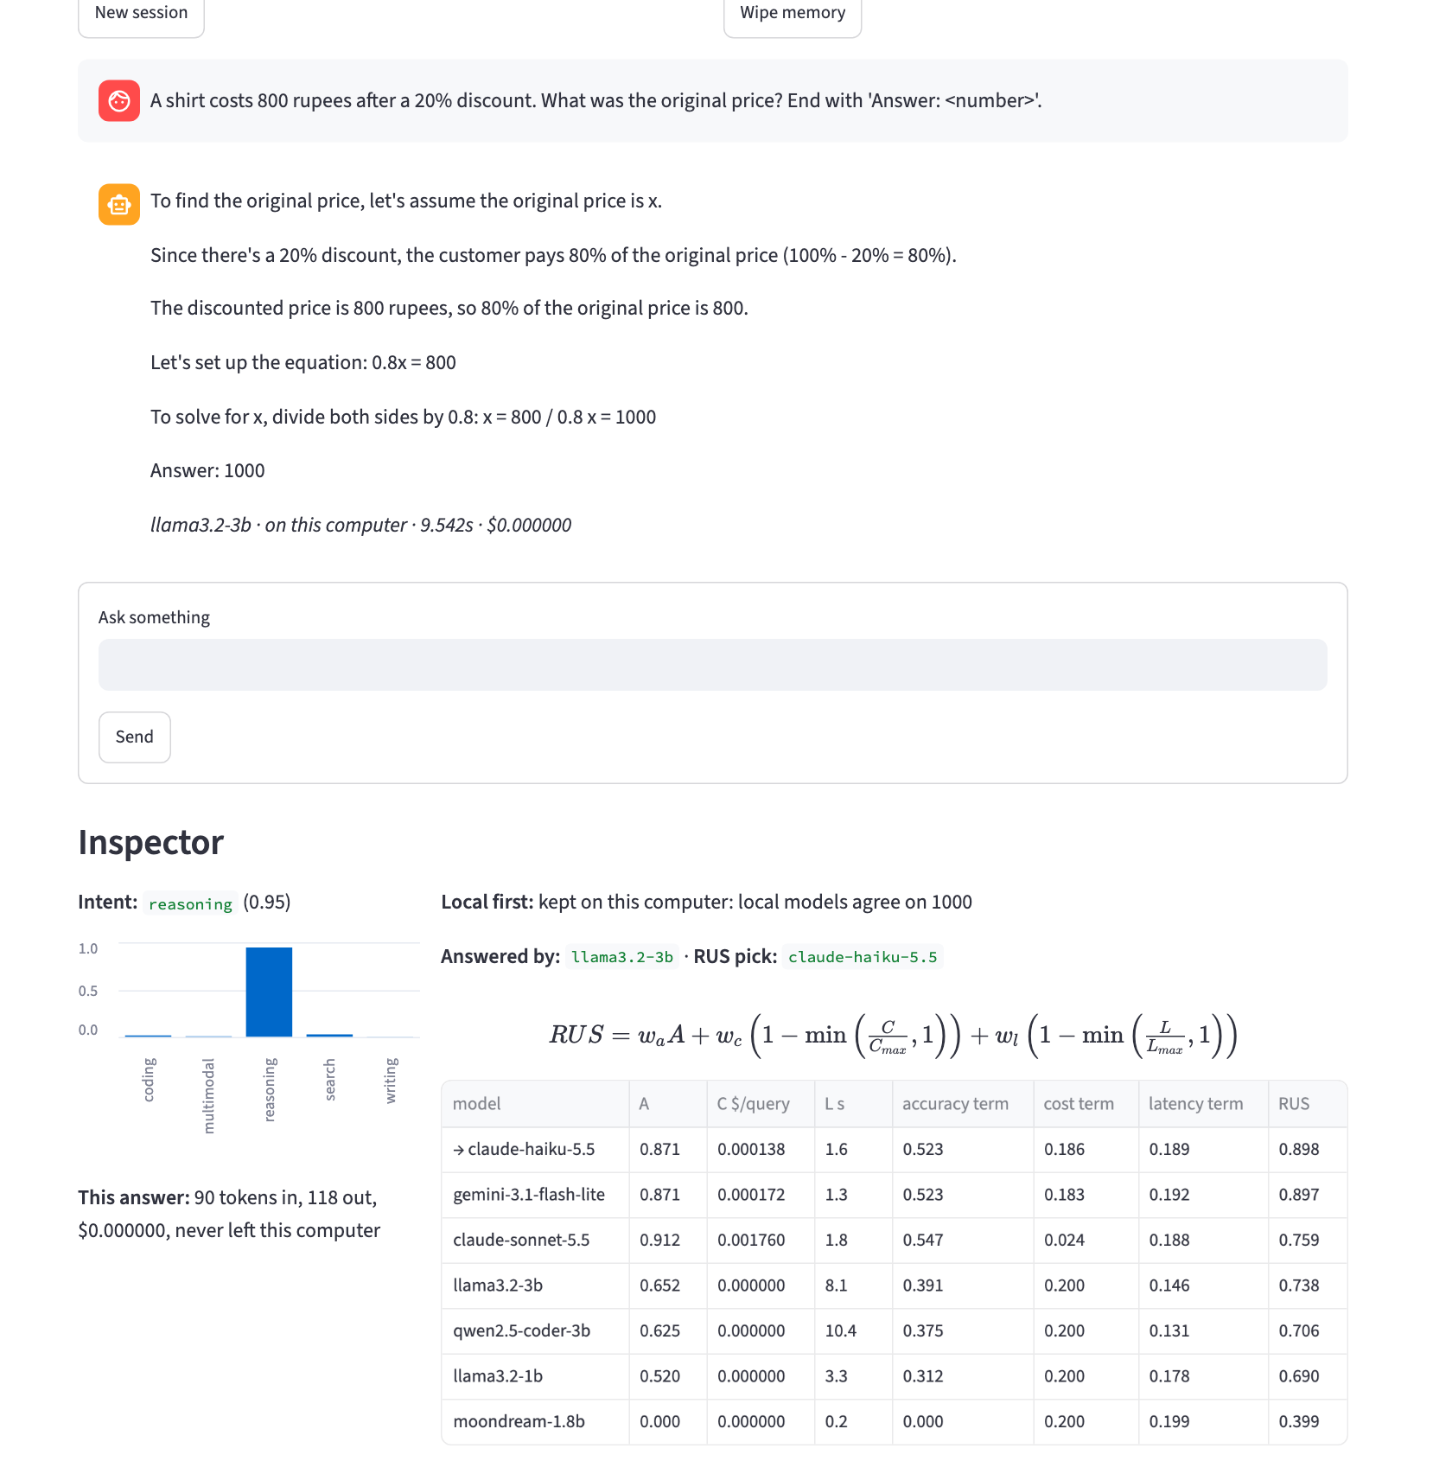
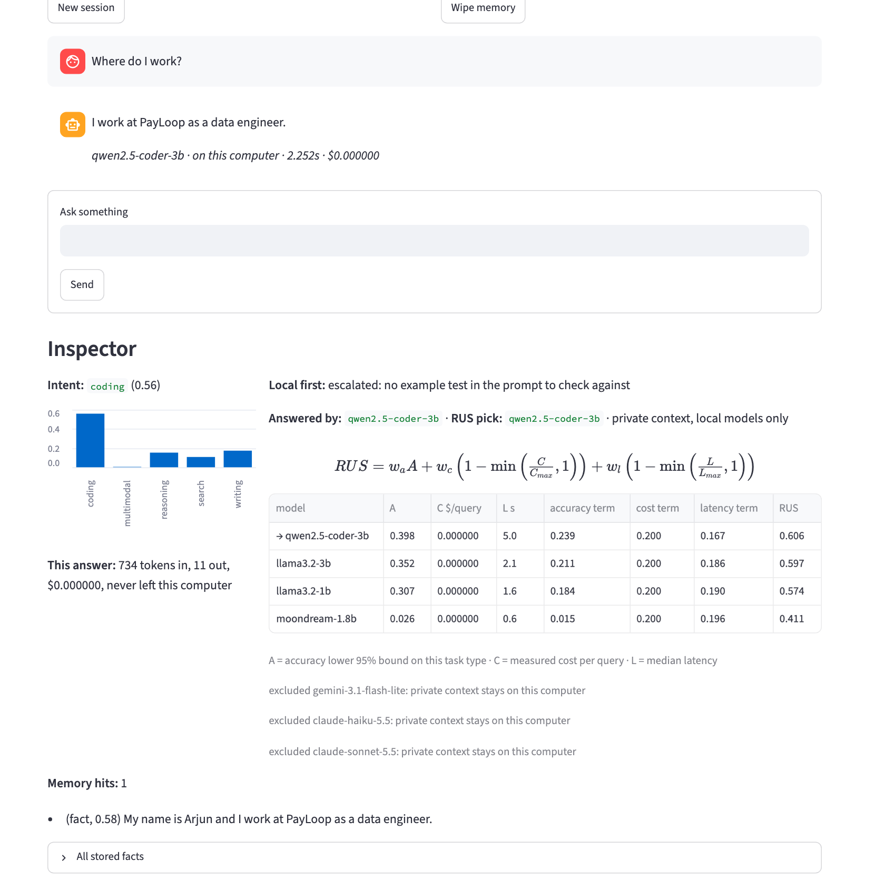
Demo: every decision is shown
Maths: two local models agree on 1000, so the answer stays on the laptop. RUS alone would have picked Claude Haiku.
Memory: “Where do I work?” recalls a stored fact, so every cloud model is excluded and the answer never leaves the computer.
Notes:
If a live demo is possible: streamlit run app.py, then repeat these two. Point at the Inspector: task type, the full RUS table, the local-first note and 'never left this computer'.

Slide 20
Limitations and next steps
What we do not claim
Next
200 test tasks: intervals are about ±5 points
On this benchmark, Haiku alone is nearly as good as routing
The classifier still misroutes 6 of 200 public prompts
Local models are 1B–3B; alone they reach 48%
Image tasks are generated and easy for cloud models
GPT-5 mini is registered but was not scored (no API credit)
7B–8B local models to raise the on-device share
More cheap checks for the local-first step
An embedding-based intent classifier
Larger benchmark runs with the same scripts
Recalibrate automatically when a provider changes price or model
Notes:
Say these before the panel does. Each is in the report with its number.

Slide 21
Thank you. Questions?
Same accuracy as the best cloud model, a fraction of the cost, and personal data that never leaves the laptop.
github.com/teni-chintham/context-aware-ai-assistant
Reproduce everything: run_final.command · MIT licence
Notes:
Close on the one sentence. Offer the live demo if there is time.

