Slide 1

Latest stable version 3.2.4(LTS)

Slide 2
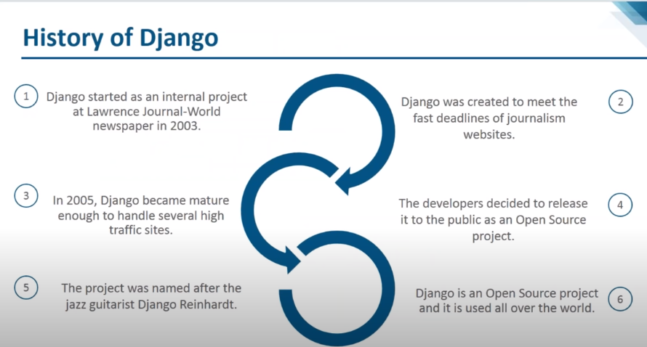
Django

Slide 3
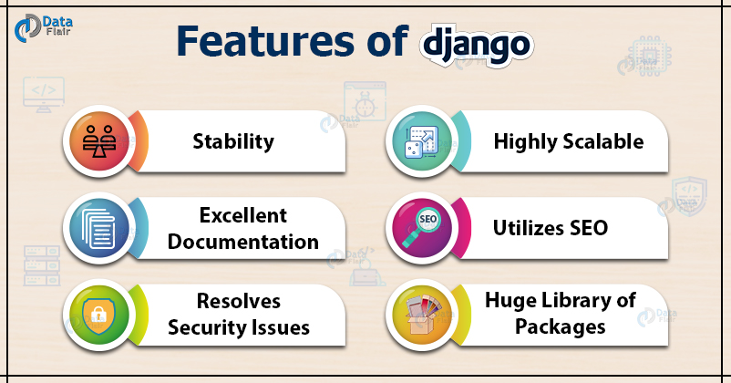
Django Features

Slide 4
Components of Django
Form:
Django has a powerful form library which handles rendering forms as HTML. The library helps in validating submitted data and converting it to Python types.
Authentication:
It handles user accounts, groups, cookie-based user sessions, etc.
Admin:
It reads metadata in your models to provide a robust interface which can be used to manage content on your site.
Internationalization:
Django provides support for translating text into various languages, locale-specific formatting of dates, times, numbers, and timezones.
Security:
Django provides safeguard against the following attacks:
Cross-Site Request Forgery (CSRF)
Cross-site scripting
SQL injection
Clickjacking
Remote code execution

Slide 5


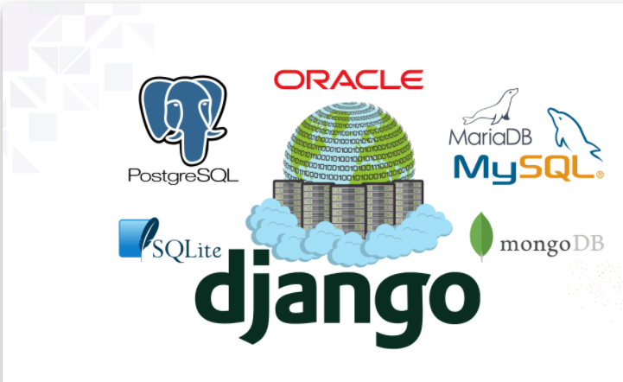
Databases supported by Django
Django is a Python-based web framework that allows you to quickly create efficient web applications. It is also called batteries included framework because Django provides built-in features for everything including Django Admin Interface, default database – SQLlite3, etc

Slide 6
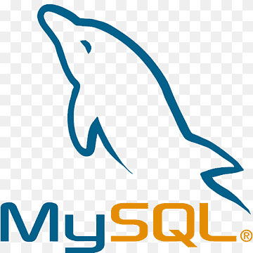
Django database connectivity
By default Sqllite was present in django.
If we wants to connect with mysql, first install mysqlclient.If phpmyadmin installed in system, no need to install mysql
Pip install mysqlclient
DATABASES = { 'default': { 'ENGINE': 'django.db.backends.mysql', 'NAME': 'djangodatabase', 'USER': 'dbadmin', 'PASSWORD': '12345', 'HOST': 'localhost', 'PORT': '3306', } }

Slide 7

Mongodb should be installed in our system before install mongodb compass,it's an grpahical user interface for mainteining databases and collections in mongodbOr we can use Mongodb cloud (Mongodb atlas).
Using djongo we can use MongoDB as a backend database for our Django project. We don’t even need to change the Django ORM
pip install djongo
DATABASES = { 'default': { 'ENGINE': 'djongo', 'NAME': 'your-database-name', } }

Slide 8
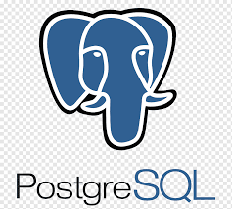
We will need to install a Postgres client first. After you ensure pg_config is available on your system, go ahead and install “psycopg2”
pip install psycopg2
DATABASES = { 'default': {
'ENGINE': 'django.db.backends.postgresql_psycopg2',
'NAME': ‘<db_name>’,
'USER': '<db_username>',
'PASSWORD': '<password>',
'HOST': '<db_hostname_or_ip>',
'PORT': '<db_port>',
}

Slide 9
Django caching
User requests URL on site, webservers make multiple calculations to create final page; database query,template rendereing,view logic and more .this is slow and expensive process for the server.
With caching, we can save calculation result ,so no need to repeat the process.
Cache Types:
Django provides built-in support for most popular type of cache,Memcached
Key-value stored as small chunks and supports distributed caching.
Cache fragments stored in database ,useful for storing complex db queries
File system,saved on separate files for each cache.slowest,but easiest in production envt
Local Memory, suitable for local development or test envt. It can't scale beyond single server.
Dummy, Used in testing ,or for structural representaion purpose
Django Caching Levels:
Per-site Cache simple to setup and cache entire site
Per-view Cache Cache individual views
Template Fragment Caching Specific section of template cache
Low-level Cached API Let's manually set,retrieve, and maintain specific objects in cache

Slide 10
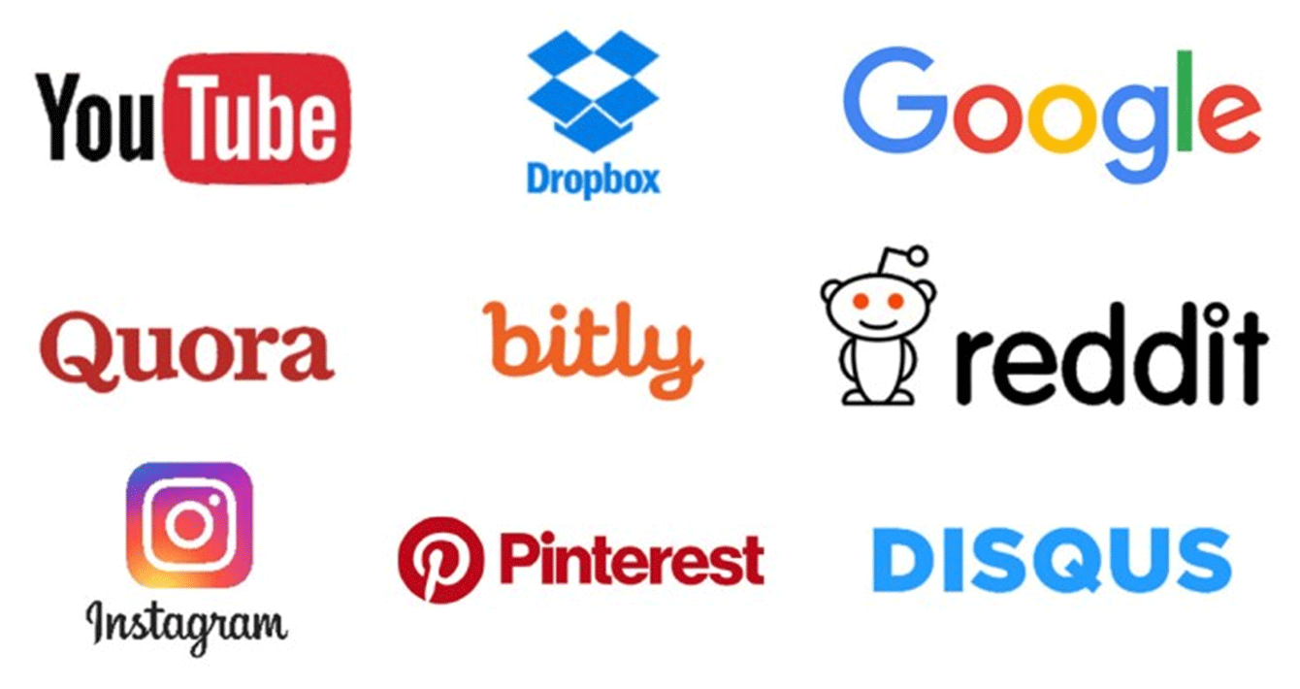
Companies using Django
:

Slide 11
Django Architecture
Django is based on MVT (Model-View-Template) architecture. MVT is a software design pattern for developing a web application
Model: Model is going to act as the interface of your data. It is responsible for maintaining data. It is the logical data structure behind the entire application and is represented by a database (generally relational databases such as MySql, Postgres).
View: The View is the user interface — what you see in your browser when you render a website. It is represented by HTML/CSS/Javascript and Jinja files.
Template: A template consists of static parts of the desired HTML output as well as some special syntax describing how dynamic content will be inserted.

Slide 12
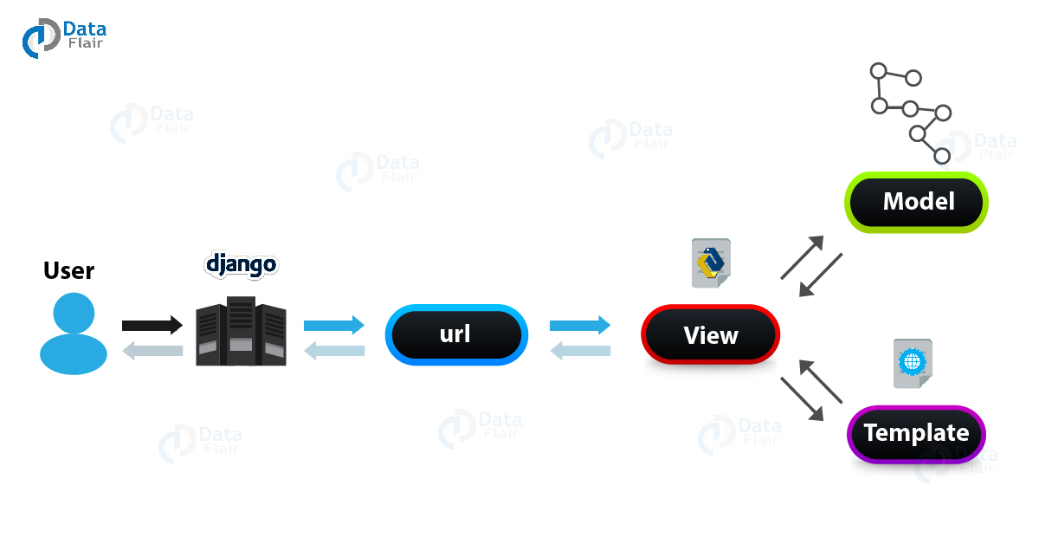
DJANGO MVC-MVT
The Model-View-Template (MVT) is a different concept compared to MVC. The main difference between these two architectural patterns is that Django itself manages the Controller part (software code that controls the interactions between the Model and View). The template is an HTML file which mixed with Django Template Language (DTL)
The developer provides the Model, the view and the template then just maps it to a URL and Django does the magic to serve it to the user.

Slide 13
Virtual Environment
Using virtual environments is not mandatory, but it’s highly recommended
Using virtual environments, each project you develop will have its isolated environment. So the dependencies won’t clash. It also allows you to maintain in your local machine projects that run on different Django versions.
We are going to use Python 3 because the most important Python libraries have already been ported to Python 3 and also the next major Django version (2.x) won’t support Python 2 anymore. So Python 3 is the way to go.
Its recommended to install virtualenv befor django

Slide 14
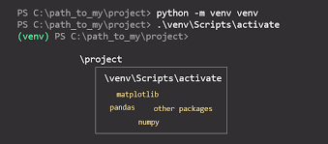
venv
If you are using Python 3.x, then you should already have the venv module from the standard library installed.
It is not for Python versions before 3.3.
It generates a configuration file that is directly understood by the Python binary and does not require copying the binary to a new location. Furthermore, it is being supported by Python developers.

Slide 15
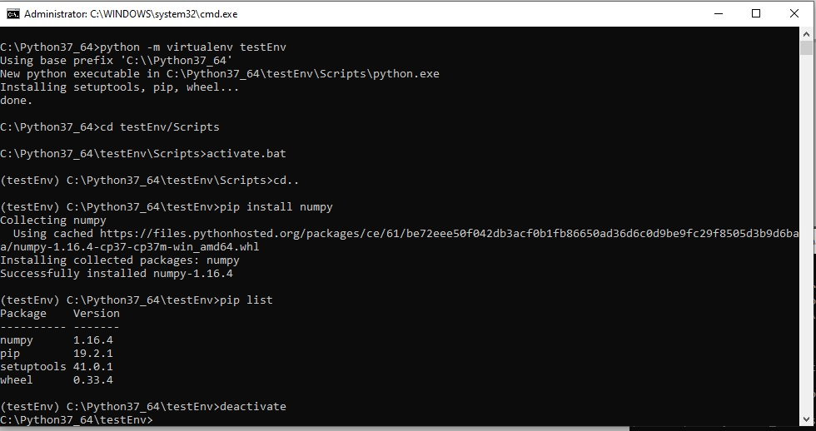
virtualenv
if you want to use this, you’ll have to install it separately as it does not come shipped with Python.

Slide 16
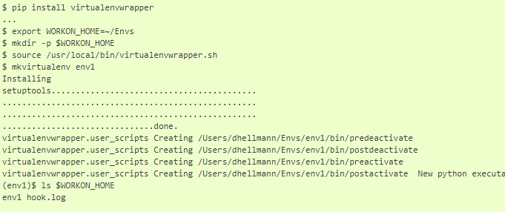
virtualenvwrapper
Wrappers for managing your virtual environments (create, delete, copy).
single command to switch between environments.
postmkvirtualenv is run when a new environment is created, letting you automatically install commonly-used tools.

Slide 17
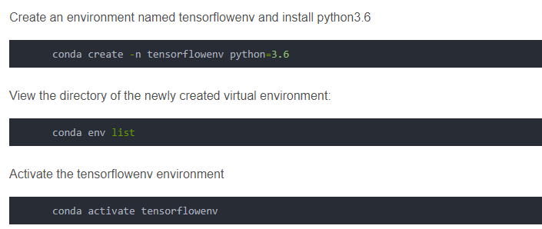
Conda

Slide 18
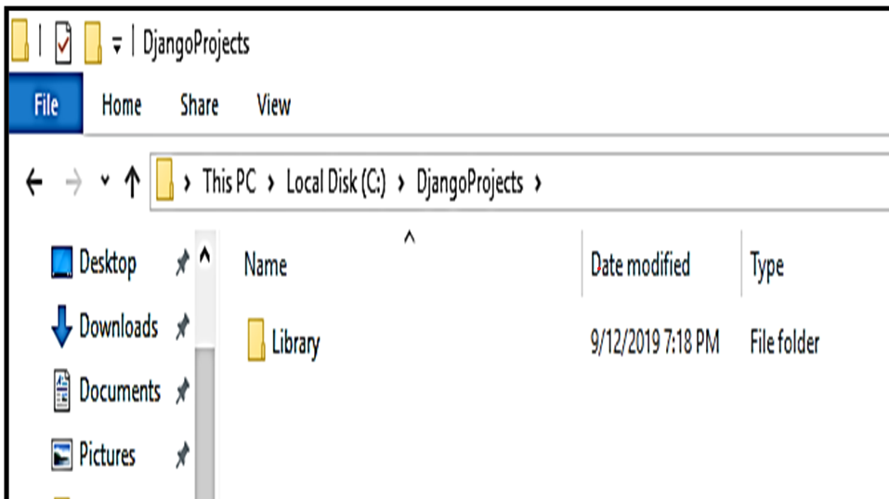
Create django project
Django-admin startproject libaray
This command creates the project folder

Slide 19
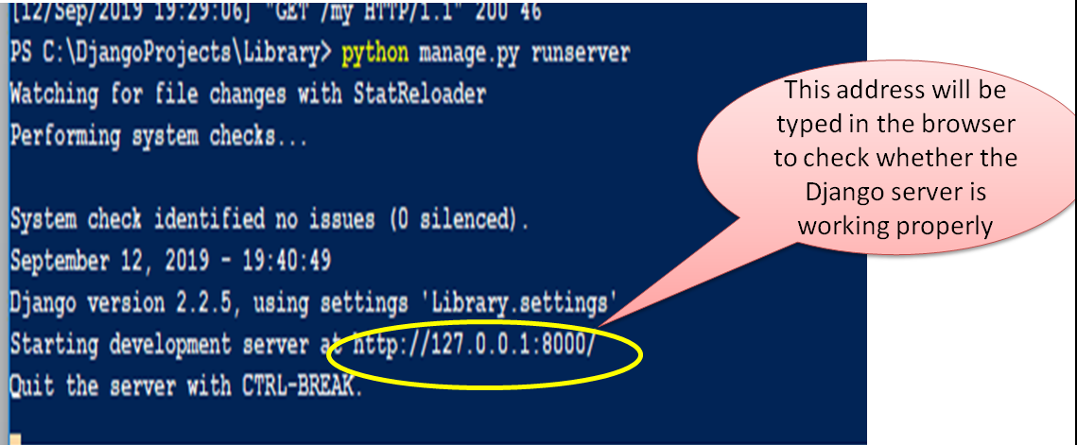
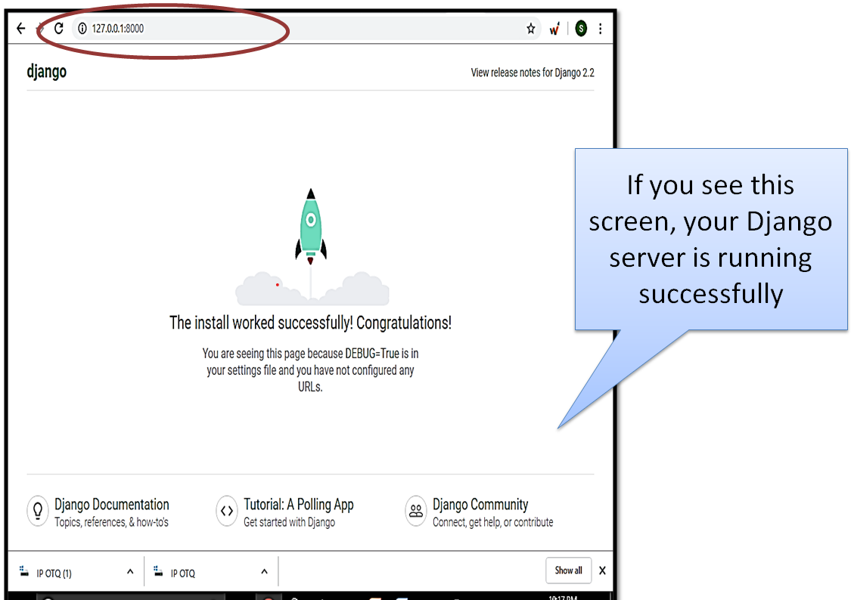
Verify Django server

Slide 20
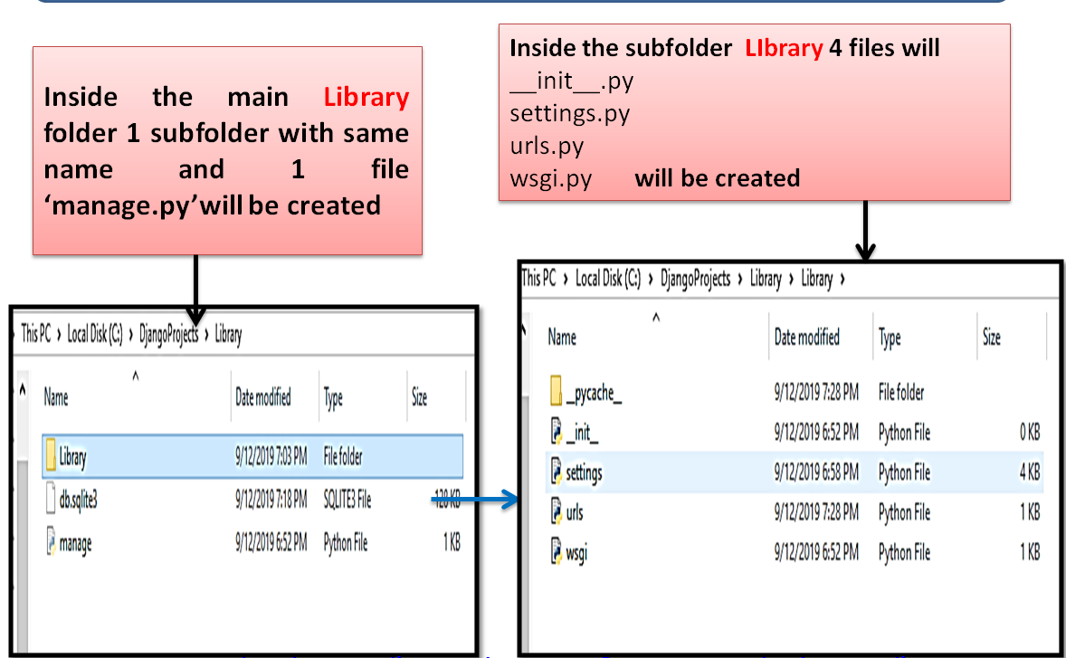
Project Folder Structure

Slide 21
Project File Details
Manage.py: Used to run dev. Server, run test, create migrations,etc., Its and command line utility
__init__.py: This empty file makes the python to consider this directory as a package
Settings.py: Contains configuration for the project
Urls.py: Management of URLs mapping to views.py
Wsgi.py : The Web Server Gateway Interface(WSGI), It is used to forward requests from a web server (such as Apache or NGINX) to a backend Python web application or framework.

Slide 22
Frequently used admin commands
Python manage.py startproject projectname – Creates Project
Python manage.py startapp applicationname – Creates application
Python manage.py createsuperuser – Creates super user
Python manage.py runserver – Starts django server
Python manage.py makemigrations – Create new migrations based on changes in models
Python manage.py migrate – Apply migration to database

Slide 23
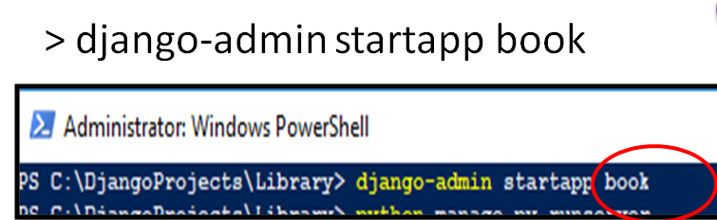
Create application
Firstly make sure django server is not running, then open Command prompt or powershell
Move to the project folder

Slide 24
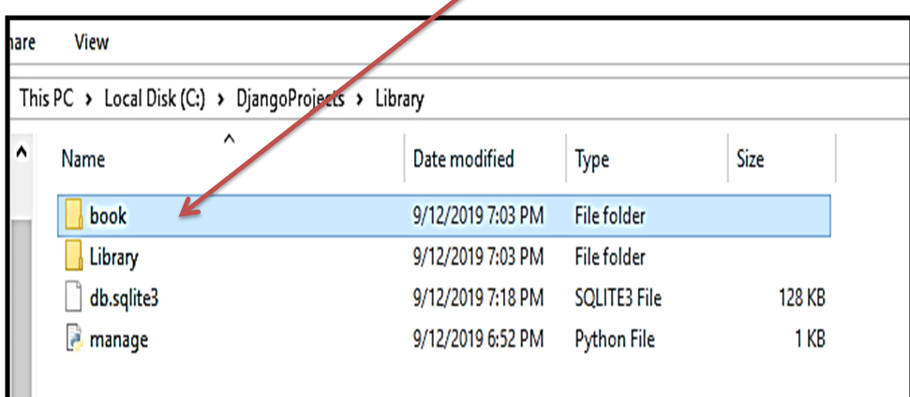
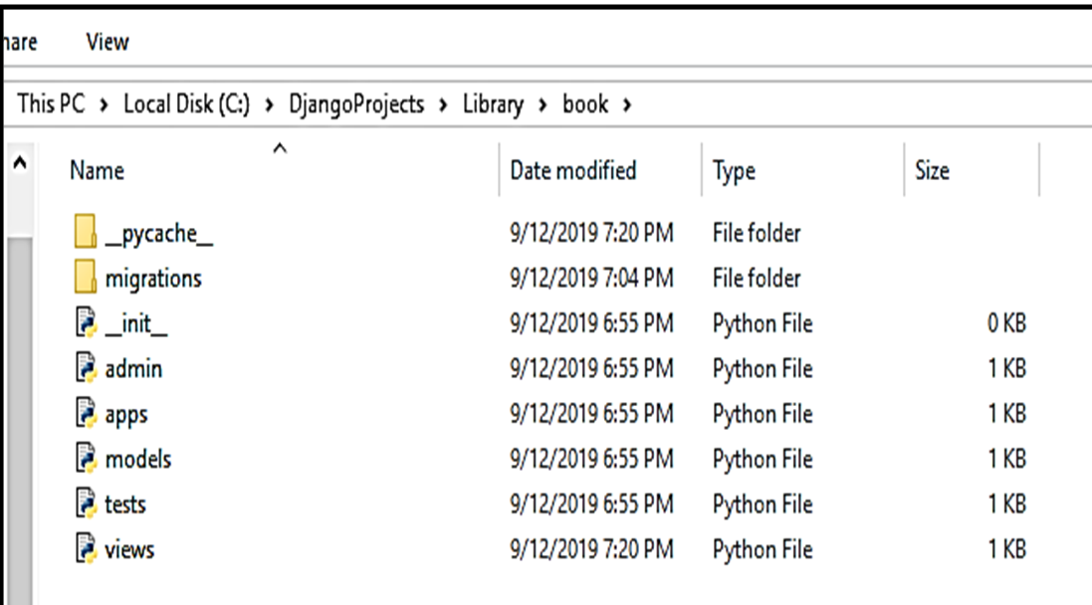

Slide 25
Application file details
Migrations/: This folder keep track of changes in models.py
Admin.py: configuration file for builtin app
Apps.py: configuration file of the current app
Models.py: define the entities of web application as models, automatically translated by django into database tables.
Tests.py: write unit test for app
Views.py: file where we handle request/response for web application

Slide 26
Object relational mapper
Django let us interact with its database models (I.e add,delete, modify and query objects) using database-abstraction API called ORM
We can access Django ORM by running the command inside our project directory
Python manage.py shell

Slide 27
Django template language
Django makes it possible to separate python and html . Python goes in views and html goes in templates. Link this two, django relies on render function and Django Template Language(DTL).
Django template engine offers DTL
Main characterisitcs of django Template language are Variables, Tags, Filters and Comments.
Template inheritance

Slide 28
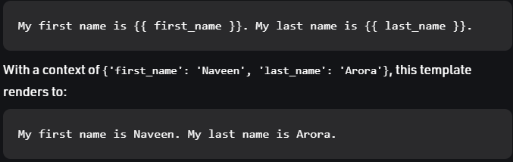
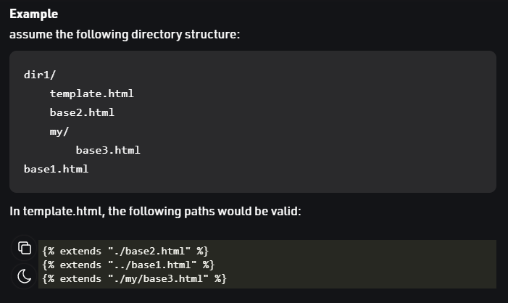
Variables outputs a value from the context, which is a dict-like object mapping keys to values.
Template Inheritance
Syntax: {% extends 'template_name.html' %}

Slide 29
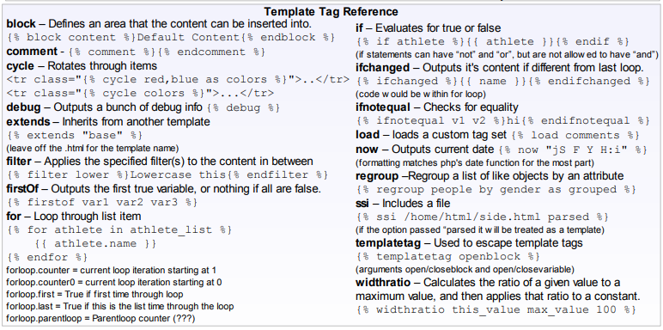

Slide 30
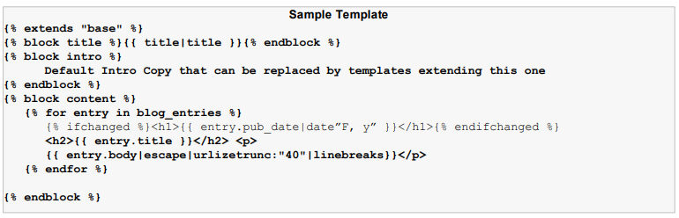

Slide 31
Advantages of Django
Object-Relational Mapping (ORM) Support − Django provides a bridge between the data model and the database engine, and supports a large set of database systems including MySQL, Oracle, Postgres, etc. Django also supports NoSQL database through Django-nonrel fork. For now, the only NoSQL databases supported are MongoDB and google app engine.
Multilingual Support − Django supports multilingual websites through its built-in internationalization system. So you can develop your website, which would support multiple languages.
Framework Support − Django has built-in support for Ajax, RSS, Caching and various other frameworks.
Administration GUI − Django provides a nice ready-to-use user interface for administrative activities.
Development Environment − Django comes with a lightweight web server to facilitate end-to-end application development and testing.

Slide 32
Disadvantages of using Django
A process cannot handle multiple requests simultaneously.
Django is a very much monolithic tool.
Components get deployed together which can create confusion.
Knowledge of full system needed to work on Django
Makes web application components tightly-coupled
You need to do lengthy programming for minor tasks

