Slide 1
Perth Hospitality Investment Opportunity
December 12, 2020

Slide 2
Overview
The presentation summarises analysis undertaken in order to determine which Perth CBD Suburb is prime for more hospitality investment.

Slide 3
Understanding the Scenario
Pandemic
The opportunity
Where to Invest??
Covid-19 has impacted the Perth tourism industry in 2020.
Before the pandemic
Over 4.7 million visitors travelled to Perth in the year ending June 2020
Majority are Domestic Overnight visitors staying in the CBD.
We are likely to see an explosion of visitors in 2022.
Identifying with Perth Suburb is best for new Hospitality investment

Slide 4
Project objective:
To determine which Perth City Suburb is best for new hospitality investment

Slide 5
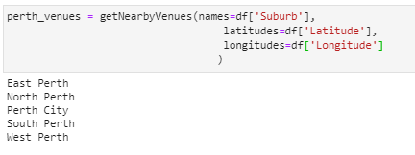
Perth Suburbs Surrounding the CBD

Slide 6
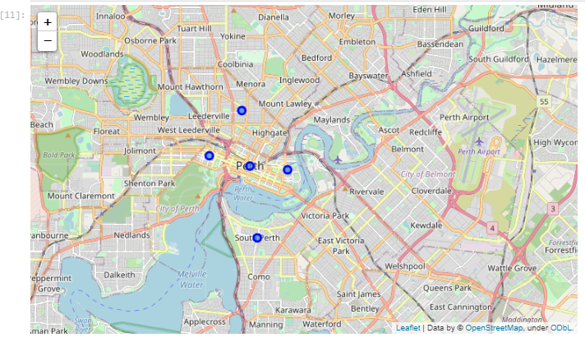
Perth Suburbs Surrounding the CBD

Slide 7
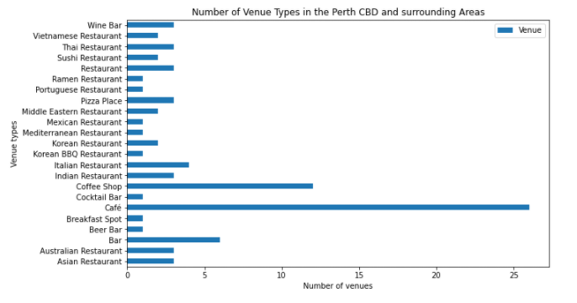
Perth Suburbs Surrounding the CBD - Venue Types

Slide 8
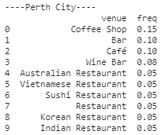
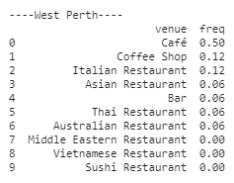
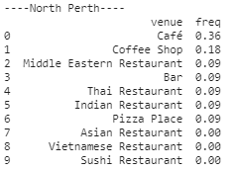
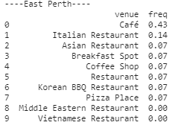
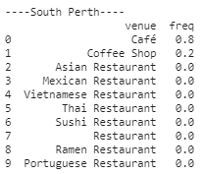
Top 10 Venues by Type
Most Diversity of venue type
Moderate Diversity of venue type
Low Diversity of venue type

Slide 9
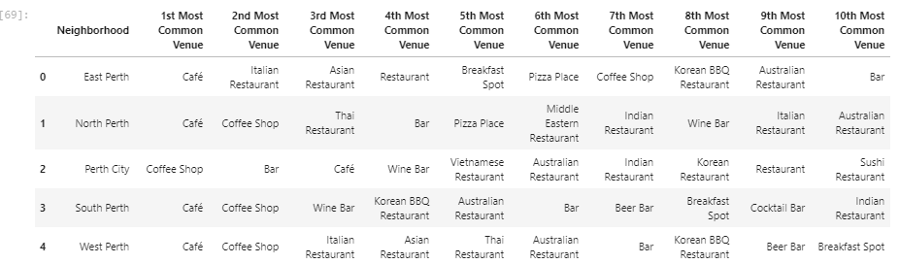
Most Common venue Type

Slide 10
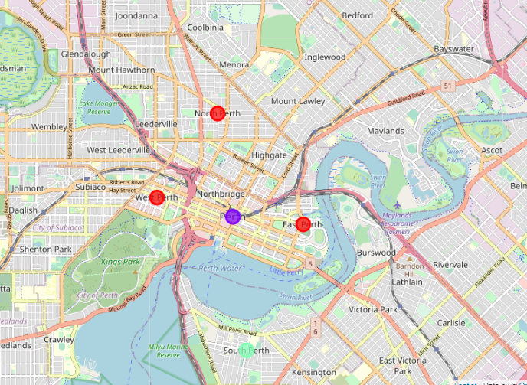
K-means Clustering of Suburbs
The Suburbs were Clustered into 3 distinct groups
Location | Venue Variety
East,North, West Perth | Moderate
Perth City | High
South Perth | Low

Slide 11
Conclusion
South Perth has the least variety in terms of hospitality venues. Investment for new Hospitality venue types should be directed to South Perth as a Priority.

