Slide 1
Tenniskönig
Tobias Fritz, Sven Haala, Marvin Kubik

Slide 2
Table of content
mbd

Slide 3
Vision
Blow up your motivation level to play tennis againt others
Compete againt others to be the best in this season
Have fun

Slide 4
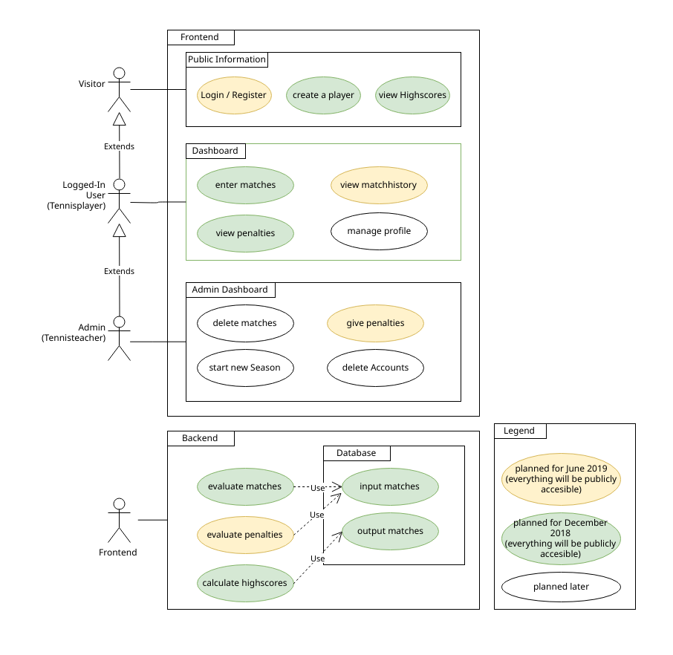
Scope - Usecases
Important:
Enter Match
View Highscore
Evaluate Mates
Calculate Highscore

Slide 5
Project Management
Scrumming with project management tool „Jira“
New Sprint every Week planned
Gives an overview:
Spent time
Tasks ToDo / in Progress / Done
Work history

Slide 6
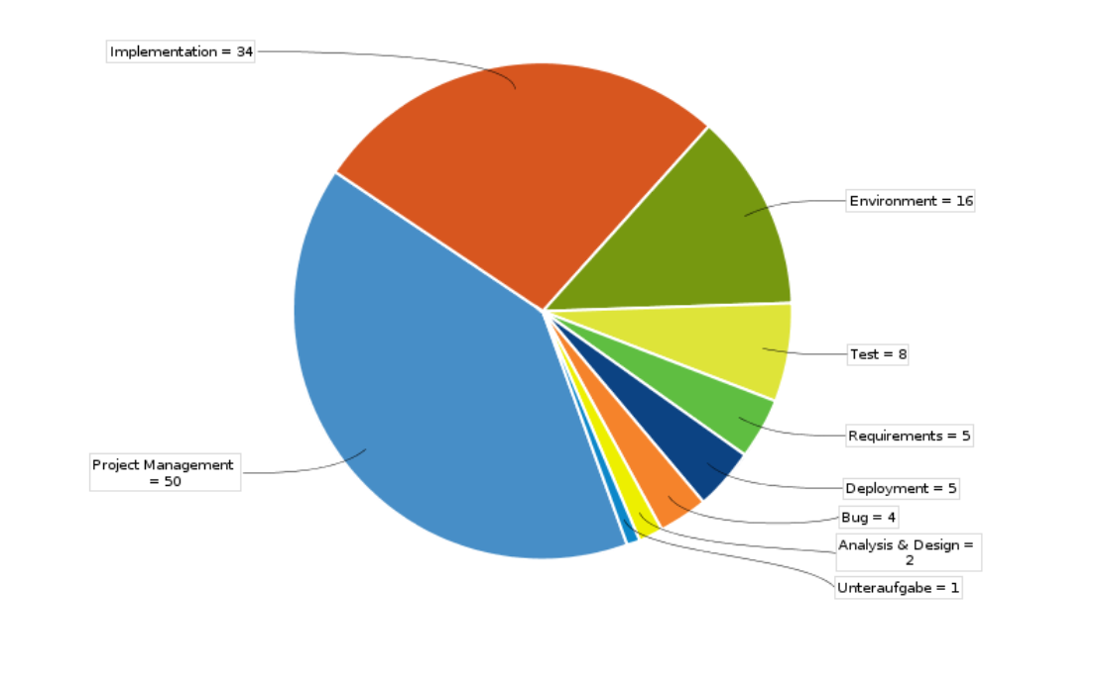
Issue Types

Slide 7
RUP
tbd

Slide 8
Project management
Time and task management system
Jira
Agile software development
Scrum
Document our progress for the world
Blogger

Slide 9



Technologie stack
Backend
Spring
Hibernate
MySQL
Frontend
tbd

Slide 10
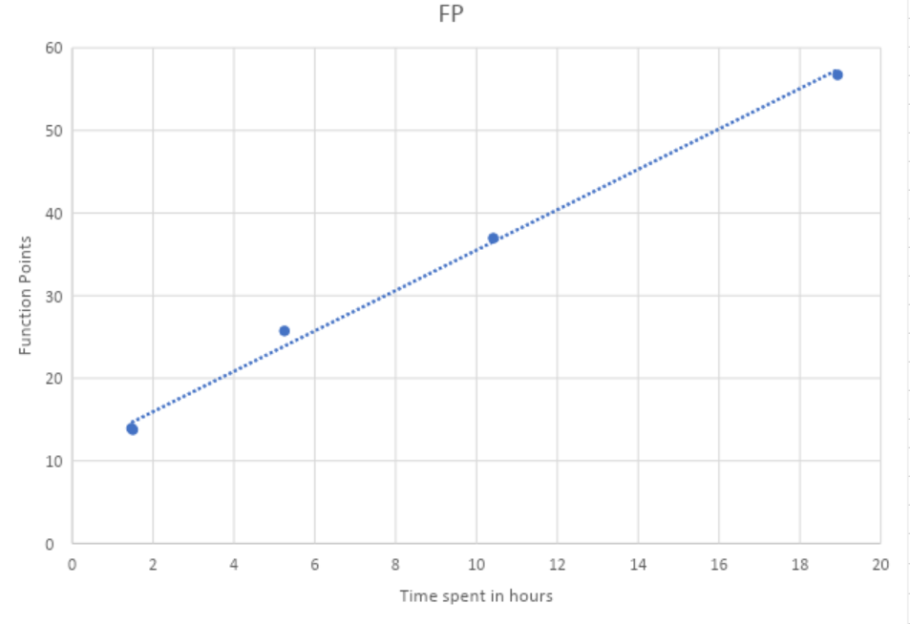
FP Time Estimation

Slide 11
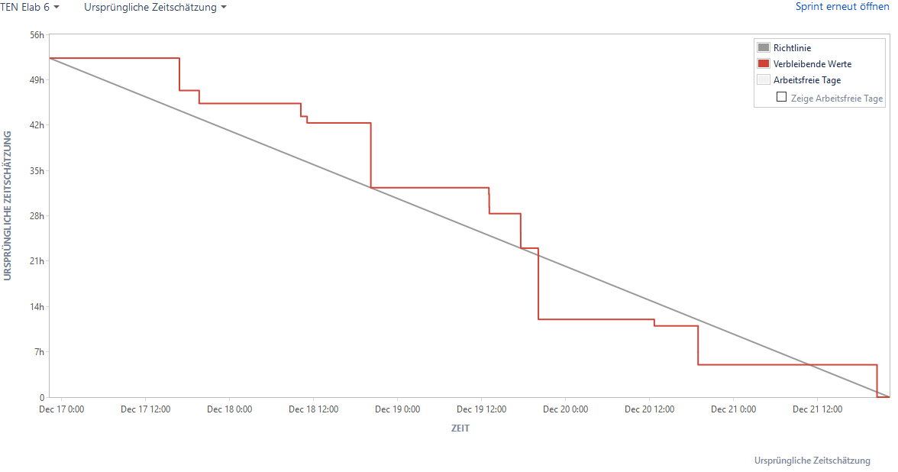

Slide 12
Testing
Unit Testing
Testing the functionality of individual functions
Functional Testing
Testing a complete functionality of the application
User Testing
Testing the usability

Slide 13





Continuous Integration
Development
Trigger
Deployment
Testing

Slide 14
Continuous Integration
Version Control
Github
Reproducible environment
Docker
Testing and Continous Integration
Junit
Travis CI

Slide 15
Risk Management

Slide 16
Architecture
tbd

Slide 17
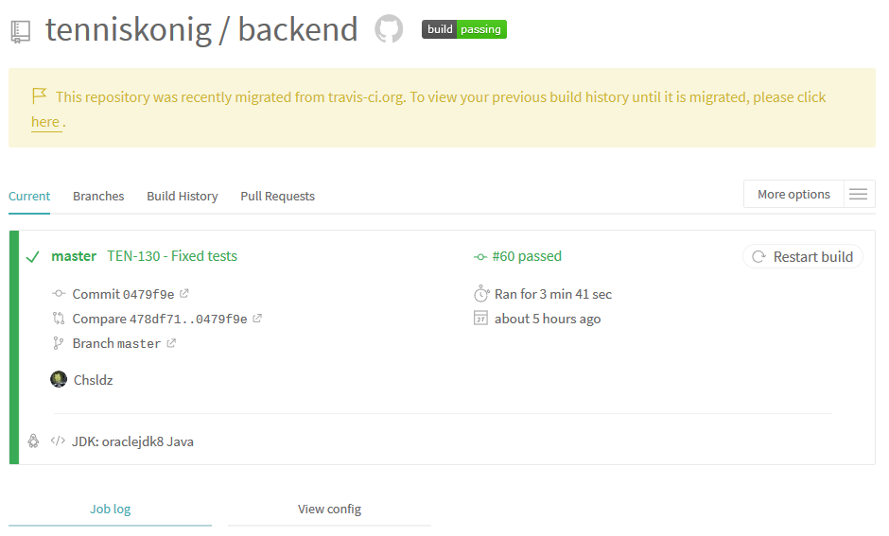
Travis CI

Slide 18
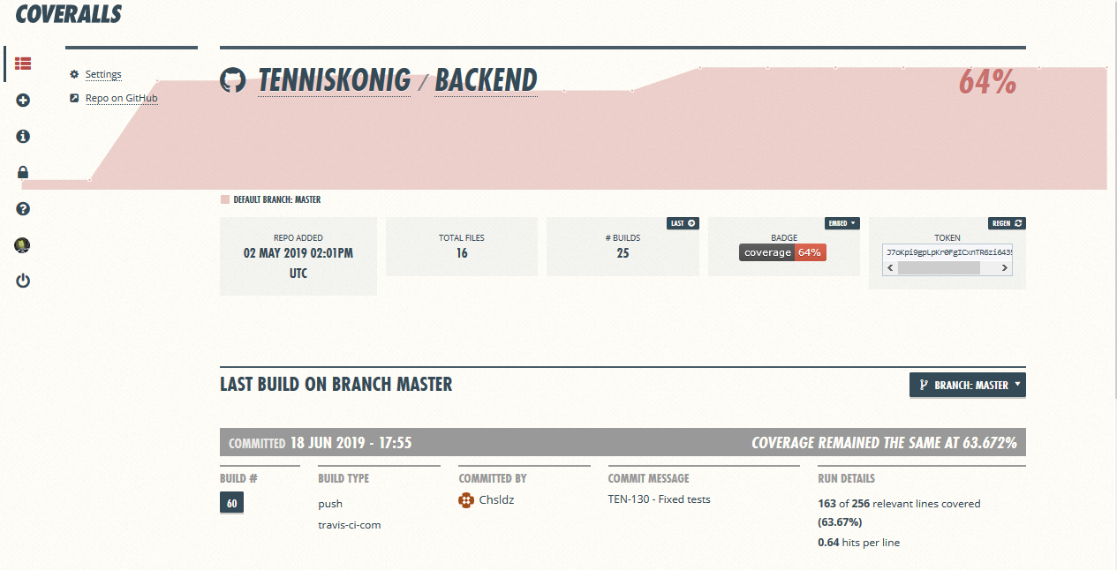
Metrics

Slide 19
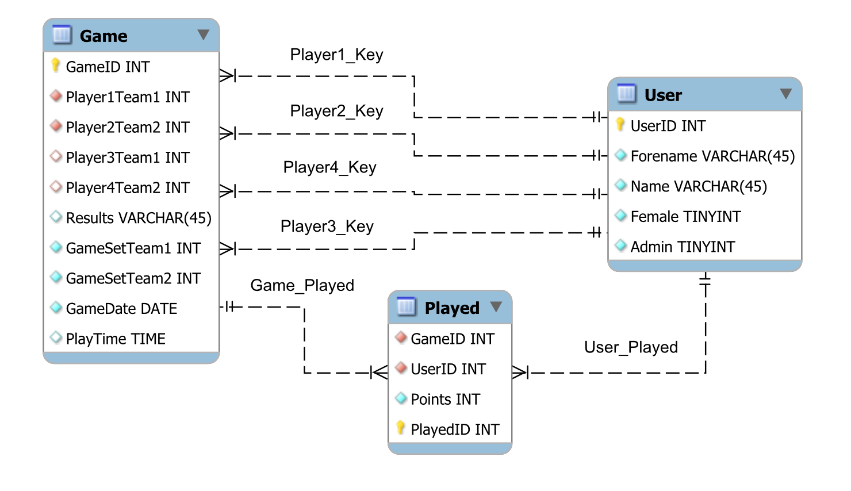
ERM-Model

Slide 20

Live Demo

Slide 21
Thanks for the attention
Your team tenniskönig is out!

