Slide 1
Tenniskönig
Tobias Fritz, Sven Haala, Marvin Kubik

Slide 2
Table of content

Slide 3
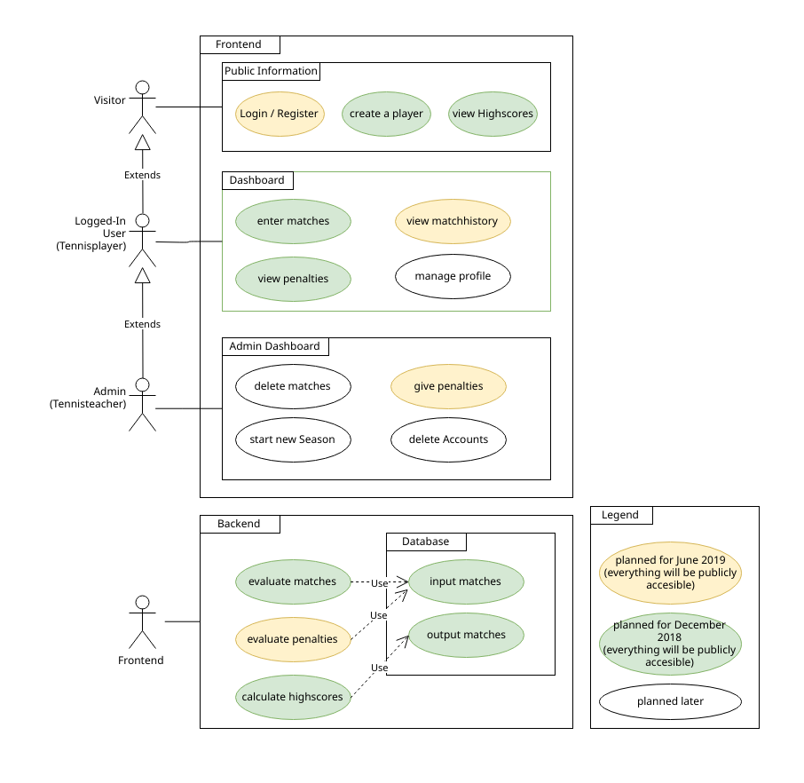
Scope - Usecases

Slide 4
Project Management
Scrumming with project management tool „Jira“
New Sprint every Week planned
Gives an overview:
Spent time
Tasks ToDo / in Progress / Done
Work history

Slide 5
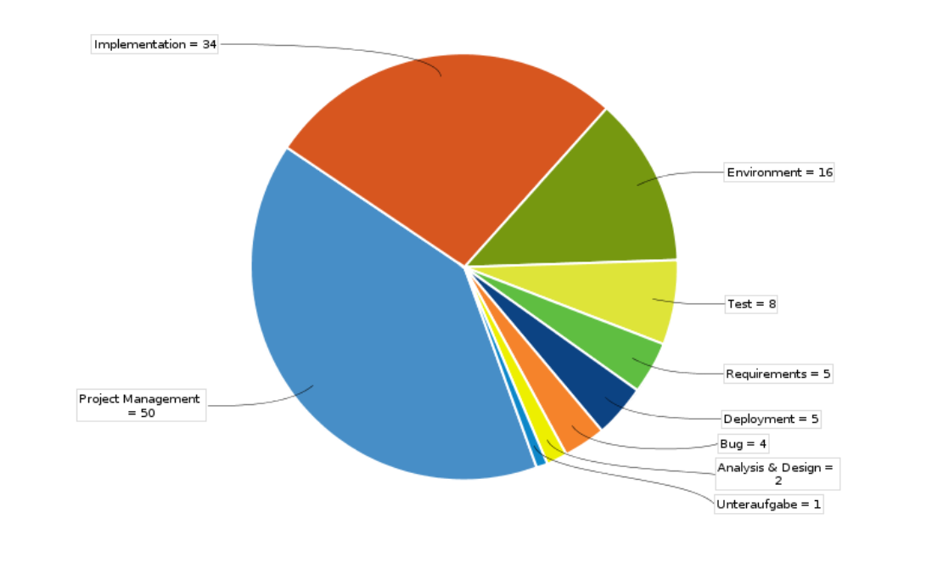
RUP

Slide 6
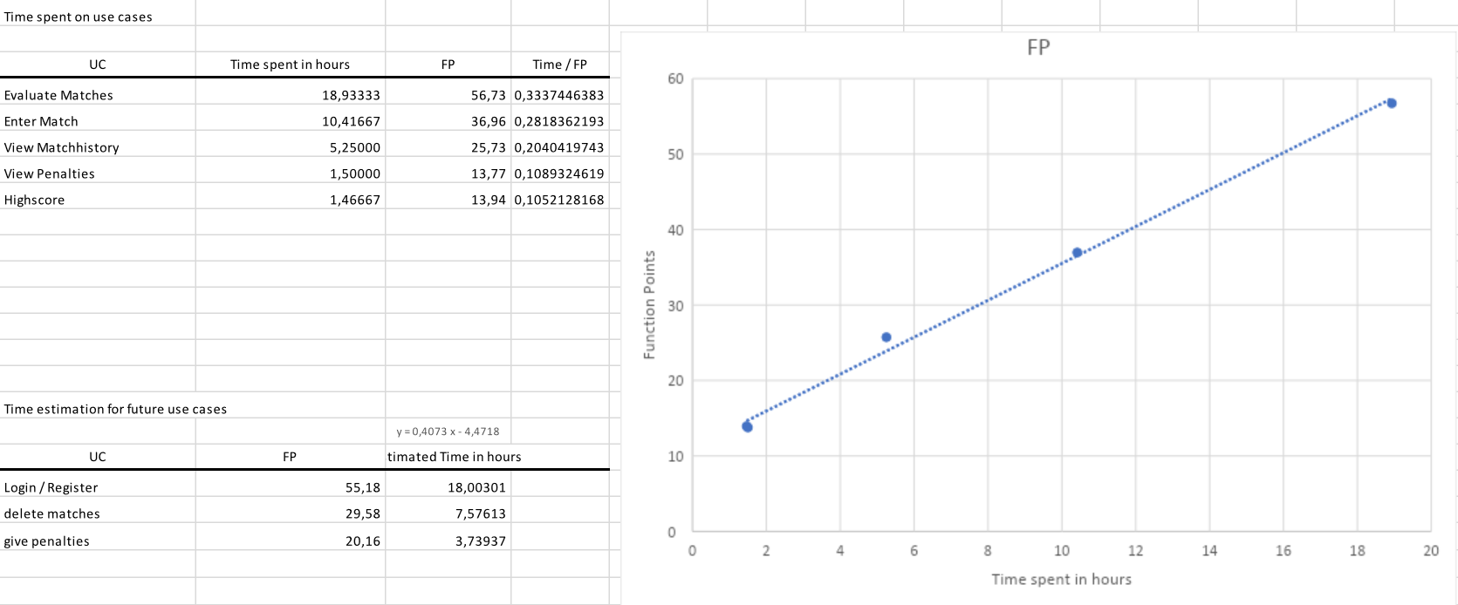
FP Time Estimation

