Slide 1


QuerySense
Venture Viability Analysis
Kongu Engineering College, Erode, Tamil Nadu

Slide 2

QuerySense
AI chatbot that understands incomplete queries and helps users access information easily.
Kongu Engineering College, Erode, Tamil Nadu

Slide 3
Context
Over 40% of users leave online systems when they cannot find information quickly.
3

Slide 4

Problem Statement
Problem
Digital systems fail to understand incomplete or unclear user querie making it difficult for people to quickly access important information online
Impact
Users struggle to find information online, while institutions face increased workload due to manual support and repeated queries.
4

Slide 5

Problem Statement/Industry
Problem Being Solved
In many online systems, users are requested to submit queries that are well-structured and complete in order for them to access information. However, users may submit queries that are either incomplete or poorly structured. This makes it impossible for the system to understand the query, and users may end up depending on humans
Supporting Data
Over 40% of users leave online systems when they cannot find information quickly.
Source: Gartner Customer Service and Support Survey Report
Area
DeepTech
Industry
Technology & Innovation
Domain
AI & ML

Slide 6



Problem Analysis
Affected Stakeholders
People who use online portals to access information as students, citizens, and customers will be impacted if the system fails to comprehend the queries due to incompleteness. Educational institutions and government agencies will also be impacted as they will have to resort to handling more manual queries.
Impact on Stakeholders
It becomes difficult for students and users to retrieve information from the system, and they get frustrated and end up wasting a lot of time. On the other hand, institutions and providers are affected by a high workload, with a large number of users requiring support, thus slowing down the delivery of information.
Root Causes
The use of specific keywords and structured queries is necessary for them to understand user queries. These systems are unable to understand queries that are partially given, ambiguous, and in natural language The systems inability to understand the context and their rigid nature make it hard for them to understand user intent
Personal/Team Connect
As students of technology and AI, we are aware of the challenges that come with retrieving information from a digital system when the queries are incomplete or unclear. Our group is interested in utilizing AI and machine learning to enhance user understanding by making information access more efficient.

Slide 7

Target Customer Segments
Primary
Students and young professionals who rely on online platforms to access information
Secondary
Educational institutions and organizations providing digital information services
5

Slide 8

Customer Segment & Persona
Primary Segment
Students and young professionals who rely on online platforms to access information
Persona
Secondary Segment
Educational institutions and organizations providing digital information services
Rahul Kumar Age in years: 22 Location: Other
Organizational Role: {Persona's
primary role}
(if applicable)

Slide 9
Customer Profile
Education: High school pass out
Gender: Male
Occupation: Student
Interests/Hobbies: Gaming and Entertainment
Primary Source of Information: Social Media
Shopping Preference: Hybrid Comfort with Technology: Medium Favourite Social Media: Instagram
Favourite Offline Gathering Spots: Parks

Slide 10

Jobs-to-be-Done
Functional JTBD
Access important information from online systems such as college portals, government websites, and service platforms quickly and easily without needing to enter perfectly structured queries.
Emotional JTBD
Feel confident and satisfied while using digital systems without frustration, confusion, or wasting time trying to get the correct information.
Social JTBD
Be able to quickly find accurate information and appear knowledgeable and efficient when interacting with peers, teachers, or colleagues.

Slide 11


Current Alternatives
Current Alternatives
Searching multiple websites, asking friends or classmates, contacting customer support, checking FAQs, or reaching out to help desks and staff for assistance.
Gaps in Current Alternatives
These methods are time-consuming, require extra effort, and often provide inconsistent or delayed responses.
Users still struggle to find accurate information quickly when their queries are incomplete or unclear.

Slide 12
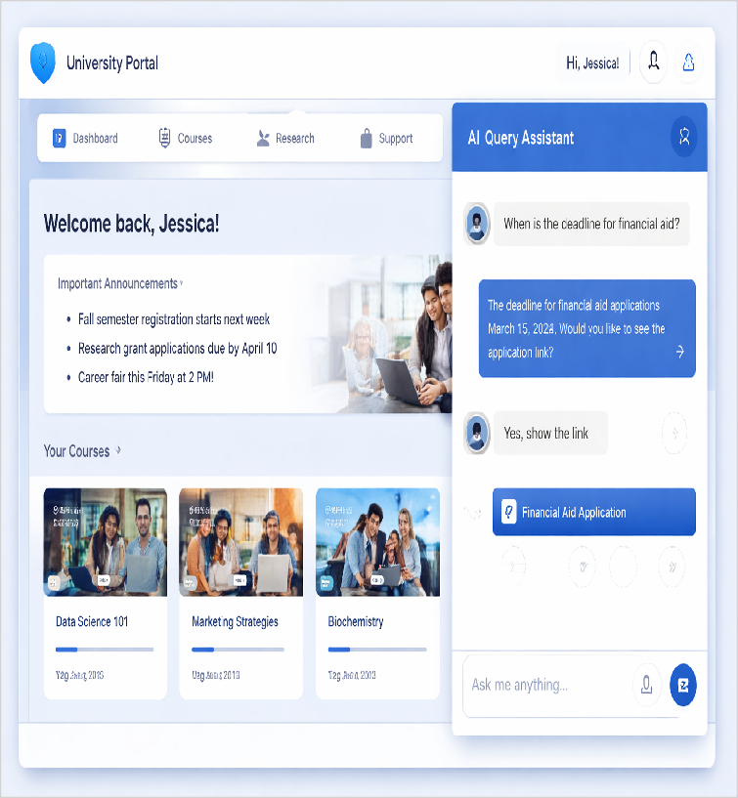
Our Solution
Solution
AI Query Understanding Chatbot – An AI-powered chatbot that can understand incomplete or poorly structured user queries and help users quickly retrieve accurate information from digital platform
Core Technologies/ Methodologies
React.js for the frontend, Node.js/FastAPI for the backend, MongoDB and Natural Language Processing with Machine Learning models
.APIs and transforms
6

Slide 13

Solution Design
Our Solution
AI Query Understanding Chatbot – An AI-powered chatbot that can understand incomplete or poorly structured user queries and help users quickly retrieve accurate information from digital platform
Key Features
AI chatbot that understands incomplete queries, detects user intent, asks clarification questions, and retrieves information quickly from digital platforms.
Uniqueness
Uses AI and NLP to understand incomplete queries, predict user intent, and provide accurate responses unlike traditional keyword-based systems.
Solution Format:
Digital Product and Digital Service
Core Technologies/ Methodologies:
React.js for the frontend, Node.js/FastAPI for the backend, MongoDB and Natural Language Processing with Machine Learning models .APIs and transforms

Slide 14

Solution Benefits
Functional Benefits
Quickly access accurate information from digital platforms, Get answers even with incomplete or unclear queries, Reduce time spent searching multiple websites, Simplify interaction with complex system
Emotional Benefits
Reduced frustration when searching for information, Greater confidence in using digital platforms, Feeling satisfied and supported while interacting with systems
Social Benefits
Users can quickly find information and appear knowledgeable among peers, Students and professionals can respond faster in discussions or tasks, Improved digital confidence in workplaces and education
Macro Benefits
This solution improves accessibility to digital information, reduces dependency on manual support, and increases efficiency in institutions and service platforms.

Slide 15


Competitors
Direct
Intercom AI chatbot, Drift chatbot, Zendesk AI chatbot
ChatGPT (OpenAI), Google Bard / Gemini, IBM Watson Assistant
Indirect
Website FAQ pages, customer support helpdesks, manual search engines
Google Search, Quora, Stack Overflow, Reddit communities
Our Uniqueness
Uses AI and NLP to understand incomplete queries, predict user intent, and provide accurate responses unlike traditional keyword-
7

Slide 16

Competitors
Direct Competitors
Intercom AI chatbot, Drift chatbot, Zendesk AI chatbot
Indirect Competitors
Website FAQ pages, customer support helpdesks, manual search engines
Direct Competitors Globally
ChatGPT (OpenAI), Google Bard / Gemini, IBM Watson Assistant
Indirect Competitors Globally
Google Search, Quora, Stack Overflow, Reddit communities

Slide 17
Macro Analysis
Favourable Trends
AREA | DESCRIPTION
Technology | Rapid growth of AI and NLP enables systems to better understand human queries.
Social | Increasing reliance on digital platforms for quick access to information.
Unfavourable Trends
AREA | DESCRIPTION
Legal | Stricter data privacy regulations may limit AI systems using user data.
Technology | Rapid tech changes may make AI systems outdated quickly.
Data Sources:
Gartner Artificial Intelligence Industry Report, 2023

Slide 18
Back-of-the-Envelope Financial Projections
Currency: Indian Rupee (INR)
Chosen Business Model: Subscriptions
AREA | YEAR 1 | YEAR 2 | YEAR 3
Revenues | 5400000 | 9720000 | 16324000
Total Expenses | 3200000 | 4479999 | 6048000
Profit | 2200000 | 5240000 | 10476000

Slide 19
Thank You!

