Slide 1
Detecting Freezing of gait in Parkinson’s patients
Vignesh Selvakumaran, MD

Slide 2
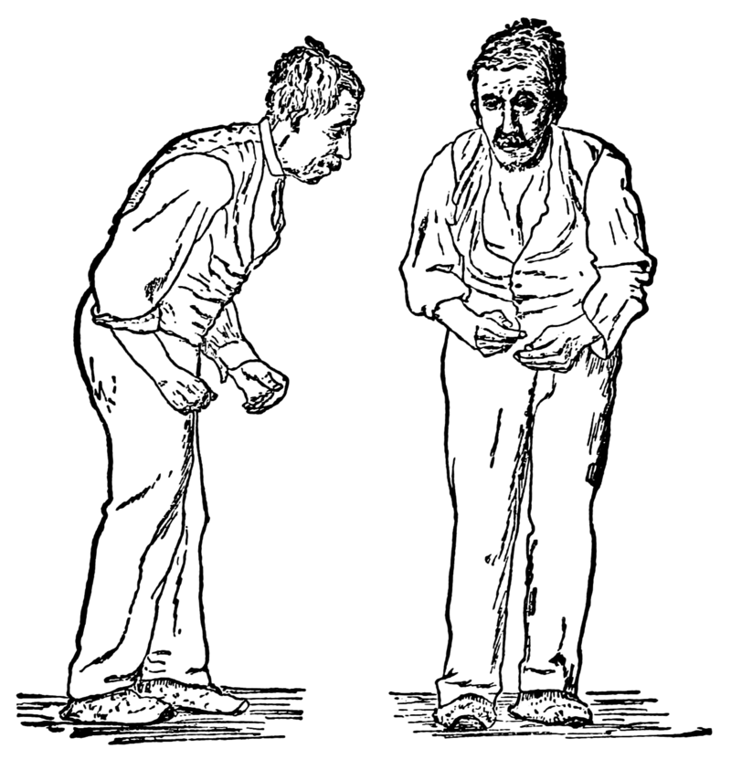
What is Parkinson’s?
Parkinson's disease affects millions and is a brain disorder
Most of the early and mid-stage symptoms center around motor control
Classic symptoms include tremoring of hands at rest, bradykinesia, rigidity and shuffling gait
Eventually symptoms get worse and develop into cognitive, psychosis, and neuropsychiatric symptoms
One of the symptoms patients may have is Freezing of Gait

Slide 3
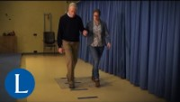
Freezing of Gait?
Patient’s describe it as “freezing of feet on the floor”
This particularly happens when turning or changing direction
Patient report them has debilitating and have adverse effects on their lifestyle, whether that’s being independent to a potential fall
Little research has been done around this, and the scientific community needs classifiers to label them to learn more

Slide 4
Classify FoG events (3 different types)
Goal

Slide 5
Goal
Data:
Kaggle Dataset:
Tfog
Defog
Daily Living
Method:
EDA- determine patterns
Feature Select/Engineering
Model Selection/Tuning
Performance

Slide 6
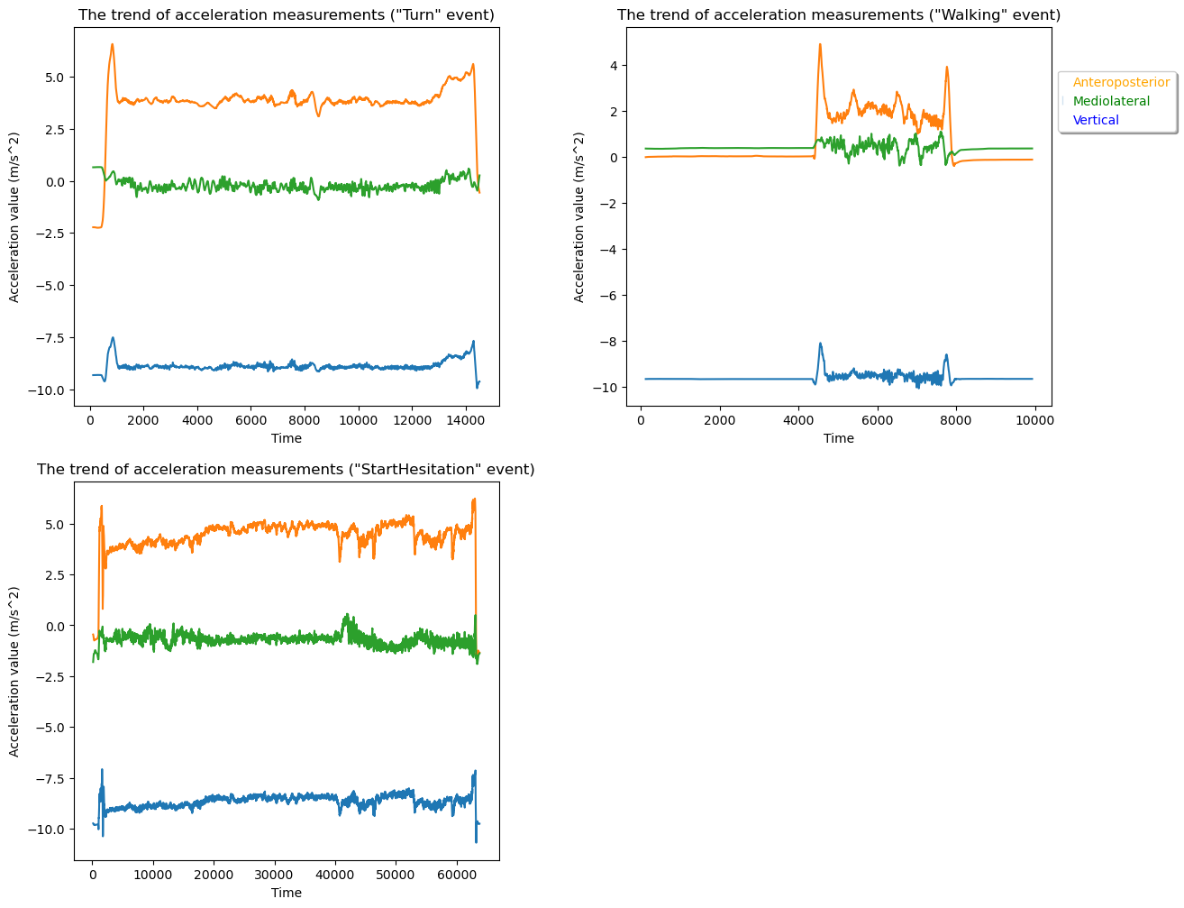
EDA
EDA
What does the data look like?
Different size, 3d accelerometer data
Patient subject data
What are the different data sets?
Different frequency data
Labelling differences
Noise/signal
Normalizing data
How do we adjust each sample size?

Slide 7
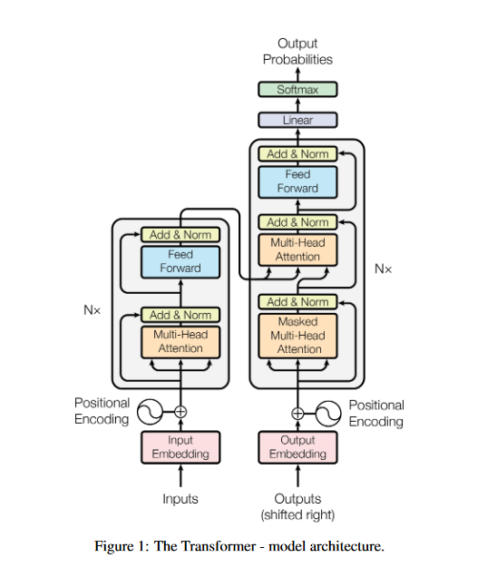
ModelS:
​Design
Supervised Multi-Labelled Classification Problem
Normalize around 0 accelerometer data (zero-padding)
Feature selection(accelerometer data, no subject data)
2 separate models for tfog and defog datasets
Transformer -> Bidirectional LSTM
Used K-stratified groups due to unequal sized labels to determine test set
Epoch = 32, performance = accuracy

Slide 8
Improvements
GPU vs TPU
Utilize Cloud TPU to decrease time
Difference Metric
We are concerned about minimizing Type II Error, or minimizing false negative (non-event), we could use a different metric like recall.
Event detection
Instead of multi-label, could simplify the model to event detection. We do not need to get all of the event, so long as we get the beginning
Combine Datasets
Could we utilize unsupervised learning with the additional datasets. Could we combine models?

Slide 9
THANK YOU
Vignesh Selvakumaran
vigneshselvakumaran@gmail.com
Thanks to Springboard and Mentor Branko Kovac

