Slide 1
Final Project Car Price Model
Diego Izaguirre

Slide 2
About the data
The dataset is collected from Kelly Bluebook based on 2005 General Motors cars.
There are a total of 804 observations with 10 independent variables.
The dependent variable I am investigating is price.
Note: one of the initial independent variables(Trim) was removed initially due to redundancy since another variable(Type) had the same description.

Slide 3
Features
Milage- The number of miles the car has been driven(Numerical).
Make- Manufacturer of the car (Qualitative).
Model- Model for each car manufacturer (Qualitative).
Type- Body type of the car (Qualitative).
Cylinder- The number of cylinders in the engine (Qualitative).
Liter- A measure of engine size (Numerical).
Doors- The number of doors (Numerical).
Cruise- Indicates if the car has cruise control; 1=cruise 0=no cruise
Sound- Indicates if the car has upgrades speakers; 1=upgraded 0=no upgrade
Leather- Indicates if the car has leather seats; 1=leather 0=no leather.

Slide 4
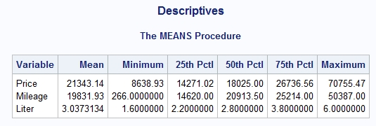
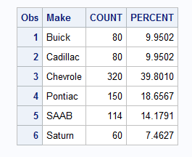
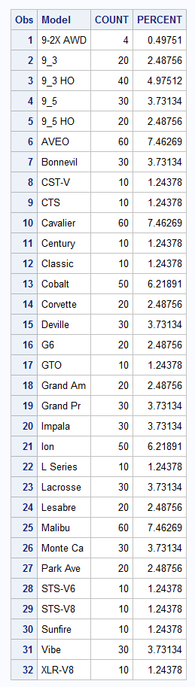
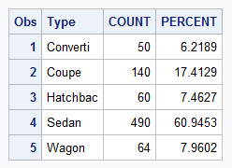
Data Exploration
First step is to look at descriptives.
Since we have mostly categorical and binary variables the only numerical variables, we can run these statistics on are Price Mileage and Liter.
For some of the categorical variables I opted to show the frequencies instead.
These help us understand the distribution of these variables better.

Slide 5
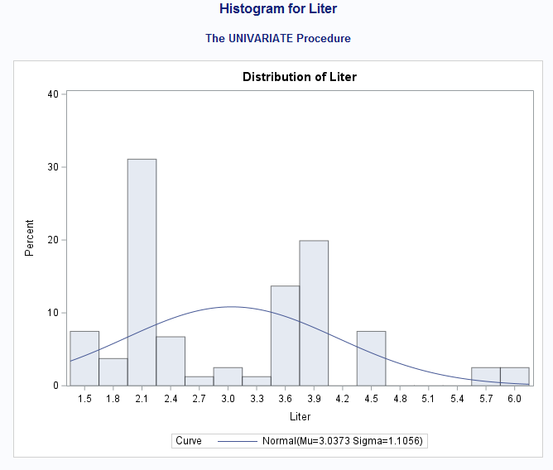
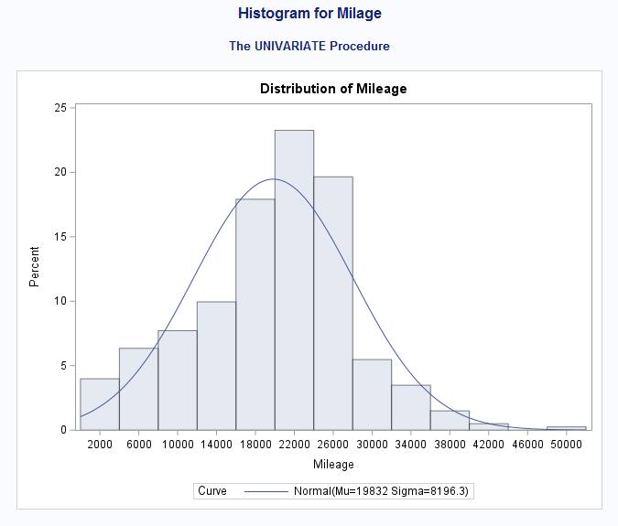
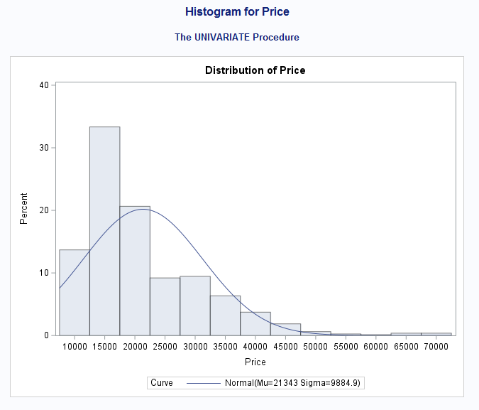
Distributions
Multi-Modal
~Normal
Right Skewed

Slide 6
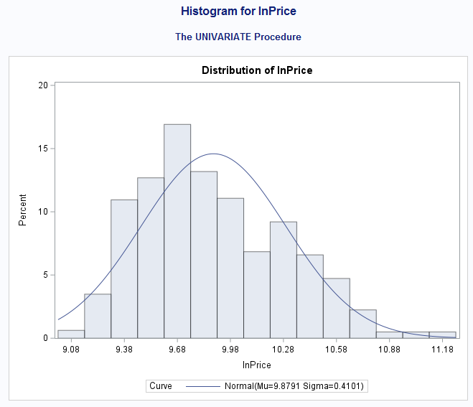
Looking at the distribution for price we see that it is right skewed.
After applying a log transformation on this we can get close to a normal distribution.

Slide 7
Issues with dimensionality
Because some of the variables have so many categories Making too many dummy variables will become an issue.
The model will not have enough observations to support the number of features.
Model and Make will be dropped in favor of Type in order to reduce dimensionality.

Slide 8
Dummy Variables
Type and doors need to be converted into dummy variables.
Type will be converted into 4 dummy variables
Type_Converti 1=true 0=false
Type_Coup 1= true 0=false
Type_Sedan 1=true 0=false
Type_Wagon 1=true 0=false
Hatchbac will be used as base level
Doors will be converted into 1 dummy variable
d_doors 1=4 doors 0=2 doors

Slide 9
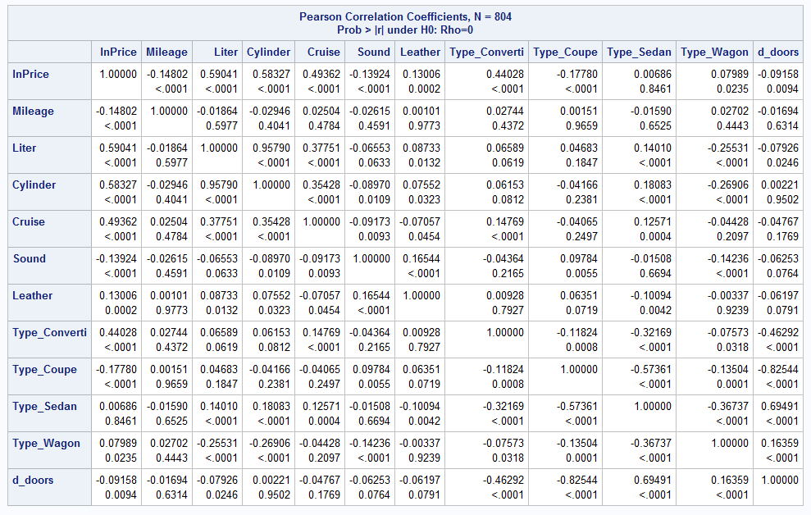
Correlation Matrix
The most highly correlated variables with price are Liter, Cylinder, Cruise, and Type_Converti.
There are a couple variables that may be collinear such as liter and cylinder which has a R value >0.90.

Slide 10
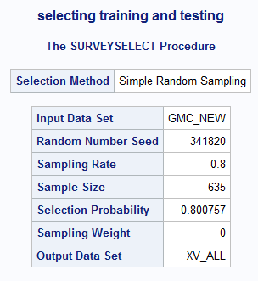
Training Testing Split
80/20 split on the dataset
80% training
20% testing

Slide 11
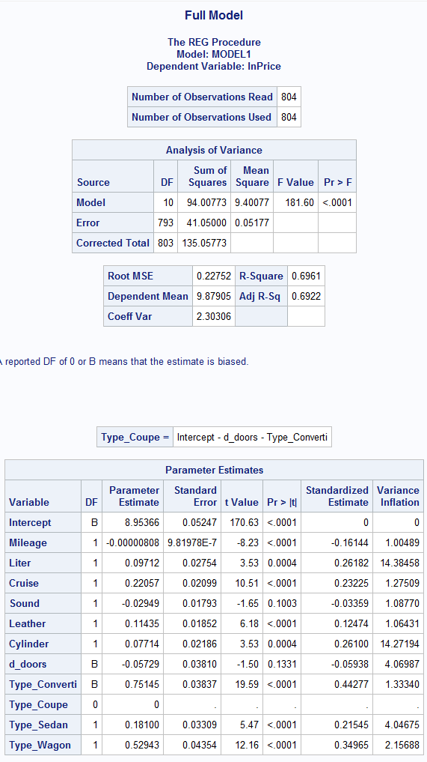
Full Model
After running a full model with the VIF statistic we see that Liter and Cylinder are indeed colinear.
Cylinder will be removed in favor of Liter because it has a slightly higher standard estimate value.
Something to note is that we still do not have enough observations for the number of features.
d_doors will be removed because it conflicts with coup, which also designates whether a car is 2 door or 4 door.
Note: Full model was run on training split from full dataset. 20% was set aside for testing.

Slide 12
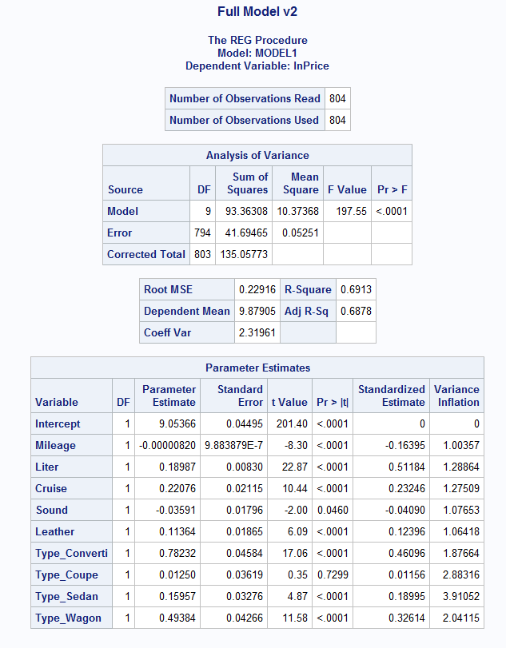
New Full Model
Now in the new model we have gotten rid of the multicollinearity, and we have an adequate number of variables

Slide 13
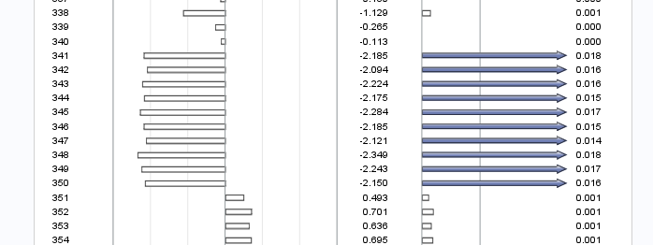
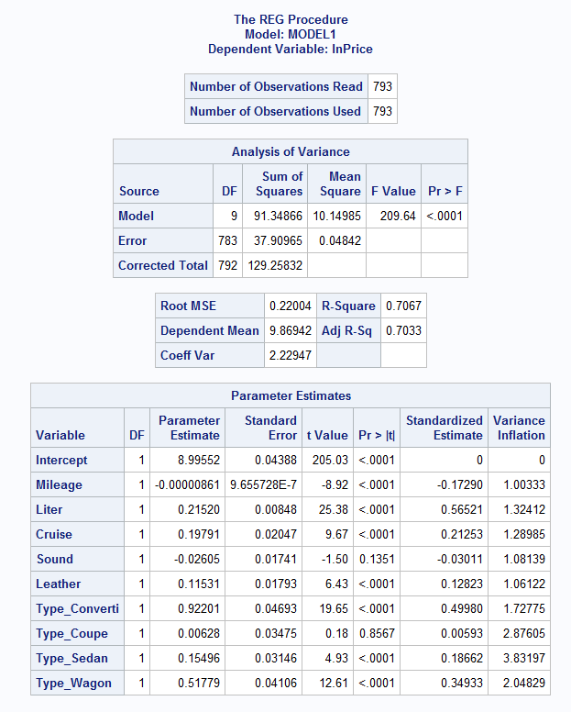
Outliers
After running the outlier and influential points statistics on the full model there were several outliers at observations 341-250 and 650.
Removal of these outliers saw a small increase in the adj-r^2 of the model as well as substantial increases in some of the effects of the parameter estimates.

Slide 14
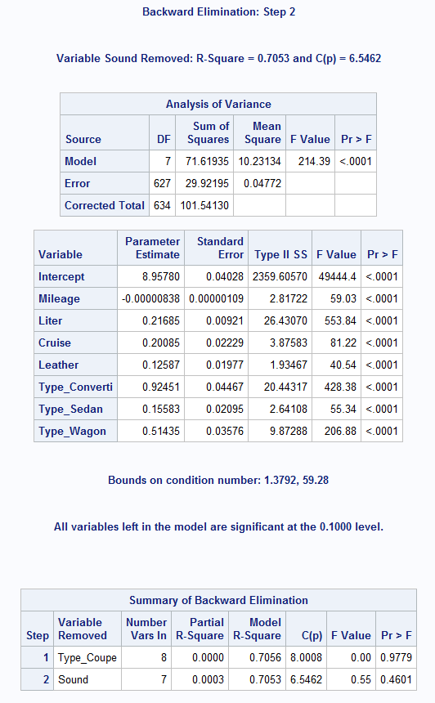
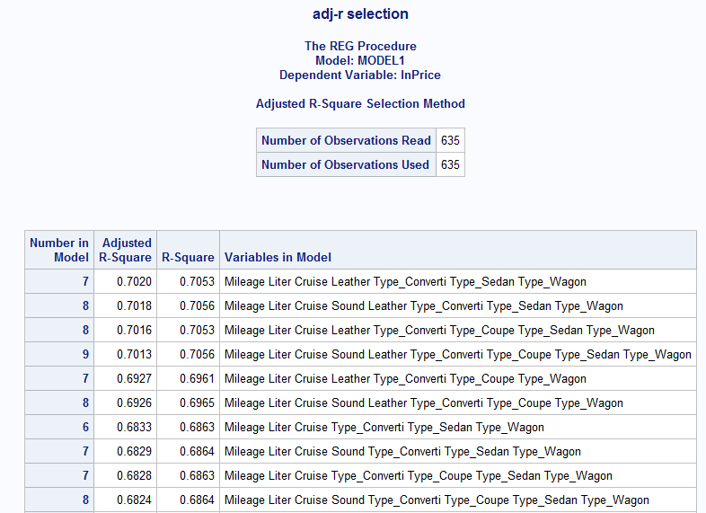
Model Selection
Backward
Adj-R^2

Slide 15
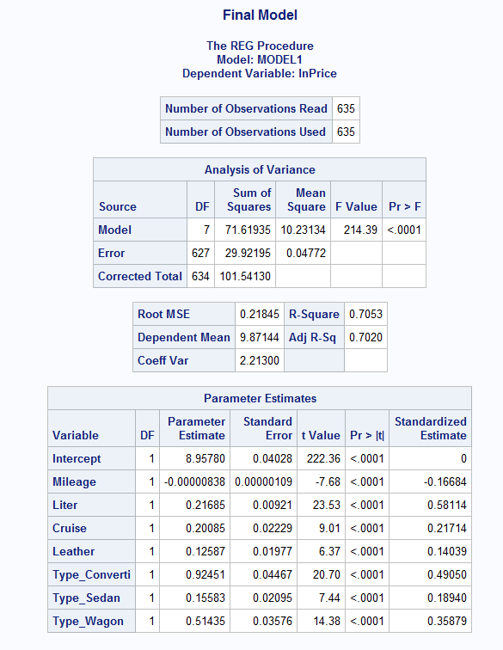
Final Model
After running two model selections I decided this was the best final model. It maximizes the adj-r^2 value while maintaining complexity low.
Type_Coup and Sound variables were dropped.
Since we applied a log transformation, we need to retransform these coefficient as shown below.
Model Equation
log(lnPrice)= 7767.248503 + Mileage* -8.37996489e^-6 + Liter*0.2421577645 + Cruise*0.2224413919 + Leather*0.1341347212 +Type_Converti*1.51559662 + Type_Sedan*0.1686275195 + Type_Wagon*0.6725509903

Slide 16
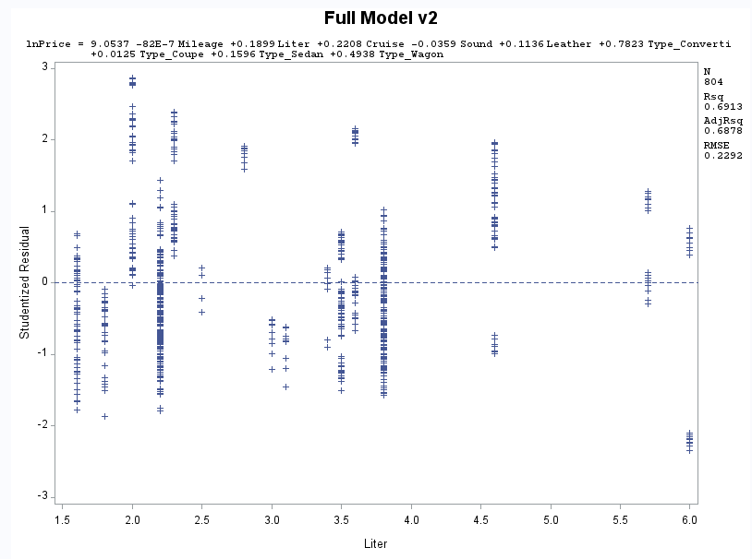
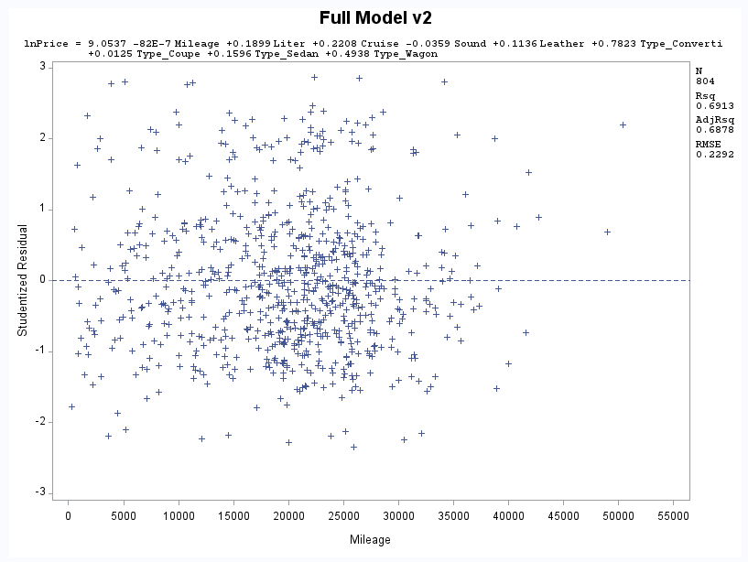
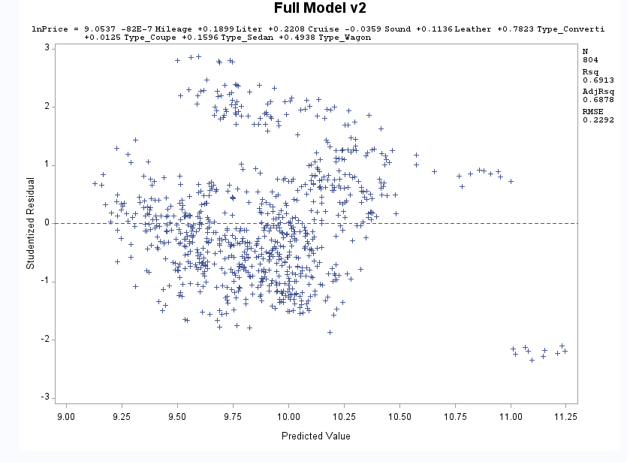
Residual Plots
Assume
Constant Variance
Independence
Linearity
Assume
Constant Variance
Independence
Linearity
Assume
Constant Variance
Independence
Linearity

Slide 17
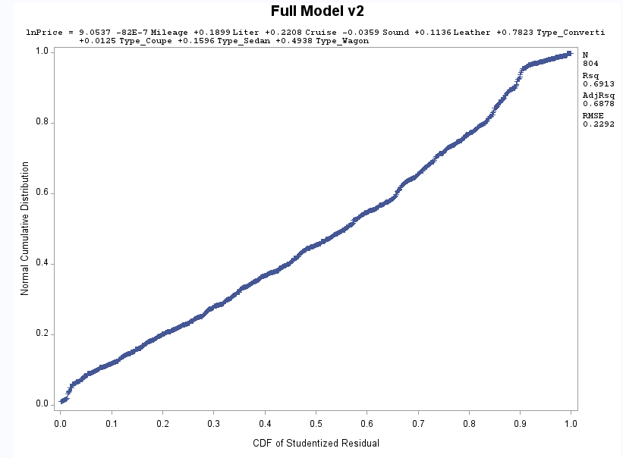
Quantile Plot
Assume Normality because this plot shows an approximately straight line.

Slide 18
Final Model Analysis
Adj-R^2: At a value of about 0.70 this means that my model explains about 70% of the variance in the data. Meaning it also fails to explain 30%.
Parameter Estimates
Mileage: This coefficient means that for 1 unit increase in Mileage there will be a -8.37996489e^-4% decrease in price. This indicates that for every mile the car is driven, the price will decrease slightly.
Liter: This coefficient means that for every 1 unit increase in Liter, there will be a 24.21577645% increase in price. So as engine size increase so does price.
Cruise: This coefficient means that if the car has cruise control, there will be a 22.24413919% increase in price. Else, there will be no increase in price.
Leather: This coefficient means that if the car has a leather interior there will be a 13.41347212% increase in price. Else there will be no increase.
Type_Converti: This coefficient means that if the car is a convertible there will be a 151.559662% increase in price.
Type_Sedan: This coefficient means that if the car is a sedan there will be a 16.86275195% increase in price.
Type_Wagon: This coefficient means that if the car is a wagon there will be a 67.25509903% increase in price.
Standard Estimates: The top 3 predictors of the price of a GM car appear to be Liter, Type_Converti, and Type_Wagon. This indicates that engine size and car type are the 2 biggest indicators of how expensive a car will be.
Goodness of Fit: F-Value = 214.39 with an alpha of 0.05 and a p value of <0.001, therefore we reject the null hypothesis and conclude the model is a good fit for the data.
RMSE: At a value of 0.21845 the error on this model is low when considered at the scale of the log transformation of the independent variable.

Slide 19
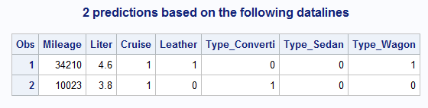
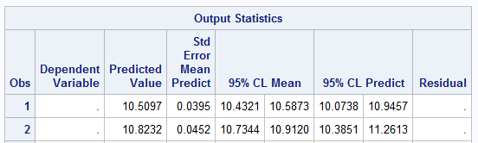
Predictions
Two predictions were done using the training set and the final model at the 95% confidence level.
These values need to be retransformed.
Prediction 1: $13489.94 with 95% certainty that the prediction lies within 12482.71 and 14578.45.
Prediction 2: $18457.01 with 95% certainty that the prediction lies within 16888.69 and 20170.97

Slide 20
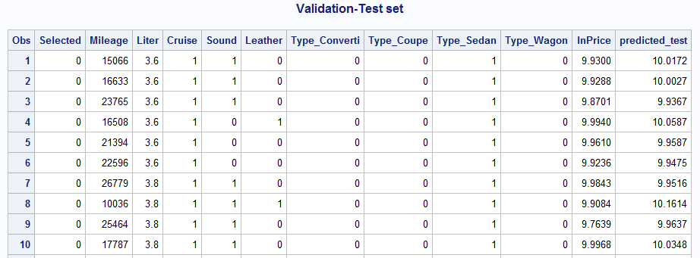
Testing Predictions

Slide 21
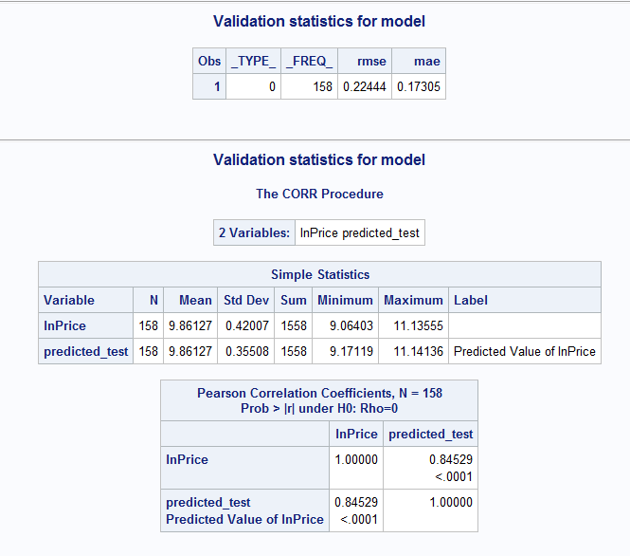
Model Validation Stats
CV-R^2 = 0.7053-0.8566=abs(-0.15)
No overfitting problem <0.3
But because there was better performance on testing perhaps there is an underfitting issue.
RMSE=0.22444
Low error
MAE=0.17305
Low absolute error
Adj-R^2= 0.8553

Slide 22
Training vs. Testing
Training
Testing
Adj-R^2: 0.7053
R^2: 0.7020
RMSE: 0.21845
GOF: ok
Residuals: ok
Adj-R^2: 0.8553
R^2: 0.8566
RMSE: 0.22444
MAE: 0.17305
CV-R^2: abs(-0.15)

Slide 23
Conclusion
The model is fairly accurate at predictions with low RMSE and MAE scores after cross validation.
Slightly better performance on testing, may indicate underfitting. But the difference is not staggering.
Overall, excellent model performance.
Some room for improvement
Highly dimensional dataset, not enough observations
Ideally all of them would be included at first, but more observations are needed in order to have a more complete initial model.

