Slide 1


Digital Spiking Neuron
Summer Internship 2024
Indian Institute of Technology, Ropar
Under the Supervision of
Dr. Devarshi Das
Harsh Gupta
Indian Institute of Technology, Bhilai
Date : 27-06-2024

Slide 2
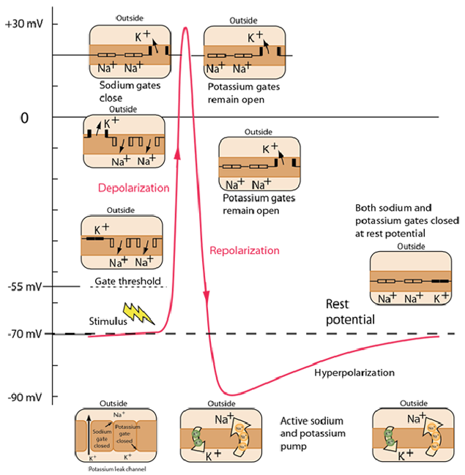
Spiking in Biological Neuron
[1]Reference : Goodman, Dan F. M., and Marcus Ghosh. ‘Neuroscience for Machine Learners’. 12 December 2023. https://doi.org/10.5281/zenodo.10366802.

Slide 3
Spiking Neuron Models
Complex
Simple
Hodgkin-Huxley(HH) model
Izhikevich (IZH) model
Leaky integrate and Fire (LIF)

Slide 4
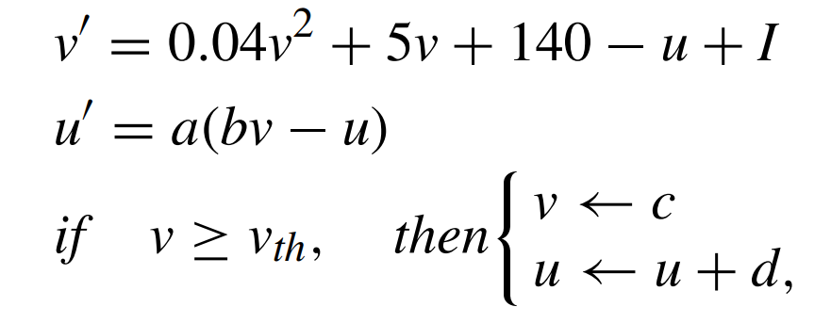
IZH Model
where v is membrane potential and u is recovery variable
[2] E.M. Izhikevich. Simple model of spiking neurons. IEEE Transactions on Neural Networks, 14(6):1569–1572, 2003.

Slide 5
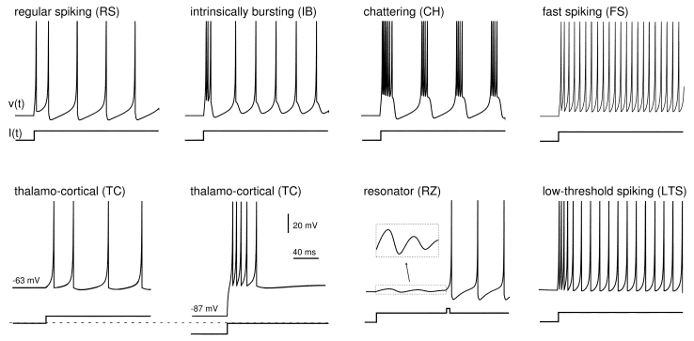
Different Spiking pattern produced by IZH Model
[2] E.M. Izhikevich. Simple model of spiking neurons. IEEE Transactions on Neural Networks, 14(6):1569–1572, 2003.

Slide 6
Problems with IZH for Digital Implementation

Slide 7
Problems with IZH for Digital Implementation
Multiplier
Quadratic Equation

Slide 8
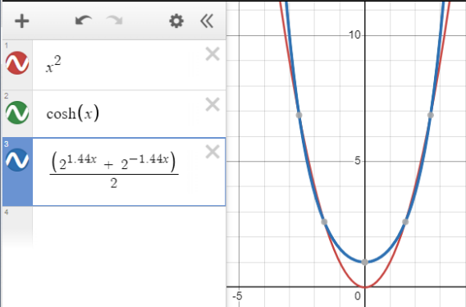

Solution in the reference paper
Estimating the v² with cosh and
[3] Junran Pu, Wang Ling Goh, Vishnu P. Nambiar, Yi Sheng Chong, and Anh Tuan Do. A low-cost high-throughput digital design of biorealistic spiking neuron, 2021.14

Slide 9

Discretizing the System

Slide 10
Parameters
 | Actual Values | Modelled Values
k1 | 380 | 380
k2 | 0.0145 | 0.015625
k3 | 62.5 | 70
k4 | 396.25 | 396

Slide 11
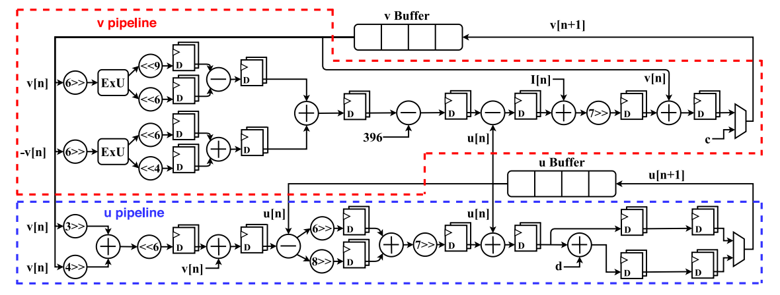
Block Diagram given in the paper

Slide 12
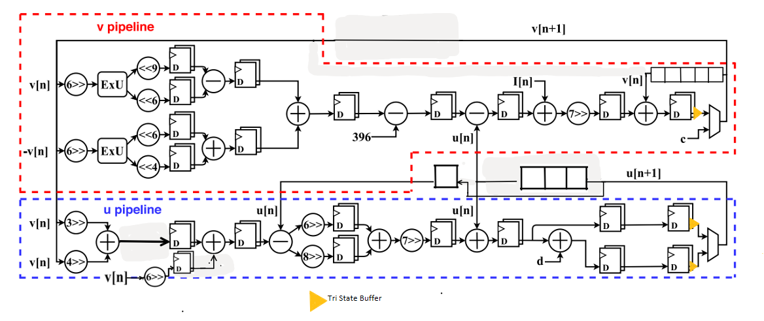
Block Diagram of Digital Implementation

Slide 13

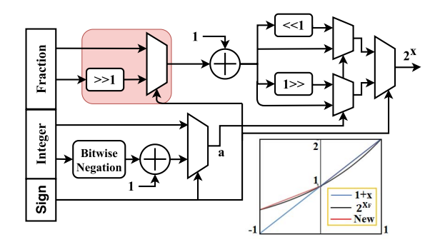
Exponential Block

Slide 14
Number Representation
2’s complement representation for signed number
21 bits for storing number, 9 bits for fractional part, 12 bits for integer part

Slide 15
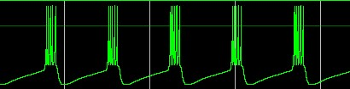
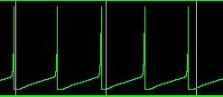
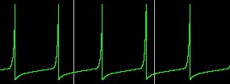
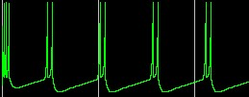
Vivado Simulation Results
_{30 mV}
Chattering Regular Spiking(Time period = 48µs)
Fast Spiking(Time Period = 25 µs) Intrinsically Bursting
_{-80 mV}

Slide 16
a, b, c, d parameters
 | a | b | c | d
Regular Spiking | 0.01953125 | 0.203125 | -80 | 15
Fast Spiking | 0.01953125 | 0.203125 | -80 | 7.25
Chattering | 0.01953125 | 0.203125 | -56 | 4.75
Intrinsically Bursting | 0.01953125 | 0.203125 | -61 | 8.5

Slide 17
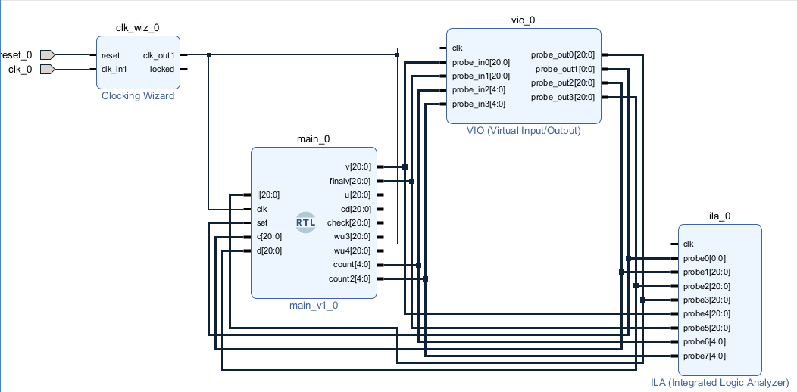
Hardware Verification
To verify that the design is synthesizable and shows expected behaviour we can use VIO and ILA

Slide 18
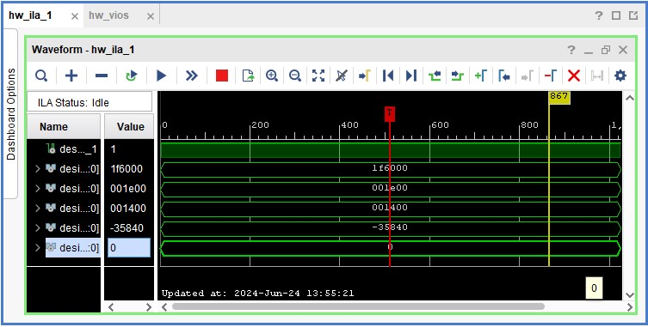
Hardware Verification
We start with set = 1
When set = 1, v is initialized with -70mV

Slide 19
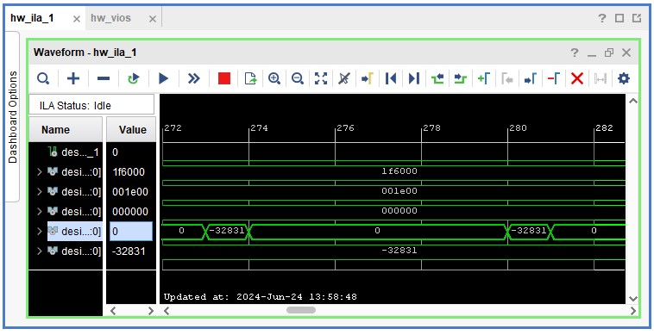
Hardware Verification
When current is 0, voltage is constant, that is (-32831^2(-9) = -64.1 mV)

Slide 20
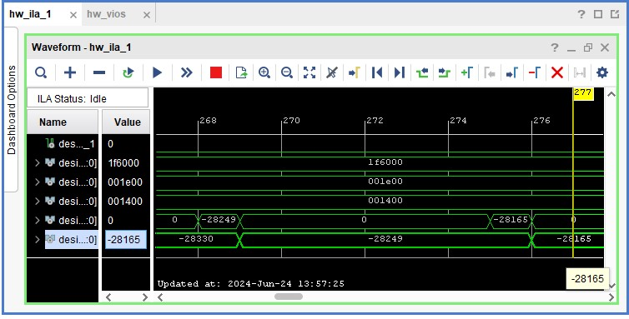
Hardware Verification
When there is current

Slide 21
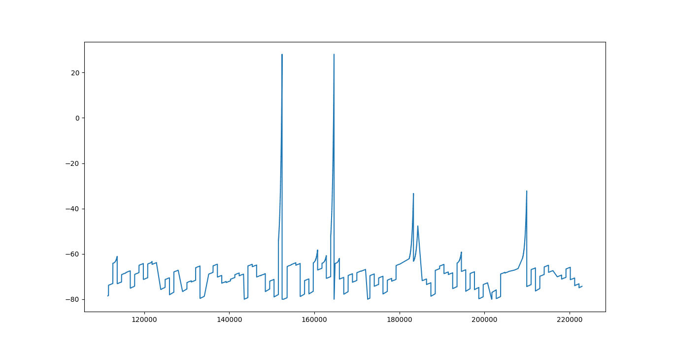
Hardware Verification using data collection
v(membrane potential in mV)
Data Samples

Slide 22
Reference
[1]Reference : Goodman, Dan F. M., and Marcus Ghosh. ‘Neuroscience for Machine Learners’. 12 December 2023. https://doi.org/10.5281/zenodo.10366802.
[2] E.M. Izhikevich. Simple model of spiking neurons. IEEE Transactions on Neural Networks, 14(6):1569–1572, 2003.
[3] Junran Pu, Wang Ling Goh, Vishnu P. Nambiar, Yi Sheng Chong, and Anh Tuan Do. A low-cost high-throughput digital design of biorealistic spiking neuron, 2021.14
Code Repository
https://github.com/tensionTaker/DigitalNeuron_v2

