Slide 1
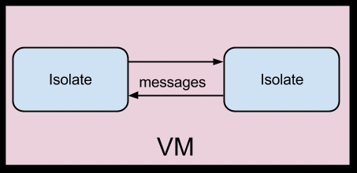
Isolates and Dependency Injection

Slide 2
What are Isolates
Dart’s version of Threads or Actors
Based on the Erlang/Elixir Actor Model
They are Isolated Processes
Does not Share Memory
Makes use of Ports and Messages to Communicate with other Isolates

Slide 3
What is Dependency Injection
A pattern that allows for passing of dependencies for external sources
Allows you to easily swap like-dependencies
Useful for changing small elements of a program
In Flutter often used for Mock and Production Data sources
Makes use of a singleton and a factory constructor

