Slide 1
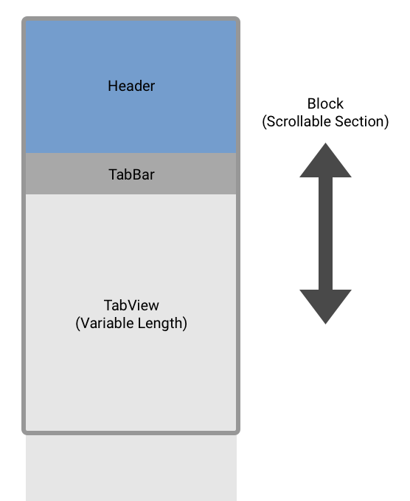
Slivers in Flutter

Slide 2
What is a Sliver
Is a Slice of the view-port
Follows the “Sliver protocol”
Fundamental Building Block of many Widgets
Similar to the protocol used by Render Box
Leading Edge and several dimensions
Are Fluid based on various constraints

Slide 3
Slivers continued
Can have Children
Slivers can have a single render box child
Sliver constraints can be translated to box constraints
Most common with Multiple Children
Slivers can have scroll physics

Slide 4
Sliver Layout
Slivers decide their geometry as they are laid out
Sliver Extent changes based on scroll offset
Dependent upon Sliver Geometry objects
Typically Lazily construct their children
Can change how they layout using Delegates
Depend on Matrix 4 objects for position relative to each sliver

