Slide 1
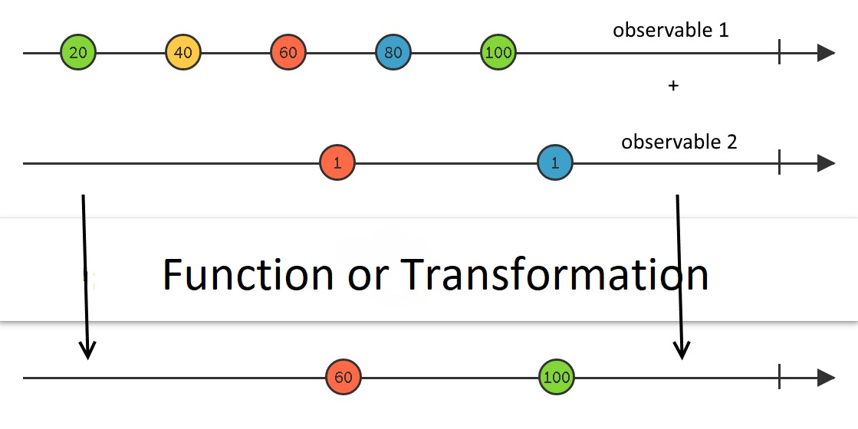
Reactive Programming

Slide 2
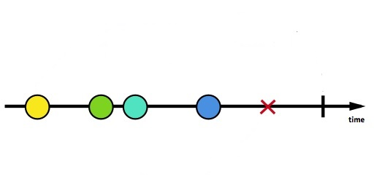
Dart Streams
Streams provide an asynchronous sequence of data.
Streams provide a way to respond to errors.
Two types of Streams in Dart: Single Subscription and broadcast
Streams are Asynchronous by default

Slide 3
Rx Observables
Observables extends the Stream class
Observable can be passed in place of a Stream
Created by wrapping Dart Streams or with a Factory
Observables are synchronous by Default
RxDart extends with a ton of new Transformations and Methods

Slide 4
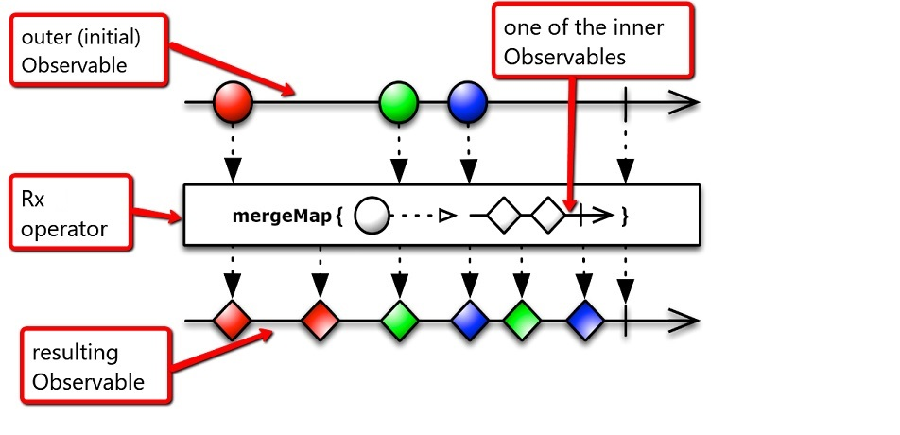
Rx Observables continued..

Slide 5
RxCommand
UI based abstraction for event handlers
Used primarily in the View Model of the App
Can react to the Execution states of the command
State Information of each command made up of four different observables
Follows MVVM or Model-View-ViewModel
Generic type RxCommand<TParam, TRESULT>

